Slide 1
Week 4 tutorial
Exercise 2 (database structures / ACID / query optimizer)
Lab 1 (query analysis / indexes)

Slide 2
Question 1
Centralized
Distributed
WWW
Cloud-based
Grid
P2P

Slide 3
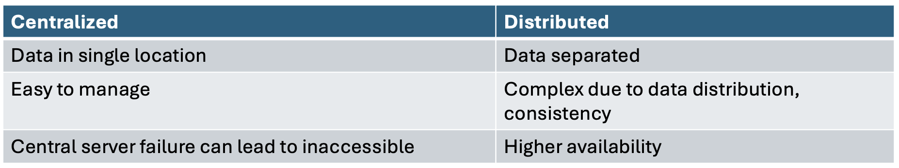
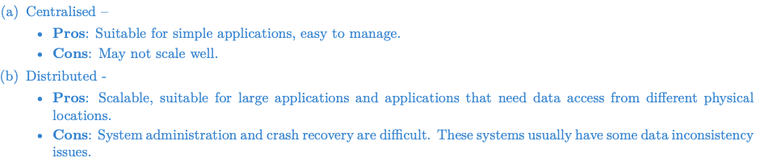
Question 1 (database structures)
Centralized vs Distributed

Slide 4


Question 1 (database structures)
Cloud storage vs WWW storage
Cloud | WWW
Managed by provider | Require more hands-on requirements
Ideal for backup, disaster recovery, and data-heavy applications | Suited for hosting websites, static content

Slide 5
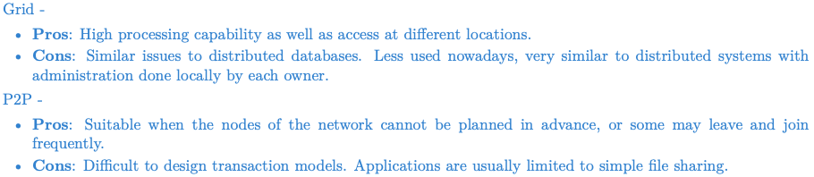
Question 1 (database structures)
Grid database: a grid computing environment, where multiple independent databases collaborate dynamically to share resources and processing power.
P2P database: no central server, each peer stores and manages its own data (nodes can join and leave the network)

Slide 6
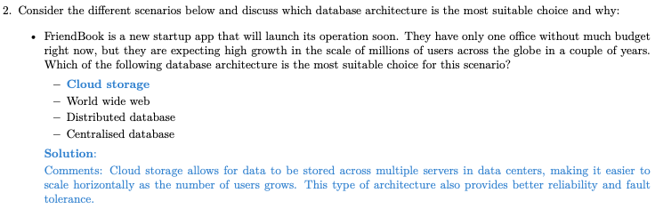
Question 2 (database structures)

Slide 7
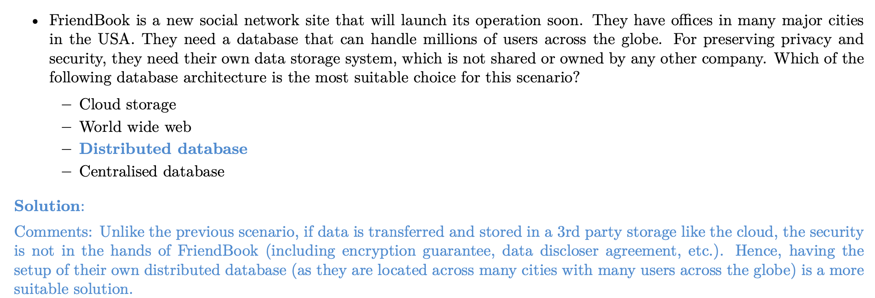
Question 2 (database structures)

Slide 8
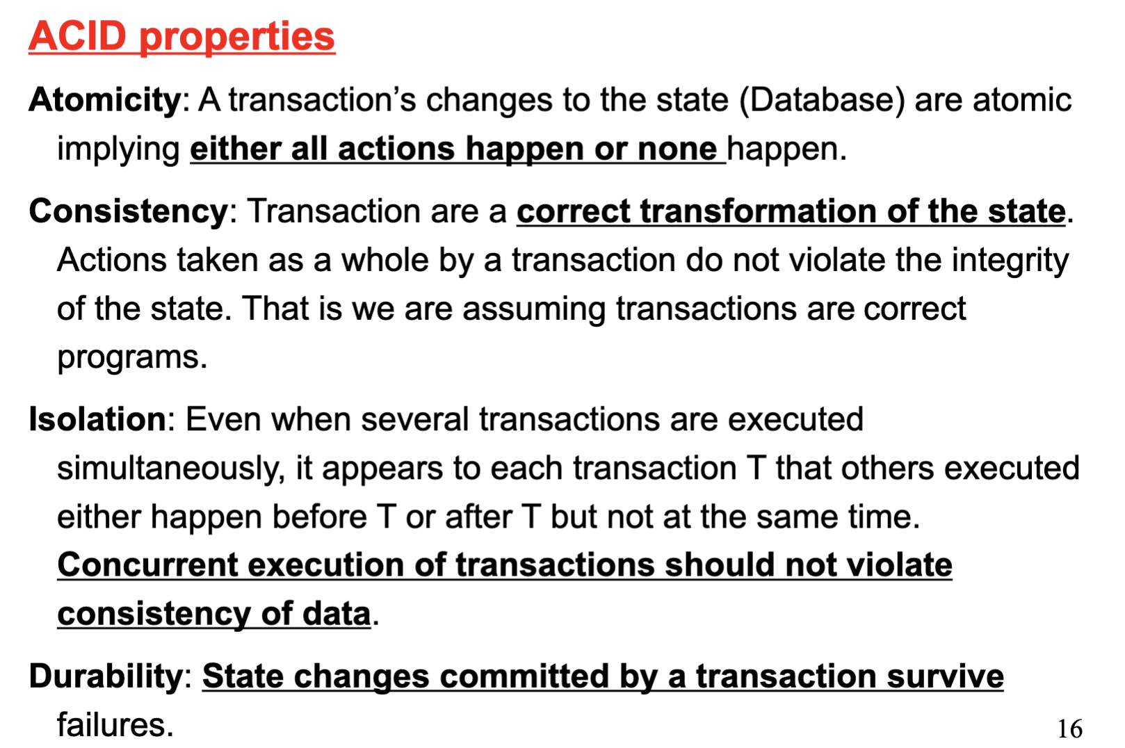
Question 3 (ACID)

Slide 9
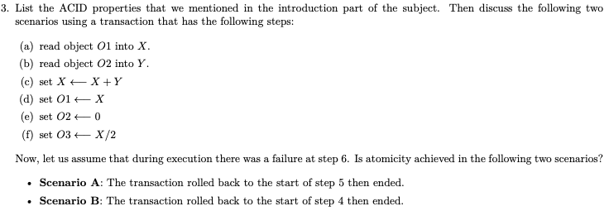
Question 3 (ACID)

Slide 10
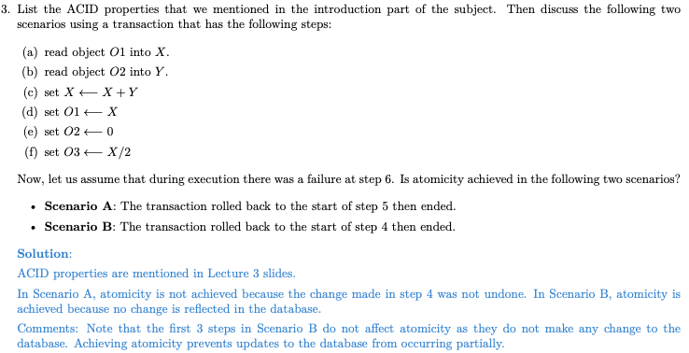
Question 3 (ACID)

Slide 11
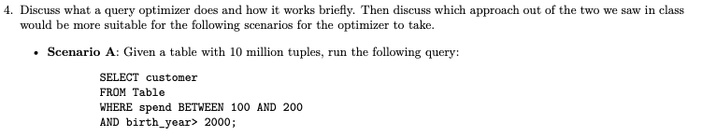
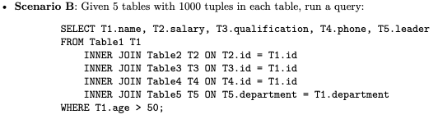
Question 4 (query optimizer)

Slide 12
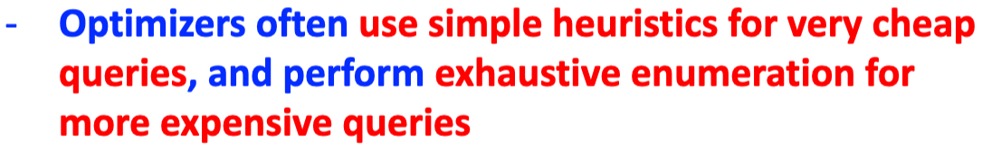
Question 4 (query optimizer)
enumerating all plans: get all query plans, evaluate the cost of each plan, choose the cheapest one
heuristic-based: Heuristic optimization transforms the query-tree by using a set of rules that typically (but not in all cases) improve execution performance

Slide 13
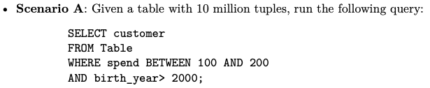
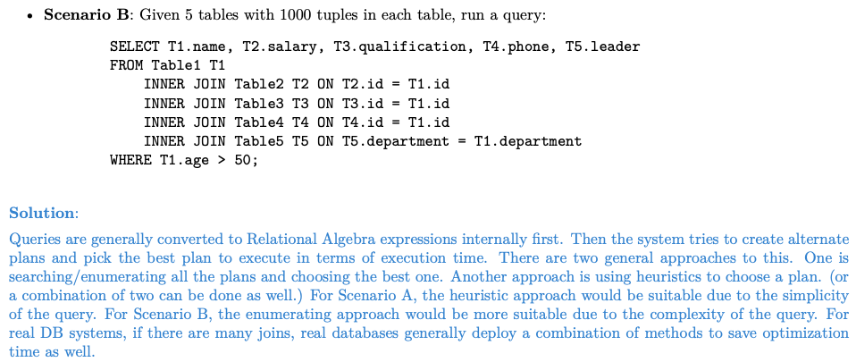
Question 4 (query optimizer)

