Slide 1
Tutorial Week5
Exercise 3
Review indexes, advantages / disadvantages
B+ tree insersion / deletion

Slide 2
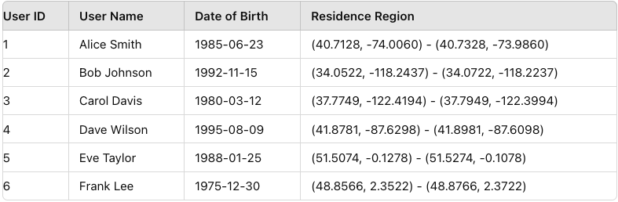
Question 1

Slide 3
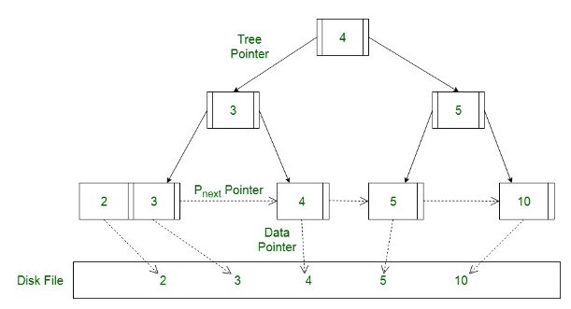
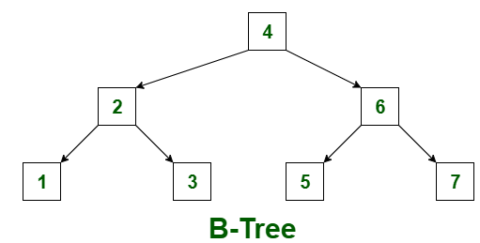
B tree / B+ tree
In the B+ tree,
pointers (to data) are stored in leaf nodes
allowing duplicated keys and redundant keys
faster insertion and deletion
sequential access is possible (linked list)

Slide 4
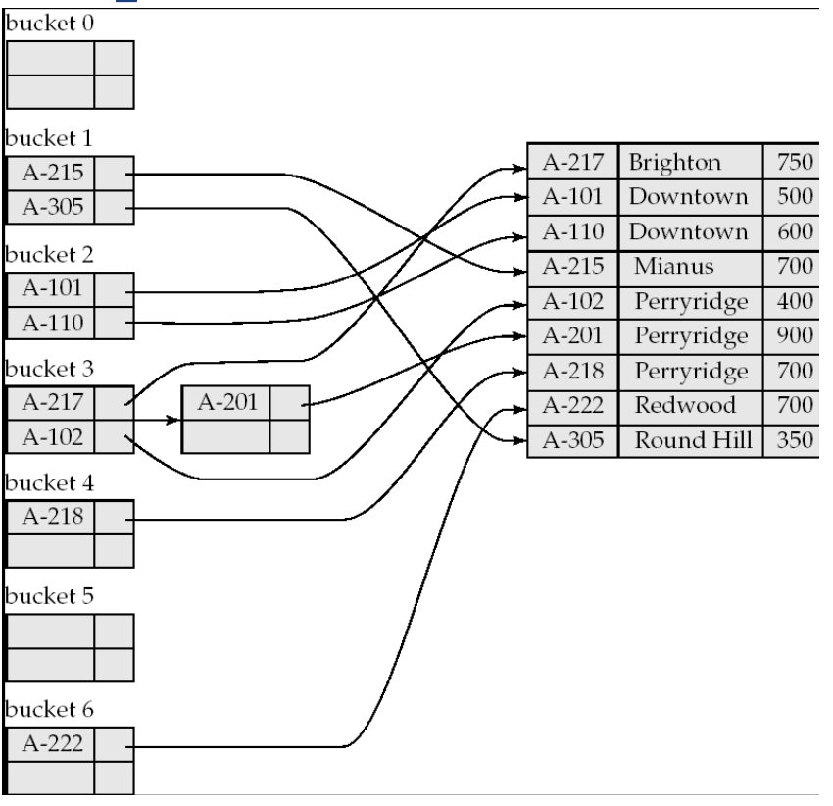
Hash Index
Order is not important
Hash indices are secondary indices
Ideal hash function: uniform / randomness

Slide 5
Types of Index
Two types of index: ordered indices / hash indices
ordered indices: search keys are stored in some order
e.g., clustering index: the order of the index records matches the order of the actual data records in the table
Pros: Efficient for range queries
Cons: Less efficient for equality searches. More complex for rebalancing during insertions and deletions.
hash indices: search keys are distributed (hopefully uniformly) across “buckets” using a “function”
Pros: Efficient for exact match queries due to direct hashing.
Cons: not efficient for range queries

Slide 6
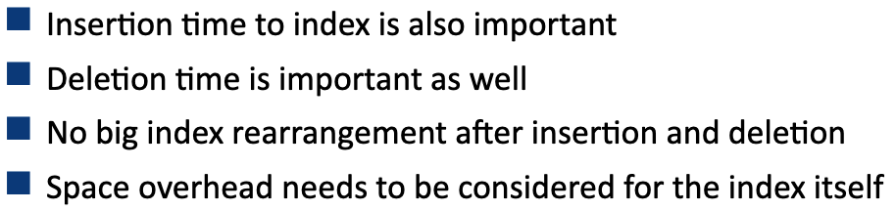
Review multiple indexes

Slide 7
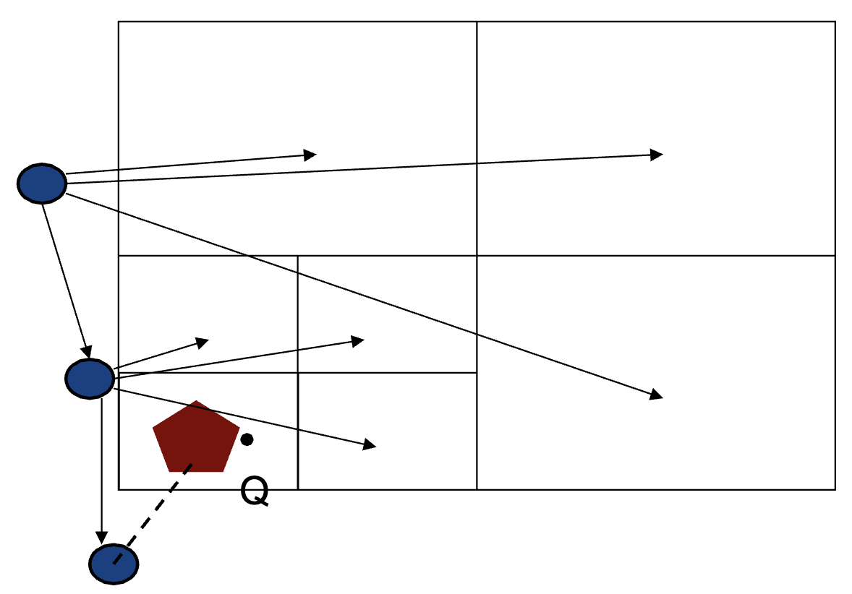
Quadtree
Each non-leaf node divides its region into
four equal-sized quadrants
Leaf nodes have between zero and some fixed
maximum number of points
Apply to Nearest Neighbor Query

Slide 8
Question 2

Slide 9
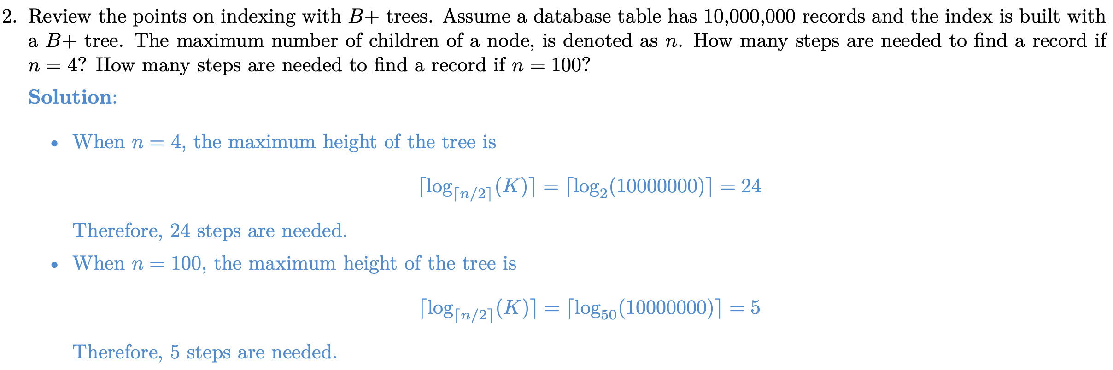
Question 2

Slide 10
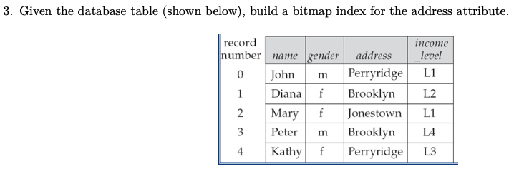
Question 3

Slide 11
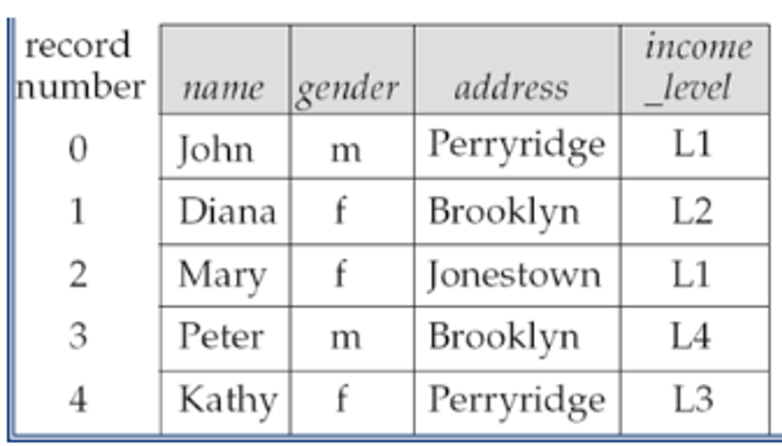
Bitmap index
Effective for columns with a low cardinality
Effective for some business analytics problem
Example: SELECT COUNT(*) FROM employees WHERE gender = ‘m’ AND income_level = ‘L1’
We use a bitmap index on the ‘gender’ and ‘income_level’ columns

Slide 12
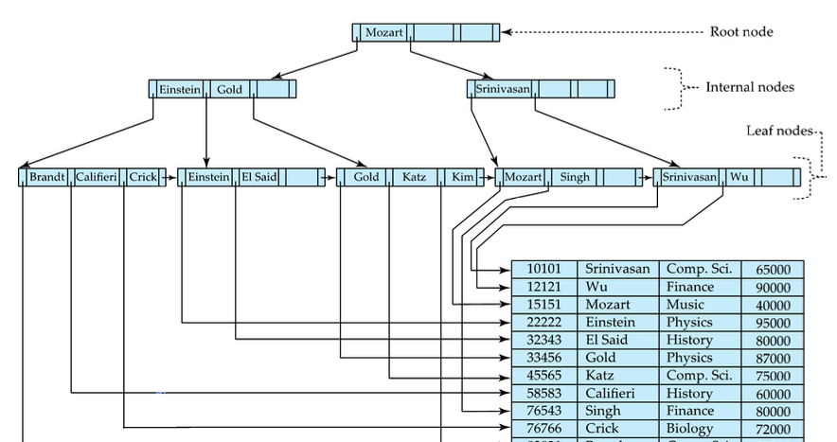
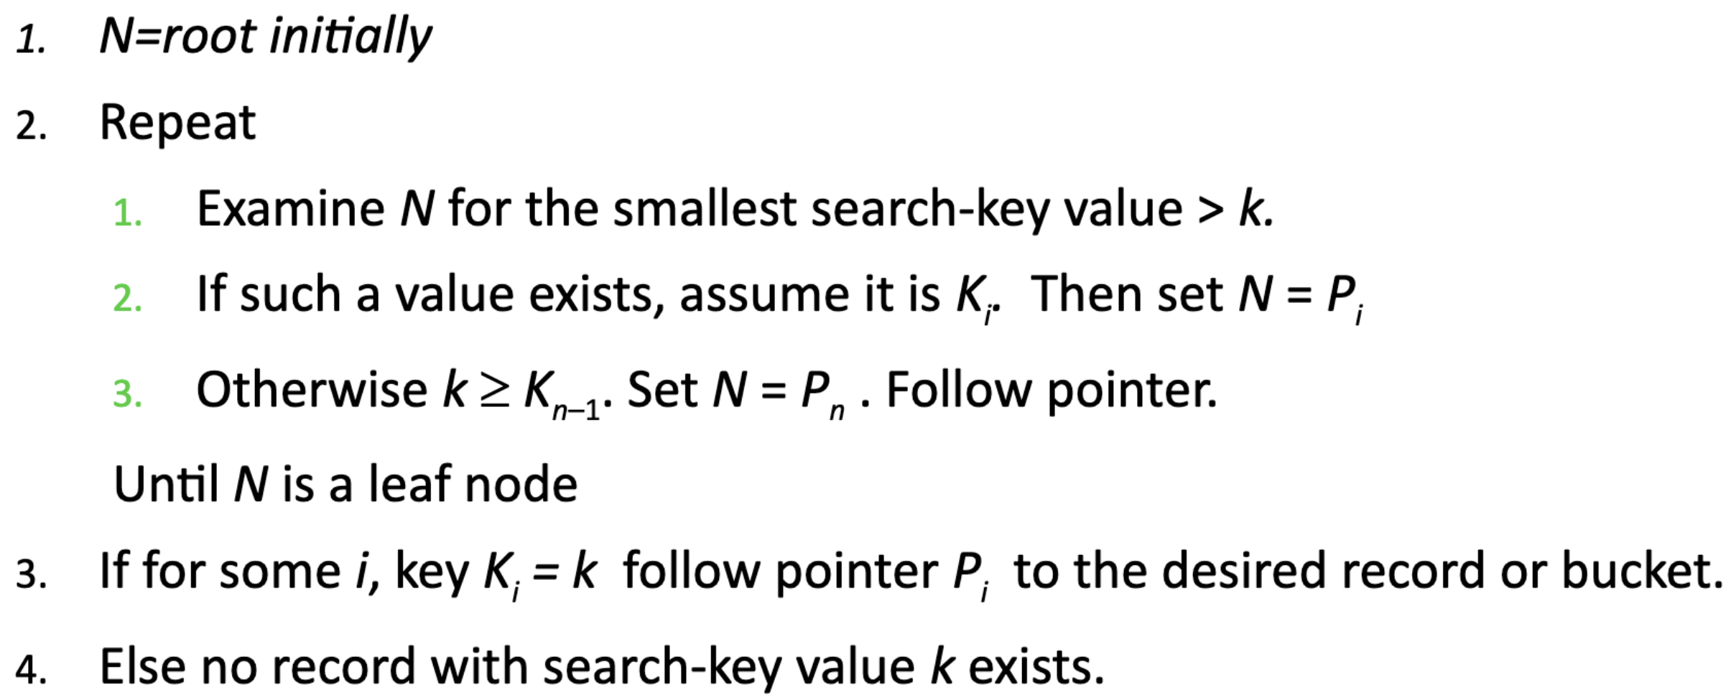
Question 4

Slide 13
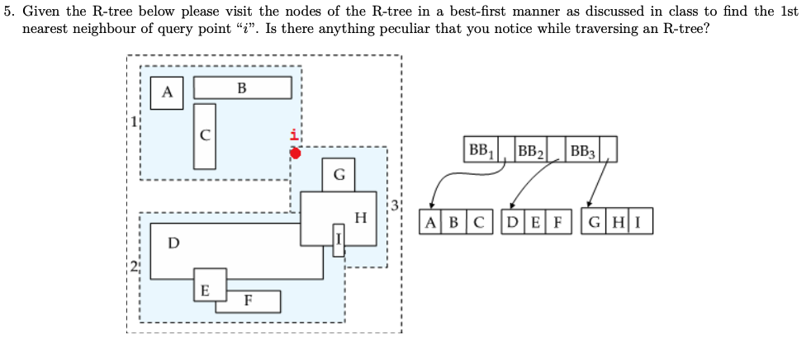
Question 5

Slide 14
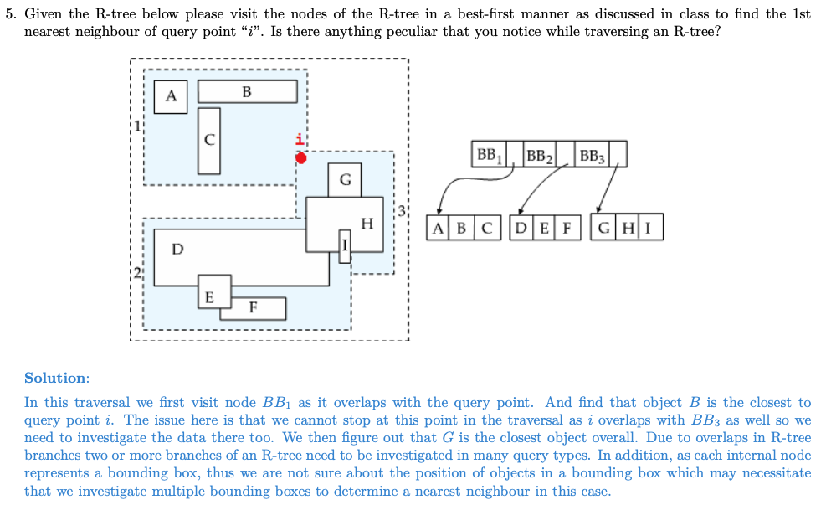
Question 5

Slide 15
B+ tree insertion / deletion

Slide 16
B+ tree insertion / deletion

