Slide 1
Tutorial Week 6
Isolation applications
Nest / Flat transactions

Slide 2
Question 1

Slide 3
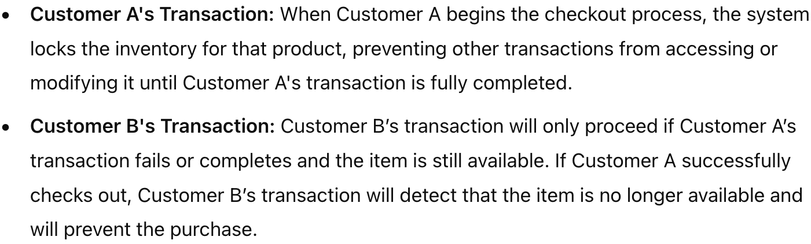
Question 1
Online shopping platform
Example: Customer A and B add the item to their cart and proceed to checkout closely.
Problem: When A is checking out, B still sees the item as available, which may lead to overselling.
Add isolation (All-or-Nothing Visibility / preventing overselling):

Slide 4
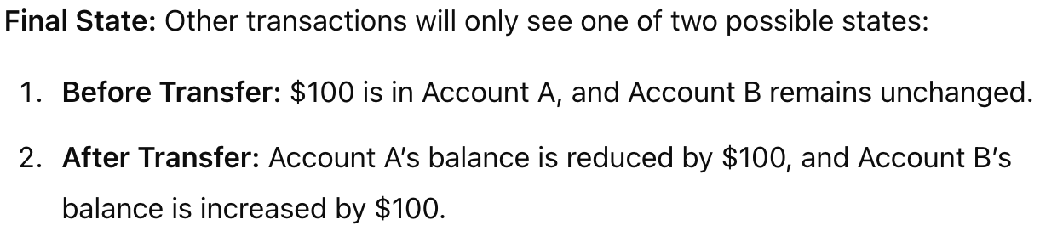
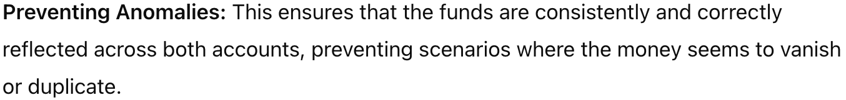
Question 1
Online banking system
Add isolation:
Benefits:

Slide 5
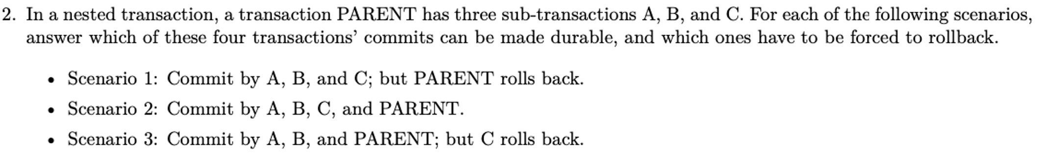
Question 2

Slide 6
Nested transaction
rules
commit cannot take place unless the parent itself commits
Sub-transactions have A, C, and I properties but not D property unless all their ancestors commit
Commit of a sub-transaction makes its results available only to its parents
All objects of a parent are visible to its children
Parents should not modify objects while children are accessing them

Slide 7
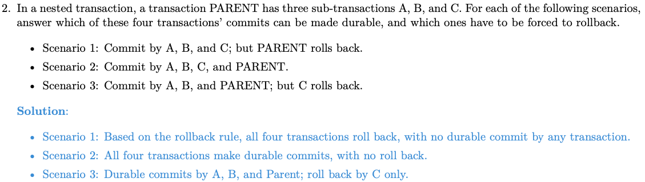
Question 2

Slide 8
Transaction Processing Monitor
TPMs manage the transfer of data between clients and servers
TPMs are essential for ensuring that transactions are handled reliably and consistently across multiple systems or databases (ACID)
It also takes appropriate actions (roll back / notification) if any error occurs

Slide 9
Question 3
An error in a single process can affect all transactions being processed, leading to potential data inconsistencies and system disruptions. This could lead to poor performance as well as monitors of different transactions cannot be distributed either.
To address this risk, it's essential to use redundancy, distributed architectures to ensure system reliability and minimize the impact of errors.

Slide 10
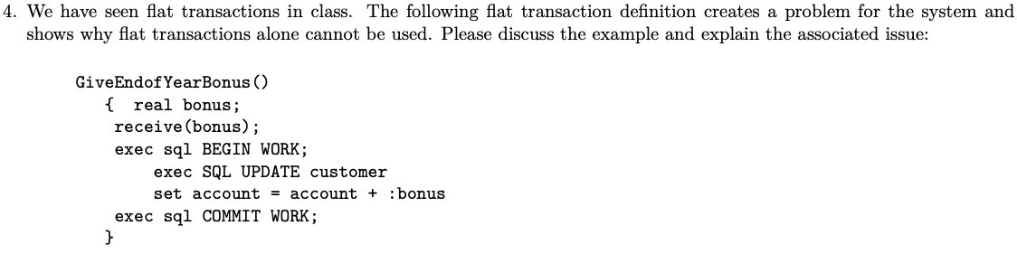
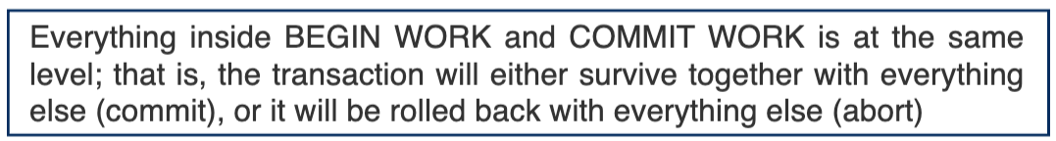
Question 4
Flat transaction =

Slide 11
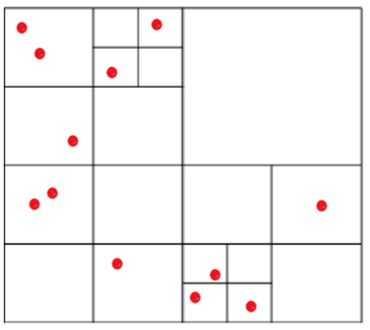
Question 5

Slide 12
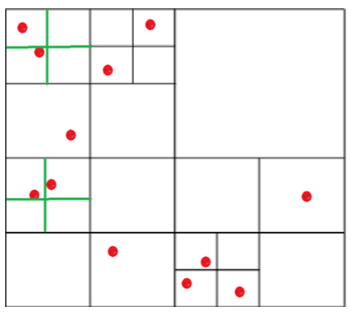
Question 5

Slide 13
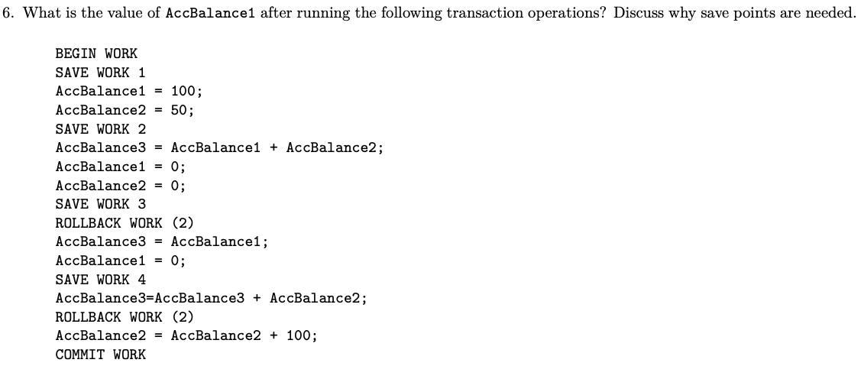
Question 6
Without save points, the transaction needs to be started from scratch every time it needs to rollback.

Slide 14
Notice
Q1:
Q4:
Draw a table to show the process next time
For online shopping system: discuss the isolation strategy (on items or customers)
For online banking system: discuss the start/end states (more strictly than shopping
platform)

