Slide 1
Week 8 tutorial
Semaphore code
Deadlock
Dependency graph

Slide 2
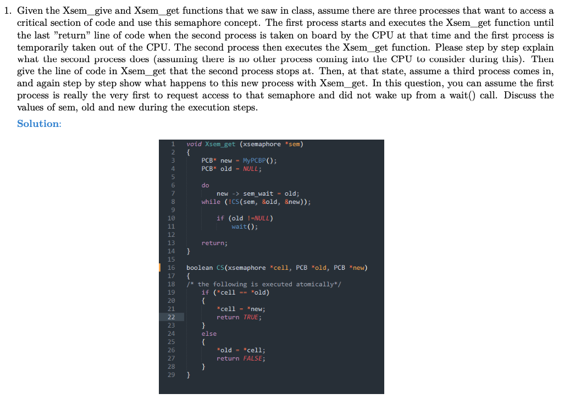
Q1

Slide 3
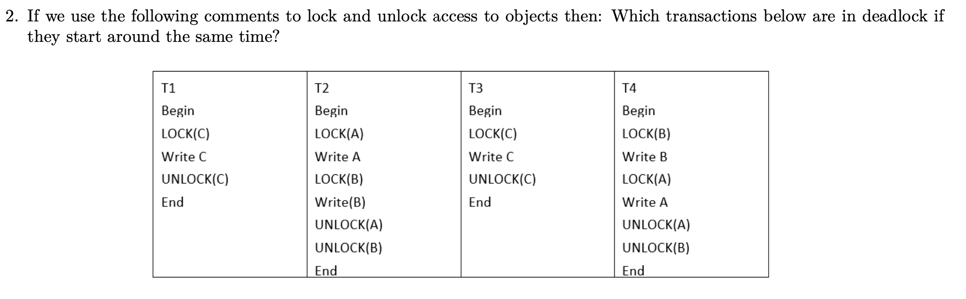
Q2

Slide 4
How to avoid deadlock
Solutions:
1. Have enough resources so that no waiting occurs
2. Do not allow a process to wait, simply rollback after a certain time.
3. Linearly order the objects and requests of objects should follow this order.

Slide 5
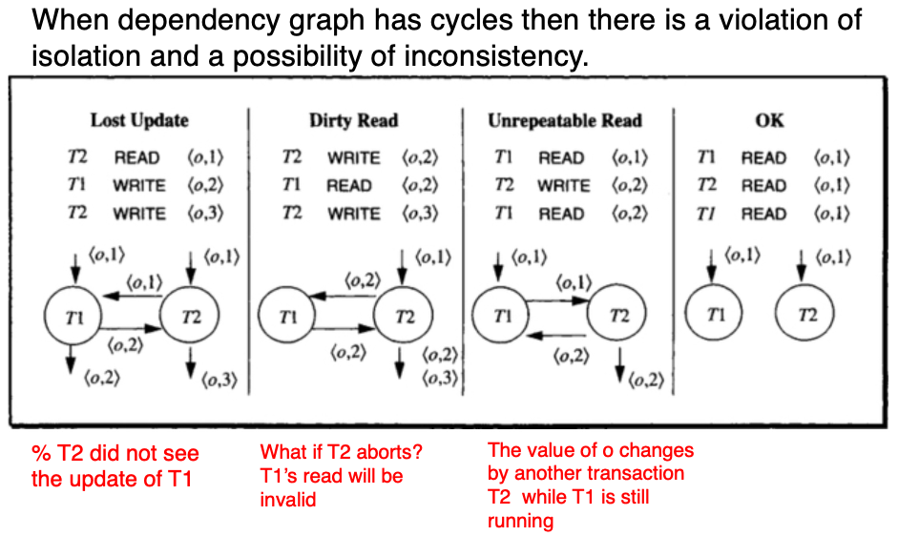
Dependency graph
Dependencies:

Slide 6
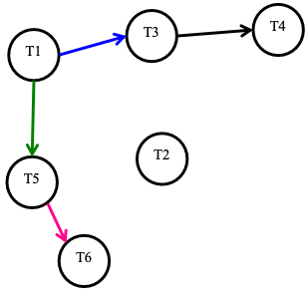
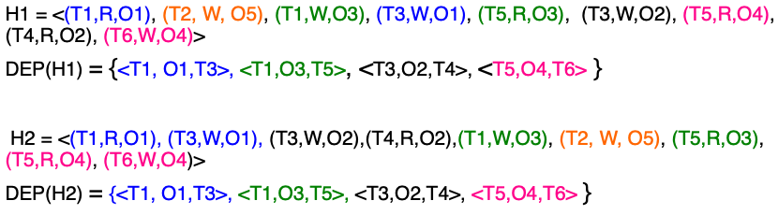
Dependency graph
Equivalence: a given database will end up in exactly
the same final state by executing either of the sequence
of operations in H1 or H2

Slide 7
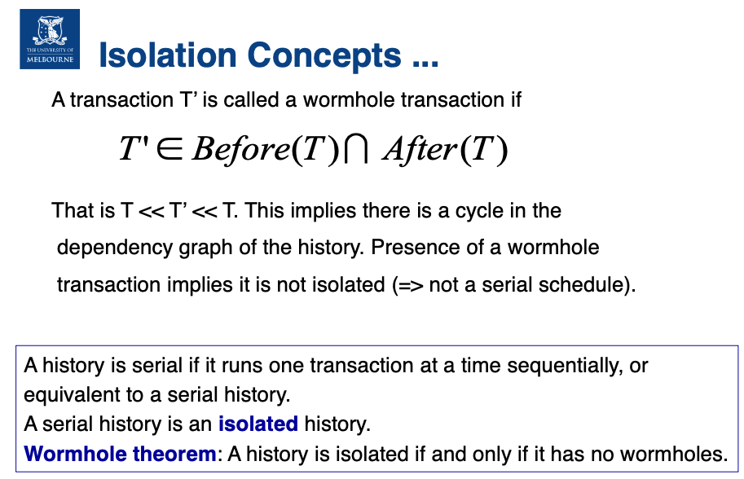
Dependency graph

Slide 8
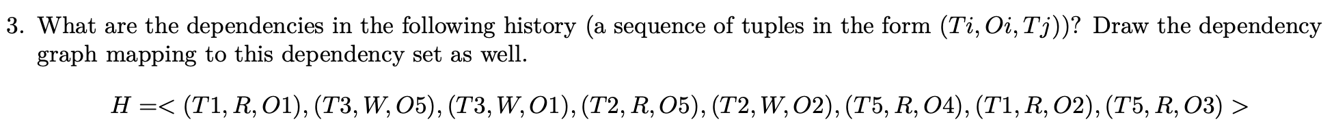
Q3+Q4

Slide 9
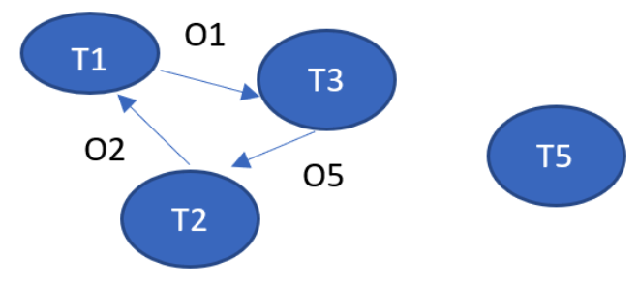
Q3 + Q4

Slide 10
Q5

Slide 11
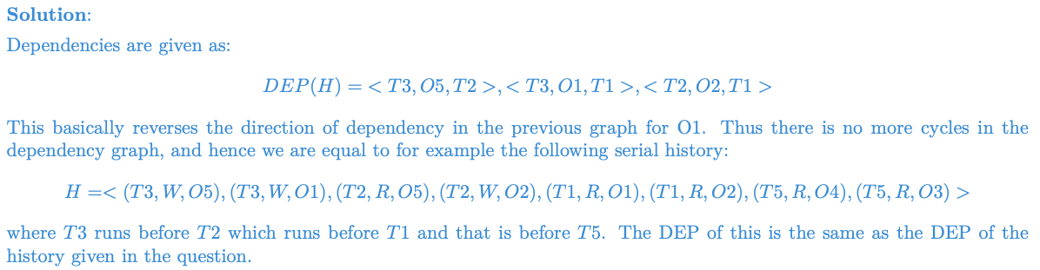
Q5
If we have H1= < (T3,W,O5),(T3,W,O1),(T2,R,O5),(T2,W,O2),(T1,R,O1),(T1,R,O2),(T5,R,O4),(T5,R,O3) >,
See whether DEP(H) = DEP(H1)

