Slide 1
Week 10 tutorial
Degrees of Isolation
Granularity of locks
Optimistic Locking

Slide 2
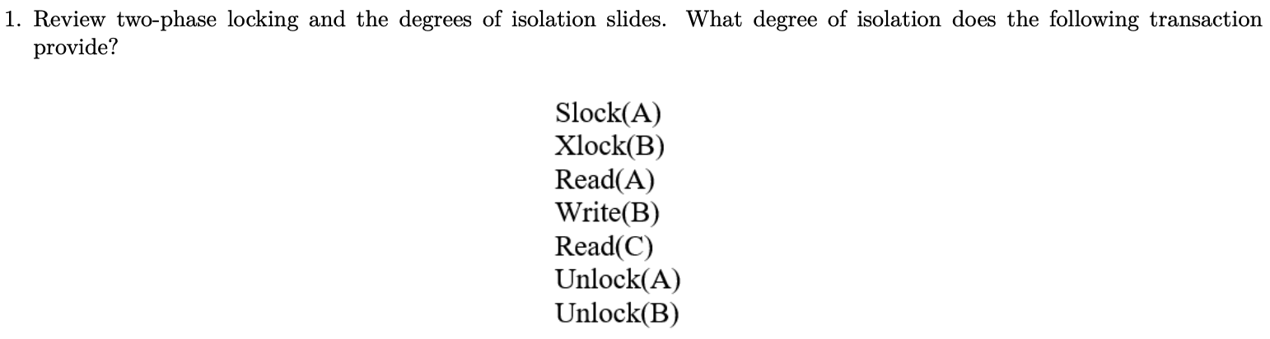
Question 1

Slide 3
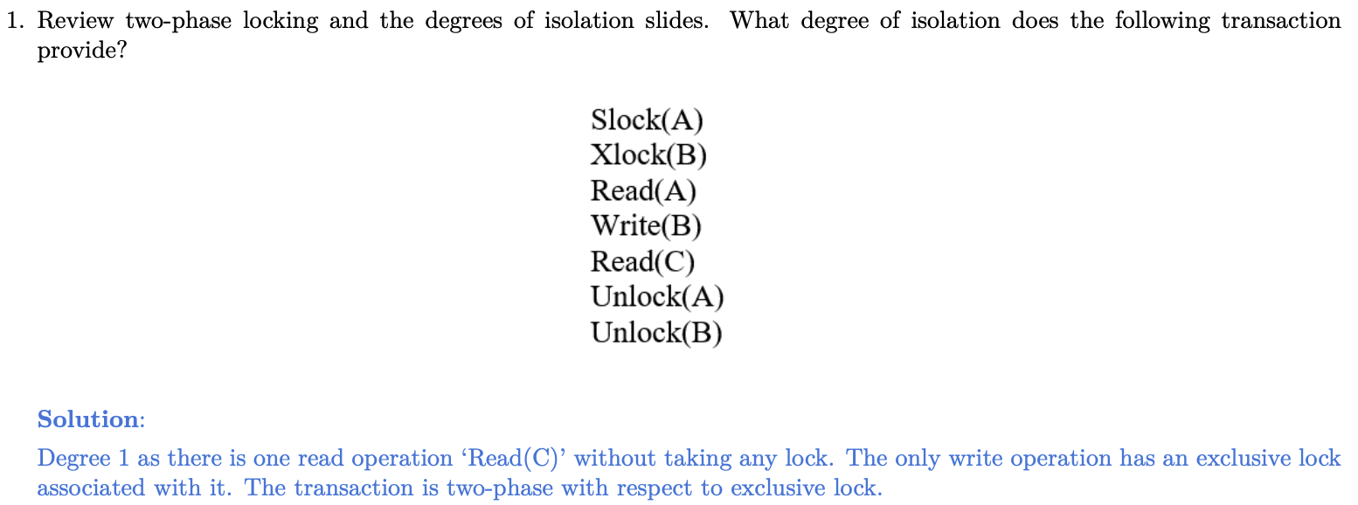
Question 1

Slide 4
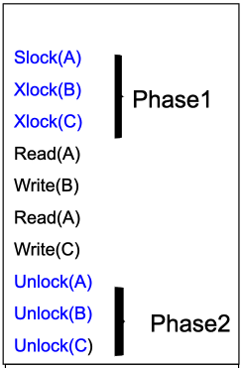
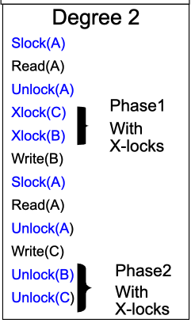
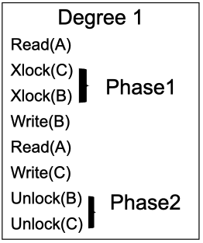
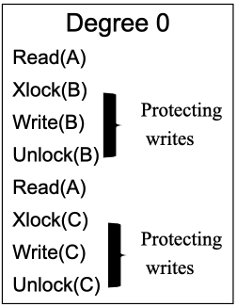
Degrees of Isolation
Well formed
yes
no
Strict Two-phased (Xlock +Slock)
Two-phased Xlock
yes
no
yes
no
Degree 3

Slide 5
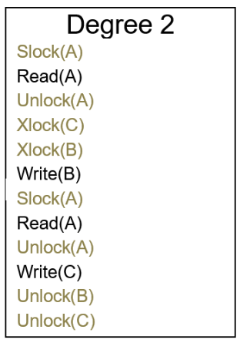
Question 2

Slide 6
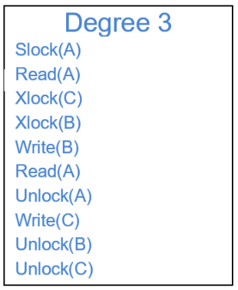
Question 2

Slide 7
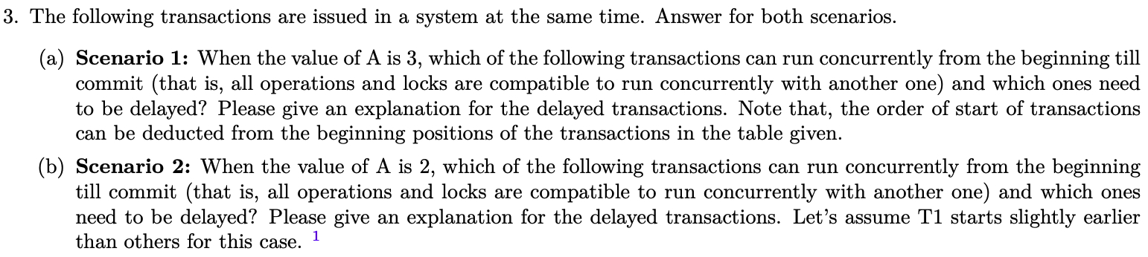
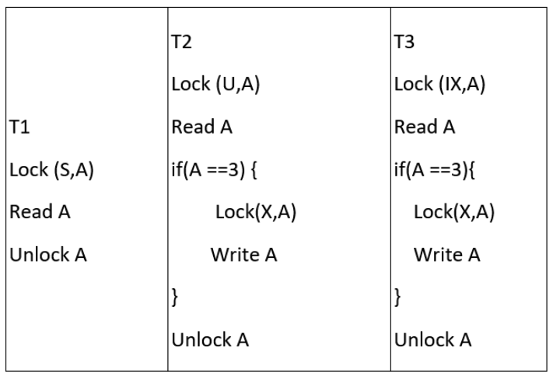
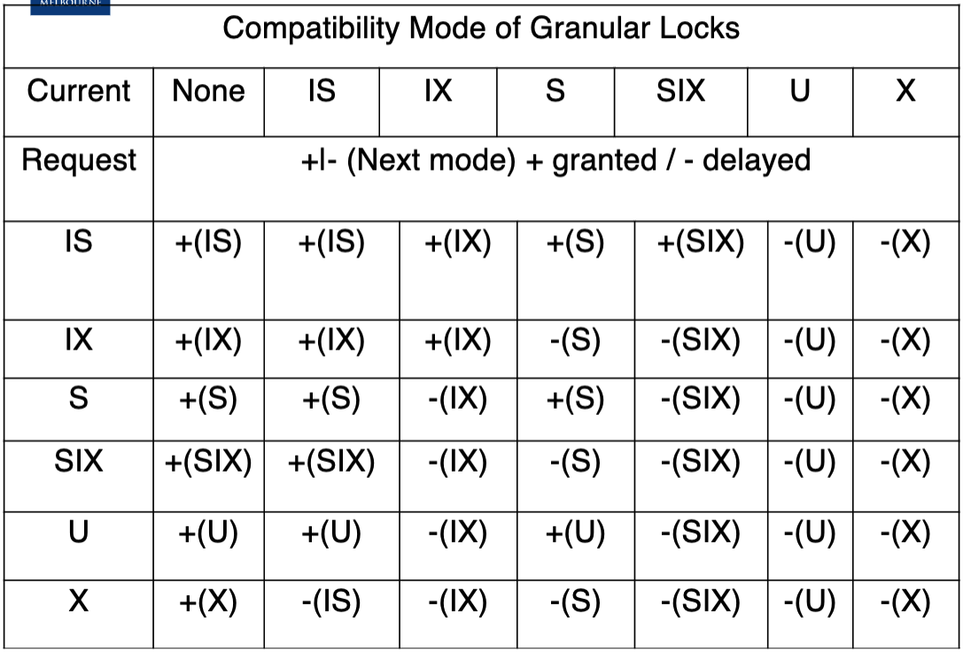
Question 3

Slide 8
Granularity of locks
IS (intention to have shared lock at finer level)
IX (intention to have exclusive lock at finer level)
U (Update lock): the relationship with S lock!

Slide 9
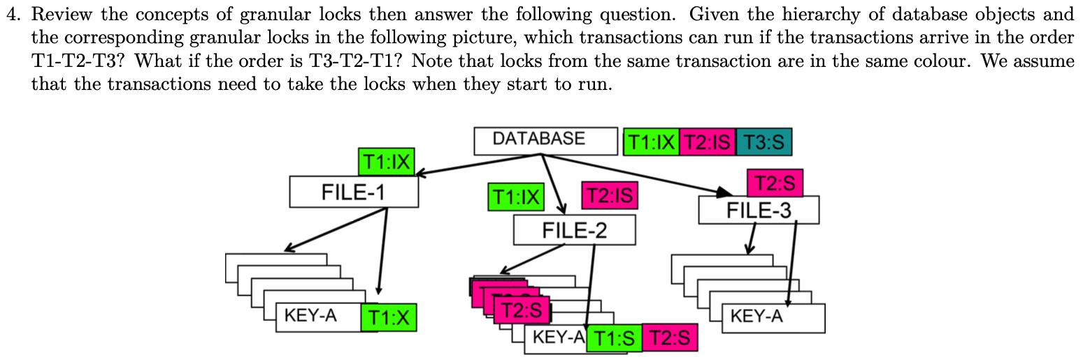
Question 4

Slide 10
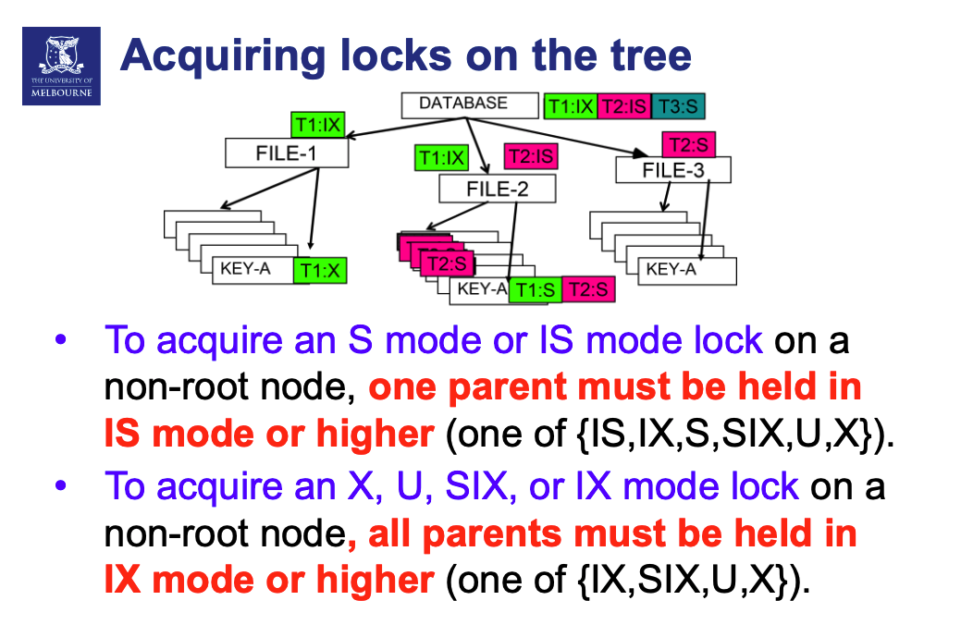
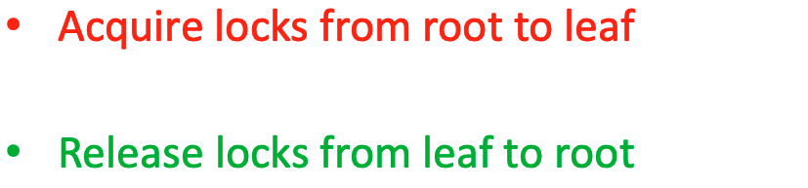

Slide 11
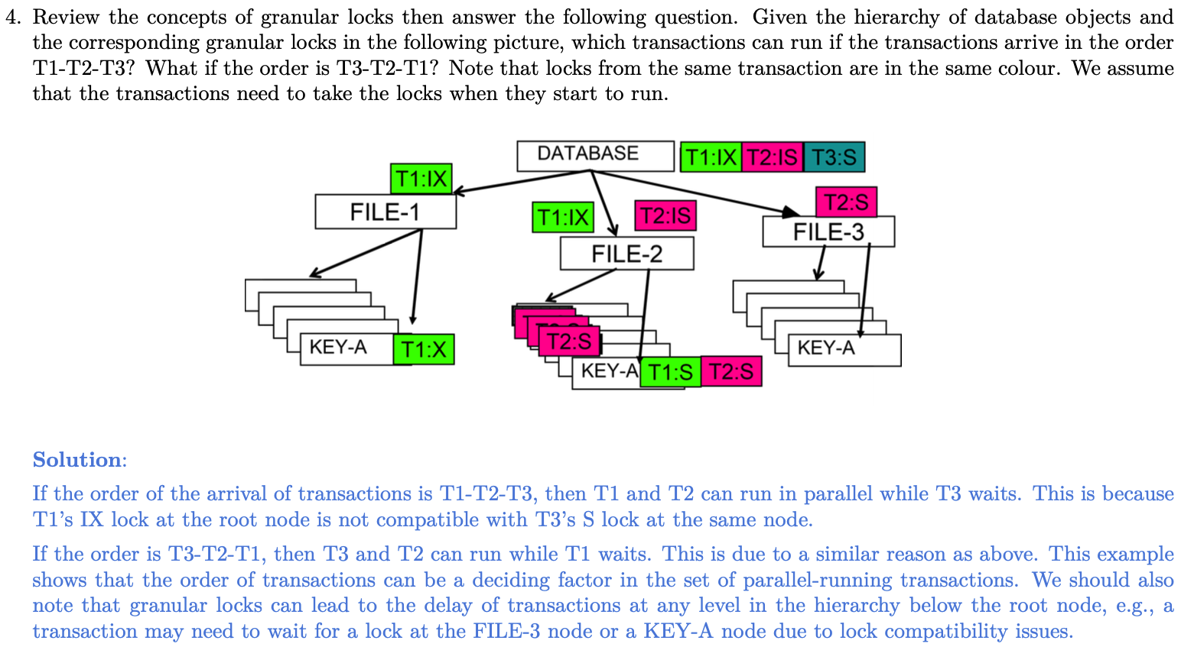
Question 4

Slide 12
Question 5

Slide 13
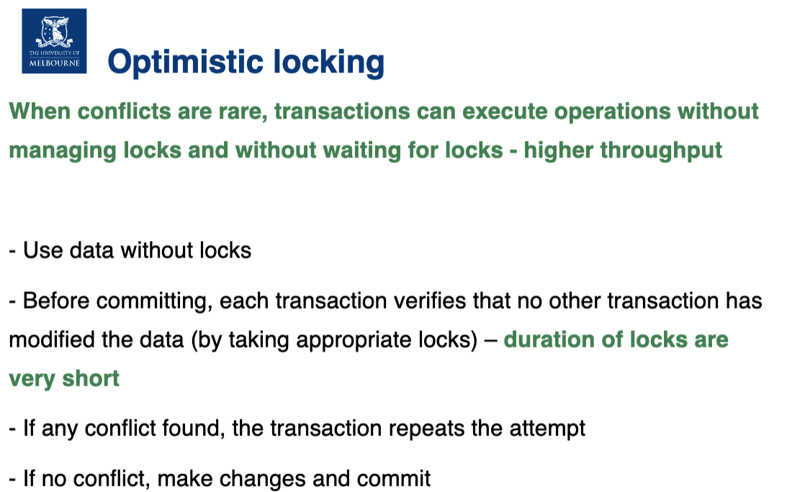
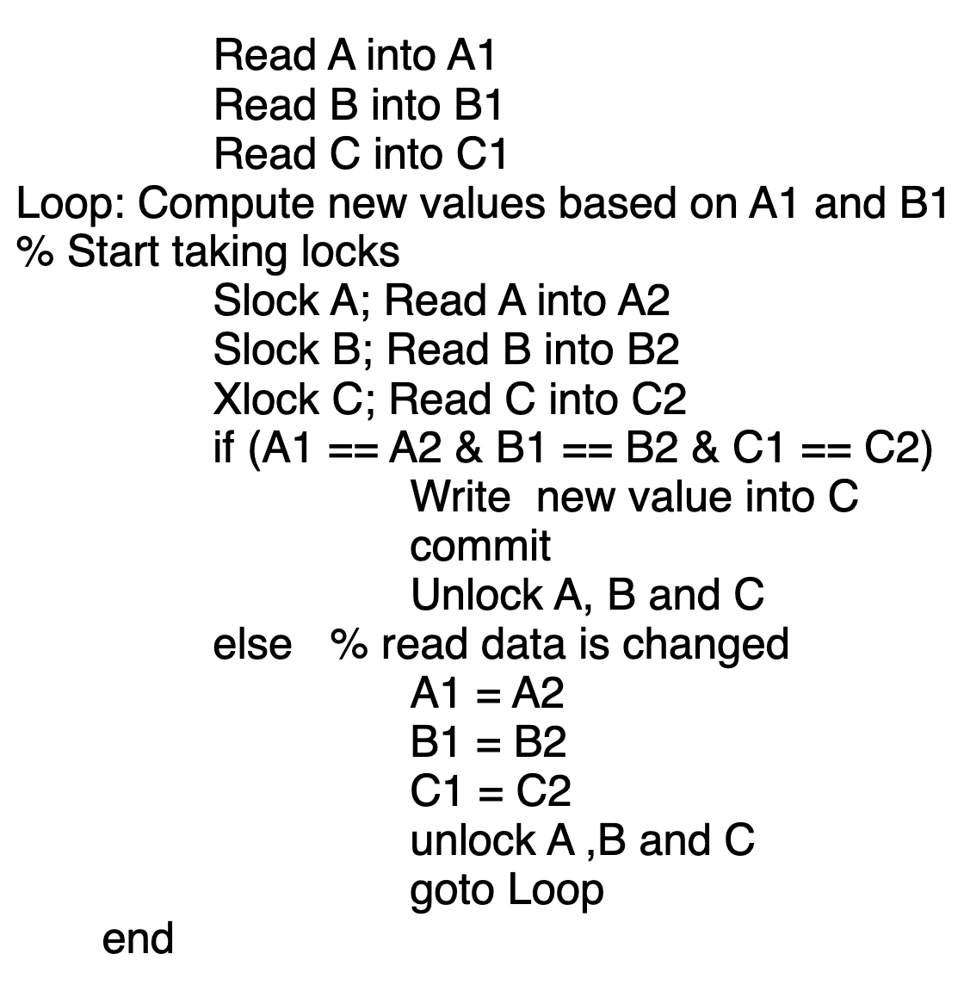
Question 5

Slide 14
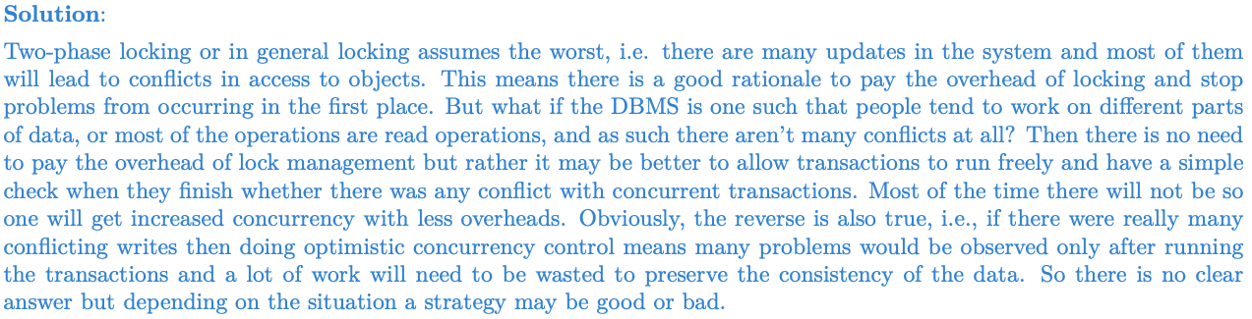
Question 5

