Slide 1
Tutorial W9
Slock, Xlock
Two-phase locking
Lab

Slide 2
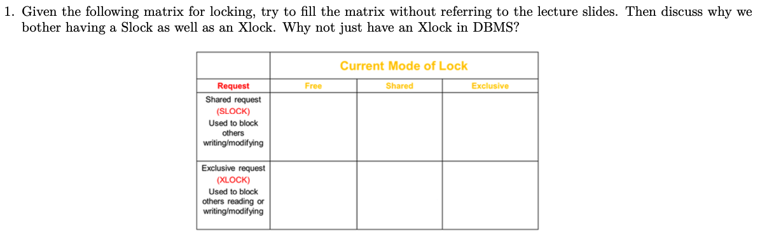
Q1

Slide 3
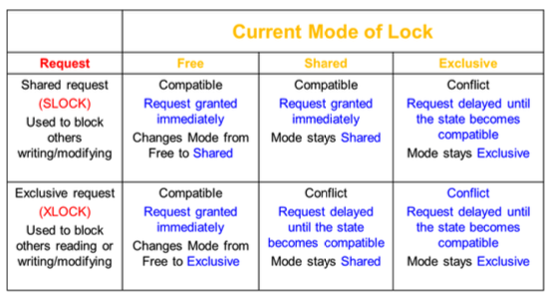
Q1

Slide 4
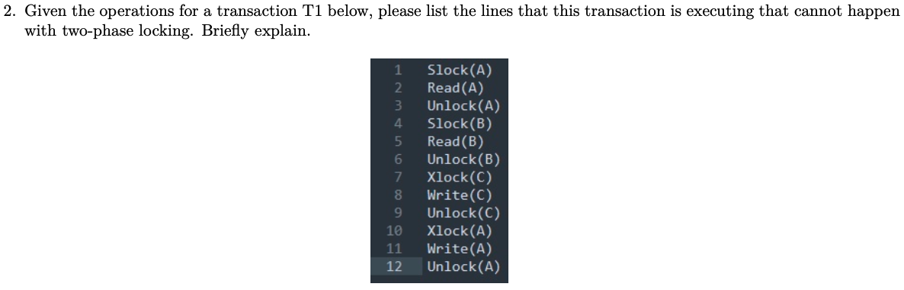
Q2

Slide 5
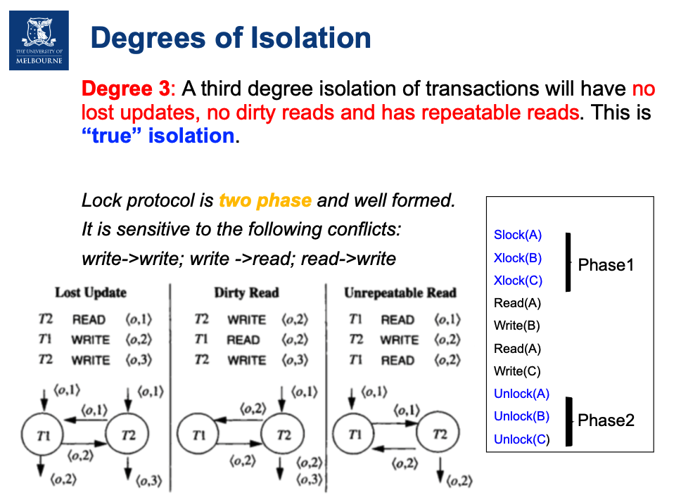
Q2

Slide 6
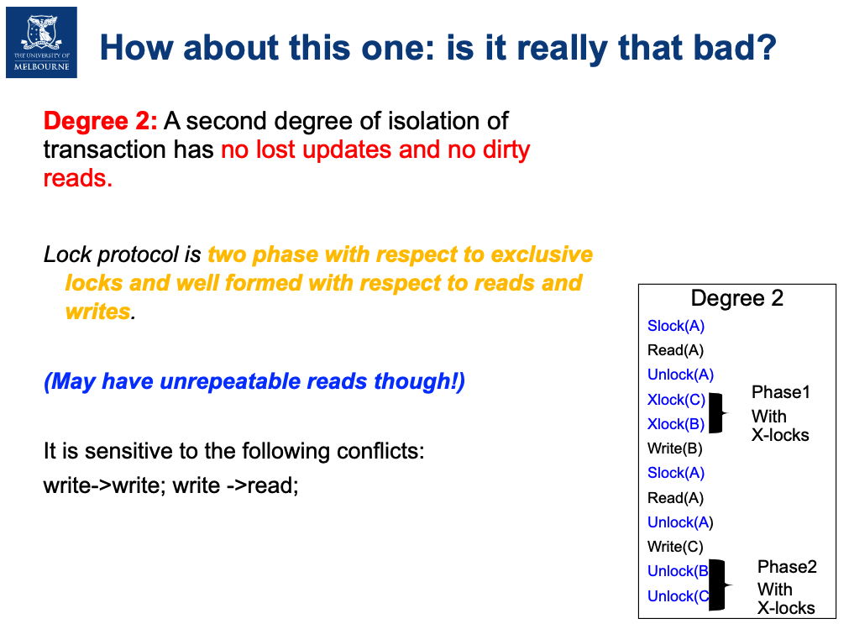
Q2

Slide 7
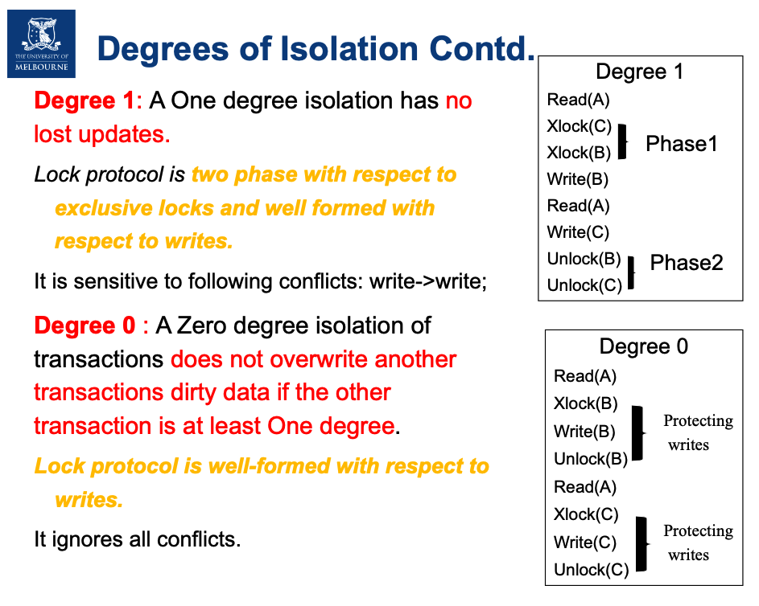
Q2

Slide 8
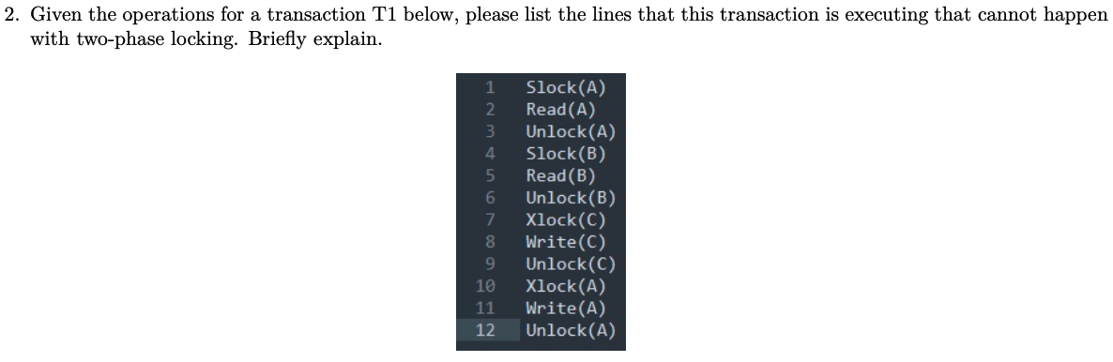

Q2

Slide 9
Q3
Question: In the strict two-phase locks (Degree 3) / two-phase exclusive locks (Degree 2),
can they cause wormholes in the dependency graph?

Slide 10
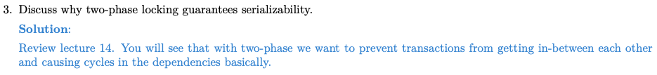
Q3
Question: In the strict two-phase locks (Degree 3) / two-phase exclusive locks (Degree 2),
can they cause wormholes in the dependency graph?

