Slide 1
Tutorial Week 2
Workshop questions:
Hard Disk Drive (HDD) / Solid State Drive (SSD)
Cache / Main Memory
NoSQL databases

Slide 2
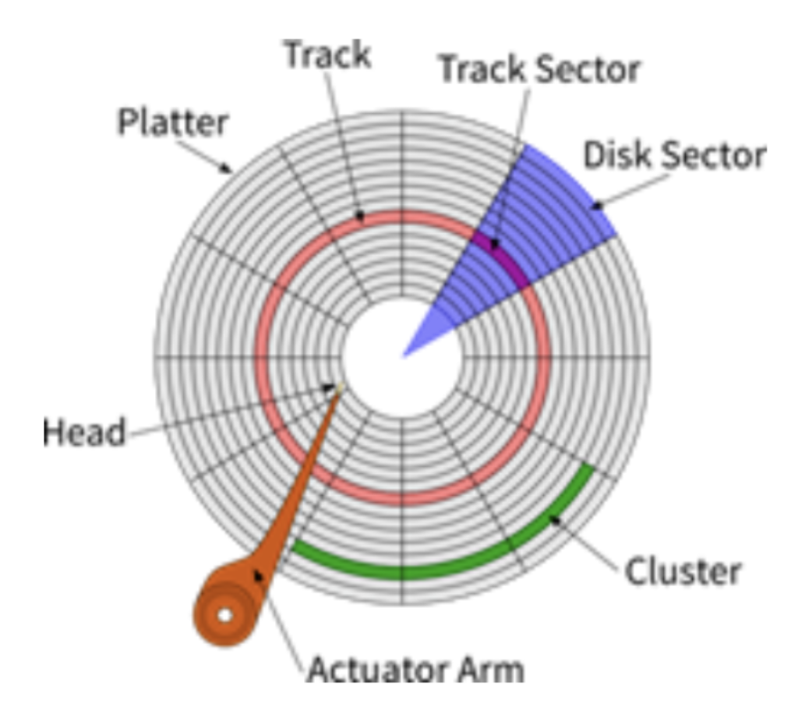
Question 1
1. hard disk drive (HDD)
Definitions of (track / sector / cluster)
Seek time delay
Rotate time delay
Is it possible: (Seek time+Rotate time = 0)?
2. solid state drive (SSD)

Slide 3
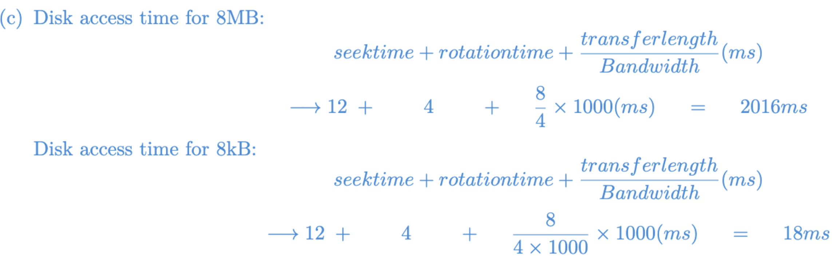
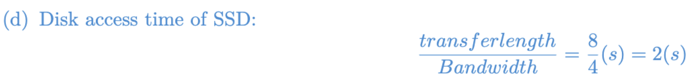
Question 1

Slide 4
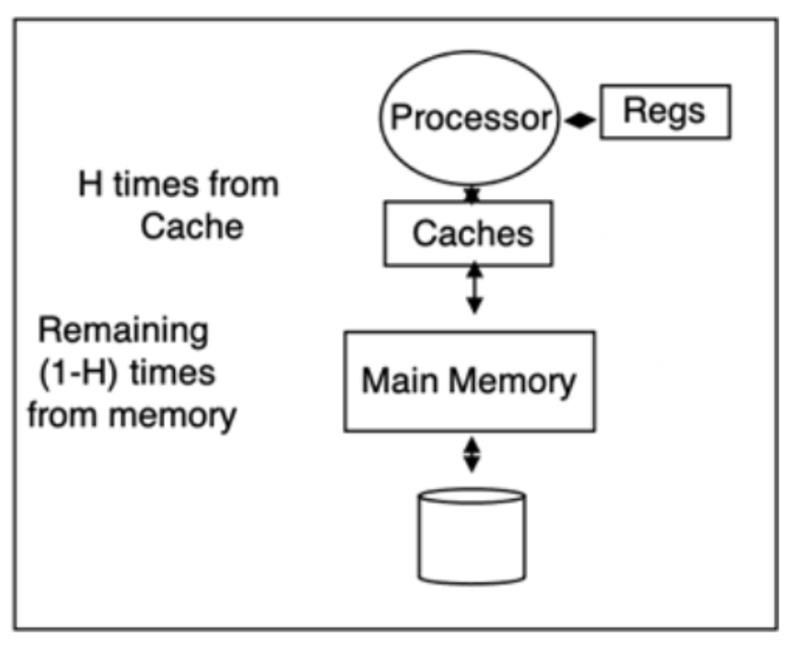
Question 2
Hierarchical Memory Structure
Definitions of (Cache / Main Memory)
Cache: smaller, faster, stores frequently accessed data
Main Memory: larger, slower, primary memory
cache hits / cache miss

Slide 5
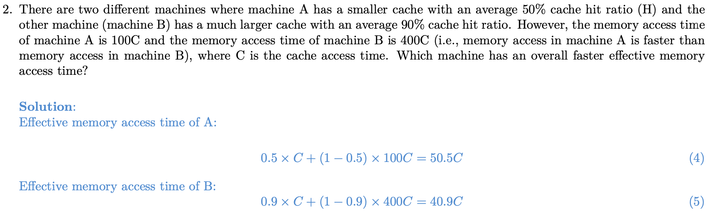
Question 2

Slide 6
Question 3
Simple File / RDBS / Object Oriented / NoSQL

Slide 7
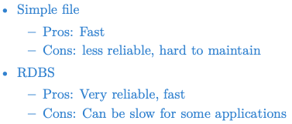
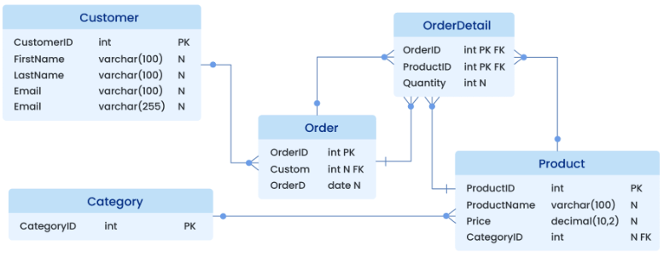
Question 3

Slide 8
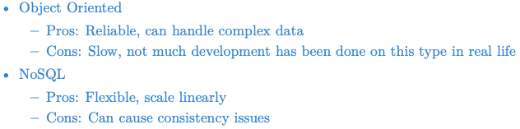
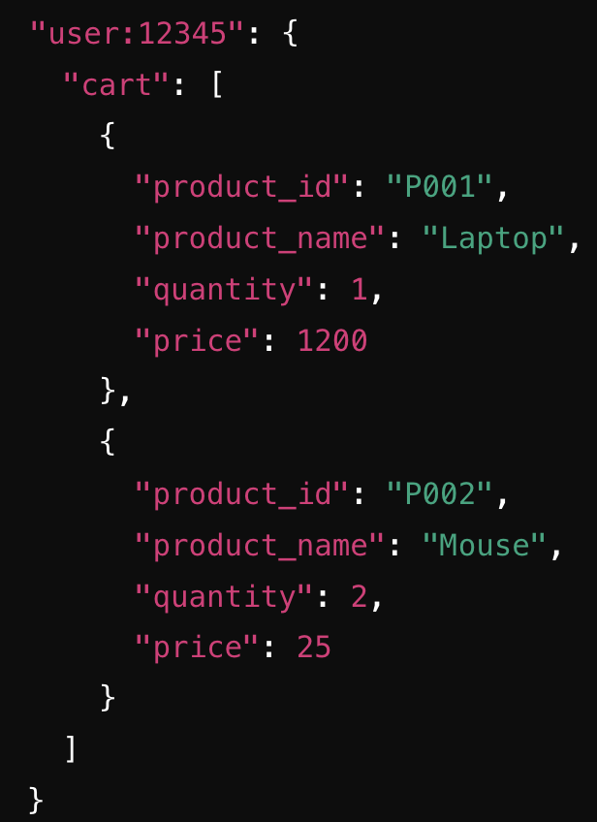
Question 3
Object Oriented example:
A car is an object (contains owner,
engine, wheels); owner and engine can
be another object with other attributes.
Query is slow (no indexes, more data
to load)
NoSQL example:

Slide 9
Question 4
Key – value database / document storage / column based / graph storage

Slide 10
Question 4
Key-value database: no need complex relational structure, only key-value pairs
Example:
Advantage: insertion / search fast

Slide 11
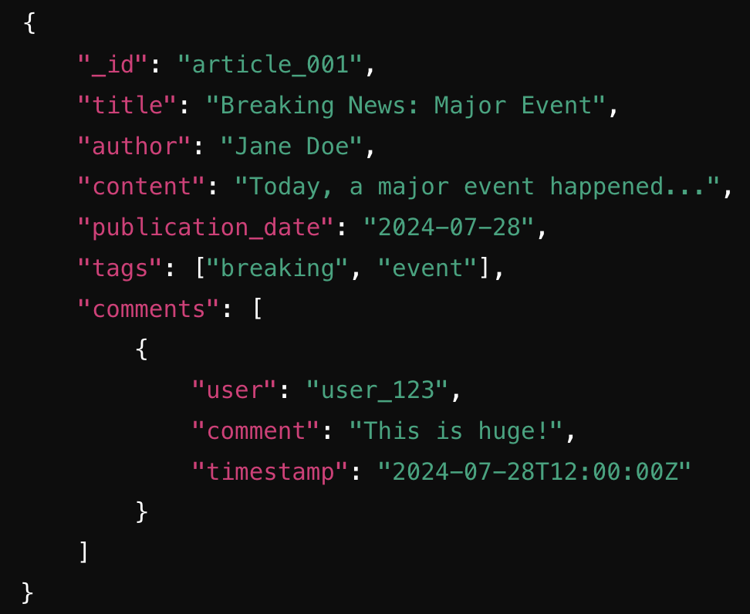
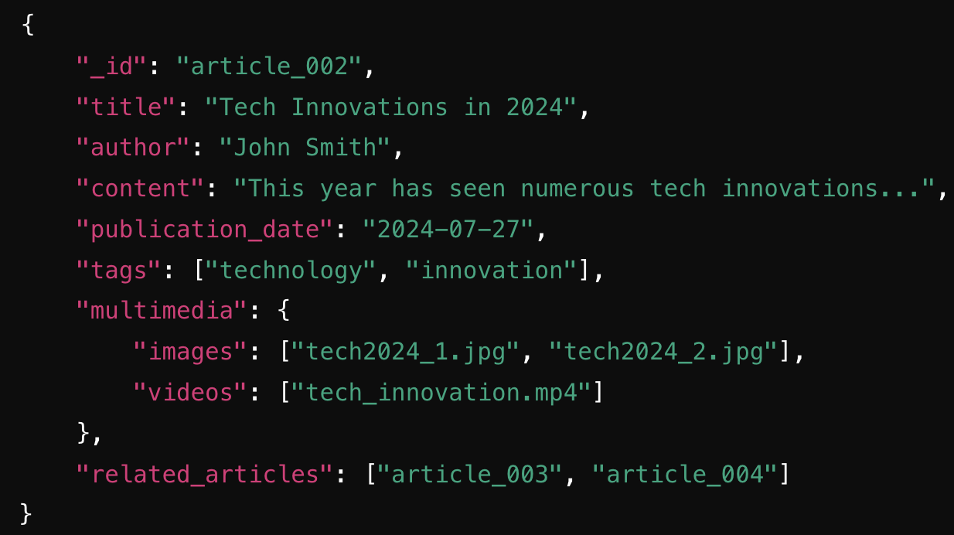
Question 4
Document storage:
Example:

Slide 12
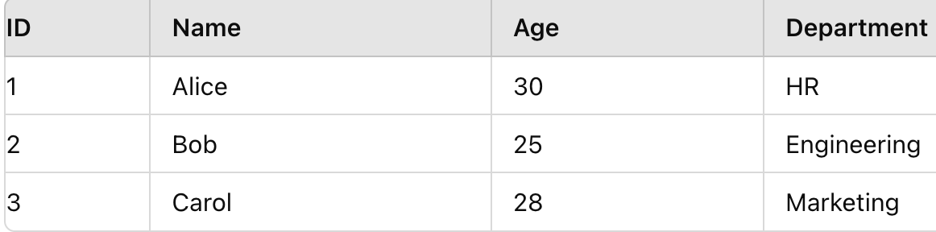
Question 4
Column-based NoSQL vs Relational database (Row-based)
Q: How is the data stored in a relational database / column-based NoSQL?

Slide 13
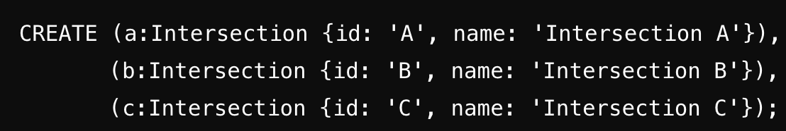
Question 4
Graph storage:
Example: Neo4j database

