Slide 1
Tutorial Week 7
Different ways for concurrency control
Semaphores

Slide 2
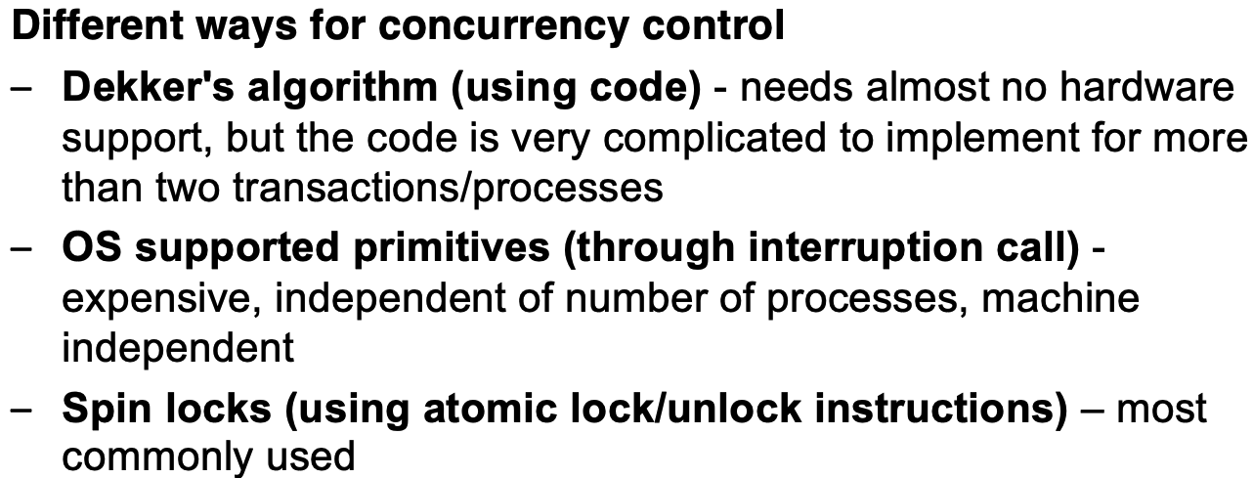
concurrency control

Slide 3
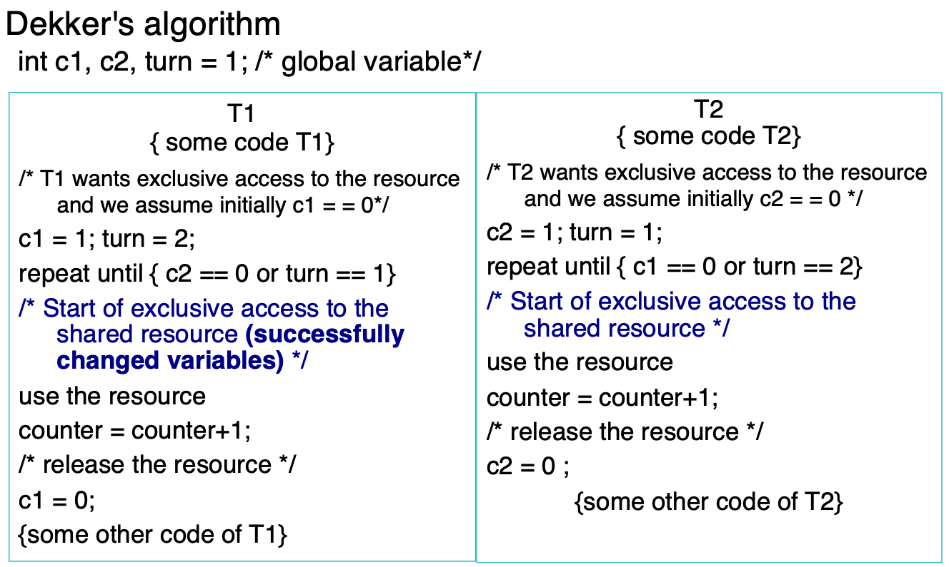
Dekker’s algorithm
no hardware
If more than two processes, code is complex
Lot of storage space
Use busy waiting
Efficient if lock contention is low

Slide 4
OS supported primitives
the process doesn't handle the lock directly; instead, the OS takes over, which centralizes control and management of locks. (no hardware)
No busy waiting: For a process, if the lock is not immediately available, it often involves putting this process to sleep and performing a context switch. Then CPU can switch to another process.
Expensive operation: it involves a lot of instructions (hundreds to thousands) to save the context of the requesting process, switch to another process, and later restore the context when the original process can resume.

Slide 5
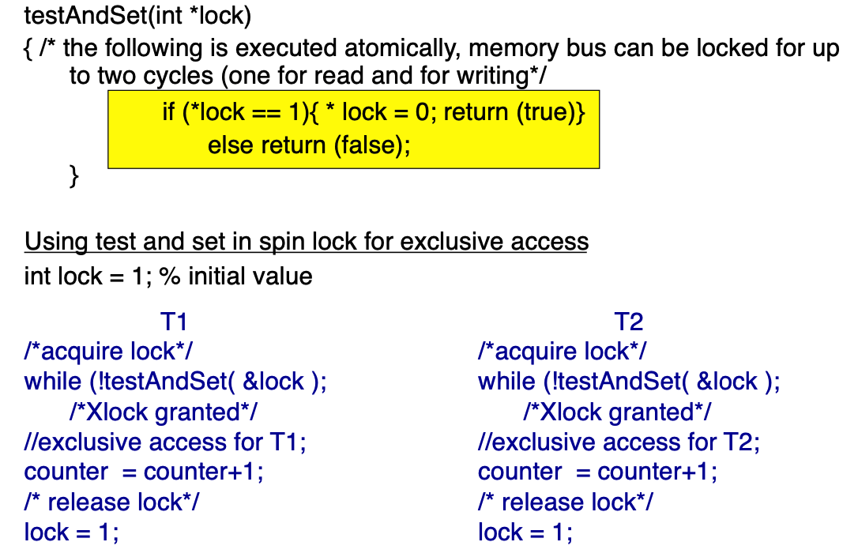
Spin lock
Hardware support (atomic operation: testAndSet)
Busy waiting
Not depend on number of processes
Efficient for low lock contentions (DB system)

Slide 6
Semaphores
Semaphore: control access to a shared resource by multiple processes or threads
Semaphores
Example: several processes (P_a, P_b, P_c) that all want to acquire a semaphore to access a shared resource. They are in a waiting queue because the semaphore is already held by another process (P_x).

Slide 7
Question 1

Slide 8
Question 1
we are not benefiting from the potential use of resources (such as accessing disk while another transaction
is using the CPU)
even under single CPU situations, concurrency can speed up things (use the CPU waiting time to do other tasks)
if there is a long-running transaction in the system, holding up every other transaction till that long one finish
(not efficient)

Slide 9
Question 2

Slide 10
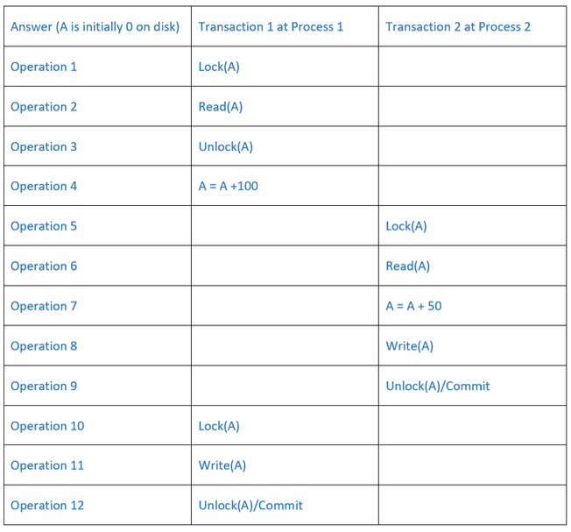
Question 2
Does not obey the Isolation property. Thus, we need something more for proper concurrency control in DBMSs.
How to solve it:
Use a higher isolation level (serializable): making transactions appear as if they are executed one after the other, rather than concurrently
Strict two-phase locking: a transaction holds all its exclusive (write) locks until it commits or aborts, ensuring that other transactions cannot see uncommitted changes,

Slide 11
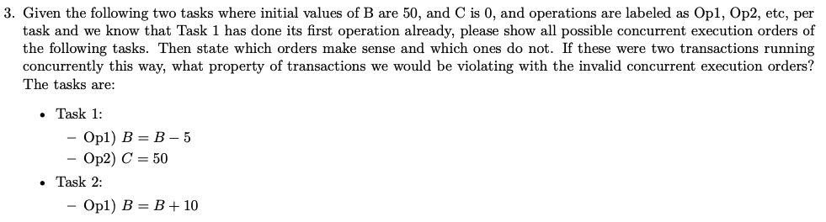
Question 3

Slide 12
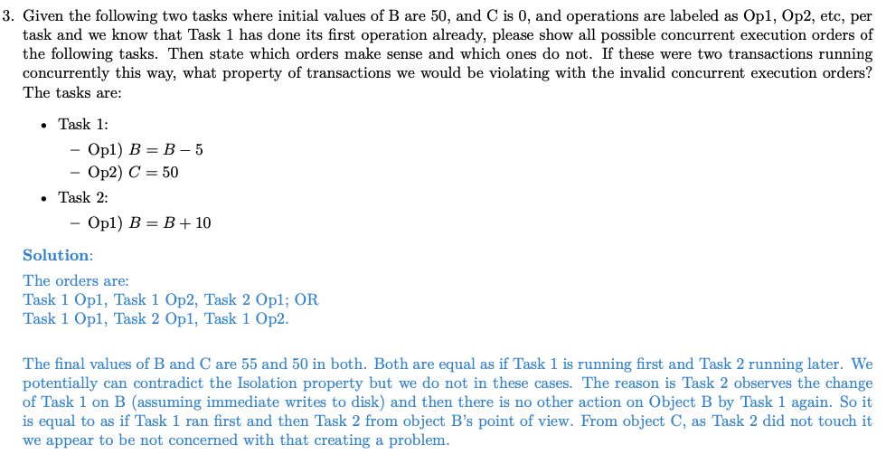
Question 3

Slide 13
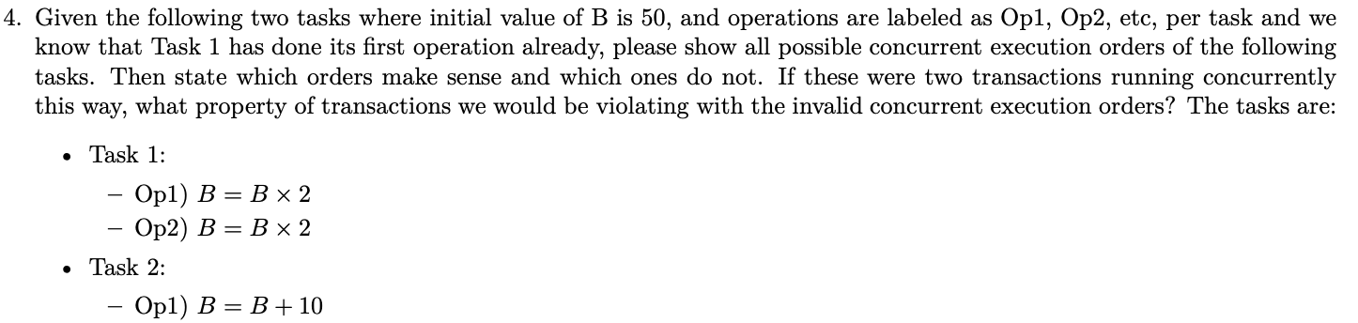
Question 4

Slide 14
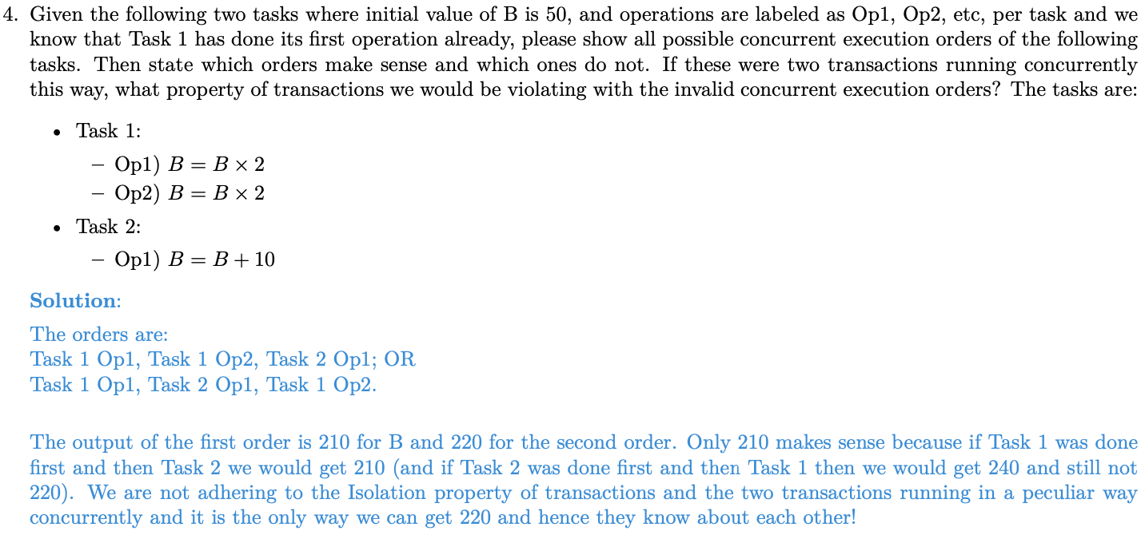
Question 4

Slide 15
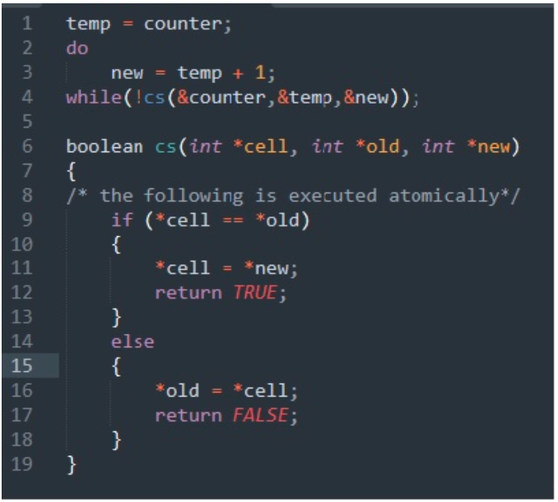
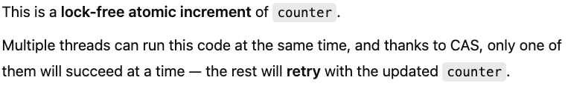
Question 5
Goal:
Example: Both my friend and I would like to add 1 score to the
Scoreboard. Make sure that both increments are recorded.

