Slide 1
Prediction Sets Adaptive to Unknown Covariate Shift
Hongxiang (David) Qiu
Department of Epidemiology and Biostatistics Michigan State University, Michigan, USA
AIEE 2024

Slide 2
What are prediction sets?

Slide 3
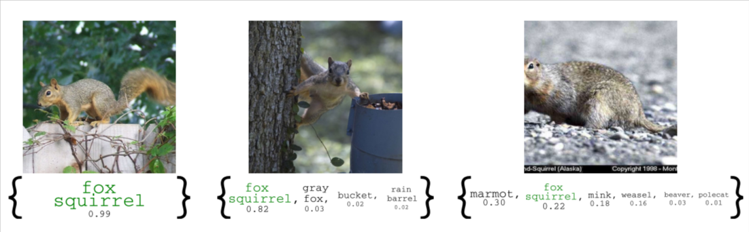
Prediction sets for image classification (Angelopoulos & Bates, 2021)
Prediction sets can quantify uncertainty of prediction models.
Prediction sets can be useful in safety-critical applications.

Slide 4
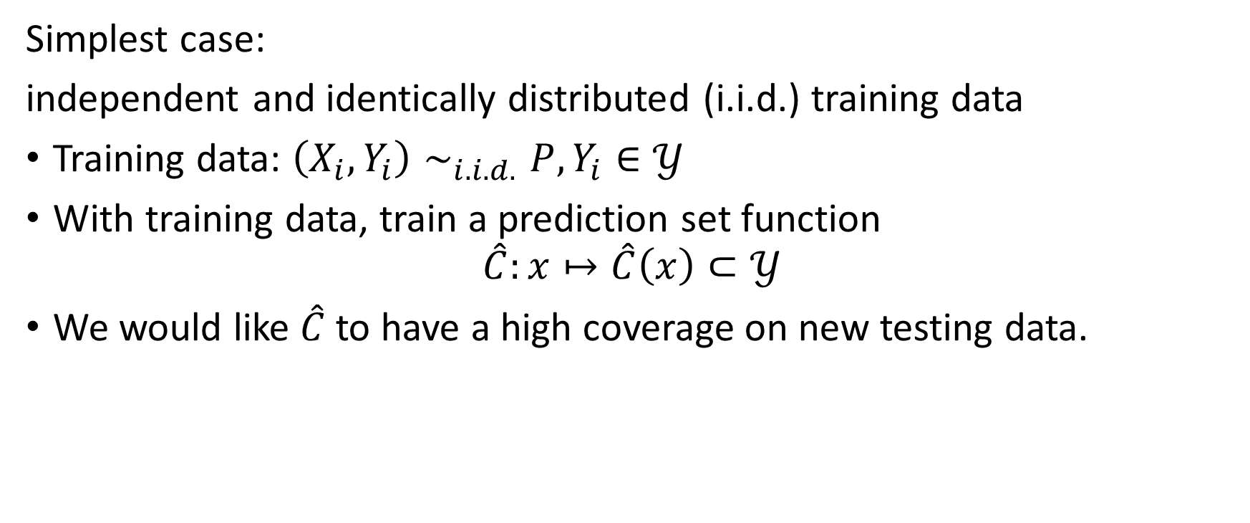
Formal problem setup
Simplest case:
independent and identically distributed (i.i.d.) training data
Training data: $\left(X_{i},Y_{i}\right)∼_{i.i.d.}P, Y_{i}∈𝒴$
With training data, train a prediction set function
$$\hat{C}:x↦\hat{C}\left(x\right)⊂𝒴$$
We would like $\hat{C}$ to have a high coverage on new testing data.

Slide 5
Review: What coverage guarantees can we achieve?

Slide 6
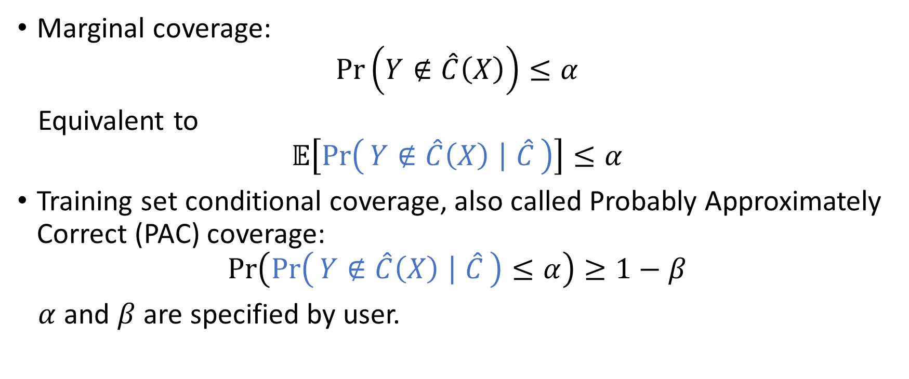
Two common coverage guarantees
Marginal coverage:
$$\operatorname{Pr}\left(Y∉\hat{C}\left(X\right)\right)≤α$$
Equivalent to
$$𝔼\left[\operatorname{Pr}\left(Y∉\hat{C}\left(X\right) ∣ \hat{C}\right)\right]≤α$$
Training set conditional coverage, also called Probably Approximately Correct (PAC) coverage:
$$\operatorname{Pr}\left(\operatorname{Pr}\left(Y∉\hat{C}\left(X\right) ∣ \hat{C}\right)≤α\right)≥1−β$$
$α$ and $β$ are specified by user.

Slide 7
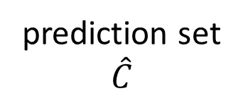
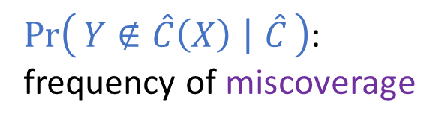
How to interpret these guarantees?
First consider the coverage error $\operatorname{Pr}\left(Y∉\hat{C}\left(X\right) ∣ \hat{C}\right)$ of $\hat{C}$.
training data
infinite sequence of i.i.d. testing data
train
apply
prediction set
$$\hat{C}$$
…
$\operatorname{Pr}\left(Y∉\hat{C}\left(X\right) ∣ \hat{C}\right)$:
frequency of miscoverage

Slide 8
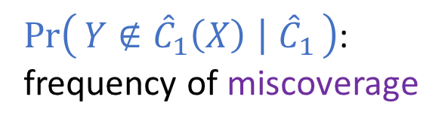
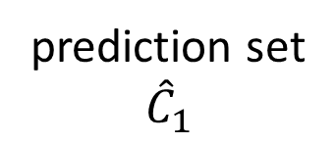
Repeat
Hypothetically, repeat the above procedure many times with different training data
training data #1
infinite sequence of i.i.d. testing data
train
apply
prediction set
$${\hat{C}}_{1}$$
…
$\operatorname{Pr}\left(Y∉{\hat{C}}_{1}\left(X\right) ∣ {\hat{C}}_{1}\right)$:
frequency of miscoverage

Slide 9

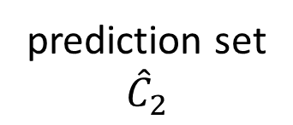
Repeat
Hypothetically, repeat the above procedure many times with different training data
training data #2
infinite sequence of i.i.d. testing data
train
apply
prediction set
$${\hat{C}}_{2}$$
…
$\operatorname{Pr}\left(Y∉{\hat{C}}_{2}\left(X\right) ∣ {\hat{C}}_{2}\right)$:
frequency of miscoverage

Slide 10
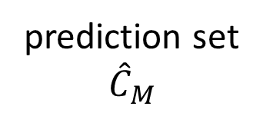
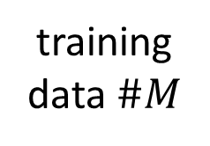
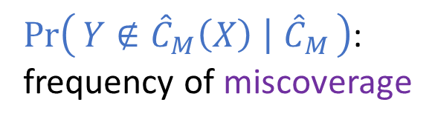
Repeat
Hypothetically, repeat the above procedure many times with different training data
training data $\#M$
infinite sequence of i.i.d. testing data
train
apply
prediction set
$${\hat{C}}_{M}$$
…
$\operatorname{Pr}\left(Y∉{\hat{C}}_{M}\left(X\right) ∣ {\hat{C}}_{M}\right)$:
frequency of miscoverage

Slide 11
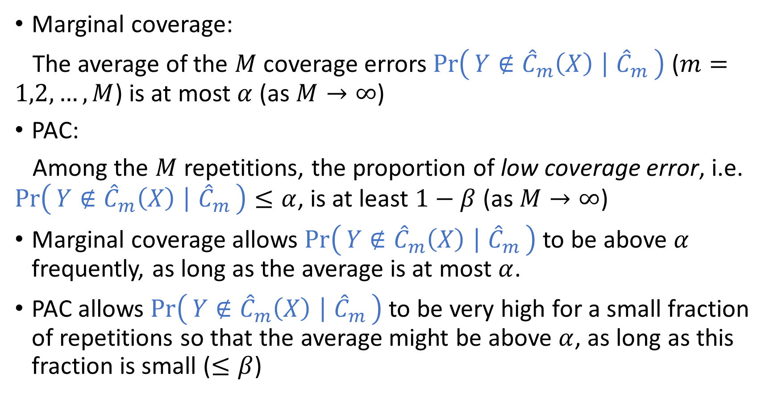
Interpret marginal coverage and PAC
Marginal coverage:
The average of the $M$ coverage errors $\operatorname{Pr}\left(Y∉{\hat{C}}_{m}\left(X\right) ∣ {\hat{C}}_{m}\right)$ ($m=1,2,…,M$) is at most $α$ (as $M→∞$)
PAC:
Among the $M$ repetitions, the proportion of low coverage error, i.e. $\operatorname{Pr}\left(Y∉{\hat{C}}_{m}\left(X\right) ∣ {\hat{C}}_{m}\right)≤α$, is at least $1−β$ (as $M→∞$)
Marginal coverage allows $\operatorname{Pr}\left(Y∉{\hat{C}}_{m}\left(X\right) ∣ {\hat{C}}_{m}\right)$ to be above $α$ frequently, as long as the average is at most $α$.
PAC allows $\operatorname{Pr}\left(Y∉{\hat{C}}_{m}\left(X\right) ∣ {\hat{C}}_{m}\right)$ to be very high for a small fraction of repetitions so that the average might be above $α$, as long as this fraction is small ($≤β$)

Slide 12
How to achieve these coverage guarantees?
For i.i.d. data, given an arbitrary algorithm to train a prediction model, inductive conformal prediction (a.k.a., split conformal prediction) can be used to construct
prediction sets achieving marginal coverage guarantee (Vovk, Gammerman & Saunders, 1999)
prediction sets achieving PAC (Vovk, 2013)
The quality of the prediction model affects the size of prediction sets, but not the coverage guarantee.

Slide 13
Prediction sets + covariate shift

Slide 14
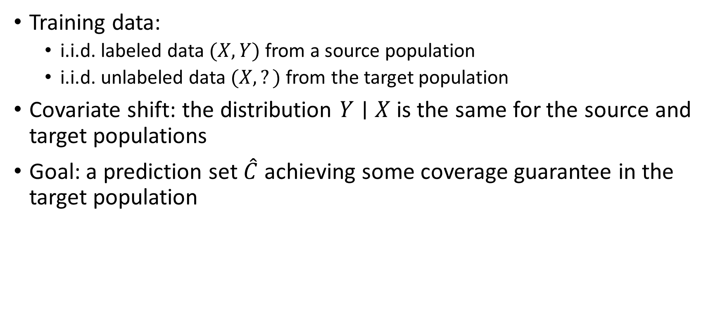
Formal problem setup
Training data:
i.i.d. labeled data $(X,Y)$ from a source population
i.i.d. unlabeled data $(X,?)$ from the target population
Covariate shift: the distribution $Y∣X$ is the same for the source and target populations
Goal: a prediction set $\hat{C}$ achieving some coverage guarantee in the target population

Slide 15
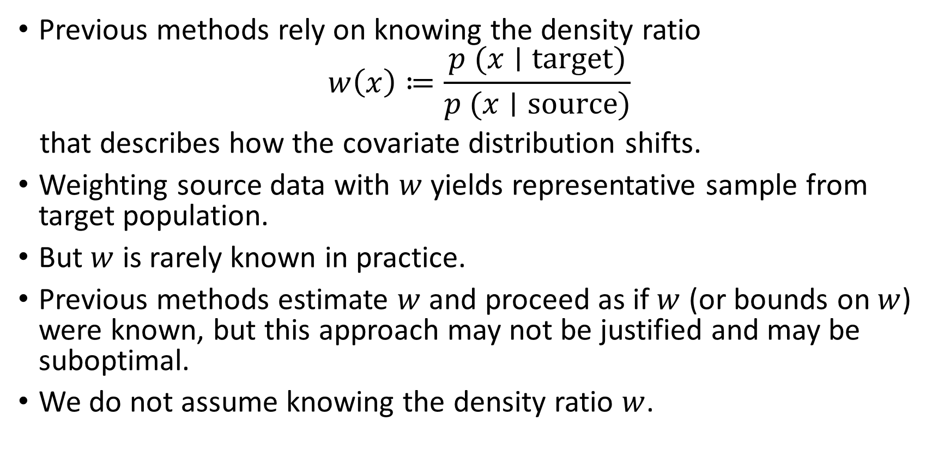
Previous works
Previous methods rely on knowing the density ratio
$$w\left(x\right)≔\frac{p (x∣\text{target})}{p (x∣\text{source})}$$
that describes how the covariate distribution shifts.
Weighting source data with $w$ yields representative sample from target population.
But $w$ is rarely known in practice.
Previous methods estimate $w$ and proceed as if $w$ (or bounds on $w$) were known, but this approach may not be justified and may be suboptimal.
We do not assume knowing the density ratio $w$.

Slide 16
Can we achieve marginal coverage or PAC?
There is no nontrivial prediction set achieving marginal coverage or PAC (Qiu, Dobriban & Tchetgen Tchetgen, 2022).

Slide 17
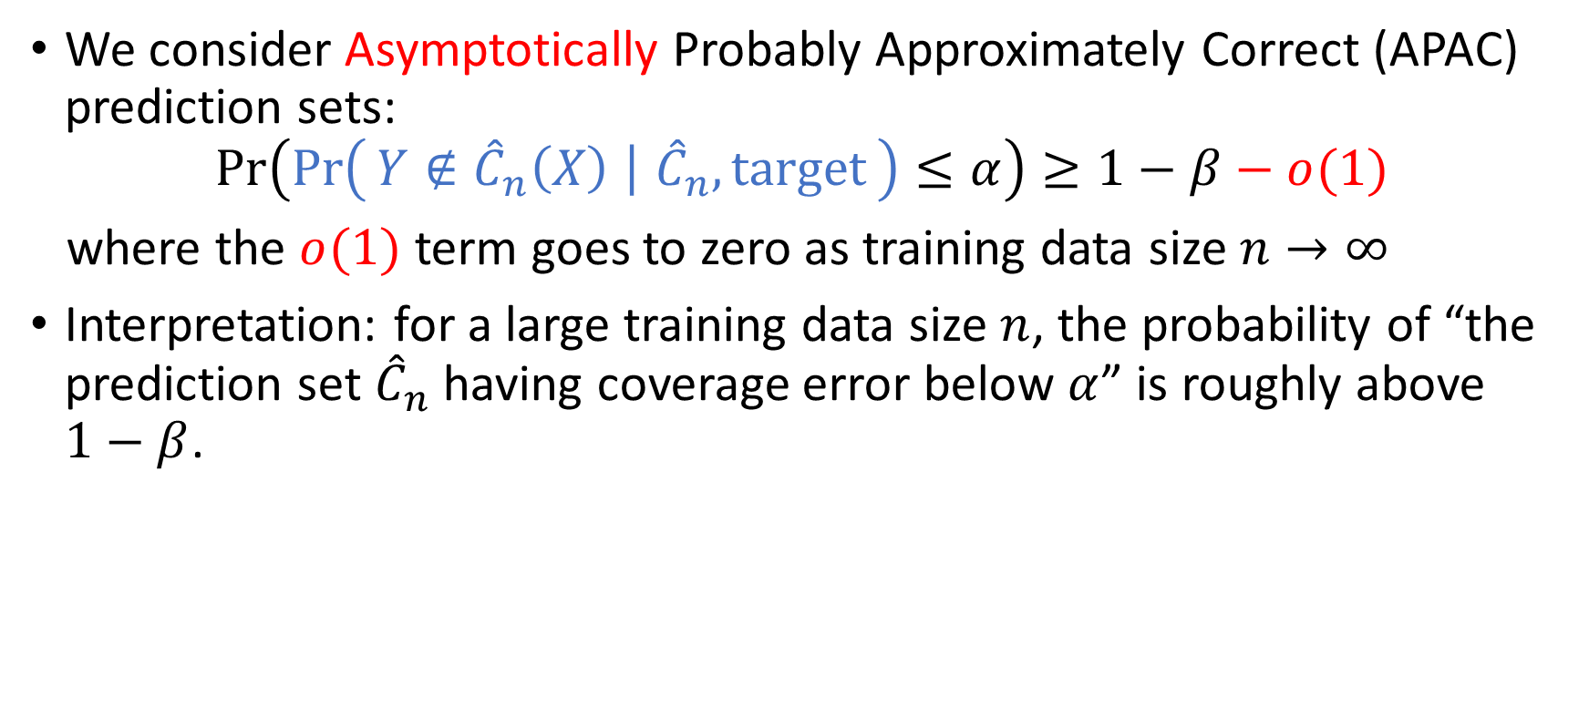
Weaker alternatives: large sample size
We consider Asymptotically Probably Approximately Correct (APAC) prediction sets:
$$\operatorname{Pr}\left(\operatorname{Pr}\left(Y∉{\hat{C}}_{n}\left(X\right) ∣ {\hat{C}}_{n},\text{target}\right)≤α\right)≥1−β−o(1)$$
where the $o(1)$ term goes to zero as training data size $n→∞$
Interpretation: for a large training data size $n$, the probability of “the prediction set ${\hat{C}}_{n}$ having coverage error below $α$” is roughly above $1−β$.

Slide 18
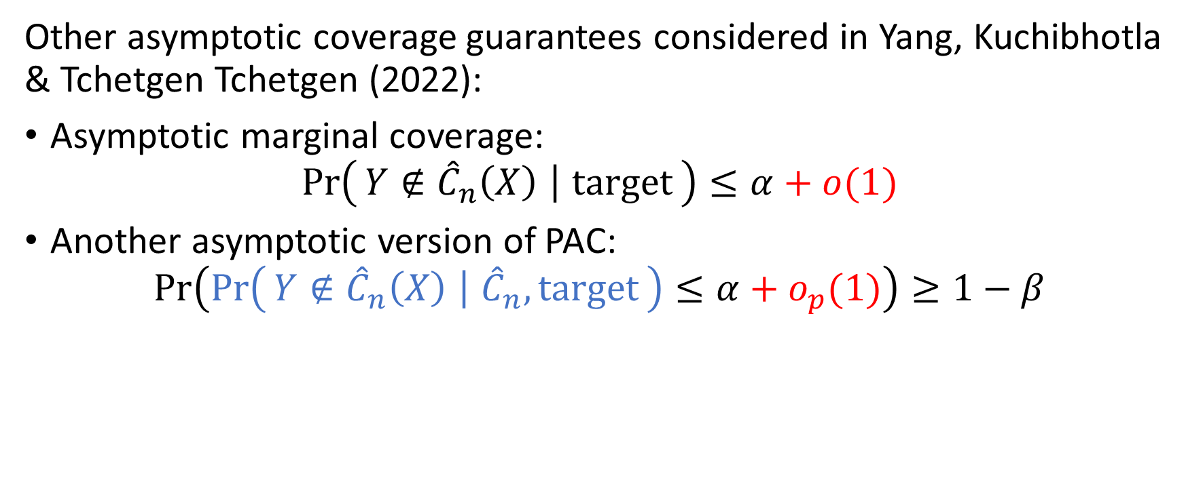
Weaker alternatives: large sample size
Other asymptotic coverage guarantees considered in Yang, Kuchibhotla & Tchetgen Tchetgen (2022):
Asymptotic marginal coverage:
$$\operatorname{Pr}\left(Y∉{\hat{C}}_{n}\left(X\right) ∣ \text{target}\right)≤α+o(1)$$
Another asymptotic version of PAC:
$$\operatorname{Pr}\left(\operatorname{Pr}\left(Y∉{\hat{C}}_{n}\left(X\right) ∣ {\hat{C}}_{n},\text{target}\right)≤α+o_{p}(1)\right)≥1−β$$

Slide 19
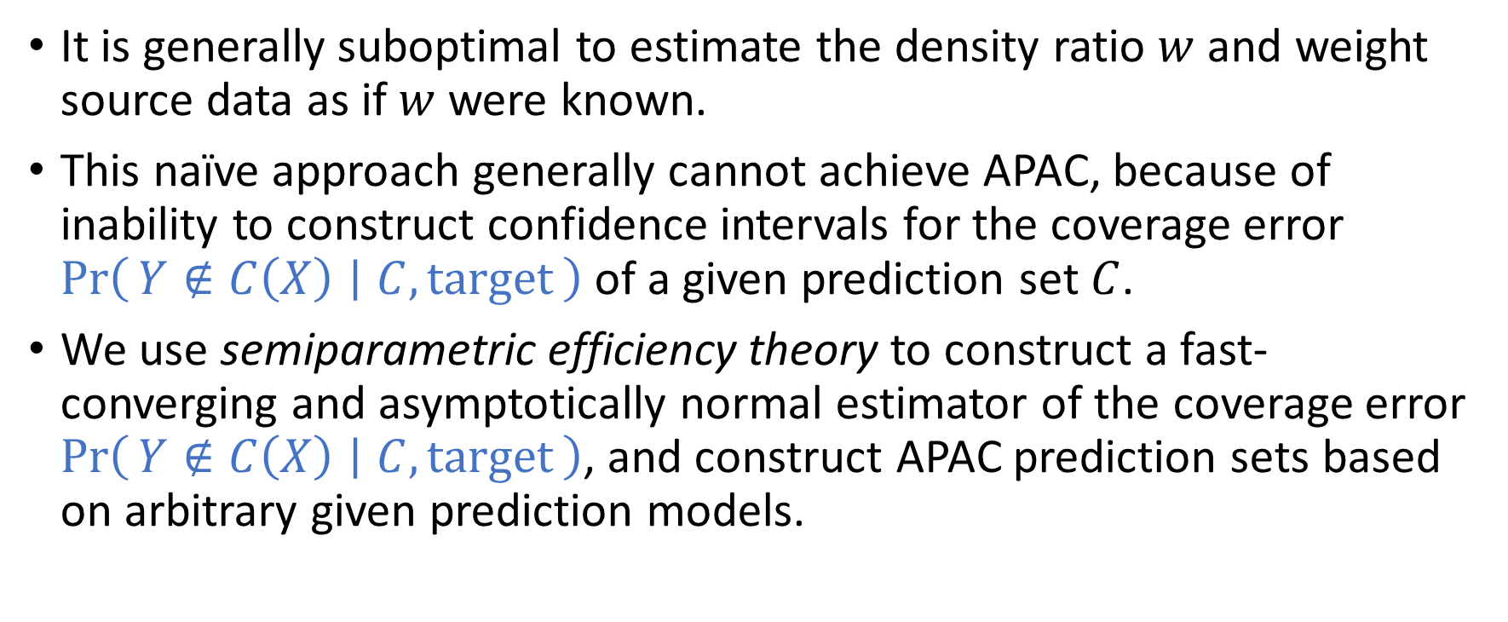
Our additional contributions
It is generally suboptimal to estimate the density ratio $w$ and weight source data as if $w$ were known.
This naïve approach generally cannot achieve APAC, because of inability to construct confidence intervals for the coverage error $\operatorname{Pr}\left(Y∉C\left(X\right) ∣ C,\text{target}\right)$ of a given prediction set $C$.
We use semiparametric efficiency theory to construct a fast-converging and asymptotically normal estimator of the coverage error $\operatorname{Pr}\left(Y∉C\left(X\right) ∣ C,\text{target}\right)$, and construct APAC prediction sets based on arbitrary given prediction models.

Slide 20
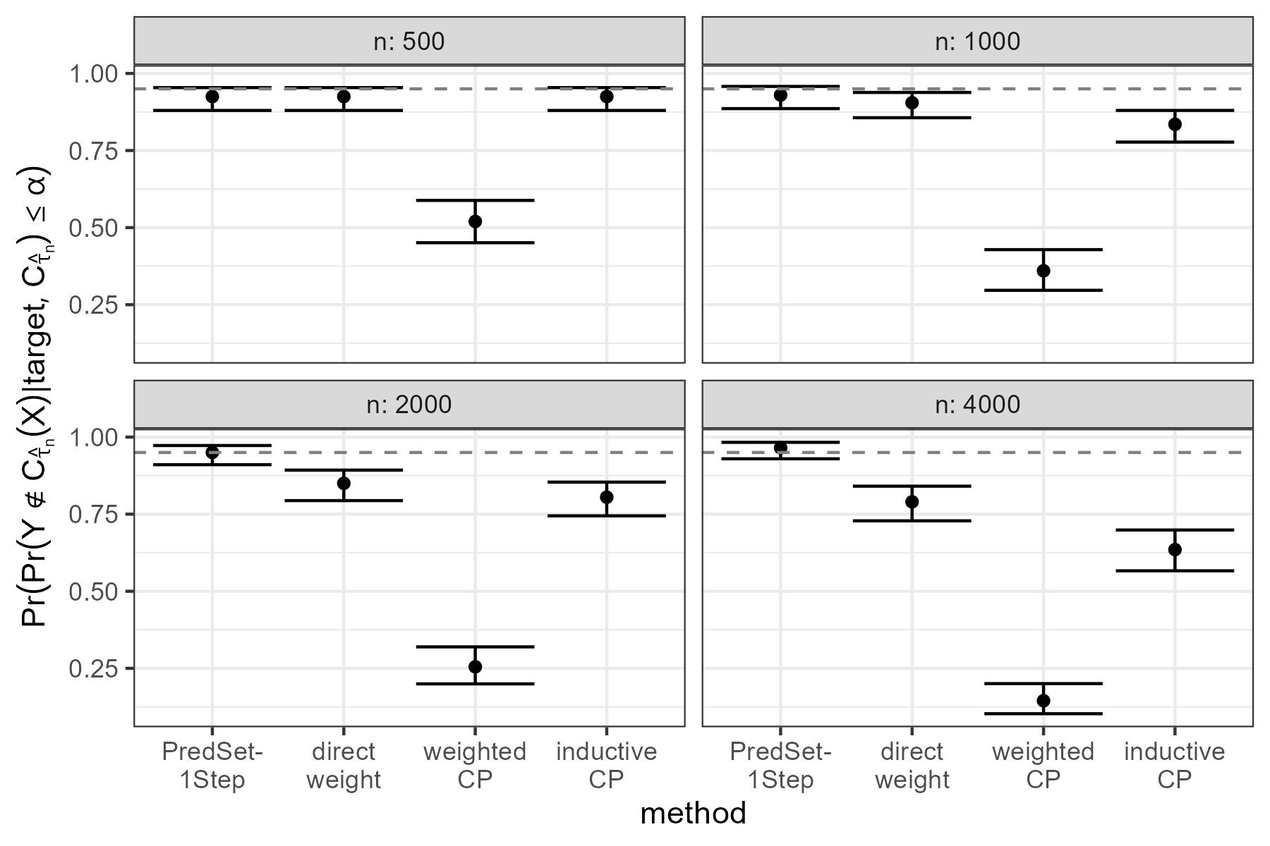
Numerical experiment

Slide 21

HIV risk prediction data
Set $α=β=5\%$: at least $1−β=95\%$ probability that the coverage error $≤α=5\%$, i.e. coverage $≥95\%$.
Method | Empirical coverage
PredSet-1Step | 95.98%
Inductive conformal prediction | 91.89%

Slide 22


Acknowledgement
Edgar Dobriban
Eric Tchetgen Tchetgen
Funding supported by NSF, NIH and Analytics at Wharton

Slide 23


Paper available online
arxiv preprint
Accepted by
The Journal of the Royal Statistical Society, Series B (Statistical Methodology)

Slide 24
References
Vovk, V. (2013). Conditional validity of inductive conformal predictors. Machine Learning, 92(2–3), 349–376.
Vovk, V., Gammerman, A., & Saunders, C. (1999). Machine-Learning Applications of Algorithmic Randomness. Sixteenth International Conference on Machine Learning, 444–453.
Qiu, H., Dobriban, E., & Tchetgen Tchetgen, E. (2022). Prediction Sets Adaptive to Unknown Covariate Shift. arXiv Preprint arXiv:2203.06126v5.
Yang, Y., Kuchibhotla, A. K., & Tchetgen Tchetgen, E. (2022). Doubly Robust Calibration of Prediction Sets under Covariate Shift. arXiv Preprint arXiv:2203.01761v1.

Slide 25
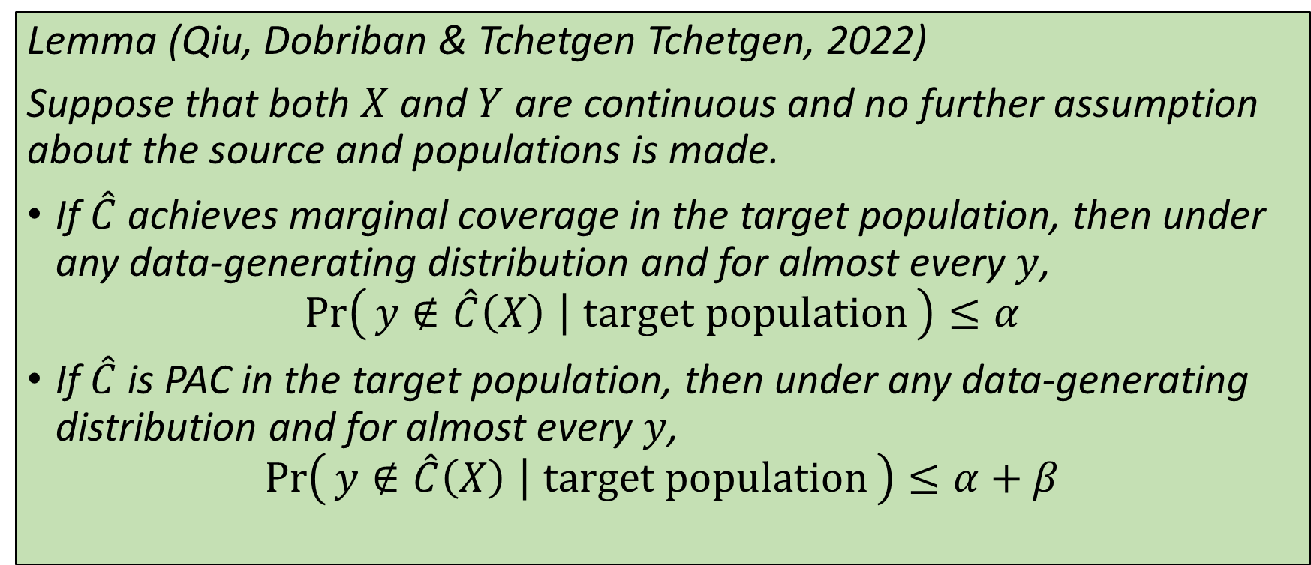
Impossibility of nontrivial prediction sets with marginal or PAC coverage under unknown covariate shift
Lemma (Qiu, Dobriban & Tchetgen Tchetgen, 2022)
Suppose that both $X$ and $Y$ are continuous and no further assumption about the source and populations is made.
If $\hat{C}$ achieves marginal coverage in the target population, then under any data-generating distribution and for almost every $y$,
$$\operatorname{Pr}\left(y∉\hat{C}\left(X\right) ∣ \text{target} \text{population}\right)≤α$$
If $\hat{C}$ is PAC in the target population, then under any data-generating distribution and for almost every $y$,
$$\operatorname{Pr}\left(y∉\hat{C}\left(X\right) ∣ \text{target} \text{population}\right)≤α+β$$

Slide 26
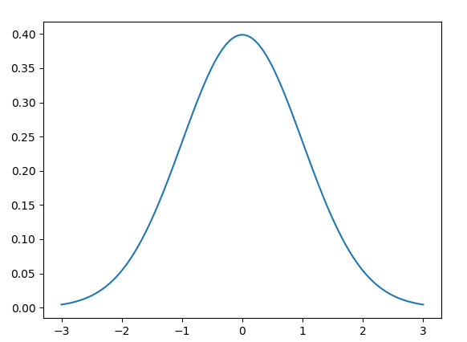

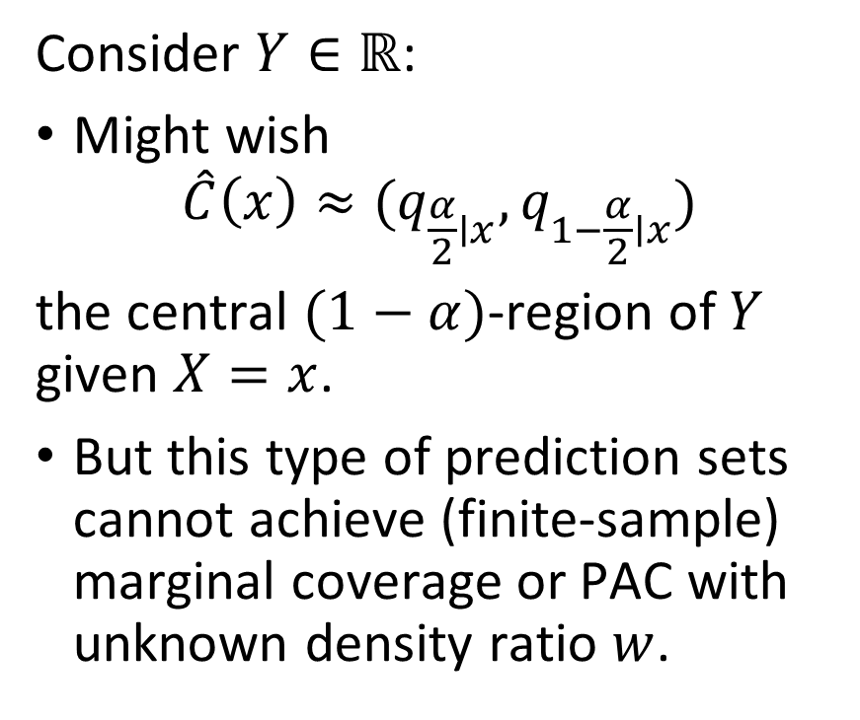

Impossibility of nontrivial prediction sets with marginal coverage or PAC
Consider $Y∈ℝ$:
Might wish
$$\hat{C}\left(x\right)≈(q_{\frac{α}{2}∣x},q_{1−\frac{α}{2}∣x})$$
the central $(1−α)$-region of $Y$ given $X=x$.
But this type of prediction sets cannot achieve (finite-sample) marginal coverage or PAC with unknown density ratio $w$.
Density of $Y∣X=x$
$$(q_{\frac{α}{2}∣x},q_{1−\frac{α}{2}∣x})$$

Slide 27

Impossibility of nontrivial prediction sets with marginal coverage or PAC
The following prediction set achieves marginal coverage and PAC but is trivial and non-informative:
$$\hat{C}\left(x\right)=\left\{\begin{aligned}ℝ \text{with} \text{probability} 1−α \\ ∅ \text{with} \text{probability} α \end{aligned}\right.$$

Slide 28
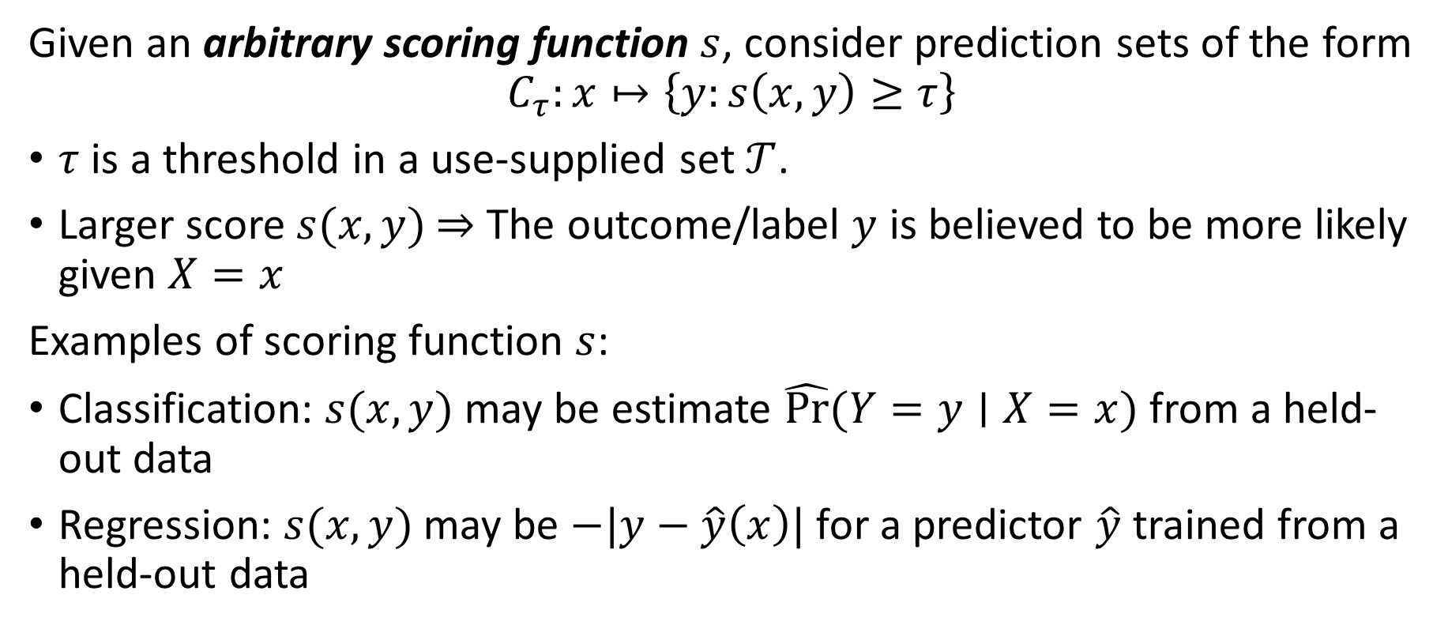
Overview of proposed method PredSet-1Step
Given an arbitrary scoring function $s$, consider prediction sets of the form
$$C_{τ}:x↦\left\{y:s\left(x,y\right)≥τ\right\}$$
$τ$ is a threshold in a use-supplied set $𝒯$.
Larger score $s(x,y)$ $⇒$ The outcome/label $y$ is believed to be more likely given $X=x$
Examples of scoring function $s$:
Classification: $s(x,y)$ may be estimate $\hat{Pr⁡}⁡(Y=y∣X=x)$ from a held-out data
Regression: $s(x,y)$ may be $−|y−\hat{y}\left(x\right)|$ for a predictor $\hat{y}$ trained from a held-out data

Slide 29
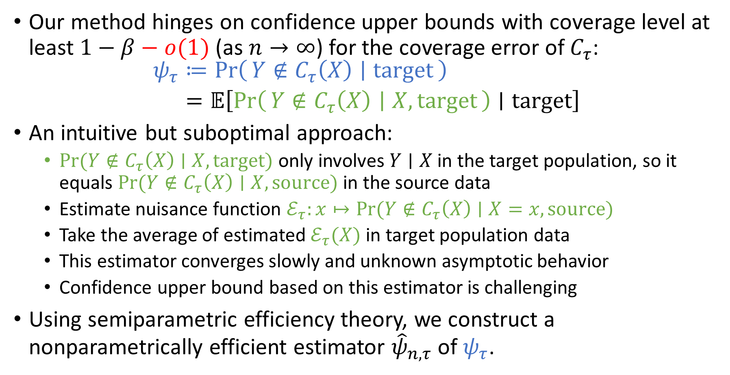
Overview of proposed method PredSet-1Step
Our method hinges on confidence upper bounds with coverage level at least $1−β−o(1)$ (as $n→∞$) for the coverage error of $C_{τ}$:
$$\begin{aligned}ψ_{τ}&≔\operatorname{Pr}\left(Y∉C_{τ}\left(X\right) ∣ \text{target}\right) \\ &=𝔼\left[\operatorname{Pr}\left(Y∉C_{τ}\left(X\right) ∣ X,\text{target}\right)∣\text{target}\right]\end{aligned}$$
An intuitive but suboptimal approach:
$Pr⁡(Y∉C_{τ}\left(X\right)∣X,\text{target})$ only involves $Y∣X$ in the target population, so it equals $Pr⁡(Y∉C_{τ}\left(X\right)∣X,\text{source})$ in the source data
Estimate nuisance function $ℰ_{τ}:x↦Pr⁡(Y∉C_{τ}\left(X\right)∣X=x,\text{source})$
Take the average of estimated $ℰ_{τ}(X)$ in target population data
This estimator converges slowly and unknown asymptotic behavior
Confidence upper bound based on this estimator is challenging
Using semiparametric efficiency theory, we construct a nonparametrically efficient estimator ${\hat{ψ}}_{n,τ}$ of $ψ_{τ}$.

Slide 30
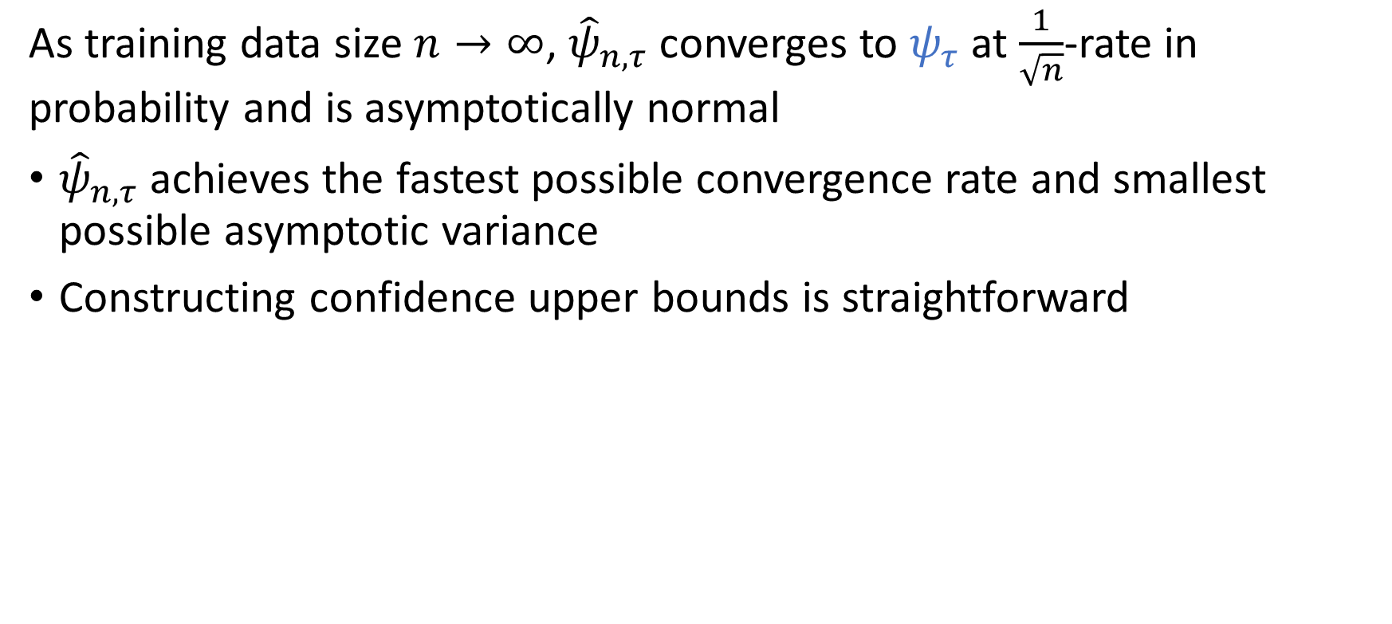
Why is our estimator better?
As training data size $n→∞$, ${\hat{ψ}}_{n,τ}$ converges to $ψ_{τ}$ at $\frac{1}{\sqrt{n}}$-rate in probability and is asymptotically normal
${\hat{ψ}}_{n,τ}$ achieves the fastest possible convergence rate and smallest possible asymptotic variance
Constructing confidence upper bounds is straightforward

Slide 31
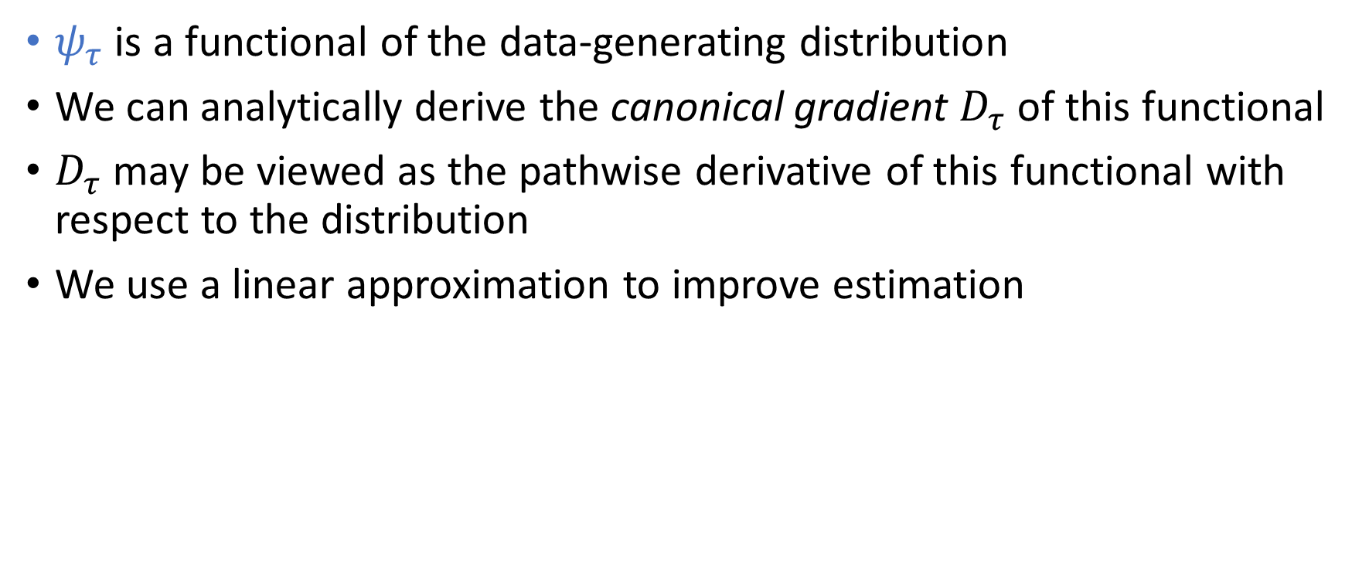

Idea behind our estimator ${\hat{ψ}}_{n,τ}$
$ψ_{τ}$ is a functional of the data-generating distribution
We can analytically derive the canonical gradient $D_{τ}$ of this functional
$D_{τ}$ may be viewed as the pathwise derivative of this functional with respect to the distribution
We use a linear approximation to improve estimation

Slide 32
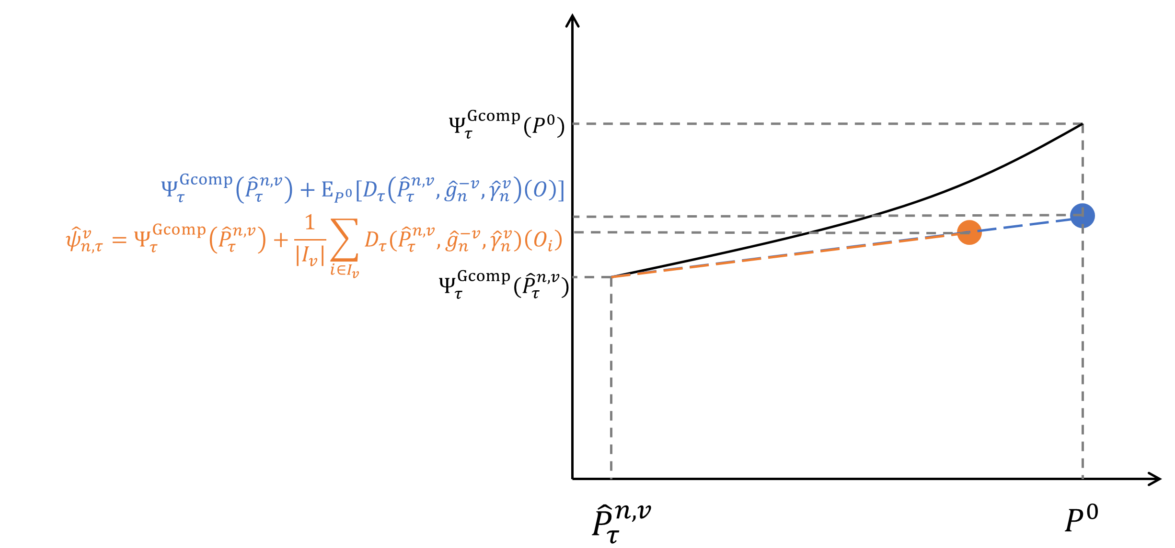
Idea behind 1-step correction

Slide 33
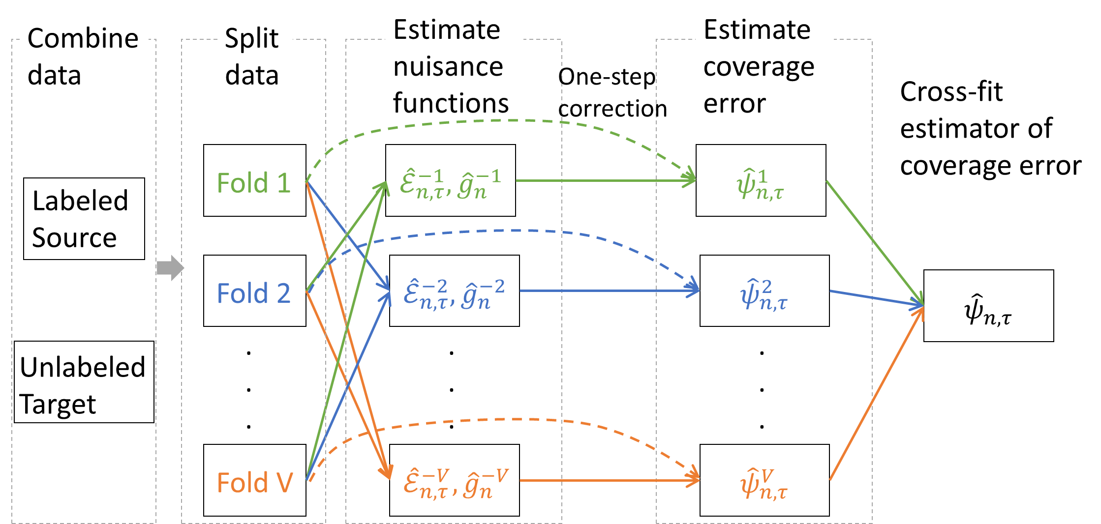
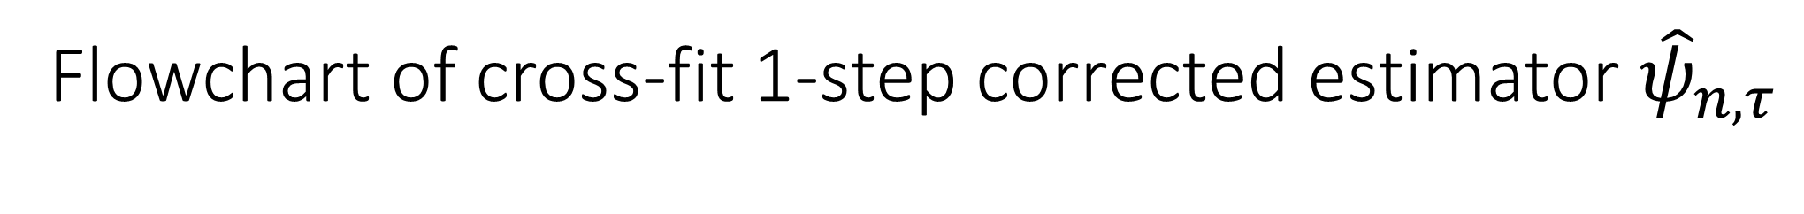
Flowchart of cross-fit 1-step corrected estimator ${\hat{ψ}}_{n,τ}$

Slide 34
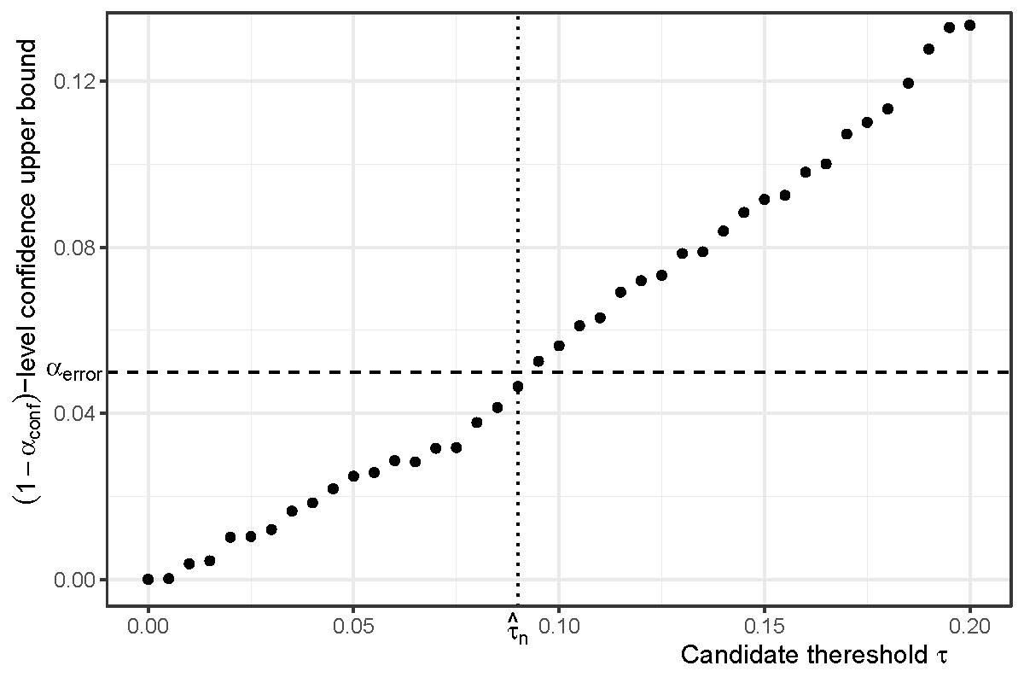
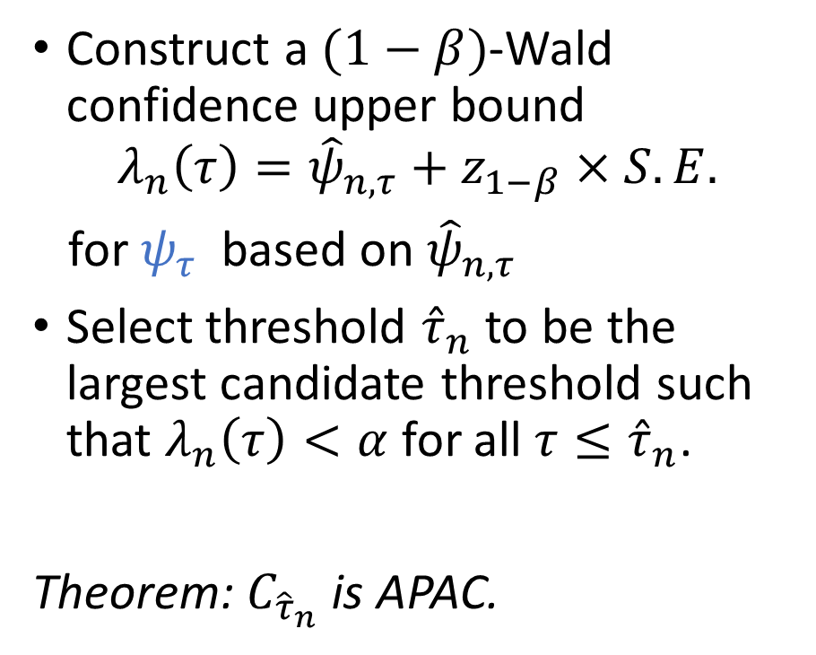
Overview of proposed method
Construct a $(1−β)$-Wald confidence upper bound
$$λ_{n}\left(τ\right)={\hat{ψ}}_{n,τ}+z_{1−β}×S.E.$$
for $ψ_{τ}$ based on ${\hat{ψ}}_{n,τ}$
Select threshold ${\hat{τ}}_{n}$ to be the largest candidate threshold such that $λ_{n}\left(τ\right)<α$ for all $τ≤{\hat{τ}}_{n}$.
Theorem: $C_{{\hat{τ}}_{n}}$ is APAC.

