Slide 1
Novel Estimators of Minimally Important Change for Patient-Reported Outcomes
Hongxiang (David) Qiu
Research Day
Department of Epidemiology & Biostatistics, CHM, MSU

Slide 2
What is patient-reported outcome (PRO)?
As the name suggests, PROs are measures about patients’ perceptions and feelings reported by patients themselves.
Subjective, vs. objective measures (e.g., height, weight, blood pressure, blood glucose)
Provides insights into patients’ health and quality of life beyond objective measures.
Also called Patient-Reported Outcome Measures (PROMs)

Slide 3
Examples of PROs at Henry Ford
https://www.henryford.com/about/quality/patient-outcomes-at-henry-ford/patient-reported-outcome-measures
Filled out online before visit or at the beginning of visit with the physician.
On a scale of 1-10,
How much pain you’re experiencing on a daily basis
How well your body’s function has returned or what physical limitations you may have
How you assess your current quality of life and general health

Slide 4
Examples of PROs in a survey study on community-living older people in the Netherlands
Filled out in a survey.
Katz-ADL index score (0-6) consisting of six dichotomous questions on bathing, dressing, toileting, transfer, incontinence and eating
Lawton IADL scale (0-7) consisting of seven dichotomous questions on housekeeping, meal preparation, shopping, telephone use, transportation, medications use, and budgeting

Slide 5
What is minimally important change (MIC)?
We may observe change in PRO within a patient between two visits/surveys.
Is that change clinically meaningful? How to interpret PROs?
Unlike objective measures,
the numerical scale of PROs can be difficult to interpret for physicians, clinicians and researchers.
for each patient, PROs can be interpretable, especially in terms of their own perception.

Slide 6
What is minimally important change (MIC)?
MIC is (loosely) defined as the smallest (hypothetical) change in PRO within a patient such that the patient perceives as important.
Also called minimally clinically important difference (MCID).

Slide 7
Why is MIC useful?
MIC informs the physician whether the PRO change is
clinically significant, or
just a small/natural variation, e.g., due to unstable reporting of PRO.
In epi studies, MIC is a reference for interpreting the effect of exposures on PROs.
A statistically significant effect on PRO might not be clinically significant.
Patients have their own MIC, so often target the population mean MIC.

Slide 8
What data to estimate MIC?
Can we use PRO change data alone?
No, because we have no idea about patients’ perception about the importance of the PRO change.
Can we directly measure MIC, e.g., ask patients about their MIC?
Maybe, but
The question may be challenging for patients to understand
Challenging to imagine hypothetical scenarios
A compromise: Ask patients whether the experienced PRO change was important.

Slide 9
Example at Henry Ford (to be implemented):
Compared to your last visit, how do you feel about your body’s function?
Much better
Slightly better
About the same
Slightly worse
Much worse
Importance level chosen by researcher/physician, e.g., at least slightly better.

Slide 10
Examples of PROs in a survey on community-living older people in the Netherlands
Has there been a decline in activities to take care of yourself, for example: taking a shower, dressing, or going to the toilet? If yes, did this decline cause limitations?
Has there been a decline in daily activities, for example: shopping, preparing a meal, or housekeeping? If yes, did this decline cause limitations?
Classified into:
No self-perceived decline
Self-perceived decline without limitations
Self-perceived decline with limitations

Slide 11
Our approach: very, very brief overview
Existing methods are biased: They answer distinct questions.
We are the first to precisely formulate MIC estimation problem.
We found a novel connection of MIC estimation with
case 1 interval censoring
causal inference/missing data (e.g., G-formula)
We will develop efficient and robust MIC estimators based on methods for the closely related problems

Slide 12
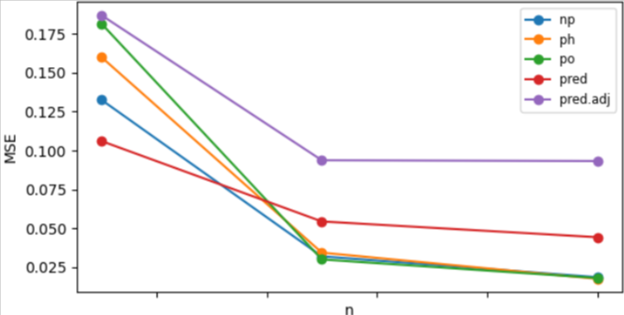
Simulation: MSE for mean MIC

Slide 13
Acknowledgement
Joint work with Xi Gong.

Slide 14

Existing methods to estimate MIC
Distribution-based methods: Look at the distribution of PRO change $C$ and use, e.g., $0.5×\text{standard} \text{deviation}$, to estimate MIC.
Not using patients’ perception $Δ$ of importance, so irrelevant to MIC.

Slide 15
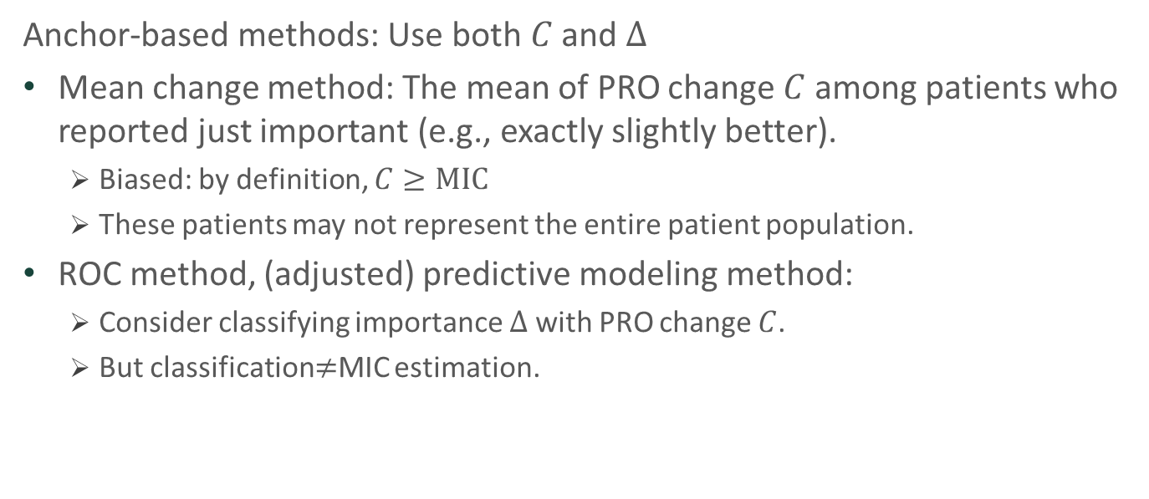
Existing methods to estimate MIC
Anchor-based methods: Use both $C$ and $Δ$
Mean change method: The mean of PRO change $C$ among patients who reported just important (e.g., exactly slightly better).
Biased: by definition, $C≥\text{MIC}$
These patients may not represent the entire patient population.
ROC method, (adjusted) predictive modeling method:
Consider classifying importance $Δ$ with PRO change $C$.
But classification$≠$MIC estimation.

Slide 16
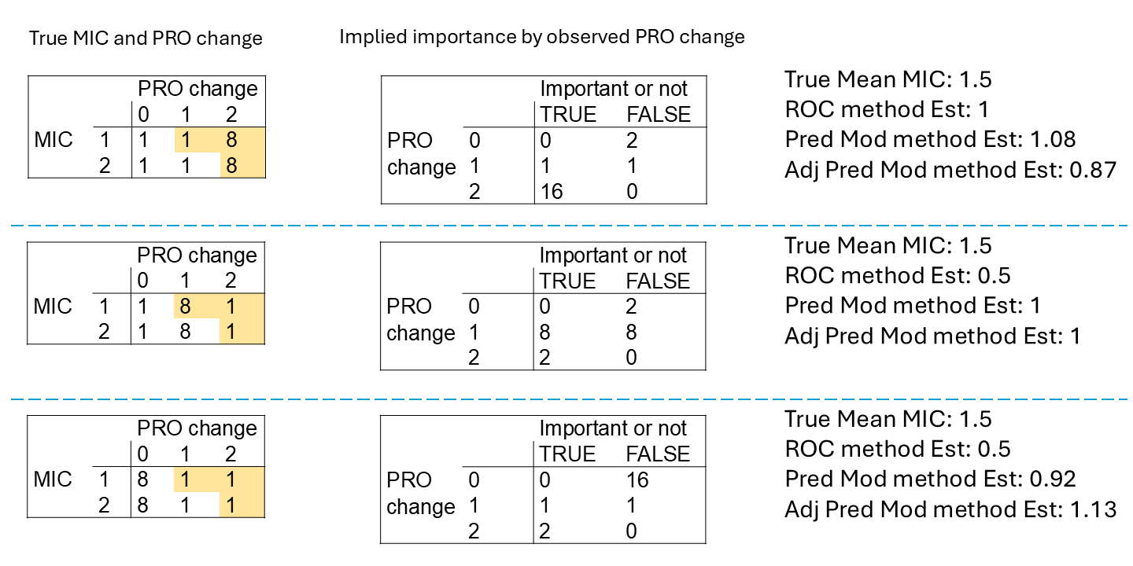

Slide 17
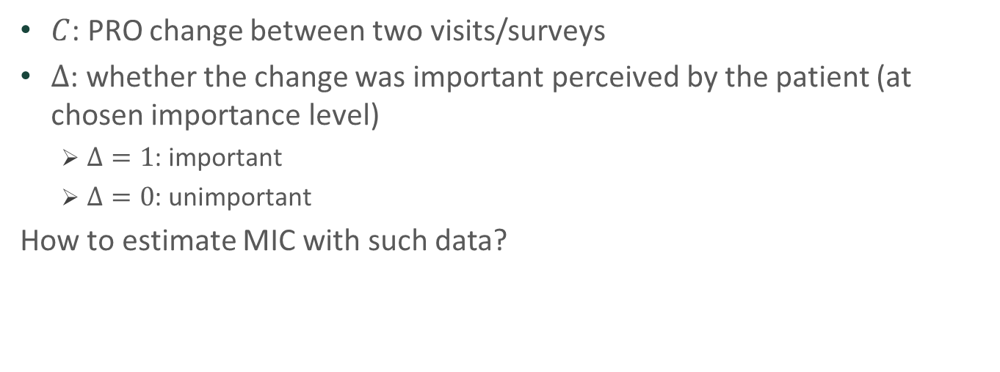
Data structure
$C$: PRO change between two visits/surveys
$Δ$: whether the change was important perceived by the patient (at chosen importance level)
$Δ=1$: important
$Δ=0$: unimportant
How to estimate MIC with such data?

Slide 18
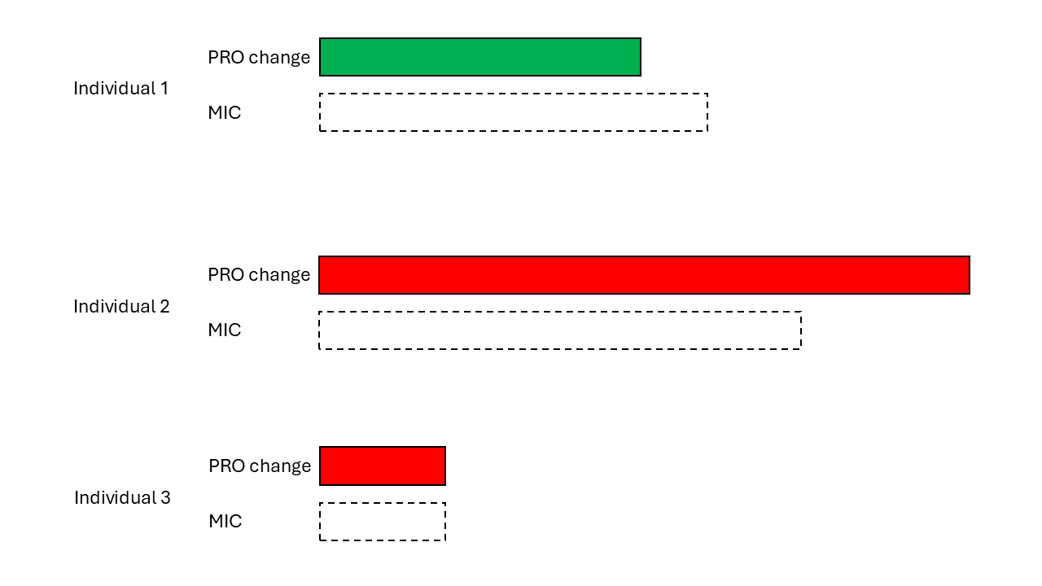
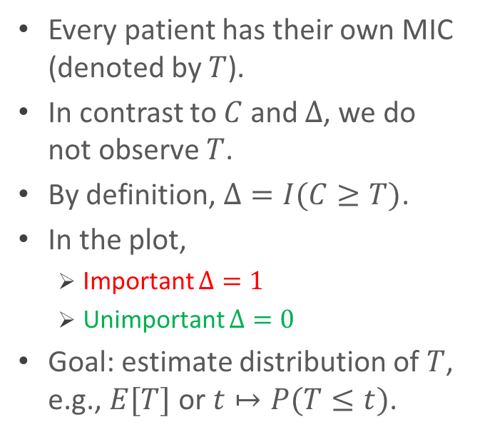
Our novel problem formulation
Every patient has their own MIC (denoted by $T$).
In contrast to $C$ and $Δ$, we do not observe $T$.
By definition, $Δ=I(C≥T)$.
In the plot,
Important $Δ=1$
Unimportant $Δ=0$
Goal: estimate distribution of $T$, e.g., $E[T]$ or $t↦P(T≤t)$.

Slide 19
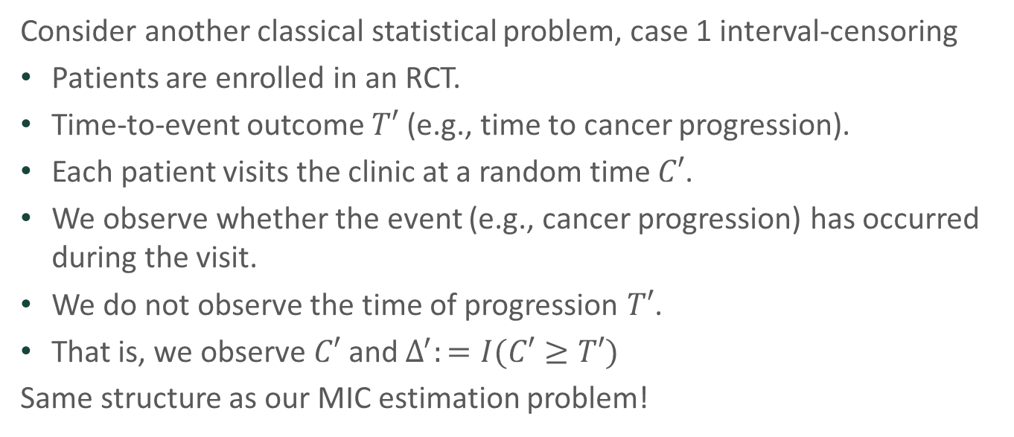
Our novel connection to interval-censoring
Consider another classical statistical problem, case 1 interval-censoring
Patients are enrolled in an RCT.
Time-to-event outcome $T′$ (e.g., time to cancer progression).
Each patient visits the clinic at a random time $C′$.
We observe whether the event (e.g., cancer progression) has occurred during the visit.
We do not observe the time of progression $T′$.
That is, we observe $C′$ and $Δ^{′}:=I(C′≥T′)$
Same structure as our MIC estimation problem!

Slide 20
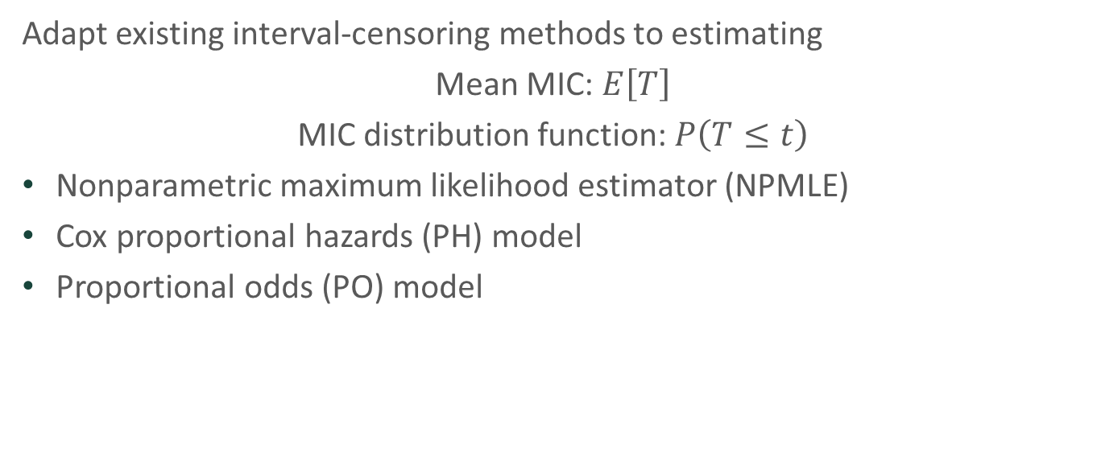
Our approach
Adapt existing interval-censoring methods to estimating
Mean MIC: $E\left[T\right]$
MIC distribution function: $P\left(T≤t\right)$
Nonparametric maximum likelihood estimator (NPMLE)
Cox proportional hazards (PH) model
Proportional odds (PO) model

Slide 21
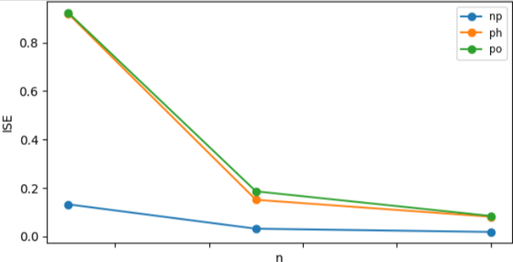
Simulation: Integrated MSE for conditional mean MIC

Slide 22
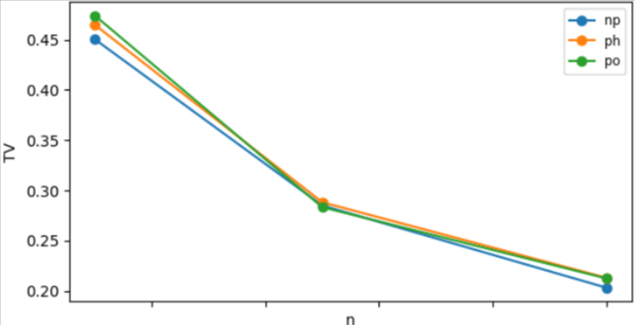
Simulation: Total variation distance of MIC distribution

Slide 23
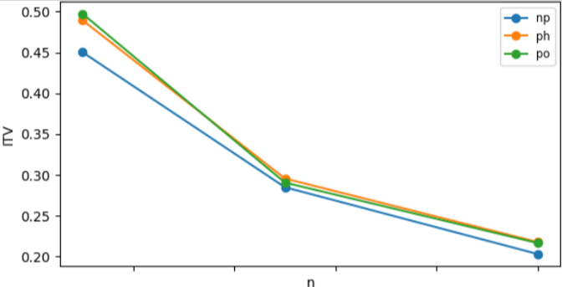
Simulation: Integrated total variation distance of conditional MIC distribution

Slide 24
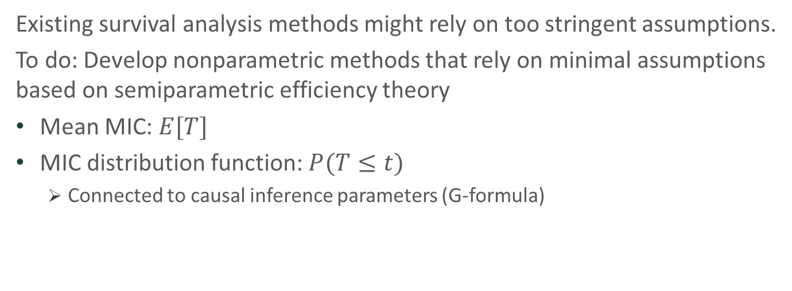
Future direction
Existing survival analysis methods might rely on too stringent assumptions.
To do: Develop nonparametric methods that rely on minimal assumptions based on semiparametric efficiency theory
Mean MIC: $E[T]$
MIC distribution function: $P(T≤t)$
Connected to causal inference parameters (G-formula)

