Slide 1

SWIFTSALES
AI-POWERED PHARMA

Slide 2
OUR CORE MISSION
INNOVATION
ACCESSIBILITY
RELIABILITY

Slide 3
"Building the future of Medicine through AI."
Malik Muhammad Ejaz, CEO

Slide 4
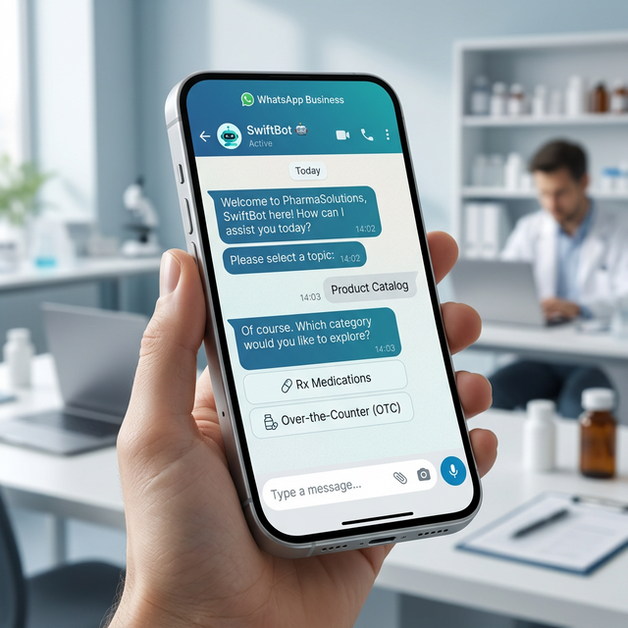
SWIFTBOT: REAL-TIME AI
Instant Q&A
Fast Orders
Fuzzy Search
Local AI

Slide 5

STRATEGIC GROWTH: NATIONAL REACH 2026

