Slide 1
Example of fault mesh with Cubit

Slide 2
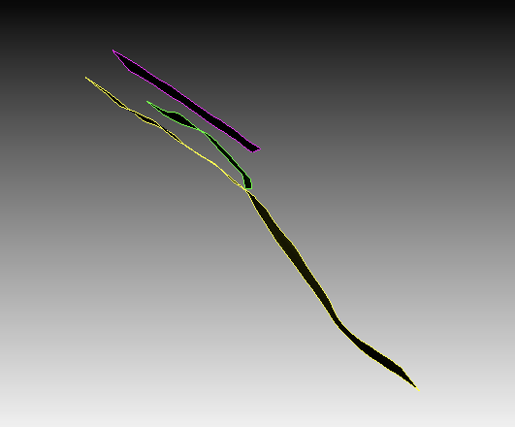
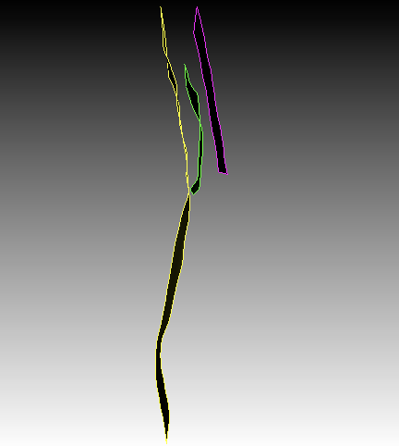
1. Import fault file SAFS-SAFZ-fault.stl into Cubit
2. %rotate the faults relative to the central point of three faults to make them align relatively along y plane (or along x plane to avoid ill mesh)
rotate volume all angle -46.0534 about origin 466499.9522785 3778308.989397 0 direction 0 0 1
3. %move faults to the position around x,y,x (0,0,0)
move vol all x -465282.5 y -3778309
%due to move action, reset zoom in the display window (right click, select "reset zoom")

Slide 3
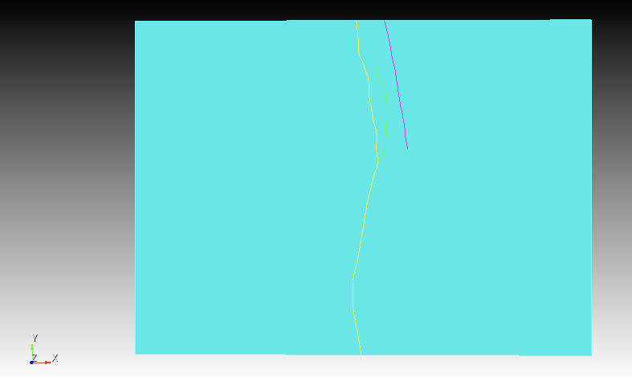
4. %make a brick volume and move the brick deeper along z brick x 66253 y 48608 z 13200 %create vol 4, with a specific width, length, height move volume 4 z -6400

Slide 4
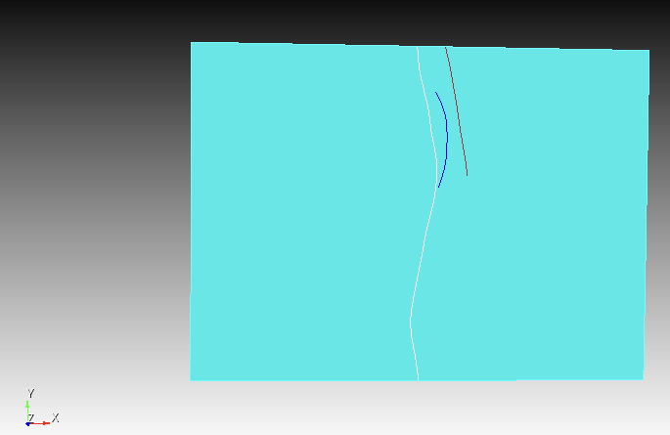
5. %turn facet-based geometry (.stl file) to ACIS geometry (CAD) for each fault (surface/vol 1,2,3), for example for surf/vol 1, do the same commands for other two surfaces (2&3), surf 1 (mid fault), surf 2(left fault), surf 3 (right fault) surface 1 scheme map %surf 1 size 500 mesh surface 1 create surface net from mapped surface 1 heal delete mesh delete vol 1 (This process will strongly smooth the fault surface (default mesh grid is large), you could specify smaller mesh grid to remain the small curvature of the fault plane, for example surf 1 size 500)

Slide 5
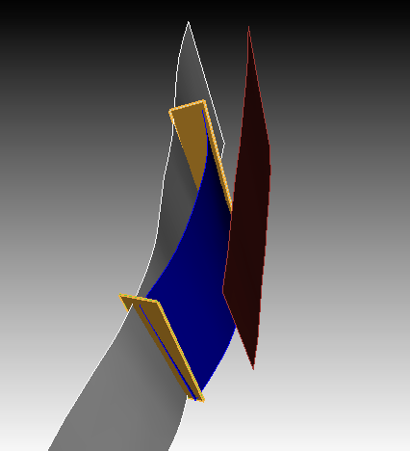
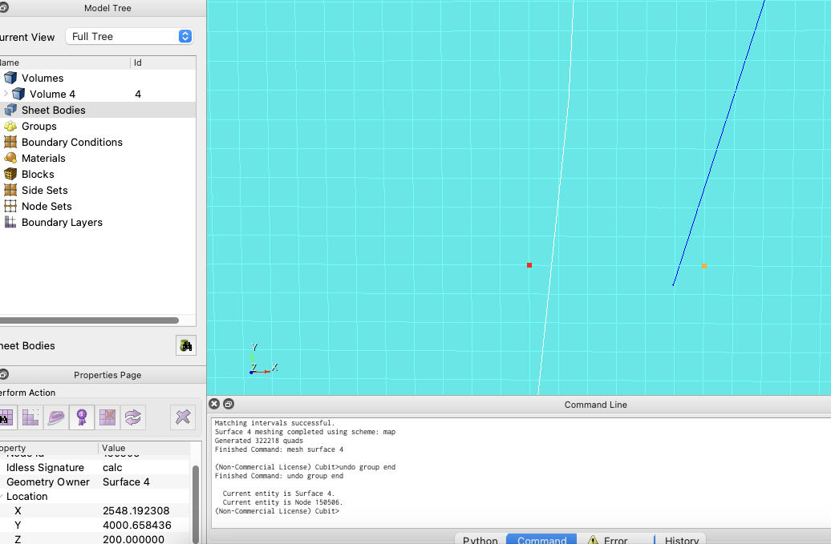
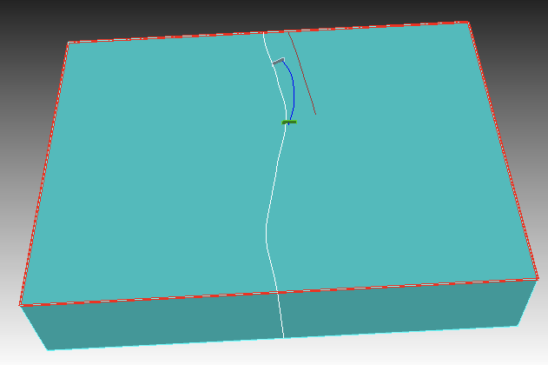
6. %create two virtual surfaces to function as webcut boundaries in order to have good mesh quality You can mesh the model ground surface (size 100 m) in order to determine location of vertexes of virtual surfaces, shown below, then delete the mesh create curve location 2348.33 17402.86 1000 location 449.68 16402.7 1000 sweep curve 37 vector 0 0 -1 distance 14500 %sweep the curve created in the last step create curve location 1448.62 4000.66 1000 location 3648.19 4000.66 1000 sweep curve 41 vector 0 0 -1 distance 14500 %sweep the curve created in the last step
Locate the vertex of virtual surface
surf 11
surf 12
surf 13
surf 10
Orange surfaces (surf 13,14) are two virtual surfaces serving for webcut, other three are fault planes (surf 10,11,12, middle,left,right fault)
surf 14
draw body 5 6 7 8 9
draw vol all

Slide 6
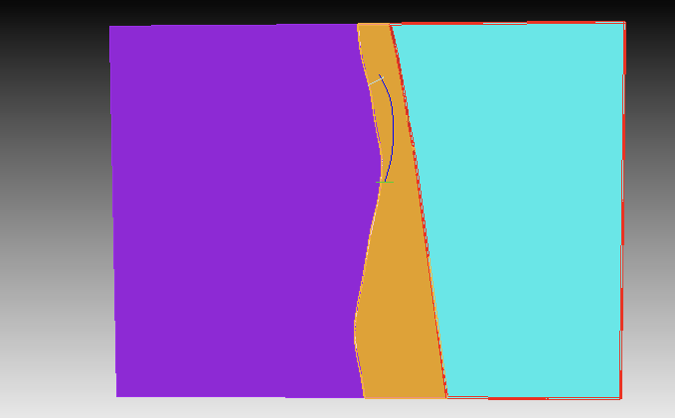
7. %Do the webcut along surf 11 and 12 to cut the model first into three segments webcut volume 4 with sheet extended from surface 12 %use right fault to cut model into two parts webcut volume 10 with sheet extended from surface 11 %use left fault to cut left part into two parts, in total three segments are generated %Rename the fault surfaces with meaningful name (fleft,fmid,fright,virtual1,virtual2), rename three segments vleft,vmid,vright
vleft
vright
vmid

Slide 7
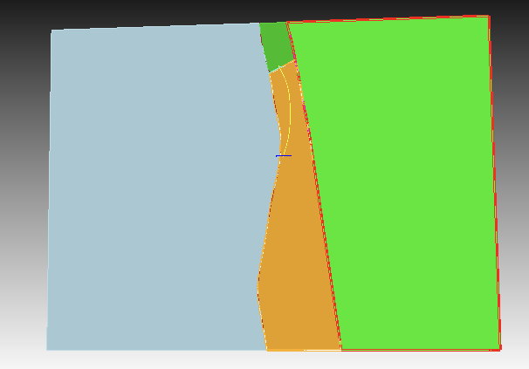
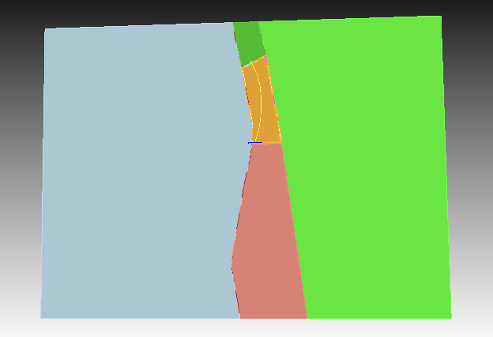
8. %Do the webcut along two virtual faults to cut the middle segment into three segments webcut vmid vmid sheet extended from virtual1 %use virtual1 surface to cut mid segment into two parts webcut vmid vmid sheet extended from virtual2 %use virtual2 surface to cut remaining mid segment part into two parts, in total three segments are generated %Rename three new segments vtop, vmid, vbottom
vtop
vleft
vmid
vright
vbottom

Slide 8
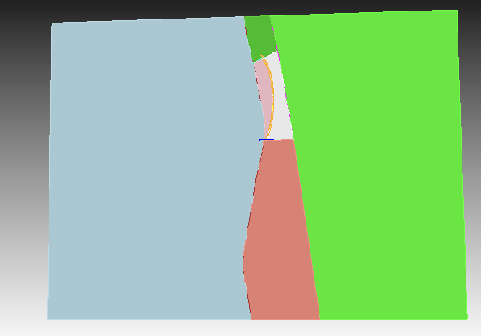
9. %Do the webcut along fault fmid to cut the vmid segment into two segments webcut vmid vmid sheet extended from fmid. %Rename two new segments vleft2,vright2
vtop
vleft
vleft2
vright
vright2
vbottom

Slide 9
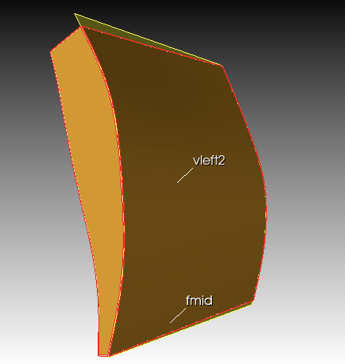
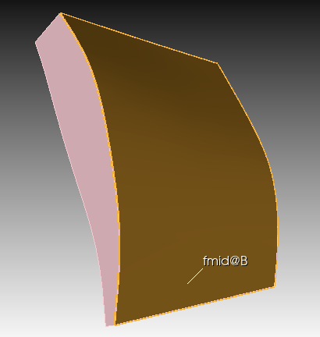
10. %remove two virtual surfaces delete virtual1 delete virtual2 %original fault plane fmid should deleted, because fmid@B (side surface of volume vleft2 can better represent this fault during mesh) delete fmid

Slide 10
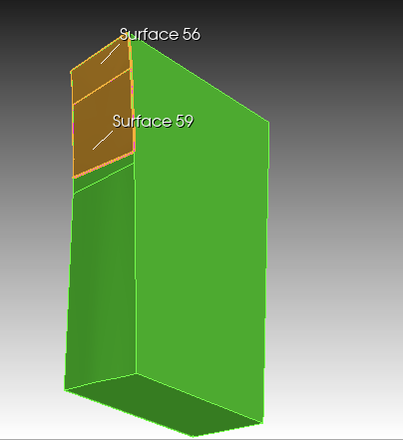
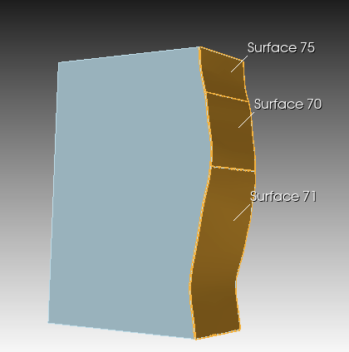
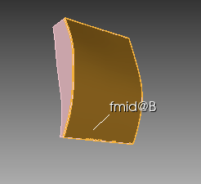
11. %A very important step is using imprint (with tolerence) to mark the boundaries of all surface planes, in order to maintain the original shape of fault planes merge tolerance 1 imprint tolerant volume all merge merge tolerance 5.000000e-04 %Then remove all sheet bodies (original fleft, fright…), only keep the volumes, without deleting the sheets, merge and mesh will have problem delete body 3, 7 %sheet body sheets are shown in model tree on the left imprint all %Make sure to do imprint and merge again to mark all necessary surface boundaries as shown below merge all
Surf for right fault
Surf for left fault
Surf for middle fault
Orange surfaces are fault surfaces, might have been segmented into several peices

Slide 11
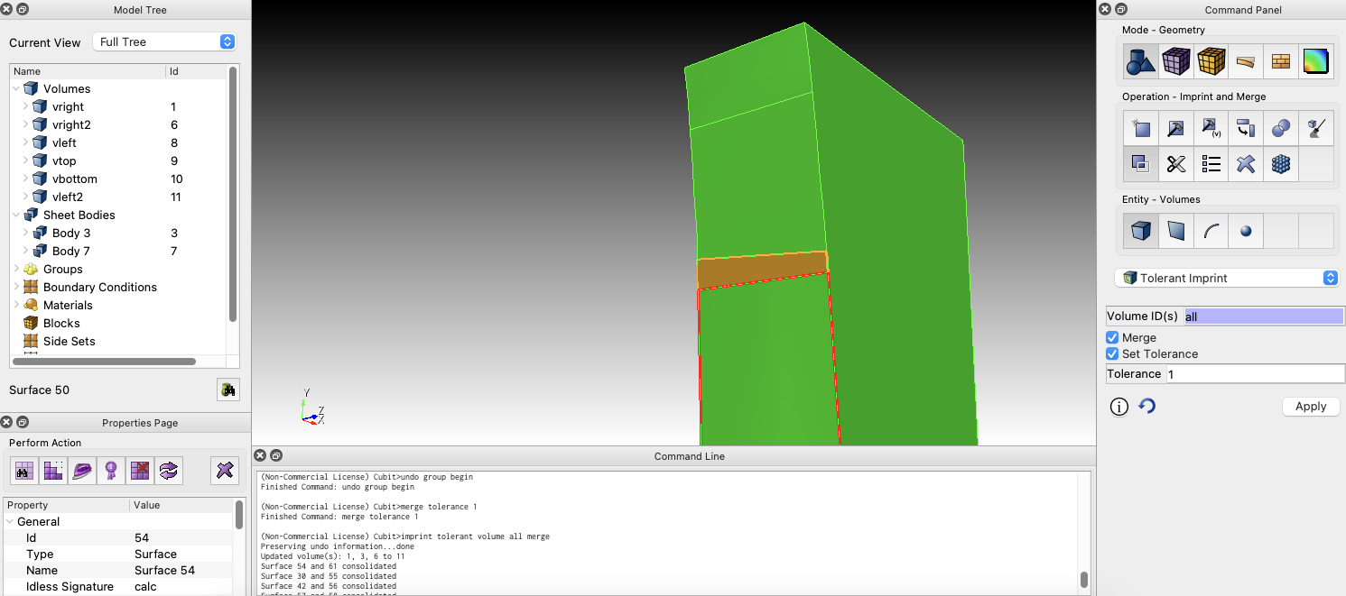
How to do tolerance volume merge on the cubit software

Slide 12
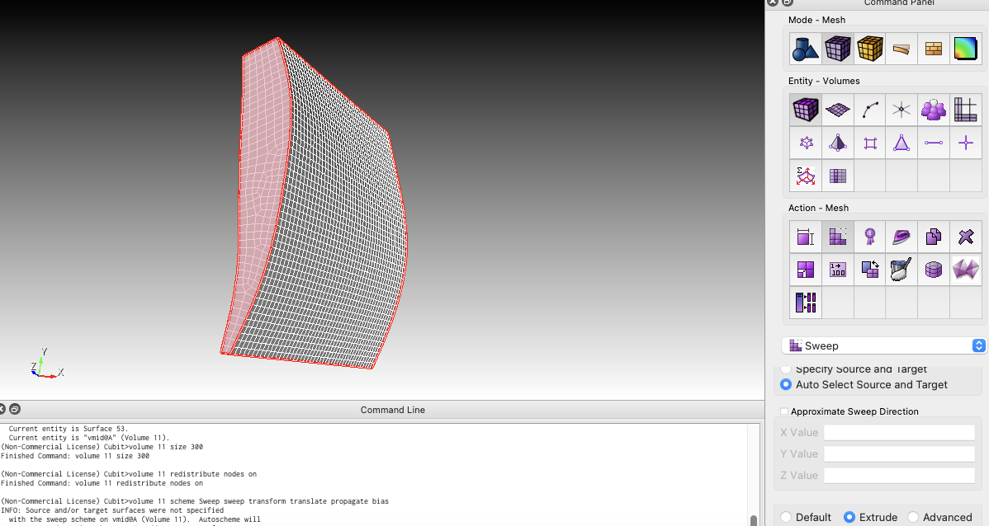
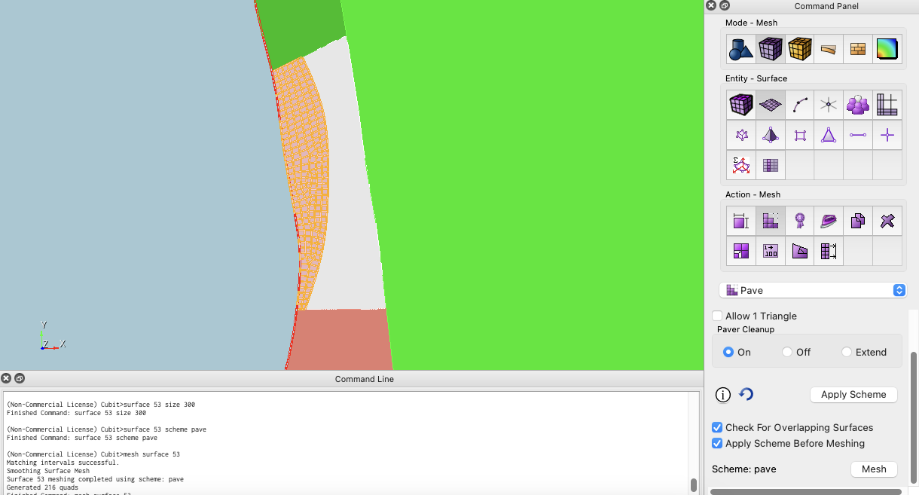
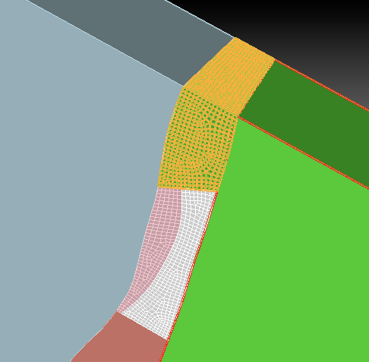
12. %Mesh segment vleft2 use “Pave” scheme and “Approximate Size” 300 for the ground surface of volume vleft2, then use “Sweep” scheme (Auto Select Source and Target) and “Approximate Size” 300 to mesh the volume; Apply the same mesh method to segments vright2, vtop
3D mesh: sweep volume
2D mesh: pave surface

Slide 13
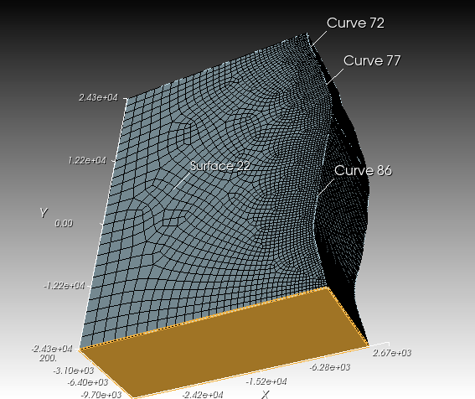
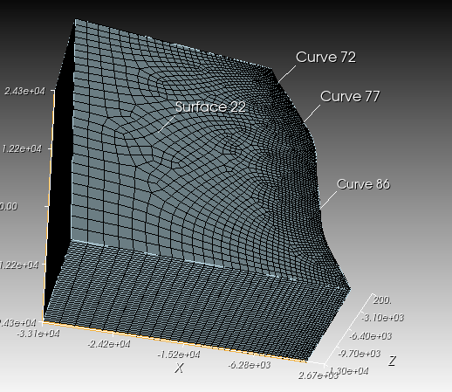
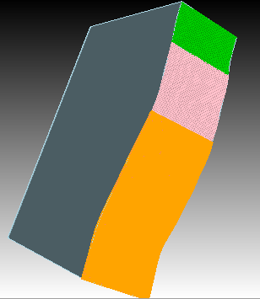
13. %Mesh segment vleft Mesh the remaining area of fault surface “fleft” , to control element size on fault interface around 300 surface 35 size 300 mesh surf 35 Mesh the ground surface of vleft, use “pave” scheme and “bias” sizing function surface 22 scheme pave surface 22 sizing function type bias start curve 72 77 86 factor 1.05 %factor 1.05 is the scaling factor mesh surf 22 Mesh the whole volume “fleft” using “sweep” scheme, selecting the ground surface as source and bottom surface as target vleft scheme Sweep source surface 22 target surface 20 mesh vleft
surface 35
surface 20 (on bottom)

Slide 14
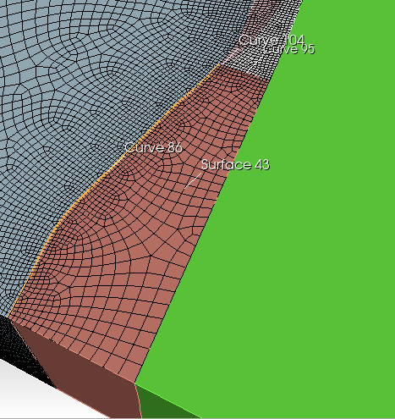
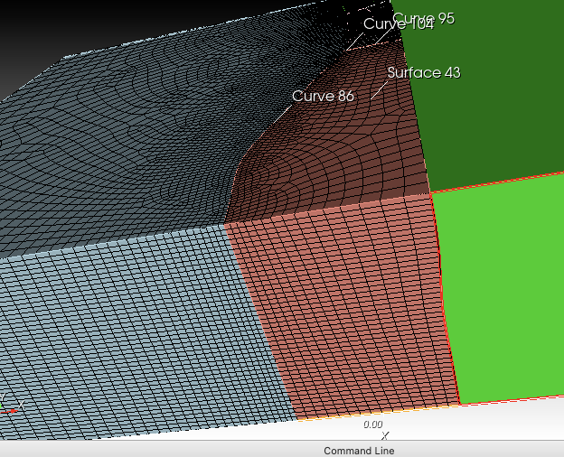
14. %Mesh segment vbottom Mesh the ground surface of vbottom, use “pave” scheme and “bias” sizing function surface 43 scheme pave surface 43 sizing function type bias start curve 86 95 104 factor 1.1 %factor 1.1 is the scaling factor mesh surf 43 Mesh the whole volume “fbottom” using “sweep” scheme, selecting the ground surface as source and bottom surface as target vbottom scheme Sweep source surface 43 target surface 41 mesh vbottom
surface 41 (on bottom)

Slide 15
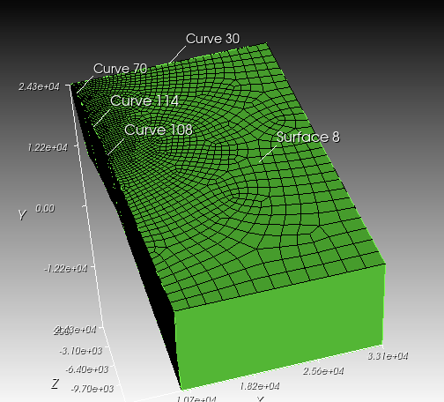
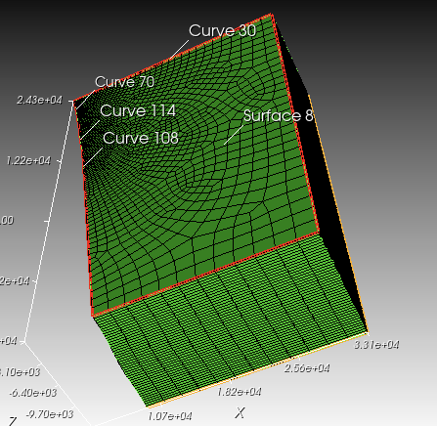
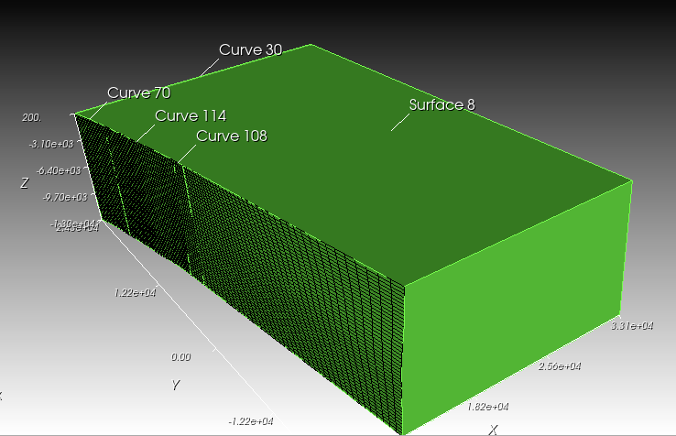
15. %Mesh segment vright Mesh the ground surface of vbottom, use “pave” scheme and “bias” sizing function surface 43 scheme pave surface 43 sizing function type bias start curve 108 144 70 factor 1.05 %factor 1.1 is the scaling factor mesh surf 43 Mesh the whole volume “fbottom” using “sweep” scheme, selecting the ground surface as source and bottom surface as target vbottom scheme Sweep source surface 8 target surface 10 mesh vbottom
surface 10(on bottom)

Slide 16
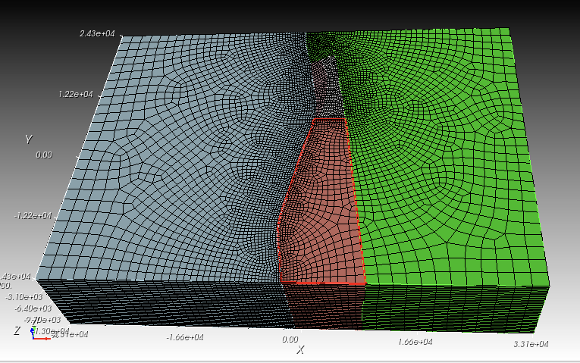
Overall mesh condition of the model

Slide 17
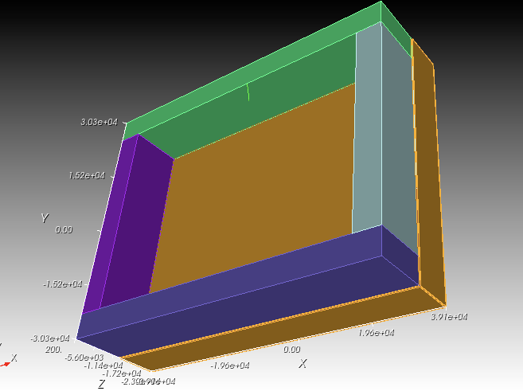
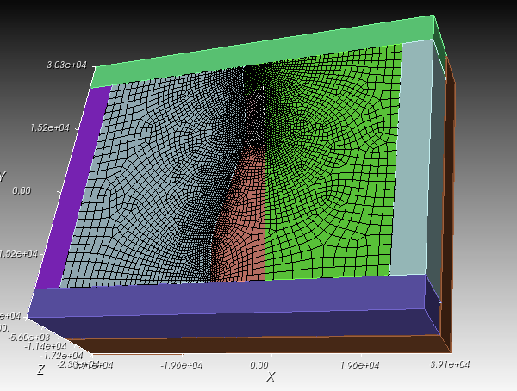
Model dimension lx= 66253, ly= 48608, lz=13200 16. %add five boundary layers (serve for providing PML layers, four side boundary and one bottom boundary) brick x 6000 y 48608 z 13200 %after making the volume, rename as “bleft” move bleft x -36126.5 z -6400 brick x 6000 y 48608 z 13200 %after making the volume, rename as “bright” move bright x 36126.5 z -6400 brick x 78253 y 10000 z 13200 %after making the volume, rename as “bup” move bup y 29304 z -6400 brick x 78253 y 10000 z 13200 %after making the volume, rename as “bdown” move bdown y -29304 z -6400 brick x 78253 y 68608 z 10000 %after making the volume, rename as “bbottom” move bbottom z -18000

Slide 18
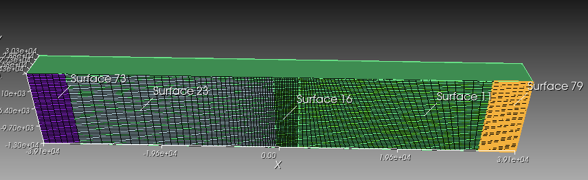
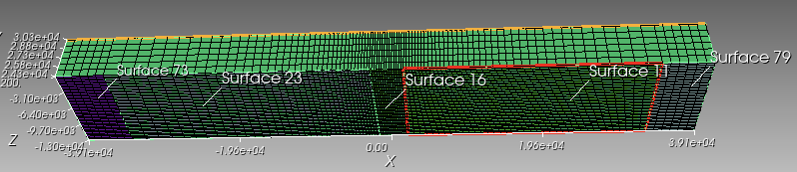
17. % Tolerance imprint and merge the boundaries with the main model Please refer to Step 11 % Mesh all the boundaries, please refer to Step 12 For example for boundary volume “bup”: bup size 1000 bup scheme Sweep source surface 73 23 16 11 79 target surface 85 (or bup scheme Sweep source surface with y_coord = 24304 target surface 85) bup redistribute nodes on %for “Extrude” sweep mesh bup
grid size 1000, containing 6 PML layers

Slide 19
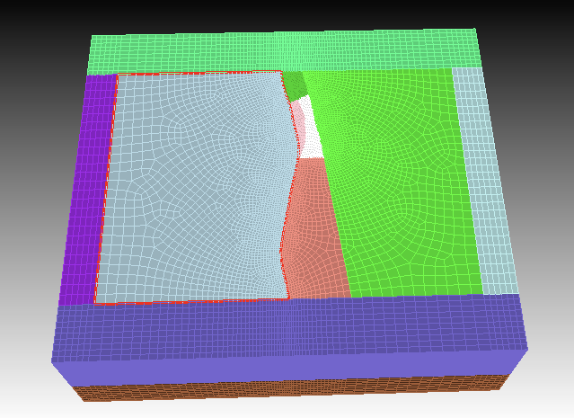
Volume meshing result : cubit01_geometry_webcut_mesh_boundary_done.cub5

Slide 20
Split fault ?
We may not need to split the fault, we could do split fault after data is imported from Cubit into Python, then we can renumber the nodes on the new split fault to better match the master and slave nodes. In addition, we need to calculate the normal direction of each fault node

Slide 21
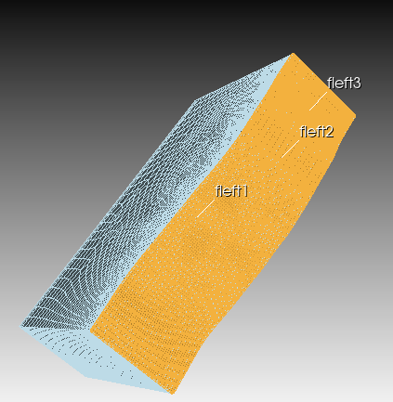
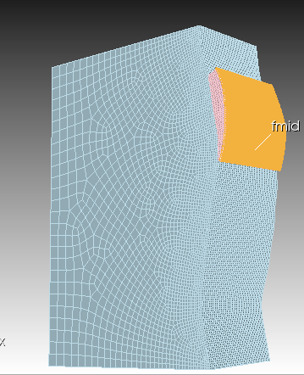
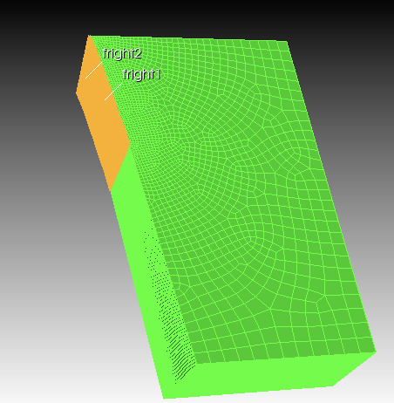
18. % Generate three fault interfaces (with split node) %Rename the fault plane surfaces with meaningful names %copy these pieces surfaces unmerge fmid %then rename the fault surfaces as fmid_vleft2 (surface in vleft2), fmid_vright2 (surface in vright2) unmerge fleft1 fleft2 fleft3 % then rename fault surfaces, with FaultName_VolumeName unmerge fright1 fright2 % then rename fault surfaces, with FaultName_VolumeName
Original fault segments

Slide 22
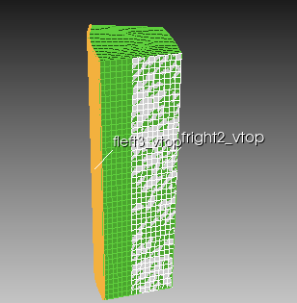
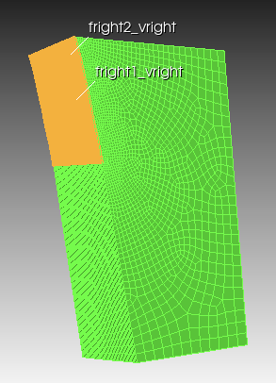
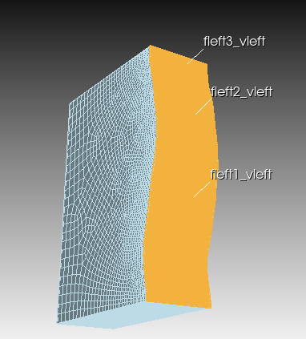
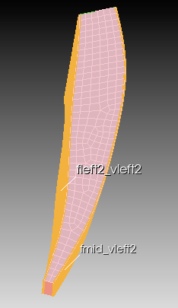
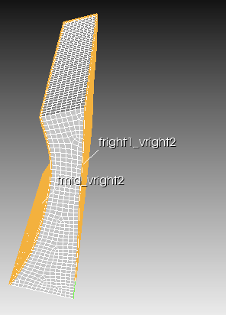
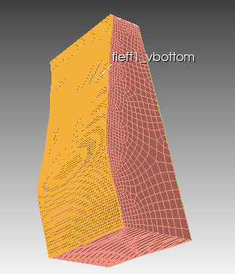
Newly generated and named fault interfaces

Slide 23
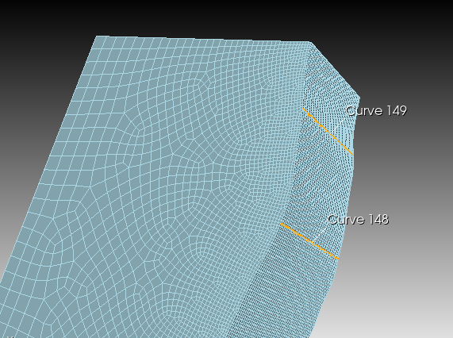
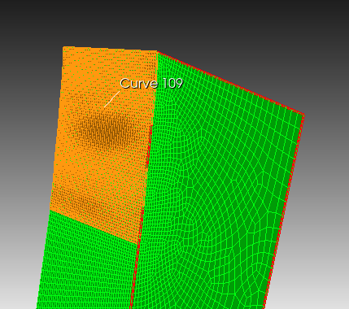
19. % Offset the fault surface backward by a small distance (for example, 2e-6, the precision of cubit is 1e-6) #{split_dist = -0.000002} %Move fault surface segments on fleft fault in volume vleft (fleft1_vleft, fleft2_vleft, fleft3_vleft) backward node in fleft3_vleft move normal to surface fleft3_vleft distance {split_dist} node in fleft2_vleft move normal to surface fleft2_vleft distance {split_dist} node in fleft1_vleft move normal to surface fleft1_vleft distance {split_dist} %The position of the other side main remain unchanged, same some effort? %Optional is move nodes on intersection curves between fleft3_vleft and fleft2_velft; fleft2_vleft and fleft1_vleft] forward, because they have been moved backward twice node in curve 148 move normal to surface fleft2_vleft distance {-split_dist} node in curve 148 move normal to surface fleft2_vleft distance {-split_dist} % Move fault surface segments on fmid fault in volume vleft2 (fmid_vleft2) backward node in fmid_vleft2 move normal to surface fmid_vleft2 distance {split_dist} % Move fault surface segments on fright fault in volume vright (fright1_vright,fright2_vright) backward node in fright1_vright move normal to surface fright1_vright distance {split_dist} node in fright2_vright move normal to surface fright2_vright distance {split_dist} %Optional is move nodes on intersection curve between fright1_vright and fright2_vright forward, because it has been moved backward twice node in curve 109 move normal to surface fright2_vright distance {-split_dist}
Curves on fault fleft
Curve on fault fright

Slide 24
Mesh results with split nodes on three fault interfaces:
cubit01_geometry_webcut_mesh_boundary_split.cub5

