Slide 1
调制信号
信号预处理
特征提取
分类识别
调制类型

Slide 2
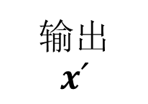
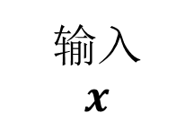
输出
$$x՛$$
输入
$$x$$
LN
MSA
+

Slide 3


$$f$$
$$g$$

Slide 4
输入层
…
…
输出层
…
隐藏层

Slide 5




激活函数
激活函数
+
$$F\left(x\right)$$
$$F\left(x\right)−x$$
加权运算
加权运算
激活函数
激活函数
加权运算
加权运算
$$x$$
$$x$$

Slide 6



𝑂
输出层
$$S$$
隐藏层
$$W$$
循环层
$$X$$
输入层

Slide 7



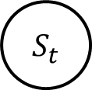



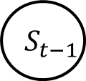








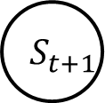


$$O_{t−1}$$
$$O_{t}$$
$$O_{t+1}$$
$$V$$
$$V$$
$$V$$
$$S_{t−1}$$
$$S_{t}$$
$$S_{t+1}$$
$$W$$
$$W$$
$$W$$
$$W$$
$$U$$
$$U$$
$$U$$
$$X_{t−1}$$
$$X_{t}$$
$$X_{t+1}$$

Slide 8







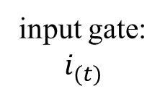




$$c_{\left(t−1\right)}$$
×
+
$$c_{\left(t\right)}$$
tanh
×
×
$$h_{\left(t\right)}$$
forget gate:
$$f_{(t)}$$
input gate:
$$i_{(t)}$$
output gate: $O_{(t)}$
$$C_{\left(t\right)}$$
$$σ$$
$$σ$$
tanh
$$σ$$
$$h_{\left(t−1\right)}$$
$$x_{\left(t\right)}$$

Slide 9
Conv Net
SVM
Output One-hot Class:
1*C*1
Input Signal
2*N*1

Slide 10
Feature Maps:
1*80N*1
Feature Maps:
2*(N-2)*256
Feature Maps:
1*(N-2)*80
2*(N+4)*1
Flatten: Full- Connection
Zero-Padding
Conv
1*3*256
Conv
1*2*80
Input Signal
2*N*1

Slide 11
Feature Maps:
1*80N*1
Feature Maps:
2*(N-2)*256
Feature Maps:
1*(N-2)*80
2*(N+4)*1
Feature Maps:
1*C*1
Flatten: Full- Connection
Zero-Padding
Conv
1*3*256
Conv
1*2*80
Full-Connection
SoftMax
Output One-hot Class:
1*C*1
Input Signal
2*N*1

Slide 12
Feature Maps:
1*80N*1
Feature Maps:
128*N*1
Feature Maps:
1*C*1
LSTM
128 cells
Flatten: Full- Connection
Full-Connection
SoftMax
Output One-hot Class:
1*C*1
Amplitude-Phase Signal:
2*N*1
Input Signal:
2*N*1

Slide 13
Feature Maps:
Feature Maps
Feature Maps:
1*C*1
Flatten: Full- Connection
Full-Connection
SoftMax
Res Stack
…
Res Stack
Output One-hot Class:
1*C*1
Input Signal
2*N*1
5 Residual Stacks

Slide 14
Cnov
Res Unit
Res Unit
Max Pooling
Residual Stack

Slide 15



$$x$$
Cnov+ReLU+BN
$$F\left(x\right)$$
Cnov+ReLU+BN
$$H\left(x\right)=F\left(x\right)+x$$
+
Residual Unit

Slide 16
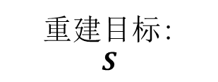
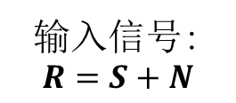
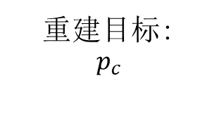
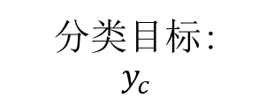
重建目标:
$$p_{c}$$
输入信号:
$$R=S+N$$
去噪网络
分类网络
分类损失函数
分类目标:
$$y_{c}$$
重建损失函数
联合损失函数
重建目标:
$$S$$

Slide 17



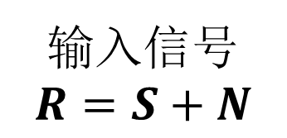
标签
$$S$$
$$P$$
$$f$$
$$g$$
$$Loss(S,S′)$$
输入信号
$$R=S+N$$
输出信号
$$S′$$

Slide 18


Input Signal:
2*N*1
Output Signal:
2*N*1
Conv
1*3*256
MaxPooling
1*2*80
UpSampling
1*2
Conv
1*3*1
Conv
1*3*64
UpSampling
1*2
Conv
1*3*64
MaxPooling
1*2
Conv
1*3*64
$$f$$
$$g$$

Slide 19
层归一化
+
前馈网络
Transformer block
层归一化
+
多头注意力
Notes:
Transformer Blocks

Slide 20
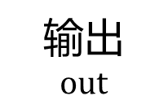



图1 注意力机制
Fig. 1 Attention mechanism
$$Q$$
矩阵乘法
矩阵乘法
归一化
SoftMax
$$K$$
输出
$$out$$
$$V$$

Slide 21
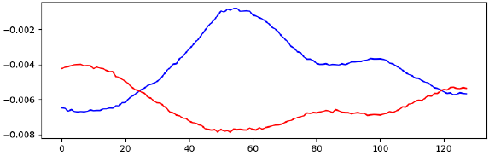
Linear Unflatten
Transformer Blocks
Transformer Blocks
AvgPool
Transformer block
UpScale
Transformer Blocks
Transformer Blocks
Head
MLP
Real / Fake
Noise Input
Generator
Discriminator
Notes:
Transformer Blocks

Slide 22
开始
读取全部数据
随机选择k个数据作为聚类中心
计算剩余数据与聚类中心的距离并分配到最近的中心簇
更新聚类中心均值
聚类中心有无变化
是
否
结束

Slide 23
自编码器
K-均值聚类
聚类结果
输入信号

Slide 24
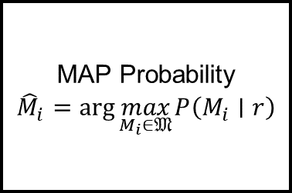
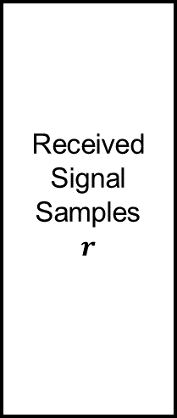
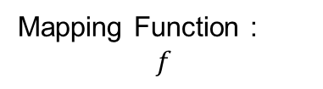


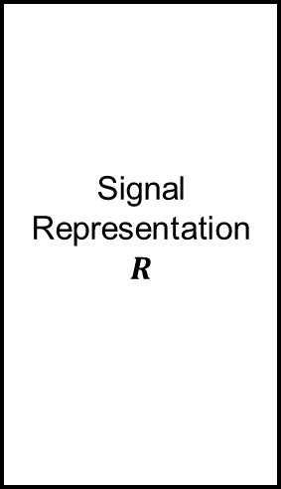
Mapping Function :
$$f$$
Received Signal Samples
$$r$$
Signal Representation
$$R$$
…
Softmax Function
MAP Probability
$${\hat{M}}_{i}=arg⁡\max_{M_{i}∈𝔐} P\left(M_{i}∣r\right)$$
$$e$$
$$y$$
…
…
…
…
The Hidden Layers
Activation Function Layer
The MAP Probabilities

Slide 25
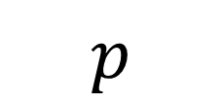




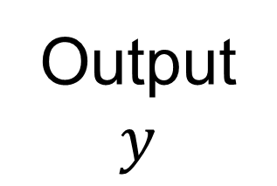
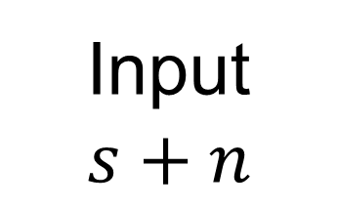
Label
$$s$$
$$p$$
$$f$$
$$g$$
$$L (s,y)$$
Loss Function
Input
$$s+n$$
Output
$$y$$

Slide 26
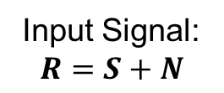
Classification Result:
$$p_{c}$$
Input Signal:
$$R=S+N$$
Denoising Network
Classification network
Classification Loss
Classification Target:
$$y_{c}$$
Reconstruction
Loss
+
Joint Loss
Reconstruction Target:
$$S$$

Slide 27
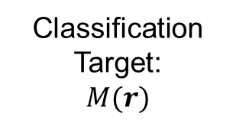
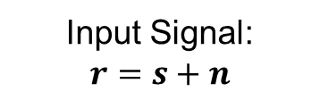
Classification Target:
$$M(r)$$
Input Signal:
$$r=s+n$$
Classification network
Cross-entropy
Loss

Slide 28
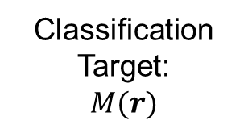
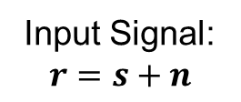
Classification Target:
$$M(r)$$
Input Signal:
$$r=s+n$$
Calculate higher-order statistics
Classification network
Cross-entropy
Loss

Slide 29
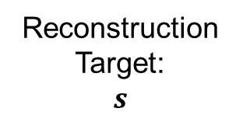
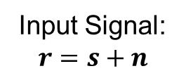
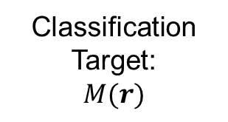
Reconstruction Target:
$$s$$
Classification Target:
$$M(r)$$
Input Signal:
$$r=s+n$$
Denoising Network
Reconstruction
Loss
Classification network
Cross-entropy
Loss

Slide 30


Input Signal:
2*N*1
Output Signal:
2*N*1
Conv
1*3*256
MaxPooling
1*2*80
UpSampling
1*2
Conv
1*3*1
Conv
1*3*64
MaxPooling
1*2
UpSampling
1*2
Conv
1*3*64
Conv
1*3*64
$$f$$
$$g$$

Slide 31
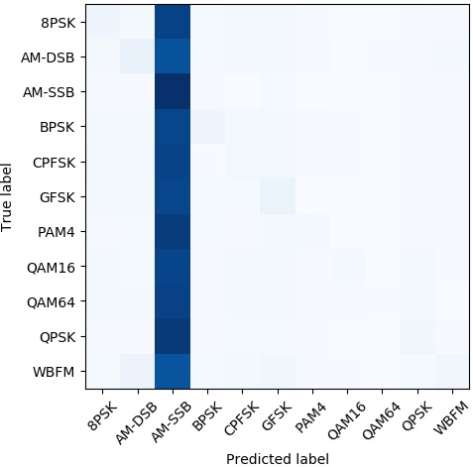

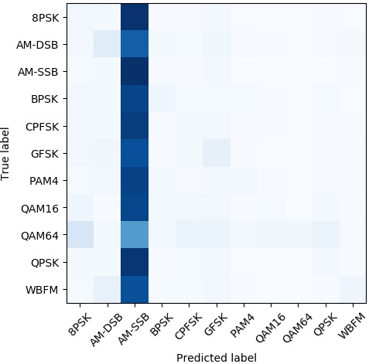
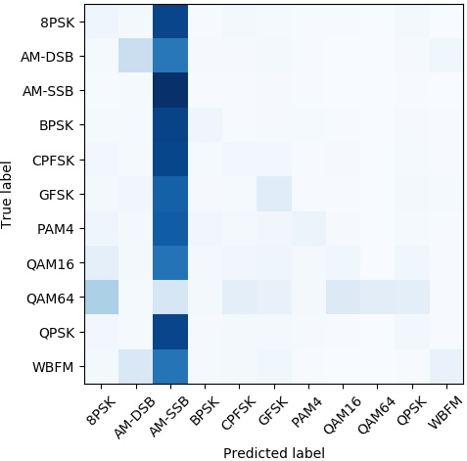
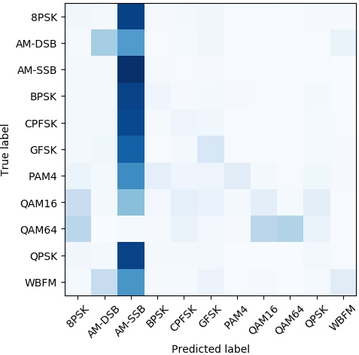
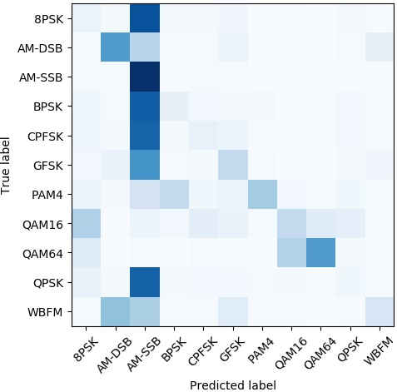
AMC
-20dB -18dB -16dB -14dB -12dB -10dB

Slide 32
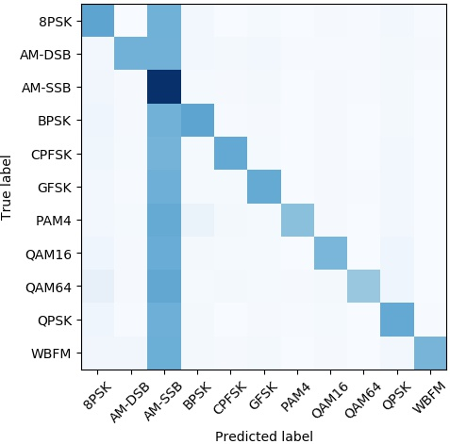
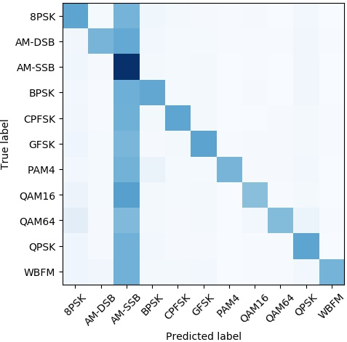
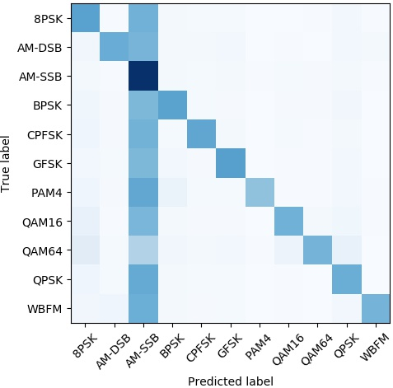
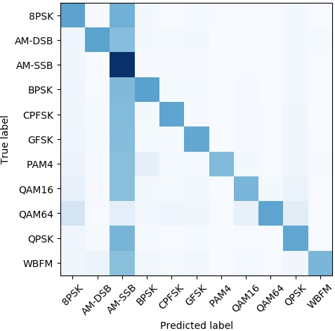
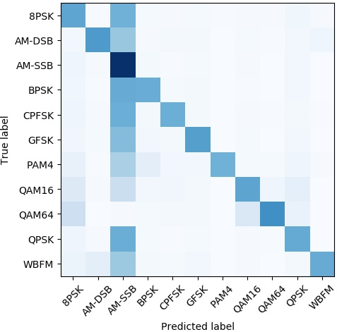
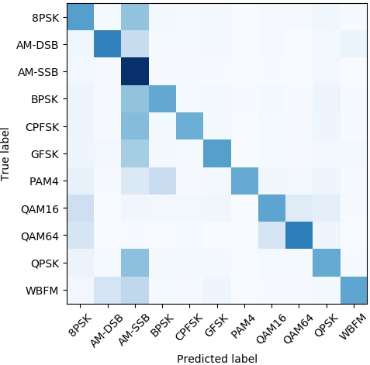
AMC-Dncnn
-20dB -18dB -16dB -14dB -12dB -10dB

Slide 33
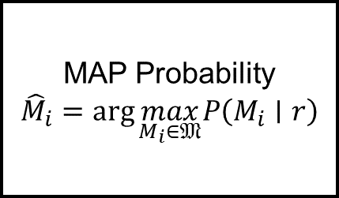

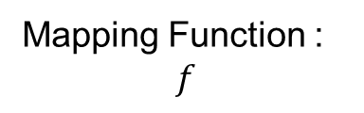

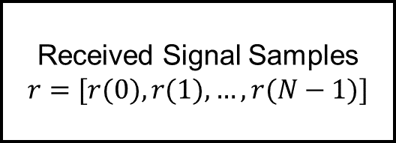
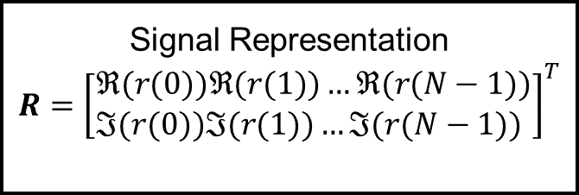
Received Signal Samples
$$r=[r(0),r(1),…,r(N−1)]$$
Mapping Function :
$$f$$
…
Softmax Function
Signal Representation
$$R={\left[\begin{aligned}&ℜ(r(0))ℜ(r(1))…ℜ(r(N−1)) \\ &ℑ(r(0))ℑ(r(1))…ℑ(r(N−1))\end{aligned}\right]}^{T}$$
MAP Probability
$${\hat{M}}_{i}=arg⁡\max_{M_{i}∈𝔐} P\left(M_{i}∣r\right)$$
$$e$$
$$y$$
…
…
…
…
The Hidden Layers
Activation Function Layer
The MAP Probabilities

Slide 34







$$h$$
$$Loss(x,y)$$
$$g$$
$$f$$
$$x+n$$
$$x$$
$$y$$

Slide 35

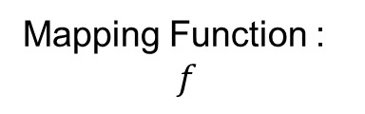


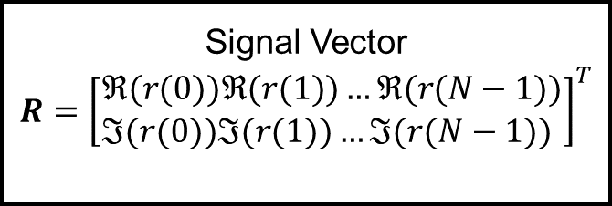
Mapping Function :
$$f$$
…
Softmax Function
Signal Vector
$$R={\left[\begin{aligned}&ℜ(r(0))ℜ(r(1))…ℜ(r(N−1)) \\ &ℑ(r(0))ℑ(r(1))…ℑ(r(N−1))\end{aligned}\right]}^{T}$$
MAP Probability
$${\hat{M}}_{i}=arg⁡\max_{M_{i}∈𝔐} P\left(M_{i}∣r\right)$$
$$e$$
$$y$$
…
…
…
…
The Hidden Layers
Activation Function Layer
The MAP Probabilities

Slide 36
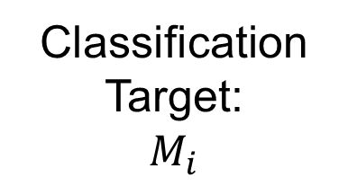
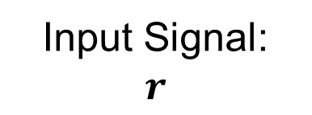
Feature extractor
（HOS、ANN、CNN、RNN…）
Classifier
(SVM、KNN、Softmax…)
Classification Target:
$$M_{i}$$
Input Signal:
$$r$$

Slide 37




Input Signal:
$$r=s+n$$
Denoising Network
Classification network
Classification Result:
$$M՛(r)$$
Reconstruction
Loss
Classification Target:
$$M(r)$$
Cross-entropy
Loss
Reconstruction Target:
$$s$$
+
Joint Loss

Slide 38

Input Signal:
$$r=s+n$$
Denoising Network
Classification network
Reconstruction
Loss
Classification Target:
$$M(r)$$
Cross-entropy
Loss
Reconstruction Target:
$$s$$
+
Joint Loss

Slide 39







Label
$$s$$
$$p$$
$$f$$
$$g$$
$$Loss(s,s′)$$
Input
$$r=s+n$$
Output
$$s′$$

