Slide 1
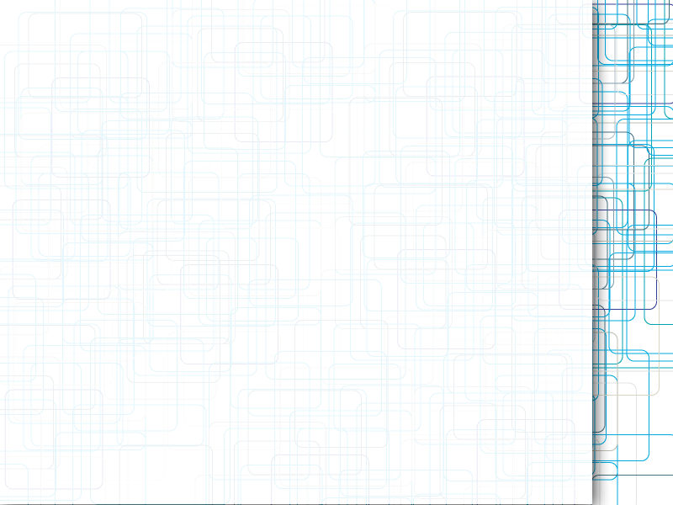
Reinforcement Learning Techniques for Ball Controlling
By Quarta Jonny
Supervisors :
Gewaltig Marc-Oliver
Denizdurduran Berat

Slide 2
Content
Project Overview
Reinforcement Learning Concepts
Neural Networks
SpiNNaker Architecture
Parallelization Strategies
Results
Conclusion

Slide 3
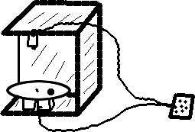
Project Overview
Reinforcement Learning
Plate with camera/motors
Purpose : balance the ball
Control system : SpiNNaker
Project phases :
  1st phase : sequential solution
  2nd phase : parallelization

Slide 4

R.L. Concepts
Actor/Critic approach
Critic System
  Reward function
  Error
  Updating

Slide 5

R.L. Concepts (2)
Actor System
  Output function
  Exploratory term
  Updating

Slide 6
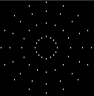


Neural Networks
Plate discretization
Mean Field Populations
Projection along each axis :
  Critic Network : x, y positions
  Actor Network : θ, ψ angles

Slide 7
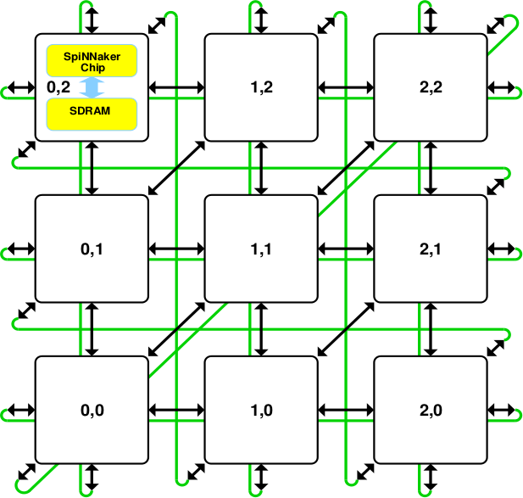
SpiNNaker Architecture
4 chips, 16 cores per chip
Multicast messages
Software API

Slide 8
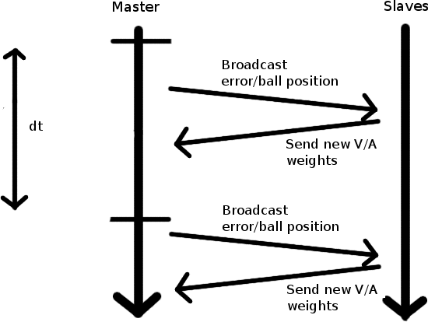
Parallelization Strategies
1 master + 59 slave nodes

Slide 9
Results
Mitigate results
  R.L. techniques not very performant
  Maybe need to add more specialized code
Parallelization not perfect
  Bad SpiNNaker performance
  Needs some additional optimizations

Slide 10
Conclusion
Enriching project
SpiNNaker difficult to program
Improvements needed
  Better R.L. techniques
  Additional parallelization optimizations

Slide 11

Questions

