Slide 1

Quiterie Lafourcade TD 10
Pierre-Joseph Delafosse TD 9
Côme L’Ollivier TD 10
Promo 2020
ECE Bond

Slide 2
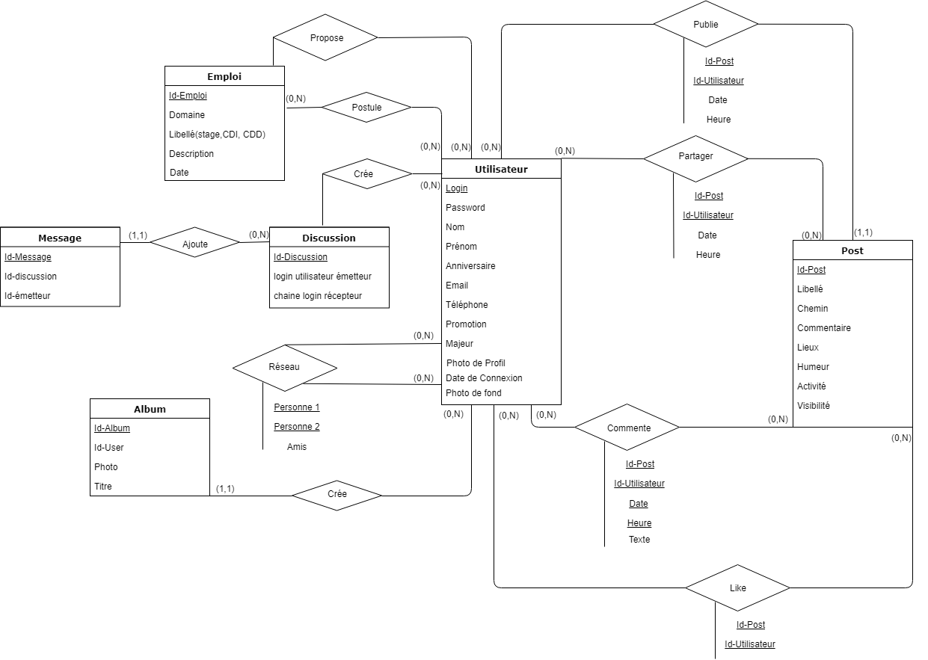
Schémas entités relations

Slide 3
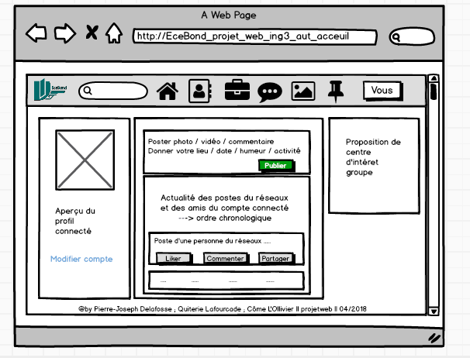
Maquette

Slide 5
Sources
Openclassroom
W3School
PHP API php.net
Stackoverflow.com

