Slide 1
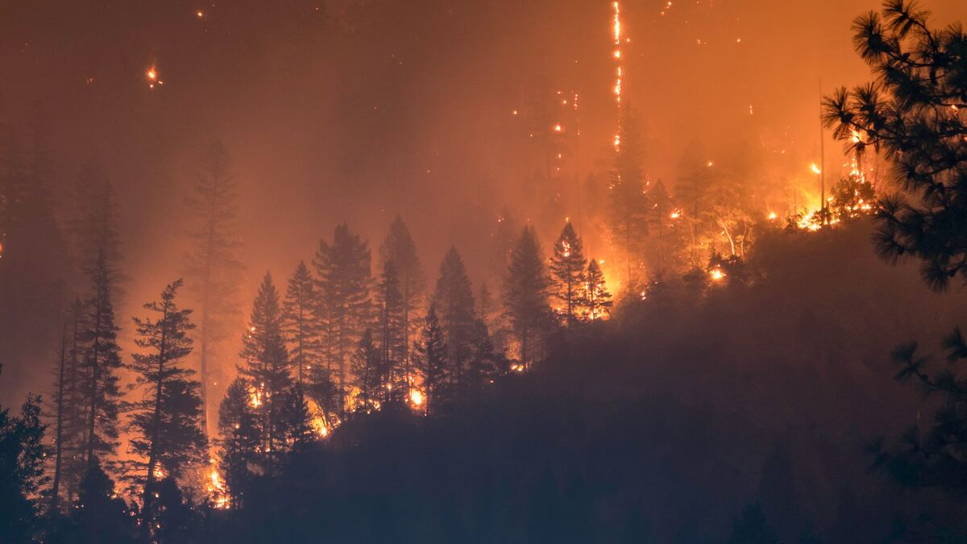
Forest Fires Area Prediction
Qinglin Mao
2034891
Qinglin.Mao20@student.xjtlu.edu.cn
Notes:
In this video, I am going to introduce the forest fires and the methods to prediction effect area by fires.

Slide 2
Research Background
The Forest fires may destroy the local natural environment and endanger the human being. While these happening of fires were not due to the nature such as lightning, rotting of leaves, etc., but human activities.
In this study, A regression model of destroyed area by forest fires was built based on the data including weather conditions, indexes of the altering system and the frequency of human activities.
Some important features was pointed out that which have high relationship with the happening of forest-fires.
Notes:
Forest fires endanger the human being and destroy environment. However, not all forest fires was not due to human activities, but nature.
In this study, a regression model was built to predict the destroyed area and some important features was pointed out to help predict fires.

Slide 3
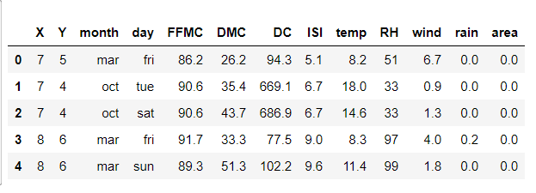
Introduction of Dataset
Forest-fires dataset was provided by UCI Machine Learning resporities in 2008-02-29.
https://archive.ics.uci.edu/ml/datasets/Forest+Fires
There were 12 input-attributes and 1 output-attributes,including:
Weather conditions
Location coordinates
Timestemp
Indexes from Fire Weather Index system
Destroyed area (output)
517 samples totally were split in the training-set (70%) and test sets (30%)
Notes:
The data was provided by UCI.
13 attributes including 12 input-attribute and one output attribute And 517 sample were provided.

Slide 4
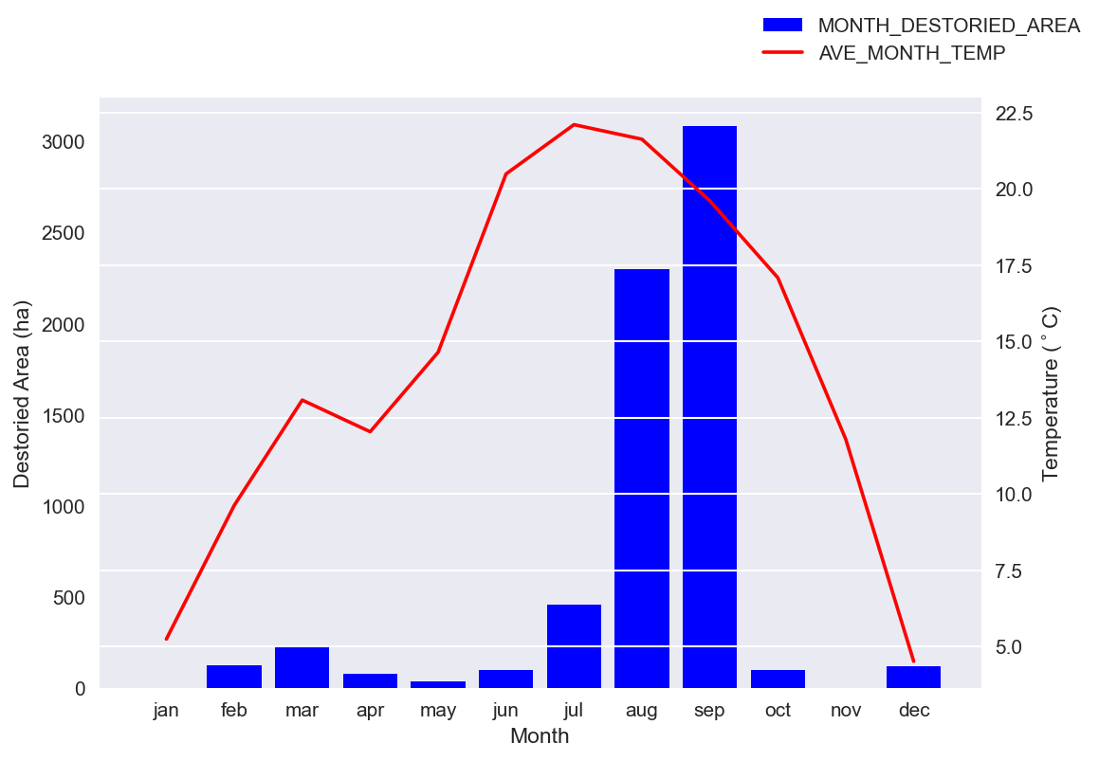
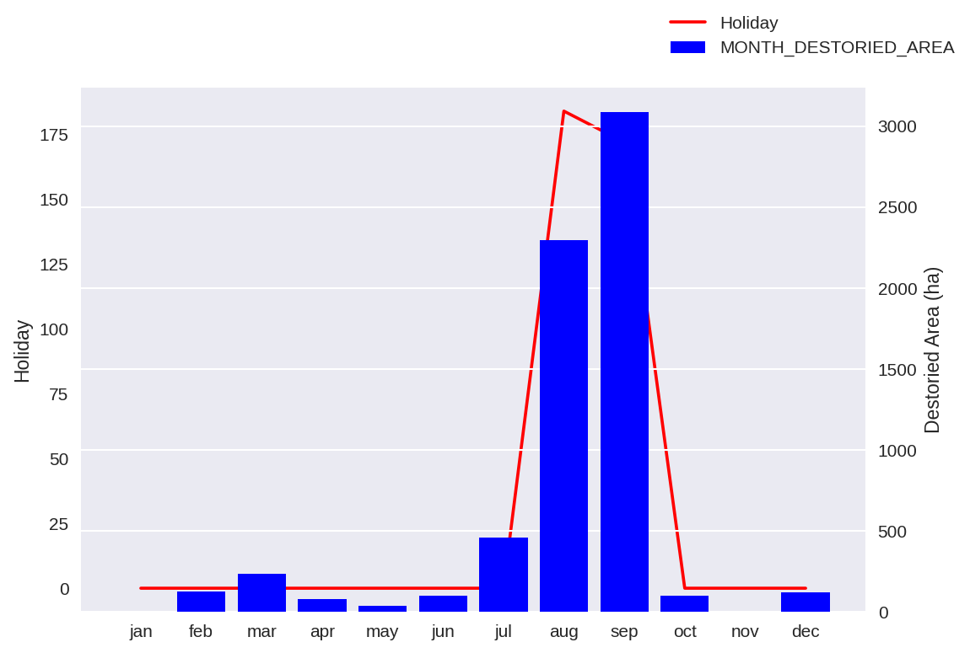
Data Describtion and Analysis
Some interesting patterns were shown by data visualization
The destroyed area had high relationship with temperature and holiday
Notes:
According to the dataset.
Some interesting pattern was shown in these figures.
Firstly, the number of destroyed area has high correlation with temperature.
Then, The fires were easily happened during the summer holiday of August and September.

Slide 5
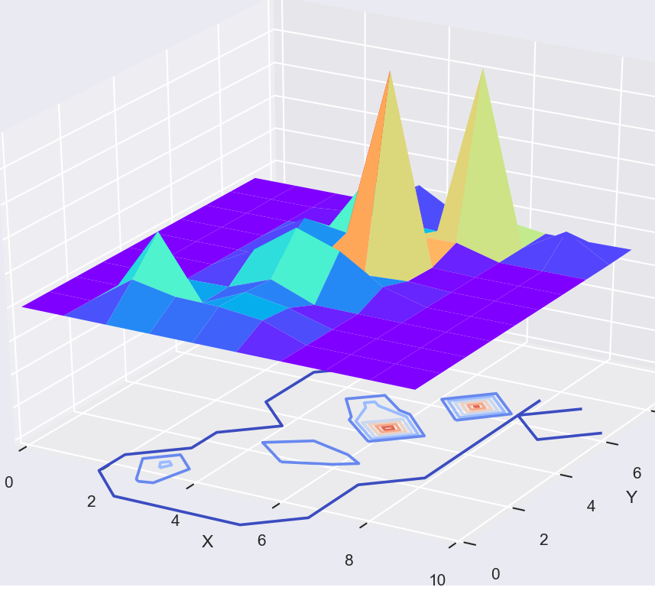
Data Describtion and Analysis
Half of places do not be fired during the recoding period.
Two Peaks shown the place that has affected seriously by the forest fires.
Notes:
Third, half of place do not be fired, but two places are affected seriously.

Slide 6
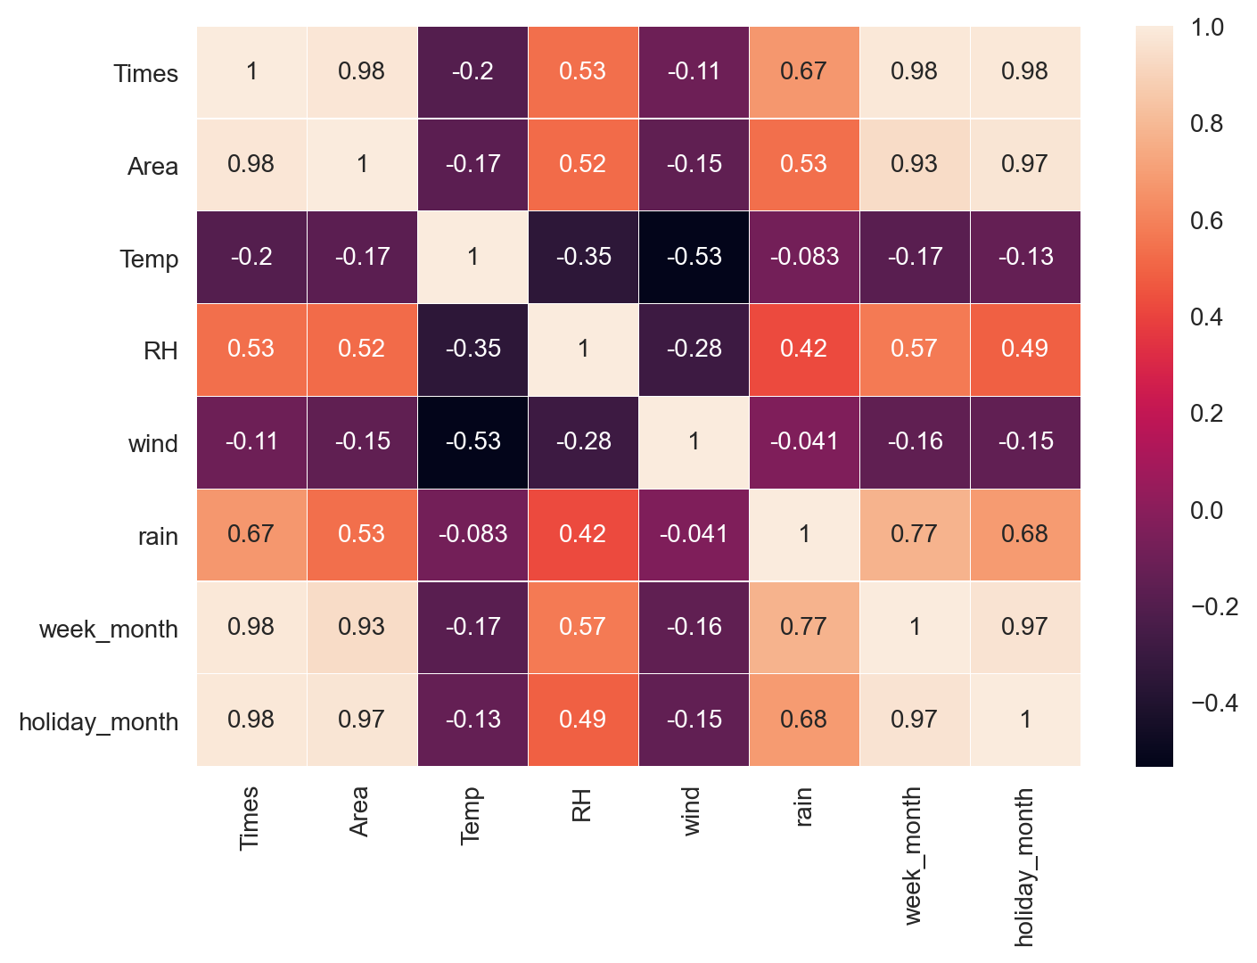
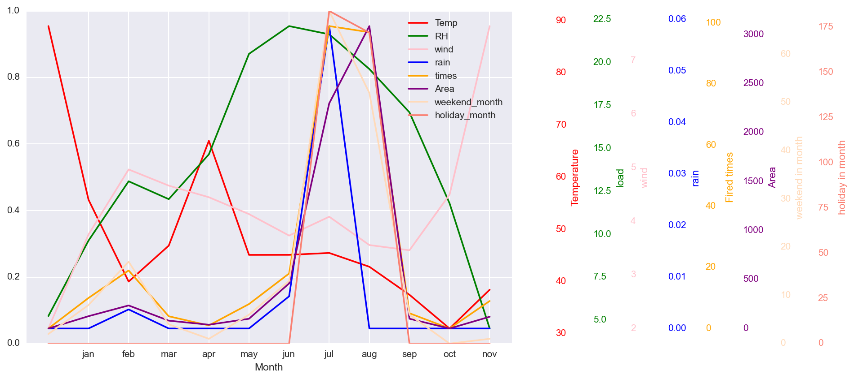
Data Describtion and Analysis
Similar tends are shown between attributes
Notes:
Some attributes had a similar trend, showing in the right figures.

Slide 7
Modeling Processing
Original Data
Mapping to Day and Month
Manual Features of Weekend and Holiday
Fitting with GridSearch
Over Sampleing
Creation,
Dedimition,
Selection
Wight Analysis
Notes:
This flow chart illustrate each step of modeling.

Slide 8
Data Processing of techniques
Data Preprocessing
String to Int
(e.g., Month: Jen to 1, Feb to 2, Day: Mon to 1, Two to 2)
Manual Features
Summer Holiday & Weekend
Feature Engineering
Creation
Polynomial Feature
One-hot Encoding
Reduction
PCA
Selection
Recursive Feature Elimination(RFE)
Mapping
log10()
Kmeans to one attribute
Notes:
这里列除所使用的技术，不讲解（这些技术较为通俗，在pre中不于讲解）。后面会对选择几个有意思的技术进行解释，Kmeans，oversamapleing
There are the feature engineering methods used in this experiment. And I will give a detail explanation of the most important method, Data discretization, later

Slide 9
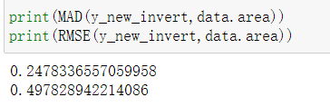
Feature Engineering
Kmeans to explained variable Area (Data discretization)
True Area
Kmeans (160 clusters）
Label (true)
Classification Model, SVC
Label to Coordinates of clusters
Label (predicted)
Predicted Area
Error between real value and back substitution value
Notes:
Data discretization is the important methods in this experiment, which increased the score of the model, balanced the distribution of explained variable area, and make the model predicting more practical.

Slide 10
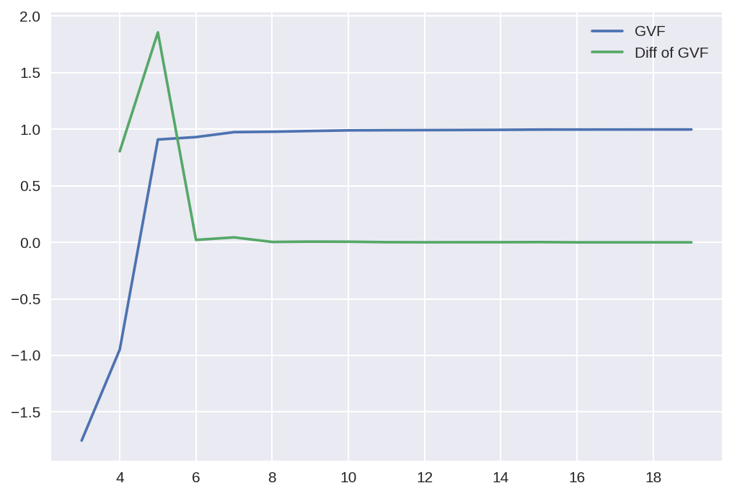
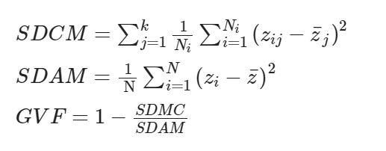
Feature Engineering
Data discretization, K-menas to explained variable Area
High aggregation, Low coupling
Notes:
This figure shown the index called good ness of fitting, the main ideal is high aggregation and low coupling. The data has low deviation in there our cluster.

Slide 11
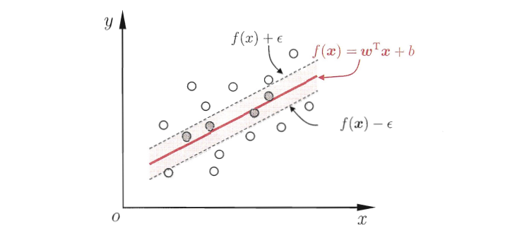
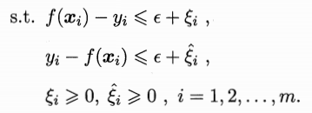


SVR Model
Support Vector Regression (SVR) with linear kernel
SVR model is similar with SVR model aiming to find a good hyperplane, however, and a pair of decision boundaries with distance of ξ.
Notes:
https://blog.csdn.net/zb123455445/article/details/78354489?utm_medium=distribute.pc_relevant_t0.none-task-blog-BlogCommendFromBaidu-1.control&depth_1-utm_source=distribute.pc_relevant_t0.none-task-blog-BlogCommendFromBaidu-1.control
SVR with linear kernel were used. SVC model was also used with some tracks to archive a regression task.

Slide 12
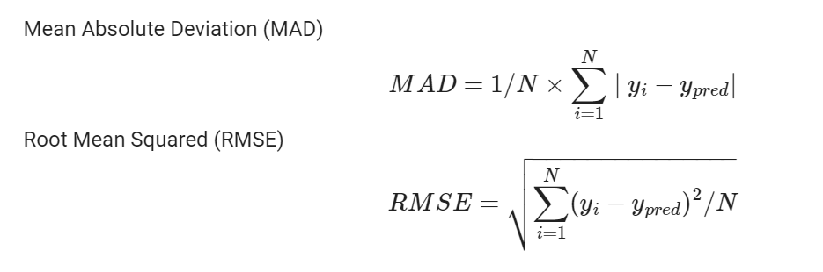
Results
Evaluation criterias:
Notes:
MAD and RMSE were used to evaluate.
The mad index was express the area predicted wrong.

Slide 13
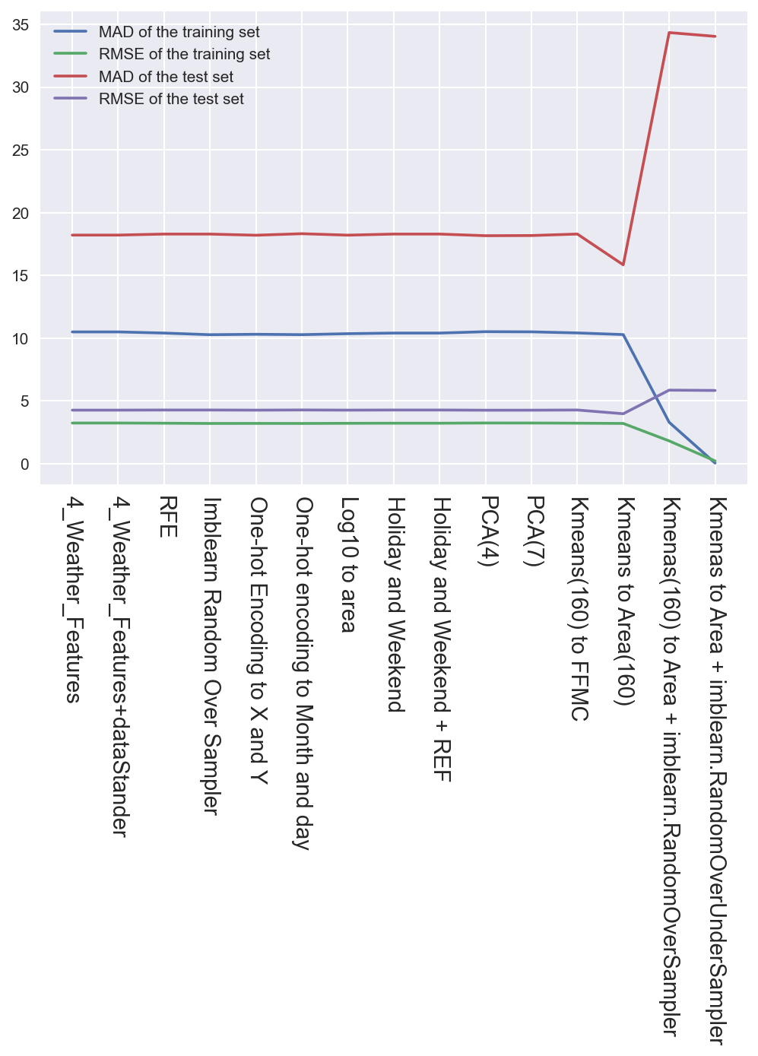
Results
Over Fitting
Baseline
Best Model
Notes:
We found that most feature engineering methods do not have contribution to prediction comparing the baseline model.
While the baseline mode was the best model in the relative paper.
However, The method that discretizating of area has a significant increase.

Slide 14
Results
Feature Engineering Strategies | MAD of Train | RMSE of Train | MAD of Test | RMSE of Test
4_Weather_Features (Baseline) | 10.49824601 | 3.240099691 | 18.21018915 | 4.267339821
4_Weather_Features+dataStander | 10.49824601 | 3.240099691 | 18.21018915 | 4.267339821
RFE | 10.40598929 | 3.225831566 | 18.29125658 | 4.276827864
Imblearn Random Over Sampler | 10.27498247 | 3.205461351 | 18.28935613 | 4.276605679
One-hot Encoding to X and Y | 10.30902744 | 3.210767422 | 18.19876345 | 4.266000873
One-hot encoding to Month and day | 10.27849725 | 3.206009553 | 18.32018414 | 4.280208422
Log10 to area | 10.35668683 | 3.218180671 | 18.20419301 | 4.266637201
Holiday and Weekend | 10.40598929 | 3.225831566 | 18.29125658 | 4.276827864
Holiday and Weekend + REF | 10.40598929 | 3.225831566 | 18.29125658 | 4.276827864
PCA(4) | 10.51597359 | 3.242834191 | 18.16102064 | 4.261574902
PCA(7) | 10.50340813 | 3.240896193 | 18.17429483 | 4.263132044
Kmeans(160) to FFMC | 10.41649583 | 3.227459655 | 18.29265227 | 4.276991030
Kmeans to Area(160) (Best model) | 10.28531856 | 3.207073208 | 15.83974359 | 3.979917536
Kmenas(160) to Area + imblearn.RandomOverSampler | 3.297507022 | 1.815903913 | 34.33974359 | 5.860012252
Kmenas to Area + imblearn.RandomOverUnderSampler | 0.050000000 | 0.223606798 | 34.03846154 | 5.834249012
Scores with various feature engineering strategies
Notes:
This table shown the detail results of models. And we can see The best model had a batter performance, especially on test set.
It is a great situation that the model was strongness.

Slide 15
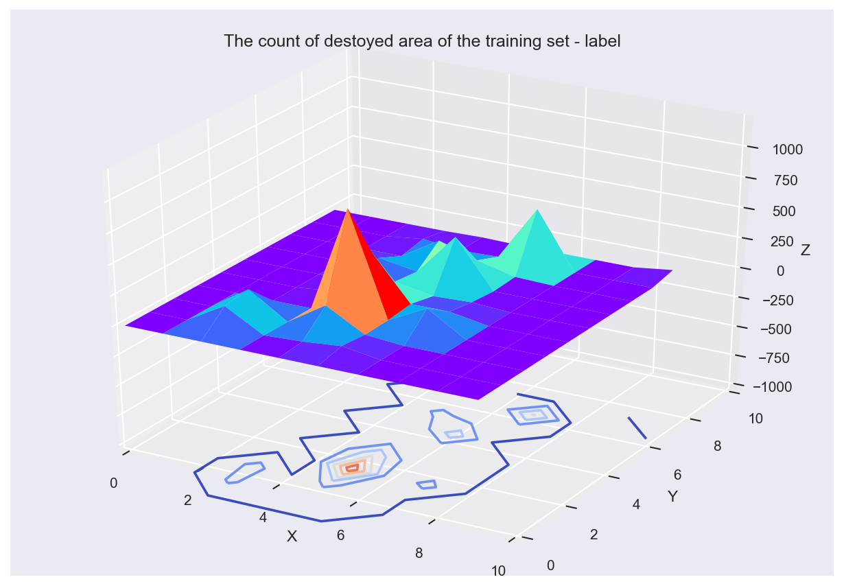

Discussion
Visualization of predicted area and true area (Kmeans)
Ture label and predict results on the training set
Notes:
In these figures, shown the results of prediction. And we can easily compare the prediction result with the true label.
These is on the training set; the peak was resorted well.

Slide 16
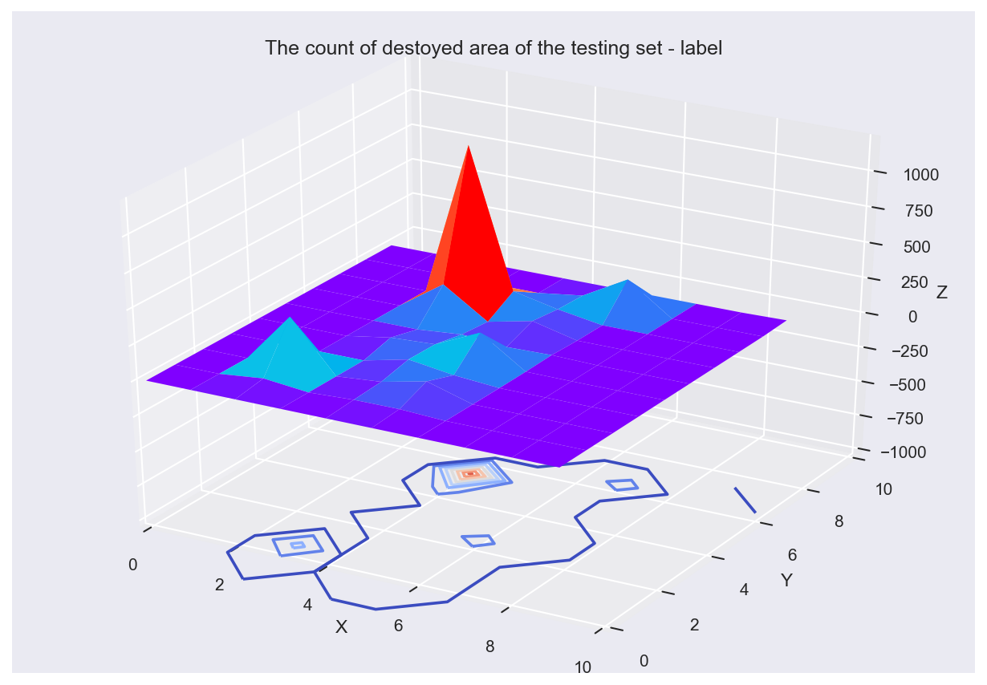
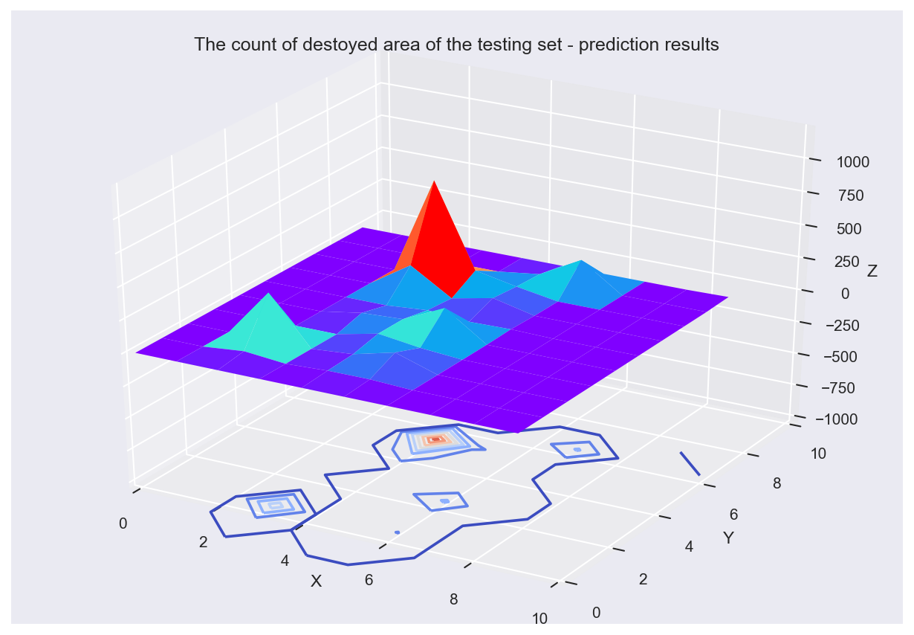
Discussion
Ture label and predict results on the testing set
Notes:
On the testing set, the performance was not good like on the training set, but the pattern was also similar.
Why I need comparing these, because an interesting thing was happened.

Slide 17
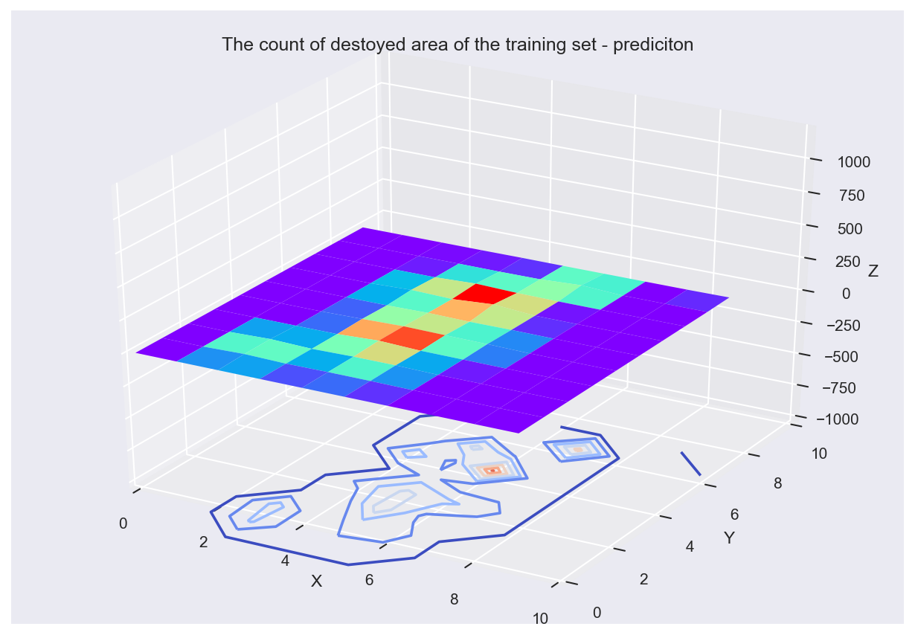
Discussion
Ture label
Baseline(MAD:10.50,RMSE:3.24)
Best Model(MAD:10.29, RMSE: 3.20)
Feature Engineering Strategies | MAD of Train | RMSE of Train | MAD of Test | RMSE of Test
4_Weather_Features (Baseline) | 10.49824601 | 3.240099691 | 18.21018915 | 4.267339821
Kmeans to Area(160) (Best model) | 10.28531856 | 3.207073208 | 15.83974359 | 3.979917536
Why are the predictions so different, even though the MAD and RMSE are almost the same.
Notes:
In these three figure, we can see that the second figure has a different totally with the true label, this is the baseline model’s prediction.
And the third figure was provided by the best model.
The interesting thing is that the models having similar performance in MAD and RMSE has different prediction performance.

Slide 18
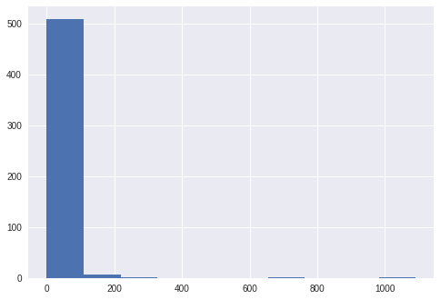
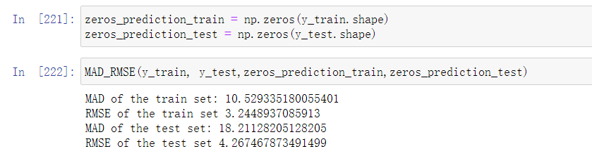
Discussion
Because the area of the predicted object in the data is 0 or very small in most cases, the number of fires is not much, and the number of extra-large fires is less.
Therefore, the model blindly predicts that there is no fire, and it can also have good performance
When all prediction are 0, the MAD and RMSE was still small and similar with Baseline’s
The distribution of destroyed area
Notes:
So, I tested the a very specific situation that the prediction is all zeros, and the MAD and RMSE was so close to the baseline model, by this way, the model can do a blindly predicts of zero. Because it also has a good performance in MAD and RMSE as well as the best and useful model.
And this situation may be resulted by the problem of unbalanced distribution of explained attribute, in most cast, the area was equal zero, and using kmeans to area mapped itself in other space and solved the this problem.

Slide 19
Conclusions
The model should be more practical significant, showing the description of the real word instead of having a good performance in numbers.
The data discretization can effectively improve the robustness of the model.
Notes:
这里可以试着放一下Kmeans的预测结果，因为也只有这个模型是能预测除较多的火灾的发生，通过调整聚类的个数。
我们在这里可以在打印一条曲线，在不同的聚类个数下，正确预测发生的次数。
There are two main conclusions. Firstly, the model can have a poor performance to real word although it has a high score in number.
Next, the distribution of explained attribute can has a serious impact of prediction and the data discretization is a good approach to revise it.

