Slide 1



Building figures with Inkscape
CODE TO MANUSCRIPT BOOTCAMP · DAY 4
Instructor: Ariel Madrigal
Facilitator: Senthilkumar Kailasam
October 29, 2026

Slide 2

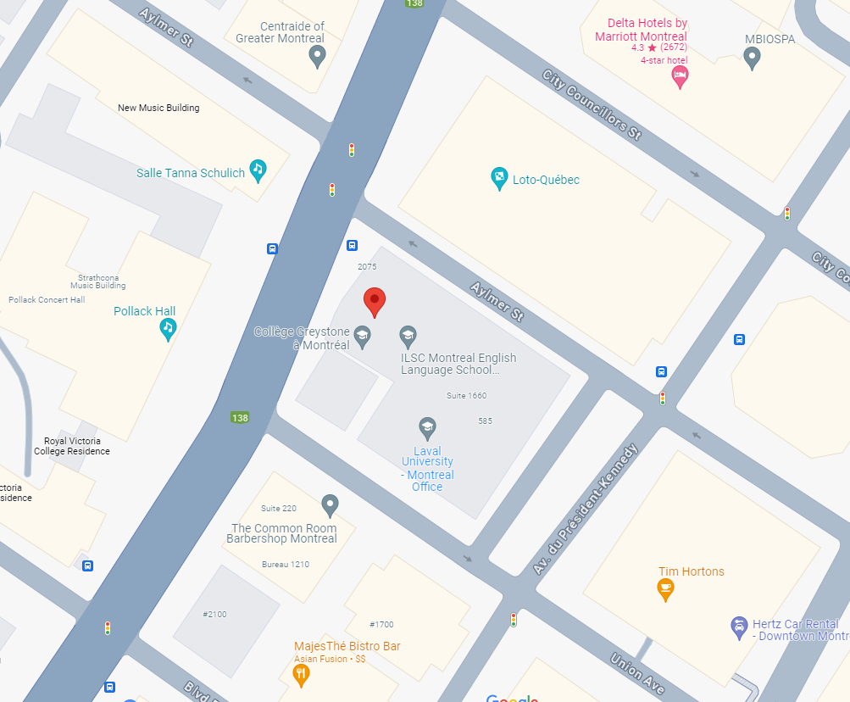
QLS-MiCM mission statement: deliver quality workshops designed to help biomedical researchers develop the skills they need to succeed.
Location: 550 Sherbrooke Street, Montreal, Quebec
https://www.mcgill.ca/micm

Slide 3
Outline:
1
Introduction to scientific figure design and Inkscape
2
Importing and editing plots
3
Building a multi-panel figure
4
Exporting and closing remarks

Slide 4
This is an interactive workshop :)
Feel free to interrupt or raise your hand to ask questions

Slide 5
The objective for today
To use Inkscape to transform a collection of independent plots into a polished, publication-ready figure
Notes:
how to use Inkscape to transform a collection of independent plots into a polished, publication-ready figure

Slide 6
Part 1: Introduction to scientific figure design and Inkscape

Slide 7
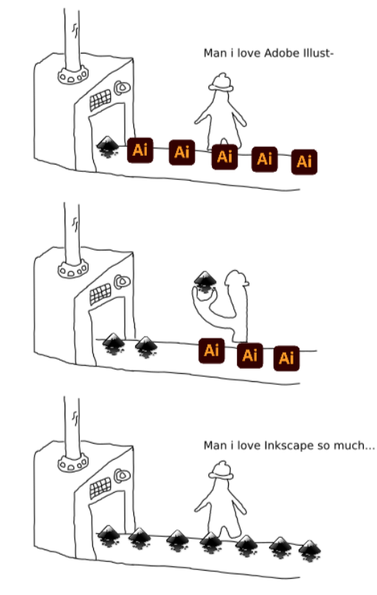
Why use Inkscape for scientific figures?
It’s free!
Open source
Cross-platform (Mac, Windows, GNU/Linux)
Supports vector graphics
Enables creation of high-resolution figures
Notes:
What you create with it is entirely yours, and you are free to distribute, share it, sell it, however you’d like — or keep it to yourself!
All files either saved or exported from Inkscape in any format (SVG, PNG, PDF, etc.) are owned by the creators of the work (that's you!) and/or the original authors in case you use derivative works.
You are responsible for publishing your work under a license of your choosing and for tracking your use of derivative works in the software. You can add and modify your license information for each file in the 'File/Document properties' dialog within Inkscape.

Slide 8

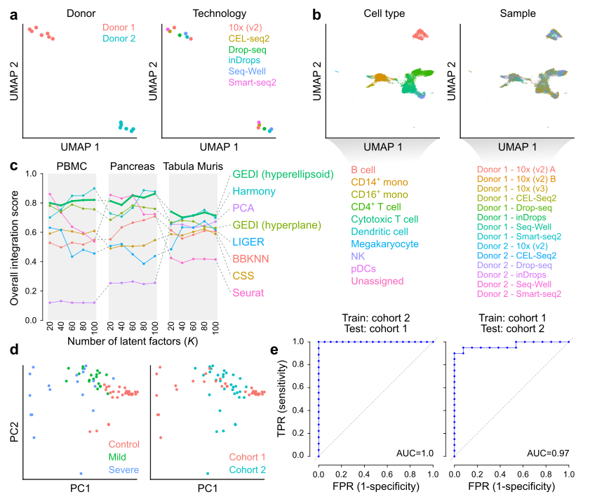


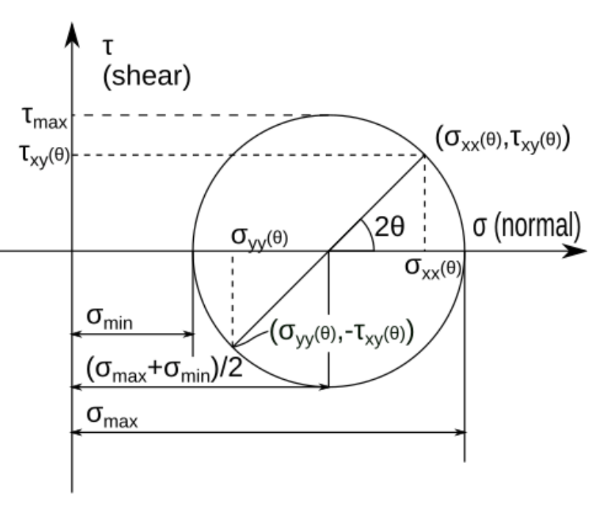
What can you do with Inkscape?
Scientific figures
But also, much more!
Notes:
Artwork and Comics, Clip art, Icons and Logos

Slide 9
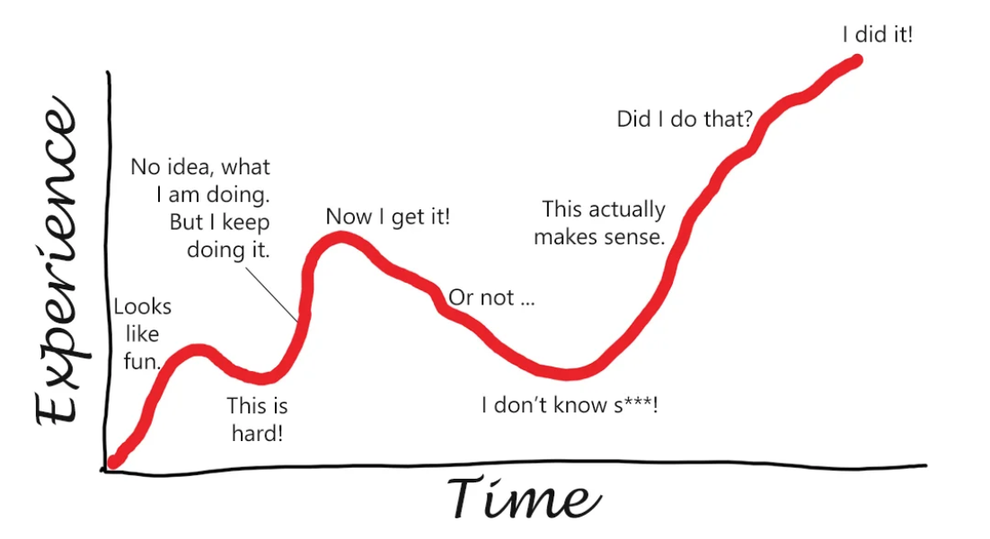
Inkscape can be hard…
But it’s worth it

Slide 10

Vector vs raster graphics
Raster graphics
Vector graphics
Made of pixels arranged in a grid
Resolution-dependent
Become blurry or pixelated when enlarged
Best for photographs and complex images
Larger image dimensions are needed for high-quality printing
Made of mathematical shapes and paths
Resolution-independent
Can be scaled to any size without losing quality
Individual elements remain editable
Ideal for plots, diagrams, illustrations, and figure assembly

Slide 11
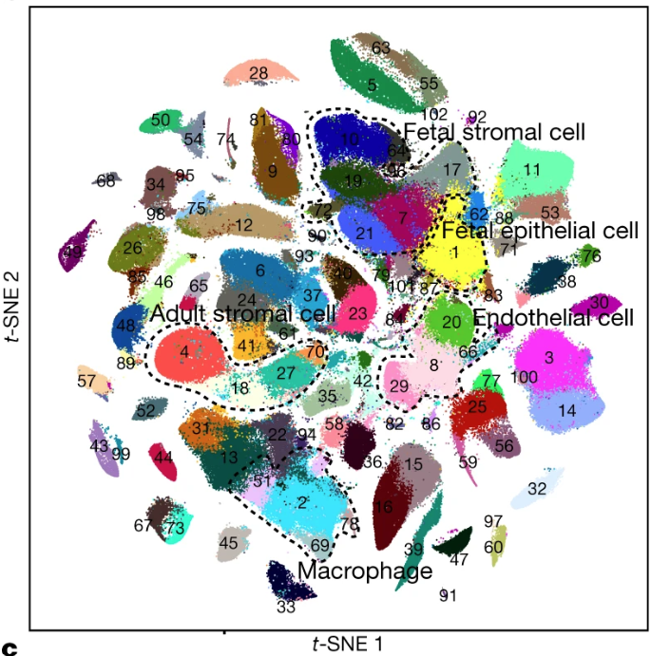
When to use vector or raster images?
Raster graphics
Vector graphics
Complex technical images:
    Microscopy images
      Histology slides
Plots with hundreds of thousands of points
When possible, use vector-based graphics:
Most of the computer-generated plots
Diagrams and schematics
Text, labels, arrows and annotations
Either:
Use rasterization options while exporting your figures (e.g. ggrastr in R)
Export rasterized versions of the plot without labels

Slide 12
Common file formats
Raster graphics
Vector graphics
PNG (.png)
TIFF (.tif, .tiff)
JPEG (.jpg, .jpeg)
SVG (.svg)
PDF (.pdf)
EPS (.eps)
Note:
If exporting as .svg in R, use the svglite package:
svglite::svglite( file, width = width, height = height, fix_text_size = FALSE)

Slide 13
Best practices for publication-quality figures
Use vector formats whenever possible to preserve quality and editability
Ensure text, labels, and legends remain readable
Align panels and use consistent spacing to create a balanced layout
Use color thoughtfully and consider accessibility (e.g., colorblind-friendly palettes)
Export figures using journal-appropriate formats and dimensions

Slide 14
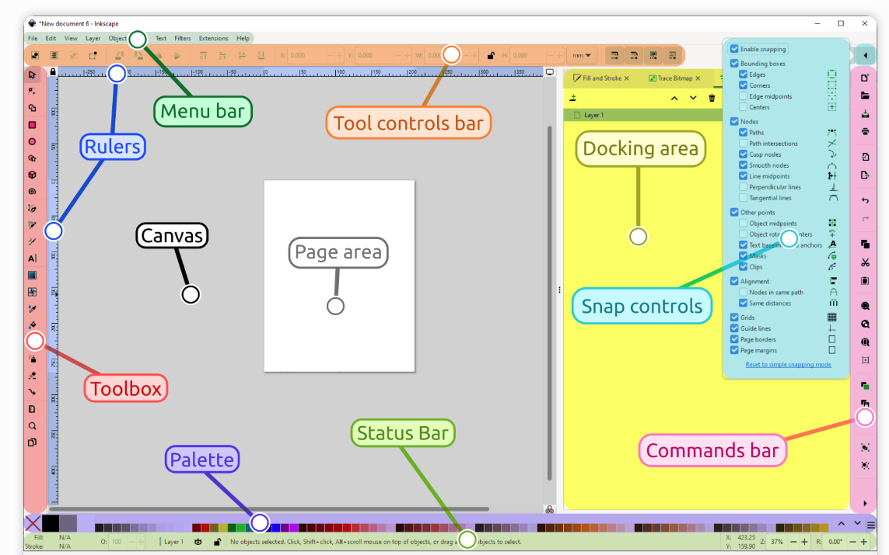
Overview of the Inkscape interface

Slide 15
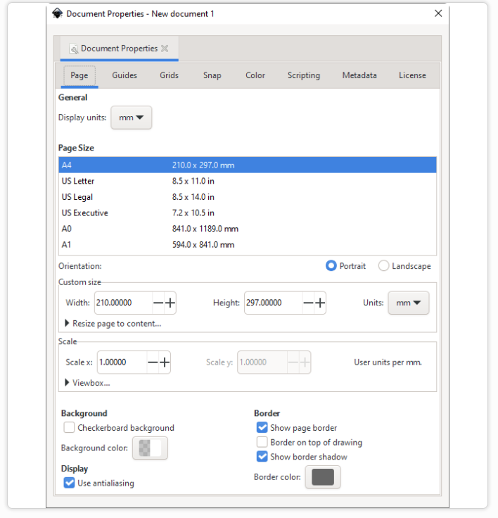
Manage the document properties
Let’s go to File -> Document Properties
1mm == 3.78 px

Slide 16
Part 2: Importing and editing plots

Slide 17




Let’s familiarize with some tools
Selector tool
Zoom tool
F3 or Z
Text tool
F8 or T
Inkscape shortcuts
https://inkscape.org/doc/keys.html

Slide 18



Let’s create some basic shapes
Make rectangles
R
Make circles, ellipses and arcs
E
Make polygons, stars
*
Inkscape shortcuts
https://inkscape.org/doc/keys.html

Slide 19
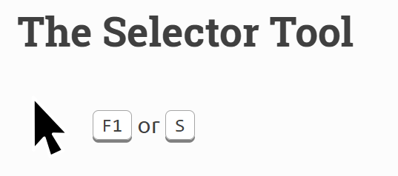
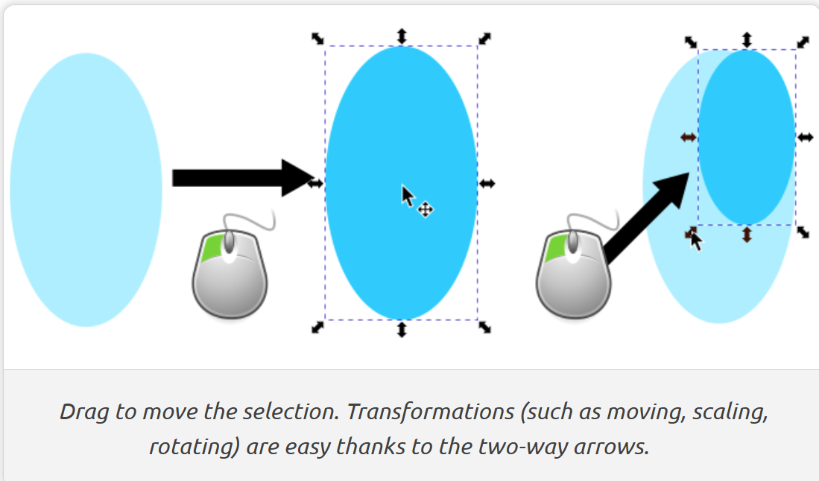
Moving, scaling, skewing and rotating objects

Slide 20
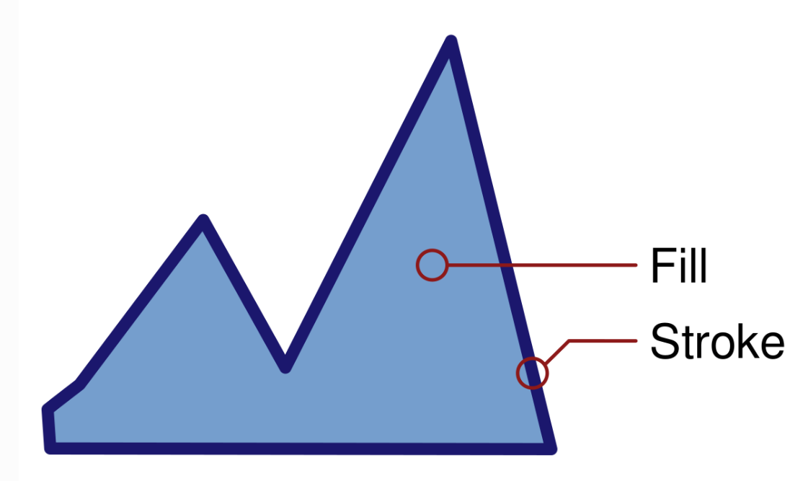
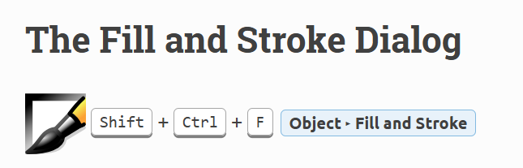
Colors
For a vector object, a separate style can be defined for its outline (or stroke) and its main color (or fill). This can be a plain color (e.g. dark red), a pattern (e.g. stripes or flowers), or a gradient (e.g. a smooth transition from green to blue).

Slide 21
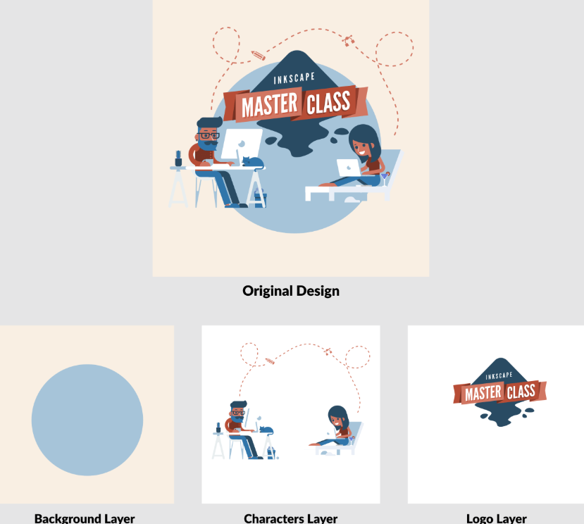
Understanding layers
Layers allow you to organize elements of your figures into sections

Slide 22
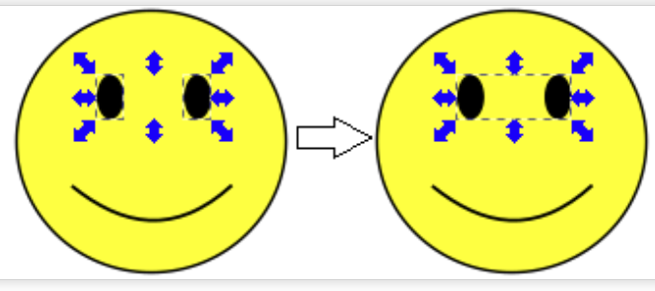
Group objects
Grouping allows you to work with multiple objects as a single object: any changes you make will equally affect all members of the group, and the entire group can be copied, duplicated or cloned as a unit

Slide 23
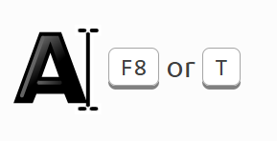
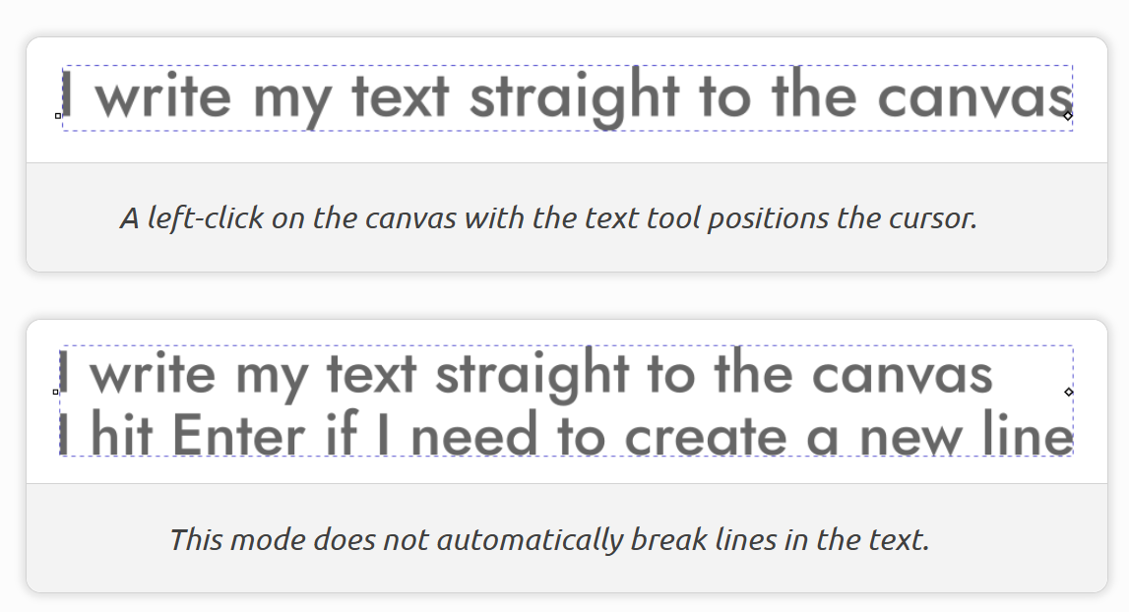
Managing fonts and text elements
Two options of how to create text:

Slide 24
Importing images into Inkscape
Go to Exercises/data:
Import the same figure in different formats:
PCA (.png, .pdf, .svg)
PCA rasterized (.pdf, .svg)

Slide 25
Part 3: Building a multi-panel figure

Slide 26
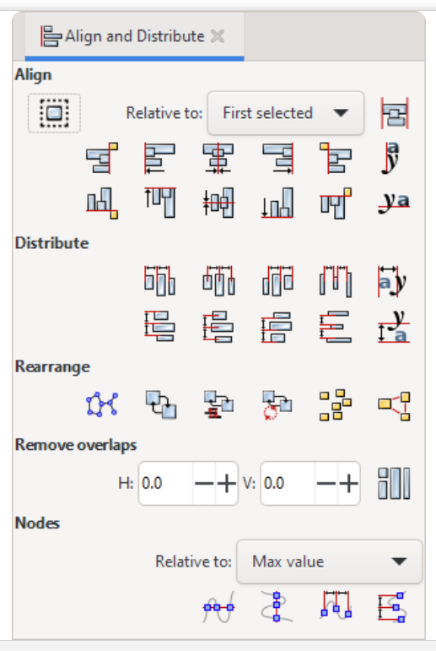
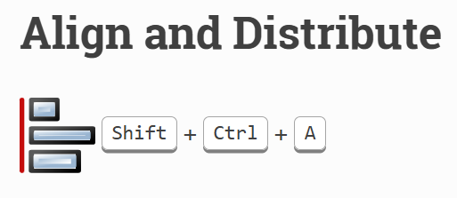
Alignment and distribution tools

Slide 27
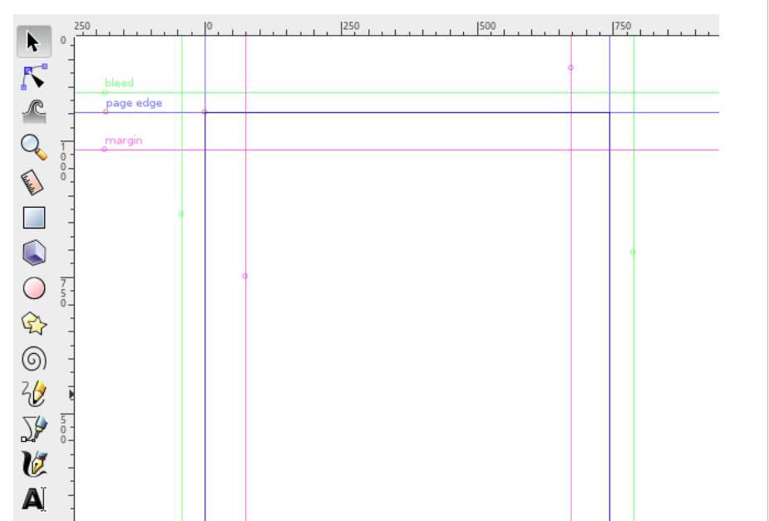
Guides

Slide 28
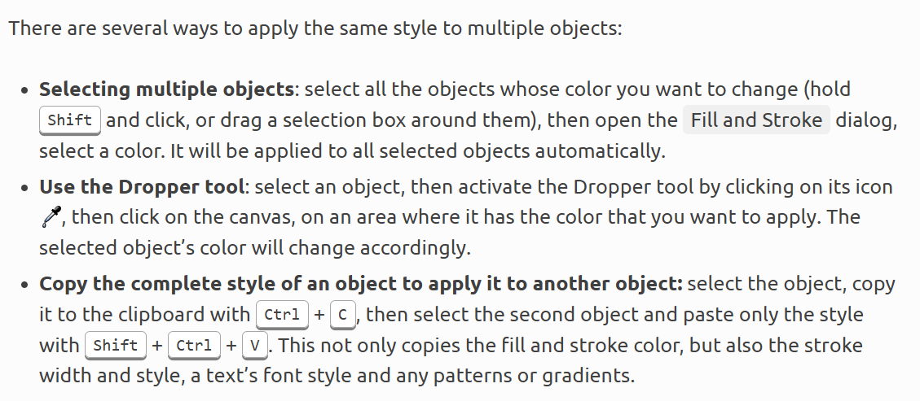
Copying a color

Slide 29
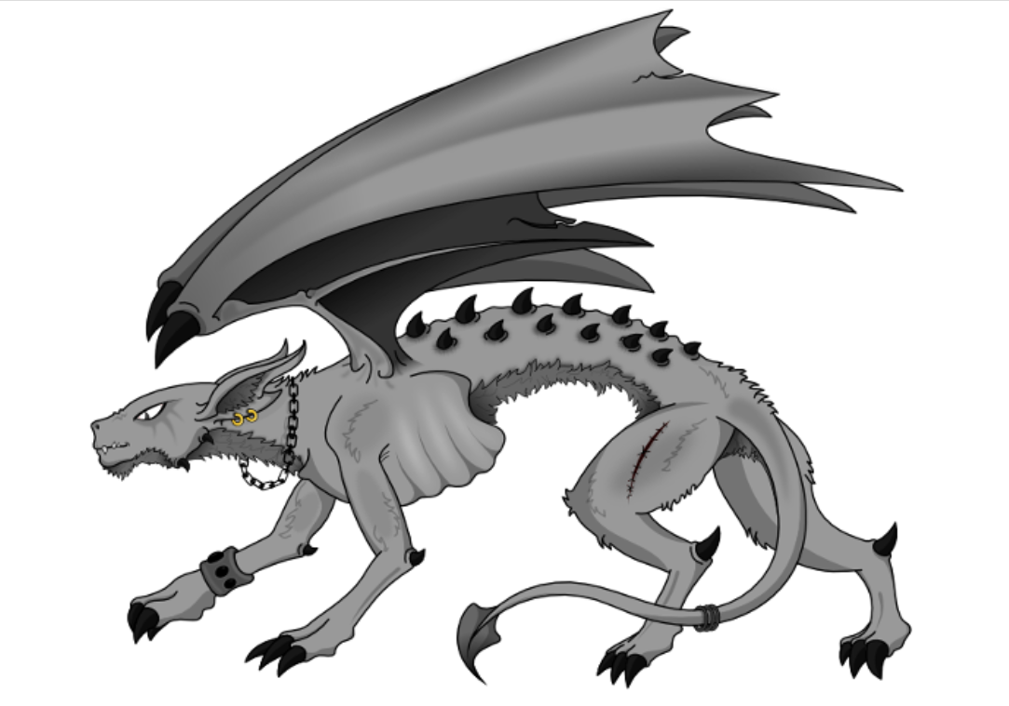
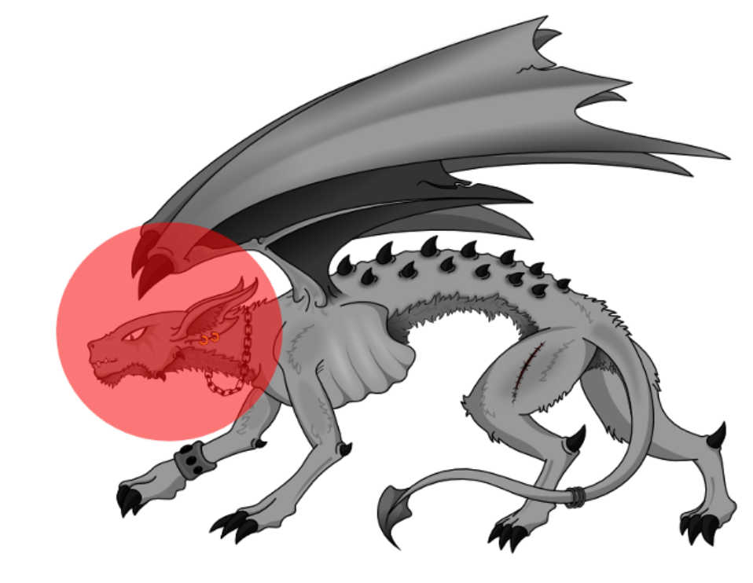

Clipping and masking
Put the object that will serve as clip (or mask) above the object that you want to clip (or mask)
Clipping
Masking

Slide 30
Let’s build a multi-panel figure
Import your own PDF figures generated in R or Python, either from previous workshops or from your own projects. For those who do not have their own figures:
Go to Exercises/data:
Import the following figures:
PCA_rasterised.svg
Plot_expression.pdf
Heatmap_geneExpression.pdf
EnhancedVolcano_raster.svg
Assemble a figure

Slide 31
Part 4: Exporting and closing remarks

Slide 32
Saving and exporting
Always save your current work as .svg (Inkscape .svg)
For exporting, you have several options:
For high-quality figures ( Save a copy to PDF)
For raster graphics file format, export to one of the following formats:
- PNG, JPEG, TIFF

Slide 33
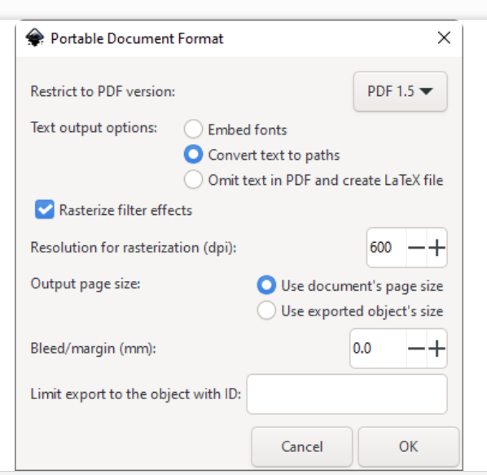
Saving a PDF
Never save as PDF only, but always keep an SVG file, because the PDF file format supports a different set of features from the SVG file format and you may lose data in the process

Slide 34
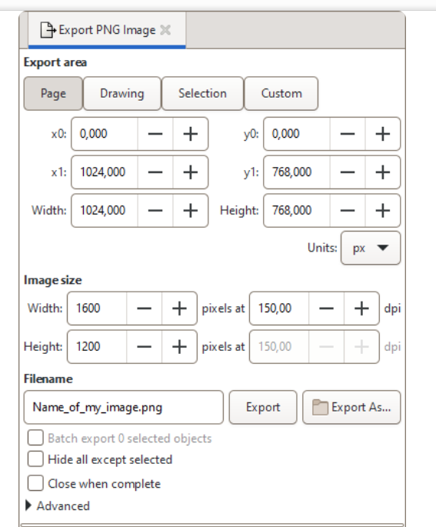
Exporting a PNG file

Slide 35
Some useful resources:
Inkscape Beginner's Guide
Inkscape manual and books
NIH BIOART source

Slide 36

Please share with us your feedback!

Slide 37



Thanks for your attention!
Keep an eye for the workshops offered by the MiCM!
info-micm@mcgill.ca
https://www.mcgill.ca/micm/

Slide 38
References
Inkscape manual. https://inkscape-manuals.readthedocs.io/en/latest/index.html
Zabala A. Designing Effective Scientific Figures: Practical Inkscape Tutorial. Bioinformatics Core Shared Training. https://bioinformatics-core-shared-training.github.io/effective-figure-design/DesigningEffectiveScientificFigures_Practical_INKSCAPE_Zabala_v00.pdf

