Slide 1



Data Visualization in Python
CODE TO MANUSCRIPT BOOTCAMP · DAY 1
From RNA-seq counts to publication-ready figures with Matplotlib & Seaborn
Instructor: Zahra Tavakol Hamedani
Facilitator: Sameena Karsan
October 26, 2026 · McIntyre 1027
Notes:
Welcome. Day 1 of the 5-day Code to Manuscript bootcamp (QLS-MiCM, CDSI, D2R, C3G). Introduce yourself and the facilitator. The session is hands-on: almost everything happens in the Colab notebook.

Slide 2

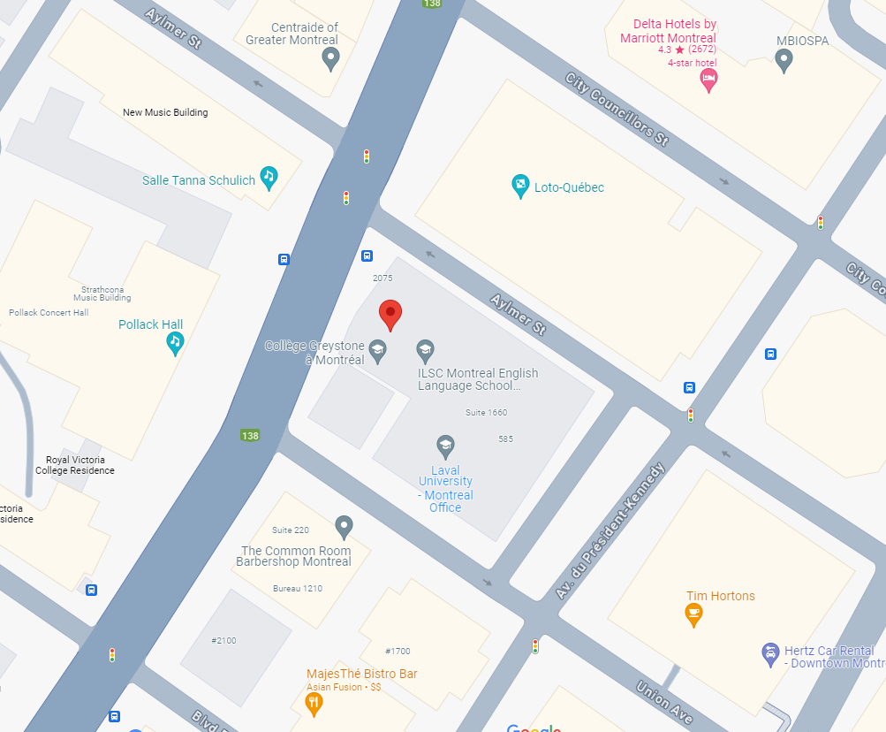

QLS-MiCM mission statement: deliver quality workshops designed to help biomedical researchers develop the skills they need to succeed.
Location: 550 Sherbrooke Street, Montreal, Quebec
Scan the QR code to sign up
for our mailing list
Contact: workshop-micm@mcgill.ca

Slide 3

Workshop Series
https://www.mcgill.ca/micm/training/workshops-series

Slide 4
The Code to Manuscript bootcamp
Day 1
Day 2
Day 3
Day 4
Day 5
Mon Oct 26
Tue Oct 27
Wed Oct 28
Thu Oct 29
Fri Oct 30
Data visualization in Python
Data visualization in R
Bring your own data
Building figures with Inkscape
Writing with LaTeX
Matplotlib · Seaborn
ggplot2
Python or R
Inkscape
Overleaf
▲ TODAY
Today's goal: turn an RNA-seq dataset into a multi-panel, publication-ready figure in Python.
Today's output → tomorrow's input: Day 2 uses the same dataset in R; the vector PDF/SVG you export today is what you polish in Inkscape (Day 4) and place in LaTeX (Day 5).
Notes:
Place today in the context of the whole week. Emphasise that the data and the exported files carry forward.

Slide 5
Learning outcomes
In this 2-hour hands-on session we explore the Python visualization ecosystem: how Seaborn's high-level statistical plots are built on Matplotlib Figure and Axes objects, and how to combine both to produce clear, high-resolution figures from real biological data.
1
Explain the Figure / Axes model and use Matplotlib's object-oriented interface.
2
Reshape data into tidy format and use axes-level vs. figure-level Seaborn functions.
3
Create QC, distribution, scatter, volcano, heatmap and PCA / t-SNE / UMAP plots of RNA-seq data.
4
Assemble a multi-panel figure at journal dimensions with a consistent, colour-blind-safe style.
5
Export vector (PDF/SVG) and high-dpi raster files ready for Inkscape and LaTeX.
Notes:
Read the objectives. Prerequisite: basic Python syntax and pandas DataFrames.

Slide 6
Outline
Module | Topic | Minutes
0 | Setup & the dataset | 10
1 | Anatomy of a Matplotlib figure | 15
2 | Seaborn, tidy data & distributions | 20
3 | Relationships: scatter, MA & volcano plots | 20
4 | Heatmaps & clustered heatmaps | 15
5 | Dimensionality reduction: PCA, t-SNE, UMAP | 15
6 | Multi-panel figures & high-resolution export | 20
 | Wrap-up, checklist & feedback | 5
✏️ Every module ends with a short exercise in the notebook.
Notes:
Roughly 2 hours. If time is short, Exercise 5 (t-SNE perplexity) can be skipped; Module 6 should not be skipped.

Slide 7
Today's dataset: SARS-CoV-2 & the eye
Bulk RNA-seq of post-mortem human ocular tissue infected ex vivo with SARS-CoV-2 or mock — Eriksen et al., Cell Stem Cell 2021 · GEO GSE164073
cornea
limbus
sclera
Exercises/data/
sample_metadata.csv
sample · tissue · condition
GSE164073_Eye_count_matrix.tsv
raw counts, genes × samples
log2cpm_filtered.csv
normalised expression
de_cornea_CoV2_vs_mock.csv
DE results (PyDESeq2)
mock
CoV2
3 tissues × 2 conditions × 3 donors = 18 samples
Same data in Day 2 (ggplot2) and in the QLS-MiCM Differential Gene Expression workshop. Today we focus on showing data, not on the statistics behind it.
Notes:
Small and fast: 18 samples, ~13k expressed genes. All processing is pre-computed by Exercises/data_scripts/prepare_data.py so we can focus on plotting. Biology hook: infected cornea shows an NF-kB / inflammatory response (SOD2, C3, IL6, TNFAIP3).

Slide 8

Interactive workshop — open the notebook!
1
Open the student notebook
in Google Colab (link in the README) — no install needed.
2
Run the first setup cell
it installs umap-learn & adjustText and loads the data from GitHub.
3
Fill in the blanks ___
in each ✏️ Exercise cell, then run it.
github.com/QLS-MiCM/
DataVisualizationInPython
4
Stuck?
raise your hand — or peek at the solutions notebook.
▶ Open in Colab
Notes:
Give everyone 3–4 minutes to open Colab and run the setup cell. Local Jupyter works too: clone the repo and run from Exercises/scripts.

Slide 9
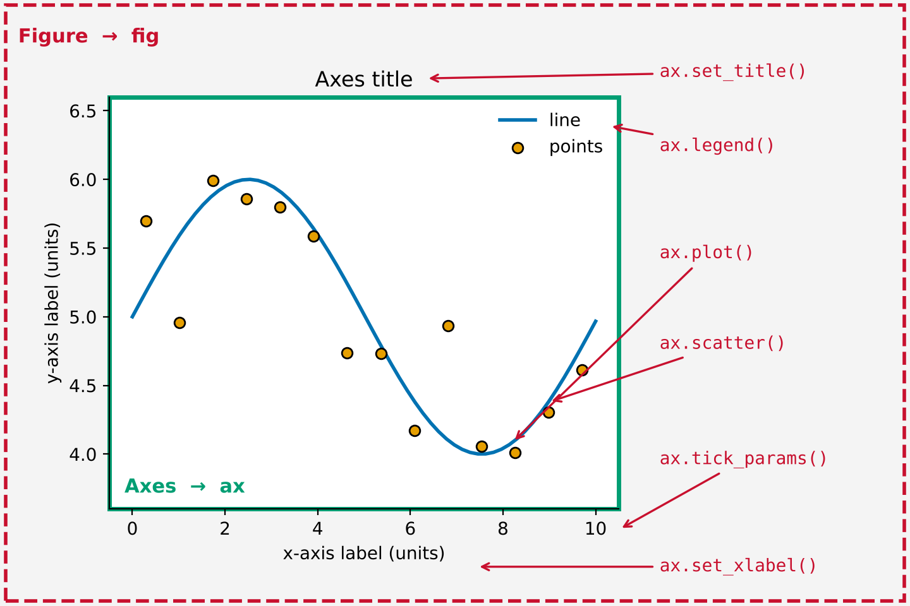
Anatomy of a Matplotlib figure
MODULE 1
Implicit (plt.)
plt.plot(x, y)
plt.title('...')
# which plot am I
# editing now?
Explicit / OO ✔ recommended
fig, ax = plt.subplots()
ax.plot(x, y)
ax.set_title('...')
ax.set_xlabel('...')
• Figure = the canvas (size, saving)
• Axes = one plot (data, labels, ticks)
• Seaborn draws on Axes → anything is customisable
Notes:
Key idea of the day. Every element of a plot is an object you can modify. Always use fig, ax = plt.subplots(); this pays off when building multi-panel figures in Module 6.

Slide 10
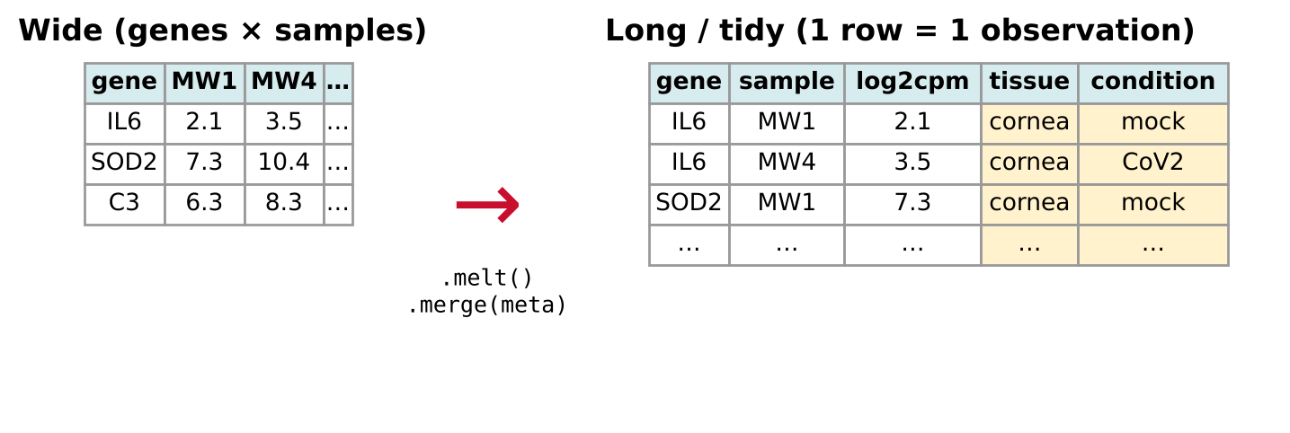
Seaborn speaks tidy data
MODULE 2
Axes-level
sns.scatterplot · boxplot · violinplot · heatmap
Draw on one Axes → pass ax= and place them in your own layout.
Figure-level
sns.relplot · catplot · displot · clustermap
Create their own figure → easy small multiples with col= / row=.
Notes:
Wide = how data are usually stored; long = how Seaborn wants them: one row per observation, columns map to x, y, hue, col.

Slide 11
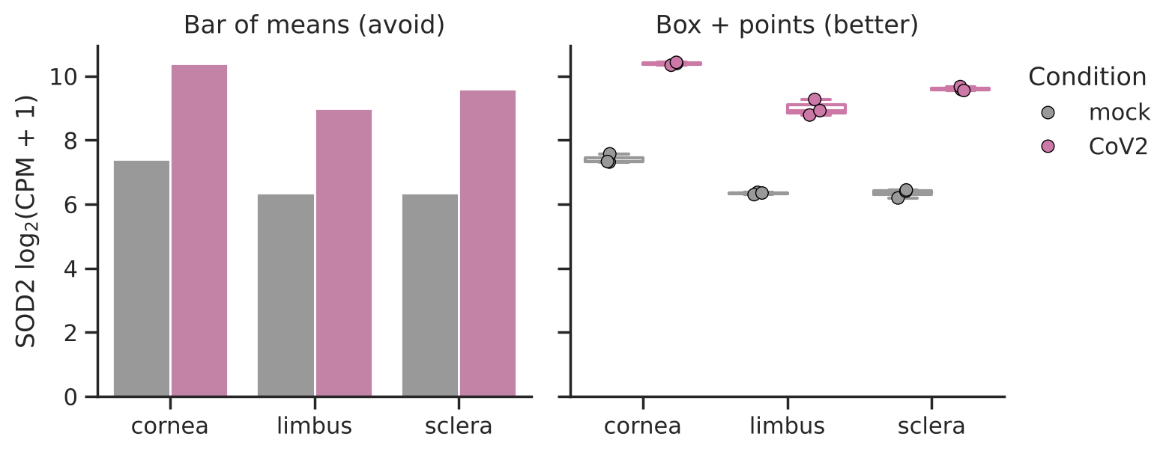
With small n, show the points
MODULE 2
• n = 3 per group: a bar of means hides sample size, spread and outliers.
• Overlay individual observations (sns.stripplot on top of sns.boxplot) and define error bars in the legend.
• Keep colours consistent: define a palette dictionary once and reuse it everywhere.
Notes:
Good/bad practice preview for Day 3. Weissgerber et al. 2015 (PLoS Biol) 'Beyond bar and line graphs' is a good reference.

Slide 12
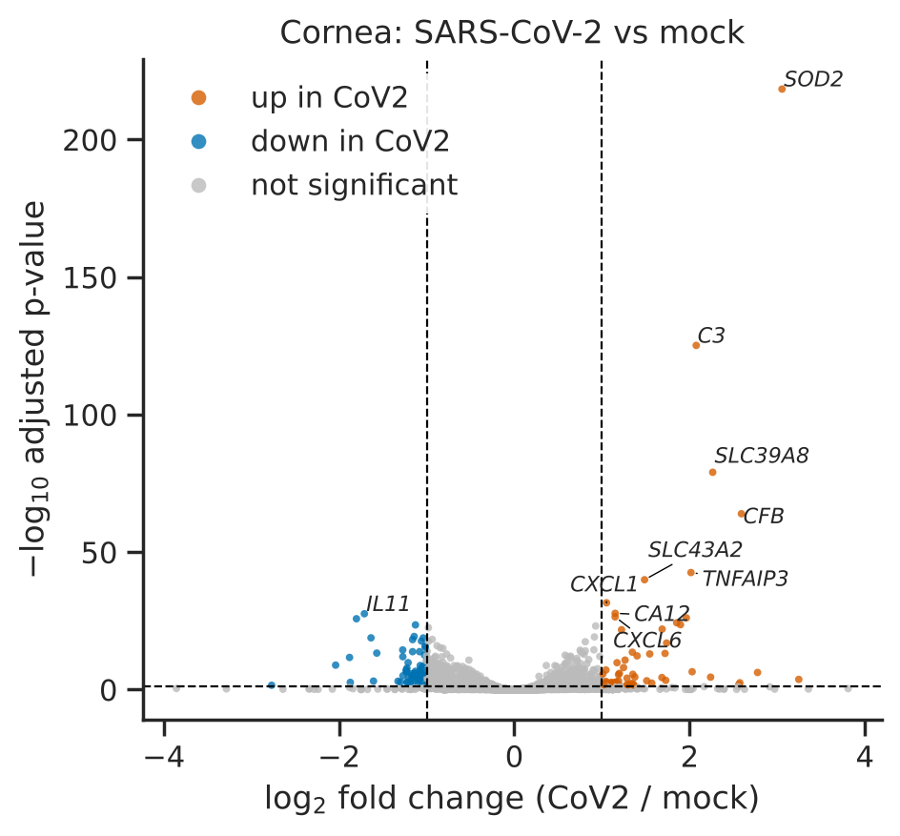
Relationships: volcano & MA plots
MODULE 3
• x: effect size — log₂ fold change
• y: significance — −log₁₀ adj. p
• Threshold lines via ax.axhline / ax.axvline
• Label key genes — adjustText avoids overlaps
• rasterized=True for >10k points: small, fast vector files
• Exercise 3: build the MA plot (mean expression vs fold change)
Notes:
Cornea CoV2 vs mock. Top genes are NF-kB targets (SOD2, C3, TNFAIP3, CXCL1) — matches the paper's inflammatory signature.

Slide 13
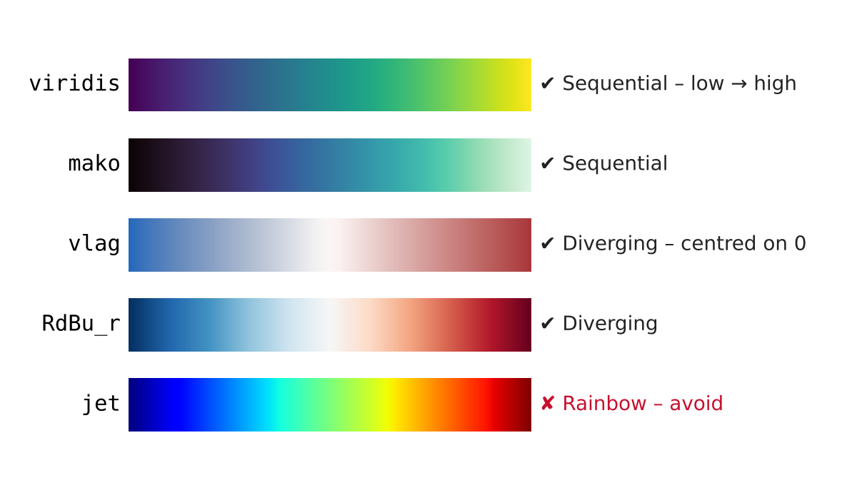
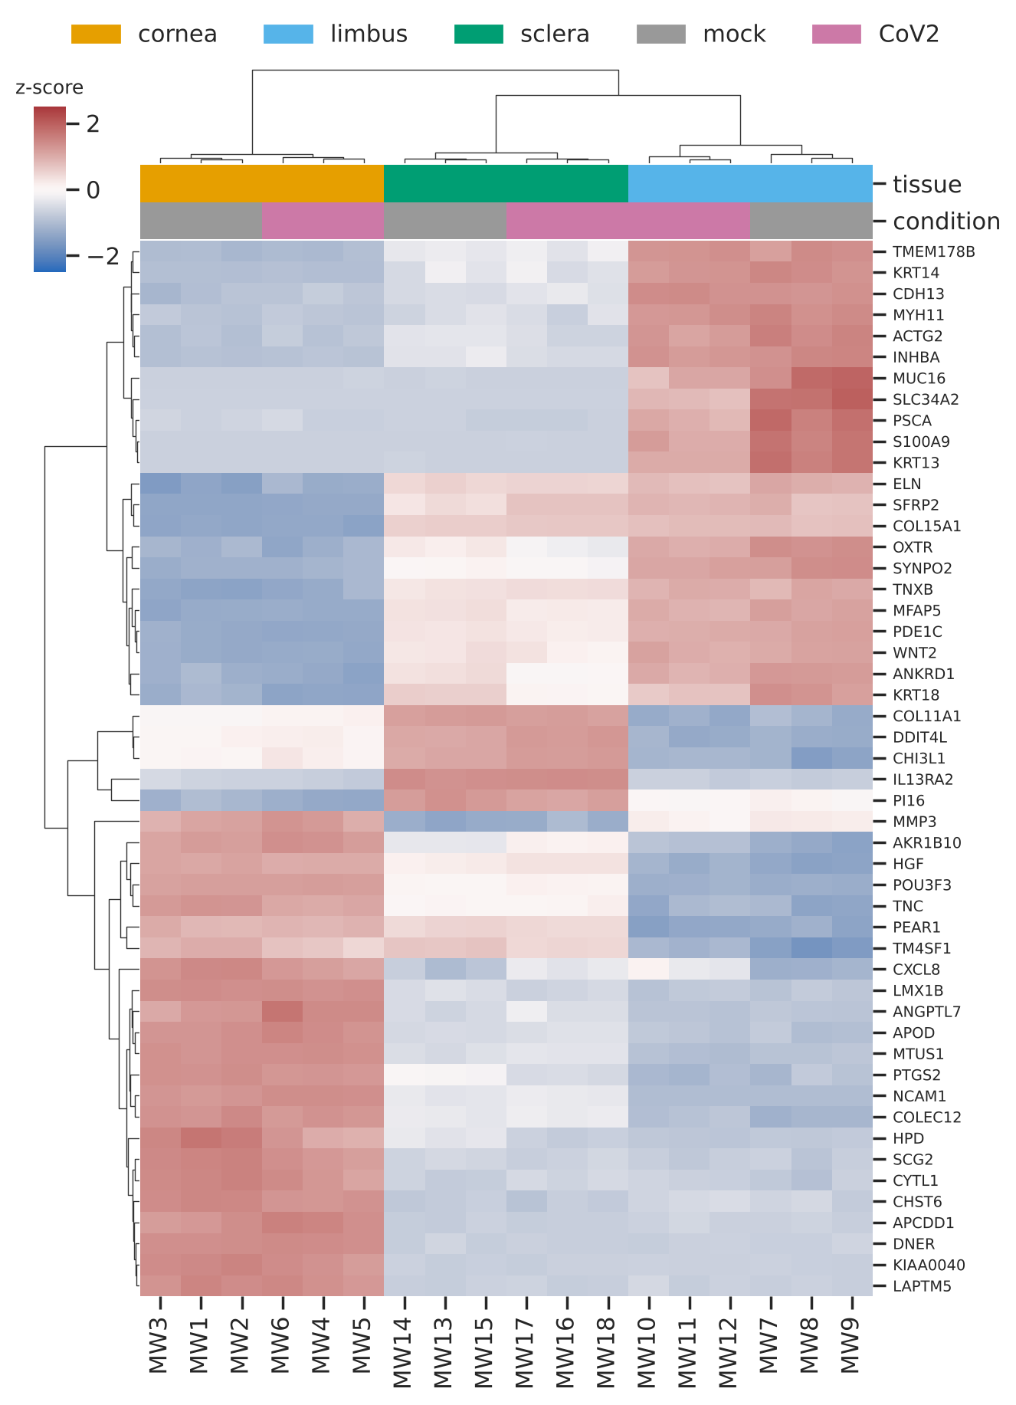
Heatmaps: choose the colour map on purpose
MODULE 4
• Sequential for low → high (correlations, counts)
• Diverging + center=0 for z-scores, fold changes
• z-score genes (z_score=0) to compare patterns
• Annotate groups with col_colors
Notes:
Rainbow/jet is not perceptually uniform and is unreadable for colour-blind readers (Crameri et al. 2020, Nat Commun).

Slide 14
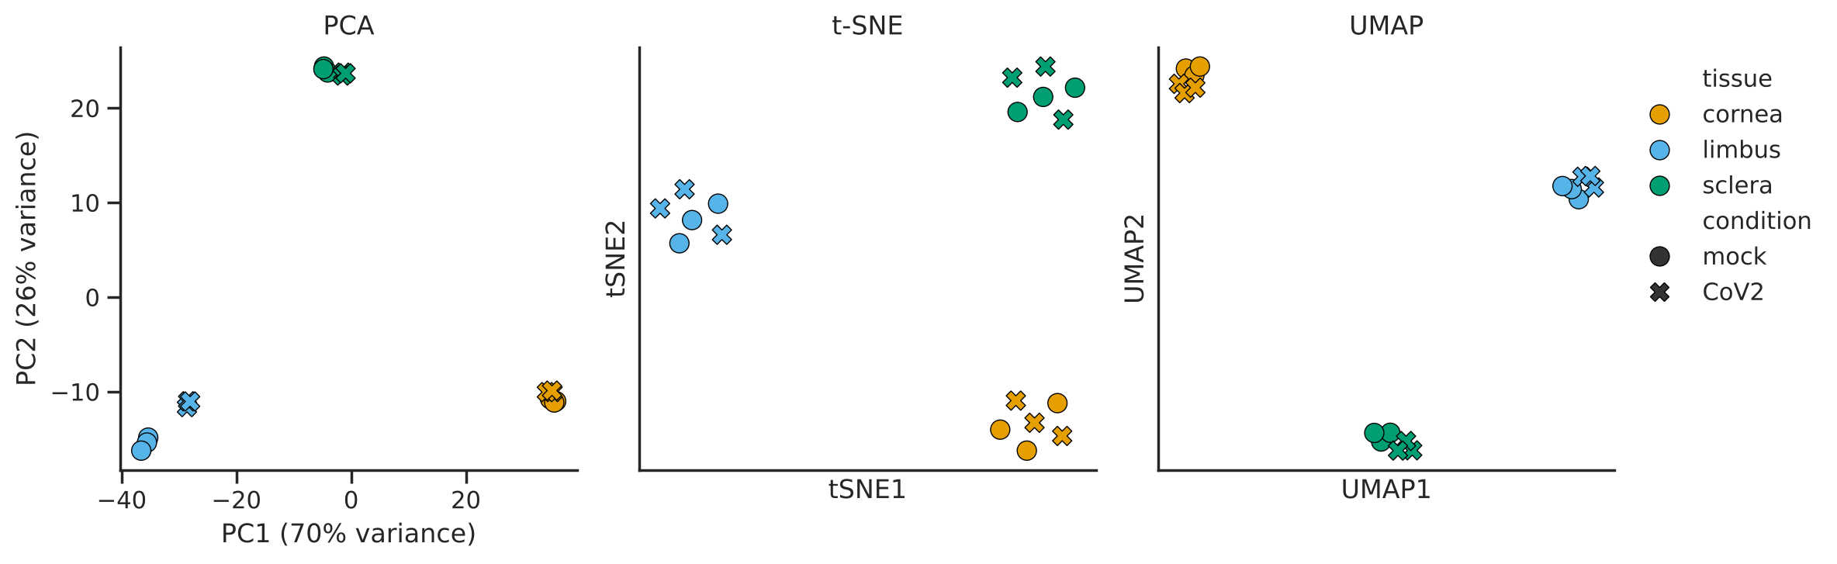
Dimensionality reduction at a glance
MODULE 5
Tissue dominates PC1–PC2; infection only separates samples in a within-tissue PCA (notebook).
 | PCA | t-SNE | UMAP
Type | linear | non-linear | non-linear
Axes mean… | % variance explained | nothing (no units) | nothing (no units)
Good for | bulk RNA-seq, global structure | local clusters | clusters + some global layout
Report | n features, scaling | perplexity, seed | n_neighbors, min_dist, seed
Notes:
Keep the maths light. Point out that tissue dominates PC1/PC2; the notebook's within-tissue PCA shows infection on PC1. Message: PCA is the default for bulk data; t-SNE/UMAP are for many points (single cell) and are sensitive to parameters — Exercise 5 shows this. Always set and report the random seed.

Slide 15
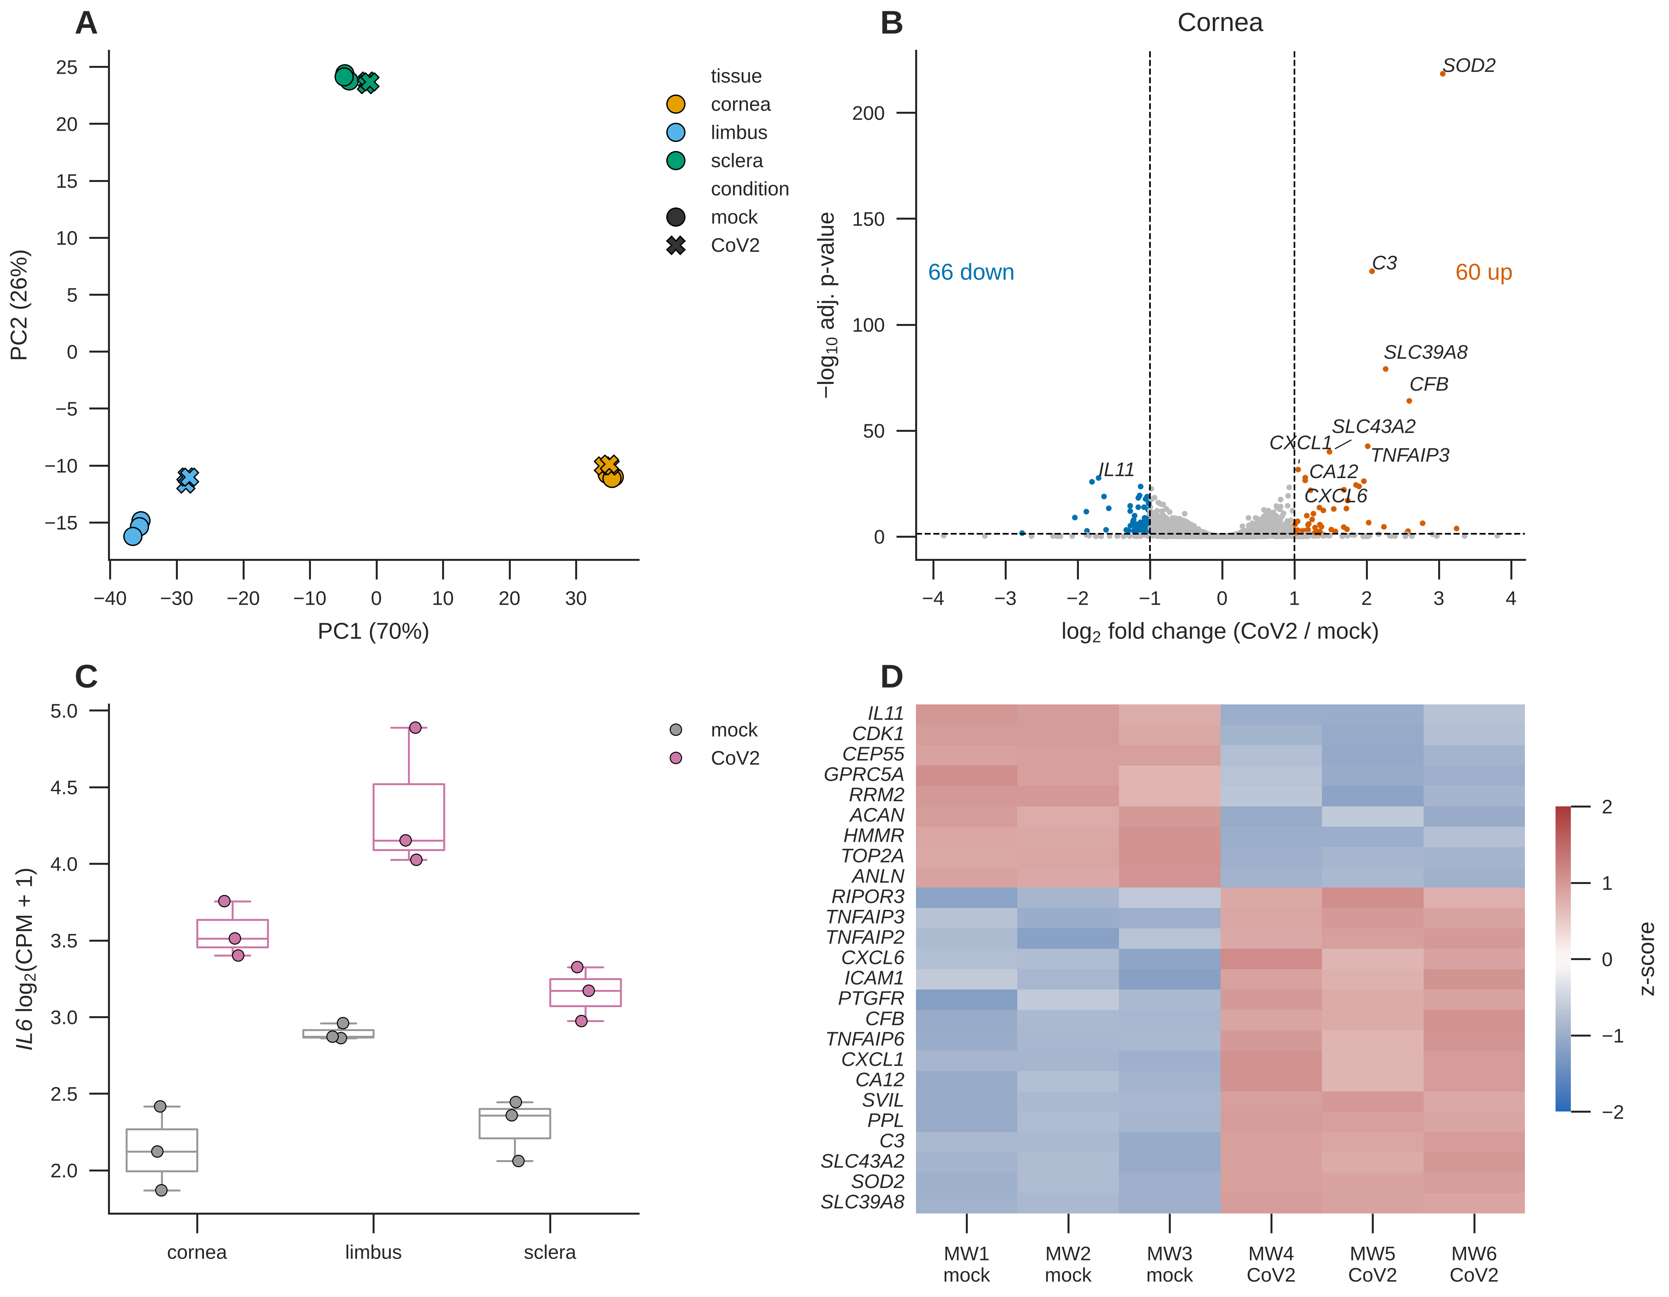
Multi-panel figures & export
MODULE 6
MM = 1 / 25.4 # mm -> inch
fig, axd = plt.subplot_mosaic(
'AB;CD',
figsize=(180*MM, 140*MM),
layout='constrained')
plt.rcParams['pdf.fonttype'] = 42
plt.rcParams['svg.fonttype'] = 'none'
# no bbox_inches='tight': keep 180 mm
fig.savefig('Fig1.pdf')
fig.savefig('Fig1.png', dpi=600)
• Size in mm: 85 (1 col) / 180 (2 col)
• Fonts ≥ 6 pt at final size
• Editable text in Inkscape via fonttype
• Vector for editing; 600 dpi PNG
Panel D uses sns.heatmap with SciPy clustering — figure-level clustermap can't live inside a layout.
Notes:
On Colab, files in figures/ vanish when the session ends: run the download cell. Never screenshot a plot for a paper. Keep the exported PDF/SVG: participants bring it to Day 4 (Inkscape).

Slide 16
Publication-figure checklist
✔
Labels
every axis labelled with units; gene names in italics
✔
Colour
same meaning in every panel; colour-blind safe; no rainbow
✔
Honesty
show individual points for small n; bars start at zero
✔
Size
built at journal column width; fonts ≥ 6 pt when printed
✔
Files
vector PDF/SVG + 600 dpi PNG; dense layers rasterised
✔
Reproducible
code saved; seeds & parameters reported in Methods
Notes:
This checklist is also at the end of the notebook. We'll build on it on Day 3 (good vs bad practices).

Slide 17
What's next & resources
Coming up this week
Learn more
• Day 2 · same plots in R with ggplot2
• Day 3 · bring your own data — good & bad practices, hands-on
• Day 4 · bring today's PDF/SVG to Inkscape
• Day 5 · put the final figure into LaTeX
• matplotlib.org/cheatsheets
• seaborn.pydata.org/tutorial
• data-to-viz.com — which chart for which data
• Rougier et al. 2014 Ten simple rules for better figures
• Crameri et al. 2020 The misuse of colour in science communication
Homework (5 min): keep your exported Figure1_cornea_CoV2.pdf / .svg — you will polish it in Inkscape on Thursday. Think about which of your own datasets you'd like to bring on Wednesday.
Notes:
Remind participants to fill the Day 3 registration question about their data type.

Slide 18
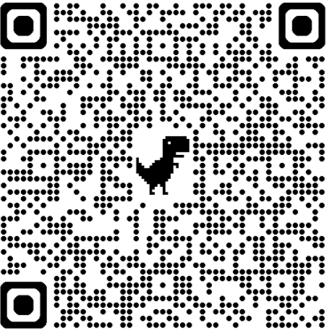
Feedback?
https://tinyurl.com/QLS-MiCM-Feedback

