Slide 1
Intro to Unix
Workshop Lead: Georgi Merhi
Workshop Facilitator:
Date: September 25th, 2026

Slide 2


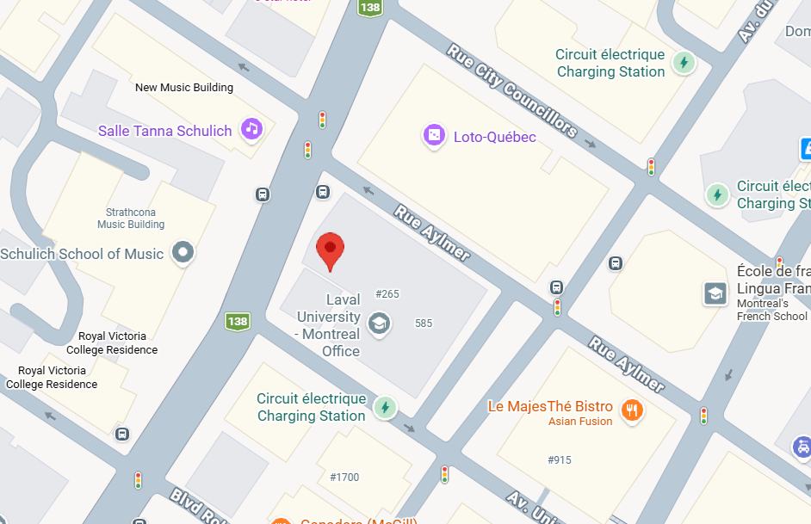
Mission statement: deliver quality workshops designed to help biomedical researchers develop the skills they need to succeed.
Location: 550, Sherbrooke Street West, Room 186
Montreal, Quebec
Scan the QR code to sign up
for our mailing list
Contact: workshop-micm@mcgill.ca
Notes:
Our organization aims to advance biomedical research at McGill University by providing workshops and bootcamps on a wide range of computational skills and tools. QLS-MiCM integrates clinical data with research in genomics, epidemiology, imaging, and other areas of biology. Our workshops are offered at various proficiency levels – from beginner to advanced – ensuring all researchers can benefit from our platform.

Slide 3
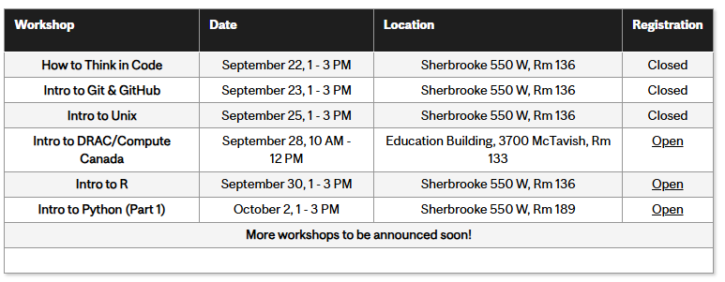
Fall 2026 Workshop Series
https://www.mcgill.ca/micm/training/workshops-series

Slide 4
Outline
Module 1
  UNIX operating system
  Filesystem structure
  File management operations
  Basic commands
Module 2
  Pipes and redirects
  Variables
  Pattern matching
  Text processing
  Material:
Module 3
  Shell scripting
  Control structures
https://github.com/QLS-MiCM/Intro-to-UNIX

Slide 5
Module 1
UNIX operating system
File system structure
File management
Basic commands

Slide 6

UNIX Operating system
Dennis Ritchie (standing) and Ken Thompson (seating) at Bell Labs, 1960’s
General purpose and interactive
Multiuser
Resource-efficient
Hierarchical file system
Compatibility (files, devices, processes)
Time sharing
Notes:
UNIX is a family of multitasking, multi-user computer operating systems
Linux is an open-source reimplementation of the UNIX OS
Ubuntu is a distribution (flavor) of Linux
EX: fedora (latest tech) and Mint (transitioners)
In-car systems use UNIX, android, smart TVs, medical equipment

Slide 7
Parts
The kernel
The core of the operating system
Manages processes’ time, memory and resources
Handles file storage
Responds to system calls
The shell
Let’s the user communicate with the kernel
Command line interpreter (CLI)
Executes the instructions requested by the user (commands)
Notes:
Kernel (software) → Responsible for managing the system and communication between software and hardware
Shell → Intermediary

Slide 8
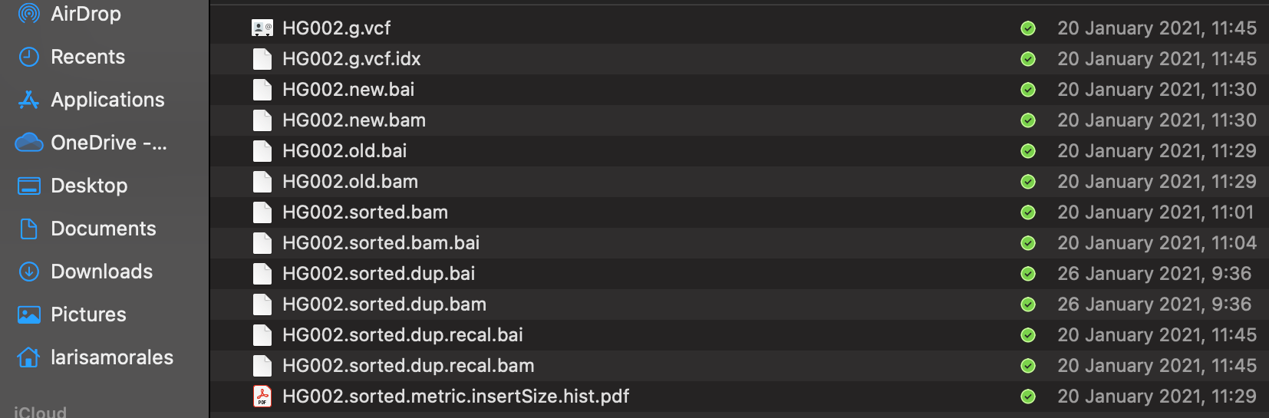
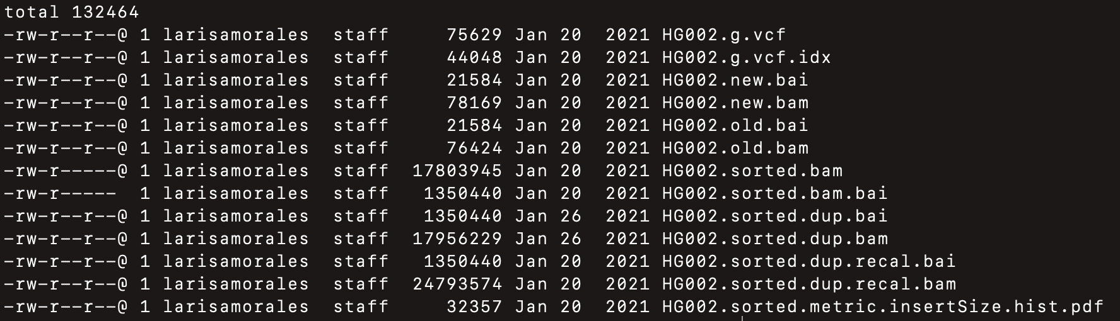
Files

Slide 9
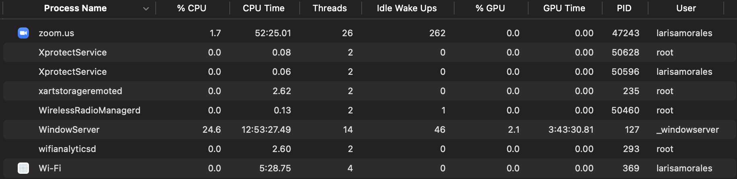
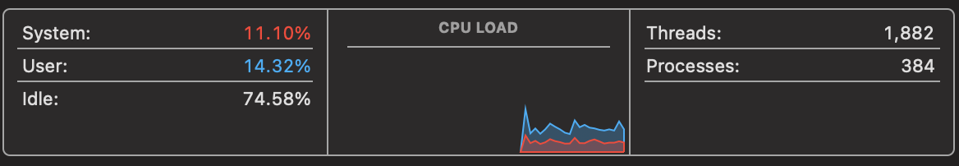
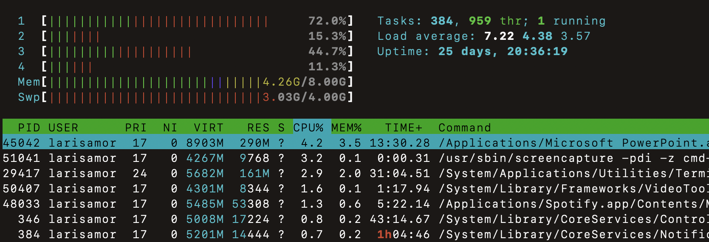
Processes
Notes:
A computer process is an instance of a computer program that is being executed by one or many threads

Slide 10
Everything is a file or a process
Notes:
This refers to the design philosophy behind an UNIX based system/OS
Directory → Special files that contain lists of other files.
Streamlined design and more efficient resource management

Slide 11
File system structure
/
bin
dev
etc
home
lib
opt
sbin
tmp
usr
cp
ls
larisams
micm
Genomes
reboot
cisco
slides
mm10.fa
hg30.fa
Program binaries - commands’ executable files
Special hardware device files - hard drive, speakers
System configuration files
Login folder - user specific files, directories and programs
Libraries required by bin and sbin to boot the system
Local user application files
Executable programs (binaries) required to start the system
Temporary files which are automatically removed periodically
User-specific system executable programs and data
Notes:
Bin → essential User Binaries
Dev → device files
Etc → Configuration files
Opt -> optional software
Sbin → system admin binaries ex: shutdown and config

Slide 12
File system structure
/
bin
dev
etc
home
lib
opt
sbin
tmp
usr
cp
ls
ciz20
micm
Genomes
reboot
cisco
slides
mm10.fa
hg30.fa

Slide 13
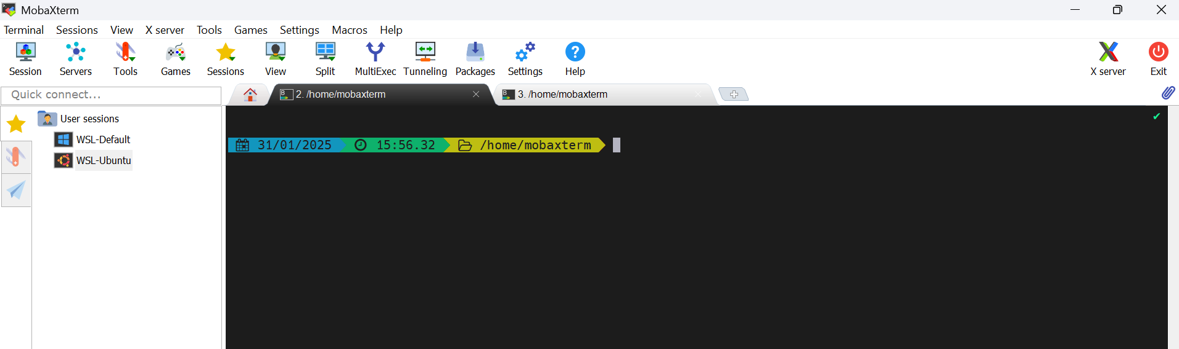
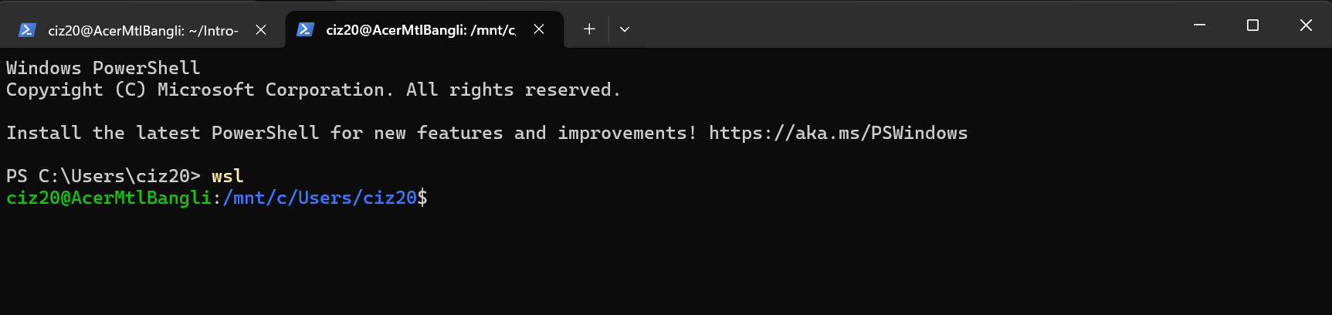
The terminal

Slide 14
Keyboard shortcuts
Ctrl+A
Ctrl+E
Ctrl+C
q
Go to the start of the line
Go to the end of the line
Stop the current process
Exist a child process (less, more, etc)

Slide 15
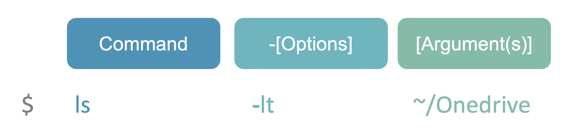
Unix commands
Programs built in the shell that perform specific actions

Slide 16
Basic commands
top
man
history
clear
See active processes and the resources they’re using
Shows the manual page of a command
List your previous commands
Clear your terminal window
% htop
% man ls
% man cd
% man htop
% history
% clear

Slide 17
Basic commands
whoami
pwd
ls
cd
Displays current user id
Shows the current directory
Prints the current directory
Access a directory
% whoami
% pwd
% ls folder1
% cd folder1

Slide 18
Special characters
.
..
*
~
Current directory
Parent directory
Match any and all characters
Home directory
% ls .
% ls ..
% ls *
% ls ~

Slide 19
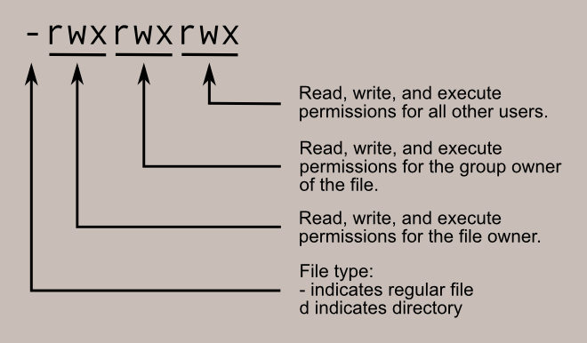
File permissions
User
r - read
w - write
x - execute
Group
Other
Adapted from https://linuxcommand.org/lc3_lts0090.php

Slide 20
File management commands
touch
mkdir
chmod
echo
Creates a new file
Creates a new directory
Change file permissions
chmod [ugo][+-][rwx]
u: user +: grant w: write
g: group -: revoke r: read
o: other x: execute
Prints something to the terminal
% touch f1.txt
% mkdir ~/intro_unix
% chmod o-w f1.txt
% echo “hello world”
Notes:
Read (r) = 4 Write (w) = 2 Execute (x) = 1
chmod go+w
Or
chmod 644 test.txt
mkdir ~/intro_unix

Slide 21
File management commands
cp
mv
cat
zcat
Copy a file
Move a file or rename it
Print the contents of a file(s) to the terminal
Print the contents of a zipped file(s) to the terminal
% cp f1.txt f1_copy.txt
% mv f1_copy.txt f1.txt
% cat f1.txt
% zcat f1.txt.gz

Slide 22
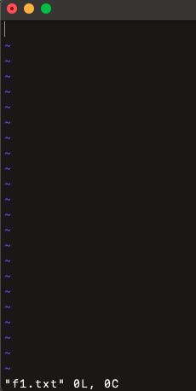
How to edit files in the terminal
nano
vi
Recommended for plain text files
Recommended for code files/scripts
To open the file
% nano f1.txt
% vi f1.txt
Press Ctrl+X
Type Y
Press Enter
Press Esc then hold
Shift+zz
To close the file
Type :xq then press Enter
Notes:
Vi steep learning curve

Slide 23
How to download a file and use it in the terminal
% cd ~/intro_unix
% mv ~/Downloads/cars.tsv data/ho1
scp [username]@[IP_address_of_the_server]:[path/of/files/on/server] [path/on/your/machine]

Slide 24
File management commands
gzip
gunzip
tar
rm
Compress a file
Decompress a file
Bundle files with compression (optional)
Removes file(s)
% gzip cars.tsv
% gunzip *
% tar –cvzf cars.tgz f*
% rm cars.tsv

Slide 25
File management commands
head
tail
more
wc
Print the first N lines of a file
Print the last N lines of a file
View contents of a file
Count words, characters lines or bytes
% head -3 cars.tsv
% tail -3 cars.tsv
% more cars.tsv
% wc cars.tsv

Slide 26
Text processing commands
cut
sort
uniq
paste
Extract columns of file
Order elements
Get set of uniq elements
Paste two files column-wise
% cut –f1 cars.csv > col1.tsv
% sort cars.tsv > cars.sort.tsv
% uniq cars.sort.tsv
% paste col1.tsv cars.tsv

Slide 27
Bonus skill

Slide 28
Create your own commands
% vi ~/.bash_profile
alias ll=“ls –l”
% source ~/.bash_profile
% ll

Slide 29
Hands on 1

Slide 30
Print the current directory and user
Create a directory named intro_unix in the home directory
Create a directory called data within intro_unix
Create a sub-directories ho1 ho2 and ho3
Create a directory called folder1 under data/ho1
Go into folder1 and create two files: f1.txt and .f2.txt
Write the numbers from 1 to 10 in f1.txt (one number per line)
Write the following sequence in .f2.txt (one letter per line)
  a a a b b b b c c c c c d d d d d d d
Notes:
.f2.txt is a hidden file so use ls -al

Slide 31
List all the contents of the directory (including .f2.txt) – hint: look at the manual of the ls command
Change the name of .f2.txt to f2.txt
Change the permissions of f1.txt so that only the user can read and write the file
Write only the first 10 lines of f1.txt and all the lines in f2.txt to a new file called f3.txt
Bonus skill
Using the file cars.tsv :
  List the unique set of countries included in the dataset
  Find the number of unique car models
Notes:
#4)Write the numbers from 1 to 10 in a1.txt (one number per line)
echo "1\n2\n3\n4\n5\n6\n7\n8\n9\n10" > f1.txt
echo {1..10} > f1.txt
#5)Write the following sequence in .a2.txt (one letter per line)
echo "a\na\nb\nb\nb\nc\nc\nc\nc\nd\nd\nd\n\nd\nd" > .f2.txt
#6)List all the contents of the directory
ls -la .
#7) Change the name of .f2.txt to f2.txt
mv .f2.txt f2.txt
#8) Change the permissions of f1.txt
chmod go-rwx f1.txt
#9) Write the contents of f1.txt and f2.txt to a new file f3.txt
head -10 f1.txt | cat f2.txt > f3.txt

Slide 32
Module 2
Pipes and redirects
Variables
Pattern matching
Text processing

Slide 33
Pipes
A way to connect the end of something with the start of something else
They are specified with the control operator “ | ”
% cat cars.tsv | head -10

Slide 34
Redirect output
>
>>
<
Will send the output of the command to a NEW file
Will APPEND the output of the command to a file
Redirect output of one command as input to another command
% ls folder1 > files.txt
% ls folder1 >> files.txt
% head -1 <(cat files.txt)

Slide 35
Variables
Used to store information
  number, text, file name, etc
The name can only contain:
  Letters (a to z or A to Z)
  Numbers (0 to 9) *not at the beginning
  Underscore (“_”)
We can have several types:
  Environment variables
  Shell variables
  Global and local variables

Slide 36
Global variable
Are variables that are accessible from any part of a script, within functions and sourced scripts.
They do not disappear when the process is done but when the shell session is closed
% MY_NAME_LOCAL=I_am_groot
% echo $MY_NAME_LOCAL
Notes:
Mention local variables as well briefly

Slide 37
Shell variables
Environment variables required by the shell to function
$USER
$HOME
$PATH
$PWD
Stores the name of the current user
Has the path to the user’s home
Contains all the directories where executable files are stored
Contains the path of the current directory

Slide 38
Environment variables
Are available to any process in the shell
% export MY_NAME=Larisa
% echo $MY_NAME

Slide 39
Variable expansions
Substituting the variable with its value
It occurs before calling a command
If the result contains spaces, the expansion should be quoted
We can use operators to modify the content of the variable before passing it on to a command

Slide 40
Variable expansions
Allow us to modify the content of the variable before passing it to a command
Extracting a part of the string
${VAR:offset}
Extracts the content starting from the offset
${VAR%pattern}
Extracts the content until it finds the pattern
Notes:
Substring extraction
string="Hello, World!“
substring=${string:7}
echo "Substring: $substring“
Suffix removal
url="http://example.com/index.html“
baseurl=${url%.html}
echo "Base URL: $baseurl"

Slide 41
Variable expansions
Replacing substrings
${VAR/pattern/replace}
Changes pattern for replace the first time it appears
${VAR//pattern/replace}
Changes pattern for replace all the times it appears
${VAR%pattern}replace
Extracts content until pattern and writes replace after
Notes:
string="Hello, World!“
new_string=${string/World/Bash}
echo "Modified string: $new_string"

Slide 42
Groupings
(…)
{…}
((…))
Subshell
Contains a list of commands. If preceded by $(…) then its expanded to the output of the commands
Group commands and affect their parsing. When written as ${VAR} it is a parameter expansion
Arithmetic instructions
They operate at the level of numbers. The expansion is also $((…))
files=$(ls *xt)
x=2
{x=4}
echo $x
x=2
(x=4)
echo $x
x=2
y=6
echo $(($x+$y))
Adapted from https://stackoverflow.com/questions/6270440/simple-logical-operators-in-bash

Slide 43
Example
Extract
% FILE_NAME=$(ls ../data/ho1 | tail -1)
% echo ${FILE_NAME:4}
% SUFFIX=${FILE_NAME:4}
Replace
% echo ${FILE_NAME%${SUFFIX}}.csv
% echo ${FILE_NAME%_*}.csv

Slide 44
Pattern matching
grep
Country Gender Mean N=
AT Male 7.3 471
AT Female 7.3 570
AT Both 7.3 1041
BE Male 7.8 468
BE Female 7.8 542
BE Both 7.8 1010
BG Male 5.8 416
BG Female 5.8 555
BG Both 5.8 971
Search a pattern in a file
% grep Male happiness.csv

Slide 45
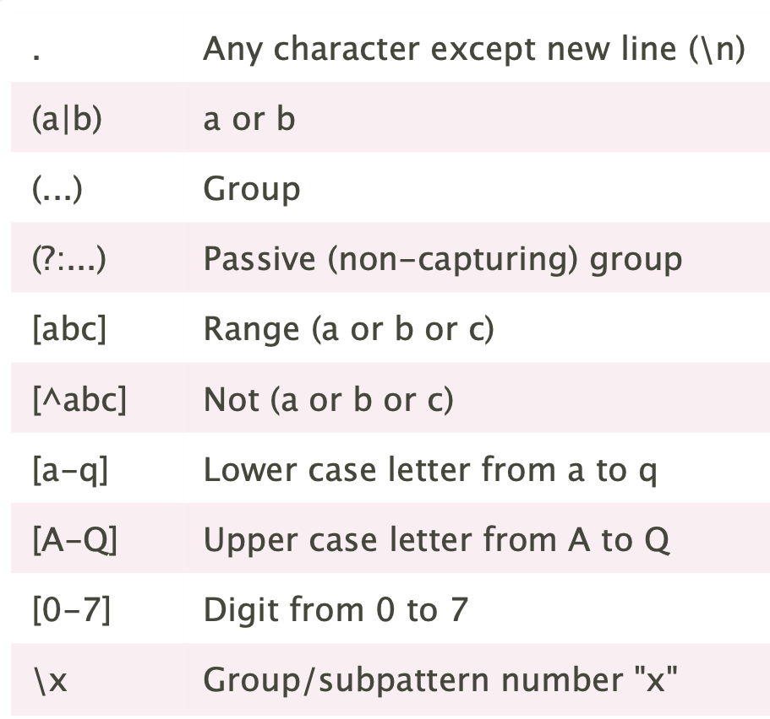
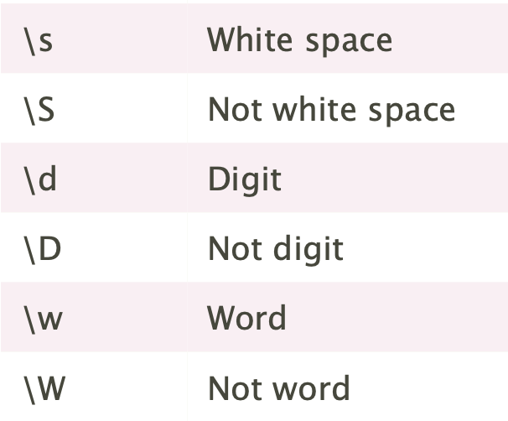
Regular expressions
Groups and ranges
Character classes
Adapted from https://cheatography.com/davechild/cheat-sheets/regular-expressions/

Slide 46
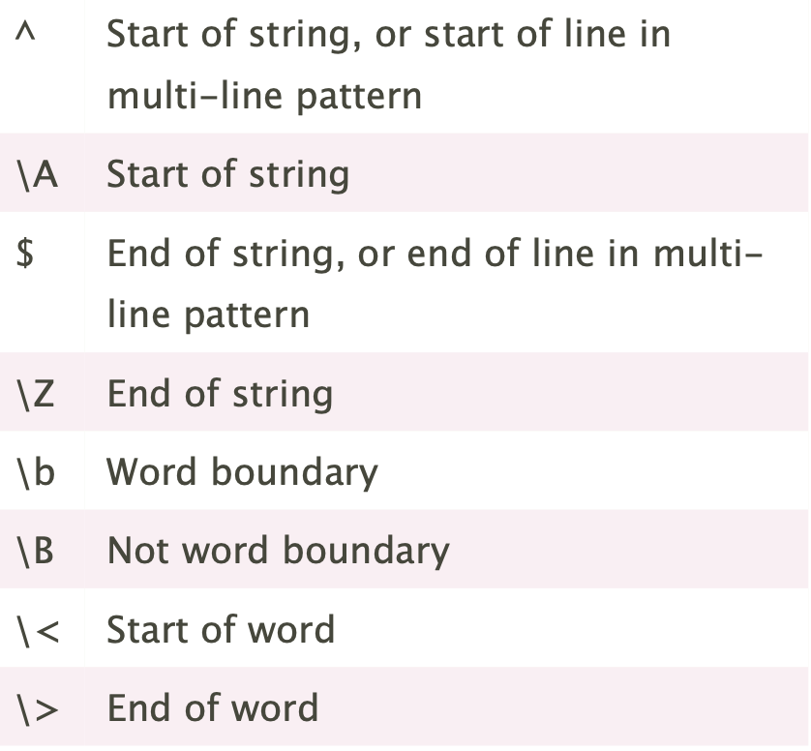
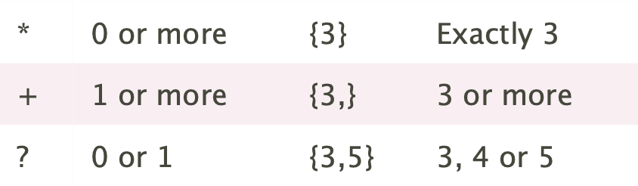
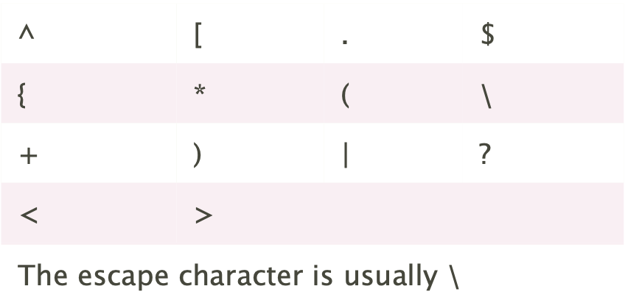
Regular expressions
Anchors
Quantifiers
Special characters
Adapted from https://cheatography.com/davechild/cheat-sheets/regular-expressions/

Slide 47
Example
All lines that start with a letter
Lines that do not start with a letter
Lines with a country from the list
% grep -E "^[A-Z]+" happiness.csv
% grep -v -E "^[A-Z]+" happiness.csv
% grep -E "^\W" happiness.csv
% grep -f countries.txt happiness.complete.tsv

Slide 48
Bonus skills

Slide 49
awk
Scripting language that provides much more flexibility for text processing
Built-in functions
length(string)
tolower(string)
toupper(string)
match(string,pattern)
Built-in variables
Entire line - $0
Fields (specified by delimiter) - $1,$2,…
Notes:
It is especially useful for handling columnar data and performing tasks like pattern matching, text extraction, and data manipulation.

Slide 50
Example
Print the 3rd column and then the 1st column
Print columns 1,3 and 2 if they contain the word “Female”
Count the number of characters in “Female” entries only
% awk '{print $3 "\t" $1}' happiness.complete.txt
% awk '/Female/ {print $1 "\t" $3 "\t" $2}' happiness.complete.txt
% awk -F "," '/Female/ { print length($0) "\t" $1 "\t" $2}' happiness.complete.tsv

Slide 51
sed
Command or streamline editor with multiple text processing functionalities
Built-in functions
s/search/replace/ for pattern substitutions
  /g – replace all occurrences
  /1,/2,… - specifying which occurrence to replace
  /I – Ignore case
  /w – write to a file with /w filename
-e to run multiple commands
  sed -e 's/a/A/' -e 's/b/B/'

Slide 52
Examples
Delete the first line
Replace capital A for lowercase a
Print the first line every 3 lines
% ls -l | sed 1d
% sed 's/A/a/g' happiness.complete.txt | head
% awk 'NR % 3 == 0' happiness.csv

Slide 53
Hands on 2.1

Slide 54
Go to the directory data/ho2 and list the files in it (move files there if missing)
Count many ”Female” and “Male” entries are listed in the file happinhowess.complete.tsv
Count how many unique countries are listed in the file happiness.complete.tsv
Notes:
#!/bin/sh
# 1) Go to the directory and list the files
cd ../data/ho2/ && ls -l
# 2) Count lines that start with a ","
grep -E "^," happiness.csv | wc -l
# 3) Convert csv into tsv
sed 's/,/\t/g' happiness.complete.csv > happiness.complete.tsv
# 4a) Count unique countries
cut -f1 happiness.complete.tsv | sed 1d | sort | uniq | wc -l

Slide 55
Hands on 2.2
Notes:
#!/bin/sh
# 1) Go to the directory and list the files
cd ../data/ho2/ && ls -l
# 2) Count lines that start with a ","
grep -E "^," happiness.csv | wc -l
# 3) Convert csv into tsv
sed 's/,/\t/g' happiness.complete.csv > happiness.complete.tsv
# 4a) Count unique countries
cut -f1 happiness.complete.tsv | sed 1d | sort | uniq | wc -l
# 4b) Count how many entries of each gender
cut -f2 happiness.complete.tsv | sed 1d | sort | uniq -c
# 4c) Replace all spaces with “_” within the same file
sed -i '' 's/ /_/g' happiness.complete.tsv
# 4d) Write a new file in which all the countries are written in lowercase
awk '{print tolower($1) "\t" $2 "\t" $3 "\t" $4}' happiness.complete.tsv > happiness.complete.lower.tsv
# 4e) Replace gender column
sed -e 's/Male/M/' -e 's/Female/F/' -e 's/Both/B/' happiness.complete.tsv | head -10
# 4f) New file with "Both" entries from the countries in the list
grep -f countries.txt happiness.complete.tsv | awk -F " " '/Both/ {print $4 "\t" $3 "\t" $1}' > happiness.complete.both.countries.tsv

Slide 56
Go to the directory data/ho2 and list the files in it
Using the file happiness.complete.tsv
  Write a new file in which all the countries are written in lowercase
  Replace “Female” for “F”, “Male for “M” and “Both” for B and look at the first 10 lines
  Write a new file with all the “Both” entries only for the countries included the file countries.txt
Notes:
# 4b) Count how many entries of each gender
cut -f2 happiness.complete.tsv | sed 1d | sort | uniq -c
# 4c) Replace all spaces with “_” within the same file
sed -i '' 's/ /_/g' happiness.complete.tsv
# 4d) Write a new file in which all the countries are written in lowercase
awk '{print tolower($1) "\t" $2 "\t" $3 "\t" $4}' happiness.complete.tsv > happiness.complete.lower.tsv
# 4e) Replace gender column
sed -e 's/Male/M/' -e 's/Female/F/' -e 's/Both/B/' happiness.complete.tsv | head -10
# 4f) New file with "Both" entries from the countries in the list
grep -f countries.txt happiness.complete.tsv | awk -F " " '/Both/ {print $4 "\t" $3 "\t" $1}' > happiness.complete.both.countries.tsv

Slide 57
What will happen?
% export MY_NAME=LARISA
% MY_NAME_LOCAL=larisa
% vi my_name.sh
#!/bin/sh
echo "My name is ${MY_NAME}"
echo "My name is ${MY_NAME_LOCAL}"
% chmod u+x my_name.sh
% ./my_name.sh

Slide 58
Module 3
Shell scripting
Control structures
HPC

Slide 59
For loop
for element in [list]
do
[COMMANDS]
done
Numbers smaller than 10
for i in {1..10}
do
echo number $i
done
This loop iterates over all the elements in the list
Executes some command until the list is over
Change file extension
for file in *tsv
do
cp “$file” “${file%.tsv}.txt”
done
Adapted from https://linuxize.com/post/bash-while-loop/

Slide 60
Conditional statements
if [TEST]
then
[COMMANDS]
fi
if [TEST]
then
[COMMANDS1]
else
[COMMANDS2]
fi
if [TEST1]
then
[COMMANDS1]
elif [TEST2]
then
[COMMANDS2]
else
[COMMANDS2]
fi
If the output of the test is True then the commands are executed. If it’s false, nothing happens.
If the test is True then executed commands1 If it’s False then executes commands2.
If test1 is True it executes commands1. If it is False then evaluates test2. If test2 is True, executes commands2. If it is false, executes commands3

Slide 61
Operators for variables
-n VAR
True if the length of VAR is greater than zero
-z VAR
True if the length of VAR is zero
-v VAR
True if the variable VAR has been assigned a value
S1 == S2
True if the strings S1 and S2 are equal
S1 != S2
True if the strings S1 and S2 are not equal
S1 < S2
True if string S1 sorts before S2
S1 > S2
True if string S1 sorts after S2
Notes:
Special Tests to proceed with loops and such → conditions

Slide 62
Operators for arithmetic operations
INT1 –eq INT2
True if INT1 is equal to INT2
INT1 –gt INT2
True if INT1 is greater than INT2
INT1 –lt INT2
True if INT1 is less than INT2
INT1 –ge INT2
True if INT1 is equal or greater than INT2
INT1 –le INT2
True if INT1 is equal or less than INT2
*Note: For arithmetic operations the statement need to be inside double square braces:
[[ INT1 –eq INT2 ]] in the case of integers

Slide 63
Operators for files
-f FILE
True if FILE exists and is a regular file
-d FILE
True if FILE exists and is a directory
-e FILE
True if FILE exists
-r FILE
True if FILE exists and is readable
-w FILE
True if FILE exists and is writeable
-s FILE
True if FILE exists and has a size greater than zero
Adapted from http://www.gnu.org/software/bash/manual/bash.html#Bash-Conditional-Expressions

Slide 64
Hands on 3.1 and solution

Slide 65
Counting and Analyzing Car Manufacturers
You have a TSV file named cars.tsv in your ho1 current directory.
The file contains data about cars, with at least the following columns: ID, Manufacturer, Model, Year.
Requirements:
Write a Bash script to process the cars.tsv file and:
  Count the total number of cars (excluding the header).
  Count the number of cars for each manufacturer (e.g., Toyota, Honda, Ford).
  Calculate the percentage of cars for each manufacturer.
  Print the results in a readable format.

Slide 66
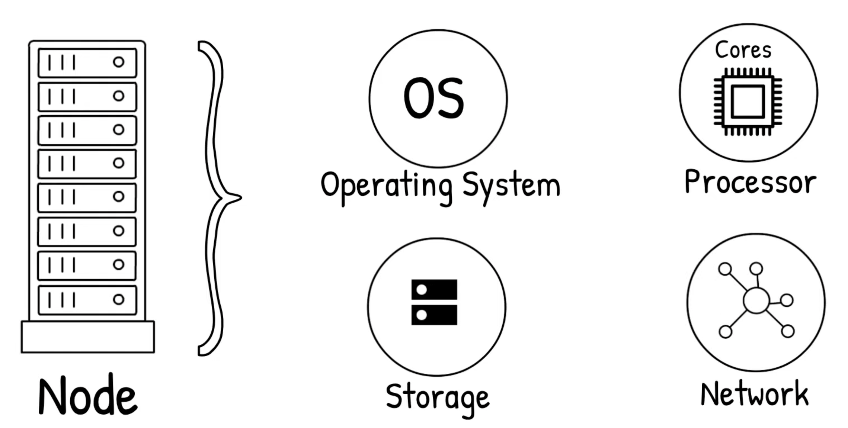
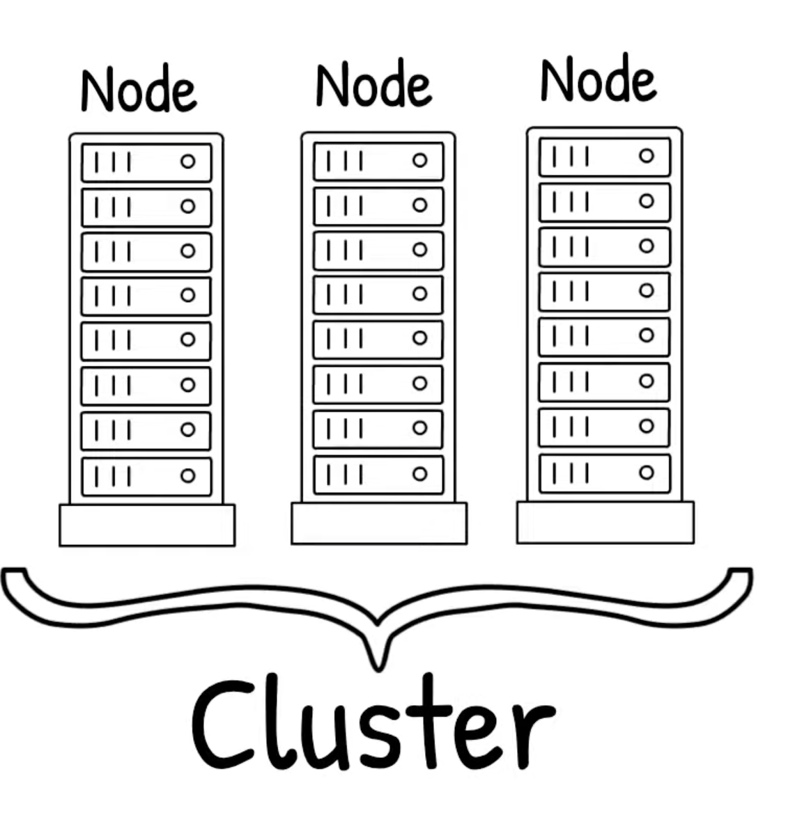
High performance computing
https://www.youtube.com/watch?v=nIBu1EFYmBU

Slide 67



Digital Research Alliance of Canada (Compute Canada)

Slide 68
Digital Research Alliance of Canada (Compute Canada)
Your own machine - SSH
Long term Storage purposes
Nearline
Projects
Short term
Scratch
User side
Cluster Login node (Headnode)
Cluster Storage types

Slide 69
Digital Research Alliance of Canada (Compute Canada)
Feature | Scratch Storage | Nearline Storage | Projects Storage
Purpose | Temporary, high-performance storage | Long-term, infrequently accessed data | Persistent, project-related storage
Performance | High | Moderate to Low | Moderate to High
Capacity | Large | Large | Moderate to Large
Backup | No | Yes | Yes
Purge Policy | Regular purges | Data retained long-term | Retained throughout project duration
Accessibility | Individual user | Individual user | Shared among project members

Slide 70
Digital Research Alliance of Canada (Compute Canada)
Overview of some important terms related to the cluster:
  Compute Nodes → one node = one computer
  Job Scheduling System → SLURM
  SLURM job priority → Fairshare

Slide 71
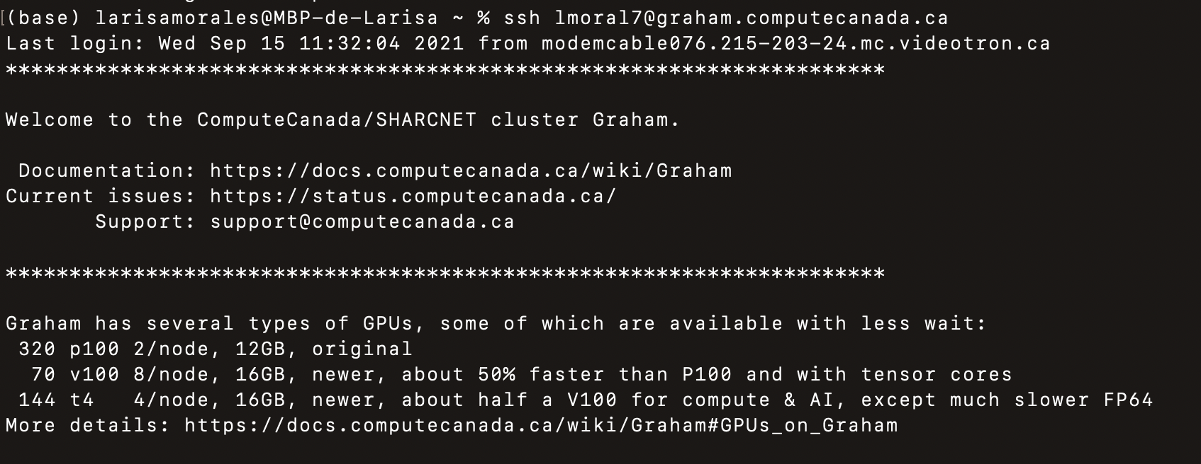
Connect to a cluster
ssh user@cluster.computecanada.ca

Slide 72
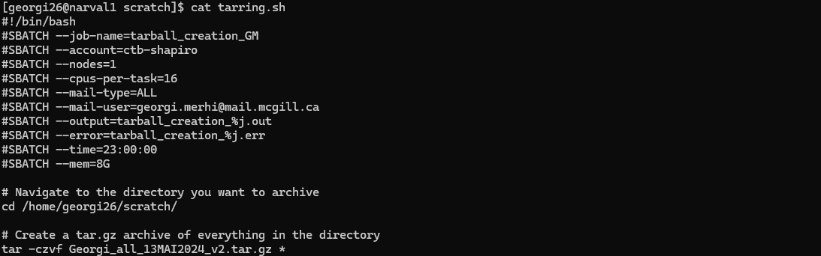
Jobs
Requesting a computing allocation to execute your code

Slide 73
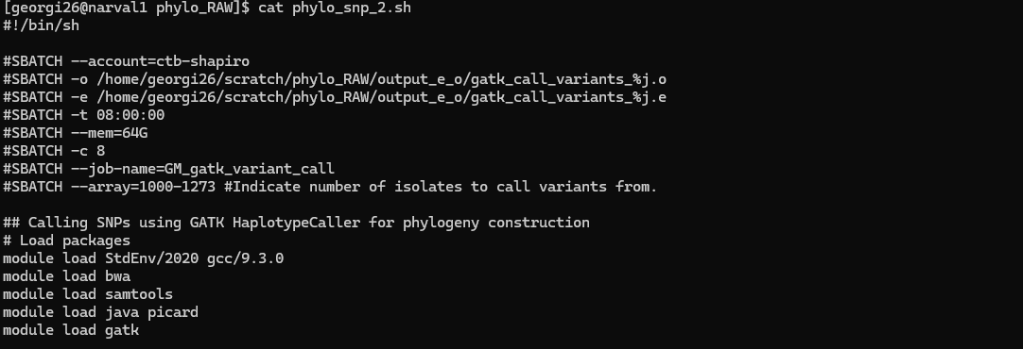
Job arrays
A job script that internally behaves like a for loop and submits individual jobs

Slide 74
Jobs - Bonus
You can use the sbatch command with flags without adding parameter directives in a job script.
Then run the command in the terminal as follows

Slide 75
Job submission/monitoring & Useful commands
sbatch job_script.slurm
Submit a job using a job script
squeue -u ${USER}
List all the processes of $USER
sq
Same as above but shorter
scancel [PID]
Cancel a process using its process ID (PID)
scancel -u ${USER}
Cancel all processes that belong to $USER
quota –s
Check your home directory usage and quota
quota --per_user
Check all users’ usage and quota

Slide 76
To summarize
UNIX is an operating system with two parts: the kernel and the shell
The shell (terminal) contains many built-in programs called commands
Commands allow the user to perform operations on files
Now you are ready to:
Automate file management operations
Extract relevant information from files without opening them
Create pipelines that connect multiple tools
Determine which data structures are more appropriate for use

Slide 77


Thank you for attending!
1
2
3
  Scan the QR code to confirm you attended today’s workshop.
Fill out the feedback survey in the next 72h.
Get recognition for this workshop on your
co-curricular record.

Slide 78
Datasets references
Hands on 1 – Cars dataset
https://perso.telecom-paristech.fr/eagan/class/igr204/datasets
Hands on 2 – Happiness surveys dataset
https://perso.telecom-paristech.fr/eagan/class/igr204/datasets
Resources
UNIX cheatsheet

