Slide 1




Introduction to UNIX and RNA-seq Repositories
June 1st 2026
Arsham Mikaeili Namini
Zahra Tavakol

Slide 2
Outline
Setup & Troubleshooting
UNIX availability check
Fix PATH / permissions
Module 1 — UNIX Basics
File management and navigation
File inspection
Pipes and redirects
Text search
Module 2 — GEO Basics
Accession types
Common files
FTP/HTTPS & Data Download

Slide 3
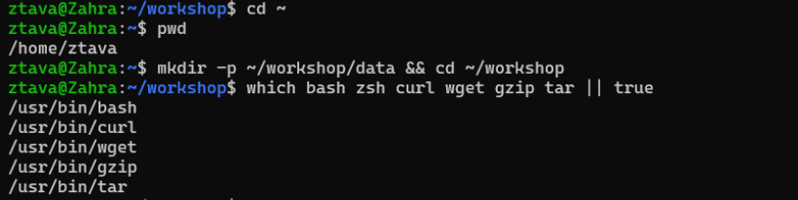
Setup & Troubleshooting
pwd
mkdir -p ~/workshop/data && cd ~/workshop
which bash zsh curl wget gzip tar || true

Slide 4
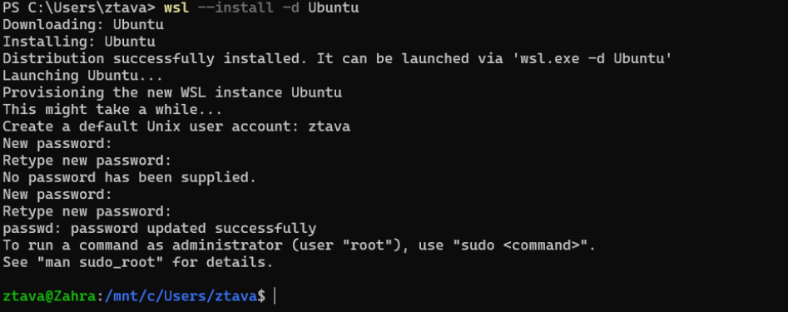
wsl --install -d Ubuntu
wsl -l -v
wsl -d Ubuntu
exit or Ctrl+D → To exit
wsl --unregister "Ubuntu"
sudo apt update -y
sudo apt install -y curl wget gzip tar grep gawk sed

Slide 5
Module 1
UNIX Basics

Slide 6
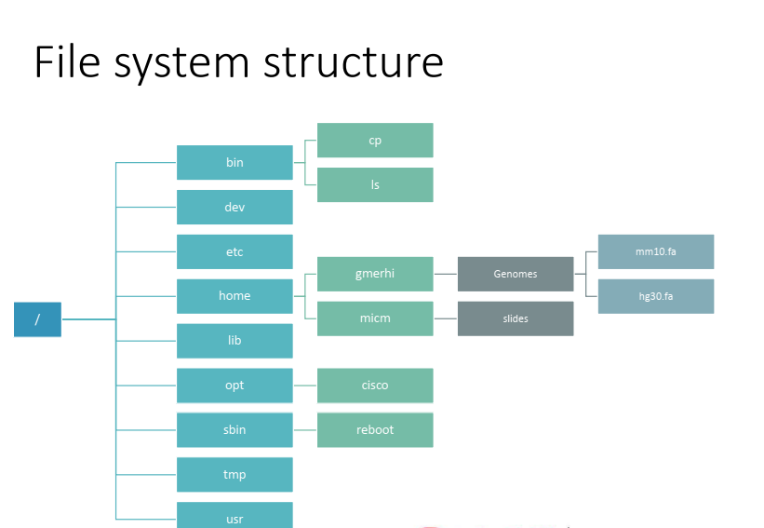

Slide 7
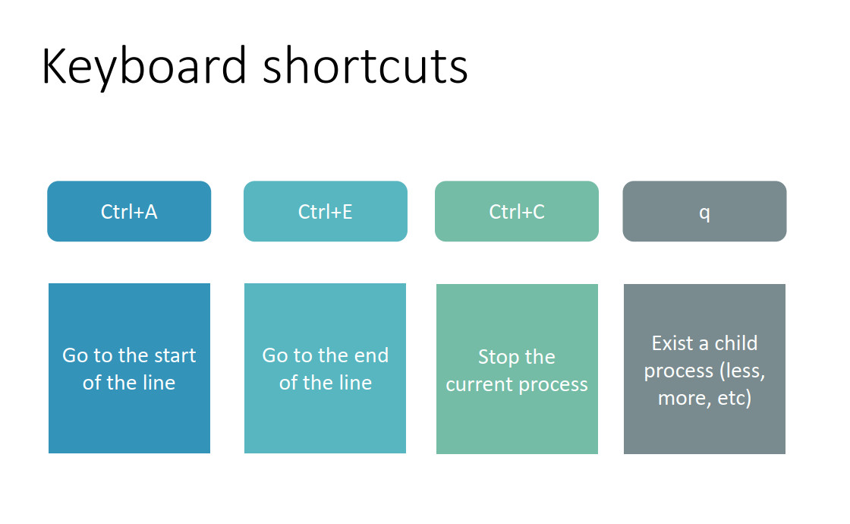

Slide 8
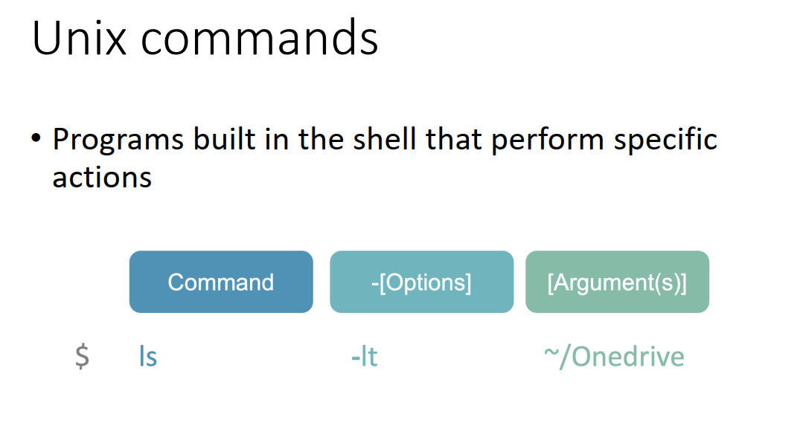

Slide 9
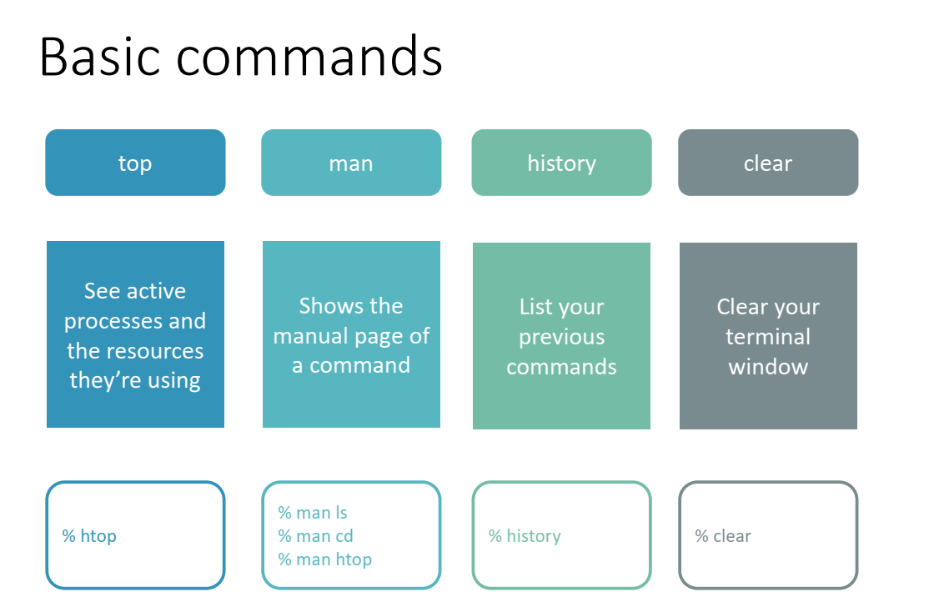

Slide 10
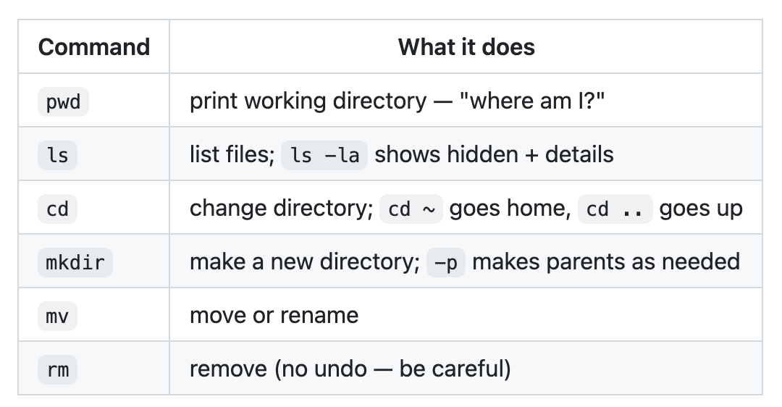
File management & navigation

Slide 11
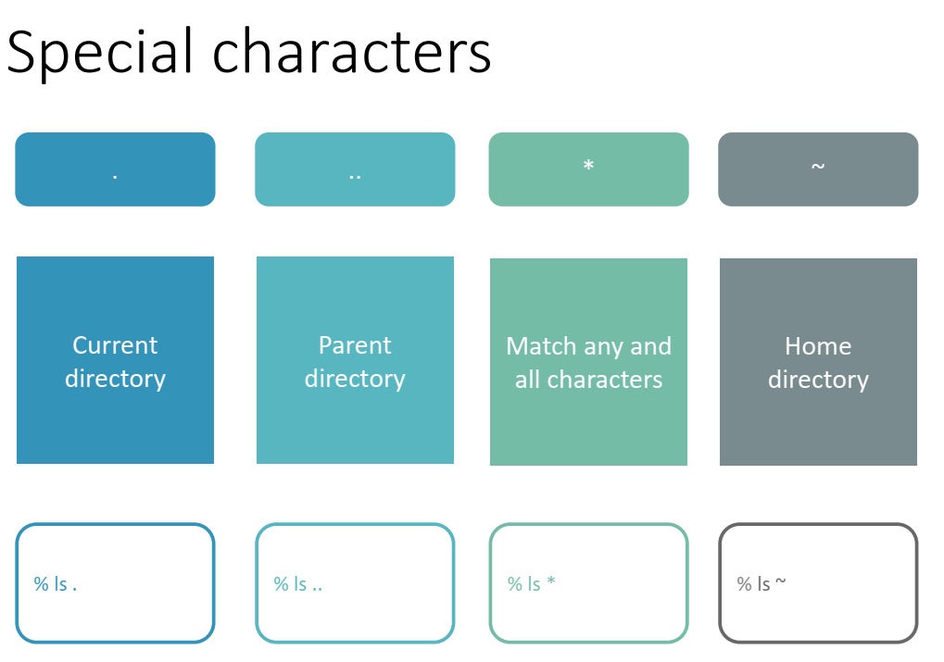

Slide 12
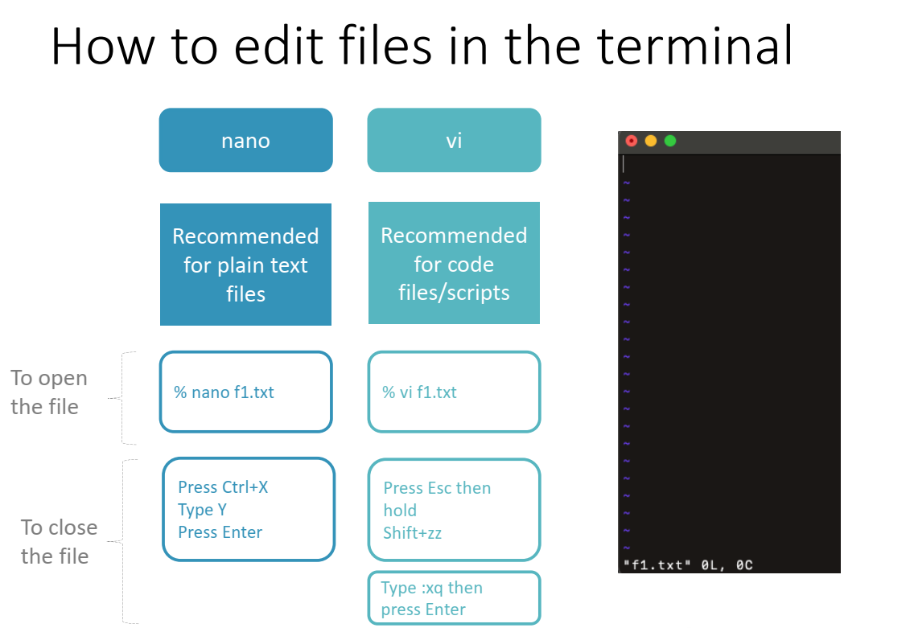

Slide 13
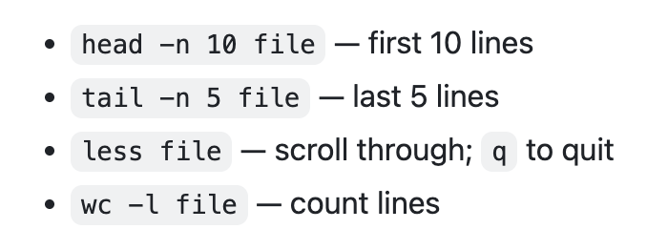
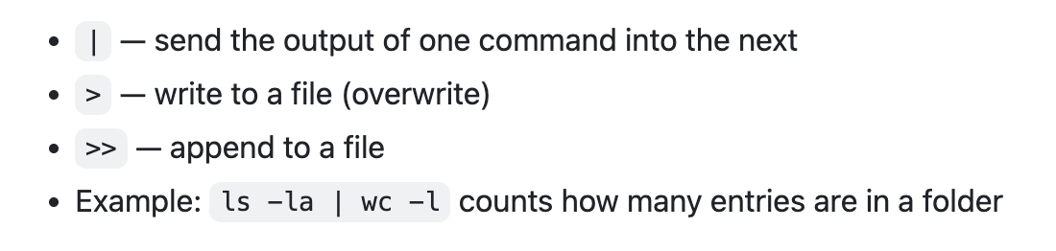
File inspection
Pipes and redirects

Slide 14
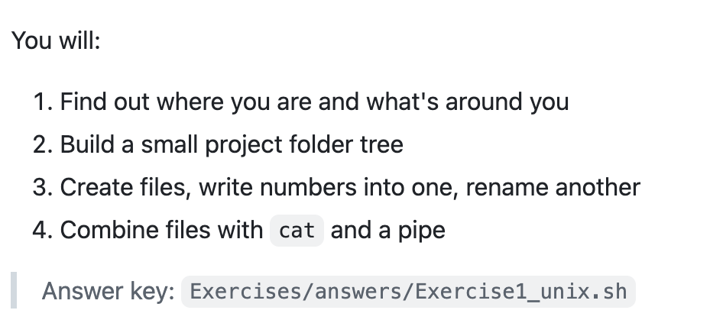
Exercise 1

Slide 15
Pattern Matching
Find lines. Then describe lines. Then compute on them.
Flow: grep → regex → awk → mini-capstone (solve today's Wordle).
By the end of this module you should be able to look at a CSV, a FASTQ, or any plain-text file and pull out exactly the rows you want — without opening the file in Excel.

Slide 16
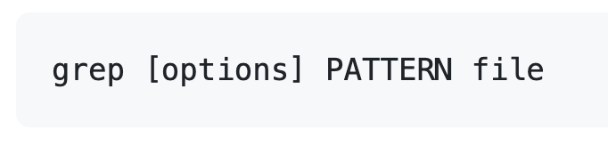
grep — "global regular expression print"
grep reads a file top to bottom and prints every line that contains the pattern you give it.

Slide 17
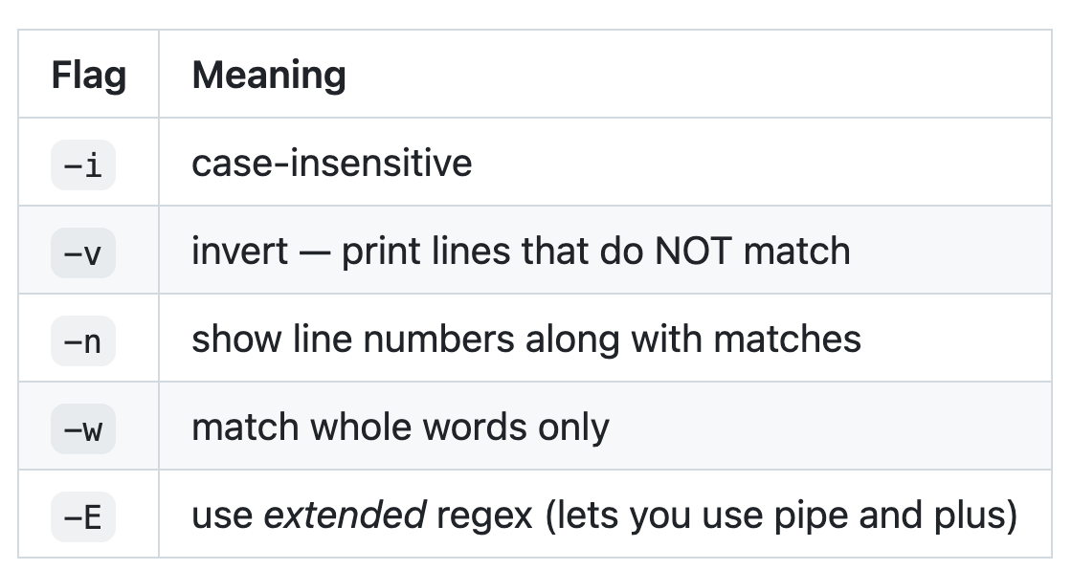
grep — "global regular expression print"
Full list can be seen in grep --help command

Slide 18
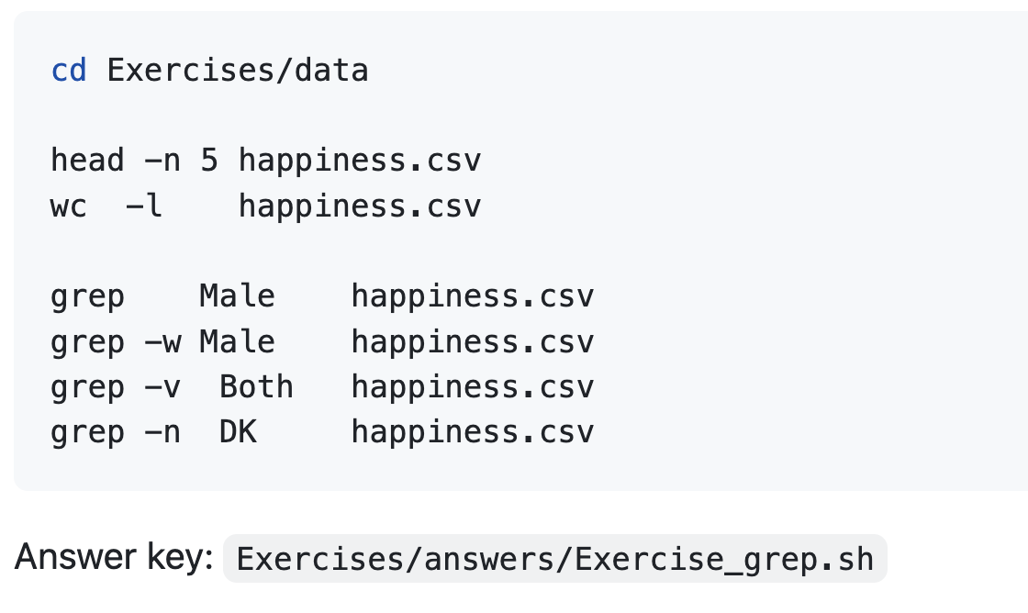
Mini Exercise — grep on a small CSV
Data file: Exercises/data/happiness.csv — 60 rows of country / gender / mean happiness / sample size.
Before you run each command, predict what you'll get.

Slide 19
Regex — describing the shape of text
`grep Male` only finds the literal letters M-a-l-e. Real questions sound like:
"lines that start with F"
"lines that end in a 4-digit number"
"country codes that are exactly 2 uppercase letters"
"5-letter English words starting with cr"
For those you need a regular expression — a tiny language for describing the shape of text.

Slide 20
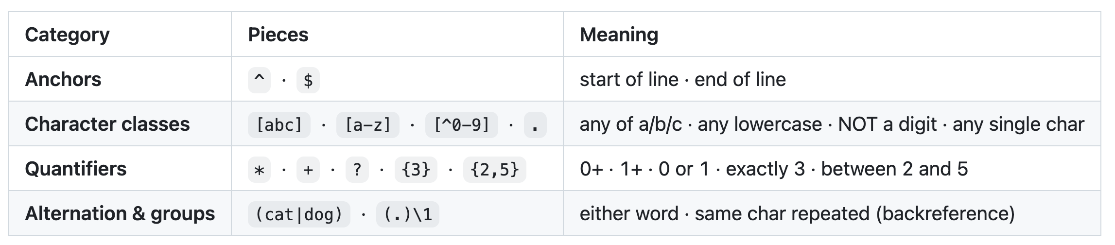
Regex — describing the shape of text

Slide 21
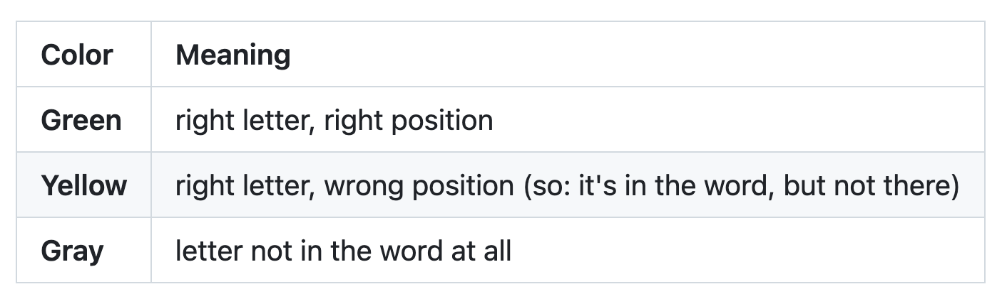
Regex — solve today's Wordle
Wordle gives you a 5-letter word. After each guess you learn, per letter:

Slide 22
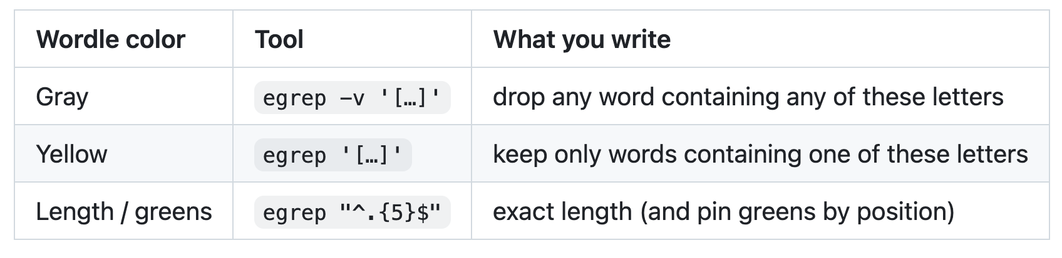
Regex — solve today's Wordle
Wordle gives you a 5-letter word. After each guess you learn, per letter:

Slide 23
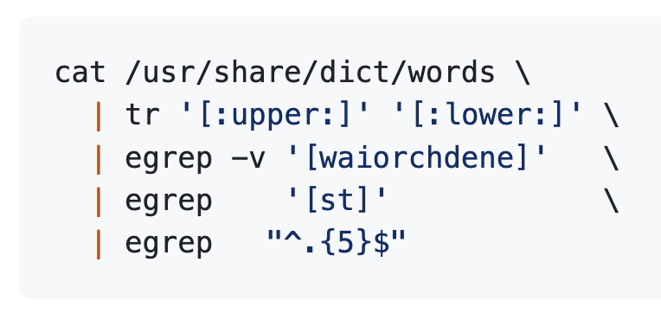
Regex — solve today's Wordle
Move to the terminal and wordle website, good luck!

Slide 24
grep finds lines. awk works with fields.
Our data is tabular: CSVs, count matrices, FASTQ records. We often want:
pull out column 3 of a CSV
count rows where column 5 ≥ 1000
compute the average of column 2
print field N for every record
grep can't do any of those. awk can.

Slide 25
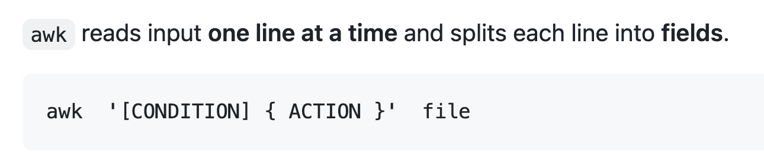
awk

Slide 26
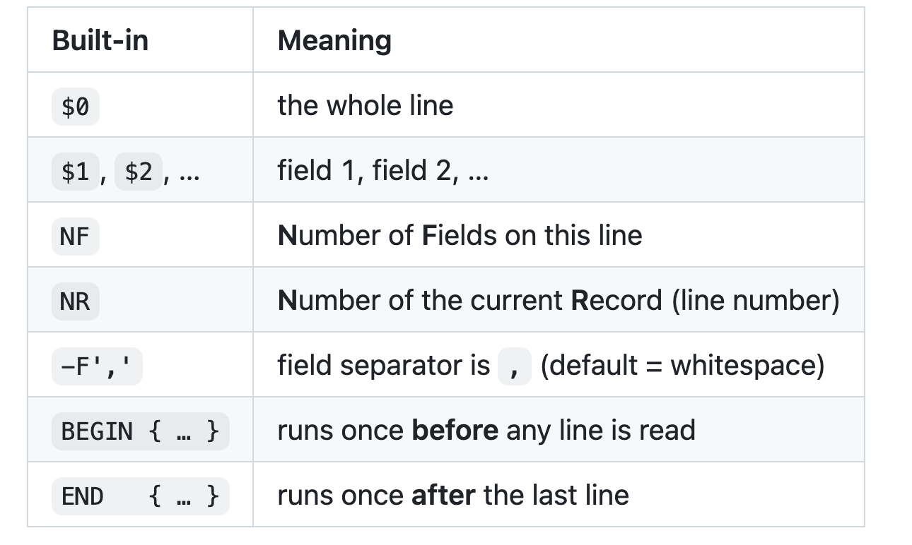
awk

Slide 27
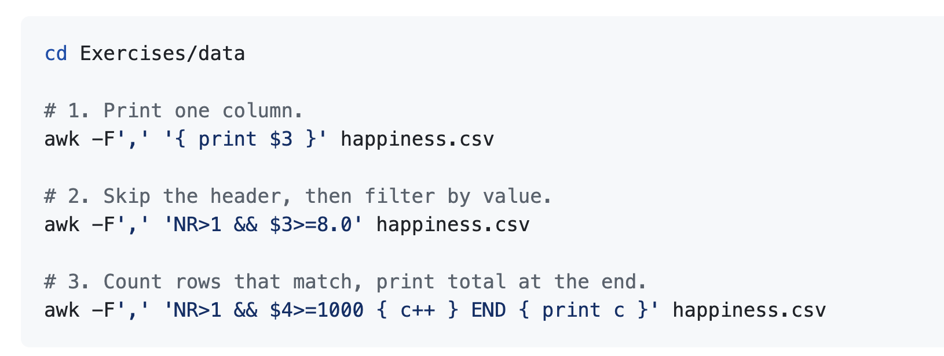
awk – Mini Exercise
Data file: Exercises/data/happiness.csv — 60 rows of country / gender / mean happiness / sample size.

Slide 28
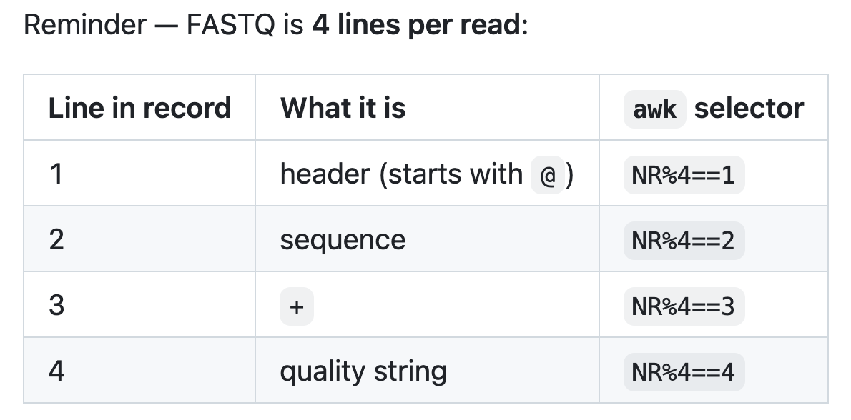
awk – in FASTQ files

Slide 29
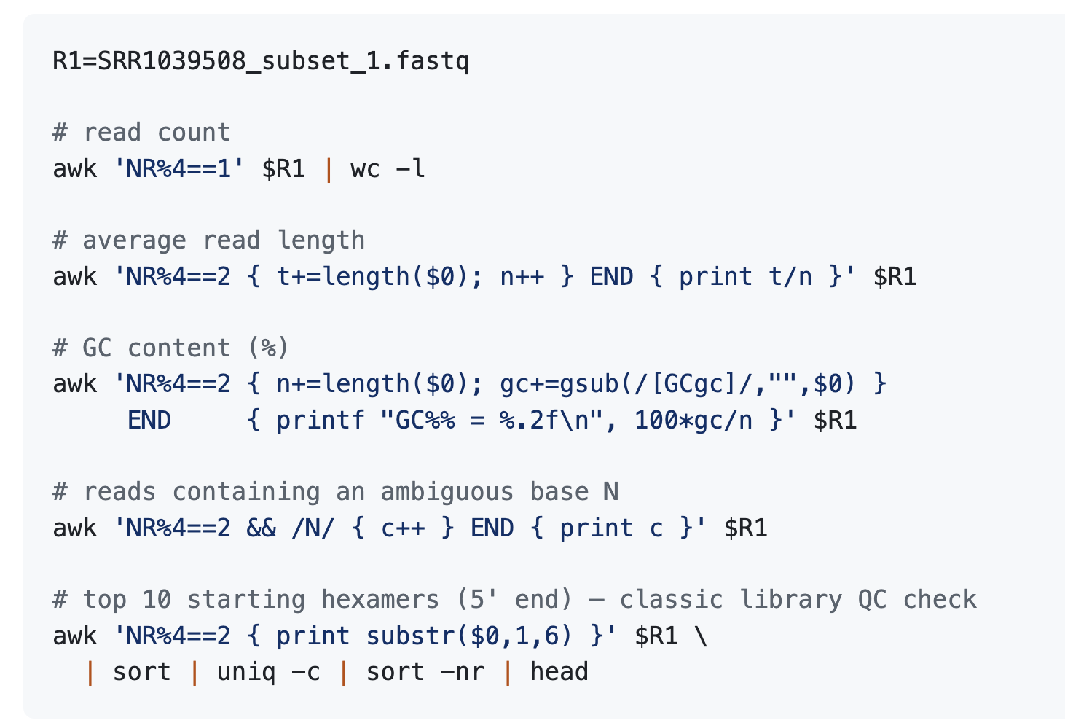
awk – in FASTQ files lets do some awk practice on the fastq files later (slide 46)

Slide 30
Module 1
GEO Basics

Slide 31
What is GEO?
Gene Expression Omnibus — NCBI's public repository for functional genomics data
Anything published with sequencing data ends up here (by NIH mandate)
Two layers of data:
Processed: count matrices, normalized expression — ready to analyze
Raw: the original FASTQ reads — sitting in SRA, linked from GEO

Slide 32
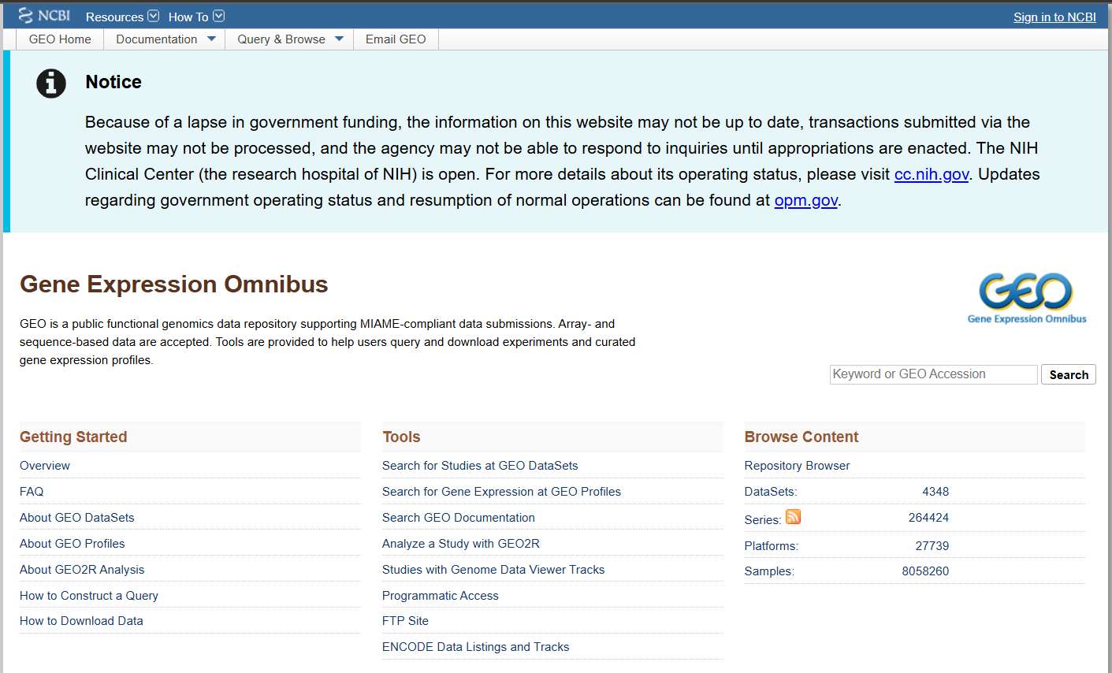
GEO (Gene Expression Omnibus)

Slide 33
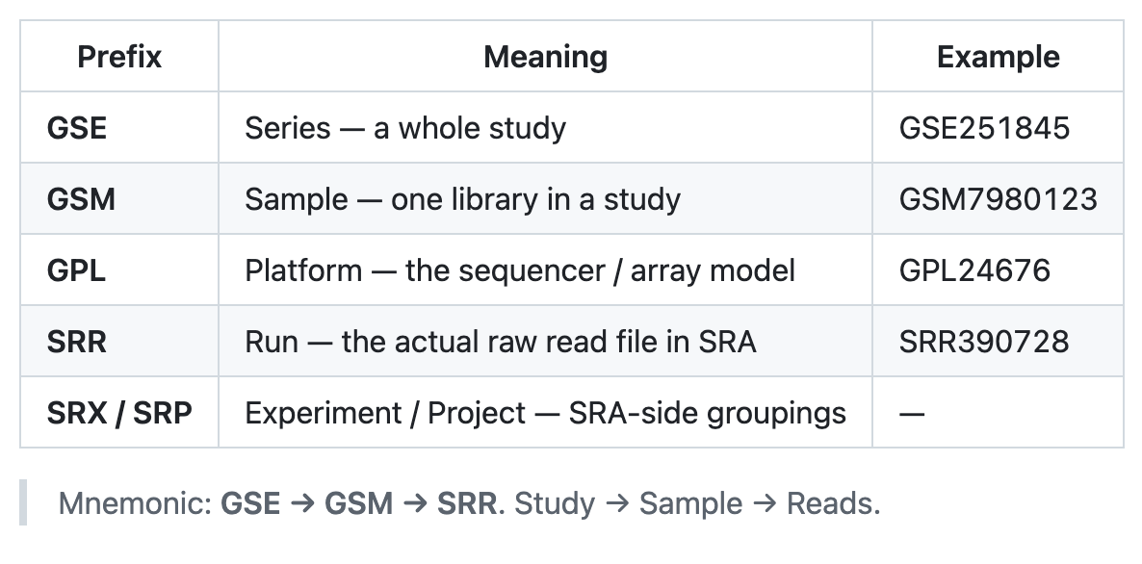
Accession types — learn to read them

Slide 34
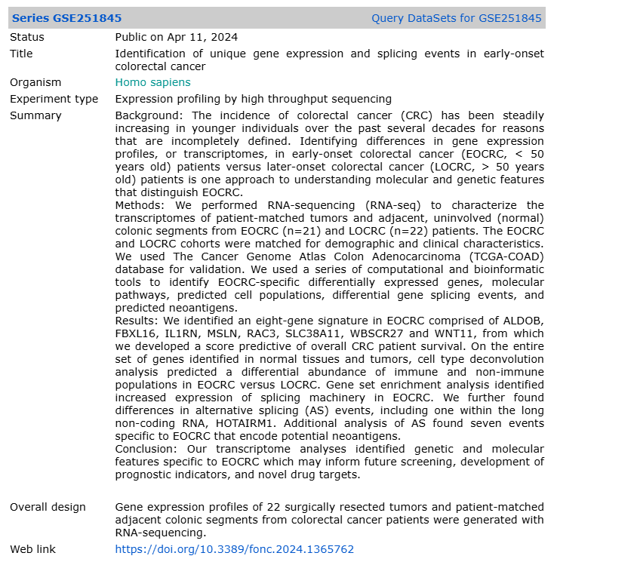
GSE251845

Slide 35
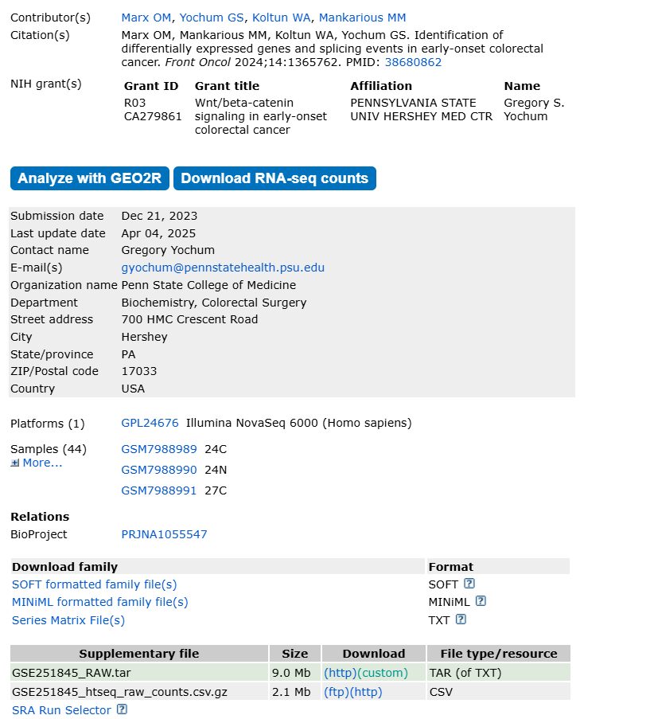
GEO accessions: GSE (series), GSM (samples), GPL (platform)
Processed data: Series Matrix / SOFT / tabular files
Raw count data: in supplementary file
Raw reads: usually in SRA/ENA as SRR… → *.fastq.gz
Raw (FASTQ): larger; needed for alignment/QC

Slide 36
Two ways to download FASTQ
#1 `wget` — the universal downloader
Works for any URL (FTP, HTTPS)
Best when GEO gives you a direct supplementary file link
Best when ENA hosts the FASTQ already gzipped (faster than going through SRA)
Pros: no install, just works
Cons: you need to know the URL

Slide 37
Two ways to download FASTQ
#2 `fastq-dump` (and fasterq-dump) — the SRA-native tool
Part of NCBI's SRA Toolkit
Takes an SRR accession directly — no URL needed
Knows how to handle paired-end splitting, read filtering, range selection
Pros: reproducible, scriptable, handles every SRR uniformly
Cons: needs install; first run downloads a cache

Slide 38
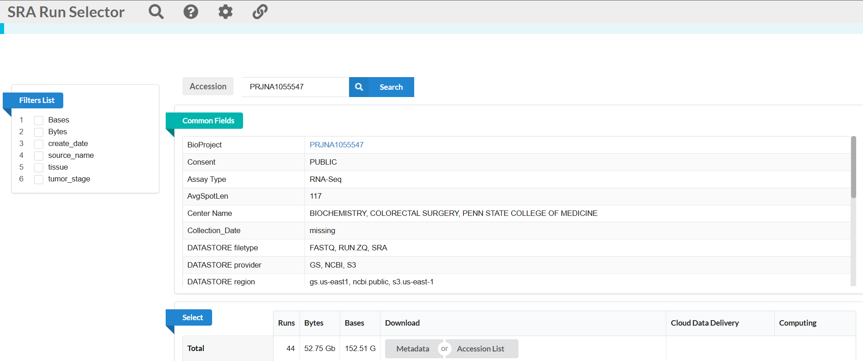
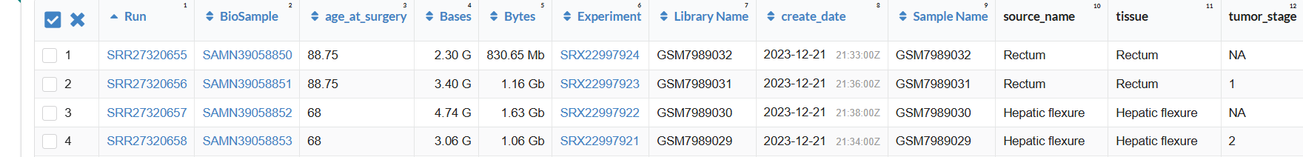
Notes:
To get fastq/fasta data

Slide 39
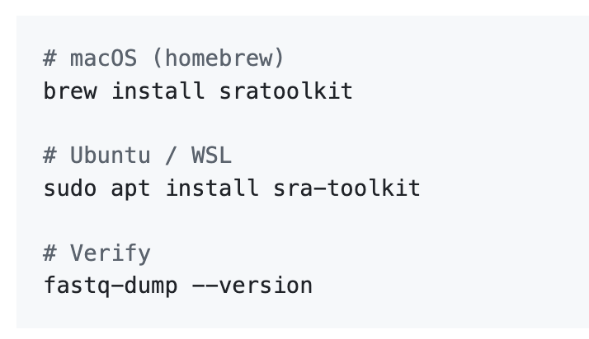
Installing SRA Toolkit (optional)

Slide 40
The two demo commands You can find both command in the github repo
Download with wget (from ENA — friendliest mirror):
Download with fastq-dump (cap at 10,000 reads for the demo):

Slide 41
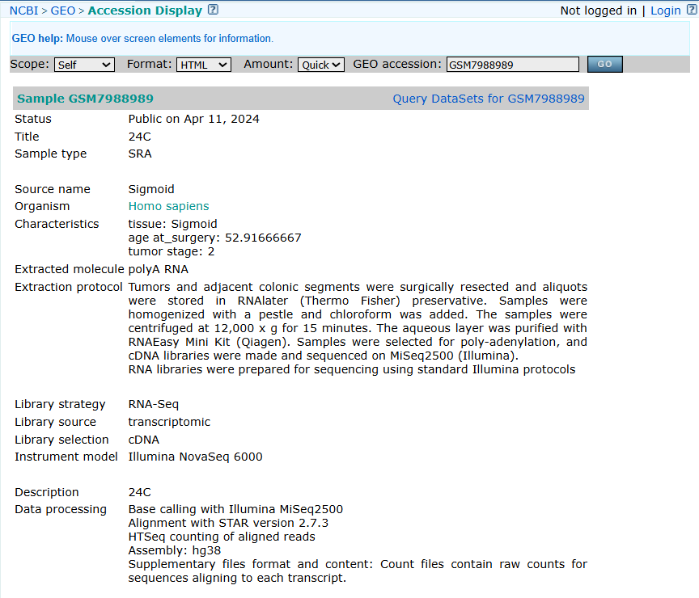

Slide 42
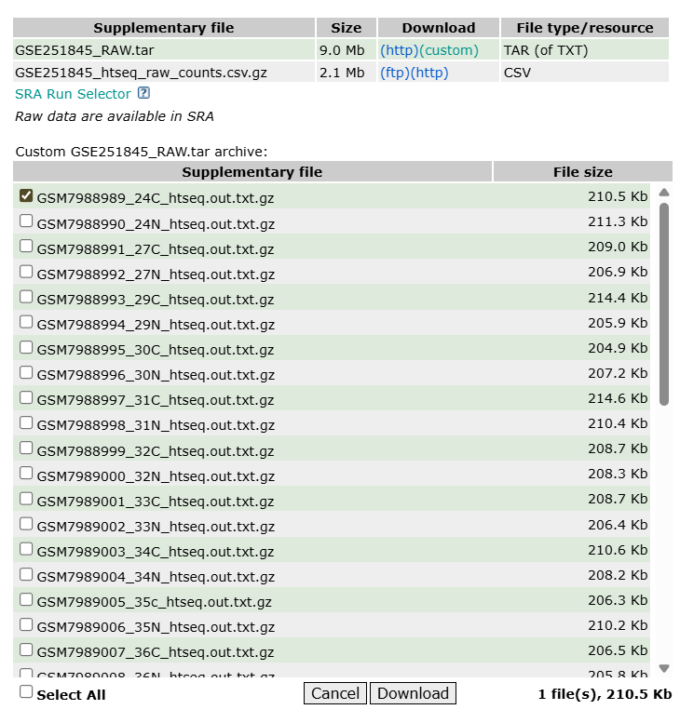

Slide 43
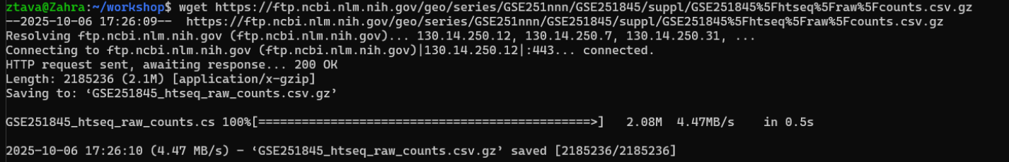
FTP / HTTPS Download
Pick one tool: curl -L -O <URL> or wget <URL>

Slide 44
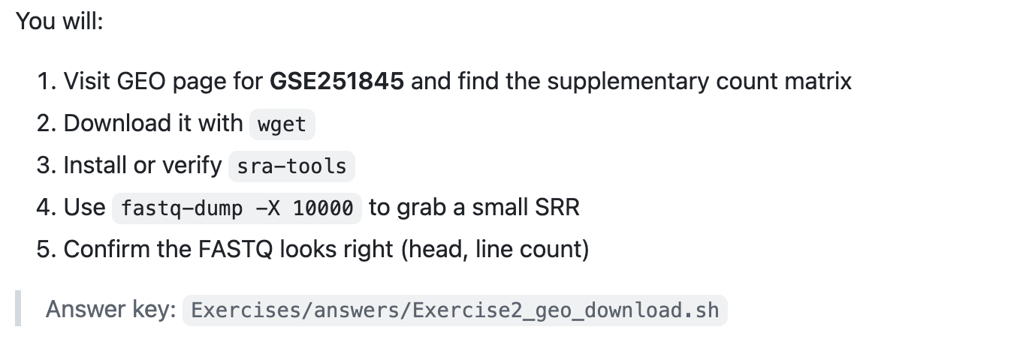
Exercise 2 — pull real data

Slide 45
Putting it together on real data
Now that you can download, let's look at the data
Two file types, two skill sets:
Counts CSV (gzipped): tabular, comma-separated, has a header
FASTQ: 4 lines per read, no header, sequence-aware

Slide 46
awk – in FASTQ files lets do some awk practice on the fastq files

Slide 47
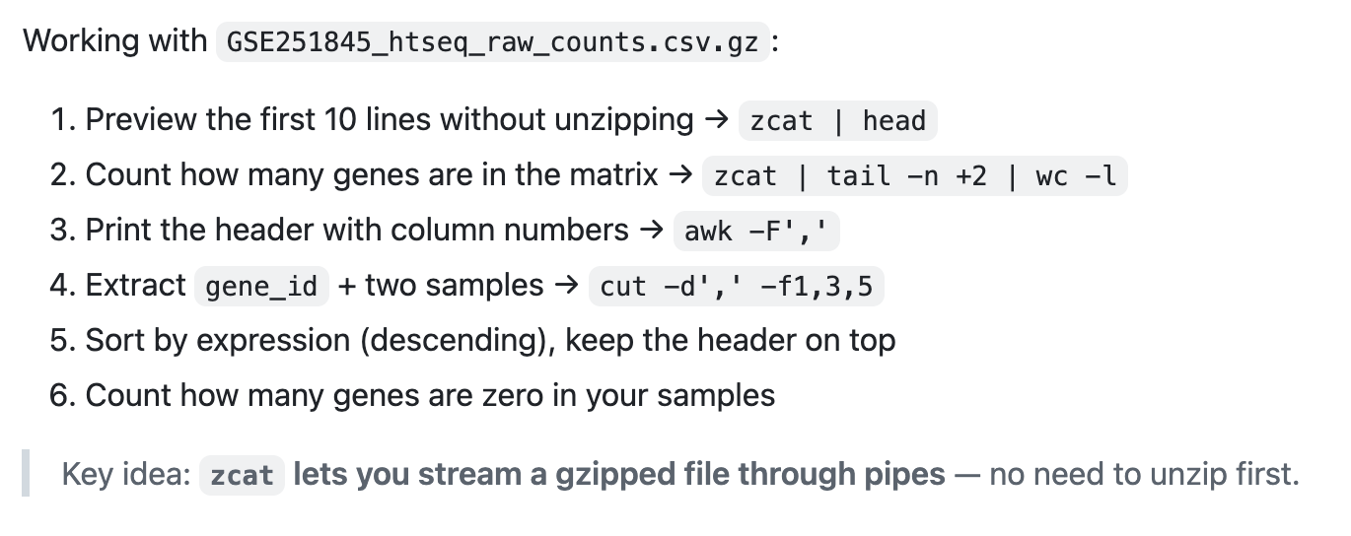
Exercise 3.1 — Counts CSV

Slide 48
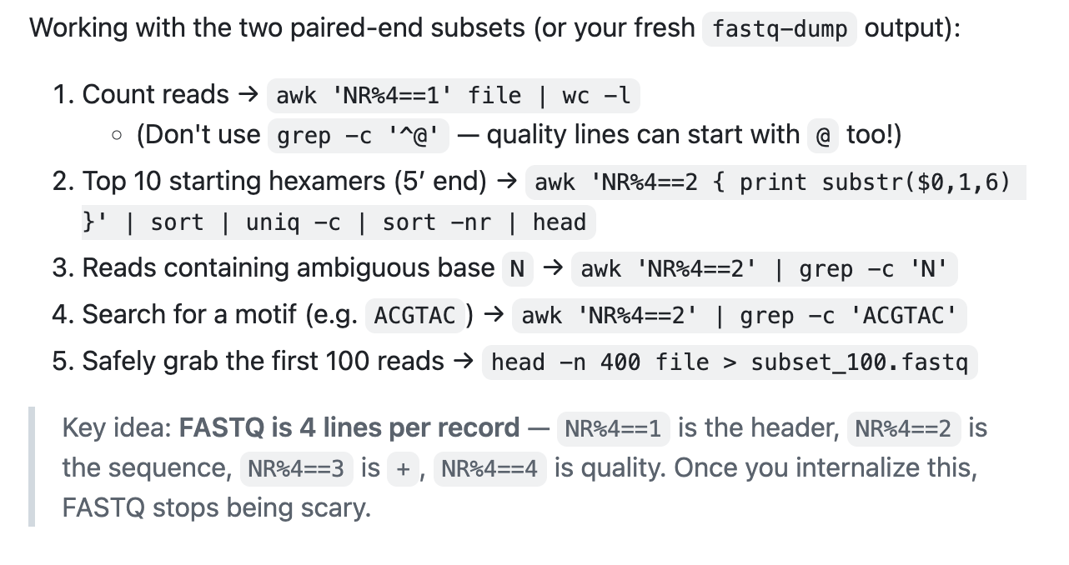
Exercise 3.2 — FASTQ inspection

Slide 49
Q&A!!!

Slide 50
With thanks to our collaborators

