Slide 1


Intro to MATLAB
Workshop Lead: Julia Forestell
Date: February 18th, 2025

Slide 2

Outline
Module 1: MATLAB Basics
Basic Arithmetic and using the command line
Programming in MATLAB
Exercises!
Module 2: MATLAB for Science
2D & 3D Plotting
Numerical Methods
Exercises!
Module 3: Additional Resources!

Slide 3
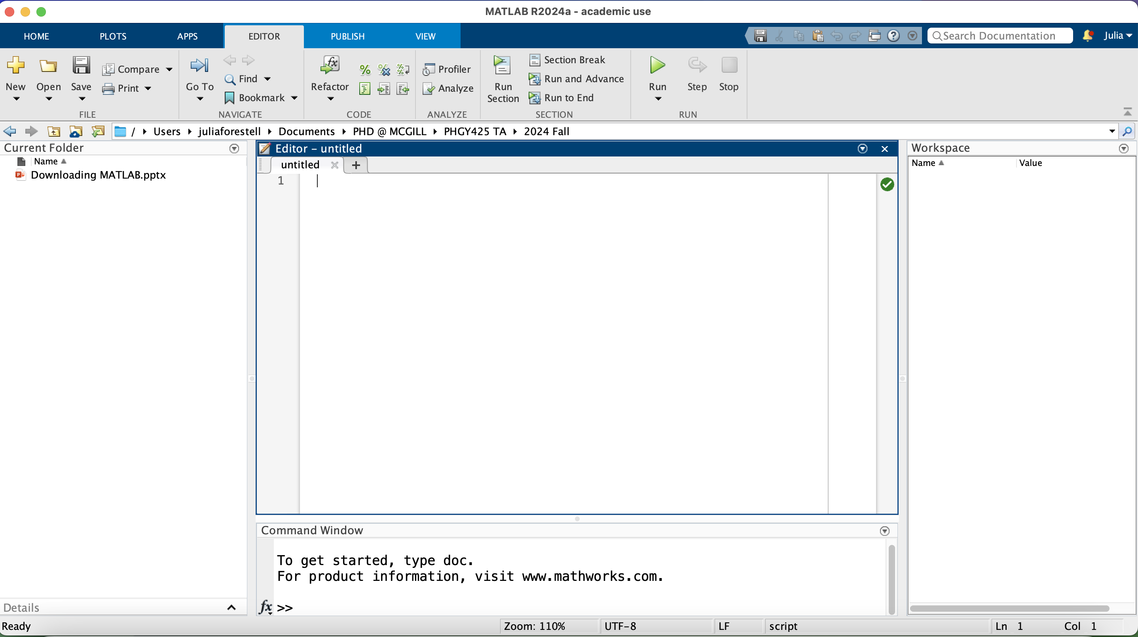
Tour of the environment
Module 1: MATLAB Basics
Editor
Variable Workspace
Working Directory
Command Line
Notes:
MATLAB overview

Slide 4
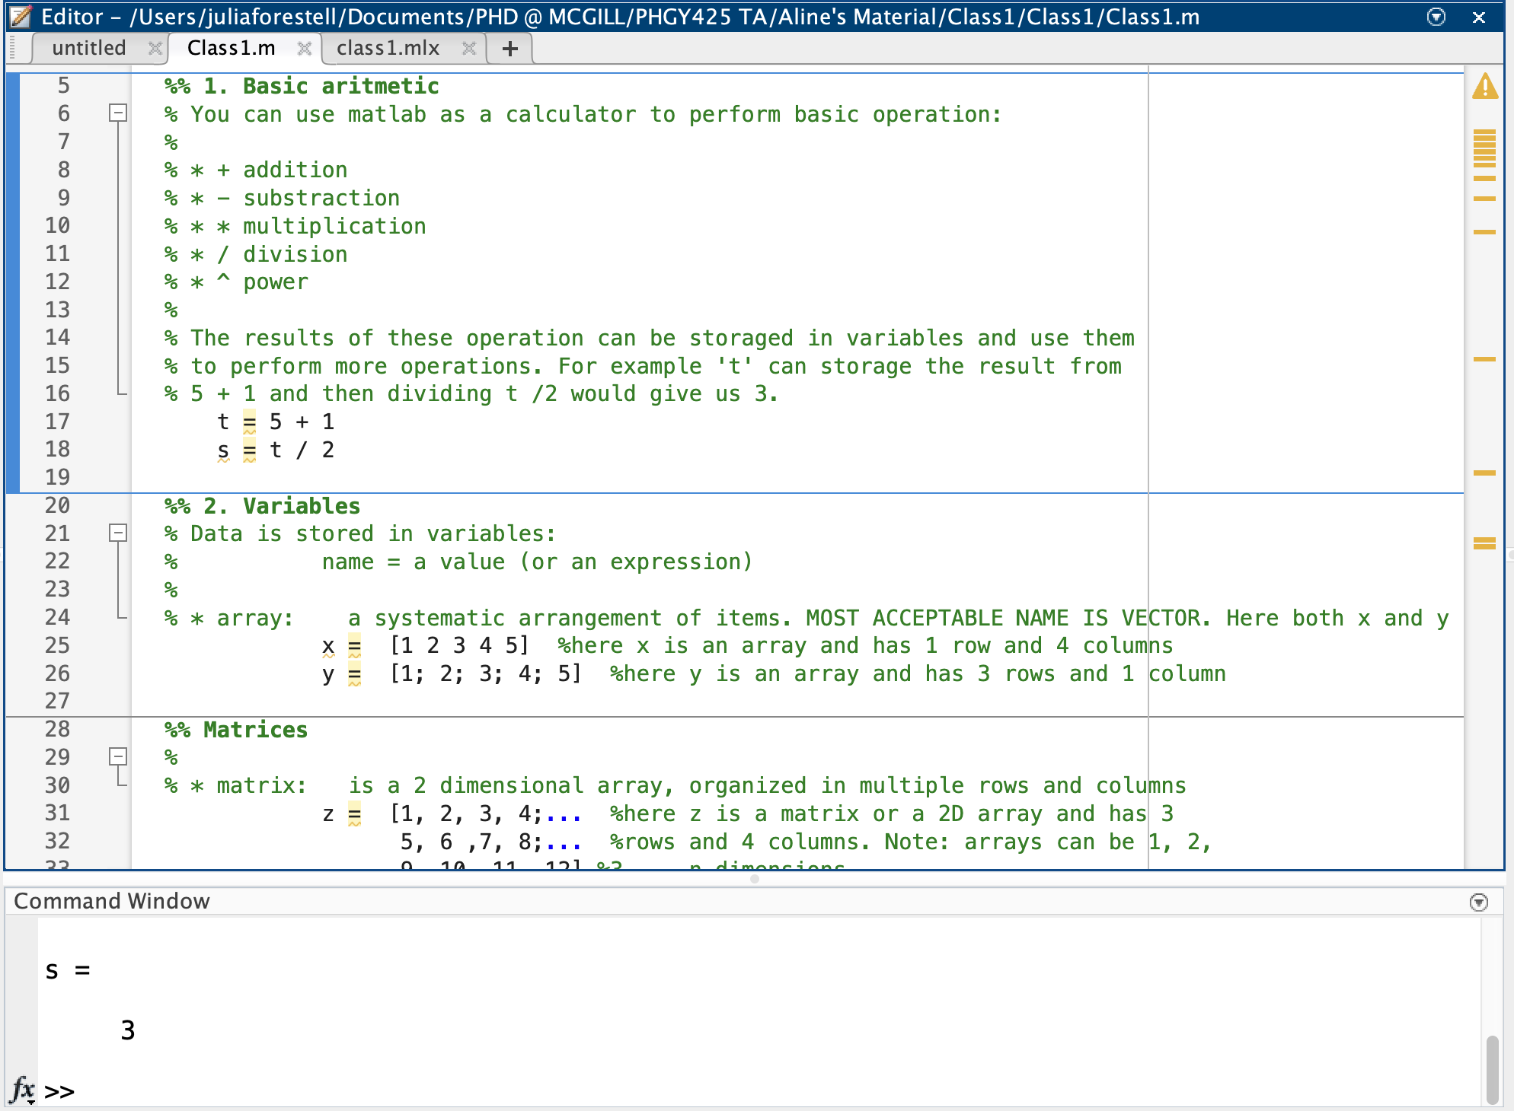
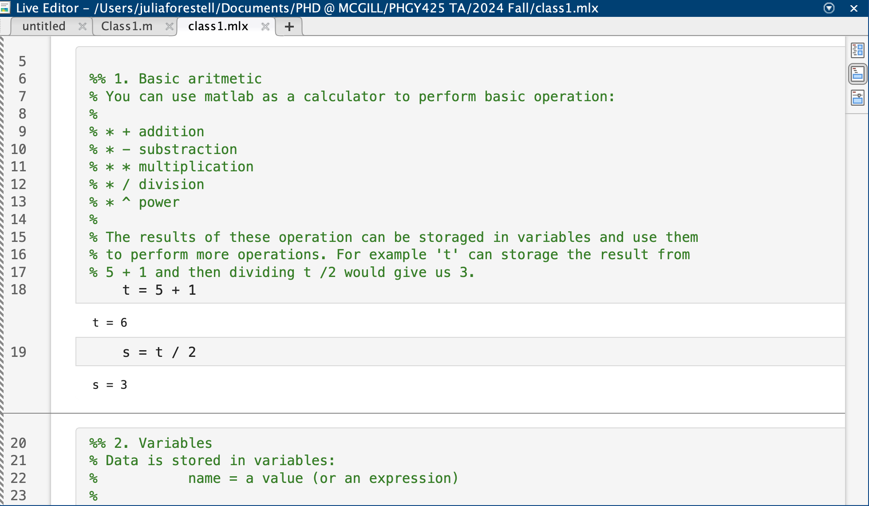
MATLAB Scripts
Module 1: MATLAB Basics
Script (.m file)
Live Script (.mlx file)

Slide 5

The command line
Module 1: MATLAB Basics
Code Along
Using MATLAB as a fancy calculator
Vectors, matrices, and arrays
Basic built-in functions
Notes:
MATLAB was created as a tool to make matrix algorithms much easier to work out!

Slide 6
Exercise 1: Command Line
Module 1: MATLAB Basics
Try It Out
Find the sum of all elements in this vector using 1 command:
[1, 3, -5, 24, 8, -76, 44, -2, 7, 13]
Type the following lines, pressing enter in between each
p = (3*2)^2
q = (3*2)^2;
What is the difference between the outputs?
Form a 6 x 1 vector a of zeros using the zeros command

Slide 7
MATLAB Scripts
Module 1: MATLAB Basics
Code Along
Basic arithmetic
Variables
Functions
If-statements and loops
Text and characters
Basic errors and troubleshooting

Slide 8
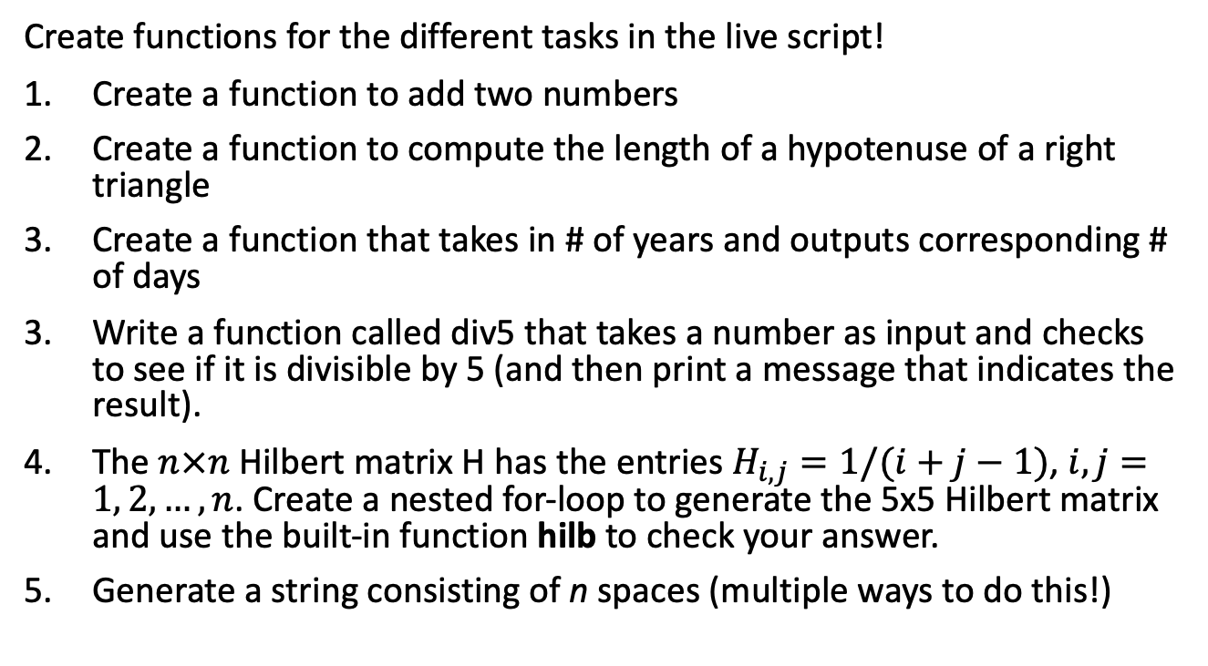
Exercise 2: Programming
Module 1: MATLAB Basics
Try It Out
Create functions for the different tasks in the live script!
Create a function to add two numbers
Create a function to compute the length of a hypotenuse of a right triangle
Create a function that takes in # of years and outputs corresponding # of days
Write a function called div5 that takes a number as input and checks to see if it is divisible by 5 (and then print a message that indicates the result).
The $n×n$ Hilbert matrix H has the entries $H_{i, j}=1/(i+j−1)$, $i, j=1, 2, …, n$. Create a nested for-loop to generate the 5x5 Hilbert matrix and use the built-in function hilb to check your answer.
Generate a string consisting of n spaces (multiple ways to do this!)

Slide 9
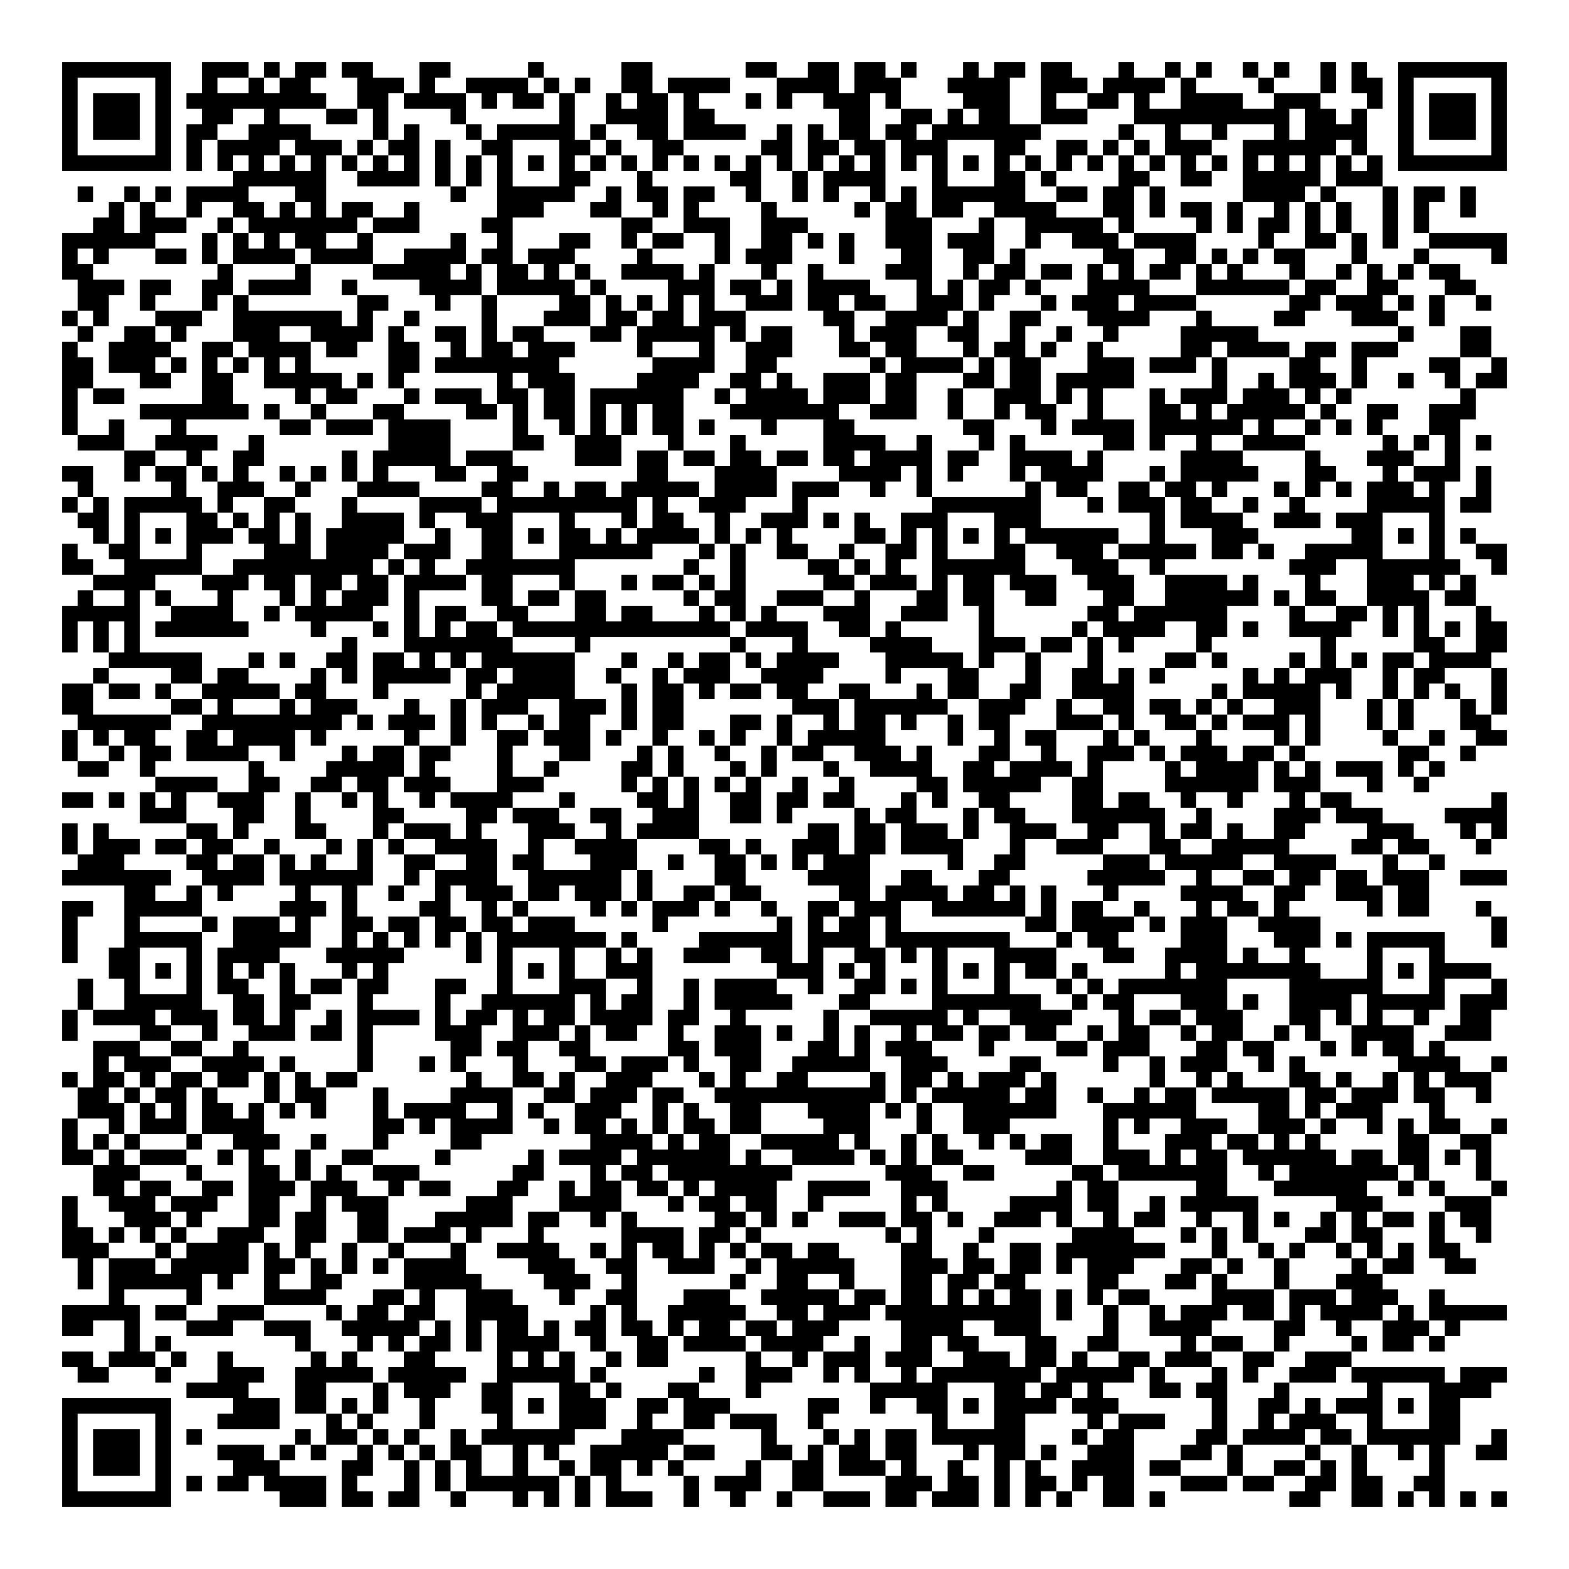


Break!
1
2
3
Scan the QR code to confirm you attended today’s workshop.
Fill out the feedback survey in the next 72h.
Get recognition for this workshop on your
co-curricular record.

Slide 10
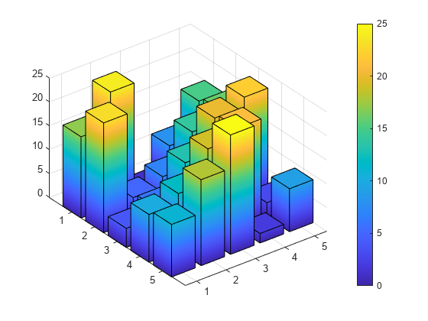
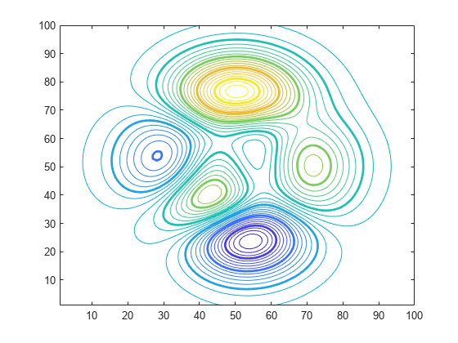
2D & 3D Plotting
Module 2: MATLAB for Science
Code Along
Basic plotting
Interacting with files

Slide 11
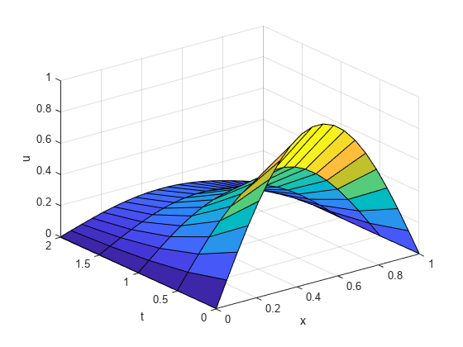
Some useful numerical methods
Module 2: MATLAB for Science
Code Along
Root finding
Curves of best fit
Solving differential equations

Slide 12
Exercise 3-4: Data Vis & Analysis
Module 2: MATLAB for Science
Try It Out
Work through exercise3_qpcr.mlx
Work through exercise4_penguins.mlx

Slide 13
Quick Links!
Module 3: Additional Resources
Want to learn more?
Mathworks self-paced courses
LinkedIn Learning – free through your student account
Want to get help?
https://www.mathworks.com/help/matlab/ Main documentation- very extensive
StackOverflow- a must ☺

Slide 14
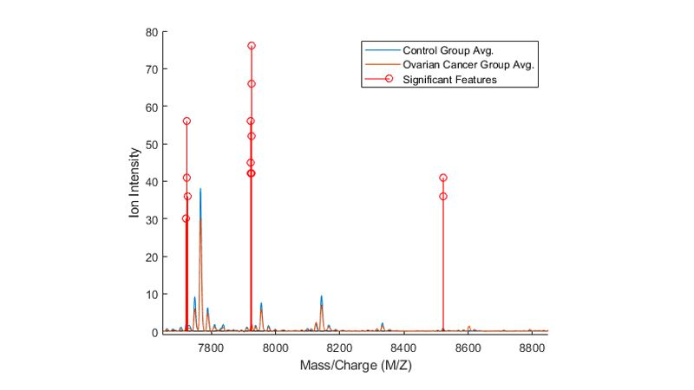
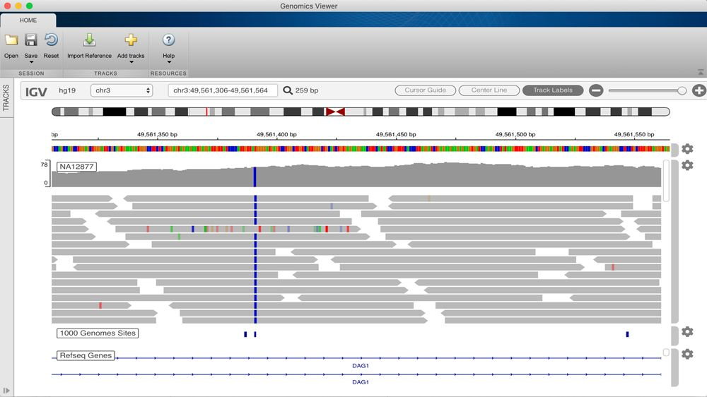
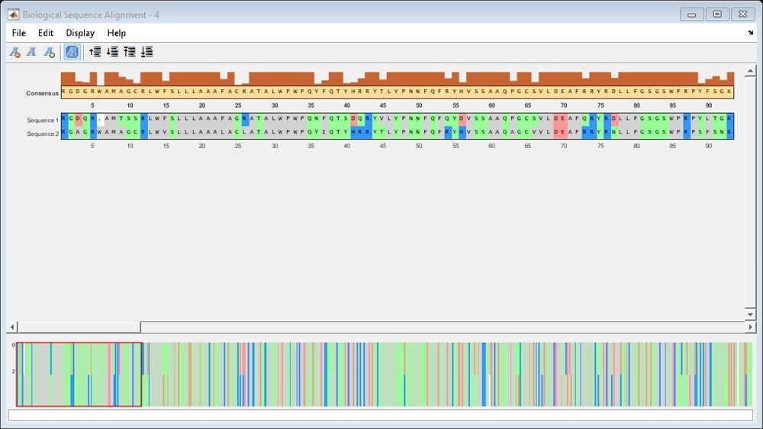
Tools for Computational Medicine
Module 3: Additional Resources
Bioinformatics Toolbox (option when installing)

Slide 15
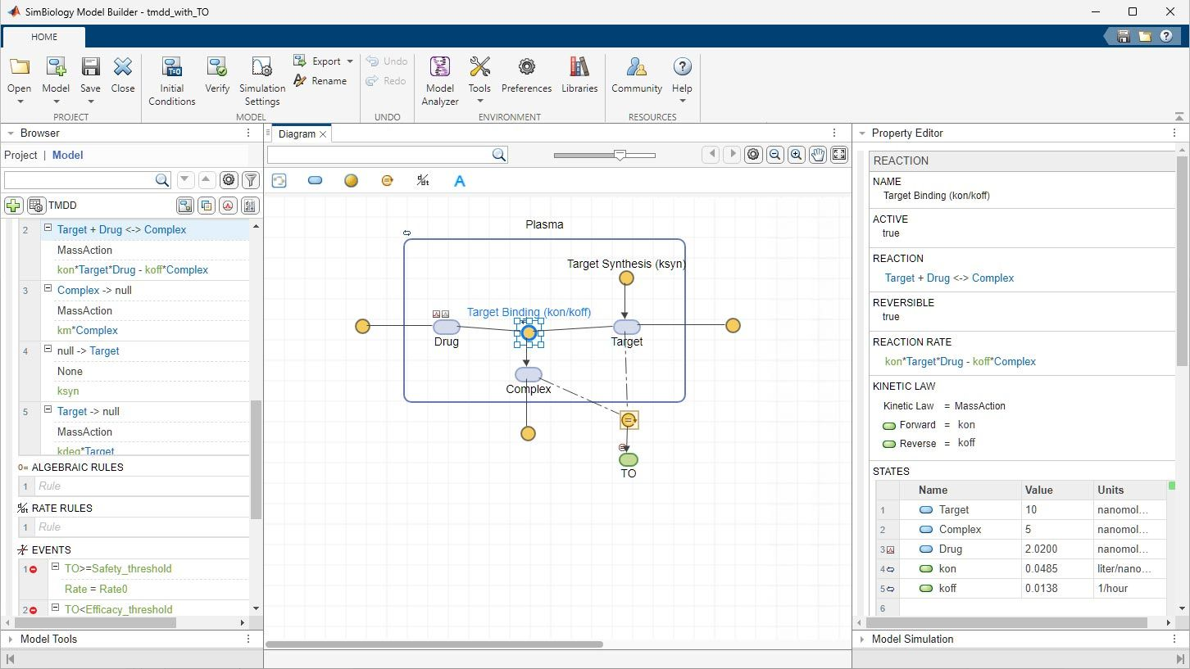
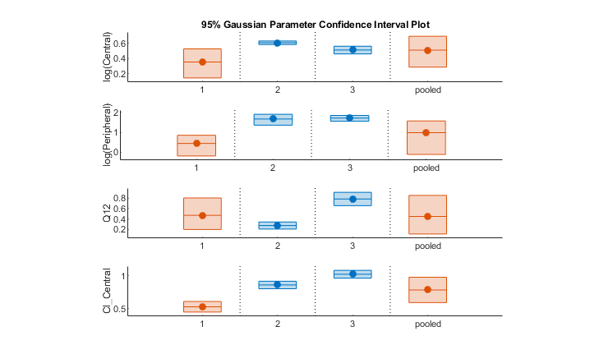
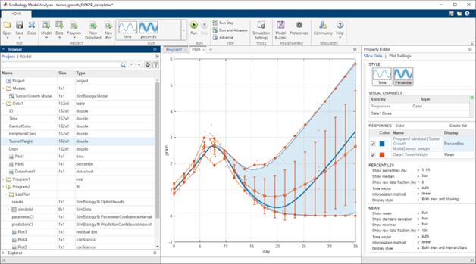
Tools for Computational Medicine
Module 3: Additional Resources
SimBiology (Simulink product)
ODE-based models (for pharmacokinetics, etc), Monte Carlo simulations, parameter estimation, tons of analysis!

Slide 16
To summarize
Now you are ready to:
Use MATLAB for many different types of calculations
Navigate the MATLAB command line and live scripts
Input, plot, and analyze data
Find tutorials and toolboxes specific to your research and/or interests!

Slide 17
Thank you for attending!
1
2
3
Scan the QR code to confirm you attended today’s workshop.
Fill out the feedback survey in the next 72h.
Get recognition for this workshop on your
co-curricular record.

