Slide 1

Welcome to
The Session Will Begin Shortly

Slide 2
R Package Development
Session #: Session Name

Slide 3
START

Slide 4
R Package Development
Instructor: Adrien Osakwe
Facilitators: Zahra Tavakol Hamedani & Megan Tsao

Slide 5


Acknowledgements
MiCM Mailing List
Biostatistics Section – SSC

Slide 6
Outline
Building a Package
  Why build a package
  Structure and implementation
  Unit testing
  Documentation
Git Refresher (optional)
GitHub Actions
  Automating package maintenance
  Installation & Testing workflow
  Handling Issues & Pull requests

Slide 7
Making the most of the session
Consider making a fork of the workshop repository
This will allow you to make modifications and test the workflows yourself!

Slide 8
1. Building a Package

Slide 9
Why bother with packages?
“Works on my machine”
  What about other users?
“Using different scripts with source() is enough”
  How do you handle file paths in different projects?
“I already have all the packages installed”
  Can you ensure reproducibility?
“I still have features to add”
  What if the code breaks? Will you know if it does?

Slide 10
Exercise
Explore the 1_Simple_Scripts folder
Try running the code
What would happen if you wanted to run this in a different folder?

Slide 11
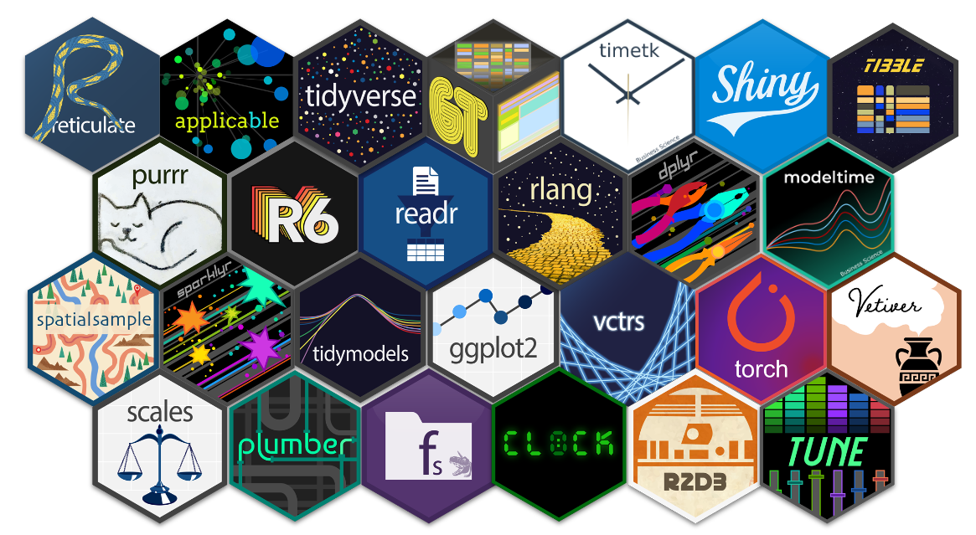
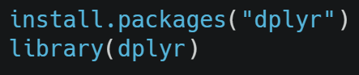
What is a package?
Set of reusable functions
Standardized formatting
No file path needed
Facilitates installation
Automates dependencies

Slide 12
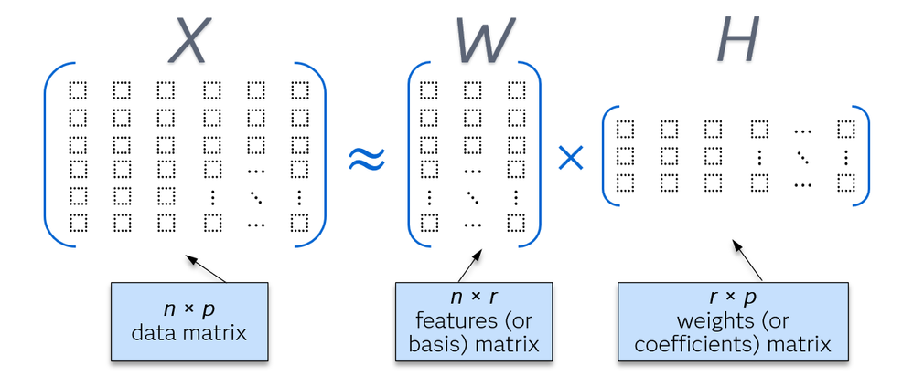
Today’s Example: bioNMF Package
We will be working on a non-negative matrix factorization (NMF) package
NMF decomposes data into clusters (r dimension)
Common for count data (gene expression)
Samples (patients) – n
Features (genes) – p
Clusters (programs) – r
Source

Slide 13
Today’s Example: NMF Package
Our NMF package must do the following:
Train an NMF model
  Takes X as input, returns W and H
Plot results
  Plot results in W and H
Source

Slide 14
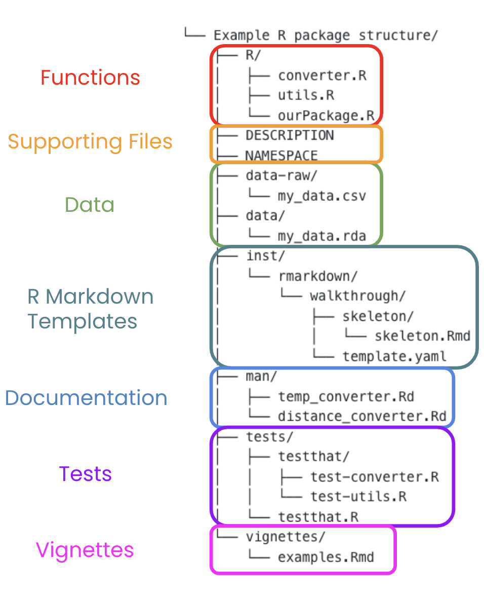
Package Structure
Packages are structured to improve readability
Each section has a specific function
Easier to understand, diagnose and contribute to

Slide 15
Package Structure
DESCRIPTION
  Package metadata
  Dependencies, authors, version #
NAMESPACE
  Specifies what functions should be visible to users
  What dependency functions can be used with the pkg:: syntax
data/ and data-raw/
  Store package data (strict format requirements)

Slide 16
Package Structure
inst/
  Store unstructured assets such as data and templates
man/
  Store function documentation
tests/
  Store package tests
vignettes/
  Package tutorials

Slide 17
Exercise
Explore the 2_Simple_Package structure
Click the ‘Build’ button at the top right
  Try running ‘install’
  Try running ‘check’
Question: where would Rcpp scripts be stored?

Slide 18
Exercise
Create a new R project a select the package template
  Include roxygen2 option
Create simple functions under R/
  Either from 1_Simple_Scripts or your own
Include dependencies
  List them in the DESCRIPTION file
Try installing with the build tab (top right)
Run the check function in the build tab

Slide 19

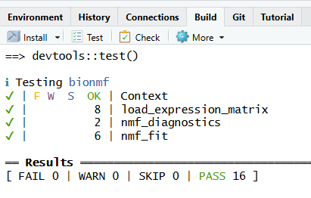
Unit Tests
Once a package is built, it must remain stable
Tests will
  Confirm the current version of the package still works
  Alert you if modifications break the codebase
  Help identify and diagnose future bugs
    Changes in package dependencies
    Unanticipated dataset traits

Slide 20
Unit Tests – Quality over Quantity
Have a lot of tests does not guarantee stability
  Some are relatively simple and can become redundant
Tests must:
  Check for edge cases
  Check function assumptions
  Check past bugs

Slide 21
Exercise
In the build tab, click the ‘test’ option to run tests
Alternatively, run devtools::test() in the console

Slide 22
Unit tests – Coverage over quantity
Having a lot of tests does not guarantee all of your code is working
Code coverage is the % of your codebase that gets executed at least once during testing
Low code coverage – a lot of code behavior is unchecked
Can check with covr::package_coverage()

Slide 23
Exercise
Run covr::package_coverage() in the console
  How much coverage do the tests have?
Run covr::report() to inspect the code coverage
  Try to make new tests that improve code coverage

Slide 24
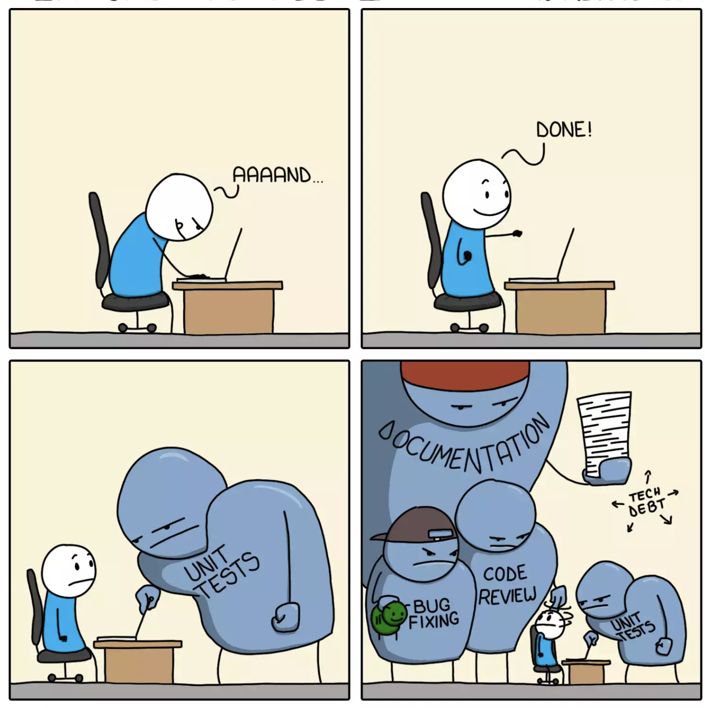
When should I build the package?
Often done after a project is completed
  Will require a lot of refactoring
Suggestion: as soon as your model works
  Easier to manage documenting functions
  Easier to accumulate tests
Switching to a package early on will save time an avoid technical debt
Source

Slide 25
Documentation
How can we ensure users know how to use the package?
GitHub Repo READMEs are not sufficient
Function documentation
Vignettes

Slide 26
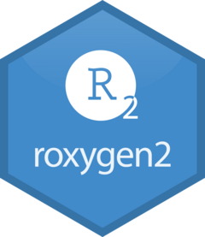
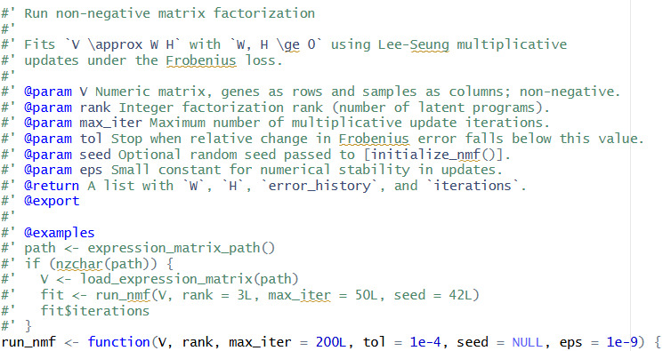
Function Documentation
Function descriptions
Detailed Argument list
Example (optional)
Rendered via roxygen2
  Stored in man/
  roxygen2::roxygenise()
2_Simple_Package/R/nmf_fit.R

Slide 27
Function Documentation
@export
  add a function to NAMESPACE
@importFrom package function_name
  Add function from a dependency to NAMESPACE
2_Simple_Package/R/nmf_fit.R

Slide 28
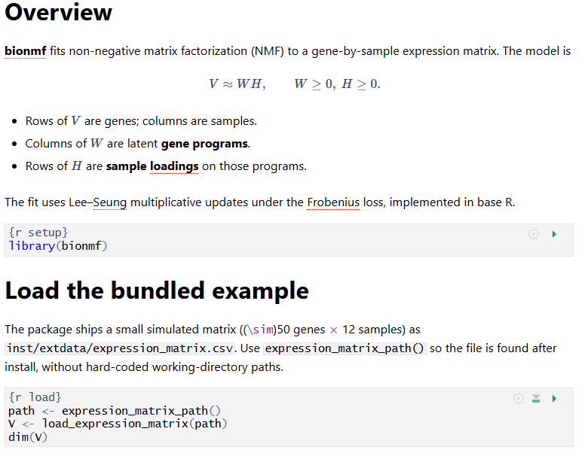
Vignettes
Reproducible tutorials
End-to-end examples
Embed code with context
Rendered via Rmarkdown
  Usually HTML

Slide 29
Exercise
Open one of the .R files and try updating the function documentation
  Run roxygen2::roxygenize() to update the function manual
Open the vignette and try tweaking the tutorial
  Use knitr to render a new html of the file

Slide 30

LLMs for Package Development
Understand your package first
  Build it yourself, expand it with LLMs
Build tests first then build features
  Helps ensure sufficiently correct behaviour
Useful for understanding a new codebase
  Generate overview/summary of repository
Note: consider looking at the Positron IDE

Slide 31
2. Git Refresher

Slide 32
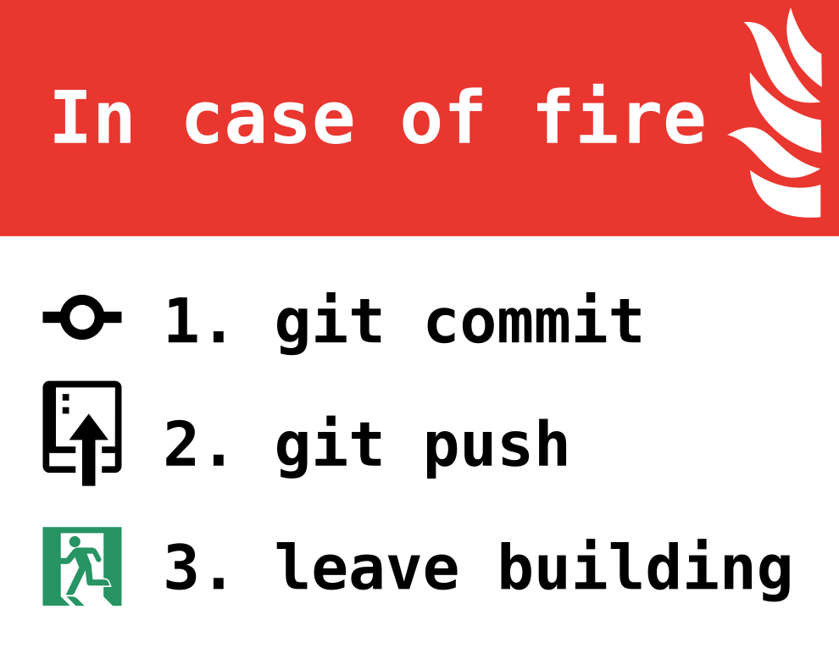
Git & GitHub for Packages
Version control systems like Git are crucial for package development and maintenance
Commits help document modifications
Pull requests facilitate code review and checks
GitHub facilitates collaboration with others and access to users
Source

Slide 33
Git Repository
Git Pipeline
Working
Directory
Staging
Area
Local Repository
Add
Commit
Code.py
*New*
Code.py
*New*
Code.py
*New*
Code.py
TRACKED
Code.py
*Modified*
Code.py
*Modified*
Code.py
*Modified*
Notes:
https://www.google.com/url?sa=i&url=https%3A%2F%2Fcourses.csail.mit.edu%2F6.S194%2F13%2Flessons%2F03-git%2Fgit-commands-and-metaphors.html&psig=AOvVaw0eLwNte0CymnSwNKJIL7Zi&ust=1654357234965000&source=images&cd=vfe&ved=0CAwQjRxqFwoTCLifgozPkfgCFQAAAAAdAAAAABAk

Slide 34
What is a Branch?
A specific “timeline” of your commit history
Allows us to implement new features without harming viable releases
New Feature
Debugged New Feature
Dev
Main/Master
Initial Commit
Debug Commit
Release 1.0.0
Patched Release

Slide 35
What is a Merge?
Action that will “merge” the commits from one branch into another
New Feature
Debugged New Feature
New Feature + Patch
Dev
Main/Master
Release 1.0.0
Patched Release
Release 1.1.0

Slide 36
Local-Remote Pipeline
Working
Directory
Staging
Area
Local Repository
Remote Repository
Add
Commit
Code.py
*New*
Code.py
*New*
Code.py
*New*
Code.py
TRACKED
Notes:
https://www.google.com/url?sa=i&url=https%3A%2F%2Fcourses.csail.mit.edu%2F6.S194%2F13%2Flessons%2F03-git%2Fgit-commands-and-metaphors.html&psig=AOvVaw0eLwNte0CymnSwNKJIL7Zi&ust=1654357234965000&source=images&cd=vfe&ved=0CAwQjRxqFwoTCLifgozPkfgCFQAAAAAdAAAAABAk

Slide 37
Local-Remote Pipeline
Working
Directory
Staging
Area
Local Repository
Remote Repository
Pull
Push
Code.py
*New*
Code.py
*New*
Code.py
*Modified*
Code.py
TRACKED
Code.py
*Modified*
Code.py
*Modified*
Notes:
https://www.google.com/url?sa=i&url=https%3A%2F%2Fcourses.csail.mit.edu%2F6.S194%2F13%2Flessons%2F03-git%2Fgit-commands-and-metaphors.html&psig=AOvVaw0eLwNte0CymnSwNKJIL7Zi&ust=1654357234965000&source=images&cd=vfe&ved=0CAwQjRxqFwoTCLifgozPkfgCFQAAAAAdAAAAABAk

Slide 38
Cloning a Repository
Working
Directory
Local Repository
Remote Repository
Clone
Code.py
*New*
Code.py
*New*
Code.py
*Modified*
Code.py
*Modified*
Code.py
*Modified*
Notes:
https://www.google.com/url?sa=i&url=https%3A%2F%2Fcourses.csail.mit.edu%2F6.S194%2F13%2Flessons%2F03-git%2Fgit-commands-and-metaphors.html&psig=AOvVaw0eLwNte0CymnSwNKJIL7Zi&ust=1654357234965000&source=images&cd=vfe&ved=0CAwQjRxqFwoTCLifgozPkfgCFQAAAAAdAAAAABAk

Slide 39
Forking a Repository
All on GitHub
You
Collaborator
Working
Directory
Local Repository
Forked Remote Repository
Original Remote Repository
Code.py
*New*
Code.py
*New*
Code.py
*New*
Code.py
*New*
Clone
Fork
Code.py
*Modified*
Code.py
*Modified*
Code.py
*Modified*
Code.py
*Modified*
Push
Pull Req.
Notes:
https://www.google.com/url?sa=i&url=https%3A%2F%2Fcourses.csail.mit.edu%2F6.S194%2F13%2Flessons%2F03-git%2Fgit-commands-and-metaphors.html&psig=AOvVaw0eLwNte0CymnSwNKJIL7Zi&ust=1654357234965000&source=images&cd=vfe&ved=0CAwQjRxqFwoTCLifgozPkfgCFQAAAAAdAAAAABAk

Slide 40
3. GitHub Actions

Slide 41
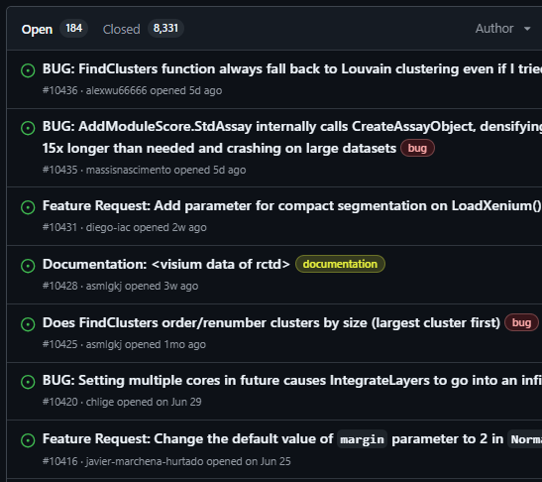
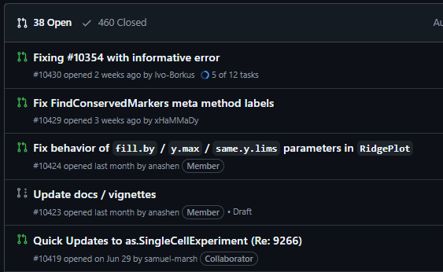
Maintaining a package is tedious
New features may break existing code
Tests might start failing
Dependencies may no longer be compatible
Cannot manually inspect this 24/7

Slide 42
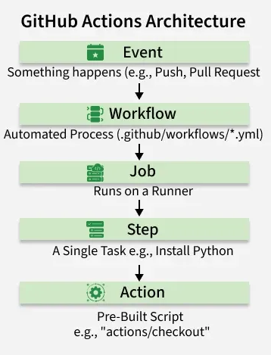
GitHub Actions
Framework to run specific workflows under certain conditions
  After a new commit
  When a pull request is made
  When a specific file/folder is changed
  When an issue is submitted
Automates your sanity checks and repetitive tasks

Slide 43
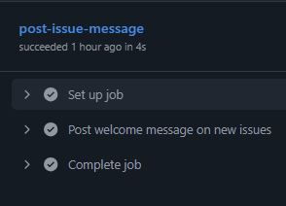
Simple Workflow – Issue Bot
If your package is very popular, you may want to streamline issue submissions
  Specific format
  Specific attachments
  Specific terminology
Bots can handle and filter issues for you

Slide 44
Exercise
Try using the issue bot on the posted GitHub repository
Compare using an issue that includes ‘bionmf’ in the title vs. not

Slide 45
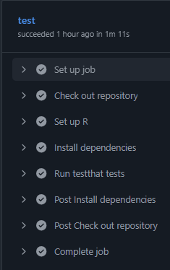
Test & Installation Workflow
Simple setup to check installation and tests
  Check for specific OS flavors and versions
  Check specific R versions
  Check code coverage
Useful for pull requests/external contributors
  Streamlines review process

Slide 46
Exercise
In your own fork of the github repository, make a change to files in the 3_Actions_Package folder
Commit the change and check the actions workflow
Check what happens if you make a pull request

Slide 47
Other tools

Slide 48

Building a package website
User experience can be improved further with a webpage
pkgdown automatically generates HTML files from your package to generate a website
Can be hosted for free via GitHub!
pkgdown::build_site()

Slide 49
Thank you!
MiCM Mailing List
Biostatistics Section – SSC

Slide 50
STOP

