Slide 1
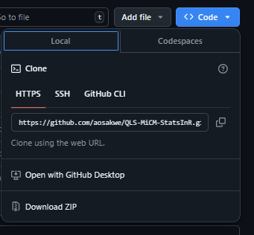
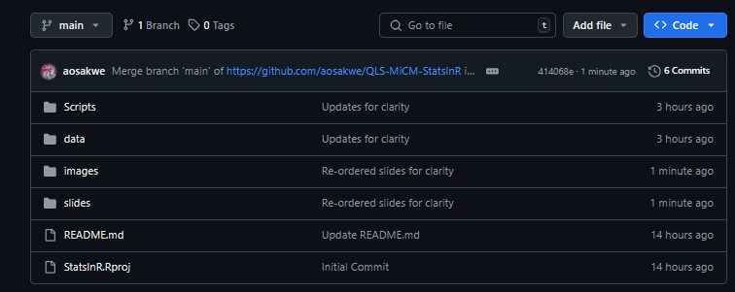
Workshop materials https://github.com/QLS-MiCM/StatsInR use ‘git clone’ command OR

Slide 2
Statistical Analysis in R
Workshop Lead: Adrien Osakwe
Facilitator: Meghana Munipalle
July 17, 2025

Slide 3



QLS-MiCM mission statement: deliver quality workshops designed to help biomedical researchers develop the skills they need to succeed.
Location: 550 Sherbrooke Street, Montreal, Quebec
Scan the QR code to sign up
for our mailing list
Contact: workshop-micm@mcgill.ca

Slide 4
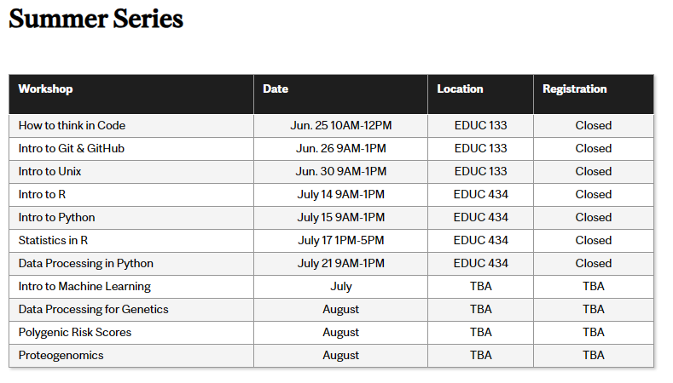
Workshop Series
https://www.mcgill.ca/micm/training/workshops-series

Slide 5
Outline
Data Wrangling
Linear Regression Models
Logistic Regression Models
Statistical Testing
Study Design
Acknowledgements
Gerardo Martinez - McGill
Alex Diaz-Papkovich - Brown
Larisa Morales Soto - HMS
Lisa Sullivan BUSPH

Slide 6
Data Wrangling
Learning objectives:
Become familiar with the dplyr syntax
Create pipes with the operator %>%
Perform operations on data frames using dplyr and tidyr functions
Examples for how to deal with missing data

Slide 7
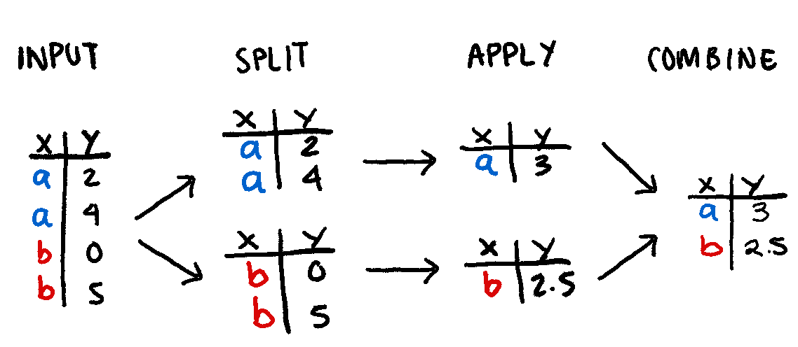
Split-Apply-Combine problem

Slide 8
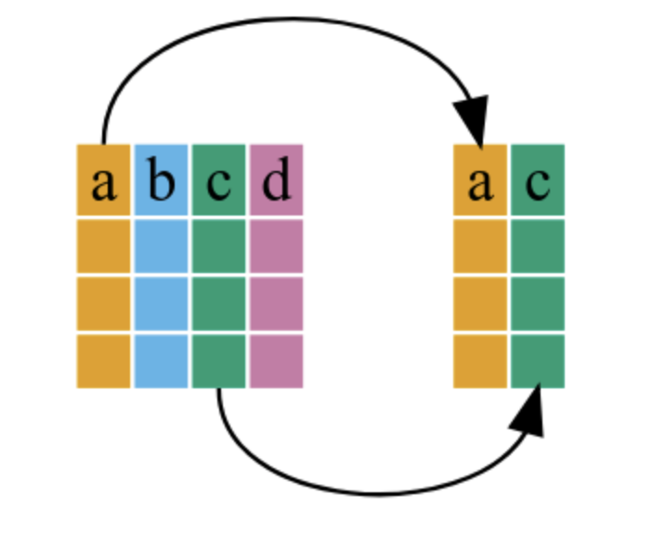
Select
https://swcarpentry.github.io/r-novice-gapminder/13-dplyr/index.html

Slide 9
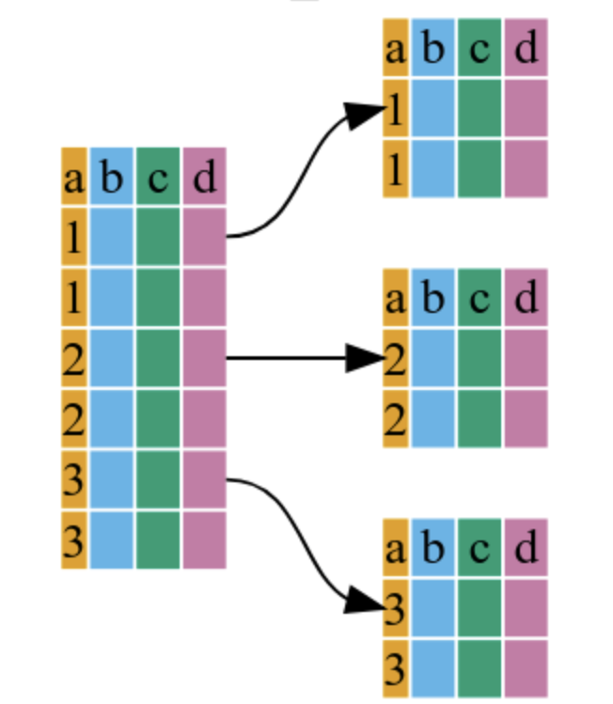
Group by
https://swcarpentry.github.io/r-novice-gapminder/13-dplyr/index.html

Slide 10
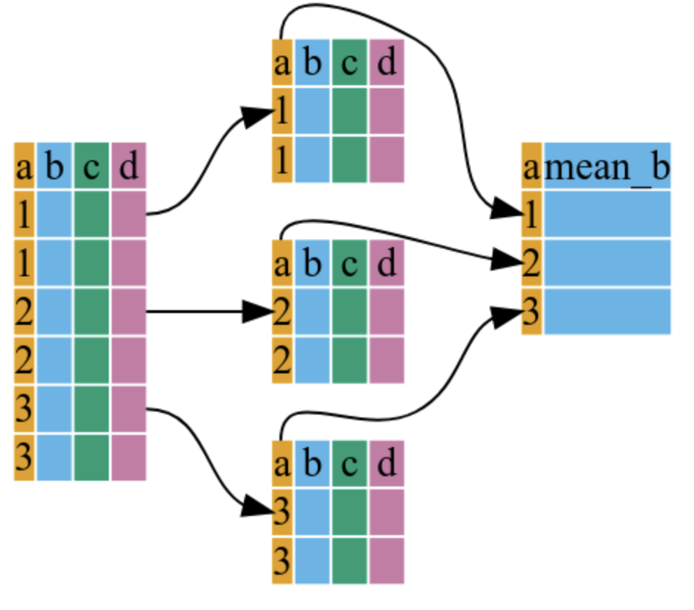
Summarize
https://swcarpentry.github.io/r-novice-gapminder/13-dplyr/index.html

Slide 11
Managing Missing Data
Most of the time, samples having missing entries
Missed medical appointment
Error with measuring instruments etc.
Represented as NA in R
Simple Solution
Drop samples with missing observations
More rigorous solutions
Fill in with average/median of dataset or condition
Train a model to ‘impute’ missing entries based on other features

Slide 12
Linear Regression
Learning objectives:
Understand the fundamental regression algorithms
What is a coefficient/effect size

Slide 13
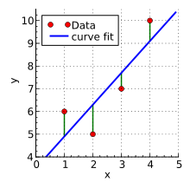
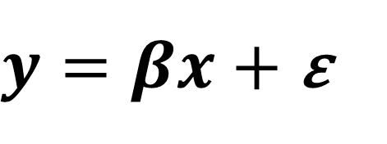
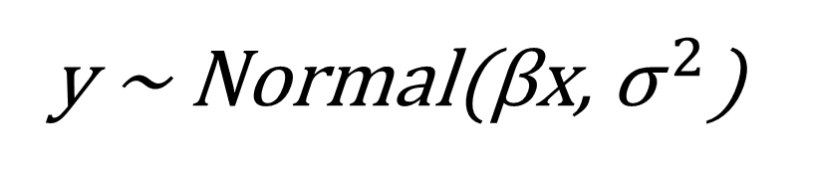
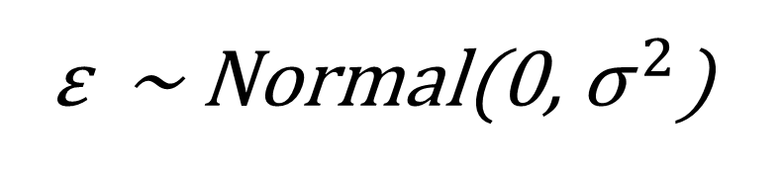
The Linear Model
Credit: Wikipedia
The fundamental model for statistics & machine learning
Follows a Normal distribution
Imagine a dataset with a dependent variable y and a set of descriptive features x
We want to learn what features in x are good predictors of y (what is their effect size/coefficient β)
$y=βx$ $+$ ε
ε ~ Normal(0, ${\text{σ}}^{ 2}$)
y ~ Normal(βx, ${\text{σ}}^{ 2}$)

Slide 14
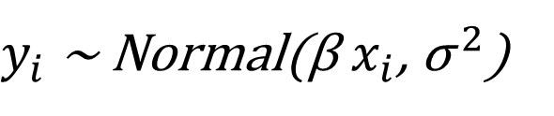
Model Assumptions
Outcome is continuous and a linear combination of predictors
Outcome is such that
Predictors must not be perfectly correlated (linear combination)
For every observation i the error is:
Normally distributed
Mean zero
Homoskedastic (same variance as other observations)
Independent (not correlated)
$y_{i}$ ~ Normal(β $x_{i}$, ${\text{σ}}^{ 2}$)

Slide 15



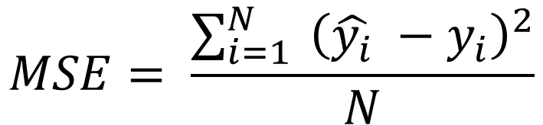
Model Fitting
Probabilistic Approach
Maximum Likelihood Estimation
Machine Learning
Mean Squared Error
$$\underset{β}{argmax}{ \text{log}\text{(}\text{Normal}\text{(}\text{β}\text{x}\text{,} {\text{σ}}^{ 2}\text{)}\text{)}}$$
$$y=βx+ε$$
$$MSE= \frac{\sum_{i=1}^{N}{{ \left(\hat{y_{i}} −y_{i}\right)}^{2}}}{N}$$
$$\hat{y}=\hat{β}x$$

Slide 16
Extensions
Interaction effects
• Outcomes depend on interactions of (e.g.) age*sex
Different Types of Data
• Multivariate regression (multiple, correlated outcomes)
• Logistic regression (Binary outcomes like healthy vs. disease)
• Multinomial/Poisson regression (Count data)
• ARIMA (Time series—data correlated over time)

Slide 17
Logistic Regression
Learning objectives:
What is a logistic function
How LR extends the linear model
Cross-Entropy

Slide 18
Working with categories
Linear Regression could be used to predict categories (technically) BUT it has many flaws
Formulation isn’t bounded (0,1)
Impractical for predicting multiple classes
Mean-Squared Error is not an optimal objective function
Propose to use the linear equation with a sigmoid function

Slide 19

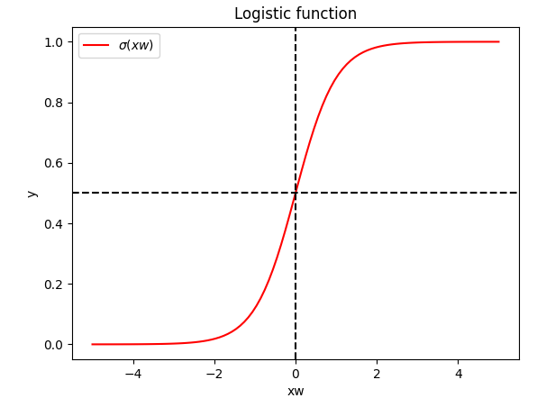

Logistic Regression
Sigmoid/Logistic function provides us with a bounded output
Range is also easy to interpret as a probability
Can also use the softmax if working with multiple classes

Slide 20

Cross-Entropy
Most commonly used loss function for classification
More intuitive meaning for classification than MSE
Faster model convergence than MSE
Is compatible with a multi-class dataset (more than two classifications)

Slide 21
Statistical Testing
Learning objectives:
Understand the formulation an assumption of standard statistical tests
Understand the interpretation of a p-value
Considerations when designing an experiment

Slide 22
Hypothesis Tests
Goal
Determine if two sets of data are different
Can approach this with test statistics
Is the difference significant or not?
Many Types of Tests
Parametric tests – make assumptions on the data distribution
Z-score vs. t-test
ANOVA
Non-parametric – does not make assumptions on data dist.
Permutation test

Slide 23
Hypothesis Formulation
Null Hypothesis
Effect size is 0
Difference between conditions is 0
Alternative Hypothesis
Effect size is NOT 0
Difference between conditions is NOT 0
We accept or reject the null based on the generated p-value (< 0.05)

Slide 24
Understanding Significance
Statistical significance DOES NOT imply causality
It is a measurement of the likelihood of the observed data happening by chance.
A p-value tells us the probability of seeing the observation if the null hypothesis is true.

Slide 25

Z-score Test
Credit: Wikipedia
Based on the Normal Distribution
Generate a Z-score from our effect size estimate
Compare to Normal(0,1) distribution
One-tail or Two-tail
Used when we have a large sample size (Central Limit Theorem)
$$z=\frac{β−μ}{SE(β)}$$

Slide 26
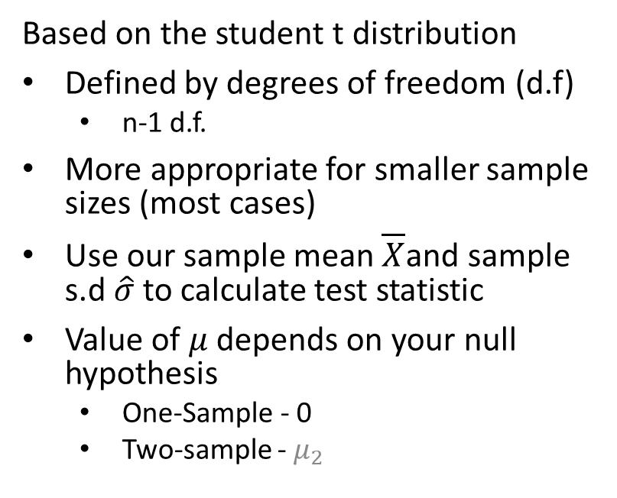
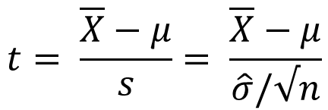
t-test
Based on the student t distribution
Defined by degrees of freedom (d.f)
n-1 d.f.
More appropriate for smaller sample sizes (most cases)
Use our sample mean $\overline{X}$and sample s.d $\hat{σ}$to calculate test statistic
Value of $μ$ depends on your null hypothesis
One-Sample - 0
Two-sample - $μ_{2}$
Credit: Wikipedia
$$t= \frac{\overline{X}−μ}{s}= \frac{\overline{X}−μ}{\hat{σ}/√n}$$

Slide 27
ANOVA
Based on the F-distribution
Similar to t-statistic
Statistic is the ratio of two Chi-squareds
Null hypothesis: multiple means are all equal
Alternative: At least one group is different
Credit: Wikipedia

Slide 28
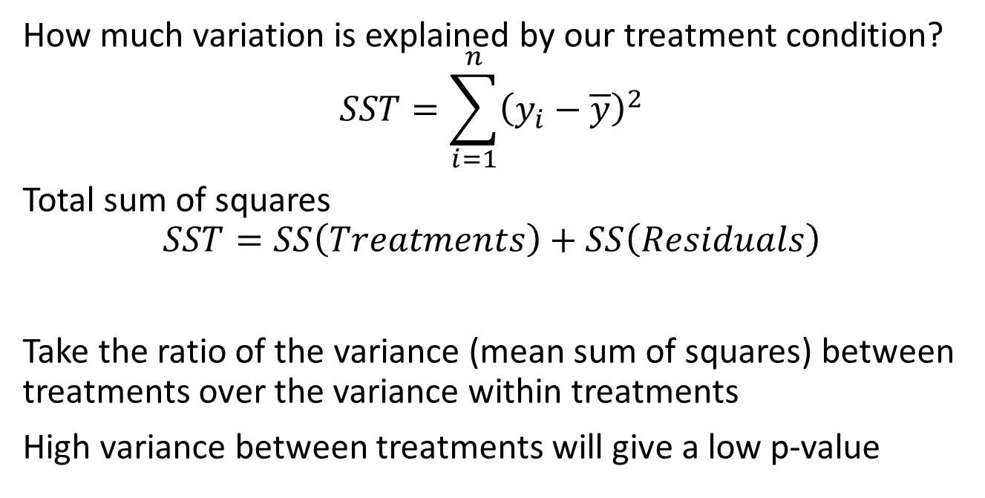
ANOVA
How much variation is explained by our treatment condition?
$$SST=\sum_{i=1}^{n}{{\left(y_{i}−\overline{y}\right)}^{2}}$$
Total sum of squares
$$SST=SS\left(Treatments\right)+SS\left(Residuals\right)$$
Take the ratio of the variance (mean sum of squares) between treatments over the variance within treatments
High variance between treatments will give a low p-value

Slide 29
Non-Parametric Test
Similar to what is done for enrichment analyses
Avoids needing to make assumptions on distributions
Can be very slow
Shuffle labels in your data to generate estimates (random baseline)
See where your true observation lies on this baseline

Slide 30
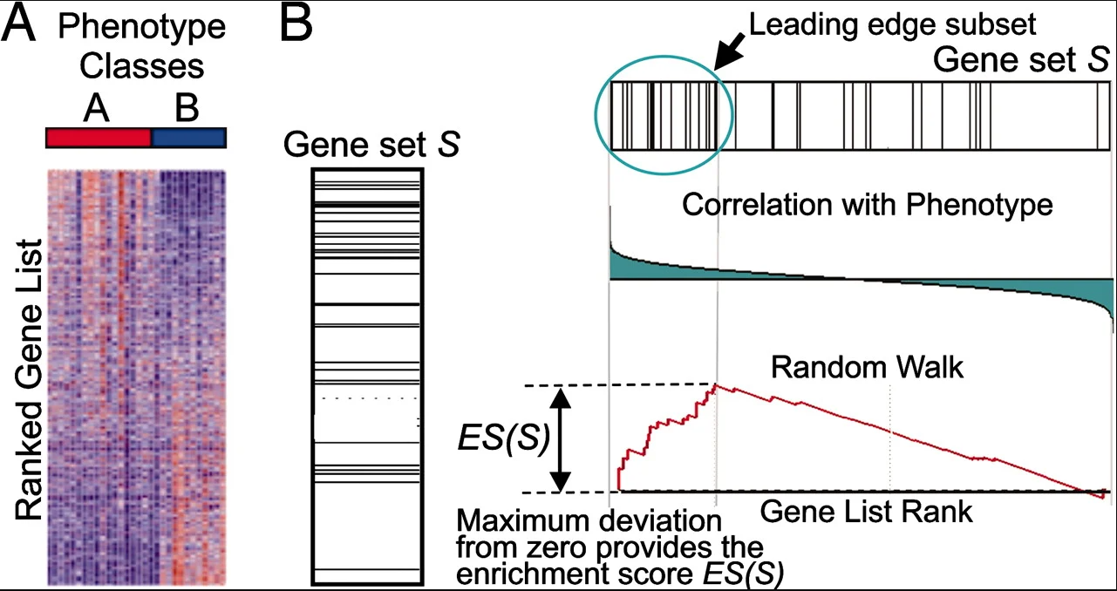
Gene Set Enrichment
Credit: GSEA

Slide 31
Multiple Testing
May test multiple hypothesis (example, effect sizes in linear model)
If null distribution is true, expect a uniform distribution of p-values
5% of tests will give a significant result
Multiple test correction methods are used to address this
Bonferonni Correction
Benjamini & Hochberg Correction
Found in results as FDR, p-adjusted, q-value

Slide 32
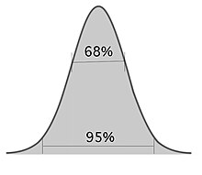
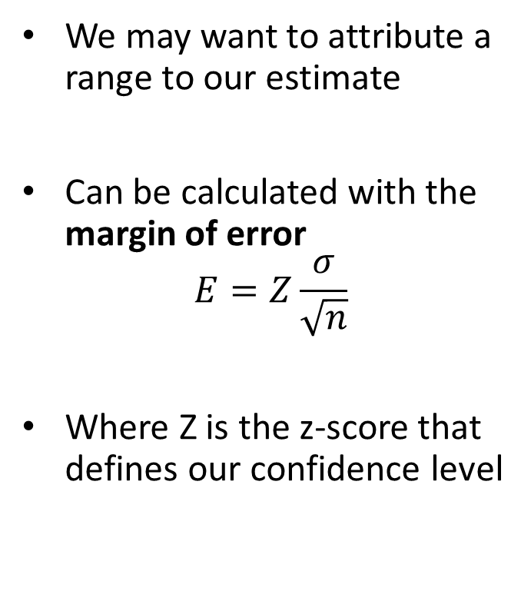
Confidence Intervals
We may want to attribute a range to our estimate
Can be calculated with the margin of error
$$E=Z\frac{σ}{\sqrt{n}}$$
Where Z is the z-score that defines our confidence level

Slide 33
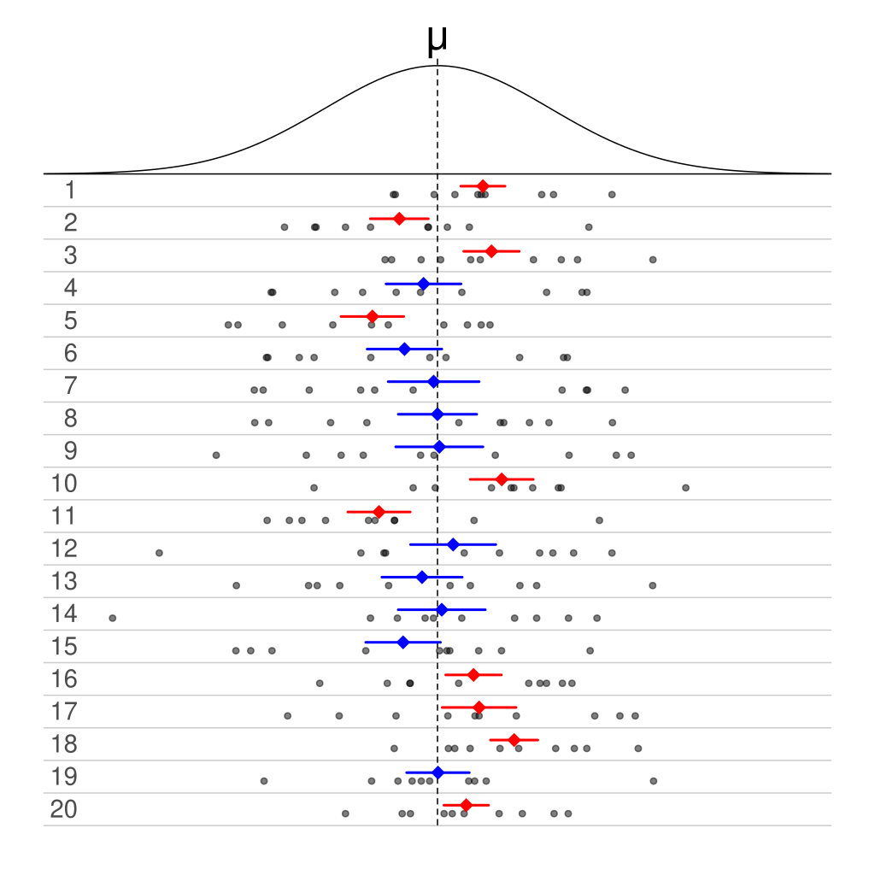
PSA: Confidence Intervals
50% CI
A 95% CI DOES NOT mean there is a 95% chance the true value is in that range
For multiple experiments, 95% of CIs will overlap with the true value
Consider a Bayesian formulation instead (beyond scope)

Slide 34
Study Design
Learning objectives:
Understand how simulations can be used to help with study design
How to determine the required sample size

Slide 35
Study Design
Data collection can be expensive and time-consuming
Need to ensure that the collected data has enough power to avoid false negatives (type II error)
Can simulate data to help decide on the statistical test used and determine the appropriate sample size

Slide 36
Determining sample size
Statistical test results depend on multiple factors
Difference in Samples
Sample Size
We want to make sure we have enough samples to avoid False Negatives (type II errors)
Can leverage the assumptions used for our statistical test to determine sample size

Slide 37
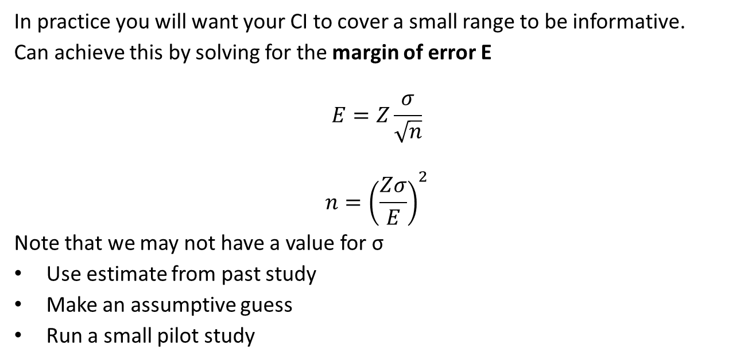
Confidence Intervals
In practice you will want your CI to cover a small range to be informative.
Can achieve this by solving for the margin of error E
$$E=Z\frac{σ}{\sqrt{n}}$$
$$n={\left(\frac{Zσ}{E}\right)}^{2}$$
Note that we may not have a value for σ
Use estimate from past study
Make an assumptive guess
Run a small pilot study

Slide 38
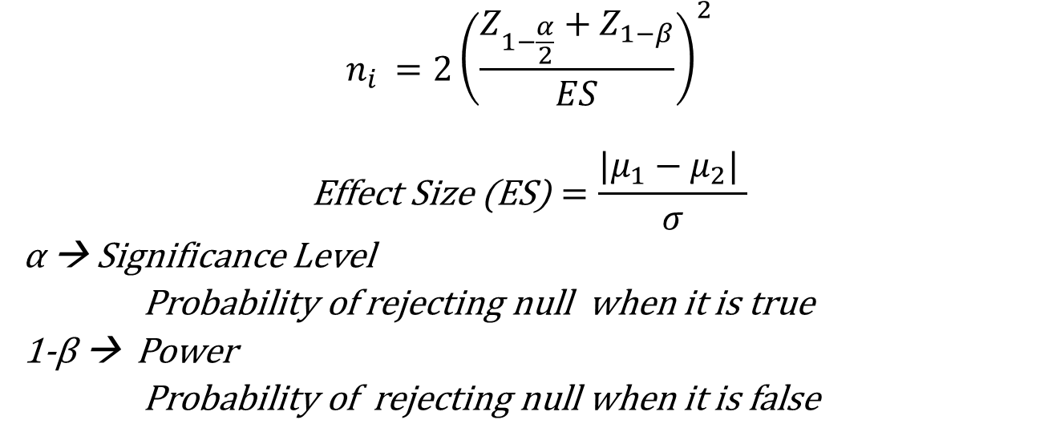
Sample Comparison
$$n_{i }=2{\left(\frac{Z_{1−\frac{α}{2}}+Z_{1−β}}{ES}\right)}^{2}$$
$$\text{Effect} \text{Size}\text{ (}\text{ES}\text{)}=\frac{|μ_{1}−μ_{2}| }{σ}$$
α → Significance Level
Probability of rejecting null when it is true
1-β → Power
Probability of rejecting null when it is false

Slide 39
To summarize
Basics for data manipulation & cleaning
Explored basic linear modeling for regression & classification
Explored statistical testing and intuition behind study design
Now you are ready to:
Use dplyr to facilitate reproducible data manipulation
Apply and interpret linear model results
Interpret confidence intervals and p-values
Explore more complex models and tests!

Slide 40
Future Statistics Workshops
Dimension Reduction
Bayesian Inference
Time-series Analysis
And more…

Slide 41
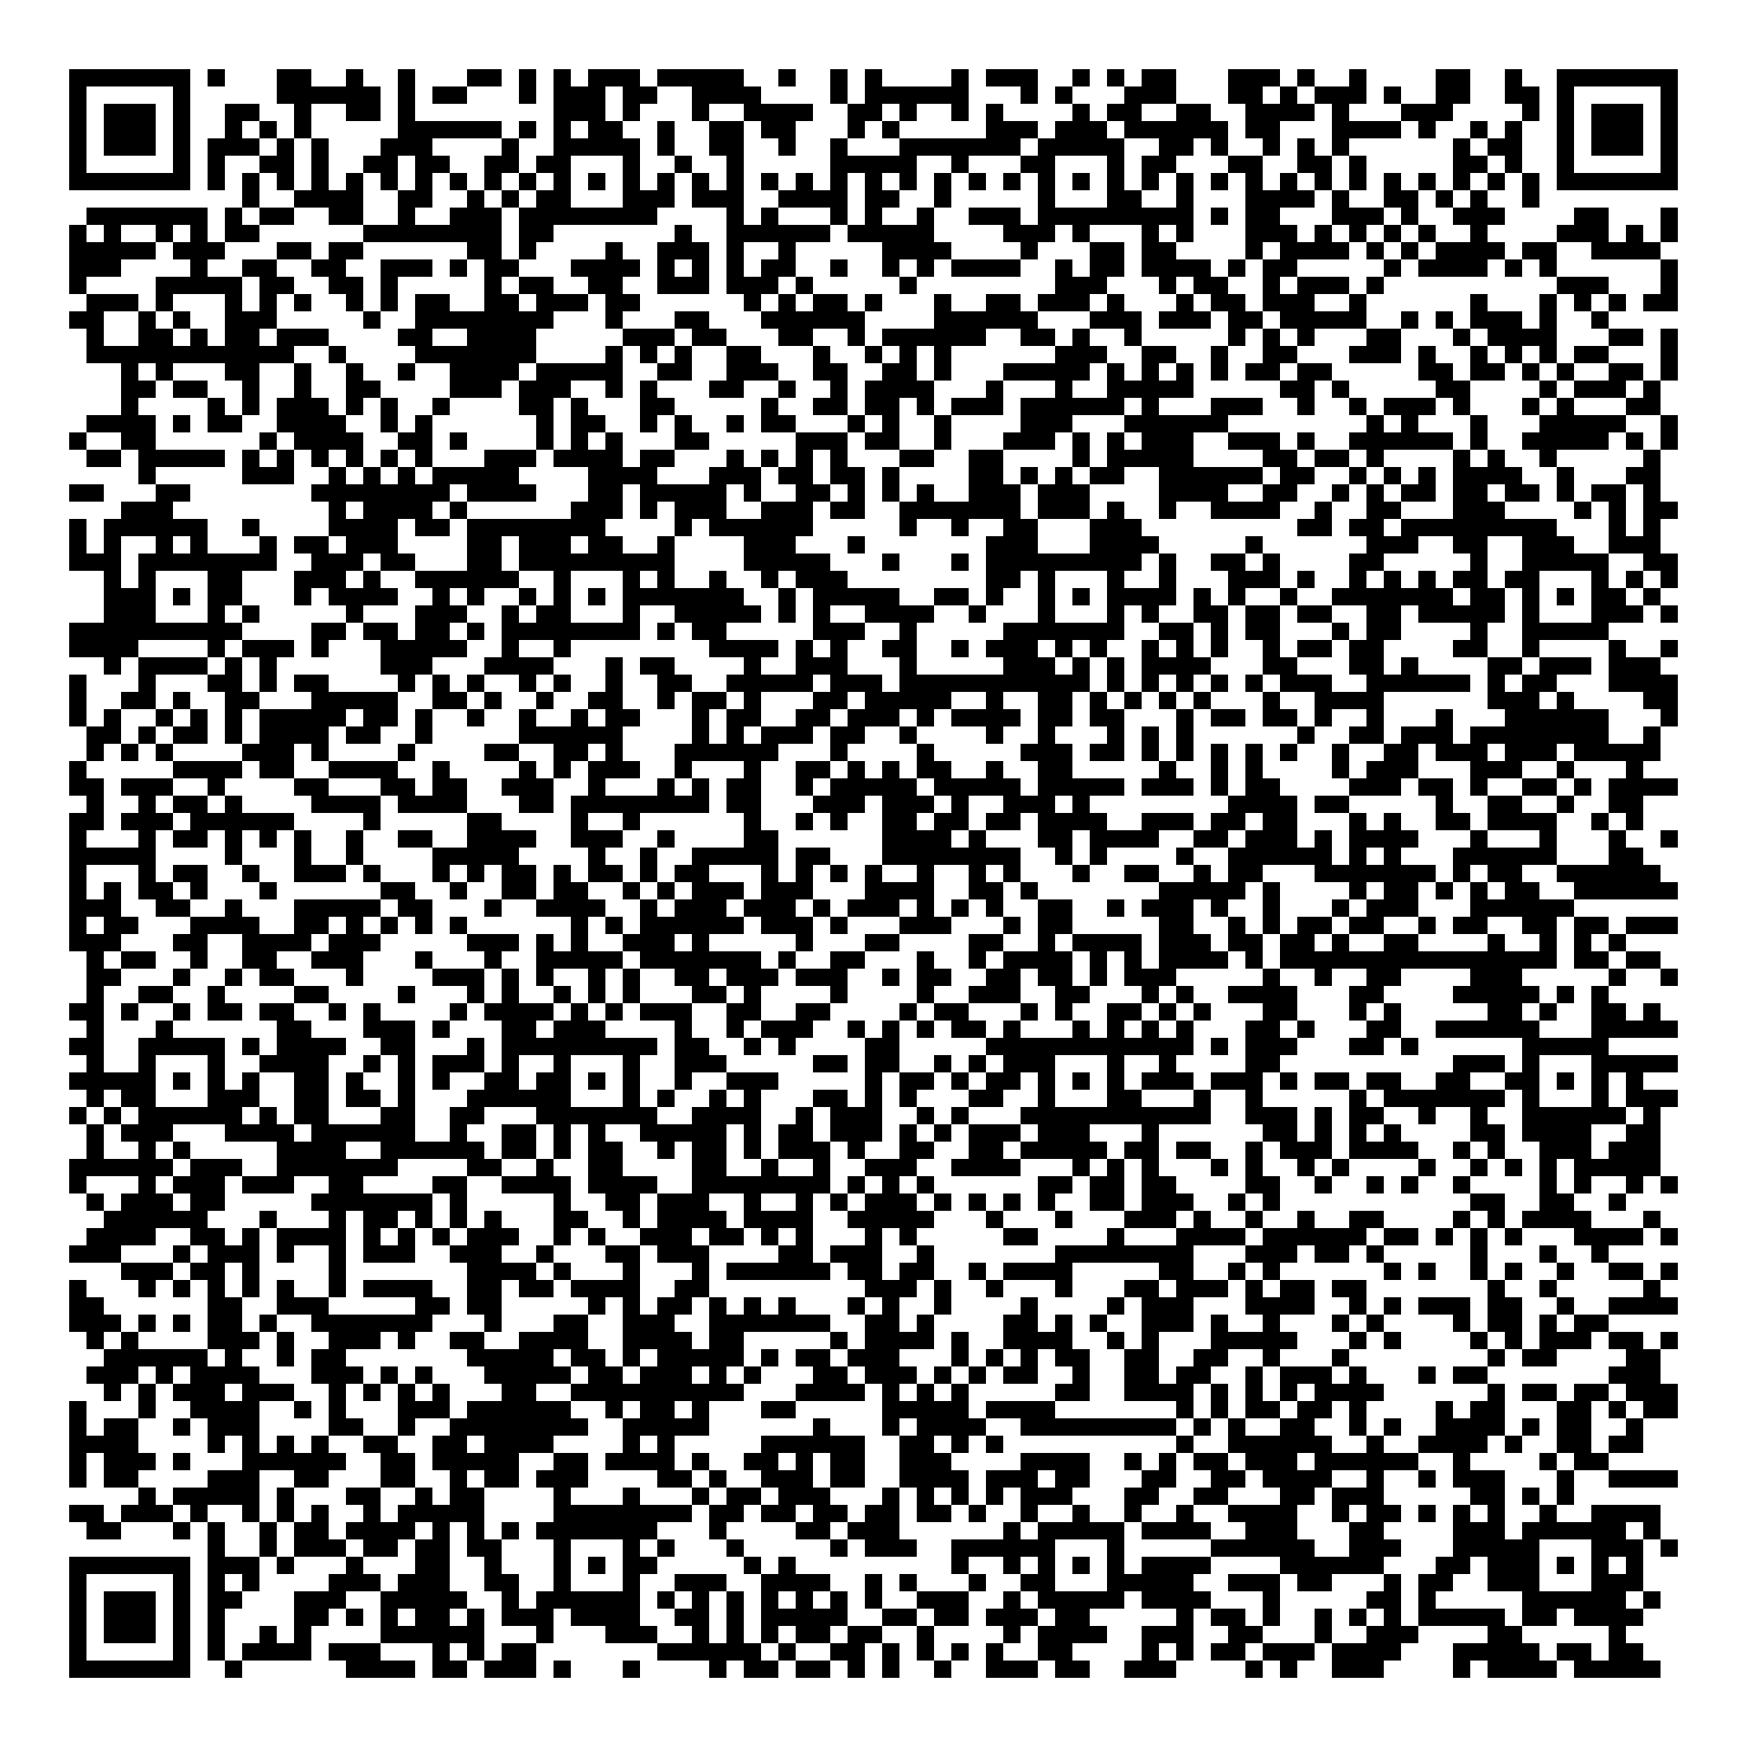


Thank you for attending!
1
2
3
Scan the QR code to confirm you attended today’s workshop.
Fill out the feedback survey in the next 72h.
Get recognition for this workshop on your
co-curricular record.

