Slide 1
Demo
Qiming Cao

Slide 2
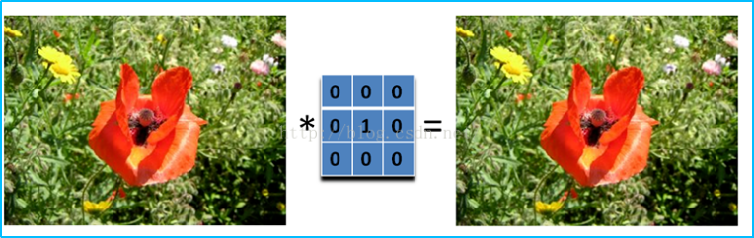
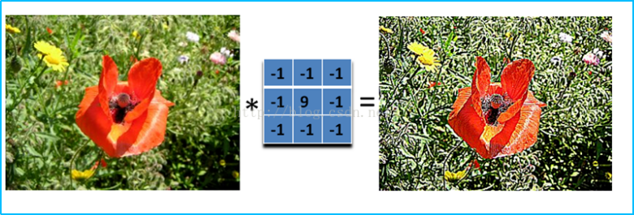
Image Processing in OpenGL
A convolution core without doing anything
A convolution core for Sharpness

Slide 3
Image Processing in OpenGL
Flow Chart
Set a gloal variable to control the active shader
Compile all shaders in advance
Generating texture, get the origin color of each pixel
Calculate convolution core
Get the color of the specified uv coordinate

