Slide 1
Nexus Monthly User and Developer Meeting
Meeting 4: Excited state workflows
Kayahan Saritas, Jaron T. Krogel
15 February 2019

Slide 2
Agenda for this Meeting
Workflow demos:
Getting band structure with DFT
Identifying relevant wavevectors and tiling matrices
Optical band gap
Quasiparticle gap
Automated tiling matrix from wavevectors
Q&A
Files located at: ./labs/lab5_excited_states
./nexus/examples/qmcpack/excited

Slide 3
Workflow Demo: Band Structure with DFT

Slide 4
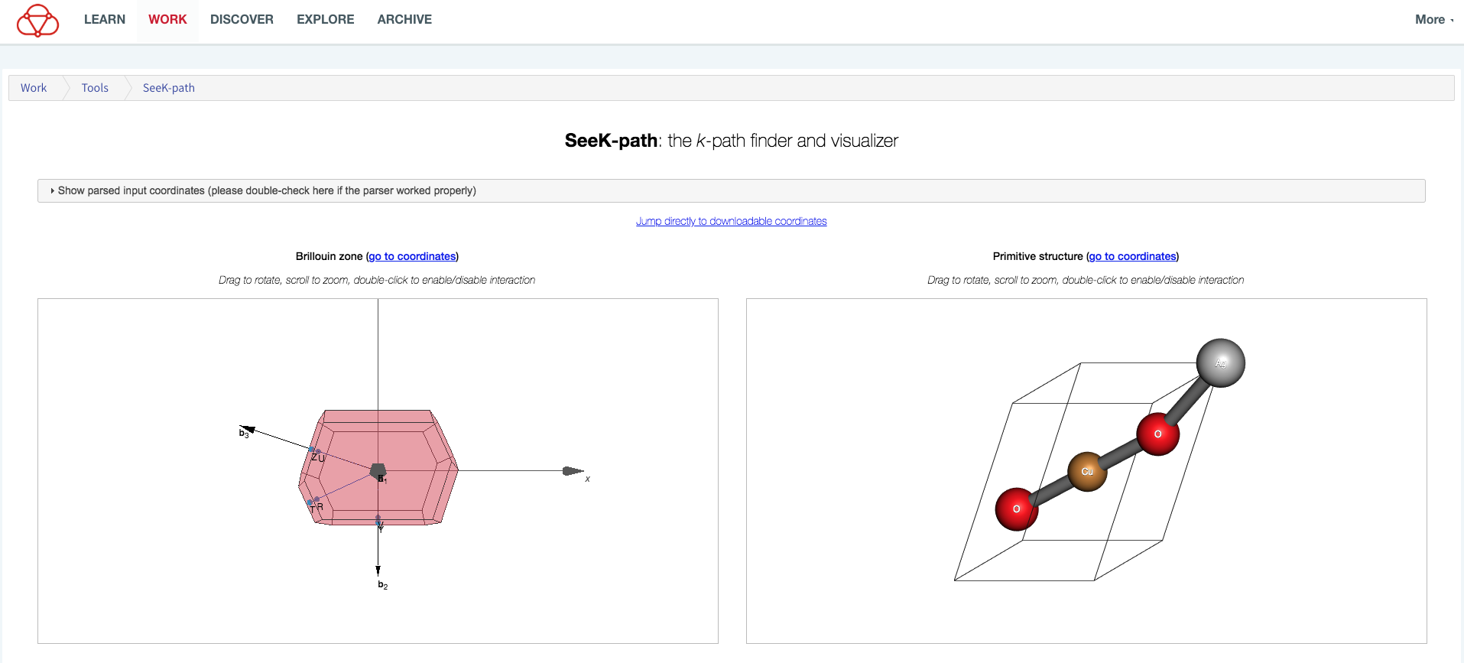
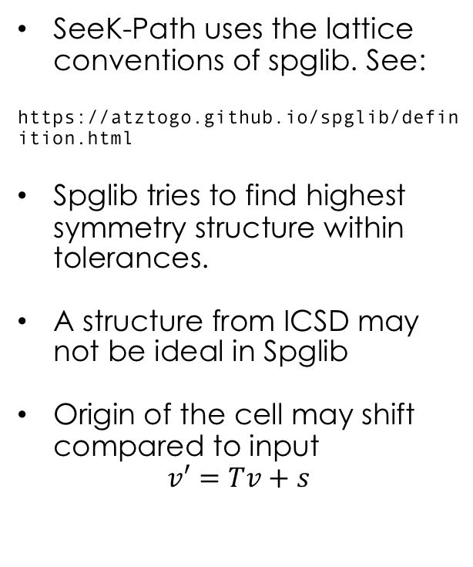
SeeK-path
Online tool: https://www.materialscloud.org/work/tools/seekpath
Python manual: https://seekpath.readthedocs.io/en/latest/
Comp. Mat. Sci. 128, 140 (2017). DOI: 10.1016/j.commatsci.2016.10.015
SeeK-Path uses the lattice conventions of spglib. See:
https://atztogo.github.io/spglib/definition.html
Spglib tries to find highest symmetry structure within tolerances.
A structure from ICSD may not be ideal in Spglib
Origin of the cell may shift compared to input
$$v′=Tv+s$$

Slide 5
Diamond band structure:
labs/lab5_excited_states/band.py
STRUCTURE
CALCULATION
ANALYSIS
#! /usr/bin/env python
from nexus import settings,job,run_project
from nexus import generate_physical_system
from nexus import generate_pwscf
from nexus import generate_pw2qmcpack
from nexus import generate_qmcpack,vmc
settings(
pseudo_dir = './pseudopotentials',
results = '',
runs = 'diamond_runs',
status_only = 0,
generate_only = 0,
sleep = 3,
machine = 'ws16'
)
dia = generate_physical_system(
units = 'A',
axes = [[ 1.785, 1.785, 0. ],
[ 0. , 1.785, 1.785],
[ 1.785, 0. , 1.785]],
elem = ['C','C'],
pos = [[ 0. , 0. , 0. ],
[ 0.8925, 0.8925, 0.8925]],
# use SeeK-path library to identify prim cell
use_prim = True,
# use SeeK-path library to get prim k-path
add_kpath = True,
C = 4
)
scf = generate_pwscf(
identifier = 'scf',
path = 'scf',
job = job(cores=16,app='pw.x'),
input_type = 'generic',
calculation = 'scf',
nspin = 2,
input_dft = 'lda',
ecutwfc = 200,
conv_thr = 1e-8,
nosym = True,
wf_collect = True,
system = dia,
kgrid = (4,4,4),
kshift = (0,0,0),
tot_magnetization = 0,
pseudos = ['C.BFD.upf'],
)
band = generate_pwscf(
identifier = 'nscf',
path = 'band',
job = job(cores=16,app='pw.x'),
input_type = 'generic',
calculation = 'nscf',
input_dft = 'lda',
ecutwfc = 200,
nspin = 2,
conv_thr = 1e-8,
nosym = True,
wf_collect = True,
system = dia,
nbnd = 8, #a sensible nbnd value can be given
verbosity = 'high', #verbosity must be set to high
pseudos = ['C.BFD.upf'],
dependencies = (scf, 'charge_density'),
)
run_project()
p = band.load_analyzer_image()
p.plot_bandstructure()
print "VBM:\n{0}".format(p.bands.vbm)
print "CBM:\n{0}".format(p.bands.cbm)
#print 'CBM, Delta'
#print p.bands.up[51]
#print 'Delta prime'
#print p.bands.up[46]

Slide 6
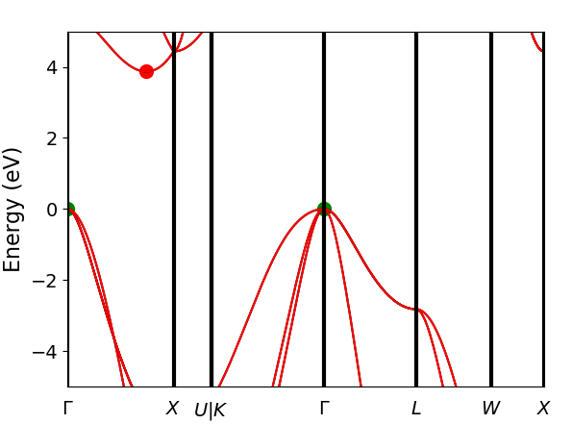
Diamond band structure:
ANALYSIS
p = band.load_analyzer_image()
p.plot_bandstructure()
print "VBM:\n{0}".format(p.bands.vbm)
print "CBM:\n{0}".format(p.bands.cbm)
#print 'CBM, Delta'
#print p.bands.up[51]
#print 'Delta prime'
#print p.bands.up[46]
eigs = [-3.2076 4.9221 7.5433 7.5433 17.1545 19.7598 28.3242 28.3242]
index = 51
kpoint_2pi_alat = [0. 0.1095605 0. ]
kpoint_rel = [0.3695652 0. 0.3695652]
occs = [1. 1. 1. 1. 0. 0. 0. 0.]
pol = up
eigs = [-4.0953 6.1376 7.9247 7.9247 17.1972 20.6393 27.3653 27.3653]
index = 46
kpoint_2pi_alat = [0. 0.0988193 0. ]
kpoint_rel = [0.3333333 0. 0.3333333]
occs = [1. 1. 1. 1. 0. 0. 0. 0.]
pol = up
insulating
energy = 5.5404
index = 0
kpoint_2pi_alat = [0. 0. 0.]
kpoint_rel = [0. 0. 0.]
pol = ['down', 'down']
energy = 3.867
kpoints
cbm
band_number = 4
energy = 17.1545
index = 51
kpoint_2pi_alat = [0. 0.1095605 0. ]
kpoint_rel = [0.3695652 0. 0.3695652]
pol = down
end cbm
vbm
band_number = 3
energy = 13.2874
index = 0
kpoint_2pi_alat = [0. 0. 0.]
kpoint_rel = [0. 0. 0.]
pol = down
end vbm
end kpoints
#print p.bands.electronic_structure
#print p.bands.direct_gap
#print p.bands.indirect_gap

Slide 7
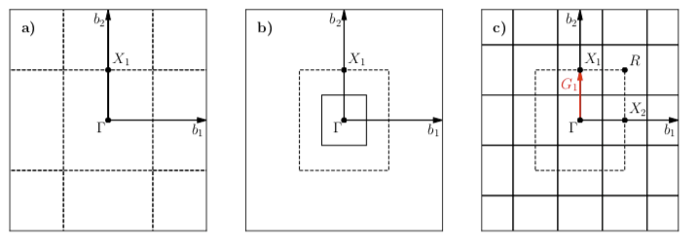




Tiling the primitive cell: 2D reciprocal square lattice example
Primitive cell
2x2 supercell
Translations of 2x2 supercell
$$X_{1}=(0,0.5)$$
energy = 3.867
kpoints
cbm
band_number = 4
energy = 17.1545
index = 51
kpoint_2pi_alat = [0. 0.1095605 0. ]
kpoint_rel = [0.3695652 0. 0.3695652]
pol = down
end cbm
vbm
band_number = 3
energy = 13.2874
index = 0
kpoint_2pi_alat = [0. 0. 0.]
kpoint_rel = [0. 0. 0.]
pol = down
end vbm
end kpoints
eigs = [-4.0953 6.1376 7.9247 7.9247 17.1972 20.6393 27.3653 27.3653]
index = 46
kpoint_2pi_alat = [0. 0.0988193 0. ]
kpoint_rel = [0.3333333 0. 0.3333333]
occs = [1. 1. 1. 1. 0. 0. 0. 0.]
pol = up
$$∆′$$
Diamond,
Indirect gap
$$∆$$
We know:
Tiling matrix
Wavevectors
$$[3,1,3]$$

Slide 8
Workflow Demo: Optical gap workflows with DMC

Slide 9
New NSCF calculation for next steps
labs/lab5_excited_states/optical.py
#Input structure
dia = generate_physical_system(
units = 'A',
axes = [[ 1.785, 1.785, 0. ],
[ 0. , 1.785, 1.785],
[ 1.785, 0. , 1.785]],
elem = ['C','C'],
pos = [[ 0. , 0. , 0. ],
[ 0.8925, 0.8925, 0.8925]],
use_prim = True, # Use SeeK-path library to identify prim cell
tiling = [3,1,3], # Tile the cell
kgrid = (1,1,1),
kshift = (0,0,0),
C = 4
)
scf = generate_pwscf(...)
nscf = generate_pwscf(
identifier = 'nscf',
path = 'nscf',
job = job(cores=16,app='pw.x'),
input_type = 'generic',
calculation = 'nscf',
input_dft = 'lda',
ecutwfc = 200,
nspin = 2,
conv_thr = 1e-8,
nosym = True,
nosym_evc = True,
noinv = True,
wf_collect = True,
system = dia,
nbnd = 8, #a sensible nbnd value can be given
verbosity = 'high', #verbosity must be set to high
pseudos = ['C.BFD.upf'],
dependencies = (scf,'charge_density'),
)
run_project()
p = nscf.load_analyzer_image()
print 'band information'
print p.bands.up
print 'twist 0 k-point:',p.bands.up[0].kpoint_rel
print 'twist 4 k-point:',p.bands.up[4].kpoint_rel
print 'twist 0 band 3 eigenvalue:',p.bands.up[0].eigs[3]
print 'twist 4 band 4 eigenvalue:',p.bands.up[4].eigs[4]
The new NSCF calculation will be for a single supertwist and it will be reused in all optical and quasiparticle gap calculations.
New NSCF calculation -> New kpoint indexes
(4,4)
(0,3)
twist 0 k-point: [0. 0. 0.]
twist 4 k-point: [0.3333333 0. 0.3333333]
twist 0 band 3 eigenvalue: 13.2874
twist 4 band 4 eigenvalue: 17.1972

Slide 10
Diamond DMC optical gap:
conv = generate_pw2qmcpack(...)
opt = generate_qmcpack(...)
qmc_ground = generate_qmcpack(
det_format = 'old',
identifier = 'vmc',
path = 'vmc_ground',
job = job(cores=16,threads=16,app='qmcpack_complex'),
input_type = 'basic',
spin_polarized = True,
system = dia,
pseudos = ['C.BFD.xml'],
jastrows = [],
calculations = [
vmc(
warmupsteps = 20,
blocks = 800,
steps = 5,
substeps = 2,
timestep = .4,
)
],
dependencies = [(conv,'orbitals'),
(opt,'jastrow')],
)
qmc_optical = generate_qmcpack(
det_format = 'old',
identifier = 'vmc',
path = 'vmc_optical',
job = job(cores=16,threads=16,app='qmcpack_complex'),
input_type = 'basic',
spin_polarized = True,
system = dia,
excitation = ['up', '0 3 4 4'], #
pseudos = ['C.BFD.xml'],
jastrows = [],
calculations = [
vmc(
warmupsteps = 20,
blocks = 800,
steps = 5,
substeps = 2,
timestep = .4,
)
],
dependencies = [(conv,'orbitals'),
(opt,'jastrow')],
)
run_project()
labs/lab5_excited_states/optical.py
Twist index, band index (ti, bi) notation
(4,4)
(0,3)
twist 0 k-point: [0. 0. 0.]
twist 4 k-point: [0.3333333 0. 0.3333333]
twist 0 band 3 eigenvalue: 13.2874
twist 4 band 4 eigenvalue: 17.1972

Slide 11
Diamond DMC optical gap: changes to QMCPACK input/output files
labs/lab5_excited_states/diamond_runs/vmc_optical/vmc.in.xml
<wavefunction name="psi0" target="e">
<determinantset type="einspline" href="../nscf/pwscf_output/pwscf.pwscf.h5" tilematrix="3 0 0 0 1 0 0 0 3” ...>
<slaterdeterminant>
<determinant id="updet" size="36">
<occupation mode="excited" spindataset="0" pairs="1" format="band">
0 3 4 4
</occupation>
</determinant>
<determinant id="downdet" size="36">
<occupation mode="ground" spindataset="1"/>
</determinant>
</slaterdeterminant>
labs/lab5_excited_states/diamond_runs/vmc_ground/einspline.tile_300010003.spin_0.tw_0.g0.bandinfo.dat
# Band State TwistIndex BandIndex Energy Kx Ky Kz K1 K2 K3 KmK
0 0 0 0 -0.297238 0.0000 0.0000 0.0000 -0.0000 -0.0000 -0.0000 1
.
.
.
35 35 0 3 0.488303 0.0000 0.0000 0.0000 -0.0000 -0.0000 -0.0000 1
36 36 4 4 0.631985 0.0000 -0.6209 -0.0000 -0.3333 -0.0000 -0.3333 1
.
.
.
labs/lab5_excited_states/diamond_runs/vmc_optical/einspline.tile_300010003.spin_0.tw_0.g0.bandinfo.dat
# Band State TwistIndex BandIndex Energy Kx Ky Kz K1 K2 K3 KmK
0 0 0 0 -0.297238 0.0000 0.0000 0.0000 -0.0000 -0.0000 -0.0000 1
.
.
.
35 35 4 4 0.631985 0.0000 -0.6209 -0.0000 -0.3333 -0.0000 -0.3333 1
36 36 0 3 0.488303 0.0000 0.0000 0.0000 -0.0000 -0.0000 -0.0000 1
.
.
.

Slide 12
Workflow Demo: Quasiparticle gap workflows with DMC

Slide 13
Diamond quasiparticle gap:
qmc_ground = generate_qmcpack(
det_format = 'old',
identifier = 'vmc',
path = 'vmc_ground',
job = job(cores=16,threads=16,app='qmcpack_complex'),
input_type = 'basic',
spin_polarized = True,
system = dia,
pseudos = ['C.BFD.xml'],
jastrows = [],
calculations = [
vmc(
warmupsteps = 20,
blocks = 800,
steps = 5,
substeps = 2,
timestep = .4,
)
],
dependencies = [(conv,'orbitals'),
(opt,'jastrow')],
)
qmc_minus = generate_qmcpack(
det_format = 'old',
...
path = 'vmc_-e',
...
system = dia,
...
)
u = qmc_minus.input.get('u')
u.size-=1
updet = qmc_minus.input.get('updet')
updet.size-=1
qmc_plus = generate_qmcpack(
det_format = 'old',
...
path = 'vmc_+e',
...
system = dia,
...
)
u = qmc_plus.input.get('u')
u.size+=1
updet = qmc_plus.input.get('updet')
updet.size+=1
run_project()
labs/lab5_excited_states/quasiparticle.py
(Python declarations) # same as band.py
(settings) # same as band.py
#Input structure
dia = generate_physical_system(
units = 'A',
axes = [[ 1.785, 1.785, 0. ],
[ 0. , 1.785, 1.785],
[ 1.785, 0. , 1.785]],
elem = ['C','C'],
pos = [[ 0. , 0. , 0. ],
[ 0.8925, 0.8925, 0.8925]],
use_prim = True, # Use SeeK-path library to identify prim cell
tiling = [3,1,3], # Tile the cell
kgrid = (1,1,1),
kshift = (0,0,0), # Assumes we study transitions from Gamma. For non-gamma tilings, use kshift appropriately
C = 4,
)
scf = generate_pwscf(...) # same as band.py and optical.py
nscf = generate_pwscf(...) # same as band.py and optical.py
conv = generate_pw2qmcpack(...) # same as band.py and optical.py
opt = generate_qmcpack(...) # same as band.py and optical.py
Change the number of electrons after the primitive cell is tiled

Slide 14
Diamond DMC optical gap: changes to QMCPACK input/output files
labs/lab5_excited_states/diamond_runs/vmc_+e/vmc.in.xml
<particleset name="e" random="yes">
<group name="u" size="37" mass="1.0">
<parameter name="charge" > -1 </parameter>
<parameter name="mass" > 1.0 </parameter>
</group>
<group name="d" size="36" mass="1.0">
<parameter name="charge" > -1 </parameter>
<parameter name="mass" > 1.0 </parameter>
</group>
</particleset>
.
.
.
<slaterdeterminant>
<determinant id="updet" size="37">
<occupation mode="ground" spindataset="0"/>
</determinant>
<determinant id="downdet" size="36">
<occupation mode="ground" spindataset="1"/>
</determinant>
</slaterdeterminant>
Einspline file is identical to the ground state
labs/lab5_excited_states/diamond_runs/vmc_+e/einspline.tile_300010003.spin_0.tw_0.g0.bandinfo.dat
# Band State TwistIndex BandIndex Energy Kx Ky Kz K1 K2 K3 KmK
0 0 0 0 -0.297238 0.0000 0.0000 0.0000 -0.0000 -0.0000 -0.0000 1
.
.
.
35 35 4 4 0.631985 0.0000 -0.6209 -0.0000 -0.3333 -0.0000 -0.3333 1
36 36 0 3 0.488303 0.0000 0.0000 0.0000 -0.0000 -0.0000 -0.0000 1
.
.
.

Slide 15
Workflow Demo: Automated tiling matrix from user specified wavevectors

Slide 16
Automated tiling matrix for n wavevectors:
./nexus/examples/qmcpack/excited/vmc-opt-tiling.py
Phys. Rev. B 92, 184301, 2015
dia_prim = generate_physical_system(
units = 'A',
axes = [[ 1.785, 1.785, 0. ],
[ 0. , 1.785, 1.785],
[ 1.785, 0. , 1.785]],
elem = ['C','C'],
pos = [[ 0. , 0. , 0. ],
[ 0.8925, 0.8925, 0.8925]],
use_prim = True,
C = 4
)
tiling = get_band_tiling(structure = dia_prim,
kpoints_rel = [[0.000, 0.000, 0.000],
[0.3768116, 0., 0.3768116]],
max_volfac = 20
)
#Alternatively:
#tiling = get_band_tiling(structure = dia_prim,
# kpoints_label = ['GAMMA', 'X’]
# max_volfac = 20
)
# Min and target volfacs will be added here
dia_tiled = generate_physical_system(
units = 'A',
axes = [[ 1.785, 1.785, 0. ],
[ 0. , 1.785, 1.785],
[ 1.785, 0. , 1.785]],
elem = ['C','C'],
pos = [[ 0. , 0. , 0. ],
[ 0.8925, 0.8925, 0.8925]],
use_prim = True,
tiling = tiling,
kgrid = (1,1,1),
kshift = (0,0,0), # Equal to kpoints_rel[0] or kpoints_label[0]
C = 4
)
print tiling, np.linalg,det(tiling)
#print p.bands.direct_gap
energy = 3.867
kpoints
cbm
band_number = 4
energy = 17.1545
index = 51
kpoint_2pi_alat = [0. 0.1095605 0. ]
kpoint_rel = [0.3695652 0. 0.3695652]
pol = down
end cbm
vbm
band_number = 3
energy = 13.2874
index = 0
kpoint_2pi_alat = [0. 0. 0.]
kpoint_rel = [0. 0. 0.]
pol = down
end vbm
end kpoints
>>> [[2, -2, 1], [0, 1, 0], [1, -1, -1]], 3

Slide 17
Automated tiling matrix for n wavevectors:
./nexus/examples/qmcpack/excited/vmc-opt-tiling.py
scf = generate_pwscf(
identifier = 'scf',
path = 'diamond/scf',
job = job(nodes=1, app='pw.x',hours=1),
input_type = 'generic',
calculation = 'scf',
nspin = 2,
input_dft = 'lda',
ecutwfc = 200,
conv_thr = 1e-8,
nosym = True,
wf_collect = True,
system = dia_prim,
tot_magnetization = 0,
pseudos = ['C.BFD.upf'],
)
nscf = generate_pwscf(
identifier = 'nscf',
path ='diamond/nscf_opt_tiling',
job = job(nodes=1, app='pw.x',hours=1),
input_type = 'generic',
calculation = 'nscf',
input_dft = 'lda',
ecutwfc = 200,
nspin = 2,
conv_thr = 1e-8,
nosym = True,
wf_collect = True,
system = dia_tiled,
nbnd = 8, #a sensible nbnd value can be given
verbosity = 'high', #verbosity must be set to high
pseudos = ['C.BFD.upf'],
dependencies = (scf, 'charge_density'),
)
print nscf.input.k_points.kpoints
>>>array([[ 0.00000000e+00, 0.00000000e+00, 0.00000000e+00],
[ 3.33333333e-01, -3.78296121e-34, 3.33333333e-01],
[ 6.66666667e-01, -3.50736650e-34, 6.66666667e-01]])

Slide 18
Summary
Getting band structure with DFT
Return the idealized primitive cell with use_prim and add reciprocal path with add_kpath
Identifying relevant wavevectors and tiling matrices
Use a non-optimal tiling matrix (e.g. [3,1,3])
Use get_band_tiling
NSCF run on a supertwist with the tiling matrix
Optical gap
Quasiparticle gap
Files located at: ./labs/lab5_excited_states
./nexus/examples/qmcpack/excited

Slide 19
Question & Answer

