Slide 1
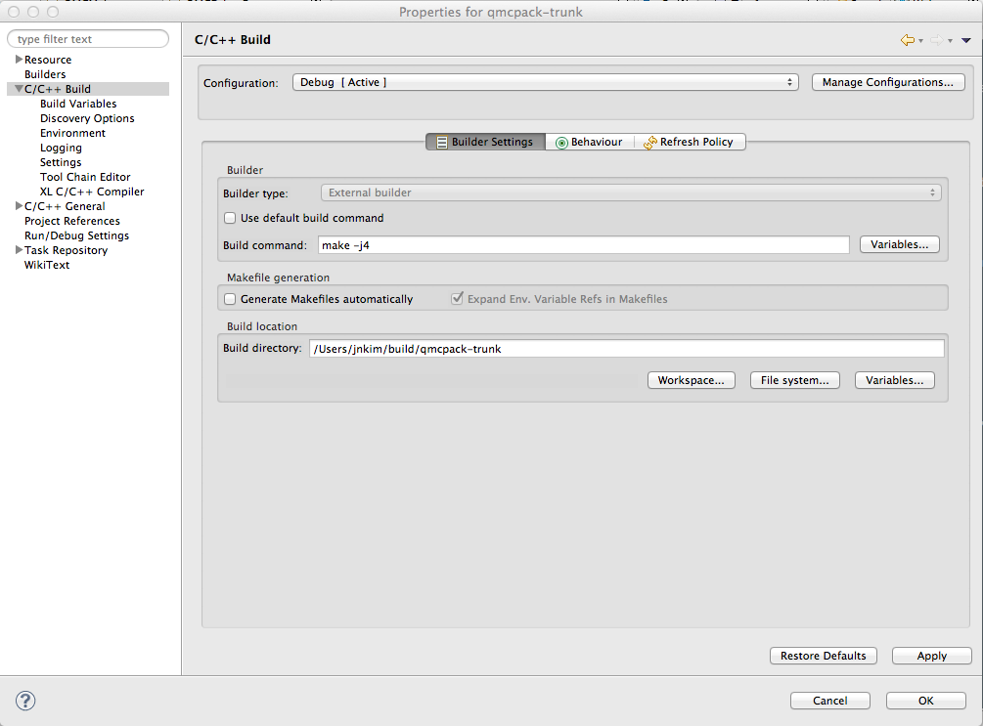
Use 4 threads
Unclick to overwrite
the default build directory
Use the cmake build directory

Slide 2
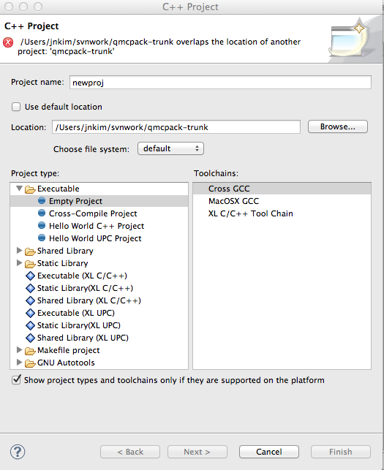
Select project name
Select QMCPACK
directory
Empty project

