Slide 1
“Tagged” data

Slide 2
Web scraping
Questionably legal and moral
Some sites forbid it, some sites allow it
Read terms of use
Arms race between web developers and users

Slide 3
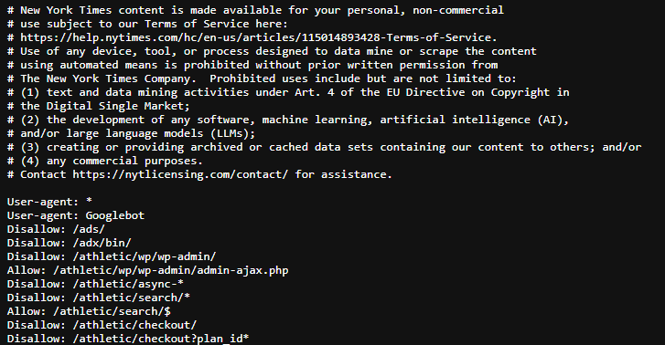
Robots.txt
“simple text file hosted on a website that communicates crawling permissions to automated agents: bots, crawlers, and scrapers.”
Sort of provides rules of use for a website
Should read before scraping

Slide 4
Web scraping 101
Basic idea: Download the html source of a webpage
Send request to website
Website returns the html code
Store html code as object
Very easy with static pages
Automated recording – download once, and have everything
Not as easy with dynamic pages
Client and server in dialogue
Content loads as you interact

Slide 5
HTML Tags
Defines structure on a webpage
Used for links, formatting of text (bold, italics), paragraphs, bullets, etc
Web browsers turn tags into a formatted page
Tags used to extract information

Slide 6
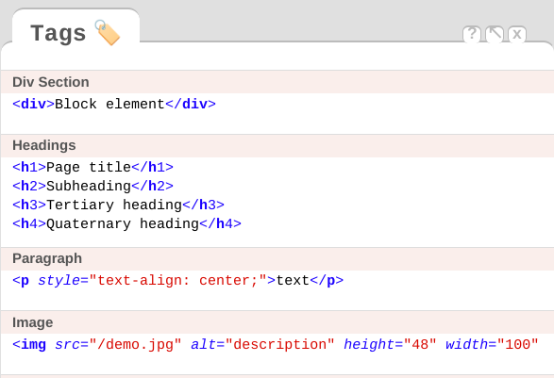
HTML

Slide 7
Tags
Define structure of webpage
Many examples:
<p> - Paragraph element
<table> - Defines table
<tr> - [Nested within table] Sets row of table
<td> - [Nested within tr] Sets cell of table row
<div> - Content division element
<a> - Anchor tag [also seen in Markdown]
<span> - Inline element

Slide 8
Attributes
Properties that identify or configure elements
id - Unique identifier for an element
class - CSS class(es) for styling or targeting
href - URL link (used in <a> tags)
src - Source file path (used in <img>, <script> tags)

Slide 9
Nested tags
Tags within tags:
<tr> within <table> and <td> within <tr>

Slide 10
Beautiful Soup
Python package for parsing tagged data
Converts raw html or xml into parsible data
Navigate using tags and attributes to find and extract data
(Same logic works in other programs (e.g., rvest for R)

Slide 11
Example
<div class="field field-name-field-taxonomy-doc-type field-type-taxonomy-term-reference field-label-inline clearfix"><div class="field-label">Document Type:&nbsp;</div><div class="field-items"><div class="field-item even"><a href="/readingroom/document-type/specialcollection" typeof="skos:Concept" property="rdfs:label skos:prefLabel" datatype="">SPECIALCOLLECTION</a></div></div></div>
<div class="field field-name-field-collection field-type-node-reference field-label-inline clearfix"><div class="field-label">Collection:&nbsp;</div><div class="field-items"><div class="field-item even"><a href="/readingroom/collection/daily-summary">Daily Summary Collection</a></div></div></div>
<div class="field field-name-field-document-number field-type-text field-label-inline clearfix"><div class="field-label">Document Number (FOIA) /ESDN (CREST):&nbsp;</div><div class="field-items"><div class="field-item even">03164645</div></div></div>
<div class="field field-name-field-page-count field-type-text field-label-inline clearfix"><div class="field-label">Document Page Count:&nbsp;</div><div class="field-items"><div class="field-item even"></div></div></div><div class="field field-name-field-creation-date field-type-datetime field-label-inline clearfix"><div class="field-label">Document Creation Date:&nbsp;</div><div class="field-items"><div class="field-item even"><span class="date-display-single" property="dc:date" datatype="xsd:dateTime" content="2018-08-03T00:00:00-04:00">August 3, 2018</span></div></div></div>

Slide 12
XML data
Extensible Markup Language
Tagged language
Could use BeautifulSoup
Lots of programs read it easily
Including Excel
But it might not be in format you want

Slide 13
Beautiful Soup usage
Extract text from webpage
Follow links on webpage

Slide 14
Example of XML
<div frus:doc-dateTime-max="1970-03-26T23:59:59-05:00"
frus:doc-dateTime-min="1970-03-26T00:00:00-05:00" n="12"
subtype="historical-document" type="document" xml:id="d12">
<head>12. Letter From President <persName corresp="#p_NRM1" type="from"
>Nixon</persName> to Secretary of State <persName corresp="#p_RWP1"
type="to">Rogers</persName><note n="1" type="source" xml:id="d12fn1"
>Source: National Archives, <persName corresp="#p_NRM1"
>Nixon</persName> Presidential Materials, <gloss
target="#t_NSC1">NSC</gloss> Files, Box 281, Agency Files,
Department of State, Vol. VI. No classification marking. Under
<persName corresp="#p_NRM1">Nixon</persName>ʼs signature is
written in an unidentified hand, “Do the notes on the next two pages
suggest this was signed by machine after HAKʼs approval? The carbon
copy indicates /s/RN.” The next two pages, which are not published,
include handwritten notes stating that “HAK Approves for
President.”</note>
<note n="2" type="summary" xml:id="d12fn2">
<persName corresp="#p_NRM1">Nixon</persName> responded favorably to
<persName corresp="#p_RWP1">Rogers</persName>ʼs statement on
U.S. African policy, which was a more detailed and in-depth
discussion on the subject than was given in <persName
corresp="#p_NRM1">Nixon</persName>ʼs February 18 Report to
Congress (<ref target="#d7">Document 7</ref>).</note>
</head>
<dateline>
<placeName>Washington</placeName>, <date calendar="gregorian"
when="1970-03-26">March 26, 1970</date>
</dateline>
</div>

Slide 15
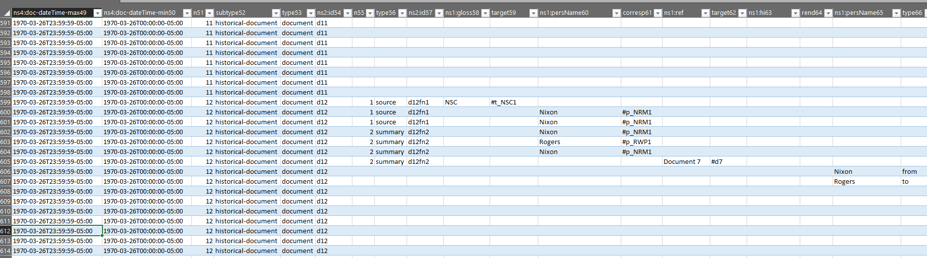

Slide 16
XML tags
As with HTML, provide structure
Separate out different fields
Can be used to get relevant information/data

Slide 17
Structure & Patterns
Know the data
Find the tags for data you want
Easy to extract data

