Slide 1
MD result on LHCII TR-PC system

Slide 2
Diffusion factor
Red data is obtained from MD
Note tagged lipids usually slower than lipid
Diffusion coefficient | in 2D (µm^2/s) | experimental reference (µm^2/s)
DOPC | 8.4 | 5~14
TR-PC | 4.5
DHPE | 4.1
TEXAS-DHPE | 2.7
DPPC | ~29.7 | ~17
TAGGED-DPPC | ~31
https://www.sciencedirect.com/science/article/pii/S0005273610000544#tblfn2
https://www.ncbi.nlm.nih.gov/pmc/articles/PMC6365552/#:~:text=The%20evaluated%20diffusion%20coefficient%20of,%2C%20GUVs%20vs%20SLBs)9.
https://pubs.acs.org/doi/abs/10.1021/jp203738m

Slide 3
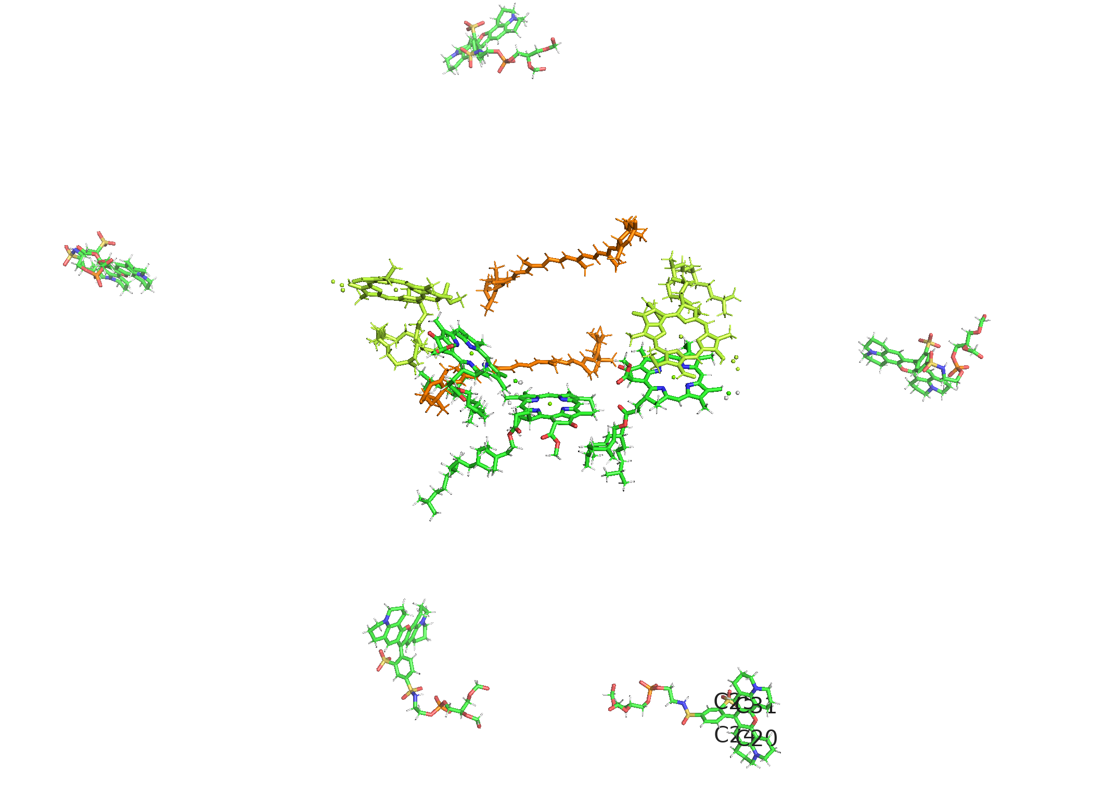
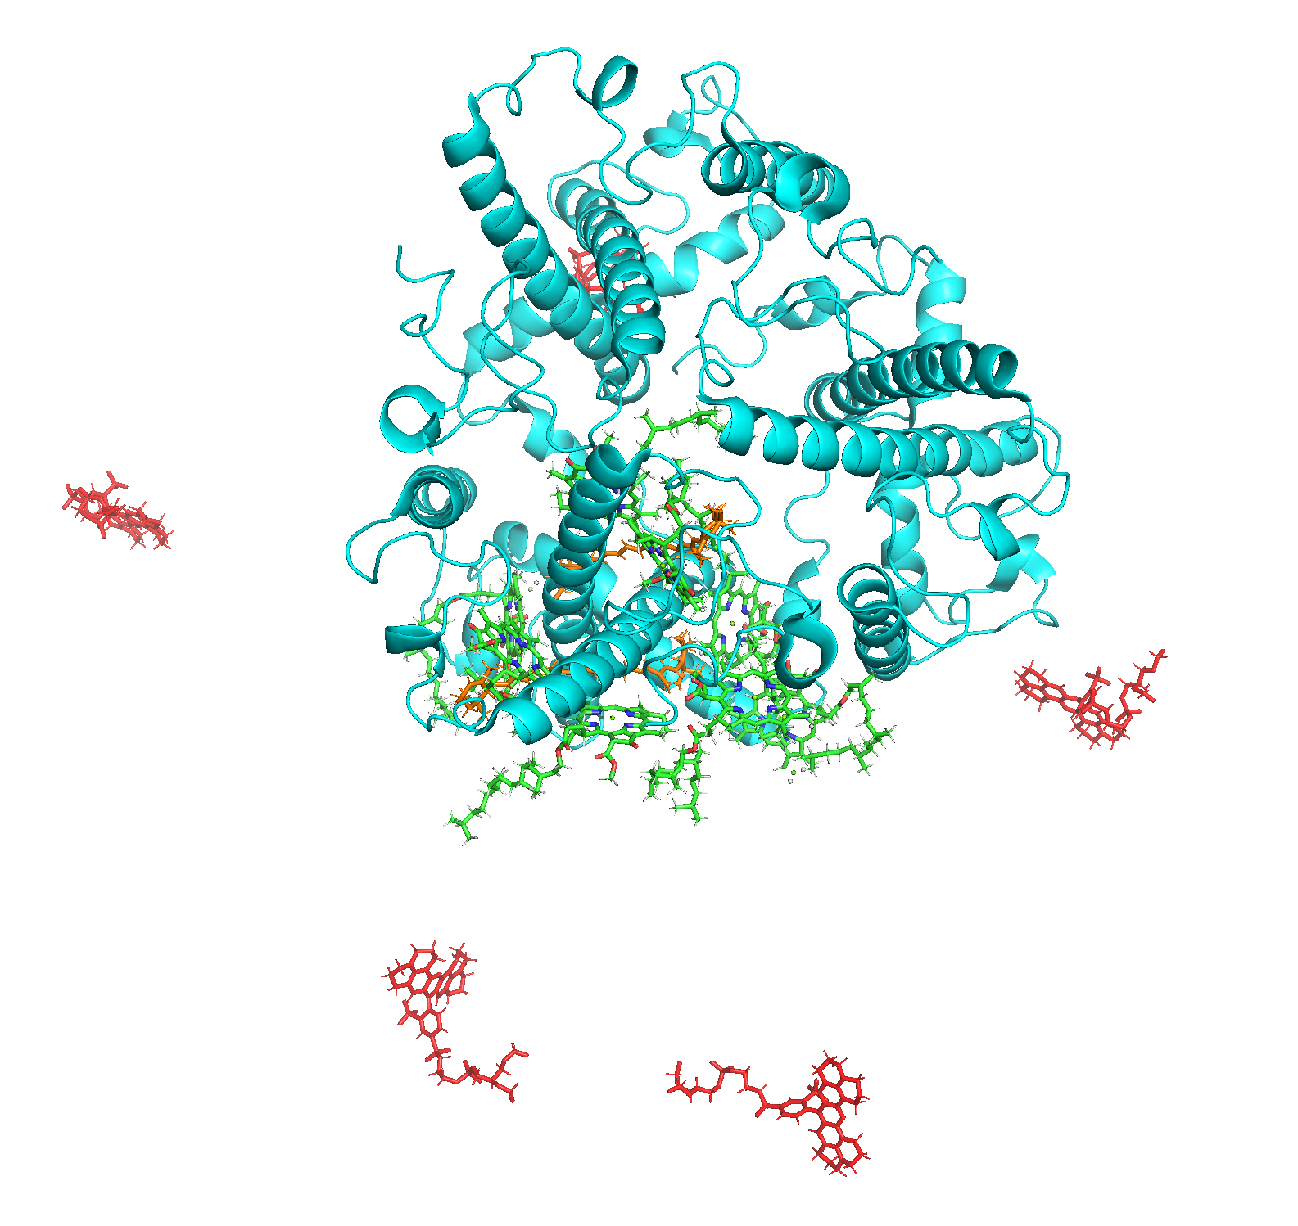
(point) Dipole-Dipole interaction
2 “outside” Texas-Red molecules to CLA 612, 611, 610 and CHL601, 608
TEX3
TEX5
TEX2
TEX4
TEX1

Slide 4
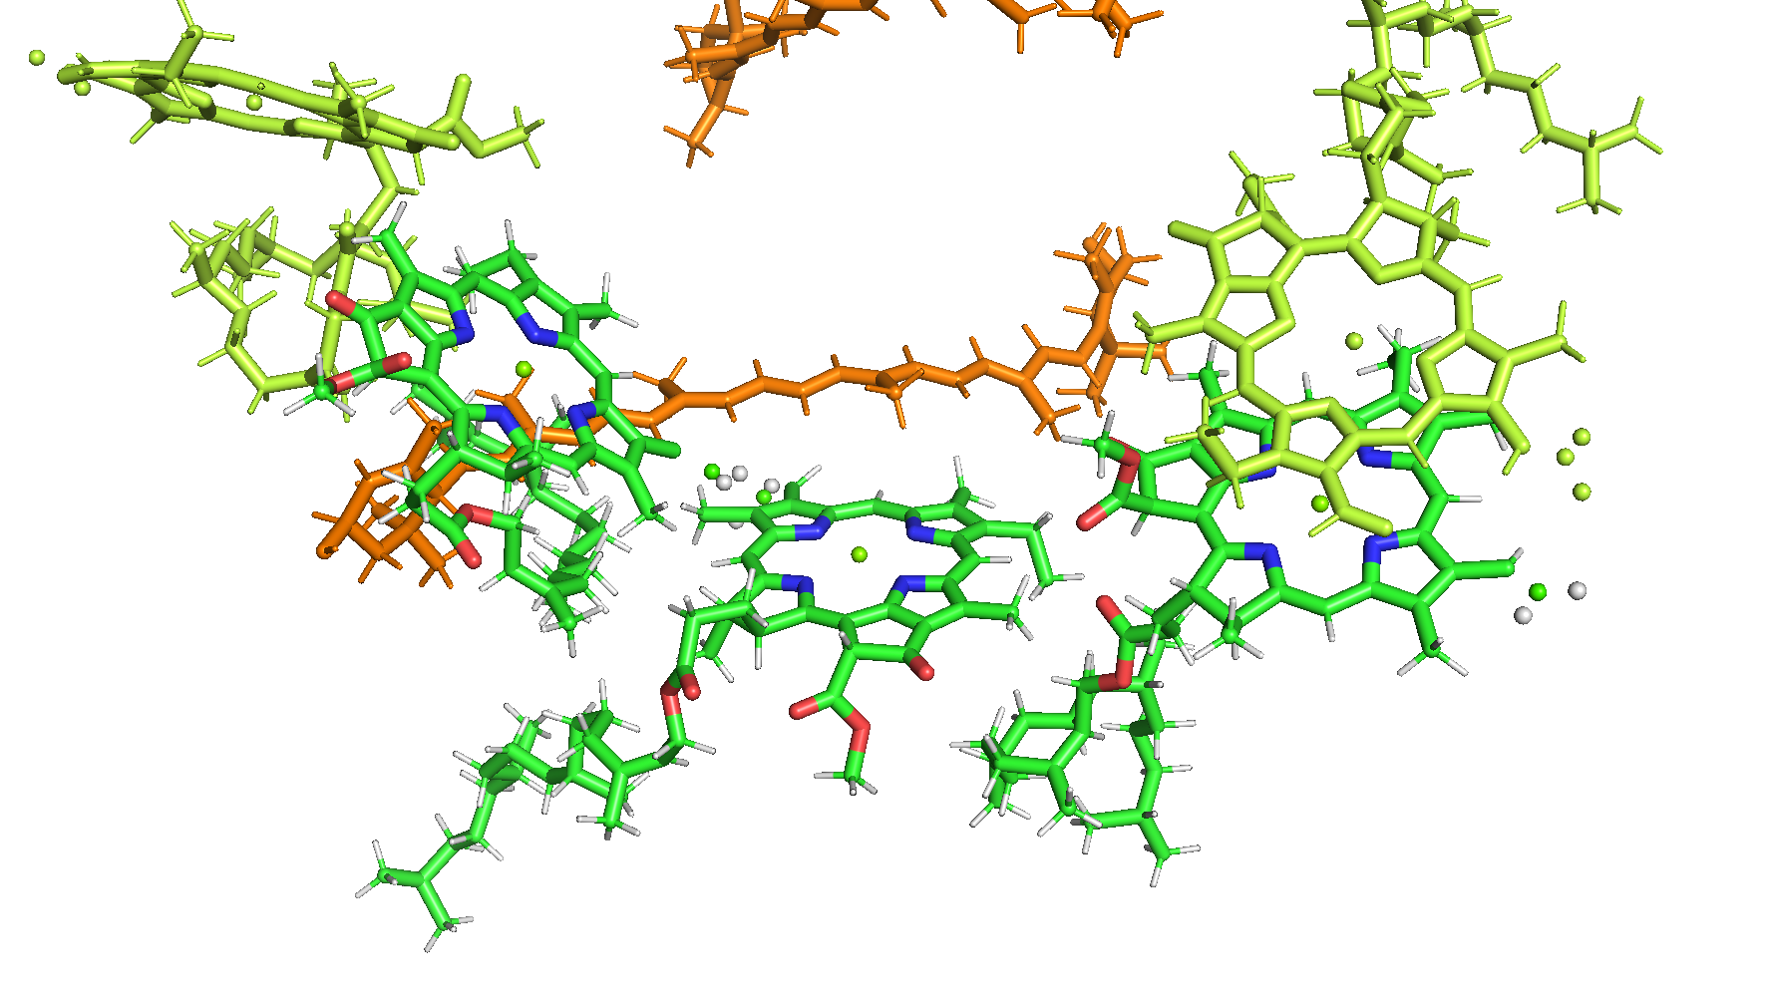
Zoom in the cluster:
CHL601
CHL608
CHL610
CHL612
CHL611
TEX4
TEX1

Slide 5
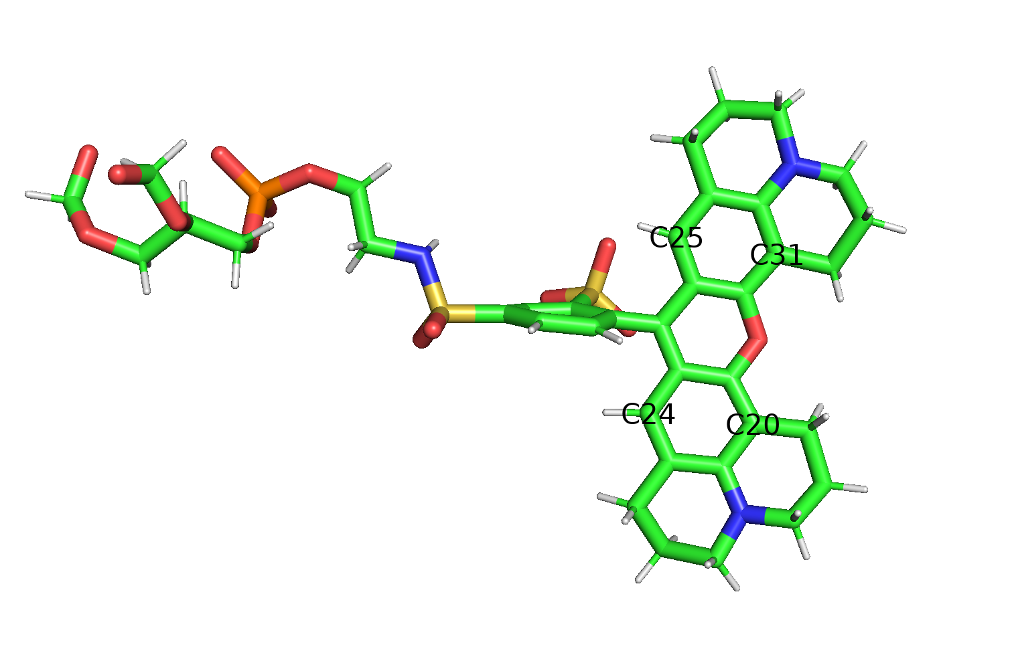
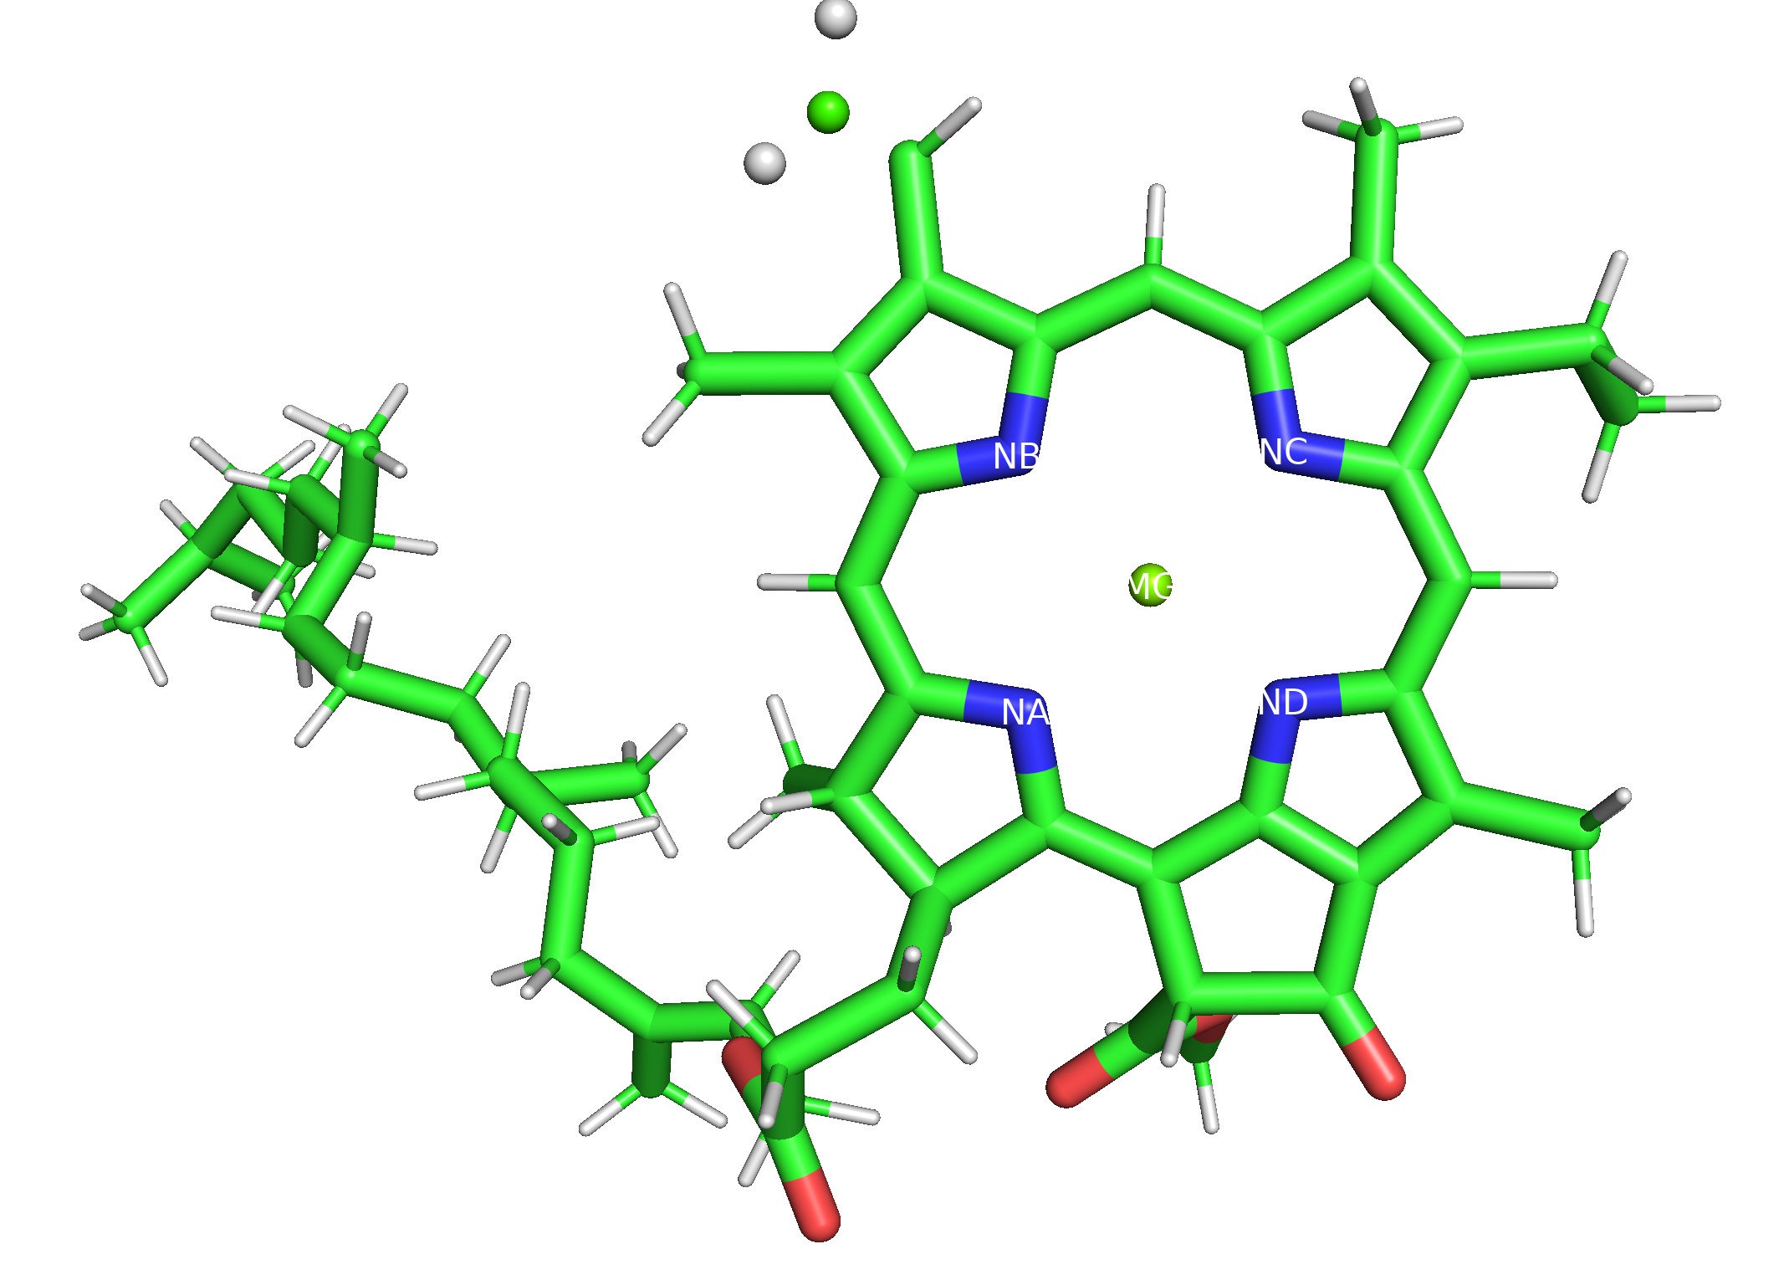
Defining dipole in analysis:
A
B
D
C
“from the sulfonate sulfur (S1) to the xanthene oxygen(O9).”
From Mg to NC atom. Normalized.
https://pubs.acs.org/doi/10.1021/jp203826q

Slide 6
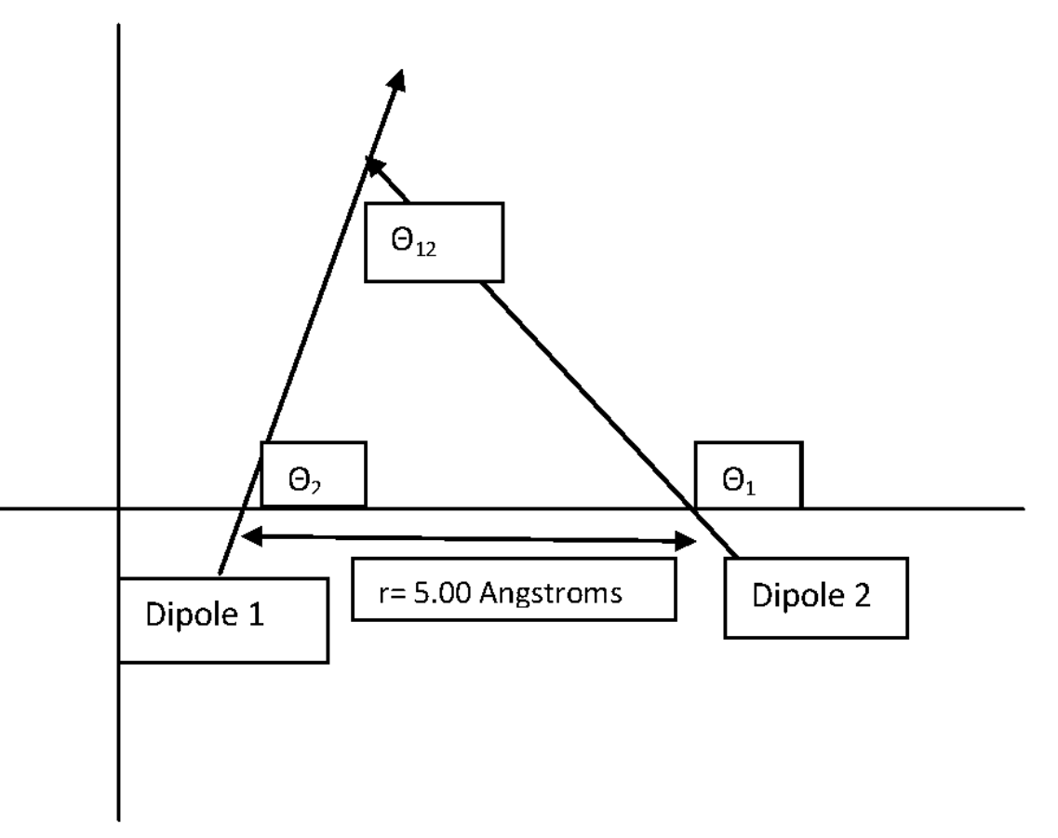
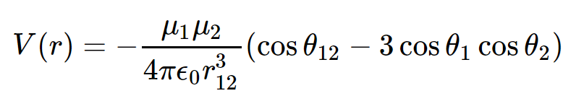
Dipole-Dipole interaction
r
Cosθ₁₂ can be obtained by dot multiply the unit vector of dipole1 and dipole2
Epsilone_0(permeativity) is taken as a factor of 2.

Slide 7
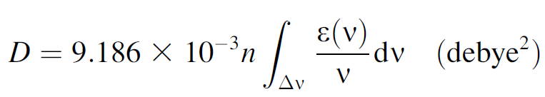
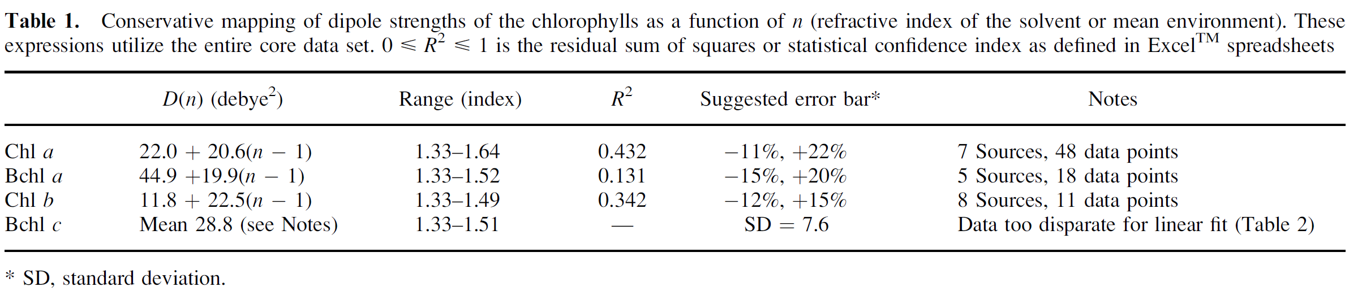
Dipole Strength
Texas-Red: “On the basis of convention, we took the Texas Red center of mass as the origin and found a net dipole moment of magnitude 21.1 Debye that points roughly from the sulfonate sulfur to the xanthene oxygen.”
Taken protein refractive index of 1.4, we re-scaled the Chl a/b dipole strength to:
Chl a: 30.52 D²
Chl b: 21.12 D²
https://pubmed.ncbi.nlm.nih.gov/12812291/

Slide 8
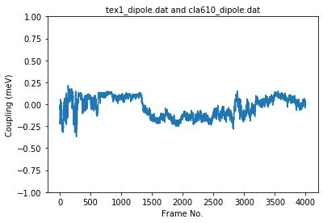
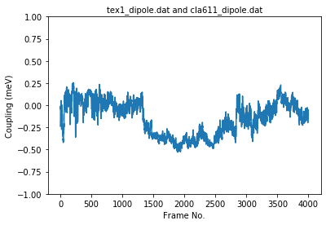
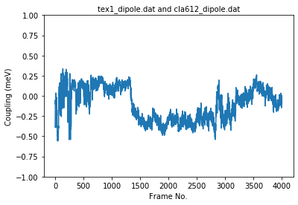
Dipole interactions: TEX1
TEX1-CLA610
TEX1-CLA611
TEX1-CLA612
note: The plot is 80ns in total, every 20 ns are divided by red lines.
Y-axis: Dipole interaction, unit in MeV.
X-axis: frame number stripped from MD trajectory. Every 1000 frames is 20 ns.

Slide 9
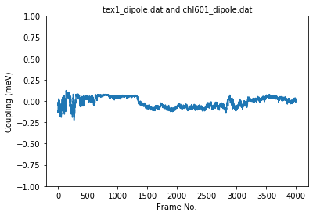
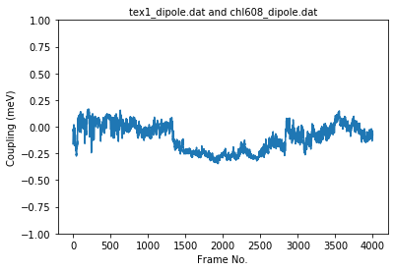
Dipole interactions: TEX1
TEX1-CHL601
TEX1-CHL608
Apparently CHL601 is less “interactive” compared to CHL608, as TEX1 is closer to the latter one. Also, the angle is in favour of TEX1-CHL608.

Slide 10
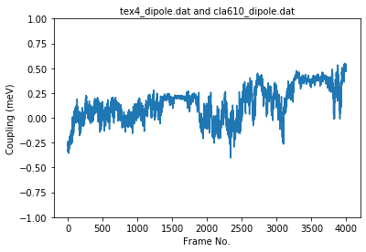
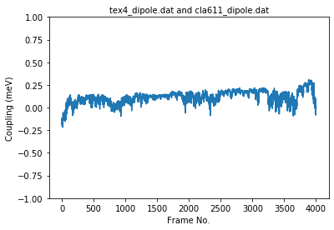
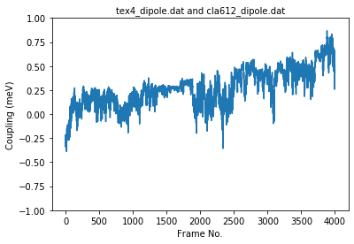
Dipole interactions: TEX4
TEX4-CLA610
TEX4-CLA611
TEX4-CLA612
Note that the yaxis is maxed at 1.2e-9 MeV

Slide 11
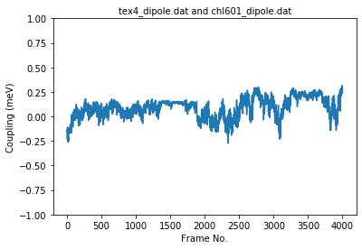
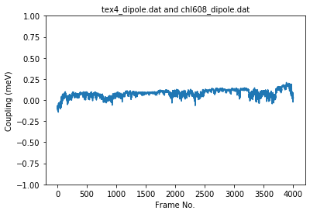
Dipole interactions: TEX4
TEX4-CHL601
TEX4-CHL608

Slide 12
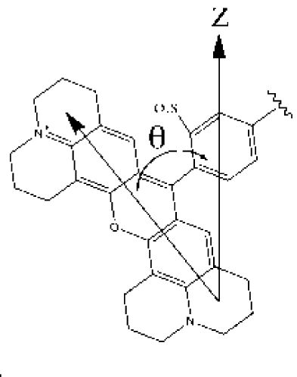
Conclusions from current progress:
CLA612 always has the largest impact because its outer positioning.
Sharp in/decrease of the dipole interaction is more likely due to the orientation of the Texas-Red rather than distance to CHLs
Factors may affect dipole interaction:
Distance between the molecule(more precisely their dipole center)
Angle between the dipoles. Need further investigation by plotting the “θ” angle.

Slide 13
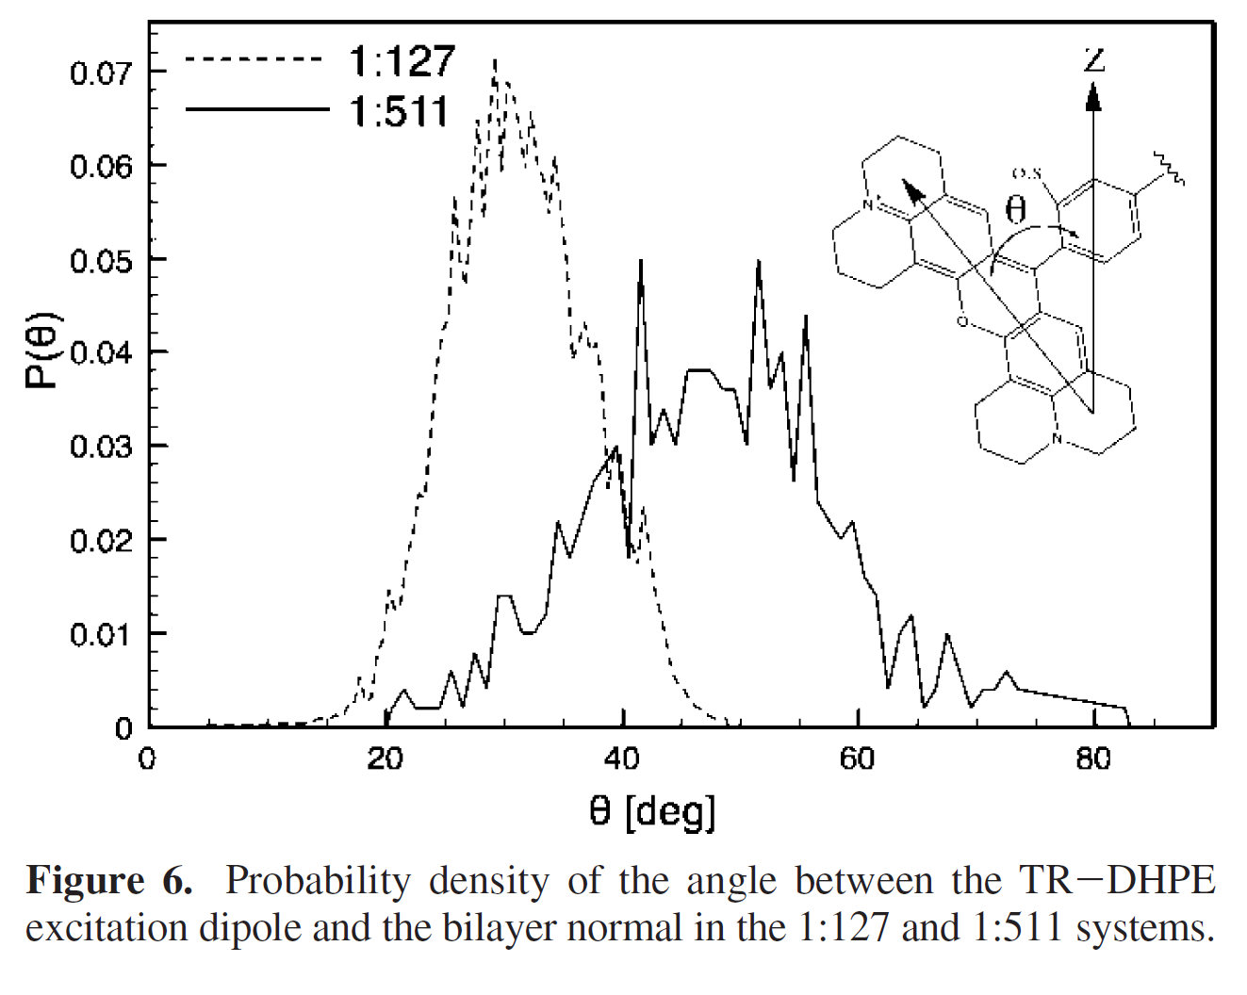
Recent update(1): The orientation of the TR dipole

Slide 14
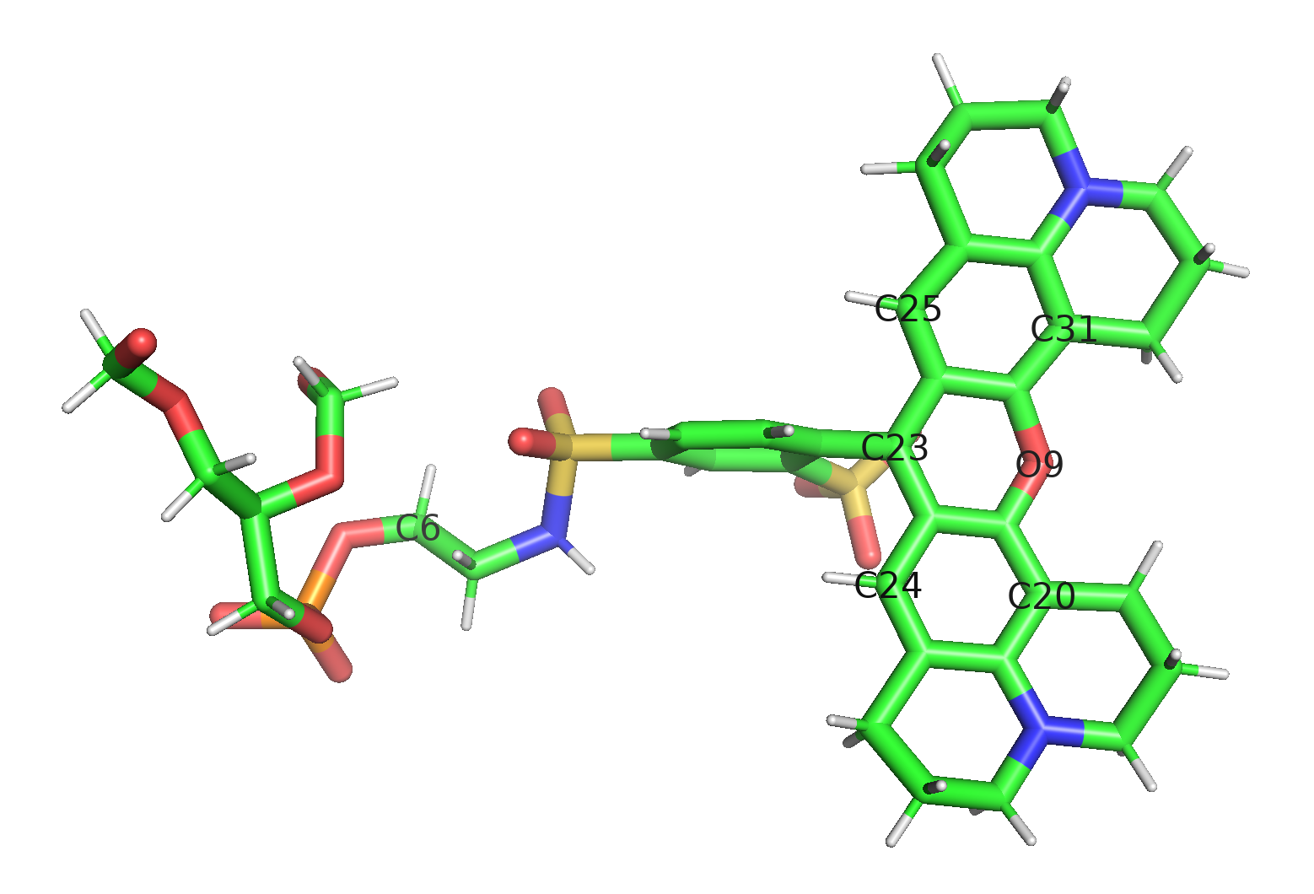
Recent update(2): The average centre to centre vector between TR and the PC it is bound to

Slide 15
Recent update(3): The average closest distance between a PC and the 3 Chla.

