Slide 1


SMART INDIA HACKATHON 2024
TITLE PAGE
Problem Statement ID - 1735
Problem Statement Title- On-device semantic segmentation of WMS services with geospatial data export.
Theme- Smart Automation
PS Category- Software
Team ID- Yet to be provided
Team Name - Passengers

Slide 2
Passengers
Necessity of the Problem and Why We Are Addressing It:
Challenges in Remote Sensing:
Remote sensing applications, such as digitization and segmentation, are widely used in environmental monitoring, urban planning, and more.
Existing segmentation solutions heavily rely on server-side GPUs, creating bottlenecks for non-technical users and reducing efficiency due to the reliance on internet connectivity and server availability.
Current Gaps:
Server dependence increases latency, costs, and often leads to limited accessibility.
Most segmentation tools are either too specialized or inaccessible to the broader community.
Why This Project?:
There's a growing need for lightweight, user-friendly applications that can perform resource-heavy tasks locally, utilizing modern device GPUs or NPUs.
By allowing on-device computation, users can achieve faster results, lower costs, and improve scalability.

Slide 3
Passengers
Proposed Solution of Prototype:
IDEA:
Input Image via WMS: The user selects a region of interest (ROI) using a Web Map Service (WMS), which serves geospatial imagery.
On-Device Segmentation: The application performs semantic segmentation on the selected image using the device's GPU/NPU (hardware acceleration).
User Interaction: The user can refine the segmentation by selecting, modifying, or adjusting the segmented features.
Geospatial Export: Segmented features are exported in geospatial formats like GeoJSON or KML. This allows for further use in GIS software or WebGIS applications for analysis or visualization.
SOLUTION ARCHITECTURE:
Input: Images are loaded via the WMS service based on the user's selected ROI.
Processing: On-device GPU/NPU handles segmentation using deep learning models such as U-Net or DeepLab. These models perform semantic segmentation in real-time, utilizing the device's hardware.
Output: Segmented features exported in geospatial format for further use in GIS software or WebGIS applications.
Why On-device GPU/NPU Matters: Emphasize the significance of moving away from server-based processing, and relying on local devices for cost-effective, faster, and more scalable solutions.

Slide 4
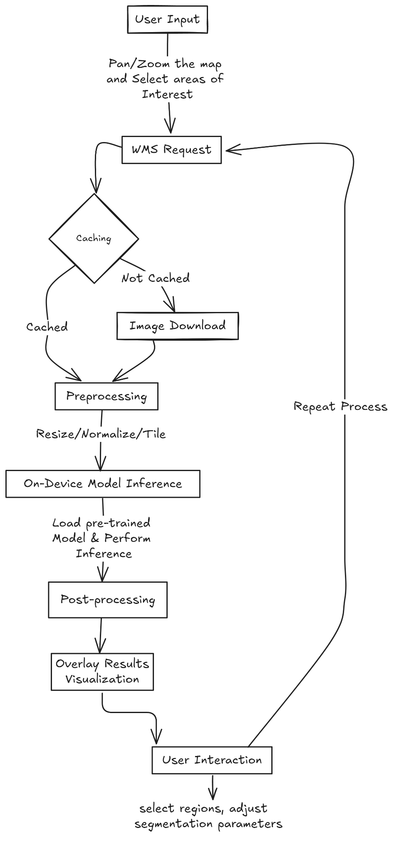
Passengers
Basic Idea

Slide 5
Passengers
Proposed Solution of Prototype contd:
How it Addresses the Problem:
Local Computation: On-device GPU/NPU utilization ensures that the system operates without requiring powerful remote servers.
User-Centric Design: The interface is built for non-technical users, ensuring accessibility.
Flexibility: Works across multiple platforms (mobile, desktop, web), increasing its usability in various scenarios.
Innovation:
Interactive Segmentation: A real-time, interactive segmentation interface that makes digitization faster and more precise.
WMS Service Integration: Full integration with OGC-compliant WMS services ensures the tool can be used with a wide variety of geospatial data providers.
Geospatial Export Capabilities: Efficient export to standard geospatial formats allows for seamless integration into existing workflows.

Slide 6









TECHNICAL APPROACH
Passengers
Framework of Prototype:
High-level Architecture:
Frontend: Web/mobile app with a simple, interactive GUI for loading WMS layers and performing segmentation.
Backend: Local segmentation engine that runs on-device, utilizing frameworks such as TensorFlow Lite or PyTorch Mobile to execute models on GPU/NPU.
WMS Integration: Use libraries like OWSLib in Python or QGIS's Python API for loading WMS tiles.
Export Module: For converting segmented areas into GeoJSON/KML and saving or sending to external GIS systems.
Libraries/Technologies:
Frontend: React (web), QGIS or ESRI Plugin (desktop).
Backend: TensorFlow Lite, PyTorch Mobile, CUDA, or Vulkan API for GPU acceleration along with flask.
Data Handling: GeoPandas, Shapely for geospatial data manipulation.
Image source: from respective company’s website

Slide 7
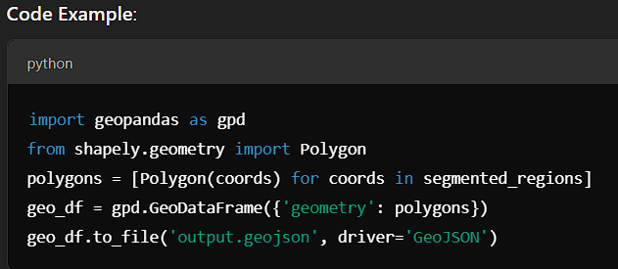
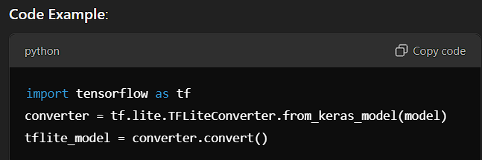
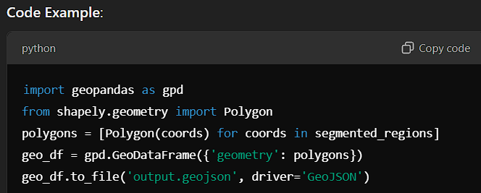
TECHNICAL APPROACH
Passengers
Development of Prototype:
Step 1: WMS Integration:
Details: Utilize WMS capabilities to load raster images (satellite imagery, topographical maps, etc.) from OGC-compliant services like OpenStreetMap, SentinelHub, ESRI etc.
Backend: Set up requests to OGC-compliant WMS services, fetching image tiles based on user-defined regions.
Frontend: Display fetched WMS layers on a map interface (using
Leaflet or OpenLayers) where users can choose regions.
Step 2: Semantic Segmentation on-device:
Model Selection: Use pre-trained models such as U-Net or DeepLab optimized for mobile devices.
Model Conversion: Convert the model using TensorFlow Lite or ONNX for compatibility with mobile devices.
Integration with GPU/NPU: Use TensorFlow Lite’s GPU delegate or PyTorch Mobile's Vulkan backend to run the model on the GPU.
code source: trial run for different parts

Slide 8
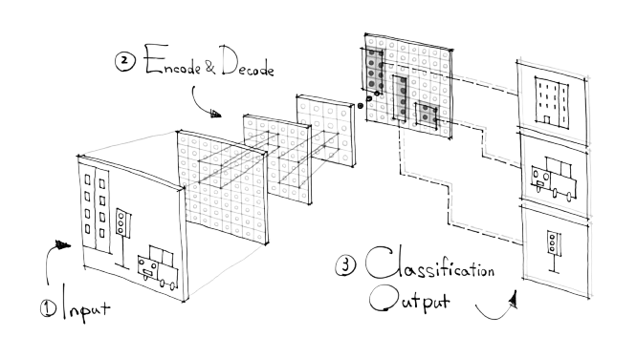
TECHNICAL APPROACH
Passengers
Development of Prototype:
Step 3: Interactive Segmentation Refinement:
Frontend: Implement an interface for users to adjust the segmentation output, allowing for manual correction of features.
Backend: Develop algorithms for user-driven corrections, ensuring that the changes can be applied seamlessly in real-time.
Step 4: Geospatial Data Export:
Conversion to GeoJSON/KML: Post-process segmented regions into geospatial formats using libraries like GeoPandas and export as GeoJSON or KML.
Step 5: Performance Optimization:
Device-Specific Optimization: Ensure efficient GPU/NPU utilization by profiling models on different device architectures (mobile vs desktop).
Image source: https://medium.com/yodayoda/segmentation-for-creating-maps-92b8d926cf7e

Slide 9
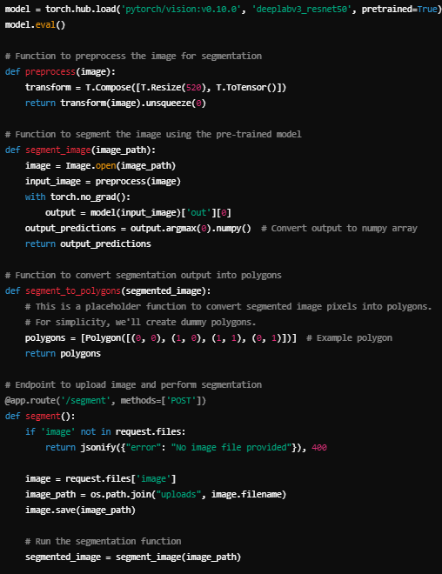
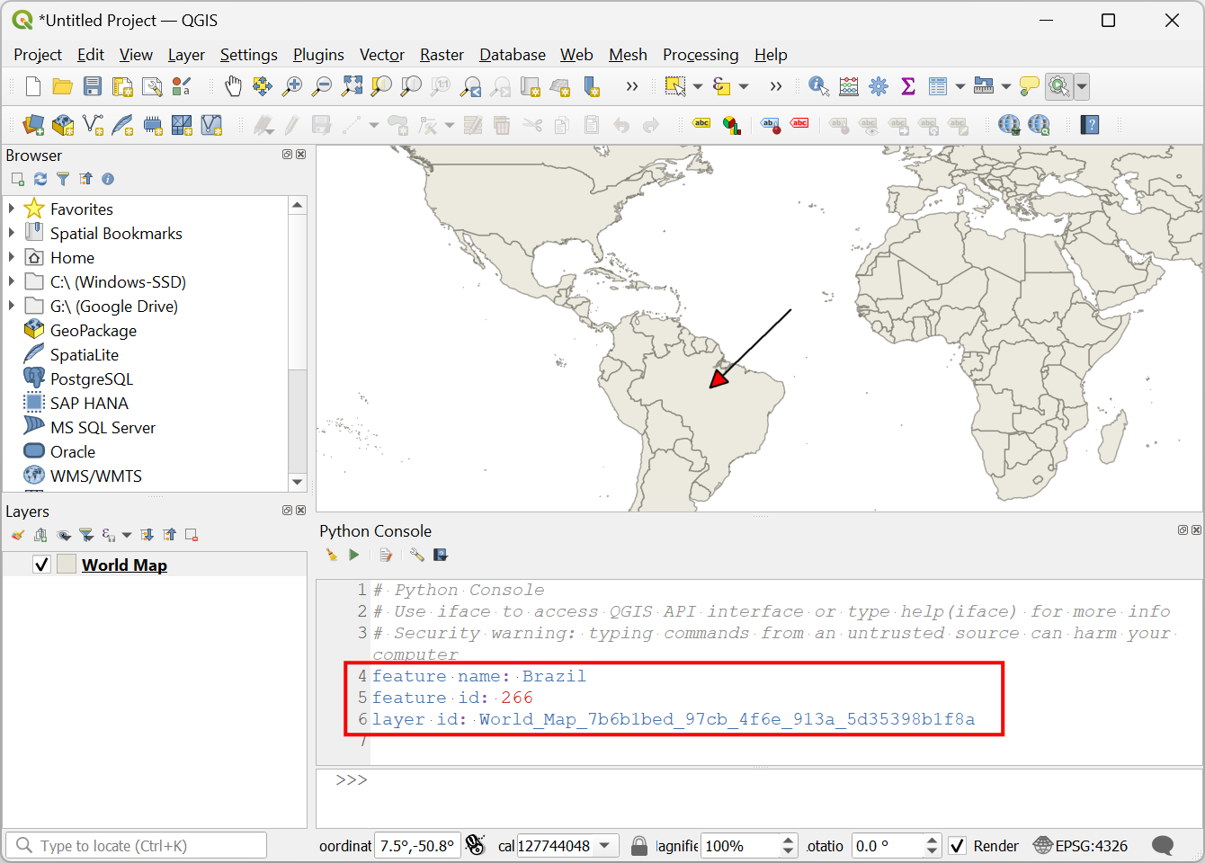
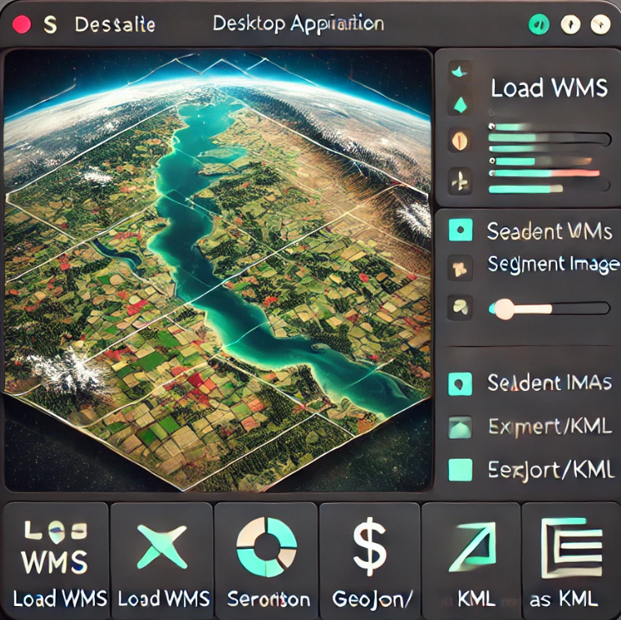
TECHNICAL APPROACH
Passengers
Image source: from demo workout of the solution

Slide 10
KEY FEATURES
Passengers
Technical Feasibility: Modern mobile and desktop devices have adequate GPU/NPU support, and libraries like TensorFlow Lite, PyTorch Mobile, and Vulkan API facilitate efficient processing. The integration of WMS services with segmentation is achievable using existing APIs.
User Accessibility: The design aims for simplicity, making it accessible to both GIS experts and general users, particularly through a mobile or desktop QGIS plugin.
Cost and Efficiency: On-device processing eliminates the need for costly server infrastructure and allows real-time operation in the field without internet reliance.
Market Viability: The solution can be integrated into existing WebGIS platforms and used for various remote sensing applications, providing a unique selling point of offline capability.
On-device Processing: Utilize the computational capabilities of GPUs/NPUs in modern devices.
User-friendly Interface: Develop a simple, intuitive interface so non-technical users can segment images without needing complex technical knowledge.
Real-time Interaction: Provide interactive segmentation, enabling users to visualize results on-screen in real-time.
Geospatial Export: Support exporting segmented features in common geospatial formats such as GeoJSON and KML for integration with GIS tools.

Slide 11
FEASIBILITY AND VIABILITY
Passengers
a) Challenges:
Device Compatibility: Ensuring that the tool runs efficiently across a variety of devices with different GPU/NPU architectures.
Model Size and Speed: Balancing model size with speed and accuracy to ensure real-time performance without consuming too much memory.
User Interface Design: Making the tool accessible to non-technical users while still providing the necessary functionality.
b) Strategies:
Optimization Techniques: Use model quantization and hardware-specific optimizations to reduce the size and increase the speed of models.
Incremental Deployment: Start with desktop GPU-based solutions, then move to mobile implementations as optimizations are confirmed.
Extensive Testing: Test the application on a wide range of devices to ensure consistent performance and compatibility.

Slide 12
IMPACT AND BENEFITS
Passengers
Impacts and Benefits of solution:
1.Environmental Protection:
Early Detection and Response: Rapid identification of oil spills allows for timely response and mitigation, minimizing the environmental damage caused by oil contamination.
Reduction in Ecosystem Damage: Prompt action helps to protect marine life, shorelines, and sensitive ecosystems from prolonged exposure to oil pollutants.
2.Regulatory Compliance:
Enforcement of Regulations: The ability to trace spills to specific vessels supports regulatory authorities in enforcing maritime pollution laws and holding responsible parties accountable.
Improved Reporting: Provides evidence for accurate reporting and documentation of environmental incidents, aiding in compliance with international conventions and agreements.

Slide 13
RESEARCH AND REFERENCES
Passengers
On-device Semantic Segmentation with GPUs/NPUs
Keypoint: Utilizes device-local GPU/NPUs to process semantic segmentation, improving speed, reducing latency, and enabling offline functionality. References:
https://www.tensorflow.org/install/source_windows
https://pytorch.org/get-started/locally/
Integration with WMS Services (OGC-Compliant)
Keypoint: Use OGC-compliant Web Map Service (WMS) to load geospatial data for segmentation, ensuring compatibility with standardized GIS systems. References:
https://www.ogc.org/standard/wms/
https://owslib.readthedocs.io/en/latest/
Geospatial Data Export (GeoJSON/KML)
Keypoint: Export segmented regions as geospatial data (GeoJSON, KML) for integration with GIS tools, enabling end-to-end workflow from segmentation to geospatial analysis. References:
https://geopandas.org/en/stable/docs.html
https://shapely.readthedocs.io/en/stable/
Existing Technologies for Remote Sensing Applications
Keypoint: Existing tools offer partial solutions (segmentation, WMS, export), but a comprehensive, GPU-accelerated on-device solution is lacking. References:
https://www.sentinel-hub.com/
https://arxiv.org/abs/1505.04597

