Slide 1


Accenture Innovation Challenge
Topic: Harness Generative AI to develop innovative solutions that boost business and societal growth

Slide 2
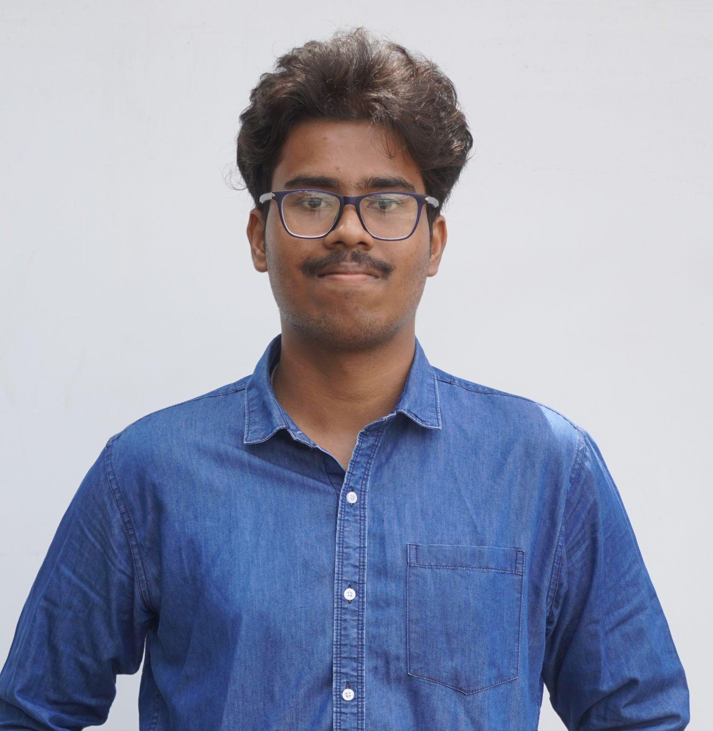

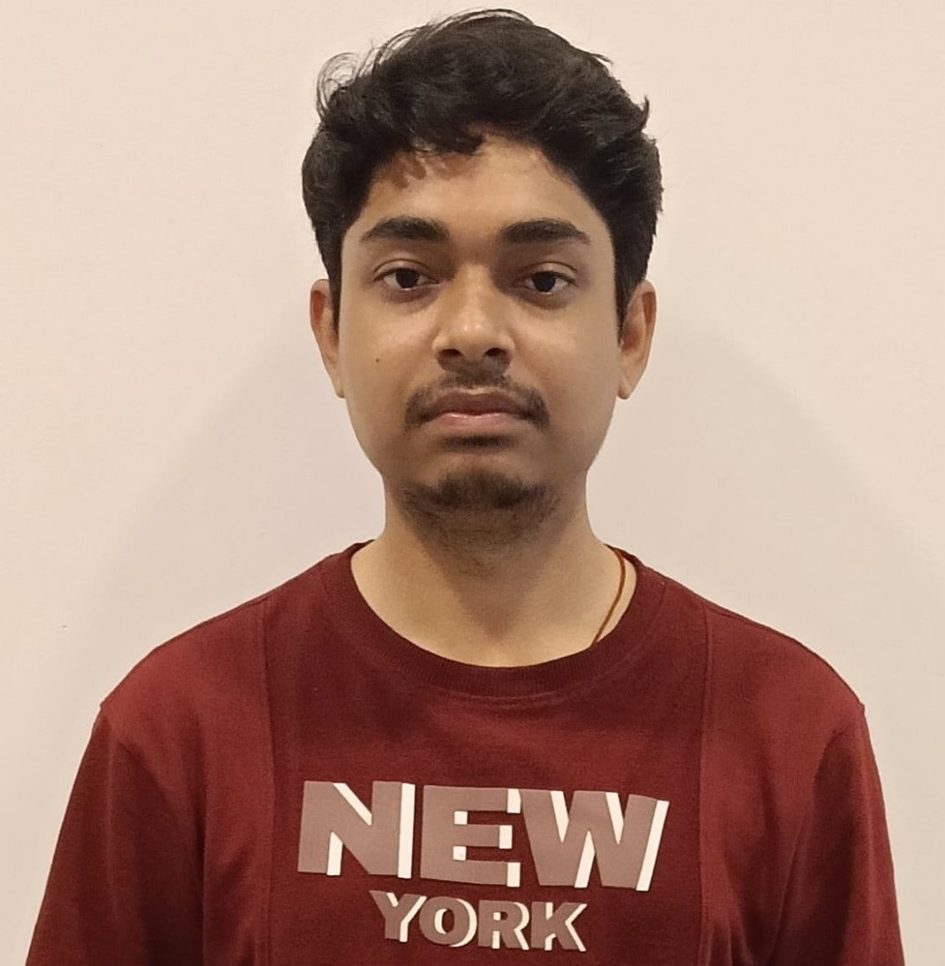

Team details
TEAM NAME: Panchayat
Deep Samanta (Team Leader)
Md Sahanawaj Karim
College:NIT Durgapur
Stream: Mechanical Engineering
Year of graduation: 2025
College:NIT Durgapur
Stream: Mechanical Engineering
Year of graduation: 2025
Photo
Aniket Kumar Gupta
Gaurav Kumar Singh
College:NIT Durgapur
Stream: Computer Science Engineering
Year of graduation: 2025
College:NIT Durgapur
Stream: Computer Science Engineering
Year of graduation: 2025

Slide 3
Describe the problem statement (200 words)
Modern hectic lifestyles and ignorance towards nutrients push most people away from healthy diets. General diet-planning solutions do not prove to be much as they consider only the necessities but forget to include other personal desires, dietary restrictions, or health objectives. Most users either do not know how to eat healthily or simply cannot stick to long-term diets. This leads to several health issues such as obesity, malnutrition, and chronic health issues.
Our solution solves the problems through using Generative AI to create person-specific diet plans. For everyone, the plan will focus on his needs, preferences, and health goals. The selection of food hinges on personal preferences, allergies, caloric needs, and medical conditions, offering balanced diets that can be maintained. Users easily follow the most adaptable meal plans, supporting their journey toward better health through NutriGen.

Slide 4
Proposed solution / your big Idea (200 words)
Solution Scope
NutriGen is a generative AI-powered nutrition platform that creates customized diet plans based on user profiles, preferences, and health goals. Dietary preferences and limitations or nutritional goals entered by the users, for example, might include low sodium or gluten-free diets. The algorithm will then generate a daily or weekly food plan with recipes best optimized for taste, nutrition, and portion control.
It is designed to well integrate with the nutritional databases and official dietary guidelines. It provides balanced meals that are in tune with the caloric needs as well as the diet of the user, offering alternative choices for variety. It can integrate with wearable devices and health applications to adjust meal plans in real-time according to the daily activity level and health progress of the users.

Slide 5
How does your innovation accelerate change with the power of Technology? (200 words)
Speeding Up Change
NutriGen revolutionizes nutrition with the totally personal diet plans, changing in real time by learning from the user's preferences, health goals, and lifestyle changes. Traditional tools can't compete with that level of personalization, professional-grade nutrition advice is now accessible to all.
This invention promotes a healthier lifestyle with easy, enjoyable meal planning tailored to an individual's choices. Users take charge of their wellbeing and plan for meals to fit in with their lifestyles and goals. It also reduces food waste because it serves portion-controlled meals based on precise caloric needs. Also, NutriGen will be highly integrated with health applications so that users can monitor their goals and track long-term improvements in their lifestyle.

Slide 6
Technologies leveraged:
Any testimonials received? : No
Technologies Used
Core Technology: Generative AI develops personalized meal plans based on user input.
NLP: Interprets user preferences, restrictions, and goals, such as vegan, keto, or gluten-free diets.
Machine Learning: Learns from vast nutrition data, dietary guidelines, and recipes, improving personalized recommendations with each interaction.
Data Science: Ensures meal plans are nutritionally balanced and aligned with health objectives.
API Integration: Connects with health apps and wearables like Fitbit and Apple Health to dynamically adjust diets based on daily activity levels, caloric burn, and health metrics..

Slide 7
How is your solution different/unique from other solutions in market? (150 words)
Unique Selling Proposition
NutriGen is different in that it will allow Generative AI to actually create plans for personalized meals based on specific dietary variations, restrictions, and health goals, developed with the evolution of user data in order to ensure the meal plan is relevant and also effective.
An integration with wearable devices suggests dynamic updates regarding plans on the basis of real-time activity, and NutriGen has become recognized as the most comprehensive and flexible meal-planning solution available in the market. It adjusts to the user while maintaining the sustainability of long-term improvements in health.
PATENT FILED: No
Do you have a working model/prototype: No
If not, will you be able to show working prototype during finale. Yes

Slide 8
1-minute video of our idea (embed on this PPT)

Slide 9
Thank you!

