Slide 1
Égalité et La Révolution Française
Présentateur : ODIN, Gabriel, Viviane, Lambert, Gérard

Slide 2
Des Contenus
01
02
L’introduction
Avant la révolution
03
04
Après la revolution
Conclusion
La définition de l’égalité
L’état sociale
L’état sociale

Slide 3

01
L’introduction
Jean-Jacques Rousseau
Le Discours sur l'origine et les fondements de l'inégalité parmi les hommes

Slide 4
Différents types d’inégalités
Richesse
Nobless
Pouvoir
Mérite personnel

Slide 5
Features Of The Topic
Mercury
Jupiter
Venus
Mars
Saturn
Neptune
Mercury is the closest planet to the Sun
It’s a gas giant and the biggest planet
Venus has a nice name, but it’s hot
Despite being red, Mars is a cold place
Saturn is a gas giant and has several rings
It’s the farthest planet from the Sun

Slide 6
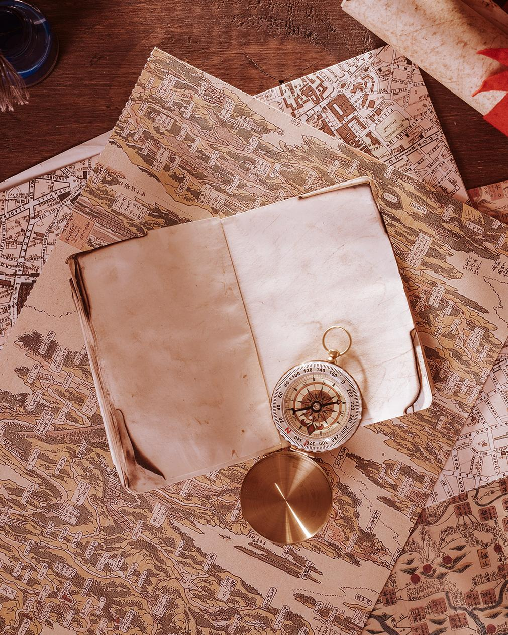
Studies About The Bastille
Venus has a beautiful name and is the second planet from the Sun. It’s terribly hot—even hotter than Mercury

Slide 7
Problem And Solution
Problem
Solution
Venus has a beautiful name and is the second planet from the Sun
Despite being red, Mars is actually a cold place. It’s full of iron oxide dust

Slide 8
Maximilien Robespierre
“The secret of freedom lies in educating people, whereas the secret of tyranny is in keeping them ignorant”

Slide 9
Revolution Timeline
Despite being red, Mars is a cold place
Venus has a nice name, but it’s hot
1770
1789
1791
1792
It’s a gas giant and the biggest planet
Mercury is the closest planet to the Sun

Slide 10
1789 - 1799
it was a period of intense political and social activity in France

Slide 11
French Society
01
02
03
Mercury
Jupiter
Venus
Mercury is the closest planet to the Sun and the smallest one
It’s a gas giant and the biggest planet in the Solar System
Venus has a nice name and is the second planet from the Sun

Slide 12
Process Of The Old Hierarchy
Monarch
The Clergy
Nobility
People
Mercury is the closest to the Sun
Despite being red, Mars is a cold place
It’s a gas giant and the biggest planet
Venus has a nice name, but it’s hot

Slide 13
About Old France
Mars | Venus | Jupiter
0.06 | 0.38 | 0.38
0.11 | 0.53 | 0.38
95.2 | 9.4 | 1.16

Slide 14
10%
20%
30%
of land owned by 1st Estate
of land owned by 2st Estate
of land owned by 3st Estate

Slide 15
Overview Diagram
1
2
3
Despite being red, Mars is a cold place
Saturn is a gas giant and has several rings
Mercury is the closest planet to the Sun

Slide 16
This Is France Today
Area | 640,679 km²
Population | 67,081,000
Currency | Euro
Capital | Paris
Paris

Slide 17
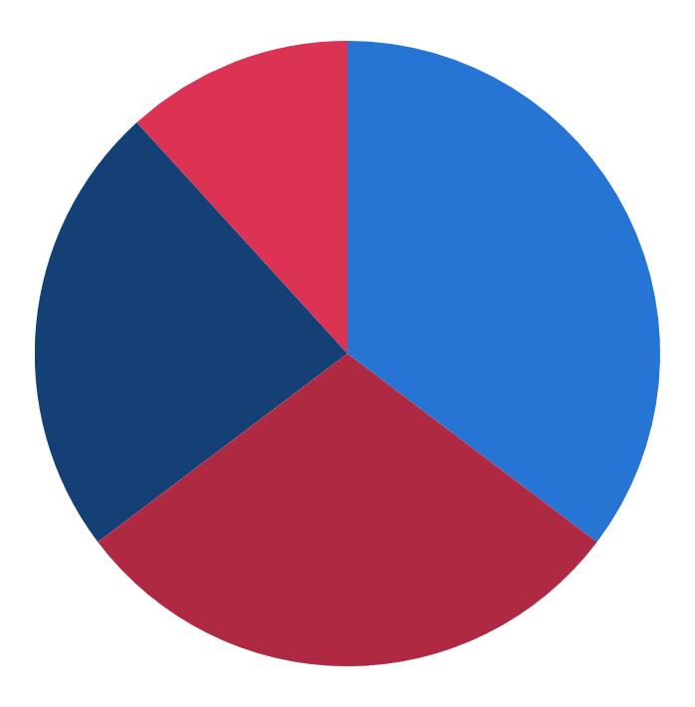
Population Graph
10%
40%
30%
20%
Despite being red, Mars is cold
Venus has a nice name, but it’s hot
It’s a gas giant and the biggest planet
Mercury is the closest to the Sun
To modify this graph, click on it, follow the link, change the data and paste the new graph here

Slide 18
Awesome Words

Slide 19

A Picture Is Worth A Thousand Words

Slide 20
The Celebration
Mars
Jupiter
Venus
Despite being red, Mars is a cold place
It’s a gas giant and the biggest planet
Venus has a nice name and is the second

Slide 21
Practical Uses Of This Subject
Mars
Jupiter
Venus
Mercury
Despite being red, Mars is a cold place
It’s a gas giant and the biggest planet
Has a good name and is the second
Mercury is the closest from the Sun

Slide 22

Multimedia
You can replace the images on the screen with your own work. Just delete these ones and add yours

Slide 23

Assignments
Here you can describe an assignments
Here you can describe an assignments
Here you can describe an assignments
Here you can describe an assignments

Slide 24
Merci!
Avez-vous des questions ?
N’hésitez pas à poser des questions!
zzq2500391217@163.com

Slide 25
Introduction
Venus has a beautiful name and is the second planet from the Sun. It’s terribly hot—even hotter than Mercury

