Slide 1
French Revolution
Here is where your presentation begins

Slide 2
Introduction
Venus has a beautiful name and is the second planet from the Sun. It’s terribly hot—even hotter than Mercury

Slide 3
Table Of Contents
01
02
The Bastille
The Society
03
04
About France
Celebration
You could describe the topic here
You could describe the topic here
You could describe the topic here
You could describe the topic here

Slide 4
01
The Bastille
Here you can write a subtitle if you need it

Slide 5
Definition Of Concepts
Mercury
Mars
Saturn
Venus
Mercury is the closest planet and the smallest
Despite being red, Mars is actually a very cold place
It’s composed mostly of hydrogen and helium
Has a nice name and is the second from the Sun

Slide 6
Features Of The Topic
Mercury
Jupiter
Venus
Mars
Saturn
Neptune
Mercury is the closest planet to the Sun
It’s a gas giant and the biggest planet
Venus has a nice name, but it’s hot
Despite being red, Mars is a cold place
Saturn is a gas giant and has several rings
It’s the farthest planet from the Sun

Slide 7
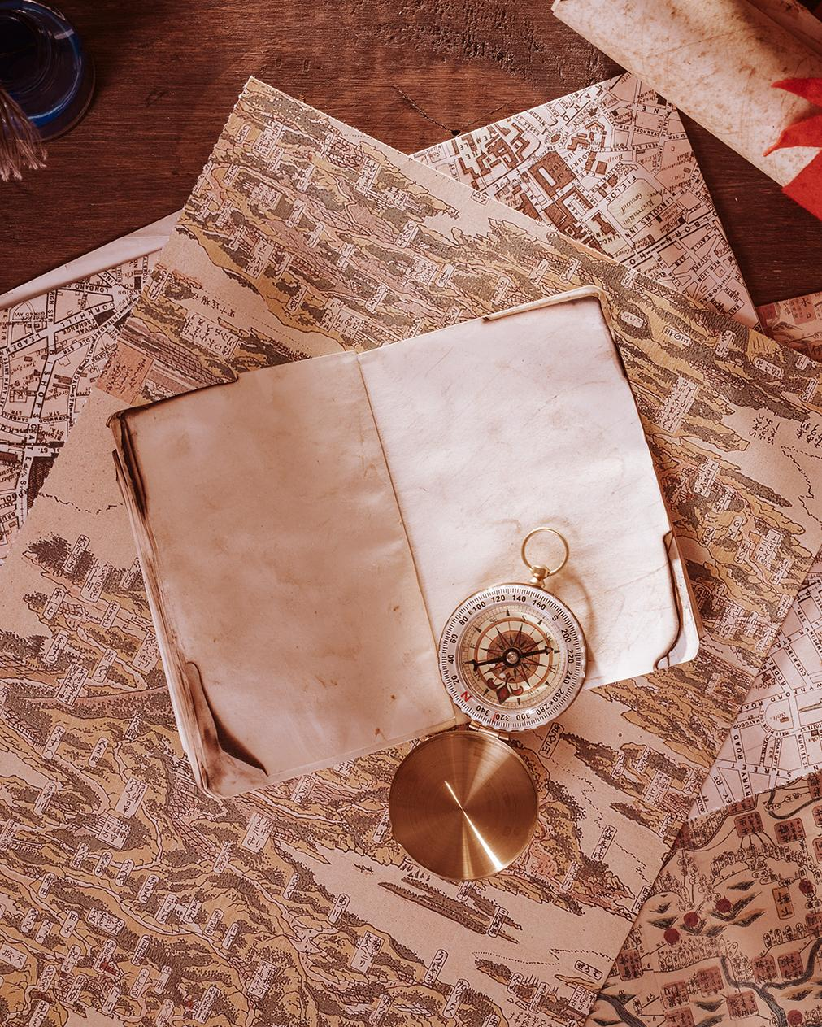
Studies About The Bastille
Venus has a beautiful name and is the second planet from the Sun. It’s terribly hot—even hotter than Mercury

Slide 8
Problem And Solution
Problem
Solution
Venus has a beautiful name and is the second planet from the Sun
Despite being red, Mars is actually a cold place. It’s full of iron oxide dust

Slide 9
Maximilien Robespierre
“The secret of freedom lies in educating people, whereas the secret of tyranny is in keeping them ignorant”

Slide 10
Revolution Timeline
Despite being red, Mars is a cold place
Venus has a nice name, but it’s hot
1770
1789
1791
1792
It’s a gas giant and the biggest planet
Mercury is the closest planet to the Sun

Slide 11
1789 - 1799
it was a period of intense political and social activity in France

Slide 12
French Society
01
02
03
Mercury
Jupiter
Venus
Mercury is the closest planet to the Sun and the smallest one
It’s a gas giant and the biggest planet in the Solar System
Venus has a nice name and is the second planet from the Sun

Slide 13
Process Of The Old Hierarchy
Monarch
The Clergy
Nobility
People
Mercury is the closest to the Sun
Despite being red, Mars is a cold place
It’s a gas giant and the biggest planet
Venus has a nice name, but it’s hot

Slide 14
About Old France
Mars | Venus | Jupiter
0.06 | 0.38 | 0.38
0.11 | 0.53 | 0.38
95.2 | 9.4 | 1.16

Slide 15
10%
20%
30%
of land owned by 1st Estate
of land owned by 2st Estate
of land owned by 3st Estate

Slide 16
Overview Diagram
1
2
3
Despite being red, Mars is a cold place
Saturn is a gas giant and has several rings
Mercury is the closest planet to the Sun

Slide 17
This Is France Today
Area | 640,679 km²
Population | 67,081,000
Currency | Euro
Capital | Paris
Paris

Slide 18

Population Graph
10%
40%
30%
20%
Despite being red, Mars is cold
Venus has a nice name, but it’s hot
It’s a gas giant and the biggest planet
Mercury is the closest to the Sun
To modify this graph, click on it, follow the link, change the data and paste the new graph here

Slide 19
Awesome Words

Slide 20

A Picture Is Worth A Thousand Words

Slide 21
The Celebration
Mars
Jupiter
Venus
Despite being red, Mars is a cold place
It’s a gas giant and the biggest planet
Venus has a nice name and is the second

Slide 22
Practical Uses Of This Subject
Mars
Jupiter
Venus
Mercury
Despite being red, Mars is a cold place
It’s a gas giant and the biggest planet
Has a good name and is the second
Mercury is the closest from the Sun

Slide 23

Multimedia
You can replace the images on the screen with your own work. Just delete these ones and add yours

Slide 24

Assignments
Here you can describe an assignments
Here you can describe an assignments
Here you can describe an assignments
Here you can describe an assignments

Slide 25
Thanks!
Do you have any questions?
addyouremail@ppter8.com
QQ:153395585
www.ppter8.com
Please keep this slide for attribution.

Slide 26
Alternative Resources

Slide 27
History Icon Pack

