Slide 1
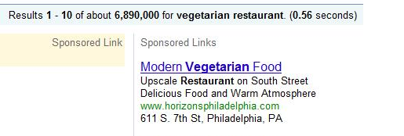
Data Mining the Google Online Marketing Challenge
Ayesha Chacko, Reshmi Krishna, and Alice Lee

Slide 2
Overview and Objectives
Google Online Marketing Challenge
Horizons Restaurant

Slide 3
Horizons’ Objective
To expand our client base to more than just vegetarians…We want all audiences to experience our cuisine, from vegans to meat-lovers and from the younger to the elderly.
“
”

Slide 4
Our Objective
“
To optimize our marketing campaigns using a wide variety of keywords that will give us a high CTR for a low CPC. Essentially, we want to find the most effective searches that will reach the broad audience that Horizons wishes to obtain.
”

Slide 5
Data Preparation I
Web-crawler for Existing Ads
Own suggested keyword searches
Looked at the ad’s rank on the page
Set a binary ‘Target’
If ranked higher than .66667, 1
Else, 0
Parsing the Existing Ads
Text-to-column to find particularly prevalent words in ads
Binary: If word is in ad: 1. Else: 0.
Creating/Finding ‘Important’ Variables
I.e. City Name, Discounts, Action words

Slide 6

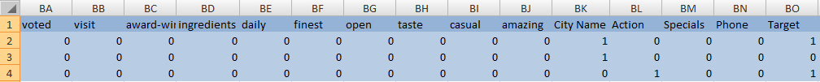
Variables
Web-crawler for Existing Ads:
Text-to-Column // Adding ‘Important’ Variables:

Slide 7
Evaluating the Attributes (InfoGain)
0.05466441 49 us
0.0268659 30 find
0.02551206 43 fresh
0.02355585 65 Specials
0.02031709 52 experience
0.01794328 26 great
0.01781031 61 casual
0.01781031 51 menus
0.01516924 4 now
0.01516924 39 specials
0.01516924 53 voted
0.01141484 3 reserve
0.01006768 46 easy
0.01006768 22 perfect
0.01006768 19 complete
0.01006768 32 greatest
0.00990054 59 open
0.00990054 54 visit
0.00885581 9 today
0.00885581 33 information
0.00885581 16 list
0.00885581 57 daily
0.00885581 62 amazing
0.00837601 23 fine
0.00786085 28 dinner
0.00648083 63 City Name
0.00648083 14 best
0.00501153 44 premium
0.00501153 27 celebrate
0.00501153 48 fun
0.00501153 18 only
0.00501153 40 tonight
0.00501153 20 three-course
0.00501153 58 finest
0.00476698 2 wine
0.00468273 25 bar
0.00420138 29 near
0.00420138 38 service
0.00420138 6 reservations
0.00395477 12 call
0.00235353 13 online
0.00227544 64 Action
0.00128979 5 dining
0.00116978 11 winning
0.00116978 10 award
0.00116978 37 delicious
0.0009471 7 enjoy
0.00076887 41 unique
0.00061845 42 come
0.00061845 66 Phone
0.0003791 1 evening
0.0003791 31 available
0.0003791 21 evening
0.0003791 47 gourmet
0.0003791 45 elegant
0.00030302 36 menu
0.00030302 55 award-winning
0.00030302 50 free
0.00030302 24 local
0.00027849 15 cuisine
0.00013141 17 romantic
0.00009846 34 dine
0.00007869 8 restaurant
0.00000156 35 new
0 60 taste
0 56 ingredients

Slide 8
Running Models
Types
J48 Decision Tree, Naïve Bayes, k-Nearest Neighbors
Results
J48 Decision Tree
65% accuracy on training set
Naïve Bayes
67% accuracy on training set
IBk
86% accuracy on training set
OVERFITTING?
Notes:
Apply a decision tree
– Non‐parametric
– Does not require that variables be selected in advance
– Does not require transformations on numeric attributes
(ie. Does not assume a normal distribution for example)
Naïve Bayes, Ibk,

Slide 9
Running Models—Resample Filter
Training set: resample filter with sample size of 80%
Test set: sample size of 20%
Results:
J48 Decision Tree
67.55% accuracy on test set
Naïve Bayes
67.02% accuracy on test set
k-Nearest Neighbors
72.87% accuracy on test set

Slide 10
Weka Output—J48 Decision Tree
=== Evaluation on test set ===
=== Summary ===
Correctly Classified Instances 127 67.5532 %
Incorrectly Classified Instances 61 32.4468 %
Kappa statistic 0.191
Mean absolute error 0.4274
Root mean squared error 0.4721
Relative absolute error 89.6969 %
Root relative squared error 97.2428 %
Total Number of Instances 188
=== Detailed Accuracy By Class ===
TP Rate FP Rate Precision Recall F-Measure ROC Area Class
0.966 0.803 0.665 0.966 0.787 0.581 A
0.197 0.034 0.778 0.197 0.315 0.581 B
Weighted Avg. 0.676 0.513 0.707 0.676 0.609 0.581
=== Confusion Matrix ===
a b <-- classified as
113 4 | a = A
57 14 | b = B

Slide 11
Weka Output—Naïve Bayes
=== Evaluation on test set ===
=== Summary ===
Correctly Classified Instances 126 67.0213 %
Incorrectly Classified Instances 62 32.9787 %
Kappa statistic 0.244
Mean absolute error 0.4036
Root mean squared error 0.4621
Relative absolute error 84.7014 %
Root relative squared error 95.1793 %
Total Number of Instances 188
=== Detailed Accuracy By Class ===
TP Rate FP Rate Precision Recall F-Measure ROC Area Class
0.846 0.62 0.692 0.846 0.762 0.691 A
0.38 0.154 0.6 0.38 0.466 0.691 B
Weighted Avg. 0.67 0.444 0.657 0.67 0.65 0.691
=== Confusion Matrix ===
a b <-- classified as
99 18 | a = A
44 27 | b = B

Slide 12
Weka Output—k-Nearest Neighbors
=== Evaluation on test set ===
=== Summary ===
Correctly Classified Instances 137 72.8723 %
Incorrectly Classified Instances 51 27.1277 %
Kappa statistic 0.3873
Mean absolute error 0.3063
Root mean squared error 0.4494
Relative absolute error 64.2735 %
Root relative squared error 92.5623 %
Total Number of Instances 188
=== Detailed Accuracy By Class ===
TP Rate FP Rate Precision Recall F-Measure ROC Area Class
0.872 0.507 0.739 0.872 0.8 0.764 A
0.493 0.128 0.7 0.493 0.579 0.764 B
Weighted Avg. 0.729 0.364 0.724 0.729 0.716 0.764
=== Confusion Matrix ===
a b <-- classified as
102 15 | a = A
36 35 | b = B

Slide 13
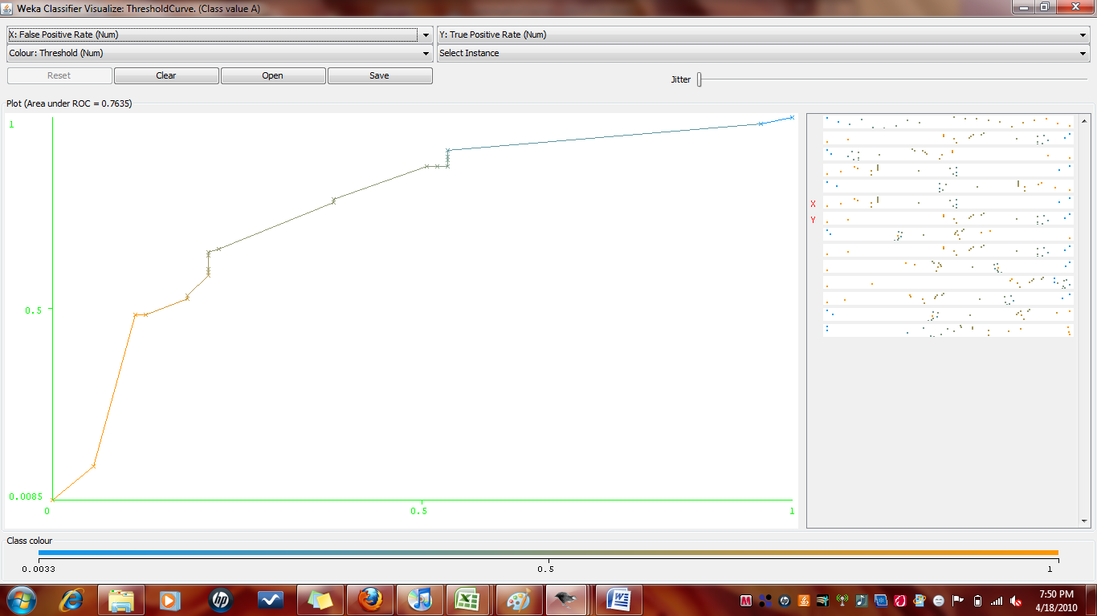

ROC Curves for k-Nearest Neighbors
TotalArea_{ROC} = 0.7635
Class A
Class B

Slide 14
AdWords Campaign
Initial Strategy: Low → High Max CPC Bids
Later Strategy: High → Low Max CPC Bids
Campaign 1: Dietary Restrictions
Ad Groups “Healthy”, “Vegetarian”, “Vegan”
Campaign 2: Upscale Restaurant
Ad Groups “Award-Winning”, “Philadelphia”, “Date Night”
End Goal: Maximize Number of Clicks
Notes:
Strategy evolved throughout the campaign:
Initial Strategy: Start with low bids and low budget caps for practice and gradually increase.
Strategy 2: Start with high bids to get high ranking → more click-throughs→ higher quality score, and gradually decrease because ad rank is based on quality score and bid.
Place higher budgets on Mon/Tue/Wed when search volume is higher.
Organize campaign based on search terms.

Slide 15
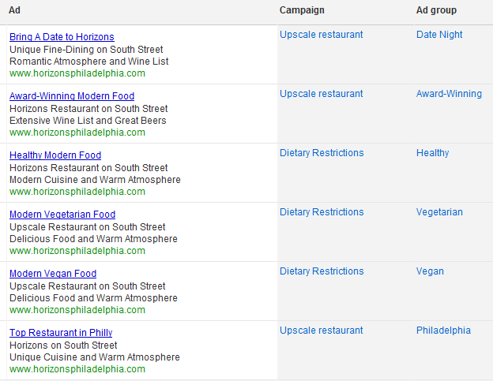
Campaign Structure

Slide 16
Google Analytics Data
Notes:
CTR over time,
CPC over time,

Slide 17
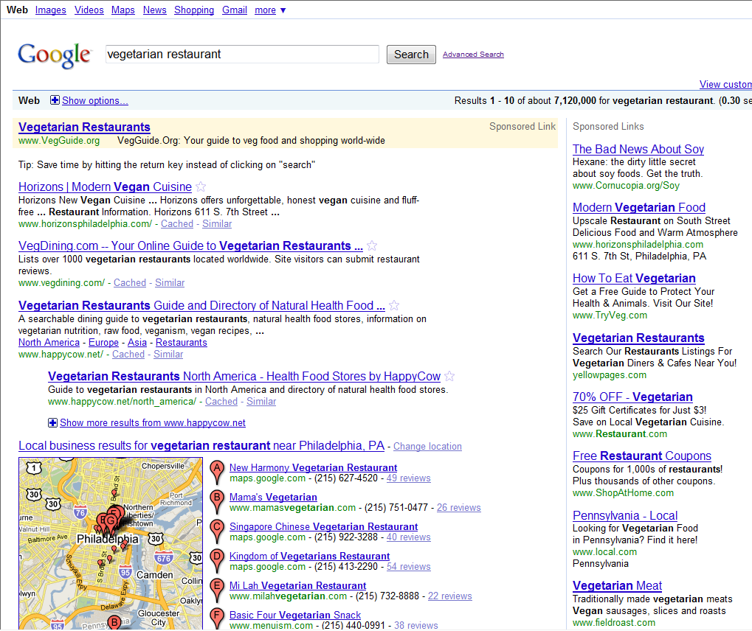

Slide 18
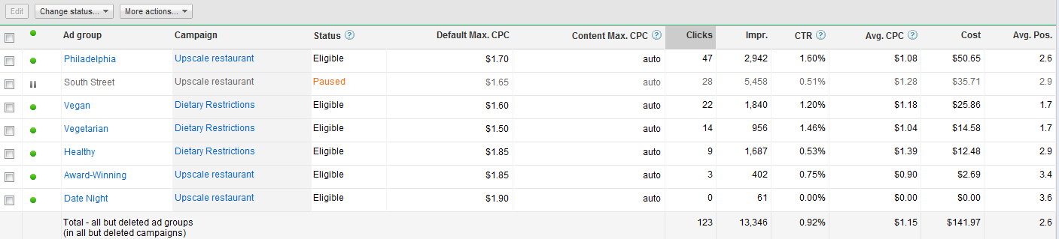
Summary (including deleted campaigns)
331 Keywords
13,118 Impressions
130 clicks
0.99% CTR
Average Position 2.5
Average CPC $1.11

Slide 19
Data Preparation II
ComScore Demographic Data
Question posed: What types of people typically search for restaurants online?
Practical application: TARGET THESE PEOPLE
Why?
More effective keyword placement and use of budget
Huge database (>1.5 mil)
Filtered out duplicate machine ID’s
Binary Target
If searched for zagat.com: 1
Else: 0

Slide 20
Models—ComScore Demographic Info
8 given attributes to predict what demographics information might be useful
census_region, hoh_most_education, country_of_origin, household_income, hoh_oldest_age, household_size, racial_background,children
Only three attributes accounted for in AdWords
Education, Age, Zip Code (location), Income
Used J48 Decision Tree, Naïve Bayes, k-Nearest Neighbors
Accuracy between 63.41 – 67.47 %
Prior 56%
k-Nearest Neighbor Classifier: 67.47%

Slide 21
Weka Output: Ranked Attributes
0.092896 census_region
0.07384 hoh_most_education
0.034558 country_of_origin
0.027011 household_income
0.013924 hoh_oldest_age
0.004643 household_size
0.000861 racial_background
0.000781 children
Didn’t use the zip_code attribute
For our ads, we used three attributes: education, income, age

Slide 22
Weka Output: Significant Attributes J48 Decision Tree
=== Evaluation on training set === === Summary === Correctly Classified Instances 813 63.4165 % Incorrectly Classified Instances 469 36.5835 % Kappa statistic 0.1809 Mean absolute error 0.4479 Root mean squared error 0.4732 Relative absolute error 91.0614 % Root relative squared error 95.4274 % Total Number of Instances 1282 === Detailed Accuracy By Class === TP Rate FP Rate Precision Recall F-Measure ROC Area Class 0.175 0.011 0.925 0.175 0.295 0.583 0 0.989 0.825 0.608 0.989 0.753 0.583 1 Weighted Avg. 0.634 0.47 0.746 0.634 0.553 0.583 === Confusion Matrix === a b <-- classified as 98 461 | a = 0 8 715 | b = 1

Slide 23
Weka Output: Significant Attributes Naïve Bayes
=== Evaluation on training set === === Summary === Correctly Classified Instances 835 65.1326 % Incorrectly Classified Instances 447 34.8674 % Kappa statistic 0.2593 Mean absolute error 0.4286 Root mean squared error 0.4628 Relative absolute error 87.1439 % Root relative squared error 93.3339 % Total Number of Instances 1282 === Detailed Accuracy By Class === TP Rate FP Rate Precision Recall F-Measure ROC Area Class 0.411 0.163 0.661 0.411 0.507 0.687 0 0.837 0.589 0.648 0.837 0.73 0.687 1 Weighted Avg. 0.651 0.403 0.653 0.651 0.633 0.687 === Confusion Matrix === a b <-- classified as 230 329 | a = 0 118 605 | b = 1

Slide 24
Weka Output: Significant Attributes k-Nearest Neighbors
=== Summary === Correctly Classified Instances 865 67.4727 % Incorrectly Classified Instances 417 32.5273 % Kappa statistic 0.3137 Mean absolute error 0.399 Root mean squared error 0.4466 Relative absolute error 81.1163 % Root relative squared error 90.0593 % Total Number of Instances 1282 === Detailed Accuracy By Class === TP Rate FP Rate Precision Recall F-Measure ROC Area Class 0.467 0.165 0.687 0.467 0.556 0.731 0 0.835 0.533 0.67 0.835 0.743 0.731 1 Weighted Avg. 0.675 0.372 0.677 0.675 0.662 0.731 === Confusion Matrix === a b <-- classified as 261 298 | a = 0 119 604 | b = 1

Slide 25
Analyzing the Data
Based on all attributes, we can say the following about people who typically search for restaurants online:
Older people between 50-58 years
People with higher income 100k+
Having household size between 2-3
Have kids
Attending/ Attended high school or college
Non-Hispanic background

Slide 26
What We Have Learned
We used the results to target specific audience in our Ads with using the “Placement” tool
Age Demographic : 55-64
Household income : 100k+
Household Education : High School/ College
Specific ad text is not all that matters—keyword placement and targeting may have more of an impact

Slide 27
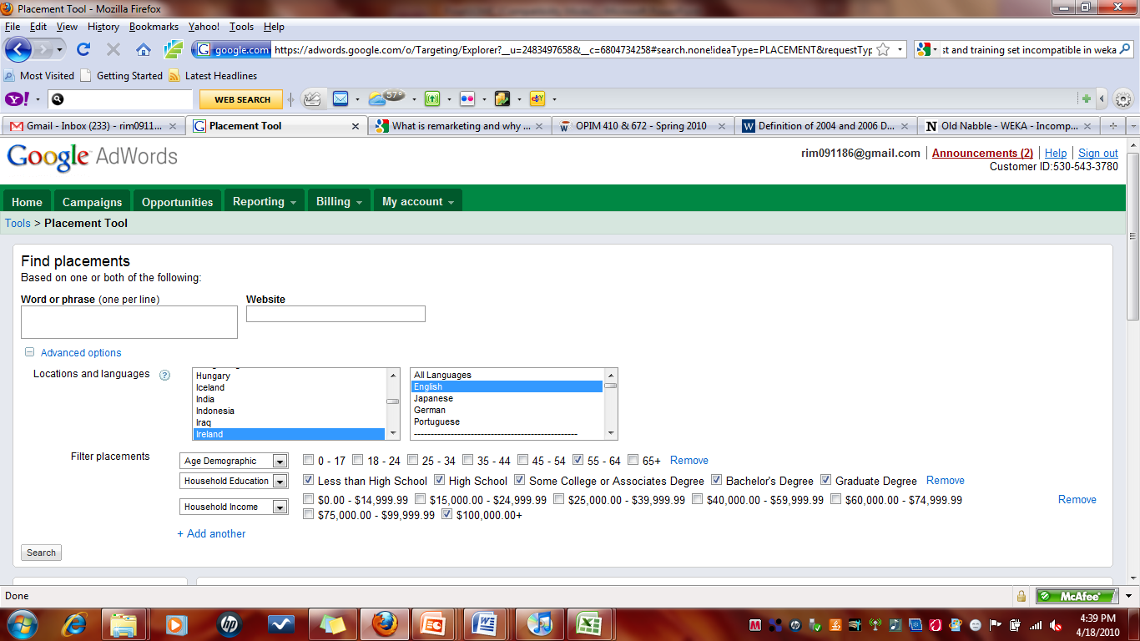
AdWords Placement Tool

Slide 28
Path to Knowledge Exploitation
Preparation
Web-crawl and parse existing ads
Manually code important variables
Mining
Predict what makes ads ‘clickable’ to certain types of audiences
Use information to construct and target ads
Exploitation
Air ads online and monitor CTR and Ad-Rank
Modify CPC and budgets for ads based on performance
Consider demographic information for targeting

Slide 29
Further Recommendations for Knowledge Exploitation
Integrate advertisements with sites such as zagat.com, happycow.net, VegGuide.org
Efficient online marketing—use demographic information to learn which avenues are least expensive/most impressionable to advertise through

Slide 30
Data Problems // Issues with WEKA Implementation
Ran into problems with compatibility of training and test sets
WEKA at first gave us different accuracy ratings when the same test was run on the same data
Missing fields in ComScore data—lead to difficulties
ComScore database was so large (>1.5mil) that we could only use a portion

Slide 31
Alternatives and Suggestions for Further Research
Cross-country marketing—specifically targeting those from other states / regions
Consider seasonality—at what times of the year would these ads be most effective and what implications does that have for the text?

