Slide 1



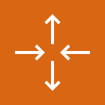

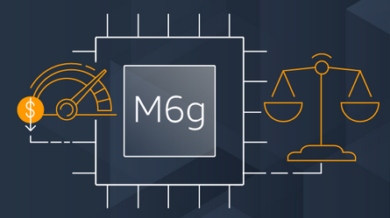

AWS Cloud
kubeconfig
K3s token
Amazon S3 bucket
VPC
Auto Scaling group
4
2
> cdk deploy
K3s control plane node
1
3
K3s worker nodes

Slide 2
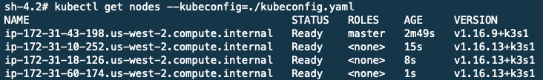
AWS Cloud
1
kubeconfig
K3s token
Amazon S3 bucket
VPC
Auto Scaling group
> kubectl
2
K3s control plane node
K3s worker nodes

