Slide 1
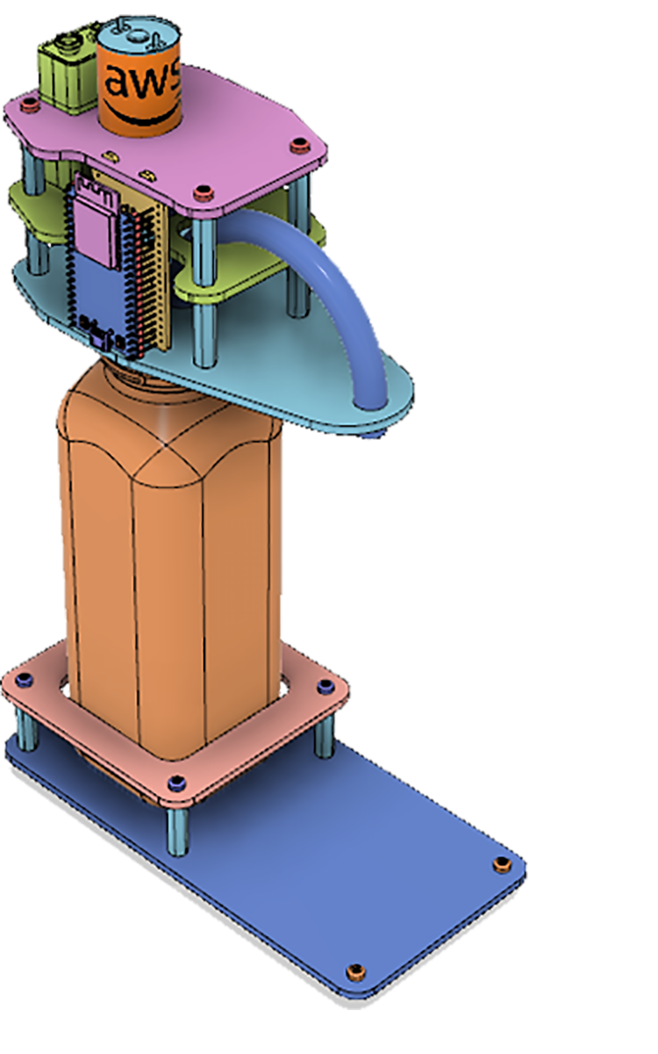









AWS Cloud
IoT
Bi-Directional
Communication
Drink dispenser
“123”
AWS IoT Core
DynamoDB Table
DispenserEvents
(logging)
API Logic
Amazon API Gateway
Webapp &
AuthN/AuthZ
DynamoDB Table
DispenserTable
(credits)
Laptop
Amazon CloudFront
Participant
Amazon Cognito
CLOUD OVERVIEW

Slide 2
AWS Cloud
key=123
event=“message”
Drink dispenser
“123”
AWS IoT Core
Topic: cmd/123
DynamoDB Table
DispenserEvents
(logging)
API: /dispense?dispenserId=123
Signed JWT
“dispenserId: 123”
“user: foo”
key=123
credits=1.25
Amazon API Gateway
Username: “foo”
DynamoDB Table
DispenserTable
(credits)
Laptop
Signed JWT
“dispenserId: 123”
“user: foo”
Amazon Cognito
User/dispenser relationship

Slide 3




AWS Cloud
IoT
shadow
for thing: 123
IoT rule
Lambda function
LogEvent
Drink dispenser
“123”
IoT topic
cmd/123
Dispenser Operations

Slide 4







AWS Cloud
1
2
Participant
User: jdoe
User Pool
(user, password, attributes)
webapp
Amazon Cognito
3
6
DynamoDB Table
UserTable
(resources)
Amazon API Gateway
/getResources
4
AWS IoT Core
AWS IAM
User Account
AWS Cloud9
5
dispenser
IoT certificate
User Account
Instance
LAB 3

