Slide 1


2
Design & workflows

Slide 2
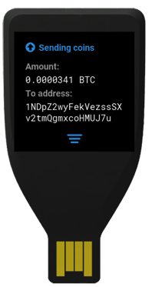
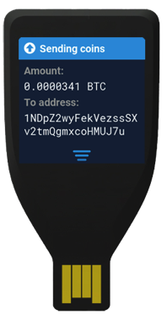
Complete, yet clean.
Keep in mind interconnection of device and software. They are creating one single experience with focus on security and still minimalistic.
Everyday connection.
Well shaped and designed for multipurpose usage. Stays with you every day.

Slide 3
Visual Design

Slide 4
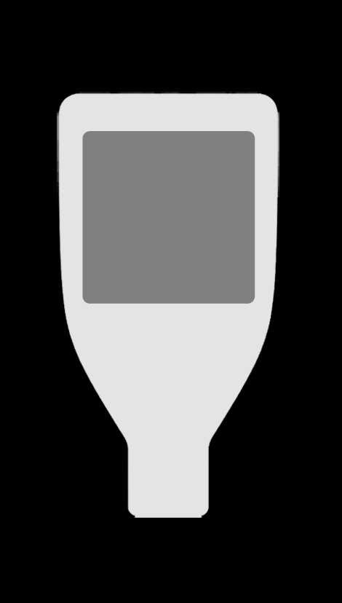
Display
Capacitive touch screen
240px width, 240px height (~31mm)
16-bit high color depth
240 px 31 mm
240 px 31 mm

Slide 5
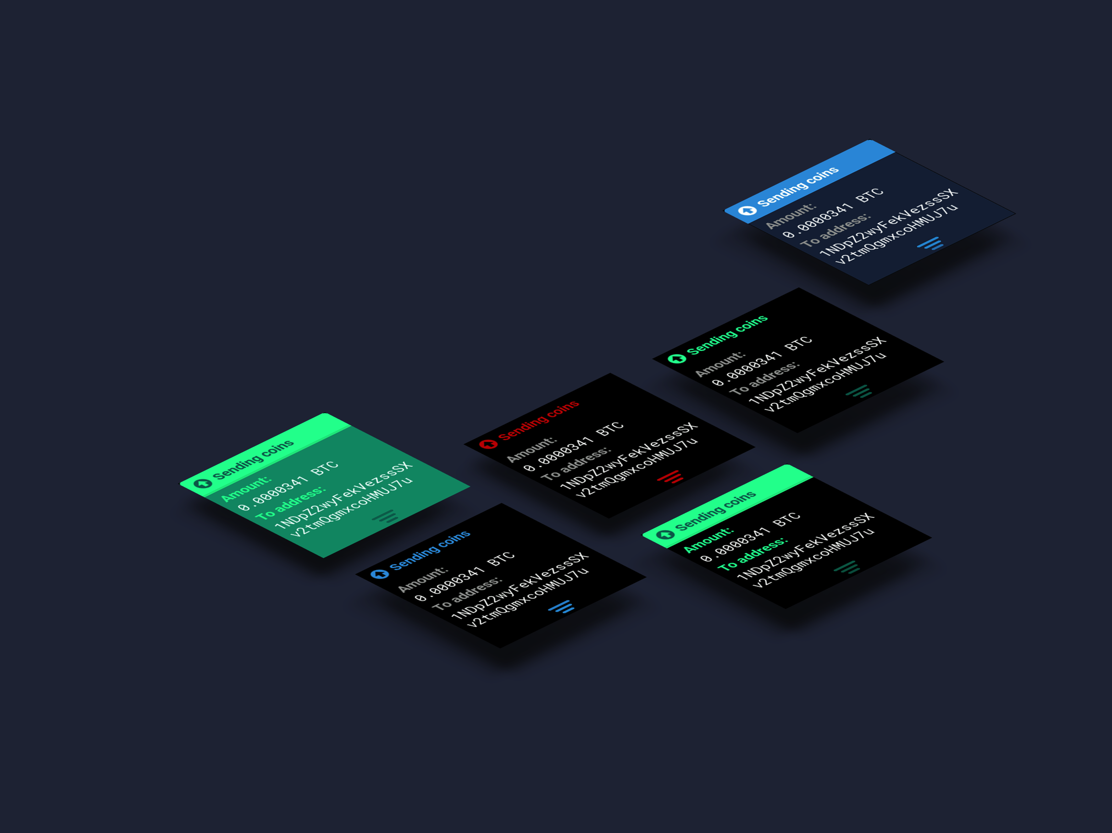
Layout practices
Maximum 5 row layout, 48px each row.
Limit the number of side-by-side controls into 3 columns.
Use the full width of the screen.
Avoid displaying too much
Information at once.
Left align elements.

Slide 6
Layout components
Static
(homescreen, PIN enter, PIN change, wipe, bootloader, loader)
Swipe
(setup, recovery, send coins, Setup, Sign, Verify )
Screens
Special
Elements
General
elements
PIN matrix
Loader
Bullet indicator
Swipe arrow
Button
Header title
Text block

