Slide 1


Shipborne Robust Message Queuing Service Prototype System
Yongguo Jiang, Qiang Liu, Qianqian Liu, Jian Su, Changshuai Qin
Ocean University of China
2019 08 11
Notes:
中文标题30-32 黑体
正文18-20细黑体
英文标题32-35 Arial
正文20-22Arial
Hello everyone, I am QinChangShuai, My presentation title is “Shipborne Robust Message Queuing Service Prototype System”OK,let's get started.

Slide 2
Overview
Background
Main Work
Challenge & Solution
System Structure
Evaluation
Notes:
let's see the overview.I will give a quick background into my research，followed by a summary of the Main Work, Challenge And Solution System Structure and evaluations.

Slide 3






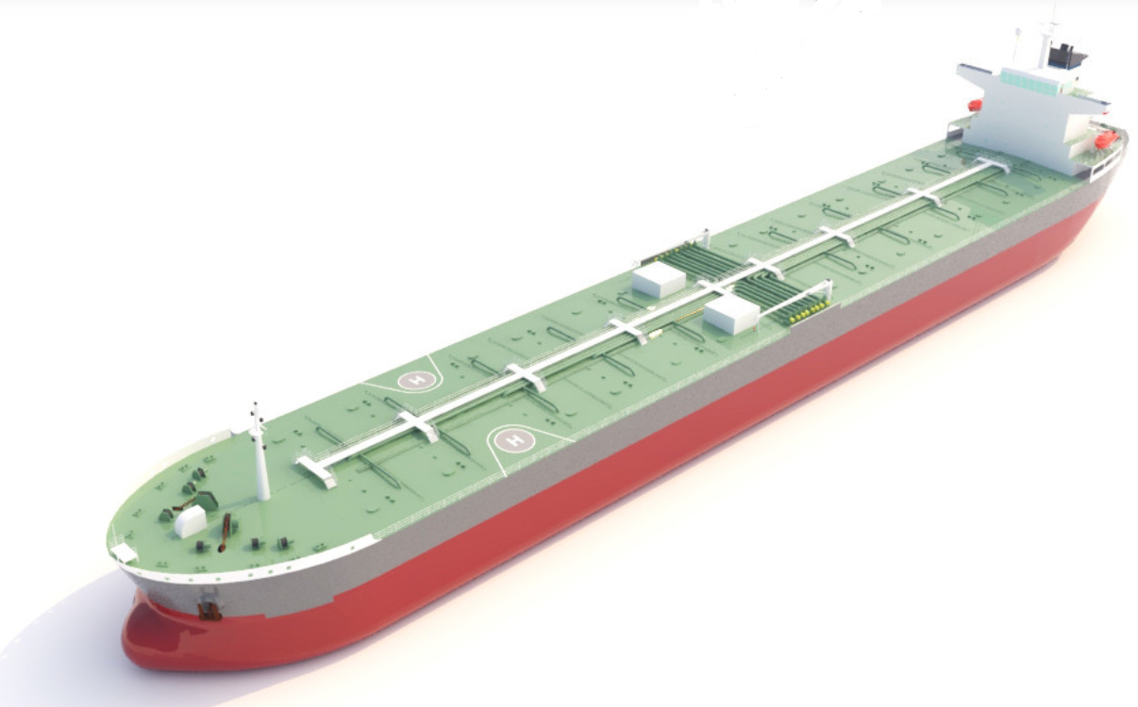



Background
Internal equipment
External communication
Remote control of the device
Notes:
Background
探索海洋，保卫航行，集成先进的设备及探测系统，新型设备助力船只。
With the use of new equipment on board, ships need to integrate a variety of detection and monitoring equipment.It mainly includes Internal equipment 、External communication and Remote control of the device.

Slide 4



Background
AIS
GPS
Cellular
Independent application system
UAV
Shipboard information system
（SIS）
Heterogeneous and tight coupling
USV
UUV
Distributed application system
Terminal
Monitoring
Notes:
Device Integration
We think the difficulty is Device Integration.Most of them use different operating systems，Such as AIS GPS UUV Terminal and so on.They are Heterogeneous and tight coupling.Ship information system (SIS) is a distributed application system.This situation reduces the communication Reliability and efficiency . How can we solve this problem?

Slide 5

Background
AIS
GPS
Cellular
UAV
Shipboard information system
（SIS）
Message-centric
Message-oriented middleware（MOM）
USV
Shielding heterogeneity
UUV
Terminal
Monitoring
Notes:
MOM Opportunities
I think this is the MOM opportunities.
Message-centric and Shielding heterogeneity
MOM provides a cross-platform messaging solution.
It ensures reliable data exchange for applications in a distributed network environment.

Slide 6




Main Work
Use MOM to meet the needs of SIS integration,especially reliability.
Cluster
Notes:
Our main work is to use MOM to meet the needs of SIS integration,especially reliability.

Slide 7


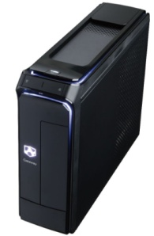




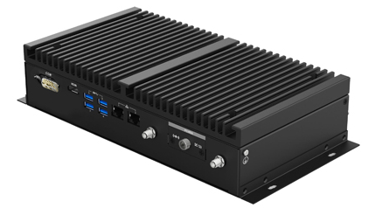
Challenge & Solution
SIS design needs to follow the design specifications of the classification society.
Redundant design
Three-profings design
SIS
Backups
Partial redundancy of data
Cluster load balancing
MOM data redundancy scale is large
Limited equipment performance
Notes:
数据部分冗余 集群负载平衡
MOM数据冗余规模较大 设备性能有限
Challenge From IACS
SIS design needs to follow the design specifications of the classification society.
It requires redundant design and Three-profings design,We're going to have two problems,MOM data redundancy scale is large and Limited equipment performance.
We used two approaches,the first one is Partial redundancy of data,second one is Cluster load balancing.

Slide 8


Challenge & Solution
Messaging service in the application uses MQ
MESSAGE
Messages are stored on the server in MQ units
Application #1
MESSAGE QUEUE
QUEUE
QUEUE
MESSAGE #3
MESSAGE #2
MESSAGE #1
COPY
Application #2
SERVER #1
SERVER #2
Notes:
应用之间传递的消息，消息以MQ为单元存储在服务器
In Traditional Reliability Cluster,Messaging service in the application uses MQ
like this.Messages are stored on the server in MQ units.

Slide 9
Challenge & Solution
Queue#3
Queue#2
Queue#1
Queue#3
Queue#3
Queue#1
Queue#2
Queue#1
Queue#2
Queue#2
Queue#3
Queue#3
SERVER #1
SERVER #2
SERVER #3
The server performs a full redundancy backup of MQ
The server performs partial redundancy backup of MQ
Server unit
MQ unit
Notes:
以服务器为单位，以MQ为单位, 减少冗余的机会，服务器对MQ进行完全冗余备份。
Reduce Redundancy
Considering the limited performance of hardware,the server performs a full redundancy backup of MQ is unacceptable.
To Reduce Redundancy,the server should perform partial redundancy backup of MQ.
Changes from server unit to MQ unit.

Slide 10

Challenge & Solution
MESSAGE
MESSAGE
Producer
Consumer
Queue#1
Queue#2
Server Failure
Message backup in message queue on different servers
Backup message queue is in use
SERVER #1
SERVER #2
Queue Group
Notes:
Message Queue Group
Message backup in message queue on different servers.Multiple message queue entities in a message queue group have the same message data.The main reason for this design is that when the Server Failure , backup message queue can be in use.

Slide 11
Challenge & Solution
Monitor message queues to provide users with available connections
How users get the queues available in the message queue group?
MQ management center
Configuration center
Monitor server node load and implement cluster load balancing
How to dynamically allocate queues in a message queue group?
Monitoring center
Notes:
用户如何获取消息队列组中可用的队列,如何动态分配消息队列组中的队列,监控服务器节点负载情况，实现集群负载均衡
System Design Challenge
so,How users get the queues available in the message queue group?
We designed the MQ management center,it can Monitor message queues to provide users with available connections.
and ,How to dynamically allocate queues in a message queue group?
We used Monitoring center,it can Monitor server node load and implement cluster load balancing
The configuration center is mainly composed of the above two parts, which is the core of the prototype system.

Slide 12


System Structure
Broker cluster
Monitoring
Request
connect
connect
Reply
Information
Manage
Connect
Producer
Consumer
reply connect
reply connect
Send/Receive
Manage
request connect
request connect
Configuration center
Notes:
First, the broke cluster send information to configuration center ,so xx can moitor it.
then,the producer and consumer request connect to configuration center ,configuration center replys connect to them.
after that,they can connect the broker cluster ,the producer can send message and the consumer can receive the message from producer.
The configuration center manage the cluster based on the information it sends.
If the requested service does not exist, the configuration center registers a new service and opens up a new message queue group in the cluster.

Slide 13

Evaluation
Prototype system
Original AMQ
Environment:
CentOS 7 64bit OS
single CPU core (3.30GHz)
8GB RAM
Fault recovery
Latency
Resource Usage
Notes:
Prototype system and Original AMQ mainly compare from the following three aspects.
Fault recovery Latency and Resource Usage

Slide 14
Evaluation
Scenario | Average Time （ms）
Network Bridge | 62
Based on Zookeeper Master/Salve | 1854
Prototype System | 687
Time FOR Fault recovery
Prototype system saves nearly 2x time compared with the scheme based on ZooKeeper
The latency has increased by about 10ms on average
Notes:
From the first figure ,we can see that Prototype system saves nearly Twice as much time compared with the scheme based on ZooKeeper .
But from second one,The latency has increased by about 10ms on average,it just a little bad.

Slide 15
Evaluation
Original AMQ performs best
The performance of the prototype system is not inferior to the scheme based on ZooKeeper
Notes:
OK,let's move on.As you can see ,Original AMQ performs best .
But, the performance of the prototype system is not inferior to the scheme based on ZooKeeper.

Slide 16
Evaluation
15ms
30ms
Node Load 400MB
Node Load 600MB
In terms of disk space utilization, the prototype system is superior.
Slave node needed nearly 2x time to retain all the data
Notes:
Picture on this slide shows Slave node needed nearly 2x time to retain all the data ,and the prototype system has lower disk usage.In terms of disk space utilization, the prototype system is superior.

Slide 17
Thank You!
Notes:
This article is mainly written by Liu Qiang, I do not know a lot about this content. I don't know much more about this aspect
Pardon me?Will you please say it again?
I am sorry ,I didn't hear you, could you come back?

