Slide 1
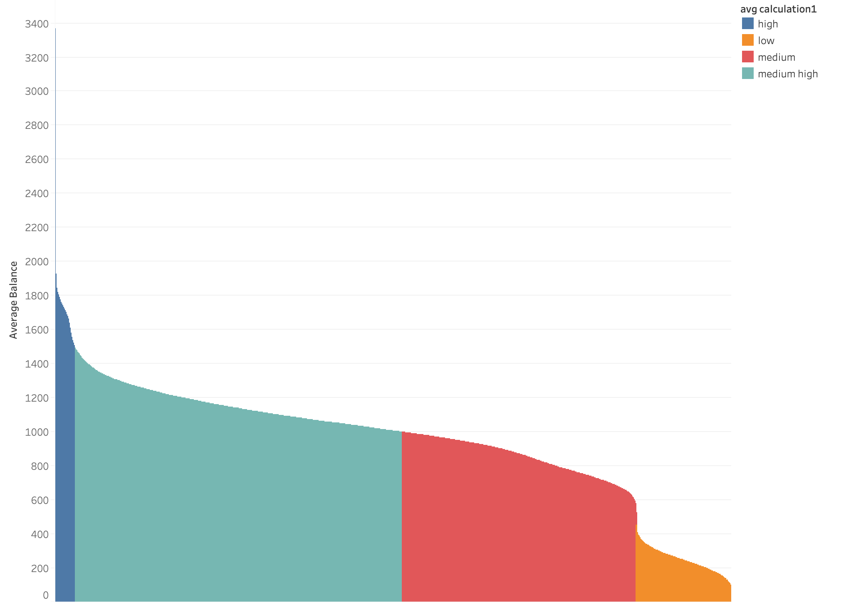
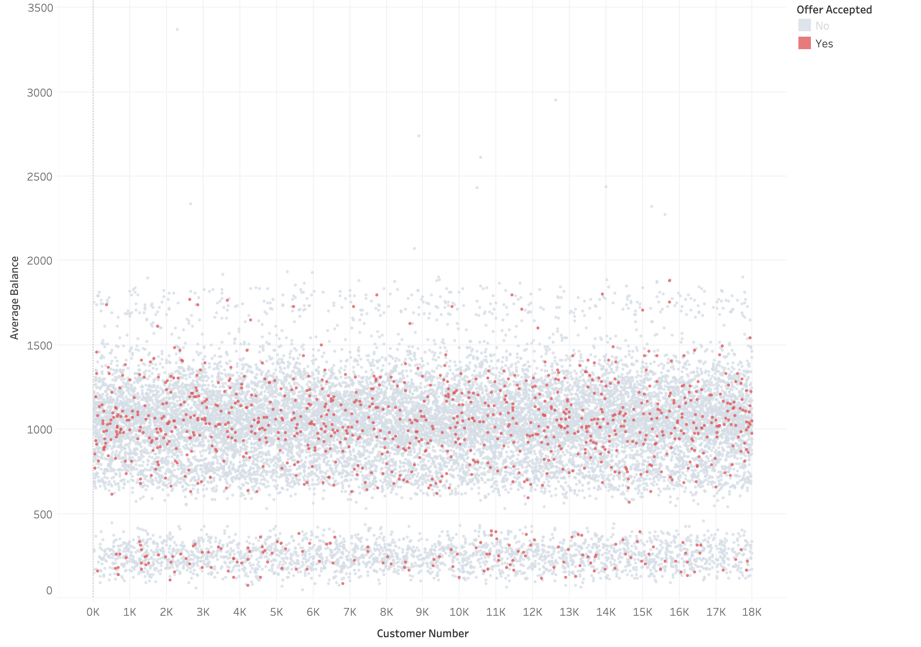
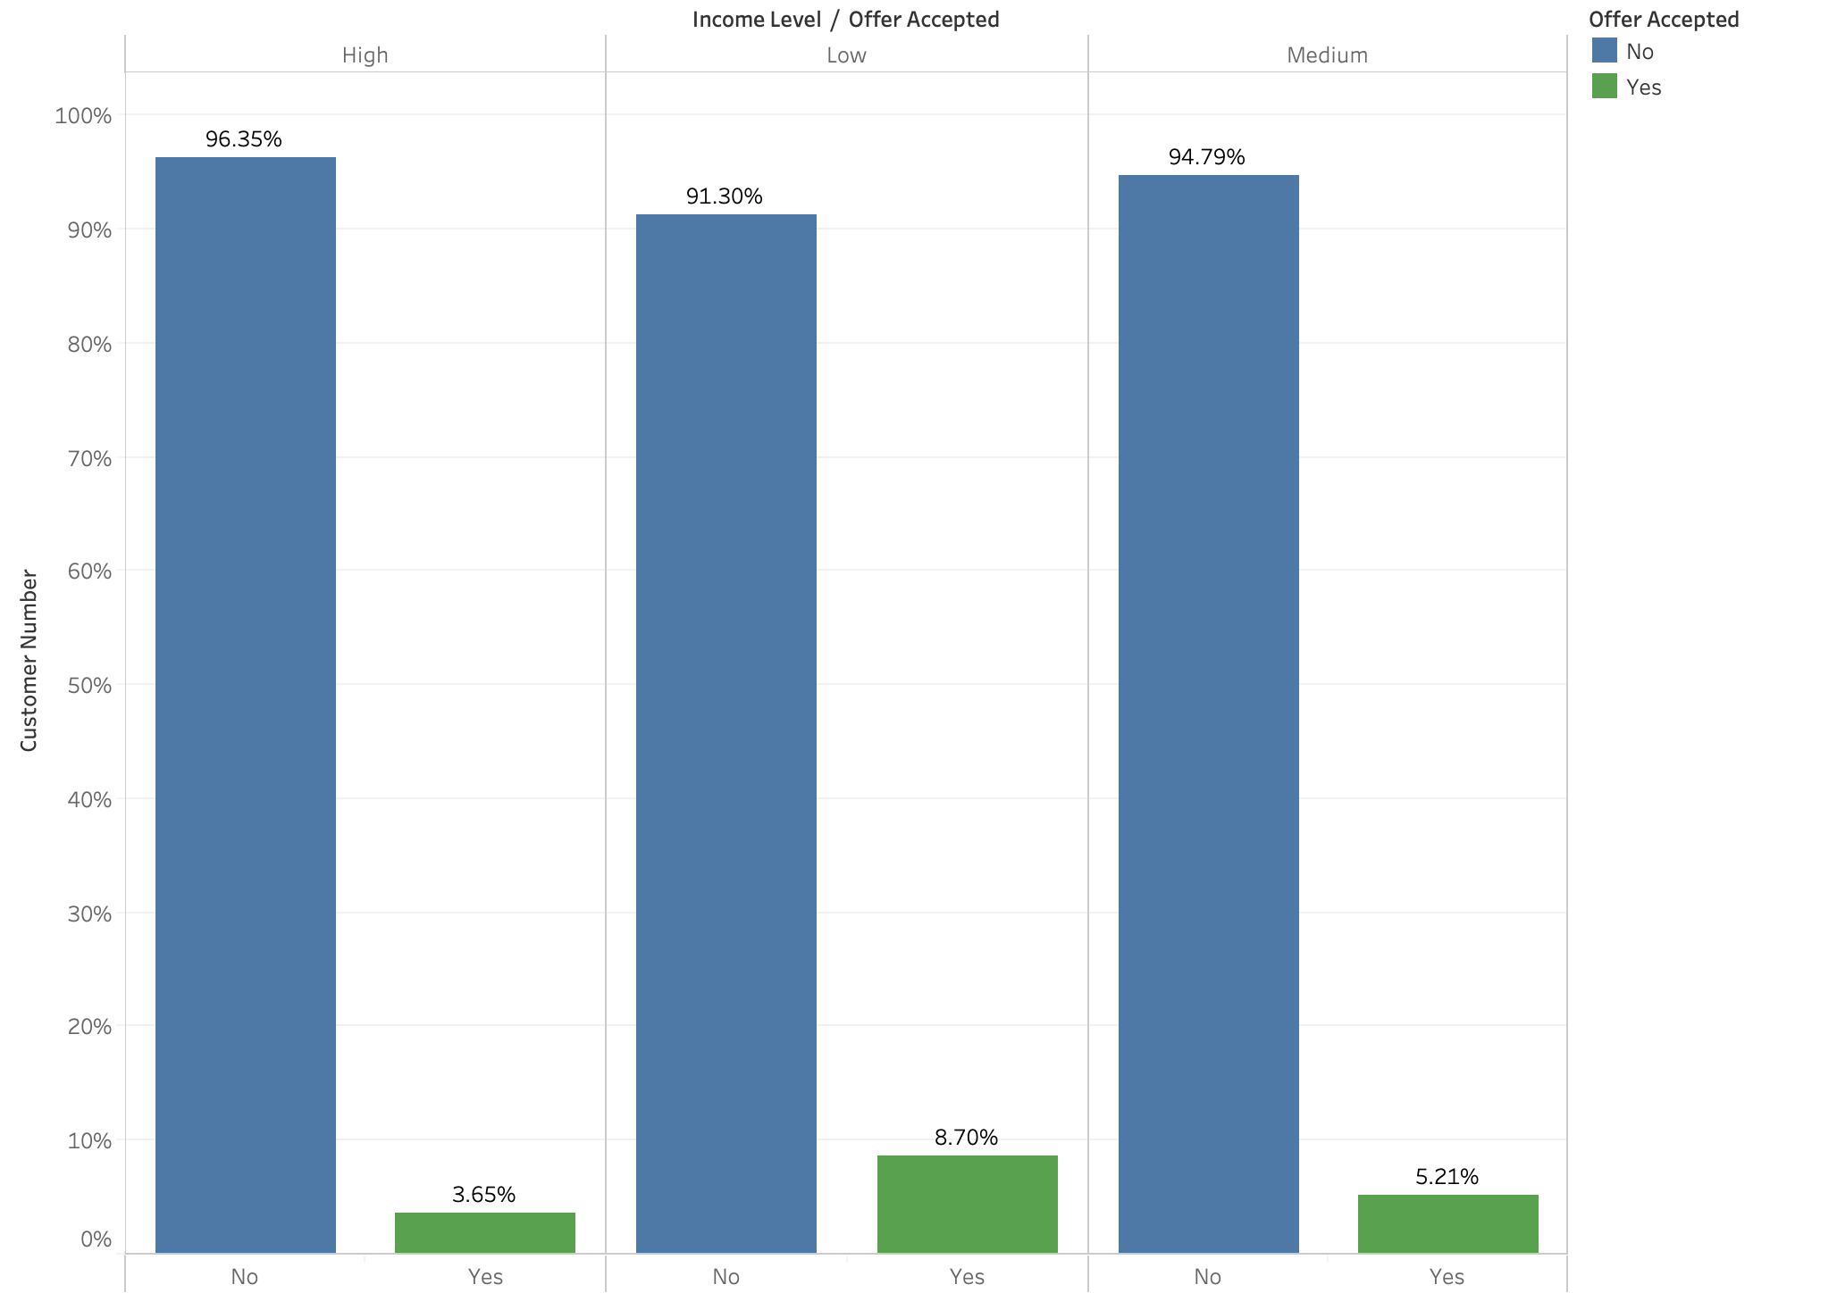
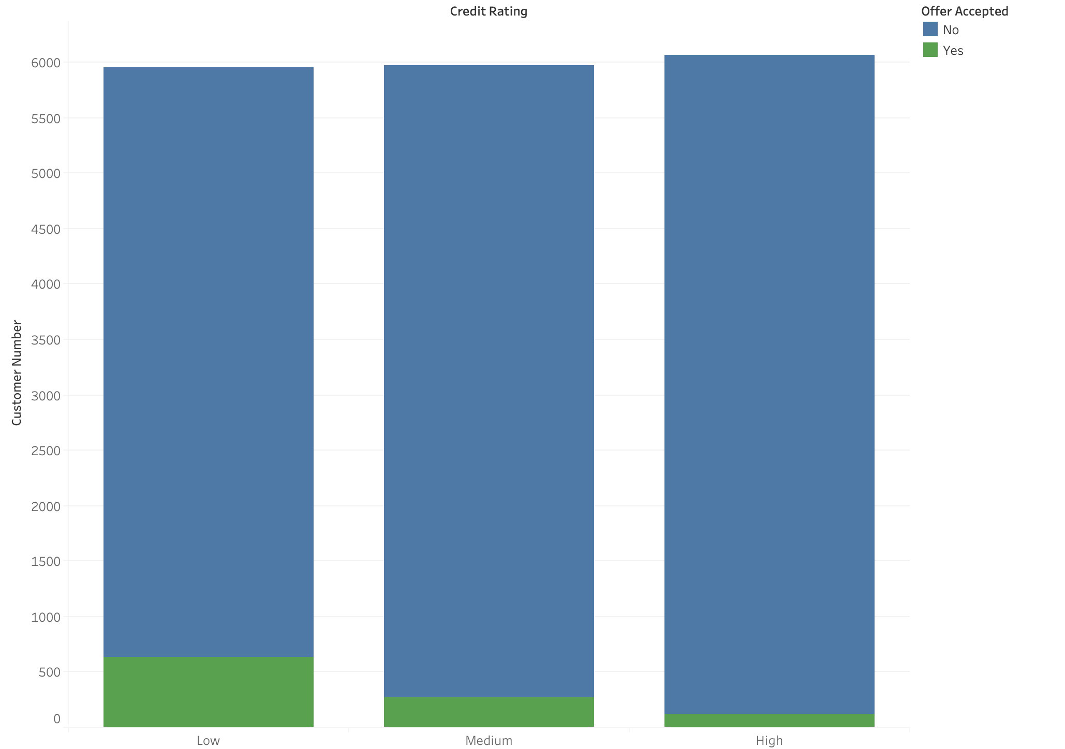
Mid Project
- QIQIN YANG
Help a bank to understand customers‘ behavior better for credit card offer
Income level in different groups
Credit Rating in different groups
Average Balance in different customer groups
Avg Balance with accept rate

Slide 2
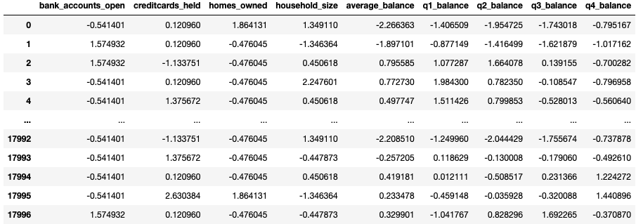
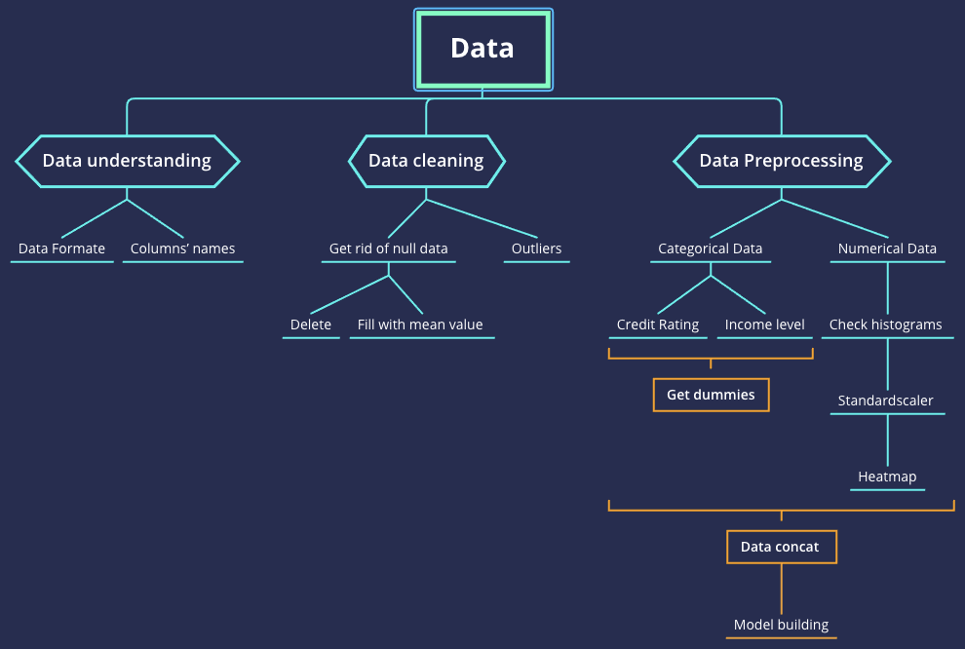
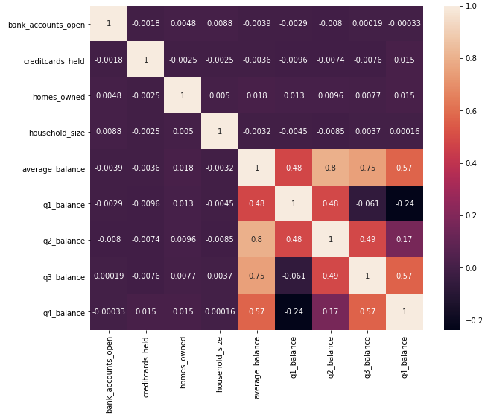
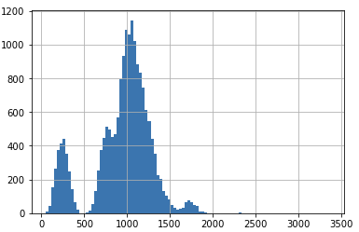
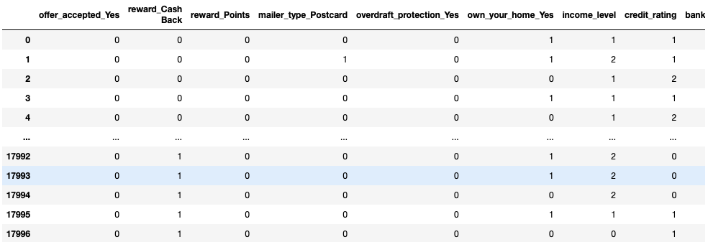
Data Checking
Avg Balance histogram
Heat Map
Steps before make model
categorical and numerical data

Slide 3
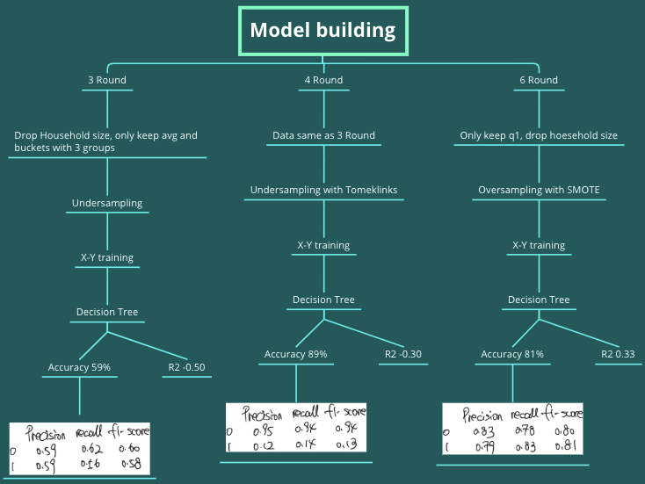
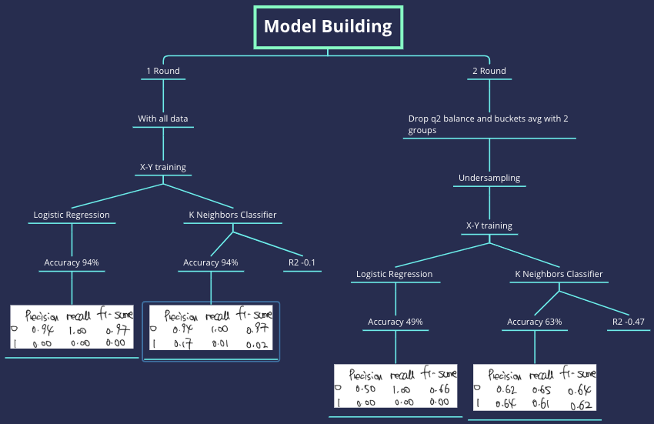
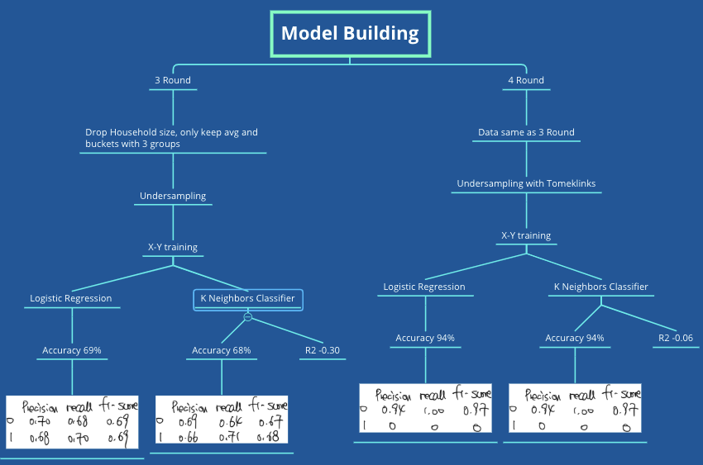
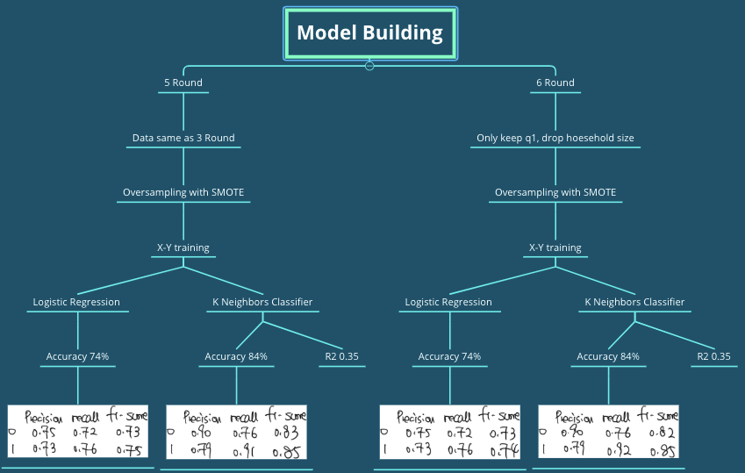
Model Building

Slide 4
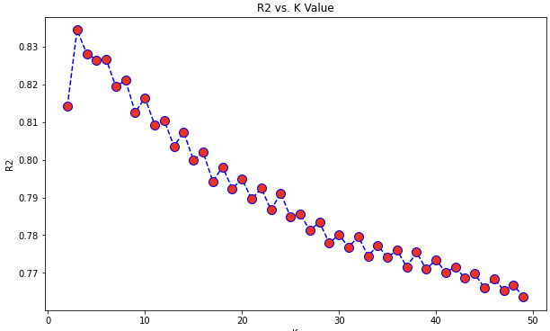
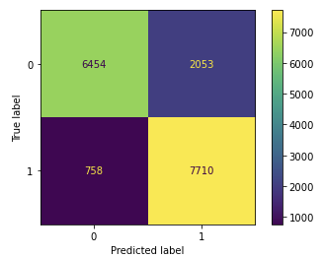
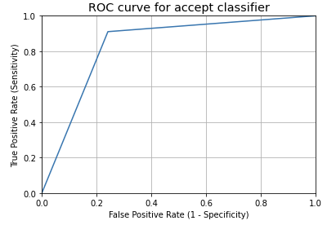
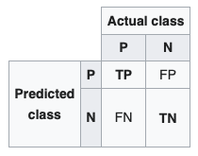
Model Evaluate
Actual class: Customers who accepted offer
Predicted class: Results from the Model
Sample imbalance
To gain customers is important
To reduce FP - PPV
R2 is not evaluate model here
To improve KNN
value 3 got best result
Precision = TP/(TP+FP)=0.79
ROC Curve

Slide 5
Thank you

