Slide 1
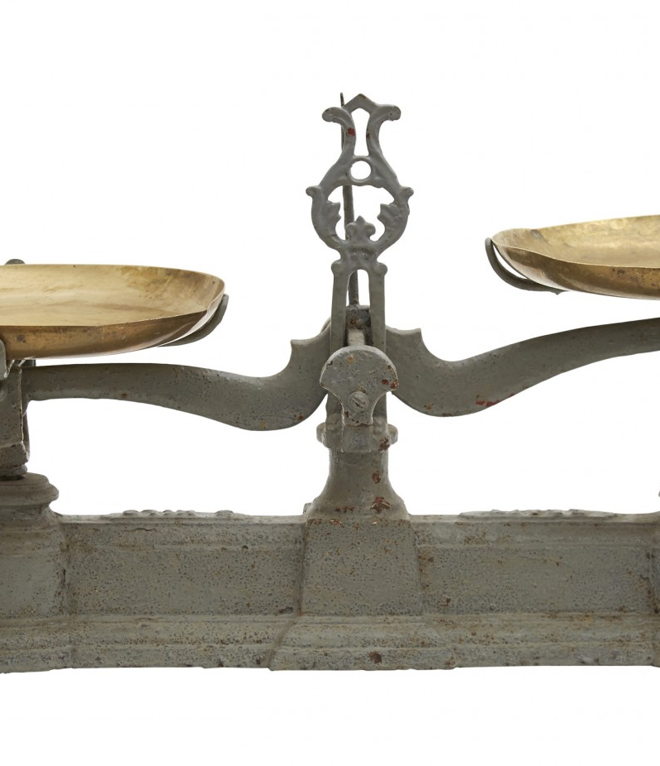
Vergelijkingen
Een vergelijking is een weegschaal met aan beide kanten getallen

Slide 2

2 + 3 = 5
| + 4
2 + 3 + 4 = 5 + 4
4
4
2
3
5

Slide 3
2 + 3 + 4 = x + 4
| + -4
2 + 3 = x
x = 5
4
4
2
3
x

Slide 4
2 + 3 = 5
| × 2
2 × (2 + 3) = 2 × 5
2
3
5
2
3
5

Slide 5
4 + 2x = 10
| - 4
2x = 6
| × ½
x = 3
x
4
10
6
x
3

Slide 6
17 = 4x + 5
12 = 4x
x = 3
2x + 4 = ½ (½x - 32) + 3x
2x + 4 = ¼x - 16 + 3x
2x + 4 = 3¼x - 16
-1¼x = -20
x = 16
2(2x + 10) - x = 7 + 3x
4x + 20 - x = 7 + 3x
3x + 20 = 7 + 3x
0 = -27
4 + 3x = x + 2(x + 2)
4 + 3x = x + 2x + 4
3x + 4 = 3x + 4
0 = 0
8x = 7x
x = 0
| + -5
| × 1/4
| a (b + c) = ab + ac
| a + b = b + a, ac + bc = (a + b) c
| + -3¼x + -4
| × -4/5
| a (b + c) = ab + ac
| a + b = b + a, ac + bc = (a + b) c
| + -3x + -20
onwaar voor elke x
| a (b + c) = ab + ac
| a + b = b + a, ac + bc = (a + b) c
| + -3x + -4
waar voor elke x
| + -7x
dus nooit door x delen (want 8≠7)

Slide 7
y = x - 2
y
y = x - 2
y = -2x + 1
-x + y = -2
2x + y = 1
x - y = 2
2x + y = 1
x - y = 2
3y = -3
x - y = 2
y = -1
x = 1
y = -1
+ -x
+ 2x
× -1
× -2
+
×1/3
+
y = -2x + 1
x

Slide 8
y = x - 2
y = -2x + 1
-x + y = -2
2x + y = 1
-1x + 1y = 1 . -2 + 0 . 1
2x + 1y = 0 . -2 + 1 . 1
1x + -1y = -1 . -2 + 0 . 1
2x + 1y = 0 . -2 + 1 . 1
1x + -1y = -1 . -2 + 0 . 1
0x + 3y = 2 . -2 + 1 . 1
1x + -1y = -1 . -2 + 0 . 1
0x + 1y = 2/3 . -2 + 1/3 . 1
1x + 0y = -1/3 . -2 + 1/3 . 1
0x + 1y = 2/3 . -2 + 1/3 . 1
x = 1
y = -1
-1 1 x 1 0 -2
2 1 y 0 1 1
-1 1 1 0
2 1 0 1
1 -1 -1 0
2 1 0 1
1 -1 -1 0
0 3 2 1
1 -1 -1 0
0 1 2/3 1/3
1 0 -1/3 1/3
0 1 2/3 1/3
1 0 x -1/3 1/3 -2
0 1 y 2/3 1/3 1
=
x -1
x -2
+
x 1/3
+
=

Slide 9
3 x 3 3 x 1 3 x 1
4 0 3 -2 4.-2 + 0.2 + 3.4 4
1 -1 7 2 = 1.-2 + -1.2 + 7.4 = 24
-3 3 2 4 -3.-2 + 3.2 + 2.4 20
3 x 3 3 x 3 3 x 3
4 0 3 -2 3 1 4 12 25
1 -1 7 2 -3 -5 = 24 6 55
-3 3 2 4 0 7 20 -18 -4
1 x 3 3 x 3 1 x 3
-2 3 1
1 -1 7 2 -3 -5 = 24 6 55
4 0 7

Slide 10
y
x
y
x
z

Slide 11
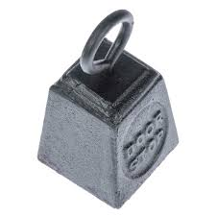
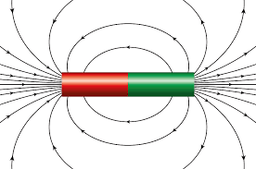

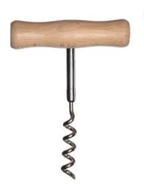
ɑ
ɑ

