Slide 1

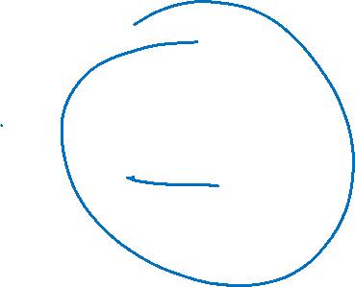
Getallen
Als ‘t heelal er niet zou zijn, was ‘t getal 3 er dan ook niet?

Slide 2

3
Natuurkunde
Wiskunde

Slide 3
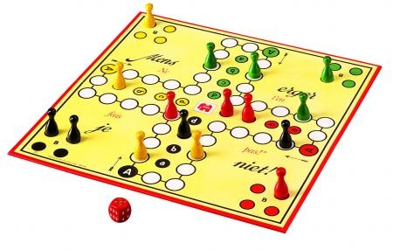

Wiskunde is de manipulatie
van betekenisloze symbolen
volgens vaste regels
Wij bepalen de regels: 1 + 1 = 3

Slide 4

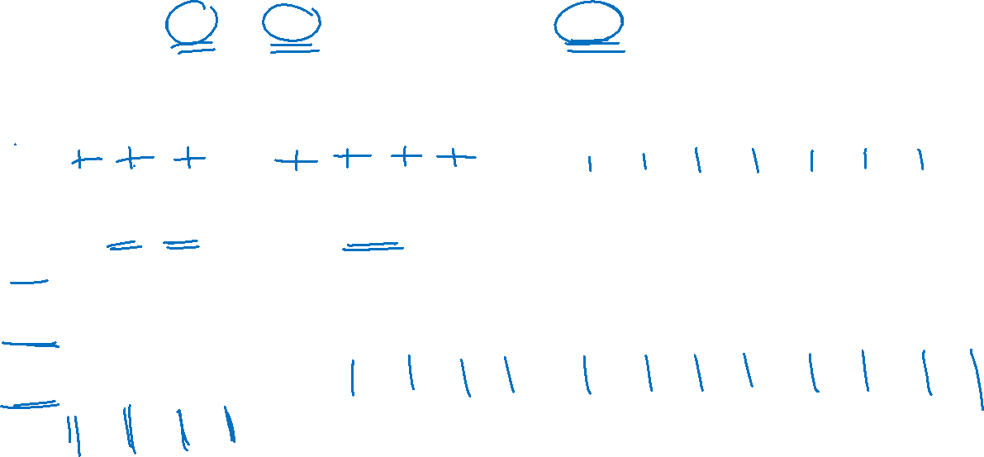
Basis-bewerkingen: + en ×
term
term
som
3 + 4 = 7
+
=
1 2 3 1 2 3 4 1 2 3 4 5 6 7
factor
factor
product
3 × 4 = 12
3
=
4
+
4
+
4
4

Slide 5
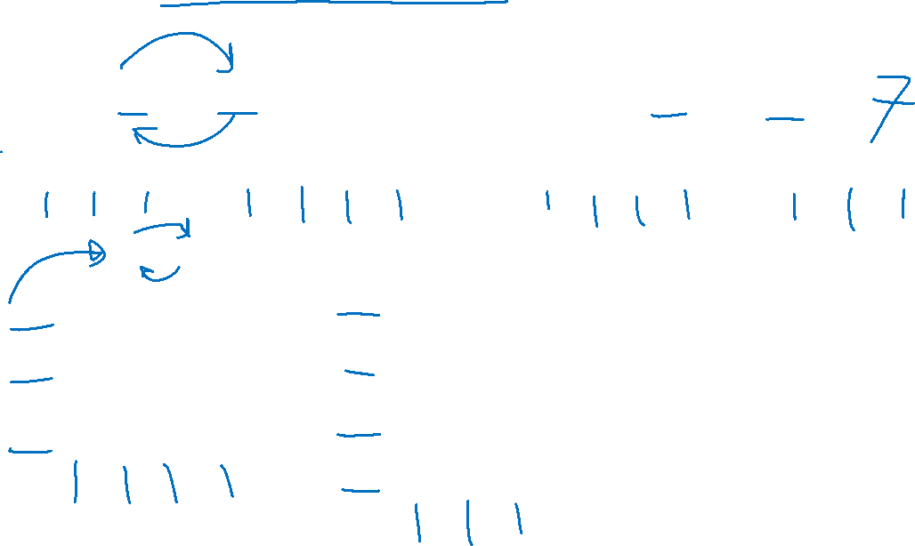
Spelregel 1: Commutatieve eigenschap
3 + 4 = 4 + 3
+
=
+
3 x 4 = 4 × 3
=
3
4
4
3

Slide 6
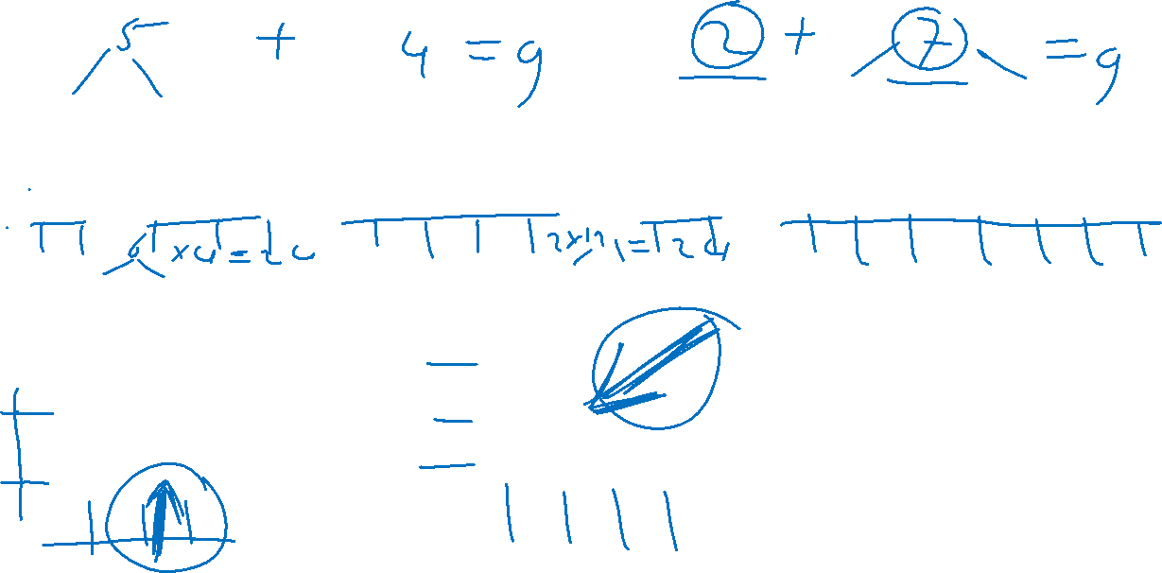
Spelregel 2: Associatieve eigenschap
( 2 + 3 ) + 4 = 2 + ( 3 + 4 )
+
+
=
+
+
(2 × 3) × 4 = 2 × (3 × 4)
2
=
3
2
4
3
4

Slide 7
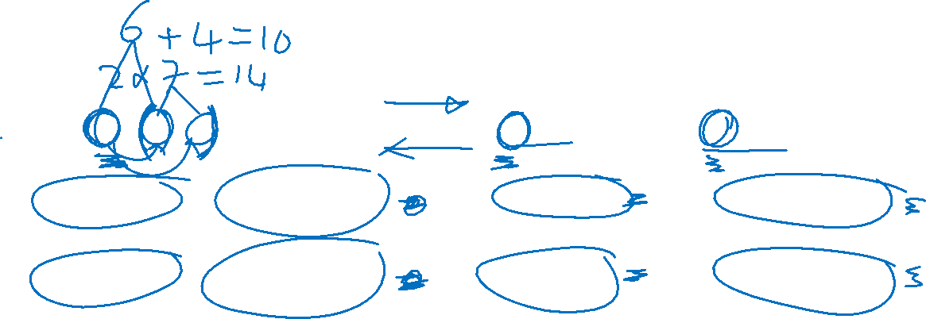
Spelregel 3: Distributieve eigenschap
2 × (3 + 4) = 2 × 3 + 2 × 4
+
2
=
2
+
2
+
3 + 4
3
4

Slide 8

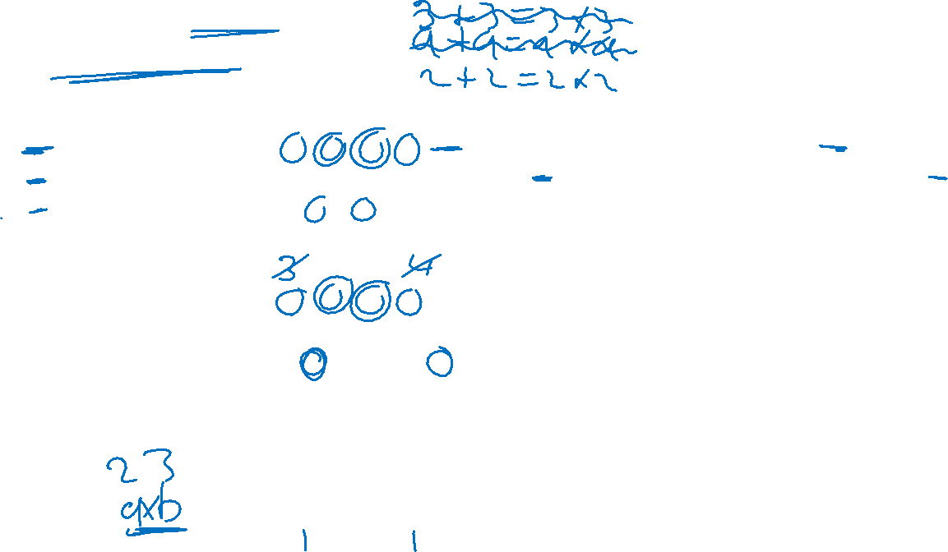
Variabelen zijn letters die
onbekende getallen voorstellen
Spelregels met getallen
1. Commutatief: 3 + 4 = 4 + 3 en 3 × 4 = 4 × 3
2. Associatief: (2 + 3) + 4 = 2 + (3 + 4) en (2 × 3) × 4 = 2 × (3 × 4)
3. Distributief: 2 × (3 + 4) = 2 × 3 + 2 × 4
Met variabelen
1. a + b = b + a en a × b = b × a
2. (a + b) + c = a + (b + c) en (a × b) × c = a × (b × c)
3. a × (b + c) = a × b + a × c
Maal-teken weglaten
1. a + b = b + a en a b = b a
2. (a + b) + c = a + (b + c) en (a b) c = a (b c)
3. a (b + c) = a b + a c

Slide 9
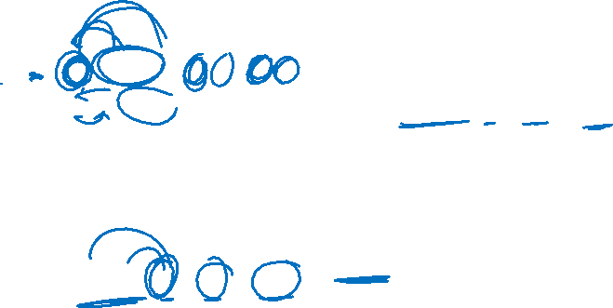
Afleiding van aanvullende spelregel
a (b + c) = a b + a c
a b = b a ⇒ (b + c) a = b a + c a
Dus, met andere letters:
(a + b) c = a c + b c

Slide 10

Neutrale elementen
Neutrale element van de optelling, symbool: 0
Hiervoor geldt:
a + 0 = a
Dus ook:
a + 0 = a
a + b = b + a ⇒ 0 + a = a
Neutrale element van de vermenigvuldiging, symbool: 1
Hiervoor geldt:
a × 1 = a
Dus ook:
a × 1 = a
a × b = b × a ⇒ 1 × a = a

Slide 11
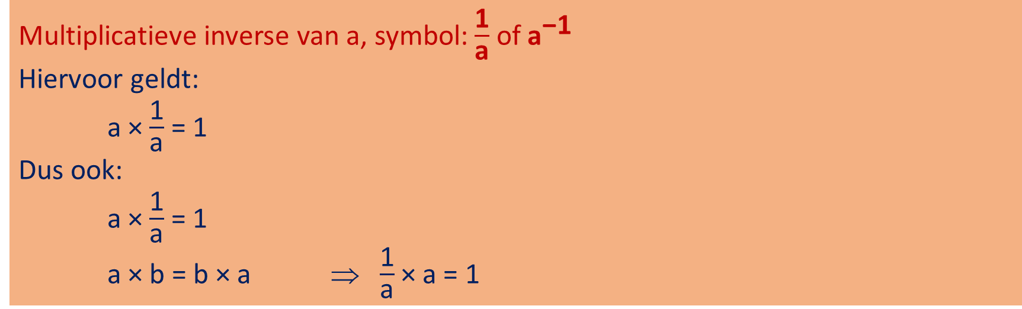
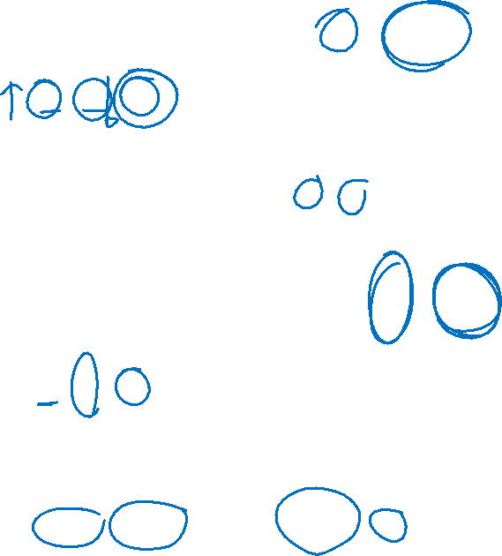
Inversen
Additieve inverse van a, symbol: -a of -1 × a
Hiervoor geldt:
a + -a = 0
Dus ook:
a + -a = 0
a + b = b + a ⇒ -a + a = 0
Multiplicatieve inverse van a, symbol: $\frac{\text{1}}{\text{a}}$ of ${\text{a}}^{\text{−1}}$
Hiervoor geldt:
a × $\frac{\text{1}}{\text{a}}$ = 1
Dus ook:
a × $\frac{\text{1}}{\text{a}}$ = 1
a × b = b × a ⇒ $\frac{\text{1}}{\text{a}}$ × a = 1

Slide 12
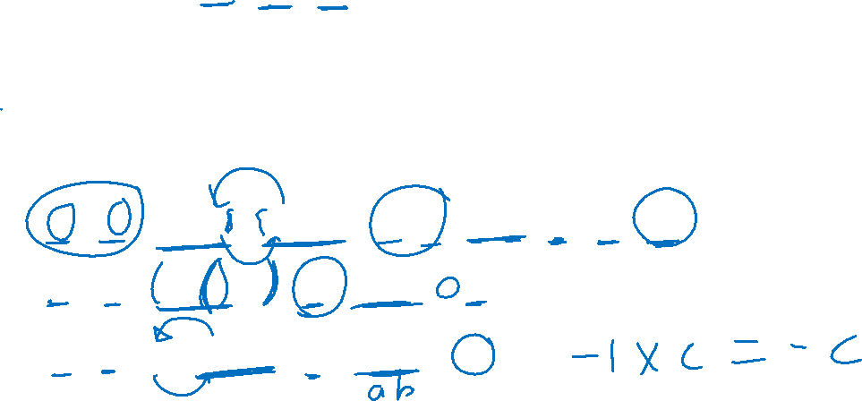
Afspraak: -1 × -1 = 1
Gevolgen:
-a × -b = (-1 × a) × (-1 × b) = -1 × -1 × a × b = 1 × ab = ab
-a × b = (-1 × a) × b = -1 × (a × b) = -ab
a × -b = a × (-1 × b) = -1 × (a × b) = -ab

Slide 13
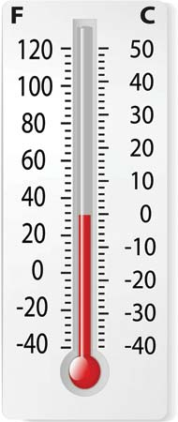
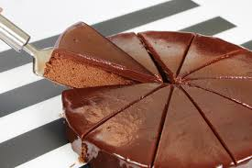

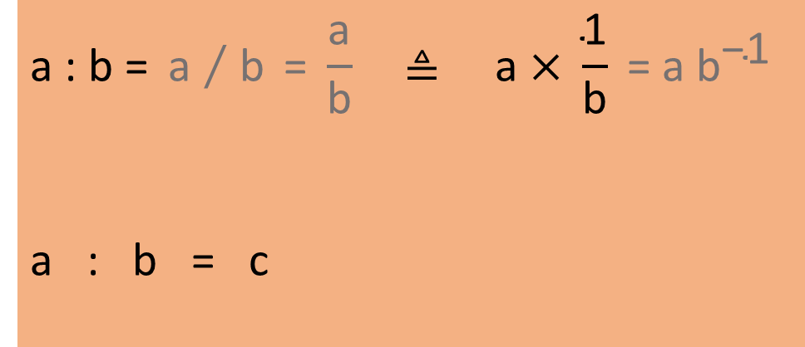

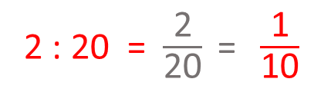
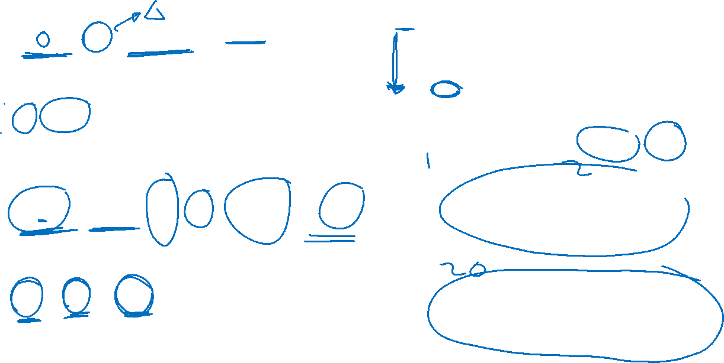
Afgeleide bewerkingen: - en :
$$\text{a}\text{ − }\text{b}\text{ ≜ }\text{a}\text{ + −}\text{b}$$
a - b = c
30 - 50 = -20
term
term
verschil van a en b
2 : 20 = $\frac{\text{2}}{\text{20}} \text{= }\frac{\text{1}}{\text{10}}$
$$\text{a}\text{ : }\text{b}\text{ = }{\text{a} }/{ \text{b} }\text{= }\frac{\text{a}}{\text{b}} \text{≜ }\text{a} \text{×} \frac{\text{1}}{\text{b}} \text{= }\text{a} {\text{b}}^{\text{−1}}$$
a : b = c
deeltal
deler
quotiënt

Slide 14
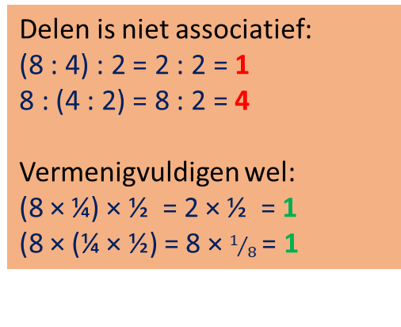
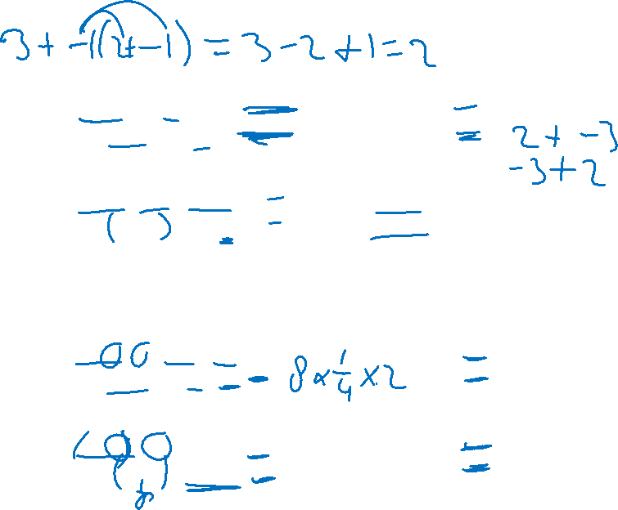
Beperkingen van - en :
Aftrekken is niet associatief:
(3 - 2) - 1 = 1 - 1 = 0
3 - (2 - 1) = 3 - 1 = 2
Optellen wel:
(3 + -2) + -1 = 1 + -1 = 0
3 + (-2 + -1) = 3 + -3 = 0
Aftrekken is niet commutatief:
3 - 2 = 1
2 - 3 = -1
Optellen wel:
3 + -2 = 1
-2 + 3 = 1
Delen is niet associatief:
(8 : 4) : 2 = 2 : 2 = 1
8 : (4 : 2) = 8 : 2 = 4
Vermenigvuldigen wel:
(8 × ¼) × ½ = 2 × ½ = 1
(8 × (¼ × ½) = 8 × $1/{8 }$= 1
Delen is niet commutatief:
8 : 4 = 2
4 : 8 = ½
Vermenigvuldigen wel:
8 × ¼ = 2
¼ × 8 = 2

Slide 15
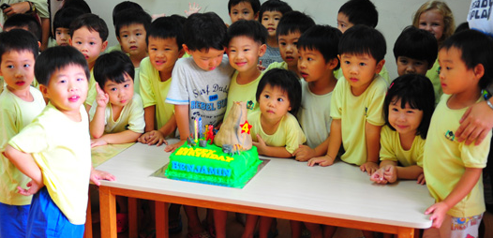
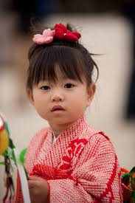
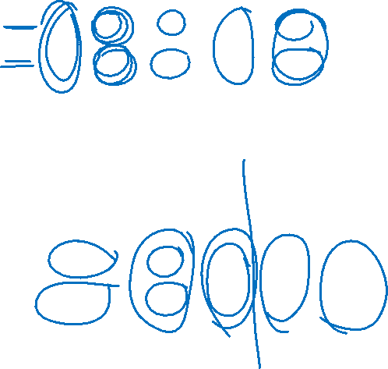
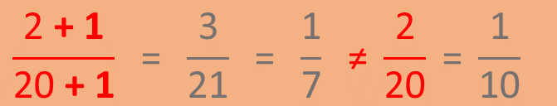
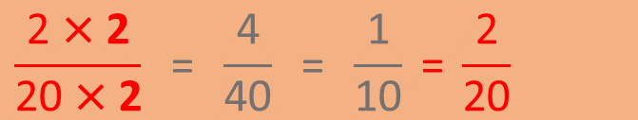
Regels voor het delen
$$\frac{\text{2} \text{×}\text{ 2}}{\text{20} \text{×}\text{ 2}} \text{=} \frac{\text{4}}{\text{40}} \text{=} \frac{\text{1}}{\text{10}} \text{=} \frac{\text{2}}{\text{2}\text{0}}$$
$$\frac{\text{2} \text{+} \text{1}}{\text{20} \text{+} \text{1}} \text{=} \frac{\text{3}}{\text{2}\text{1}} \text{=} \frac{\text{1}}{\text{7}} \text{≠ }\frac{\text{2}}{\text{2}\text{0}} \text{=} \frac{\text{1}}{\text{10}}$$

Slide 16
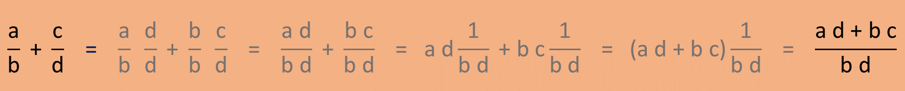
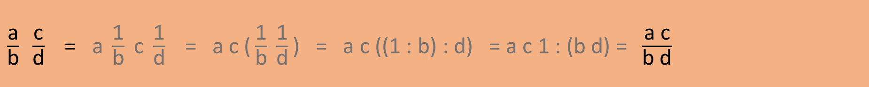
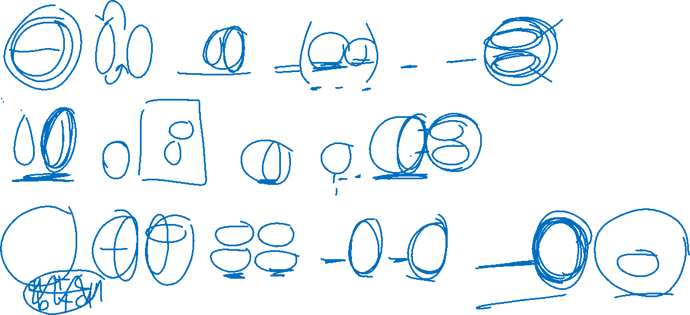
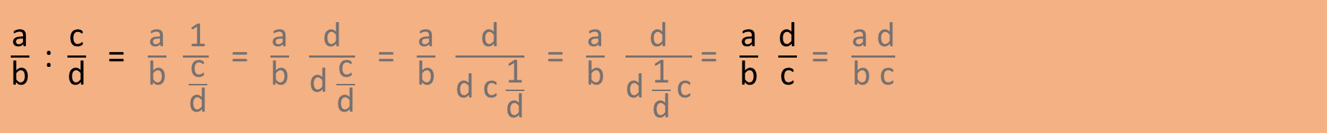
Rekenen met breuken
$\frac{\text{a}}{\text{b}} \frac{\text{c}}{\text{d}}\text{ = }\text{a} \frac{\text{1}}{\text{b}} \text{c} \frac{\text{1}}{\text{d}} \text{=} \text{a} \text{c}\text{ (}\frac{\text{1}}{\text{b}} \frac{\text{1}}{\text{d}}\text{) }\text{=} \text{a} \text{c}\text{ ((1 : }\text{b}\text{) : }\text{d}\text{) = }\text{a} \text{c}\text{ 1 : (}\text{b} \text{d}\text{) = }\frac{\text{a} \text{c}}{\text{b} \text{d}}$
$\frac{\text{a}}{\text{b}}\text{ : }\frac{\text{c}}{\text{d}} \text{= }\frac{\text{a}}{\text{b}} \frac{\text{1}}{\frac{\text{c}}{\text{d}}} \text{= }\frac{\text{a}}{\text{b}} \frac{\text{d}}{\text{d} \frac{\text{c}}{\text{d}}} \text{=} \frac{\text{a}}{\text{b}} \frac{\text{d}}{\text{d} \text{c} \frac{\text{1}}{\text{d}}} \text{=} \frac{\text{a}}{\text{b}} \frac{\text{d}}{\text{d} \frac{\text{1}}{\text{d}} \text{c}}$ $\text{= }\frac{\text{a}}{\text{b}} \frac{\text{d}}{\text{c}} \text{= }\frac{\text{a} \text{d}}{\text{b} \text{c}}$
$$\frac{\text{a}}{\text{b}}\text{ +} \frac{\text{c}}{\text{d}} \text{=} \frac{\text{a}}{\text{b}} \frac{\text{d}}{\text{d}} \text{+} \frac{\text{b}}{\text{b}} \frac{\text{c}}{\text{d}} \text{=} \frac{\text{a} \text{d}}{\text{b} \text{d}}\text{ + }\frac{\text{b} \text{c}}{\text{b} \text{d}}\text{ =} \text{a} \text{d}\frac{\text{1}}{\text{b} \text{d}}\text{ + }\text{b} \text{c}\frac{\text{1}}{\text{b} \text{d}}\text{ =}\text{ (}\text{a} \text{d}\text{ + }\text{b} \text{c}\text{)}\frac{\text{1}}{\text{b} \text{d}} \text{=} \frac{\text{a} \text{d}\text{ + }\text{b} \text{c}}{\text{b} \text{d}}$$

