Slide 1

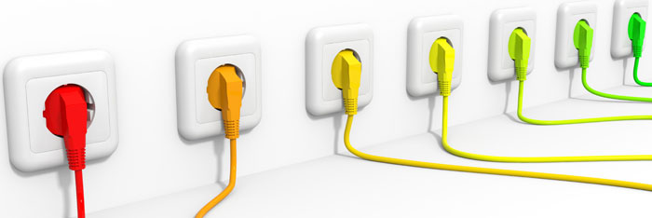

Spanning, stroom en weerstand
Uitgelegd met behulp van water

Slide 2

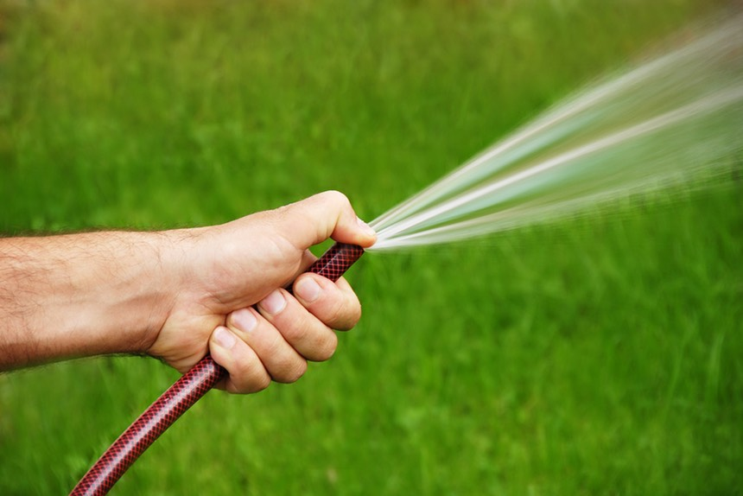

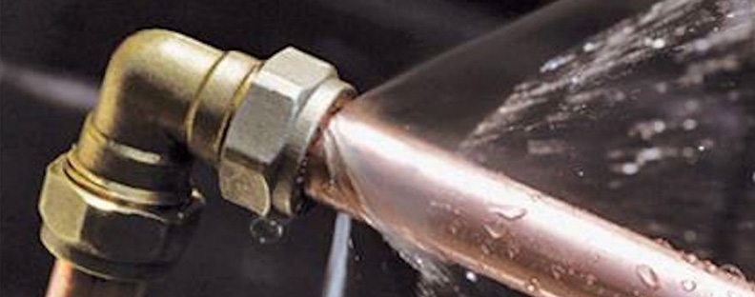

Slide 3
I [A]
hoge druk
vernauwing 1
+
U_{b} [V]
R₁ [Ω]
pomp
druk x
U_{x} [V]
-
vernauwing 2
R₂ [Ω]
lage druk
0 V

Slide 4

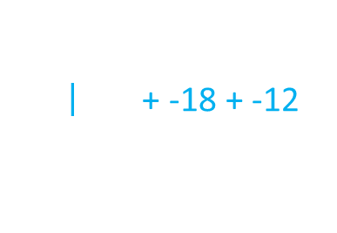
5A
18A
12A
10A
1e wet van Kirchhoff:
I = 0
op elk knooppunt
15A
$$\left| \text{+ −18 + −12}\right.$$
$$\text{5} \text{+} \text{10} \text{+} \text{1}\text{5 }\text{=} \text{18} \text{+} \text{12 }$$
$$\text{}\text{ 5 }\text{+}\text{ 10 }\text{+}\text{ 15 }\text{+} \text{−18 }\text{+} \text{−12 = 0}$$

Slide 5
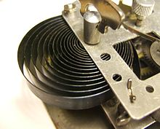

12V
+
-
4V
8V
+
­-
2e wet van Kirchhoff:
U = 0
in elke lus
14V
10V
-
+
$$\text{1}\text{4}\text{ + }\text{10}\text{ + −4 + −12 + −8 }\text{=} \text{0}$$

Slide 6
+
U [V]
-
R [Ω]
I [A]
Wet van Ohm:
U = R I
voor elke weerstand
2A
8V = 4Ω × 2A
4Ω

Slide 7

$$\text{K}\text{2: } \text{U}\text{b} \text{+ }\text{−}\text{U}\text{1}\text{ + }\text{−}\text{U}\text{2} \text{= 0 } \text{⇒} \text{U}\text{b}\text{= }\text{U}\text{1}\text{ + }\text{U}\text{2}$$
$$\text{Ohm}\text{: }\text{U}\text{1}\text{ = }\text{R}\text{1} \text{I} ∧ \text{U}\text{2}\text{ = }\text{R}\text{2} \text{I}$$
$$\text{K}\text{2 }∧ \text{Ohm} \text{⇒} \text{U}\text{b}\text{ = }\text{R}\text{1} \text{I}\text{ + }\text{R}\text{2} \text{I}$$
⇒$\text{U}\text{b}\text{ = }\left(\text{R}\text{1}\text{ + }\text{R}\text{2}\right) \text{I} \left| × \frac{\text{1}}{\text{R}\text{1} \text{+} \text{R}\text{2}}\right.$
⇒ I = $\frac{\text{1}}{\text{R}\text{1}\text{+}\text{R}\text{2}} \text{Ub} \left| \text{Oh}\text{m} \right.$
$\text{}$ $\text{U}\text{1}\text{ = }\frac{\text{R}\text{1}}{\text{R}\text{1 }\text{+ }\text{R}\text{2}}$ $\text{Ub}$ ∧ $\text{U}\text{2}\text{ = }\frac{\text{R}\text{2}}{\text{R}\text{1 }\text{+ }\text{R}\text{2}}$ $\text{Ub}$
I
R₁
U₁
+
U_{b}
I
R_{v}
-
R_{v}
R₂
U₂

Slide 8
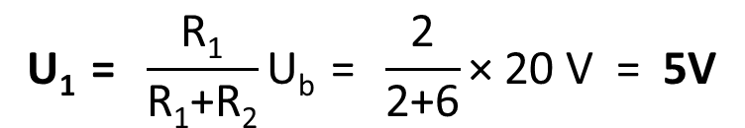
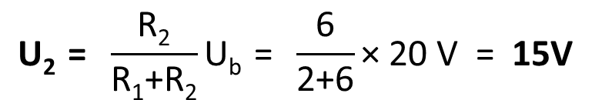

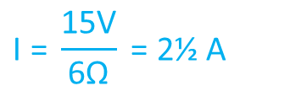
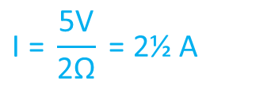
Spanningsdeler
I = 2½A
$$\text{U}\text{1 }\text{= }\frac{\text{R}\text{1}}{\text{R}\text{1}\text{+}\text{R}\text{2}}\text{U}\text{b}\text{ = }\frac{\text{2}}{\text{2+6}}\text{× 20 }\text{V}\text{ = }\text{5}\text{V}$$
+
R₁=2Ω
U_{b}=20V
$$\text{I}\text{ = }\frac{\text{5}\text{V}}{\text{2}\text{Ω}} \text{= 2½} \text{A}$$
-
R₁=6Ω
$$\text{U}\text{2 }\text{=} \frac{\text{R}\text{2}}{\text{R}\text{1}\text{+}\text{R}\text{2}}\text{U}\text{b}\text{ = }\frac{\text{6}}{\text{2+6}}\text{× 20 }\text{V}\text{ = }\text{15}\text{V}$$
$$\text{I}\text{ = }\frac{\text{15}\text{V}}{\text{6}\text{Ω}} \text{= 2½} \text{A}$$
R_{v} = (2+6)Ω = 8Ω
$\text{C}\text{heck}\text{: }\text{U}\text{b}\text{ = }\text{Rv}\text{ ×}$ I = 8Ω × 2½A = 20V

Slide 9
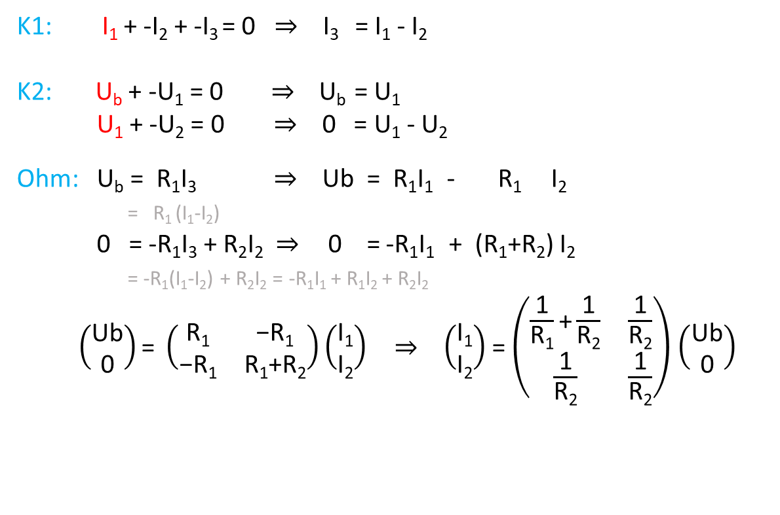
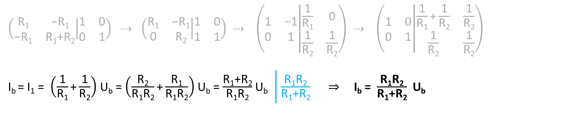
Stroomdeler
I₁
I₂
K1: I₁ + -I₂ + -I₃ = 0 $⇒$ I₃ = I₁ - I₂
K2: U_{b} + -U₁ = 0 $⇒$ U_{b} = U₁
U₁ + -U₂ = 0 $⇒$ 0 = U₁ - U₂
Ohm: U_{b} = R₁I₃ $⇒$ Ub = R₁I₁ - R₁ I₂
= R₁ (I₁-I₂)
0 = -R₁I₃ + R₂I₂ $⇒$ 0 = -R₁I₁ + (R₁+R₂) I₂
= -R₁(I₁-I₂) + R₂I₂ = -R₁I₁ + R₁I₂ + R₂I₂
$\left(\begin{matrix}\text{U}\text{b} \\ \text{0}\end{matrix}\right)\text{= }\left(\begin{matrix}\text{R}\text{1} & \text{−}\text{R}\text{1} \\ \text{−}\text{R}\text{1} & \text{R}\text{1}\text{+}\text{R}\text{2}\end{matrix}\right)\left(\begin{matrix}\text{I}\text{1} \\ \text{I}\text{2}\end{matrix}\right) ⇒ \left(\begin{matrix}\text{I}\text{1} \\ \text{I}\text{2}\end{matrix}\right)$ = $\left(\begin{matrix}\frac{\text{1}}{\text{R}\text{1}}\text{+}\frac{\text{1}}{\text{R}\text{2}} & \frac{\text{1}}{\text{R}\text{2}} \\ \frac{\text{1}}{\text{R}\text{2}} & \frac{\text{1}}{\text{R}\text{2}}\end{matrix}\right)$ $\left(\begin{matrix}\text{U}\text{b} \\ \text{0}\end{matrix}\right)$
I_{b}
I₃
+
U_{b}
U₁
U₂
I₂
I₁
R₁
R_{v}
R₂
-
$\left(\begin{matrix}\text{R}\text{1} & \text{−}\text{R}\text{1} \\ \text{−}\text{R}\text{1} & \text{R}\text{1}\text{+}\text{R}\text{2}\end{matrix} | \begin{matrix}\text{1} & \text{0} \\ \text{0} & \text{1}\end{matrix}\right)$ $⇢$ $\left(\begin{matrix}\text{R}\text{1} & \text{−}\text{R}\text{1} \\ \text{0} & \text{R}\text{2}\end{matrix} | \begin{matrix}\text{1} & \text{0} \\ \text{1} & \text{1}\end{matrix}\right)$ $⇢$ $\left(\begin{matrix}\text{1} & \text{−1} \\ \text{0} & \text{1}\end{matrix} | \begin{matrix}\frac{\text{1}}{\text{R}\text{1}} & \text{0} \\ \frac{\text{1}}{\text{R}\text{2}} & \frac{\text{1}}{\text{R}\text{2}}\end{matrix}\right)$ $⇢$ $\left(\begin{matrix}\text{1} & \text{0} \\ \text{0} & \text{1}\end{matrix} | \begin{matrix}\frac{\text{1}}{\text{R}\text{1}}\text{+}\frac{\text{1}}{\text{R}\text{2}} & \frac{\text{1}}{\text{R}\text{2}} \\ \frac{\text{1}}{\text{R}\text{2}} & \frac{\text{1}}{\text{R}\text{2}}\end{matrix}\right)$
I_{b} = I₁ = $\left(\frac{\text{1}}{\text{R}\text{1}}\text{+}\frac{\text{1}}{\text{R}\text{2}}\right)$ U_{b} = $\left(\frac{\text{R}\text{2}}{\text{R}\text{1}\text{R}\text{2}}\text{+}\frac{\text{R}\text{1}}{\text{R}\text{1}\text{R}\text{2}}\right)$ U_{b} = $\frac{\text{R}\text{1}\text{+}\text{R}\text{2}}{\text{R}\text{1}\text{R}\text{2}}$U_{b} $\left| \frac{\text{R}\text{1}\text{R}\text{2}}{\text{R}\text{1}\text{+}\text{R}\text{2}}\right.$ $⇒$I_{b} = $\frac{\text{R}\text{1}\text{R}\text{2}}{\text{R}\text{1}\text{+}\text{R}\text{2}}$U_{b}
G_{v} = G₁ + G₂
R_{v}

Slide 10
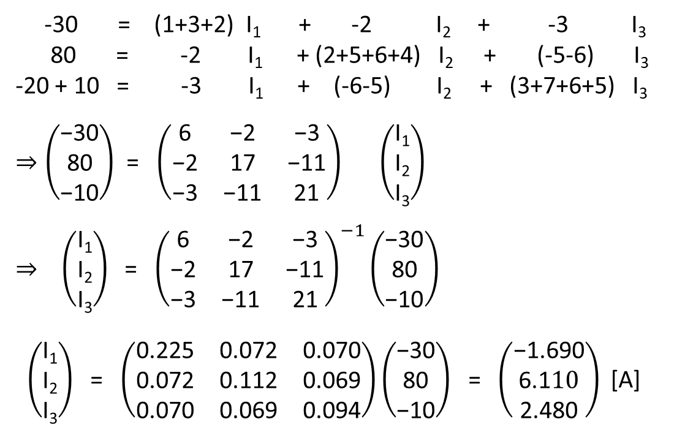
57.360V
1Ω
+
-
1.690A
30V
I₁
-30 = (1+3+2) I₁ + -2 I₂ + -3 I₃
80 = -2 I₁ + (2+5+6+4) I₂ + (-5-6) I₃
-20 + 10 = -3 I₁ + (-6-5) I₂ + (3+7+6+5) I₃
$⇒\left(\begin{matrix}\text{−}\text{30} \\ \text{80} \\ \text{−10}\end{matrix}\right)$ = $\left(\begin{matrix}\text{6} & \text{−2} & \text{−3} \\ \text{−2} & \text{17} & \text{−11} \\ \text{−3} & \text{−11} & \text{21}\end{matrix}\right) \left(\begin{matrix}\text{I}\text{1} \\ \text{I}\text{2} \\ \text{I}\text{3}\end{matrix}\right)$
$⇒ \left(\begin{matrix}\text{I}\text{1} \\ \text{I}\text{2} \\ \text{I}\text{3}\end{matrix}\right)$ = ${\left(\begin{matrix}\text{6} & \text{−2} & \text{−3} \\ \text{−2} & \text{17} & \text{−11} \\ \text{−3} & \text{−11} & \text{21}\end{matrix}\right)}^{−1}\left(\begin{matrix}\text{−}\text{30} \\ \text{80} \\ \text{−10}\end{matrix}\right)$
$\left(\begin{matrix}\text{I}\text{1} \\ \text{I}\text{2} \\ \text{I}\text{3}\end{matrix}\right)$ = $\left(\begin{matrix}\text{0}\text{.225} & \text{0.072} & \text{0.070} \\ \text{0.072} & \text{0.112} & \text{0.069} \\ \text{0.070} & \text{0.069} & \text{0.094}\end{matrix}\right)\left(\begin{matrix}\text{−}\text{30} \\ \text{80} \\ \text{−10}\end{matrix}\right)$ = $\left(\begin{matrix}\text{−}\text{1.690} \\ \text{6.1}10 \\ \text{2.480}\end{matrix}\right)\text{ [}\text{A}\text{]}$
7.800A
39.960V
4.170A
55.560V
2Ω
3Ω
27.360V
+
4Ω
5Ω
20V
-
I₂
I₃
7.360V
80V
+
21.774V
80V
6Ω
7Ω
-
6.110A
3.660A
2.480A
+
-
-10V
0V
10V

