Slide 1
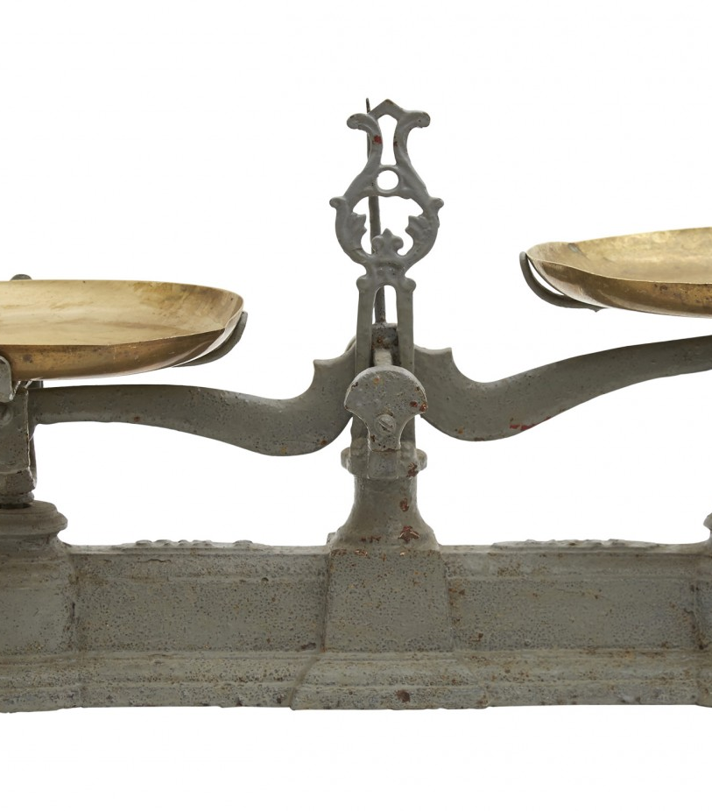
Vergelijkingen
Een vergelijking is een weegschaal met aan beide kanten getallen

Slide 2

2 + 3 = 5
| + 4
2 + 3 + 4 = 5 + 4
4
4
2
3
5

Slide 3
2 + 3 + 4 = x + 4
| + -4
2 + 3 = x
x = 5
4
4
2
3
x

Slide 4
2 + 3 = 5
| × 2
2 × (2 + 3) = 2 × 5
2
3
5
2
3
5

Slide 5
4 + 2x = 10
| - 4
2x = 6
| × ½
x = 3
x
4
10
6
x
3

Slide 6

17 = 4x + 5
12 = 4x
x = 3
2x + 4 = ½ (½x - 32) + 3x
2x + 4 = ¼x - 16 + 3x
2x + 4 = 3¼x - 16
-1¼x = -20
x = 16
2(2x + 10) - x = 7 + 3x
4x + 20 - x = 7 + 3x
3x + 20 = 7 + 3x
0 = -27
4 + 3x = x + 2(x + 2)
4 + 3x = x + 2x + 4
3x + 4 = 3x + 4
0 = 0
8x = 7x
x = 0
| + -5
| × ¼, $↻$
| a (b + c) = ab + ac
| a + b = b + a, ac + bc = (a + b) c
| + -3${\text{1}}/{\text{4}}$x + -4
| × ${\text{5}}/{\text{4}}$
| a (b + c) = ab + ac
| a + b = b + a, ac + bc = (a + b) c
| + -3x + -20
onwaar voor elke x
| a (b + c) = ab + ac
| a + b = b + a, ac + bc = (a + b) c
| + -3x + -4
waar voor elke x
| + -7x
dus nooit door x delen (want 8 ≠ 7)

Slide 7
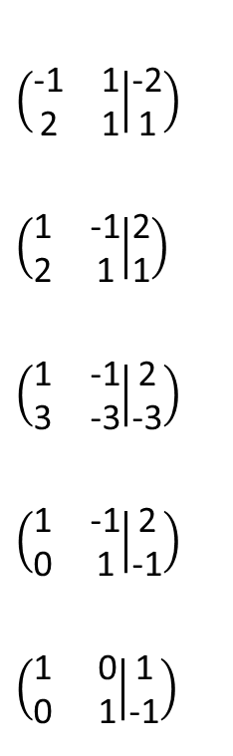

y = x - 2
y
y = x - 2
y = -2x + 1
-x + y = -2
2x + y = 1
x - y = 2
2x + y = 1
x - y = 2
3y = -3
x - y = 2
y = -1
x = 1
y = -1
+ -x
+ 2x
× -1
× -2
+
× ${\text{1}}/{\text{3}}$
+
$$\left(\begin{matrix}\text{-1} & \text{1} \\ \text{2} & \text{1}\end{matrix} | \begin{matrix}\text{-2} \\ \text{1}\end{matrix}\right)$$
$$\left(\begin{matrix}\text{1} & \text{-1} \\ \text{2} & \text{1}\end{matrix} | \begin{matrix}\text{2} \\ \text{1}\end{matrix}\right)$$
$$\left(\begin{matrix}\text{1} & \text{-1} \\ \text{3} & \text{-3}\end{matrix} | \begin{matrix}\text{2} \\ \text{-3}\end{matrix}\right)$$
$$\left(\begin{matrix}\text{1} & \text{-1} \\ \text{0} & \text{1}\end{matrix} | \begin{matrix}\text{2} \\ \text{-1}\end{matrix}\right)$$
$$\left(\begin{matrix}\text{1} & \text{0} \\ \text{0} & \text{1}\end{matrix} | \begin{matrix}\text{1} \\ \text{-1}\end{matrix}\right)$$
y = -2x + 1
x

