Slide 1

GIT
Distributed Version Control System
Linus Torvalds (creator of Linux) has quipped about the name git, which is British English slang for a stupid or unpleasant person.
Torvalds said: "I'm an egotistical bastard, and I name all my projects after myself. First 'Linux', now 'git' ".
The man page describes git as "the stupid content tracker".

Slide 2
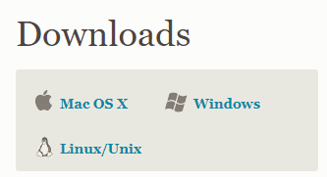
Download GIT from:
https://git-scm.com/download

Slide 3
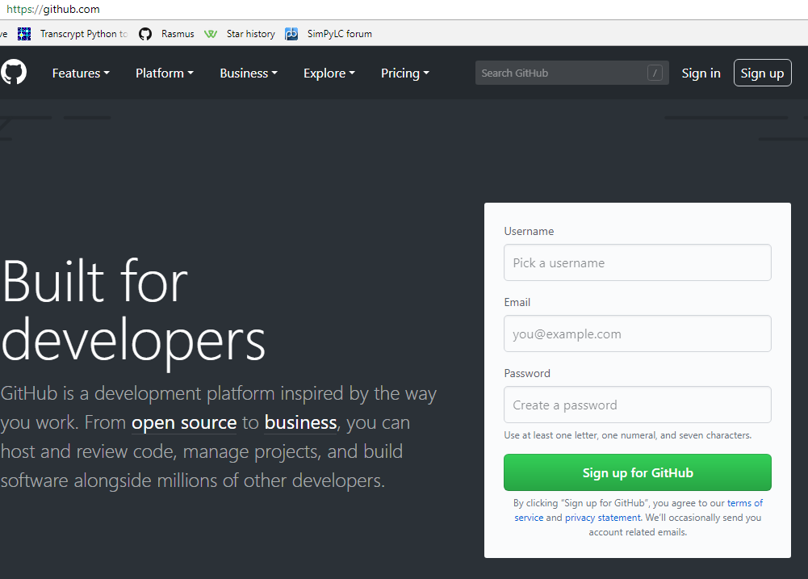

Slide 4
git config --global user.name "Jacques de Hooge"
git config --global user.email jdeh@transcrypt.org

Slide 5
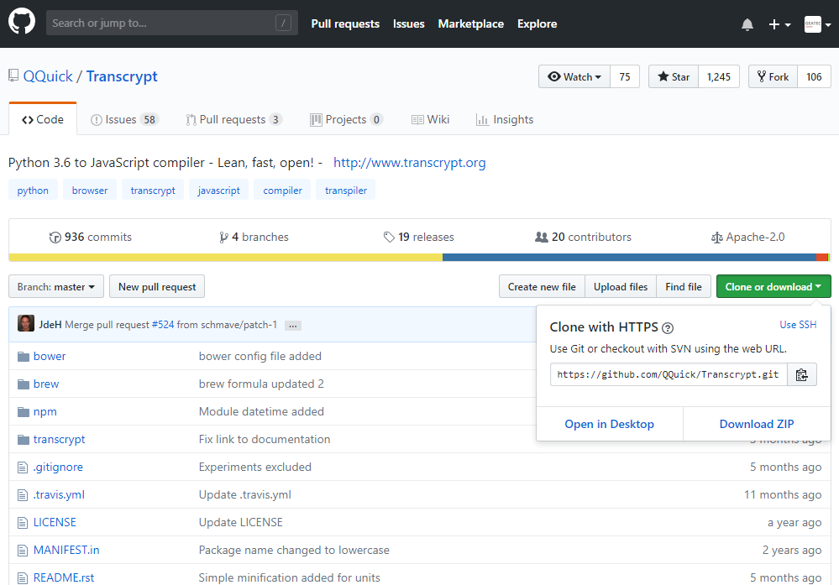

Slide 6
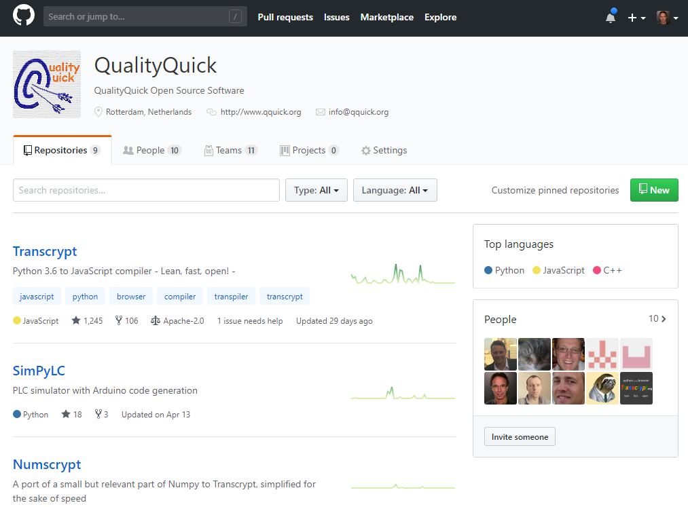

Slide 7
# Clone remote repository
git clone ://github.com/QQuick/Transcrypt.git

Slide 8
# add file to the staging area (git add . adds everything)
git add modules.py
# first commit
git commit –m“added module support"
# add file to the staging area
git add sourcemaps.py
# second commit
git commit –m“added sourcemaps“
# pushes all changes to remote repository
git push origin master

Slide 9
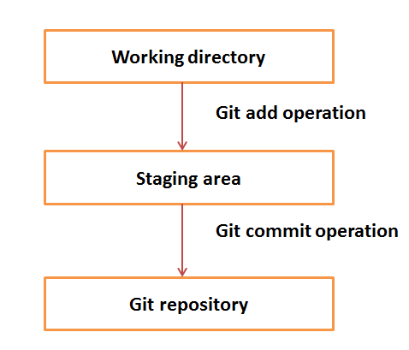

Slide 10
# Update remote from local
git push origin master
# Update local from remote
git pull origin master

Slide 11
contents of the .gitignore file:
*.nogit
*.pyc
*.npp
*.egg-info/
**.__pycache__/
dist/
transcrypt/docs/sphinx/_build/
transcrypt/development/attic/
transcrypt/development/docs/
transcrypt/development/experiments/
transcrypt/development/automated_tests/*/autotest.html
transcrypt/development/automated_tests/*/autotest.min.html
transcrypt/development/automated_tests/**/__javascript__/
transcrypt/modules/re/__javascript__/
transcrypt/modules/time/__javascript__/
...
...

Slide 12
# create new branch
git checkout -b develop
# switch to existing branch
git checkout develop
(Make local changes, add and commit)
# upload changes to remote develop branch
git push origin develop
# show all branches
git branch
* develop ← current branch
master

Slide 13
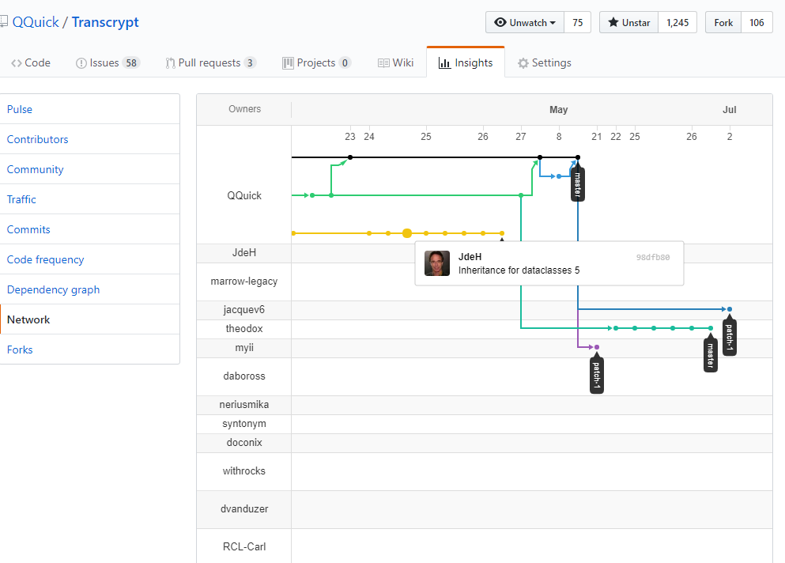

Slide 14
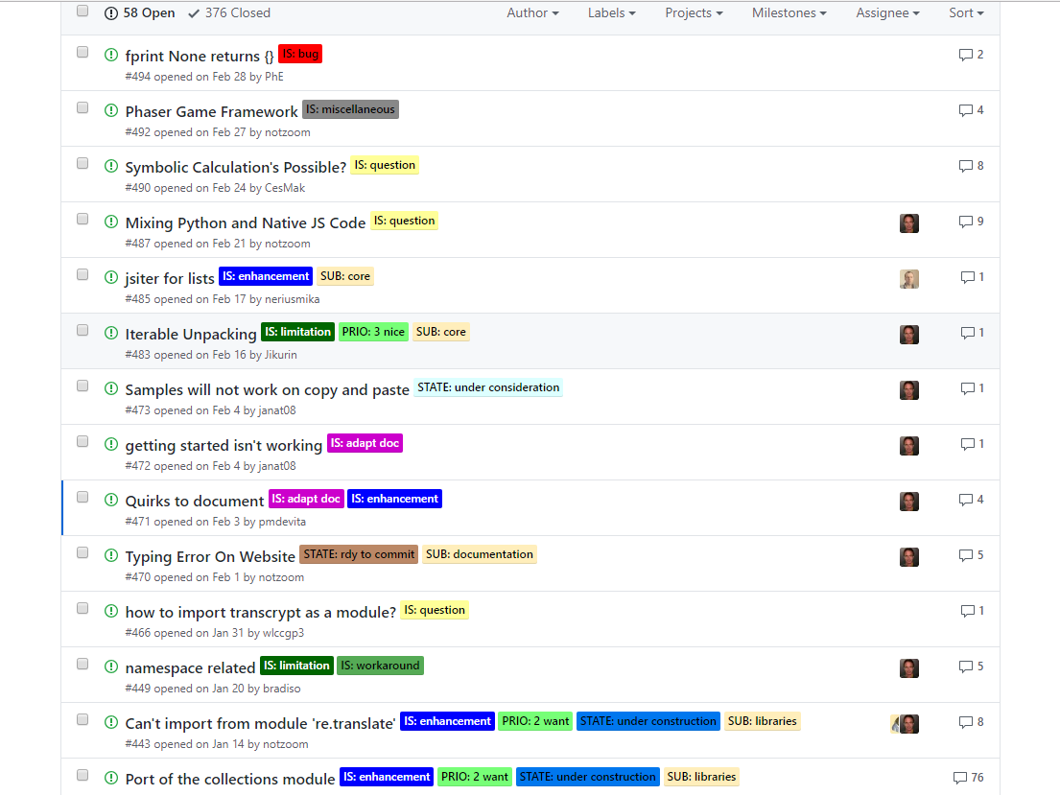

Slide 15
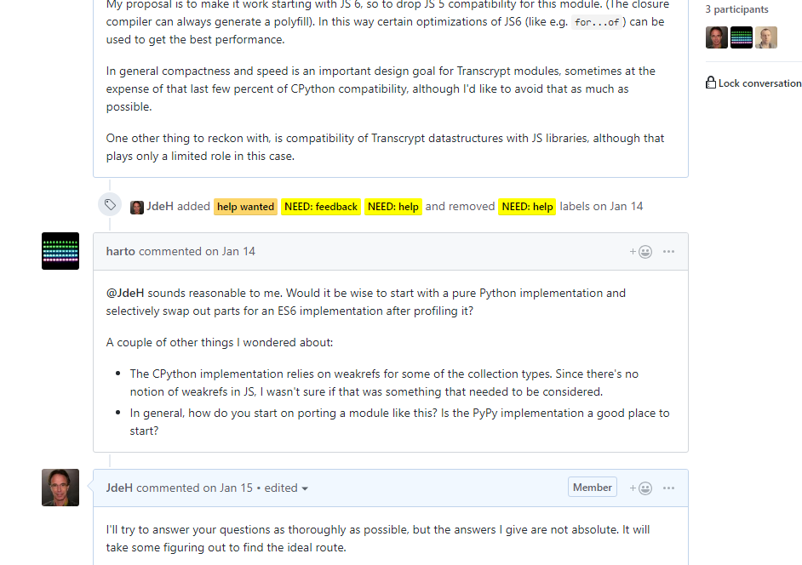

Slide 16
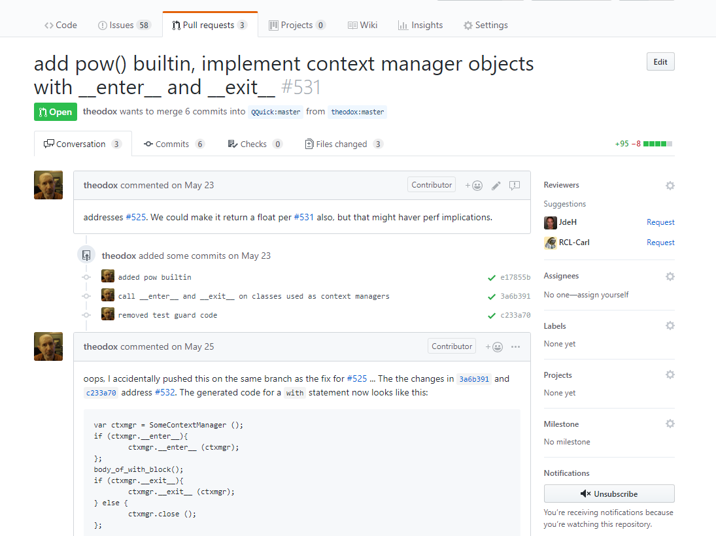

Slide 17
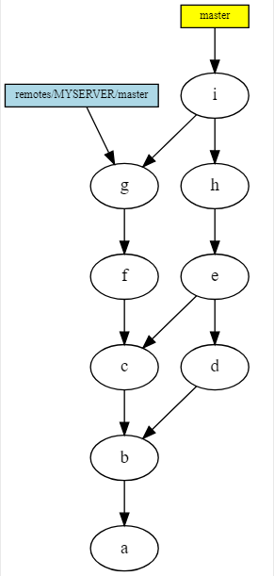

Slide 18
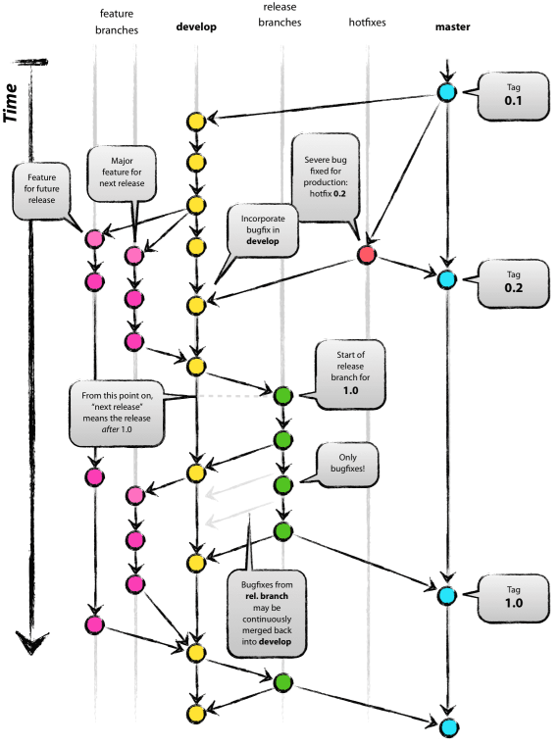

Slide 19
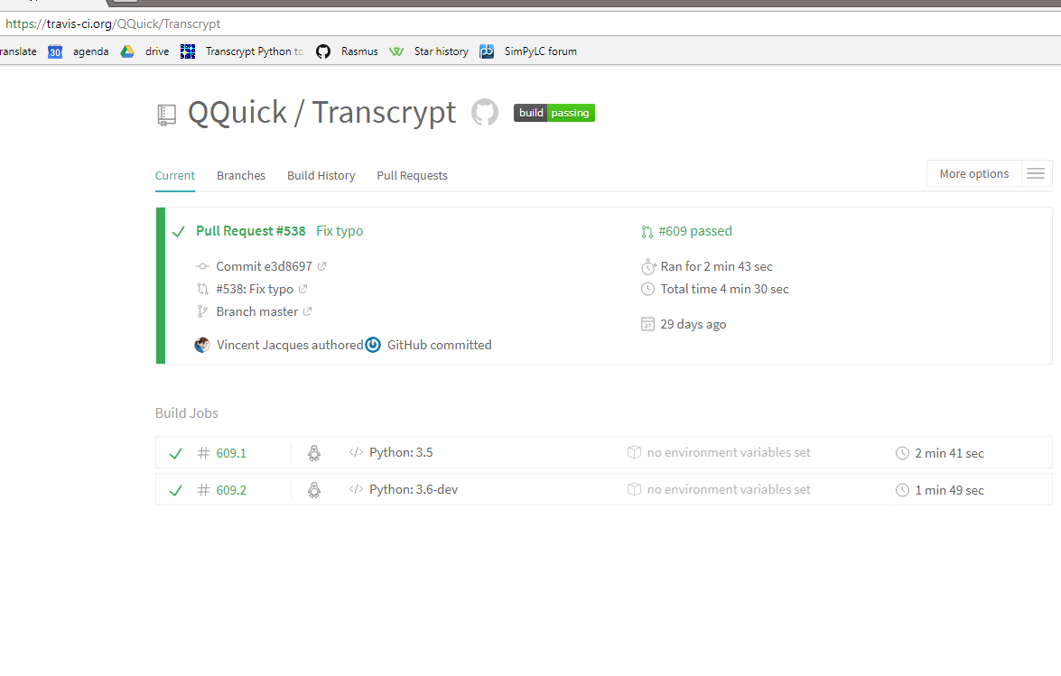

Slide 20


Slide 21
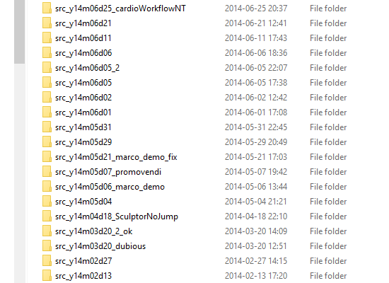

Slide 22


