Slide 1

GIT
Distributed Version Control System
Linus Torvalds (creator of Linux) has quipped about the name git, which is British English slang for a stupid or unpleasant person.
Torvalds said: "I'm an egotistical bastard, and I name all my projects after myself. First 'Linux', now 'git' ".
The man page describes git as "the stupid content tracker".

Slide 2
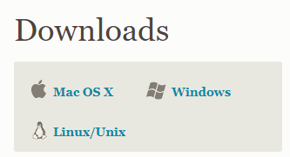
Download GIT from:
https://git-scm.com/download

Slide 3
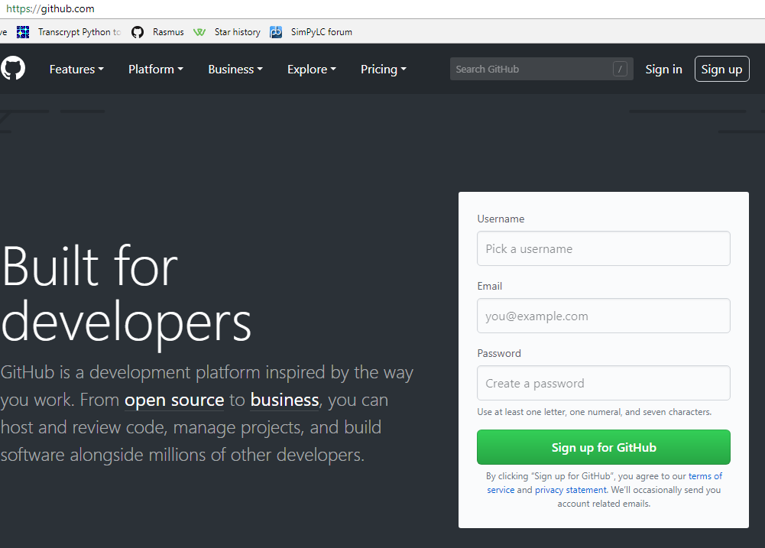

Slide 4
git config --global user.name "Jacques de Hooge"
git config --global user.email jdeh@transcrypt.org

Slide 5
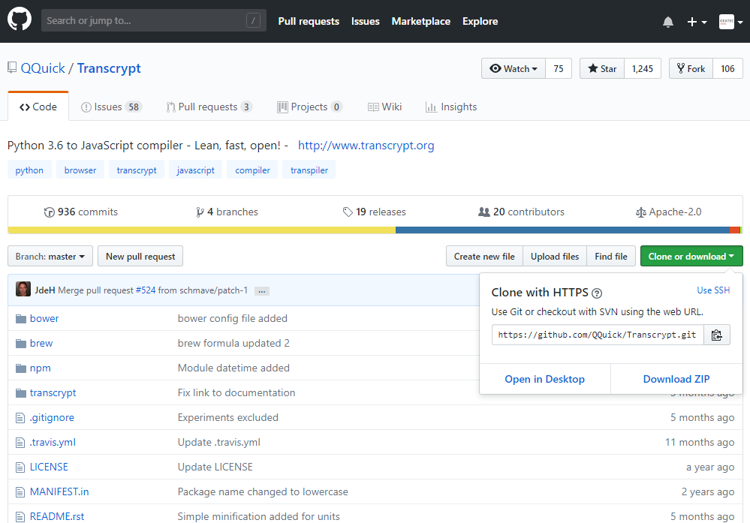

Slide 6
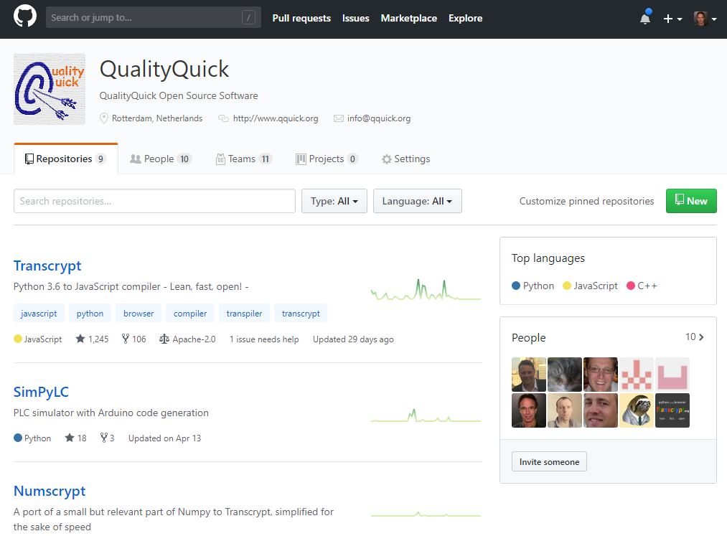

Slide 7
# Clone remote repository
git clone ://github.com/QQuick/Transcrypt.git

Slide 8
# add file to the staging area (git add . adds everything)
git add modules.py
# first commit
git commit –m“added module support"
# add file to the staging area
git add sourcemaps.py
# second commit
git commit –m“added sourcemaps“
# pushes all changes to remote repository
git push origin master

Slide 9
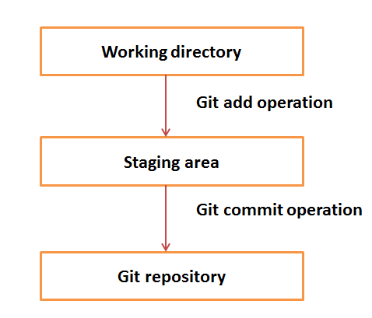

Slide 10
# Update remote from local
git push origin master
# Update local from remote
git pull origin master

Slide 11
contents of the .gitignore file:
*.nogit
*.pyc
*.npp
*.egg-info/
**.__pycache__/
dist/
transcrypt/docs/sphinx/_build/
transcrypt/development/attic/
transcrypt/development/docs/
transcrypt/development/experiments/
transcrypt/development/automated_tests/*/autotest.html
transcrypt/development/automated_tests/*/autotest.min.html
transcrypt/development/automated_tests/**/__javascript__/
transcrypt/modules/re/__javascript__/
transcrypt/modules/time/__javascript__/
...
...

Slide 12
# create new branch
git checkout -b develop
# switch to existing branch
git checkout develop
(Make local changes, add and commit)
# upload changes to remote develop branch
git push origin develop
# show all branches
git branch
* develop ← current branch
master

Slide 13
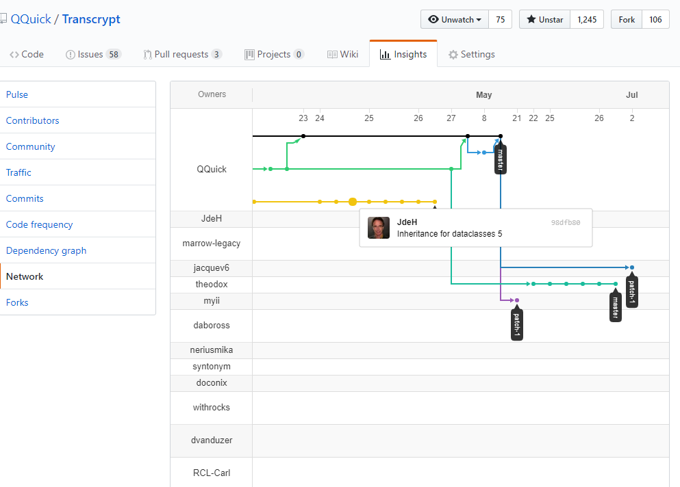

Slide 14
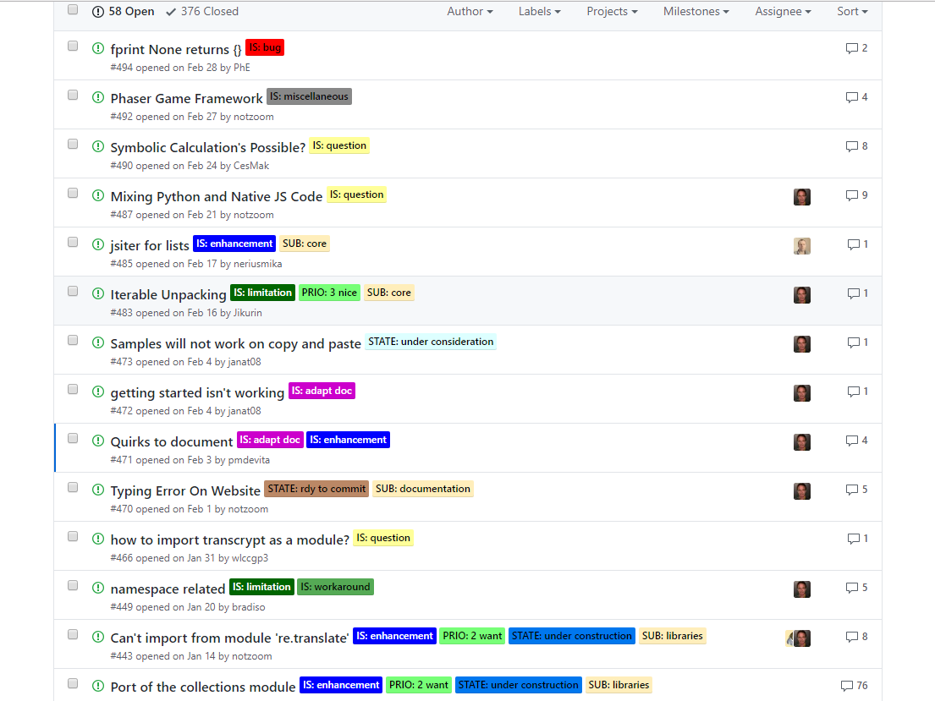

Slide 15
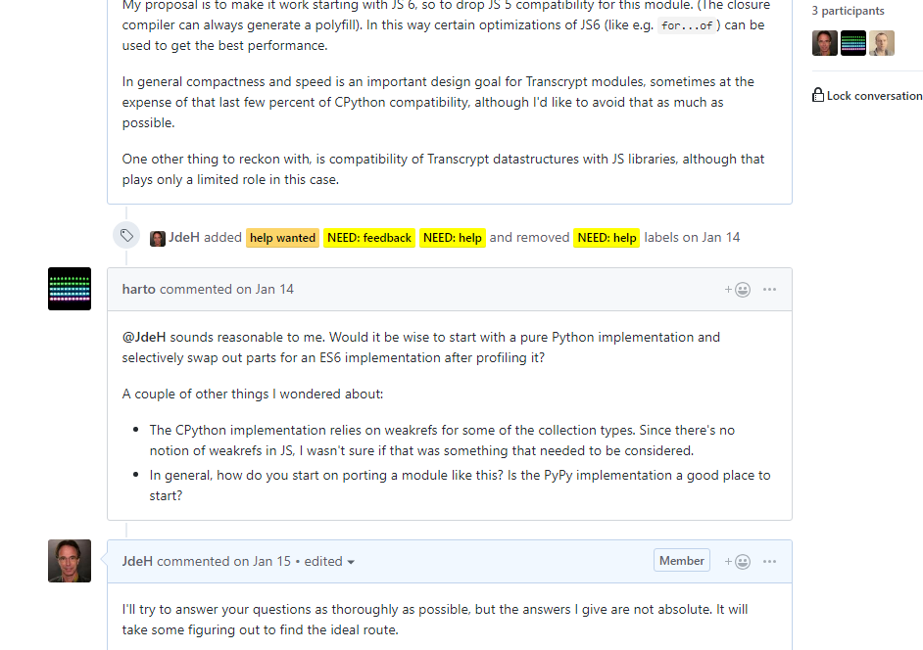

Slide 16
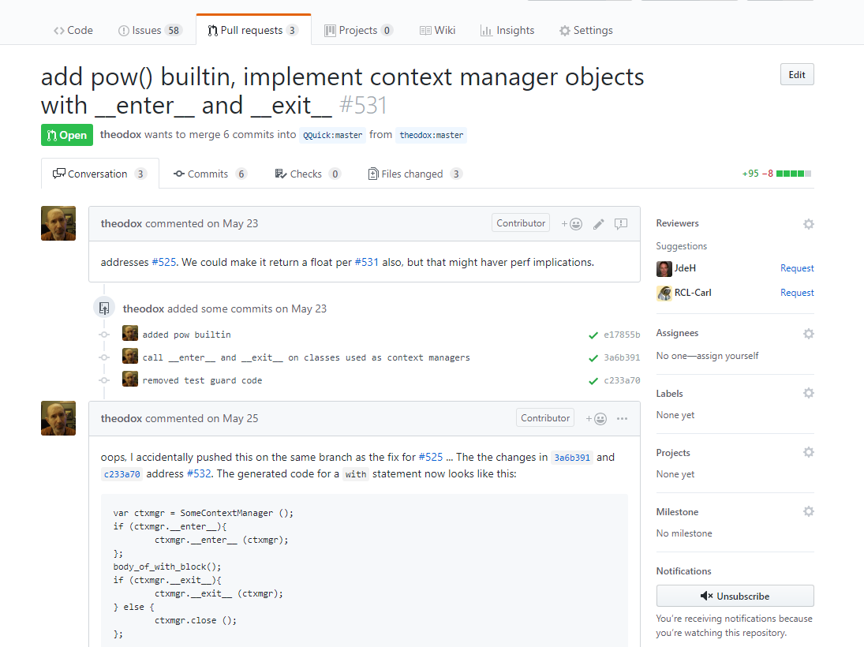

Slide 17
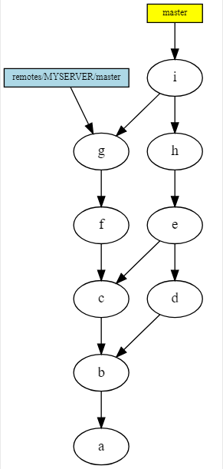

Slide 18
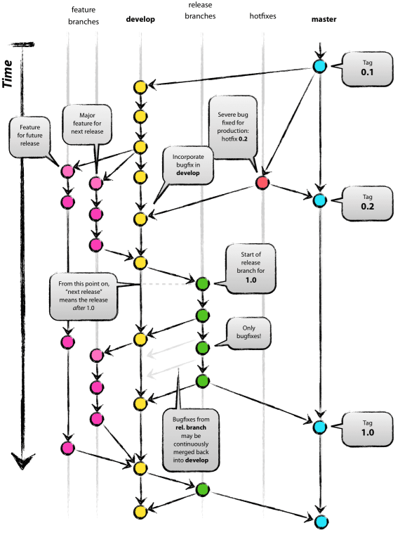

Slide 19
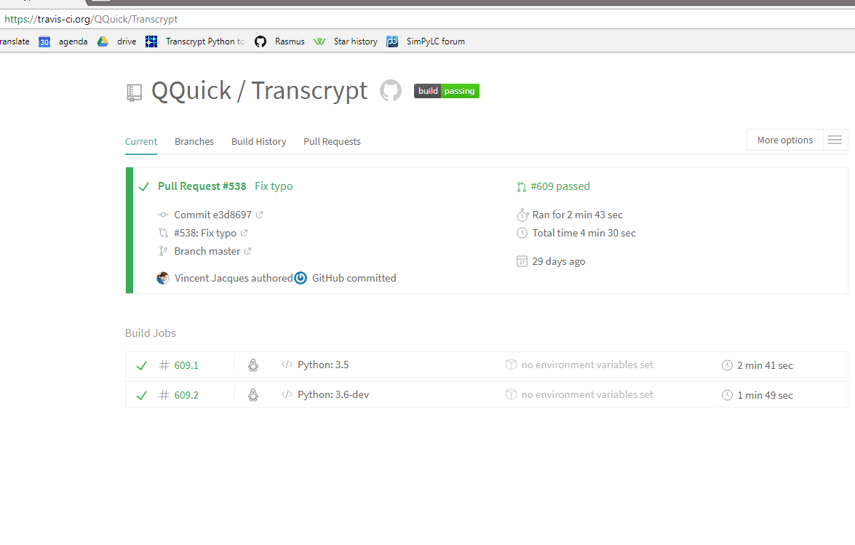

Slide 20

Second line of defense: offline storage

Slide 21
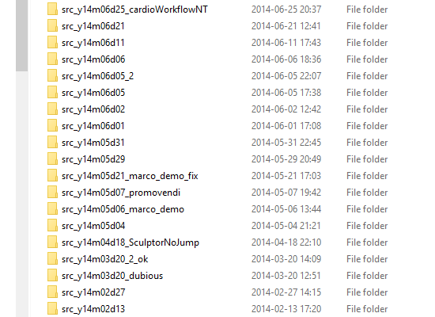
Keep it simple (and sortable)

Slide 22

Beat systematical errors by chaotic redundancy

Slide 23
GIT essentials
understanding git
understanding git 2
a successful git branching model
turn feature branch into master
merge specific files from other branch
remove files that are listed in .gitignore
git for computer scientists

Slide 24
On the HR, for optimal support use:
Git 2.18.0
VS Code 1.26.1
Arduino IDE 1.8.6
Classroom / persoonlijke website.
HR CMI GitLab server: https://gitlab.cmi.hro.nl

Slide 25
Lokaal project uploaden naar GitLab
First create a new project on GitLab and then:
git remote add origin
https://gitlab.cmi.hro.nl/hojac/git_workshop_test.git
git push -u origin –all
git push -u origin --tags

