Slide 1

QRCode based Library Auditing System
Github link: https://github.com/QR-Code-based-Library-Auditing-System/A6_BATCH_2020
Batch No: A-06 Project Guide:
K.Bhanu 164G1A0509 Mr. P. Veera Prakash, M.Tech.
G.R.Komala 164G1A0539 Assistant Professor`
T.Narasimhaiah 164G1A0559
K.Raghunath 174G5A0504
Srinivasa Ramanujan Institute of Technology
Department of Computer Science & Engineering

Slide 2
Abstract
Library Audit is an inspection of various books of accounts by an auditor followed by physical checking of inventory to make sure that all departments are following documented system of recording transactions.
Library Auditing is a useful information management tool to improve library services. In the present scenario it has become an enormous problem for any educational institution. It has been a major problem for the librarians for auditing books. Auditing is done by the employees by manually which requires much time to count books, large in number. By this they are getting health issues too.

Slide 3
Contd..
In this application, QRCodes are generated for each book containing the unique identity of book. QRCodes are generated by using Google QRCode Generator. Since there are more amount of books QRCode generation is automated by using UIPath, automation tool.
Application contains a QRCode Scanner which scans the QRCodes on the books and gives the report in the excel containing the missing books. This application is developed by using Android studio.

Slide 4
Requirements
Implementation Requirements
RAM Capacity :4GB
Android Phone(version above Ice cream Sandwich)
Development Requirements
Operating Systems-Windows 7/8/10(64-bit)
Platform-Android Studio 3.3, UIPath
Programming in- Java,Extensible Markup Language(XML)

Slide 5
Literature Survey
a.Existing System
In existing system Library audit is done manually by group of employees within an organization.
Used to search books one by one
It has been major problem for librarians to audit the books
Limitations
Existing system requires more man power for auditing
More time is necessary to complete the auditing
Results may not be accurate
Maintenance of Hardcopy is required

Slide 6
Contd.
b.Proposed system
Library audit is done by scanning the QRCodes on the books
QRCodes are generated automatically by using UiPath
Books database is stored in firebase database
Each book is scanned using QRCode scanner app and the data is matched with the database
The matched row in the database can be updated
The rows which are not updated while scanning are retrieved
Final report is generated in the excel sheet which contains the missing books

Slide 7
Planning
Task | Date
Requirements and Ananlysis | 07-01-2020
QRCode Generation | 24-01-2020
QRCode scanner and verfication | 28-02-2020
Report generation | 05-03-2020
Testing Phase | 20-03-2020
Document submission | 05-04-2020

Slide 8
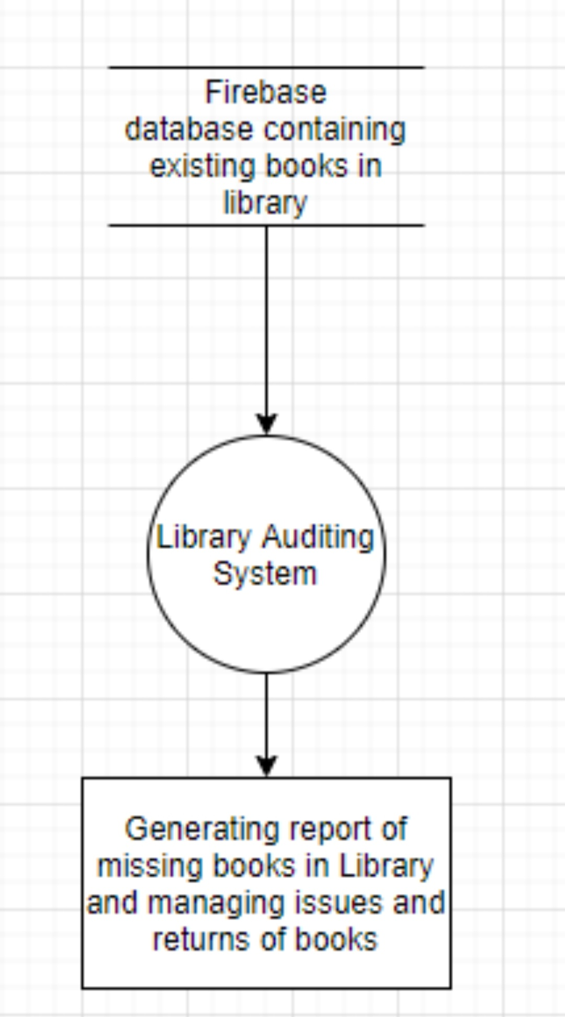
Design
DataFlow Diagram
Level-0

Slide 9
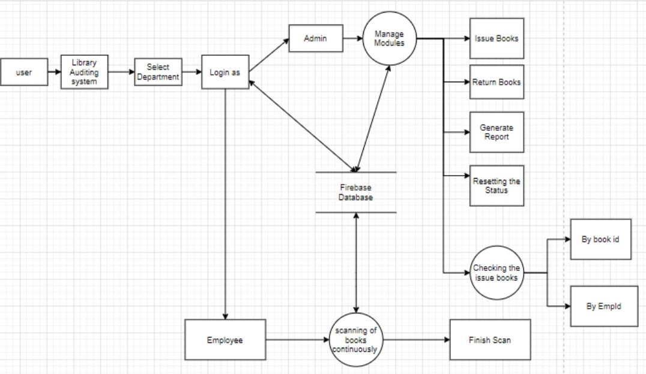
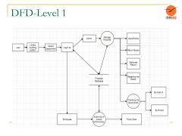
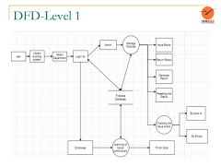
DFD-Level 1

Slide 10
Implementation
Continuous scanning
dbvScanner.decodeContinuous(new BarcodeCallback() { @Override public void barcodeResult(final BarcodeResult result) { updateText(result.getText()); mReference.addListenerForSingleValueEvent(new ValueEventListener() { @Override public void onDataChange(@NonNull DataSnapshot dataSnapshot) { long num = dataSnapshot.getChildrenCount(); for (int i = 0; i < num; i++) { String str = String.valueOf(i); String acno = dataSnapshot.child(str).child("AccNo").getValue().toString(); if ((result.getText()).equals(acno)) { if((dataSnapshot.child(str).child("Status").getValue().toString()).equals("1"))

Slide 11
Contd…
{ Toast.makeText(ContinuousScanActivity.this, "Already Scanned", Toast.LENGTH_SHORT).show(); break; } else { Toast.makeText(ContinuousScanActivity.this, "Scanned", Toast.LENGTH_SHORT).show(); mReference.child(str).child("Status").setValue("1"); beepSound(); break; } } } } @Override public void onCancelled(@NonNull DatabaseError databaseError) { Toast.makeText(ContinuousScanActivity.this, "null", Toast.LENGTH_SHORT).show(); } });

Slide 12
References
QRCode :ieeexplore.ieee.org/document/7966807
QRCode generation:https://www.the-qrcode-generator.com/
Difference between QRCode and Barcode:https://www.scienceabc.com/innovation/whats-qr-code-how-its-different-from-barcode.html

Slide 13
THANK YOU
Queries
?

