Slide 1
QRCS Corporation
Enabling the post-quantum internet through next-generation cryptography and secure communication systems.

Slide 2
Introduction
OUR COMPANY
OUR VISION
QRCS Corporation is a Canadian cybersecurity company specializing in post-quantum cryptography. We develop modular, deployment-ready protocols that secure communication, key exchange, and routing for governments, financial institutions, and critical infrastructure.
We envision a secure digital future built on quantum-resistant foundations. QRCS is committed to delivering scalable, verifiable technologies that protect privacy, strengthen trust, and enable secure global communications in the quantum computing era.

Slide 3
Strategic Vision
Quantum computing is poised to render classical encryption obsolete, placing national security, financial systems, and digital communications at unprecedented risk. As the threat horizon accelerates, QRCS is building the cryptographic foundation for a secure digital future—where quantum resistance is not an upgrade, but the baseline.
Our strategic vision is to enable seamless, global transition to post-quantum cryptography through modular, interoperable technologies. We have developed a complete ecosystem of protocols, including secure transport (QSTP), messaging (QSMP), remote access (PQS), key coordination (MPDC), anonymous routing (AERN), provisioning (SKDP), and local derivation (HKDS)—all powered by our internal cryptographic engine, QSC. These components are designed not only for security, but for performance, integration, and long-term resilience.
QRCS focuses on first-principles redesign of communication and trust mechanisms, not mere retrofits of existing systems. Our protocols are engineered to be deployable in defense infrastructure, sovereign networks, cloud environments, and high-assurance financial systems—anywhere security, privacy, and reliability cannot be compromised.
As global standards shift and regulatory mandates emerge, QRCS is positioned to lead with practical, quantum-safe solutions. We envision our technologies becoming essential infrastructure—empowering governments, enterprises, and individuals to operate with confidence in a post-quantum world.

Slide 4
Market Risk
Quantum Breakage of Legacy Encryption
Core algorithms like RSA and ECC will be rendered obsolete by quantum computers, threatening the foundation of global cybersecurity.
Silent Data Exposure
Data harvested today can be decrypted in the future—putting national secrets, financial records, and personal communications at long-term risk.
Protocol Obsolescence
Protocols such as TLS, SSH, and VPNs cannot withstand quantum threats and were not designed for post-quantum upgrade paths.
Regulatory & Compliance Pressure
NIST, NSA, and international bodies are mandating post-quantum migration—leaving organizations scrambling to adapt.
Lack of Deployable Solutions
Enterprises and governments face a shortage of practical, verifiable, and modular quantum-safe tools—leaving a global readiness gap.

Slide 5
Our Platform
QRCS delivers a modular cryptographic platform of independently deployable, interoperable technologies.
Component | Role | Built With
QSC | Cryptographic engine | Kyber, Dilithium, SPHINCS+, McEliece
MPDC | Multi-party key orchestration | Asymmetric/symmetric hybrid + network coordination
PQS | Secure remote shell | Post-quantum key exchange, certificate-free trust
QSTP | Quantum-safe transport | TLS replacement using KEM-based session tickets
SKDP | Distributed key provisioning | Stateless, trustless fragment exchange
HKDS | Localized key derivation | Efficient sealing with zero external dependence
QSMP | Encrypted messaging | Lightweight, asynchronous, integrity-verified
AERN | Anonymous routing | Fully quantum-secure onion-routing architecture

Slide 6
Spin-Off Applications
Our platform enables a deep pipeline of commercialization paths:
Post-quantum VPNs, firewalls, and secure cloud APIs
Quantum-resilient zero-trust architectures
Secure mesh networks for disaster zones and IoT
Anonymous publishing, uncensorable networks (AERN)
Digital sovereignty tools for nation-states
Post-quantum secure bootloaders, firmware updates
Next-gen military-grade key management systems
Embedded crypto cores for quantum-safe chips

Slide 7
Competitive Edge
Formal Models
Post-Quantum Native Design
Modular & Interoperable
Protocols include professional documentation and security proofs for certification, audit, and institutional deployment.
All protocols use quantum-safe primitives—secure by design, not retrofitted from classical models.
Each protocol operates standalone or combined, enabling flexible integration across legacy and modern systems.
Full IP Ownership
Deployment-Ready Codebase
Zero-Trust & Sovereign Security
All cryptographic designs are internally developed, giving QRCS complete control over licensing and integration.
Efficient C implementations are optimized for embedded devices, cloud infrastructure, and high-assurance environments.
Supports national security, zero-trust architectures, and digital sovereignty for critical infrastructure and defense systems.

Slide 8
Technical Highlights
QSC: Internal cryptographic library implementing Kyber, Dilithium, SPHINCS+, and McEliece with hardened primitives and modularity.
QSMP: Lightweight, post-quantum secure messaging protocol with asynchronous delivery, message authentication, and integrity verification.
MPDC-I: Multi-party coordination protocol using agent-assisted entropy and root-trusted topological key exchange.
PQS: Stateless, certificate-minimal shell protocol with anti-replay protection and fixed-length authenticated packet format.
SKDP: Fragment-based, trustless key provisioning system resistant to tampering and single-point failure.
HKDS: Local key derivation protocol with hierarchical sealing and zero reliance on external storage.
AERN: Topology-aware, anonymous encrypted routing protocol—designed as a quantum-secure successor to TOR.
QSTP: TLS-like transport protocol using post-quantum KEMs and AEAD, with downgrade and timing attack resistance.

Slide 9
Strategic Advantages
Post-quantum compliance is mandatory—QRCS makes it deployable.
Advantage | QRCS Offers
Market Need | $25B+ market by 2030 (Gartner, BIS)
Timing | 2024–2027: Transition window before NIST/PQC adoption
IP Control | Protocols, libraries, and security models are internally designed
Format | ISO-spec-ready protocols, C-level implementations
Integration | Drop-in for government, defense, cloud, fintech, satellite, IoT

Slide 10
Current Status
PROTOCOL STACK
FORMAL SPECIFICATIONS
Core technologies fully implemented and internally validated, including QSC, PQS, MPDC, SKDP, HKDS, QSTP, and QSMP.
ISO-style documentation and formal security analyses complete for all major protocols.
BENCHMARKED CODE
PILOT READY
C implementations performance-tested across x86 and ARM platforms, with support for AVX, AVX2, and AVX-512 acceleration.
Stack is suitable for controlled deployments in defense, finance, and infrastructure sectors. SDK packaging, onboarding scripts, and integration tools in progress for partner-facing deployments.

Slide 11
CALL TO ACTION
QRCS is advancing the frontier of secure communications in a world entering the quantum era.
We invite investors, strategic partners, and innovation leaders to join us in deploying critical cryptographic infrastructure for the next generation of digital systems.
Whether you represent defense, finance, cloud services, or national infrastructure—we are ready to engage, integrate, and deliver.
Do you have any questions?
contact@qrcscorp.ca
(613) 316-7183
www.qrcscorp.ca

Slide 12
MAIN IDEAS OF A PITCH DECK
PRESENTATION
INVESTORS
VALUE
A great presentation for a pitch deck should be concise, clear and easy to understand. Visual elements such as charts, graphs, images, and videos can help to make the presentation engaging
When it comes to picking investors for a pitch deck, it's important to research potential investors and understand their preferences, goals and interests
The value of a product is determined by how much customers are willing to pay for it. It's a combination of factors, including the quality of the product, its features, and how well it meets customer needs

Slide 13
MARKET SIZE OVERVIEW
OUTER CIRCLE
$100M
Include the total size of the market, which represents the entire potential customer base for the product or service
$20M
MIDDLE CIRCLE
Identify the target market for the product or service, which may be a subset of the total market. This could be based on factors such as demographics, geography, or specific needs
$5M
INNER CIRCLE
Indicate the current market size, which represents the portion of the target market that the company has successfully captured

Slide 14
ROADMAP INFOGRAPHIC
INITIATIVE | OBJECTIVE | JAN | FEB | MAR | APR | MAY | JUN | JUL | AUG | SEP | OCT | NOV | DEC
Understanding | Analyze and understand the needs of your target audience
Conduct research | Research existing products in the industry and analyze them
Brainstorm ideas | Generate ideas based on user feedback and research findings
Develop a prototype | Create a basic version of the product to show investors
Test for usability | Put the prototype through rigorous testing processes
Analyze feedback | Analyze feedback

Slide 15
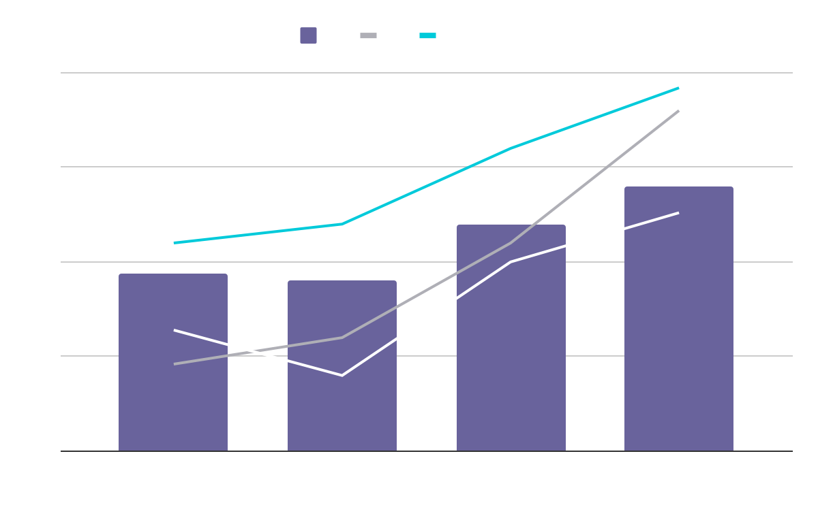
KPI DASHBOARD
PRODUCT | UNITS | REVENUE | RETURNS
Item 1 | 500 | 2,000,000 | 40
Item 2 | 1,000 | 50,750 | 10
Item 3 | 250 | 1,500,000 | 300
Item 4 | 500 | 2,000,000 | 40
Item 5 | 1,000 | 50,750 | 10
Item 6 | 250 | 1,500,000 | 300
Item 7 | 500 | 2,000,000 | 40
Item 8 | 1,000 | 50,750 | 10
$4,000,000
$100,000
$5,000
Revenue
General costs
Benefit
Follow the link in the graph to modify its data and then paste the new one here. For more info, click here

Slide 16
ICON PACK

Slide 17
ALTERNATIVE RESOURCES
Here’s an assortment of alternative resources whose style fits the one of this template:
White technology design for wallpaper
Gradient cyber futuristic background

Slide 18
RESOURCES
Did you like the resources on this template? Get them for free at our other websites:
VECTORS
Artificial intelligence concept twitter header
Artificial intelligence concept youtube thumbnail
PHOTOS
Woman wearing virtual reality simulator
Medium shot woman holding smartphone
ICONS
Icon Pack: Innovation | Lineal

Slide 21
JANUARY
FEBRUARY
MARCH
APRIL
MAY
JUNE
PHASE 1
Task 1
Task 2
PHASE 2
Task 1
Task 2
JANUARY
FEBRUARY
MARCH
APRIL
PHASE 1
Task 1
Task 2

Slide 24
...and our sets of editable icons
You can resize these icons without losing quality.
You can change the stroke and fill color; just select the icon and click on the paint bucket/pen.
In Google Slides, you can also use Flaticon’s extension, allowing you to customize and add even more icons.

Slide 25
Educational Icons
Medical Icons

Slide 26
Business Icons
Teamwork Icons

Slide 27
Help & Support Icons
Avatar Icons

Slide 28
Creative Process Icons
Performing Arts Icons

Slide 29
Nature Icons

Slide 30
SEO & Marketing Icons

