Slide 1
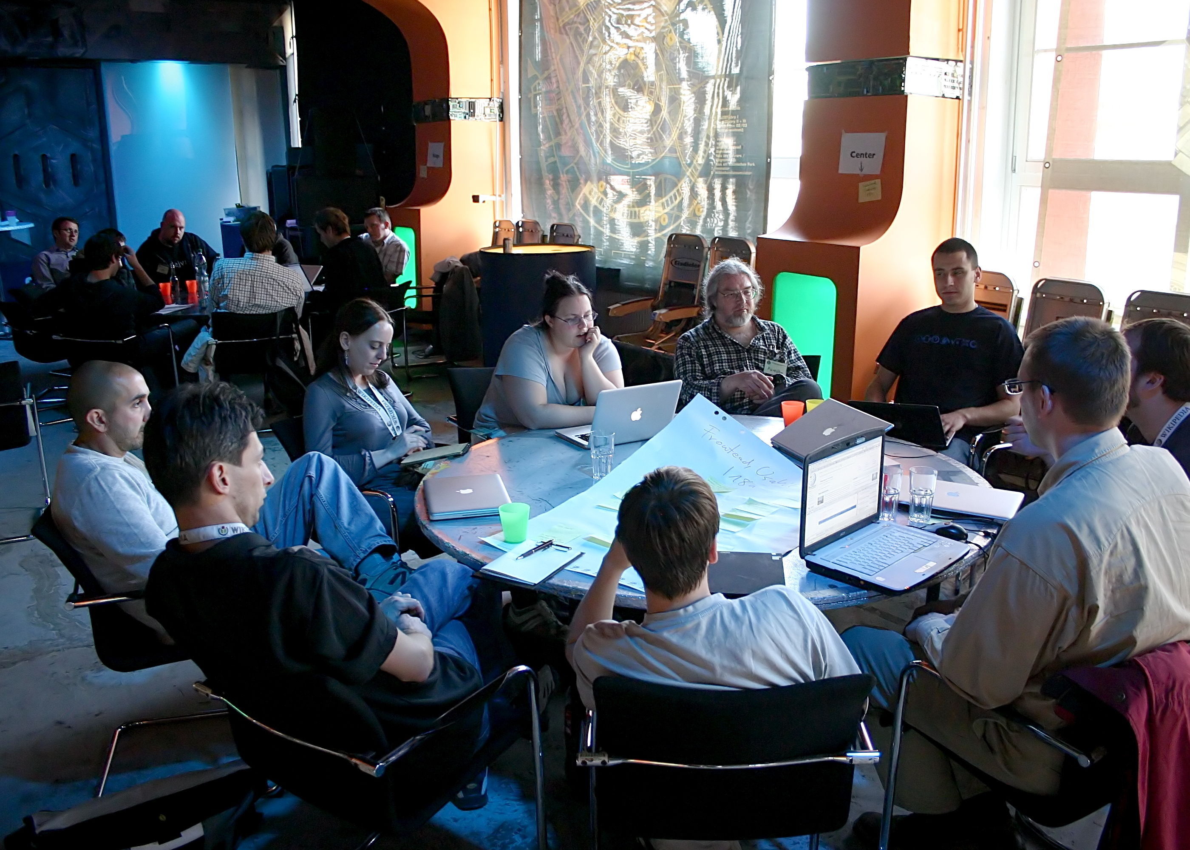
CASCADE
From 0 → Profit
AI automation micro-consulting playbook (acquire → audit → implement → retain)
EPSILON · AI + Security
Notes:
[Sources] - Meeting photo: https://upload.wikimedia.org/wikipedia/commons/f/fb/Wikimedia_Conference_Berlin_-_Developer_meeting_%287700%29.jpg (via image search: turn4image5) [/Sources]

Slide 2
0 → Profit Flywheel
The profit engine is a loop
Acquire → Audit → Deliver → Prove → Retain
1) Lead gen
2) Audit call
3) Proposal
6) Retainer
5) Case study
4) Implement
Goal: consistent, repeatable wins (not random heroics).
CASCADE · EPSILON
Notes:
[Sources] - Concept synthesized from audit → demo → ROI → proposal workflow described in 01-audit-methodology.md (e.g., discovery + demo + ROI), 04-proposal-template.md (pricing/next steps). [/Sources]

Slide 3
Positioning
Stop losing leads to slow response times
Simple promise + clear outcome sells.
10+ hrs
3–5
< 60s
Hours reclaimed per week (target)
Automation opportunities per audit
Response time goal
What you offer (in human language)
• Instant lead follow-up + qualification (website/social/missed calls)
• Appointment scheduling + reminders (fewer no-shows)
• FAQ automation (24/7 answers, fewer interruptions)
• Optional optimization + reporting (monthly)
Message: outcomes, not tools
Notes:
[Sources] - Landing page promise + outcomes: 03-landing-page-copy.md (hero + problem/solution sections). - Audit objective: 01-audit-methodology.md L6-L8 (3–5 opportunities; 5–15 hrs/wk). [/Sources]

Slide 4
Offer Ladder
Offer ladder (free → paid → recurring)
Make the next step obvious.
Free AI Workflow Audit
Guided Setup
Done-For-You + Retainer
$0
$500–$800
$1,200 + $300–$500/mo
90 minutes
1–2 weeks
2–3 weeks
Discovery + mapping
Live demo
ROI snapshot
Phase 1 automations
Team training
2-week support
Phase 1 + Phase 2
Monitoring + optimization
Monthly reporting
Pricing is a ladder, not a menu
Notes:
[Sources] - Pricing options & descriptions: 03-landing-page-copy.md (pricing section), 04-proposal-template.md (options + investment comparison). [/Sources]

Slide 5

Day 0: Build the demo system
Set up demos in ~3–4 hours
You close faster when you can show it live.
3–4 hrs
$0
3
Total setup time
Budget
Demos
Demo stack (free tiers)
Typebot
Cal.com
Make.com
Sheets
Twilio
Lead qualifier
FAQ bot
3 working demos:
• Lead capture (chatbot → sheet → email)
• 24hr reminders (SMS)
• FAQ auto-responder
Day 0: demo stack
Notes:
[Sources] - Demo setup goals + tool stack: 10-quick-start-checklist.md L6-L19, 06-demo-setup-guide.md L6-L56. - Chatbot icon (Public Domain): https://freesvg.org/1538298822 (downloaded PNG). [/Sources]

Slide 6
Lead Gen
Fill the pipeline (fast, ethical, repeatable)
Your goal is booked audits, not “likes.”
Outbound channels
Weekly activity targets
• Cold email (high personalization)
• Warm intros (existing network)
• LinkedIn DM (value-first)
• Local groups (FB / community posts)
Send 50–100 tailored messages → book 3–5 audits
Keep it simple:
1) Specific observation
2) Clear benefit (hours + leads)
3) Single CTA: “20-min call?”
Subject lines that get opened
“Quick question about [Business Name]’s follow-up”
“Noticed something on your website…”
“Are you losing leads to slow response times?”
Follow-up cadence: Day 0 → Day 3 → Day 7 → 30–60d re-engage
Pipeline is a numbers game, but personalization is the cheat code
Notes:
[Sources] - Outreach channels, subject lines, and cadence: 02-outreach-email-templates.md (templates + cadence), esp. subject lines and follow-up suggestions. - Activity target (50–100 emails): 02-outreach-email-templates.md (conversion benchmarks section). [/Sources]

Slide 7
Audit Call
Run a 90–120 minute audit that sells itself
Discovery → Opportunities → Demo → ROI
1
Part 1: Discovery (30m)
Lead flow, comms, scheduling, ops. Get numbers.
2
Part 2: Opportunity map (30m)
Pick top 3–5 wins. Document time + revenue impact.
3
Part 3: Demo (20m)
Show 1–2 automations live (“set it & forget it”).
4
Part 4: ROI + recommendation (10m)
Calculate time saved, tool cost, payback period.
Pro tip: quantify everything (hours/week, no-shows/week, leads/day).
Audit = discovery + proof + ROI
Notes:
[Sources] - Audit structure: 01-audit-methodology.md L31-L36 and sections PART 1–4. - Demo guidance: 01-audit-methodology.md L1-L32 in "Live Demonstration" portion. [/Sources]

Slide 8
Solution Mapping
Typical automation menu (prioritized)
Start with quick wins, then deepen.
Phase 1: Quick wins (Week 1–2)
Phase 2: High impact (Week 3–4)
• Lead qualification chatbot
• Appointment reminders (7d / 24h / 2h)
• FAQ auto-responder
• 7-day nurture sequence
• CRM data sync + lead scoring
• Review request automation
• Reporting dashboard
Success metrics
• Response time < 5 minutes
• No-shows down 40–60%
• 5–15 hrs/week reclaimed
When to pitch Phase 2
After Phase 1 is stable + you can measure impact.
Start small. Prove value. Then scale.
Notes:
[Sources] - Phase 1/2 examples: 01-audit-methodology.md (Example Recommendation: Phase 1–3), 04-proposal-template.md (Implementation roadmap; additional opportunities). [/Sources]

Slide 9
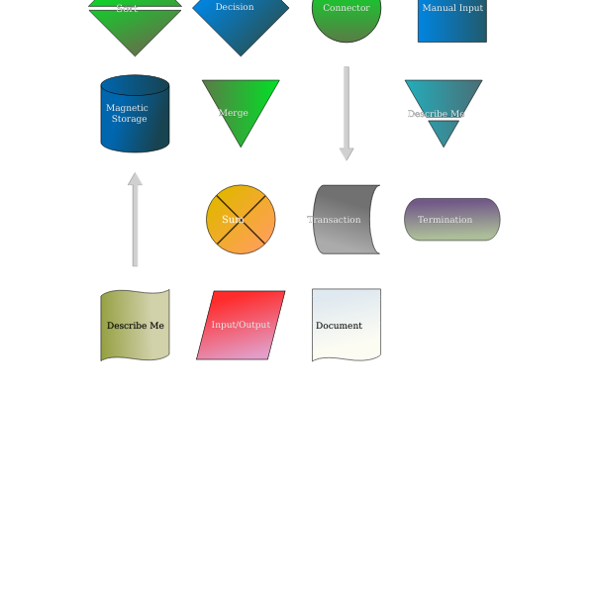
Implementation Blueprints
Core automations (copy/paste patterns)
Make.com scenarios you can reuse across industries.
1) Lead capture
Typebot webhook
Google Sheets (add row)
Gmail (send email)
2) 24hr reminder
Schedule
Sheets (search rows)
Twilio (send SMS)
Sheets (update row)
3) Thank you + review
Reusable patterns
> custom code
Schedule
Sheets (search)
Gmail (thank you)
Sheets (update row)
Steal these patterns shamelessly (then customize)
Notes:
[Sources] - Make.com scenario patterns + modules: 08-make-automation-blueprints.md (Scenario #1–3). - Flowchart symbols image (Public Domain): https://freesvg.org/flowchart-symbols (downloaded PNG). [/Sources]

Slide 10
Client Comms
Automated touchpoints that feel human
Confirm → remind → show up → follow up
Use templates, then personalize with {{name}}, {{intent}}, {{booking_time}}.
Instant
confirmation
7-day
reminder
24-hour
reminder
2-hour
reminder
Post-call
thank you
Email + SMS
Email
Email + SMS
SMS
Email + review
Compliance notes: get consent for marketing SMS; transactional reminders usually OK. Include STOP/opt-out.
Fewer no-shows = instant ROI
Notes:
[Sources] - Email/SMS templates and touchpoints: 09-email-sms-templates.md (Email #1–#5; SMS #1–#5) including decision matrix and compliance notes. [/Sources]

Slide 11
ROI
The numbers that close deals
Time saved + revenue impact − tool costs.
Example time-savings math
Costs & payback
Current time spent/week:
• Lead follow-up: 5h
• Scheduling: 3h
• FAQs: 4h
Total: 12h/week
Automation reduces 70–80% → reclaim 8–10h/week
Monthly value (example): 32–40h × $50/hr = $1,600–$2,000
Typical tool costs/month:
• Make.com/Zapier: ~$29
• OpenAI API: ~$15–$30
• Chatbot: ~$20–$40
• Integrations: $0–$50
Total: ~$64–$149
Example net benefit: $1,600 − $149 = $1,451/mo
Payback: < 1 month
ROI is the language of “yes.”
Notes:
[Sources] - ROI examples: 01-audit-methodology.md (Time Savings Calculation + Cost-Benefit Analysis + Payback Period). [/Sources]

Slide 12
Close
Turn the audit into a signed proposal
Executive summary → opportunities → roadmap → options
Proposal structure (what buyers actually read)
1) Executive summary
2) Detailed findings
3) Roadmap + options
Current pain + cost
Top 3 opportunities
ROI + payback
Current process map
Proposed solution stack
Success metrics
Phase 1 (quick wins)
Phase 2 (scale)
DIY vs guided vs DFY
Close line: “Which option fits best—DIY, Guided Setup, or Done-For-You?”
Make the decision easy
Notes:
[Sources] - Proposal components and option framing: 04-proposal-template.md (Executive Summary; Pricing & Next Steps; Investment Comparison). [/Sources]

Slide 13
Proof
Case studies turn “maybe” into “yes”
Build an asset factory: before/after → testimonial → distribution
Case study template (30-day story arc)
Distribution loop
• Challenge (quantify the pain)
• Solution (what you built + tools)
• Results (metrics + ROI)
• Testimonial (quote/video)
• Visual proof (screenshots, before/after table)
Publish → use in outreach → re-engage 30–60 days later
Where it goes:
• Landing page social proof
• Proposal attachments
• LinkedIn posts / carousels
• Re-engagement email (30–60d)
Rule of thumb: document EVERYTHING during delivery so proof is effortless later.
Proof compounds
Notes:
[Sources] - Case study structure + distribution checklist: 05-case-study-framework.md (template + collection checklist + distribution). - Re-engagement email concept: 02-outreach-email-templates.md (re-engagement template). [/Sources]

Slide 14
Next actions (7-day sprint)
1
Day 1–2: Build the 3-demo stack (chatbot, reminders, FAQ)
2
Day 3: Practice the demo + customize for 2–3 industries
3
Day 4: Launch landing page + outreach (50–100 messages)
4
Day 5–7: Run 3–5 audits → send proposals within 24h
Close metric: 30–50% of audits → implementations. Keep the loop spinning.
Notes:
[Sources] - 7-day plan: 10-quick-start-checklist.md (What's Next section) + 02-outreach-email-templates.md (cadence + close rate benchmark). [/Sources]

