Slide 1
Highlight Format Template – Slide 1
Image(s)
Scientific Achievement
Text that presents what was learned, not what was done
Significance and Impact
Identify why the achievement is important
Research Details
List of what was done
Short figure caption
Reference(s). Include DOI.
Acknowledge user facilities if appropriate
Institution logos can go along the bottom
Notes:
Template Instructions: 1-2 paragraph description of highlight – NOT the abstract of the paper… talking points for a speaker using the slide that summarizes the most important aspects.
Acknowledgements – From the paper, with additional info if the acknowledgement is not sufficient.
Publication/ press releases/ related links
NOTE: A limited amount of text with engaging pictures and graphics work best.

Slide 2
Highlight Format Template – Slide 2
NQISRC In tellectual Role: [Lead/Collaborator/Minor]
NQISRC Funding Role: [Sole/Majority/Minority]
Explanation of Funding Institution Contributions
Funder1: <..>
Funder 2: <…>

Slide 3
How to Build a DOE Office of Science Highlight Slide
Purpose
Convey current scientific and technical research results that are intriguing, succinct, relevant, and easily understood by both technical and non-technical communities.
Use
Information can be employed and adapted for multiple uses, including meetings with other federal agencies, review committees, scientific panels, and budget meetings.
Highlight text can also be a critical component of annual budget request documents that are reviewed by DOE senior leadership and Congress.
Needs
It is exceptionally important to convey the importance or significance the research has on the particular research field.
A standard format for scientific highlights helps the Office of Science to efficiently and effectively communicate research results to the public.

Slide 4
How to Build a DOE Office of Science Highlight Slide
Submission
Highlights should be submitted regularly to your Point of Contact (POC). In general, highlights should focus on a published, or soon to be published, paper.
Information on publication timing, should be shared (in writing).
Highlights involving sensitive information that would compromise patents, for example, should be shared via secure means, not as a highlight slide.
Send your POC a copy the published paper (if available) or preprint if not yet published with the highlight.
If your institution has a press release (or planned press release), please forward to your POC.
All graphics should be clear and large enough to be easily viewed. Keep resolution of the embedded graphic in mind.
Well crafted highlight slides may be presented by many different people with many different science backgrounds!

Slide 5
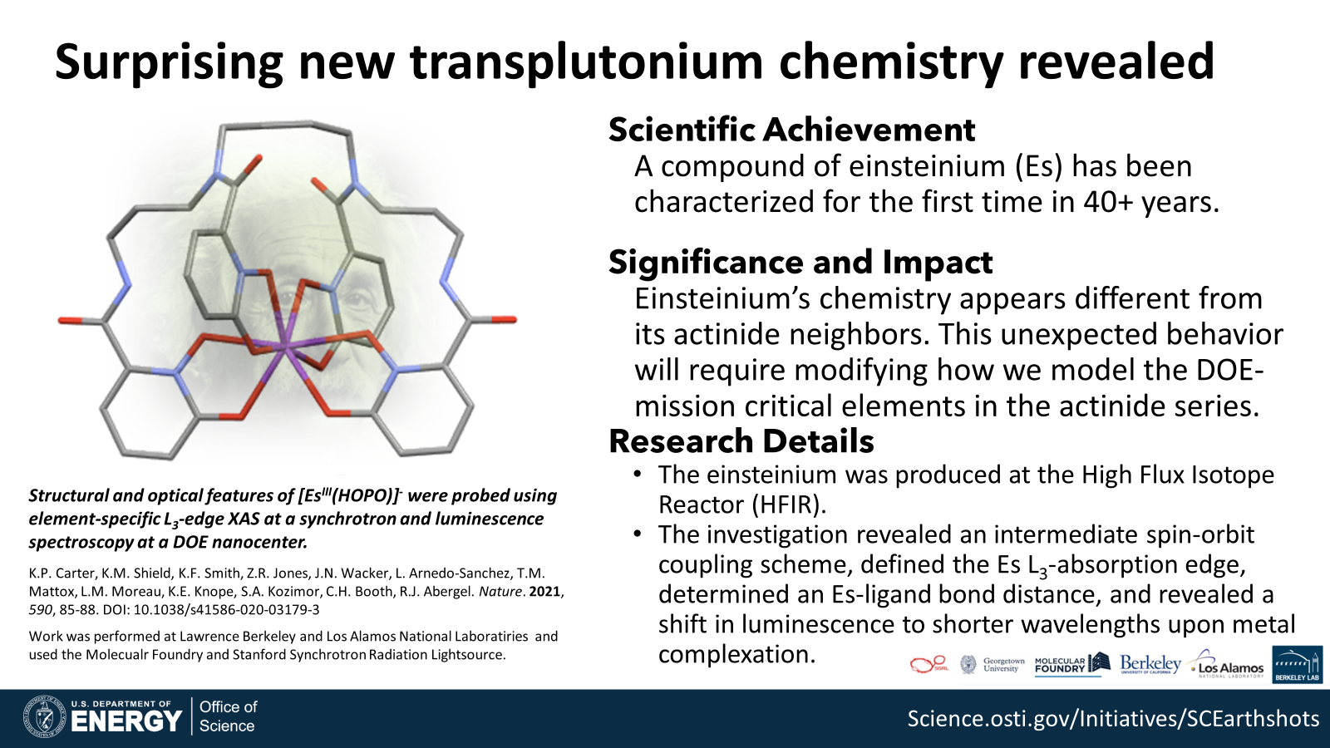
How to Build a DOE Office of Science Highlight Slide
Title
Attention grabbing and accessible but not exaggerated
Text
All text should be short and to the point – minimize words and stress significance to society
Scientific Achievement – 50 words or less
Significance and Impact – 50 words or less
Importance, relevance, or intriguing component of the finding to the field
Research Details – Address the research approach in 2-4 bullet points
Citation - Full citation with DOI is preferable
Define all acronyms and initialisms

Slide 6
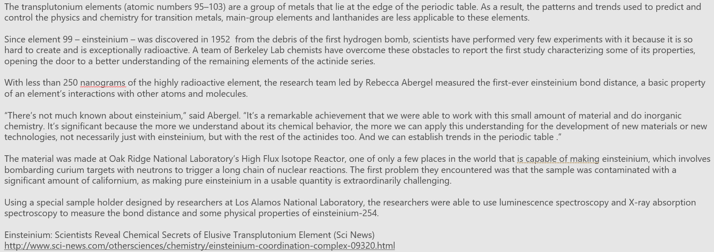
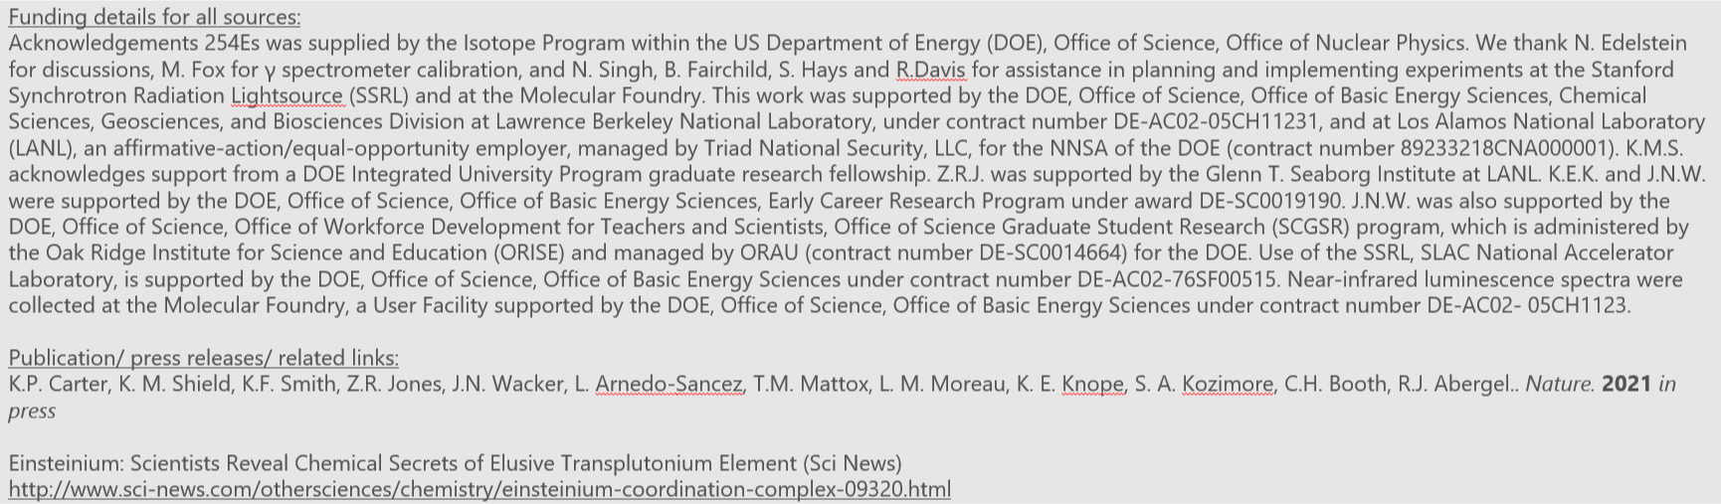
How to Build a DOE Office of Science Highlight Slide
PowerPoint Notes
Give a 1-2 paragraph detailed explanation with acknowledgements.
Sponsor delineation of work should be made clear here and reflect acknowledgements/credit lines in addition to info on Slide 2.
(Optional) Include any press releases / feature articles from the institution or Office of Science feature articles.
Do not provide multiple links to the same article cross-posted in different places.

Slide 7
How to Build a DOE Office of Science Highlight Slide
Figures
Visually compelling figure(s) to explain the research
Include legends and descriptive caption
DOE has the right to use published journal images per contractual funding agreements
Institutional logo(s)
Include affiliations or institutional logos
Indicate institution where research was performed (if possible)
EERC logos can be included as well

Slide 8
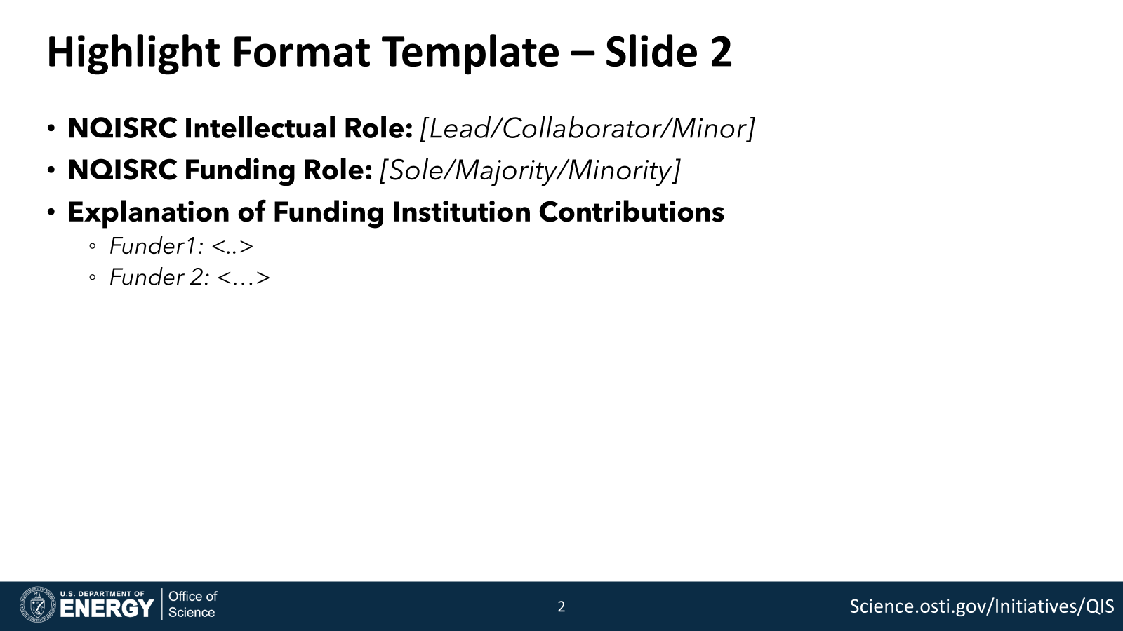
How to Build a DOE Office of Science Highlight Slide
Intellectual/Funding Role
Intellectual role: Select "lead" for publications in which the NQISRC was the lead institution contributing to the published result; select "collaborator" if the NQISRC was one of a group of collaborators with roughly equal contributions; select "minor" if the NQISRC contributed to work led by a person or project outside the NQISRC.
Funding: Select "sole" if NQISRC was the sole source of funding for this work. Select "majority" if other sources contributed, but NQISRCs made up most of the funding. Select "minority" if NQISRC funding was a minority of the overall funding.
Explanation of Funding Institution Contributions
Delineates the contribution made by each funding source
Makes clear why it is appropriate for multiple funded projects to contribute
Ex: Student/postdoc funding from other sources, use of facilities/foundries, complementary scope of projects

Slide 9
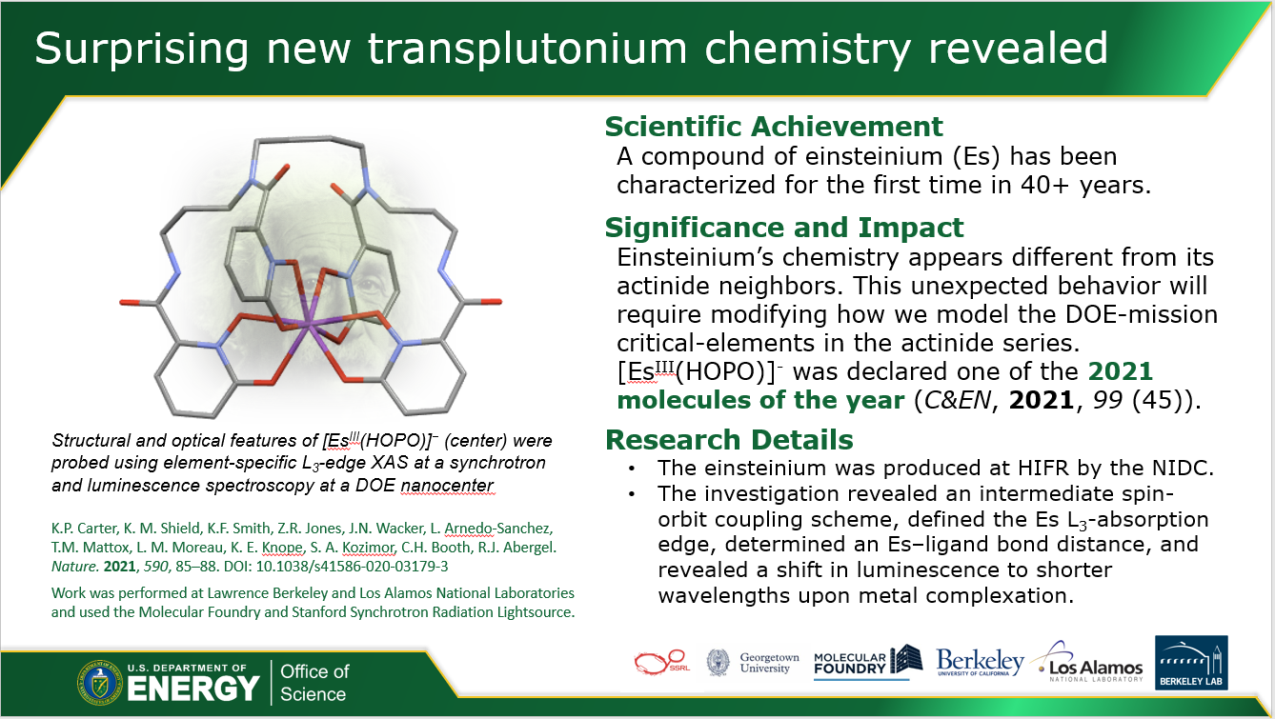
Surprising new transplutonium chemistry revealed
Scientific Achievement
A compound of einsteinium (Es) has been characterized for the first time in 40+ years.
Significance and Impact
Einsteinium’s chemistry appears different from its actinide neighbors. This unexpected behavior will require modifying how we model the DOE-mission critical elements in the actinide series.
Research Details
The einsteinium was produced at the High Flux Isotope Reactor (HFIR).
The investigation revealed an intermediate spin-orbit coupling scheme, defined the Es L₃-absorption edge, determined an Es-ligand bond distance, and revealed a shift in luminescence to shorter wavelengths upon metal complexation.
Structural and optical features of [Es^{III}(HOPO)]⁻ were probed using element-specific L₃-edge XAS at a synchrotron and luminescence spectroscopy at a DOE nanoscience center.
K.P. Carter, K.M. Shield, K.F. Smith, Z.R. Jones, J.N. Wacker, L. Arnedo-Sanchez, T.M. Mattox, L.M. Moreau, K.E. Knope, S.A. Kozimor, C.H. Booth, R.J. Abergel. Nature. 2021, 590, 85-88. DOI: 10.1038/s41586-020-03179-3
Work was performed at Lawrence Berkeley and Los Alamos National Laboratiries and used the Molecualr Foundry and Stanford Synchrotron Radiation Lightsource.
Notes:
1-2 paragraph description of highlight
The transplutonium elements (atomic numbers 95–103) are a group of metals that lie at the edge of the periodic table. As a result, the patterns and trends used to predict and control the physics and chemistry for transition metals, main-group elements and lanthanides are less applicable to these elements.
Since element 99 – einsteinium – was discovered in 1952 from the debris of the first hydrogen bomb, scientists have performed very few experiments with it because it is so hard to create and is exceptionally radioactive. A team of Berkeley Lab chemists have overcome these obstacles to report the first study characterizing some of its properties, opening the door to a better understanding of the remaining elements of the actinide series.
With less than 250 nanograms of the highly radioactive element, the research team led by Rebecca Abergel measured the first-ever einsteinium bond distance, a basic property of an element’s interactions with other atoms and molecules.
“There’s not much known about einsteinium,” said Abergel. “It’s a remarkable achievement that we were able to work with this small amount of material and do inorganic chemistry. It’s significant because the more we understand about its chemical behavior, the more we can apply this understanding for the development of new materials or new technologies, not necessarily just with einsteinium, but with the rest of the actinides too. And we can establish trends in the periodic table .”
The material was made at Oak Ridge National Laboratory’s High Flux Isotope Reactor, one of only a few places in the world that is capable of making einsteinium, which involves bombarding curium targets with neutrons to trigger a long chain of nuclear reactions. The first problem they encountered was that the sample was contaminated with a significant amount of californium, as making pure einsteinium in a usable quantity is extraordinarily challenging.
Using a special sample holder designed by researchers at Los Alamos National Laboratory, the researchers were able to use luminescence spectroscopy and X-ray absorption spectroscopy to measure the bond distance and some physical properties of einsteinium-254.
Funding details for all sources:
Acknowledgements 254Es was supplied by the Isotope Program within the US Department of Energy (DOE), Office of Science, Office of Nuclear Physics. We thank N. Edelstein for discussions, M. Fox for γ spectrometer calibration, and N. Singh, B. Fairchild, S. Hays and R.Davis for assistance in planning and implementing experiments at the Stanford Synchrotron Radiation Lightsource (SSRL) and at the Molecular Foundry. This work was supported by the DOE, Office of Science, Office of Basic Energy Sciences, Chemical Sciences, Geosciences, and Biosciences Division at Lawrence Berkeley National Laboratory, under contract number DE-AC02-05CH11231, and at Los Alamos National Laboratory (LANL), an affirmative-action/equal-opportunity employer, managed by Triad National Security, LLC, for the NNSA of the DOE (contract number 89233218CNA000001). K.M.S. acknowledges support from a DOE Integrated University Program graduate research fellowship. Z.R.J. was supported by the Glenn T. Seaborg Institute at LANL. K.E.K. and J.N.W. were supported by the DOE, Office of Science, Office of Basic Energy Sciences, Early Career Research Program under award DE-SC0019190. J.N.W. was also supported by the DOE, Office of Science, Office of Workforce Development for Teachers and Scientists, Office of Science Graduate Student Research (SCGSR) program, which is administered by the Oak Ridge Institute for Science and Education (ORISE) and managed by ORAU (contract number DE-SC0014664) for the DOE. Use of the SSRL, SLAC National Accelerator Laboratory, is supported by the DOE, Office of Science, Office of Basic Energy Sciences under contract number DE-AC02-76SF00515. Near-infrared luminescence spectra were collected at the Molecular Foundry, a User Facility supported by the DOE, Office of Science, Office of Basic Energy Sciences under contract number DE-AC02- 05CH1123.
Publication/ press releases/ related links:
Carter, K.P., Shield, K.M., Smith, K.F. et al. Structural and spectroscopic characterization of an einsteinium complex. Nature 590, 85–88 (2021). https://doi-org.proxy.scejournals.org/10.1038/s41586-020-03179-3
Einsteinium: Scientists Reveal Chemical Secrets of Elusive Transplutonium Element (Sci News)
http://www.sci-news.com/othersciences/chemistry/einsteinium-coordination-complex-09320.html
NOTE: A limited amount of text with engaging pictures and graphics work best.

