Slide 1
Chapter 8
Input/Output
I/O basics
Keyboard input
Monitor output
Interrupt driven I/O
DMA

Slide 2
I/O Basics
Definitions
  Input
    transfer data from the outside world to the computer:
    keyboard, mouse, scanner, bar-code reader, etc.
  Output
    transfer data from the computer to the outside:
    monitor, printer, LED display, etc.
  Peripheral: any I/O device, including disks.
LC-3 supports only a keyboard and a monitor

Slide 3

Device Registers
I/O Interface
  Through a set of Device Registers:
    Status register (device is busy/idle/error)
    Data register (data to be moved to/from device)
  The device registers have to be read/written by the CPU.
LC-3
    KBDR: keyboard data register
    KBSR: keyboard status register
    DDR: display data register
    DSR: display status register
KBSR[15] - keyboard ready (new character available)
KBDR[7:0] - character typed (ASCII)
DSR[15] - monitor ready
DDR[7:0] - character to be displayed (ASCII)
LC-3
KBSR
DSR
KBDR
DDR

Slide 4
Addressing Device Registers
Special I/O Instructions
  Read or write to device registers using specialized I/O instructions.
Memory Mapped I/O
  Use existing data movement instructions (Load & Store).
  Map each device register to a memory address (fixed).
  CPU communicates with the device registers as if they were memory locations.
LC-3
  Uses memory mapped I/O:
xFE00 KBSR Keyboard Status Register
xFE02 KBDR Keyboard Data Register
XFE04 DSR Display Status Register
XFE06 DDR Display Data Register
XFFFE MCR Machine Control Register

Slide 5
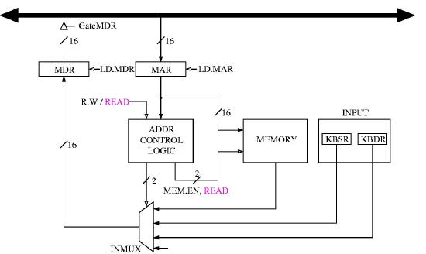
Memory-mapped Input

Slide 6
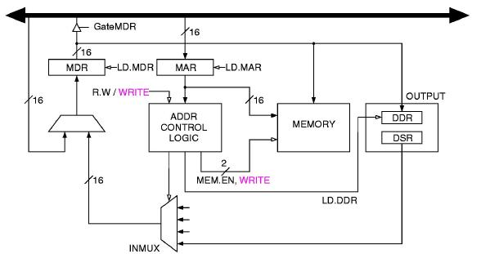
Memory-mapped Output

Slide 7
Synchronizing CPU and I/O
Problem
  Speed mismatch between CPU and I/O:
    CPU runs at up to 2 GHz, while all I/O is much slower.
  Example : Keyboard input is both slow, and irregular.
  We need a protocol to keep CPU & KBD synchronized.
Two possible solutions:
  Polling (handshake synchronization)
  Interrupt-driven I/O

Slide 8
Synchronizing CPU and I/O - 2
Polling, or handshake synchronization
  CPU checks the KBD Ready status bit.
  If set, CPU reads the data register and resets the Ready bit.
  Start over.
  Makes CPU-I/O interaction seem to be synchronous.
Interrupt-driven I/O
  An external device is allowed to interrupt the CPU and
  demand attention
  The CPU attends to the device in an orderly fashion
  (more later)

Slide 9
Polling v/s Interrupts (Who’s driving?)
Polling: CPU in charge
  CPU checks the ready bit of status register
  (as per program instructions).
    If (KBSR[15] == 1) then load KBDR[7:0] to a register.
  If the I/O device is very slow, CPU is kept busy waiting.
Interrupt: peripheral in charge
  Event triggered - when the I/O device is ready,
  it sets a flag called an interrupt.
  When an interrupt is set, the CPU is forced to an
  interrupt service routine (ISR) which services
  the interrupting device.
  There can be different priority levels of interrupt.
  Specialized instructions can mask an interrupt level.

Slide 10
Polling Algorithm
Input (keyboard)
    The CPU loops checking the Ready bit
    When bit is set, a character is available
    CPU loads the character waiting in the keyboard data register
Output (monitor)
    CPU loops checking the Ready bit
    When bit is set, display is ready for next character
    CPU stores a character in display data register

Slide 11
Polling details
Keyboard
  When key is struck
    ASCII code of character is written to KBDR[7:0]
    (least significant byte of data register).
    KBSR[15] (Ready Bit) is set to 1.
    Keyboard is locked until CPU reads KBDR.
    The CPU sees Ready Bit, reads KBDR, and clears
    the Ready Bit, unlocking the keyboard.
Monitor
  When CPU is ready to output a character
    CPU checks DSR[15] (Ready Bit) until it is set to 1
    CPU writes character to DDR[7:0]
    Monitor sets DSR[15] to 0 while it is busy displaying
    the character, then sets it back to 1 to indicate readiness
    for next character.

Slide 12
Simple Polling Routines
START LDI R1, A ;Loop if Ready not set
BRzp START
LDI R0, B ;If set, load char to R0
BR NEXT_TASK
A .FILL xFE00 ;Address of KBSR
B .FILL xFE02 ;Address of KBDR
Input a character from keyboard
START LDI R1, A ;Loop if Ready not set
BRzp START
STI R0, B ;If set, send char to DDR
BR NEXT_TASK
A .FILL xFE04 ;Address of DSR
B .FILL xFE06 ;Address of DDR
Output a character to the monitor

Slide 13
Keyboard Echo: combine the above
START LDI R1,KBSR ;Loop if KB not ready
BRzp START
LDI R0,KBDR ;Get character
ECHO LDI R1,CRTSR ;Loop if monitor not ready
BRzp ECHO
STI R0,CRTDR ;Send character
BR NEXT_TASK
KBSR .FILL xFE00 ;Address of KBSR
KBDR .FILL xFE02 ;Address of KBDR
DSR .FILL xFE04 ;Address of DSR
DDR .FILL xFE06 ;Address of DDR

Slide 14
Example: Print a string
LEA R1, STR ;Load address of string
LOOP LDR R0, R1, #0 ;get next char to R0
BRZ DONE ;string ends with 0
LP2 LDI R3, DSR ;Loop until MON is ready
BRzp LP2
STI R0, DDR ;Write next character
ADD R1, R1, #1 ; Set address to next char
BR LOOP
STR .STRINGZ "Char String"
DONE HALT

Slide 15
Interrupt-driven I/O
Generating the interrupt signal
  The I/O device must want to request service.
  The device must have the right to request service,
  This request must be more urgent than the
  processor’s current task.
Handling the interrupt signal
  We will wait untile we understand stacks
  before getting to this.

Slide 16
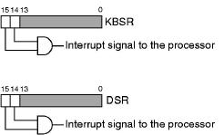
Generating the Interrupt
Using the Status Register
  The peripheral sets a Ready bit in SR[15] (as with polling)
  The CPU sets an Interrupt Enable bit in SR[14]
  These two bits are anded to set the Interrupt.
    In this way, the CPU has the final say in who gets to interrupt it!

Slide 17
Priority
  Each task has an assigned priority level
    LC-3 has levels PL0 (lowest) to PL7 (highest).
    If a higher priority task requests access,
    a lower priority task will be suspended.
  Likewise, each device has an assigned priority
    The highest priority interrupt is passed on to
    the CPU only if it has higher priority than
    the currently executing task.
  If an INT is present at the start of the instruction cycle,
  an extra step is inserted:
    The CPU saves its state information so that
    it can later return to the current task.
    The PC is loaded with the starting address of
    the Interrupt Service Routine
    The FETCH phase of the cycle continues as normal.

Slide 18
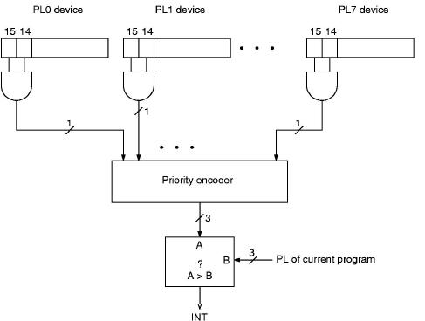
Device Priority

Slide 19
Interrupts - More
  Another method of enabling devices to interrupt is the Interrupt mask register: each bit specifies whether the corresponding device is allowed
  to interrupt.
  In the CPU, the control logic checks
  the INT bit before each instruction
  fetch stage.
  If INT is set:
    CPU State information & PC are saved
    PC ← address of corresponding ISR
    Change mask settings
    (allow nested interrupts)
    ISR is executed
    Reset mask settings
    Saved CPU state & PC are restored
  How can CPU tell who interrupted?
Interrupt mask register
Interrupt lines
CPU INT

Slide 20
Interrupt – Who called?
How can CPU tell who interrupted?
  Polling
  Vectored Interrupts
    Multiple CPU INT lines, each dedicated to a device or group of devices
    (Intel: INT0, INT1 …)
    Each INT line sends the CPU to a specific ISR (Interrupt Service Routine).
    The ISR must figure out who called if more than one device is associated
    with that INT line.
  Daisy Chain
    CPU sends an interrupt acknowledge (IACK) that is passed from
    one device to another.
    Interrupting device puts the address of its ISR on the Data Bus.
    Order of devices in the chain is the priority.
    Example: SCSII, USB
IACK
Data bus

Slide 21
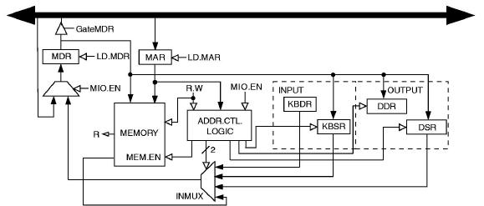
Memory-mapped I/O revisited

Slide 22
DMA – Direct Memory Access
DMA
  A device specialized in transferring data between memory and an I/O device (disk).
  CPU writes the starting address
  and size of the region of memory
  to be copied, both source and
  destination addresses.
  DMA does the transfer in the background.
  It accesses the memory only when the CPU is not accessing it
  (cycle stealing).
CPU
memory
DMA
I/O Dev

