Slide 1
Ch.30 Product Metrics

Slide 2
Measures, Metrics and Indicators
A measure provides a quantitative indication of the extent, amount, dimension, capacity, or size of some attribute of a product or process
The IEEE glossary defines a metric as “a quantitative measure of the degree to which a system, component, or process possesses a given attribute.”
An indicator is a metric or combination of metrics that provide insight into the software process, a software project, or the product itself

Slide 3
Measurement Principles
The objectives of measurement should be established before data collection begins;
Each technical metric should be defined in an unambiguous manner;
Metrics should be derived based on a theory that is valid for the domain of application (e.g., metrics for design should draw upon basic design concepts and principles and attempt to provide an indication of the presence of an attribute that is deemed desirable);
Metrics should be tailored to best accommodate specific products and processes [Bas84]

Slide 4
Measurement Process
Formulation. The derivation of software measures and metrics appropriate for the representation of the software that is being considered.
Collection. The mechanism used to accumulate data required to derive the formulated metrics.
Analysis. The computation of metrics and the application of mathematical tools.
Interpretation. The evaluation of metrics results in an effort to gain insight into the quality of the representation.
Feedback. Recommendations derived from the interpretation of product metrics transmitted to the software team.

Slide 5
Goal-Oriented Software Measurement
The Goal/Question/Metric Paradigm
  (1) establish an explicit measurement goal that is specific to the process activity or product characteristic that is to be assessed
  (2) define a set of questions that must be answered in order to achieve the goal, and
  (3) identify well-formulated metrics that help to answer these questions.
Goal definition template
  Analyze {the name of activity or attribute to be measured}
  for the purpose of {the overall objective of the analysis}
  with respect to {the aspect of the activity or attribute that is considered}
  from the viewpoint of {the people who have an interest in the measurement}
  in the context of {the environment in which the measurement takes place}.

Slide 6
Metrics Attributes
Simple and computable. It should be relatively easy to learn how to derive the metric, and its computation should not demand inordinate effort or time
Empirically and intuitively persuasive. The metric should satisfy the engineer’s intuitive notions about the product attribute under consideration
Consistent and objective. The metric should always yield results that are unambiguous.
Consistent in its use of units and dimensions. The mathematical computation of the metric should use measures that do not lead to bizarre combinations of unit.
Programming language independent. Metrics should be based on the analysis model, the design model, or the structure of the program itself.
Effective mechanism for quality feedback. That is, the metric should provide a software engineer with information that can lead to a higher quality end product

Slide 7
Collection and Analysis Principles
Whenever possible, data collection and analysis should be automated;
Valid statistical techniques should be applied to establish relationship between internal product attributes and external quality characteristics
Interpretative guidelines and recommendations should be established for each metric

Slide 8
Metrics for the Requirements Model
Function-based metrics: use the function point as a normalizing factor or as a measure of the “size” of the specification
Specification metrics: used as an indication of quality by measuring number of requirements by type

Slide 9
Function-Based Metrics
The function point metric (FP), first proposed by Albrecht [ALB79], can be used effectively as a means for measuring the functionality delivered by a system.
Function points are derived using an empirical relationship based on countable (direct) measures of software's information domain and assessments of software complexity
Information domain values are defined in the following manner:
  number of external inputs (EIs)
  number of external outputs (EOs)
  number of external inquiries (EQs)
  number of internal logical files (ILFs)
  Number of external interface files (EIFs)

Slide 10
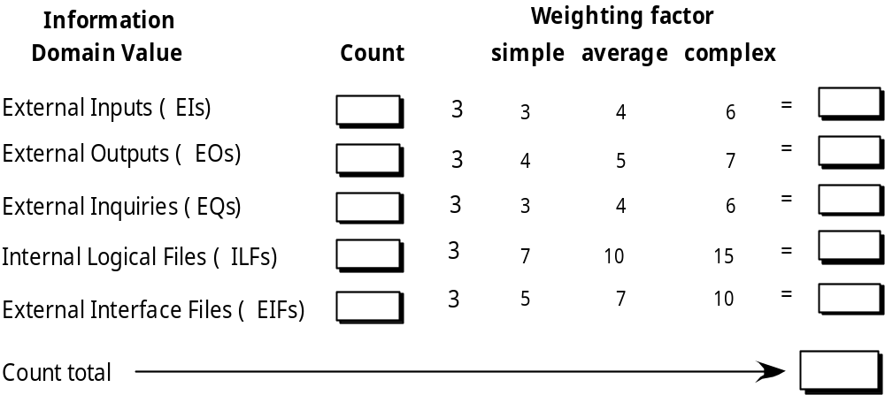
Function Points

Slide 11
Architectural Design Metrics
Architectural design metrics
  Structural complexity = g(fan-out)
  Data complexity = f(input & output variables, fan-out)
  System complexity = h(structural & data complexity)
HK metric: architectural complexity as a function of fan-in and fan-out
Morphology metrics: a function of the number of modules and the number of interfaces between modules
  Number of external interface files (EIFs)

Slide 12
Metrics for OO Design-I
Whitmire [Whi97] describes nine distinct and measurable characteristics of an OO design:
  Size
        Size is defined in terms of four views: population, volume, length, and functionality
  Complexity
        How classes of an OO design are interrelated to one another
  Coupling
        The physical connections between elements of the OO design
  Sufficiency
        “the degree to which an abstraction possesses the features required of it, or the degree to which a design component possesses features in its abstraction, from the point of view of the current application.”
  Completeness
        An indirect implication about the degree to which the abstraction or design component can be reused

Slide 13
Metrics for OO Design-II
Cohesion
  The degree to which all operations working together to achieve a single, well-defined purpose
Primitiveness
  Applied to both operations and classes, the degree to which an operation is atomic
Similarity
  The degree to which two or more classes are similar in terms of their structure, function, behavior, or purpose
Volatility
  Measures the likelihood that a change will occur

Slide 14
Distinguishing Characteristics
Berard [Ber95] argues that the following characteristics require that special OO metrics be developed:
  Localization—the way in which information is concentrated in a program
  Encapsulation—the packaging of data and processing
  Information hiding—the way in which information about operational details is hidden by a secure interface
  Inheritance—the manner in which the responsibilities of one class are propagated to another
  Abstraction—the mechanism that allows a design to focus on essential details

Slide 15
Class-Oriented Metrics
Proposed by Chidamber and Kemerer [Chi94]:
  weighted methods per class
  depth of the inheritance tree
  number of children
  coupling between object classes
  response for a class
  lack of cohesion in methods

Slide 16
Class-Oriented Metrics
  Proposed by Lorenz and Kidd [Lor94]:
  class size
  number of operations overridden by a subclass
  number of operations added by a subclass
  specialization index
  The MOOD Metrics Suite [Har98b]:
  Method inheritance factor
  Coupling factor
  Polymorphism factor

Slide 17
Operation-Oriented Metrics
  Proposed by Lorenz and Kidd [Lor94]:
  average operation size
  operation complexity
  average number of parameters per operation

Slide 18
Component-Level Design Metrics
Cohesion metrics: a function of data objects and the locus of their definition
Coupling metrics: a function of input and output parameters, global variables, and modules called
Complexity metrics: hundreds have been proposed (e.g., cyclomatic complexity)

Slide 19
Interface Design Metrics
Layout appropriateness: a function of layout entities, the geographic position and the “cost” of making transitions among entities

Slide 20
Design Metrics for Web and Mobile Apps
Does the user interface promote usability?
Are the aesthetics of the App appropriate for the application domain and pleasing to the user?
Is the content designed in a manner that imparts the most information with the least effort?
Is navigation efficient and straightforward?
Has the App architecture been designed to accommodate the special goals and objectives of App users, the structure of content and functionality, and the flow of navigation required to use the system effectively?
Are components designed in a manner that reduces procedural complexity and enhances the correctness, reliability and performance?

Slide 21
Code Metrics
  Halstead’s Software Science: a comprehensive collection of metrics all predicated on the number (count and occurrence) of operators and operands within a component or program
  It should be noted that Halstead’s “laws” have generated substantial controversy, and many believe that the underlying theory has flaws. However, experimental verification for selected programming languages has been performed (e.g. [FEL89]).

Slide 22
Metrics for Testing
  Testing effort can also be estimated using metrics derived from Halstead measures
  Binder [Bin94] suggests a broad array of design metrics that have a direct influence on the “testability” of an OO system.
  Lack of cohesion in methods (LCOM).
  Percent public and protected (PAP).
  Public access to data members (PAD).
  Number of root classes (NOR).
  Fan-in (FIN).
  Number of children (NOC) and depth of the inheritance tree (DIT).

Slide 23
Maintenance Metrics
  IEEE Std. 982.1-1988 [IEE94] suggests a software maturity index (SMI) that provides an indication of the stability of a software product (based on changes that occur for each release of the product). The following information is determined:
  M_{T} = the number of modules in the current release
  F_{c} = the number of modules in the current release that have been changed
  F_{a} = the number of modules in the current release that have been added
  F_{d} = the number of modules from the preceding release that were deleted in the current release
  The software maturity index is computed in the following manner:
  SMI = [MT - (Fa + Fc + Fd)]/MT
  As SMI approaches 1.0, the product begins to stabilize.

